Slide 1

Introduction to Neural Nets
CGnal S.r.l – Corso Venezia 43 - Milano
19 Novembre 2021| Milano
1

Slide 2
Introduction
DAY 1
Brief overview of Machine Learning (Supervised, Unsupervised)
Introduction to Graph, Graph Theory and main metrics for characterizing graphs
Graph Machine Learning
DAY 2
Community detection on Graphs
Supervised Machine Learning on Graphs
Explainability & Interpretability
DAY 3
Introduction to explainability problem
LIME & SHAP
Simple Neural Networks
DAY 4
Introduction to Neural Networks, TensorFlow and Computational Graphs
Implementation and training of simple Neural Networks
Advanced Neural Networks
DAY 5
Convolutional Neural Networks and Recurrent Neural Networks
Advanced Topics

Slide 3
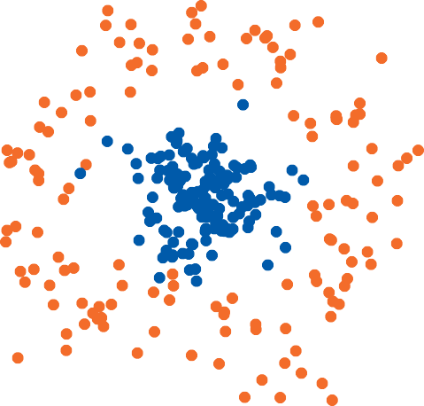





Linear models + feature expansion recap
Feature engineering
$$x_{2}$$
$x_{1}+$ $x_{2}$
$$x_{1}$$
$$x_{1}$$
Finding good features (aka feature engineering) is a highly non-trivial task

Slide 4
Linear models + feature expansion recap
Feature engineering
$$x_{2}$$
$x_{1}+$ $x_{2}$
$$x_{1}$$
$$x_{1}$$
Finding good features (aka feature engineering) is a highly non-trivial task
Can we automate it?

Slide 5
Idea: add another model
Some model
Linear model
Raw features
”Good” features
Prediction
▶
Add another model

Slide 6
Idea: add another model
Some model
Linear model
Raw features
”Good” features
Prediction
Add another model
Train everything simultaneously
▶
▶

Slide 7


Can it be another linear model?
$z=g\left(x\right)=a+b ∙x$
$$y=q\left(z\right)=c+d ∙z$$
Linear model
Linear model
𝑥
𝑦!
Raw features
”Good” features
Prediction
$$y=f\left(x\right)=q\left(g\left(x\right)\right)=c+d\left(a+b ∙x\right)=c+d a+d b x$$
NO! Two linear models resuls in a linear model. We MUST add non linearities!!

Slide 8

Fix: just introduce a nonlinearity
Linear model
$$a(∙)$$
Linear model
Raw features
Nonlinearity
”Good” features
Prediction
$$y=f\left(x\right)=q\left(a(g\left(x\right))\right)=c+d ∙ a\left(a+b ∙x\right)$$
$a(∙)$ some nonlinear scalar function (applied elementwise)

Slide 9
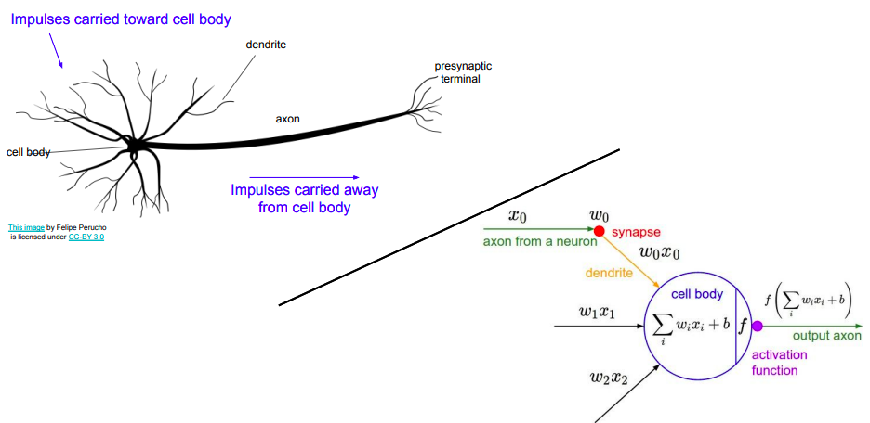
Why they are called «neural»
A very common and widely-used model for the behaviour of neurons is based on the combination of a linear function of several inputs, then passed through a non-linear activation
Credits: http://cs231n.stanford.edu/slides/2017/cs231n_2017_lecture4.pdf

Slide 10
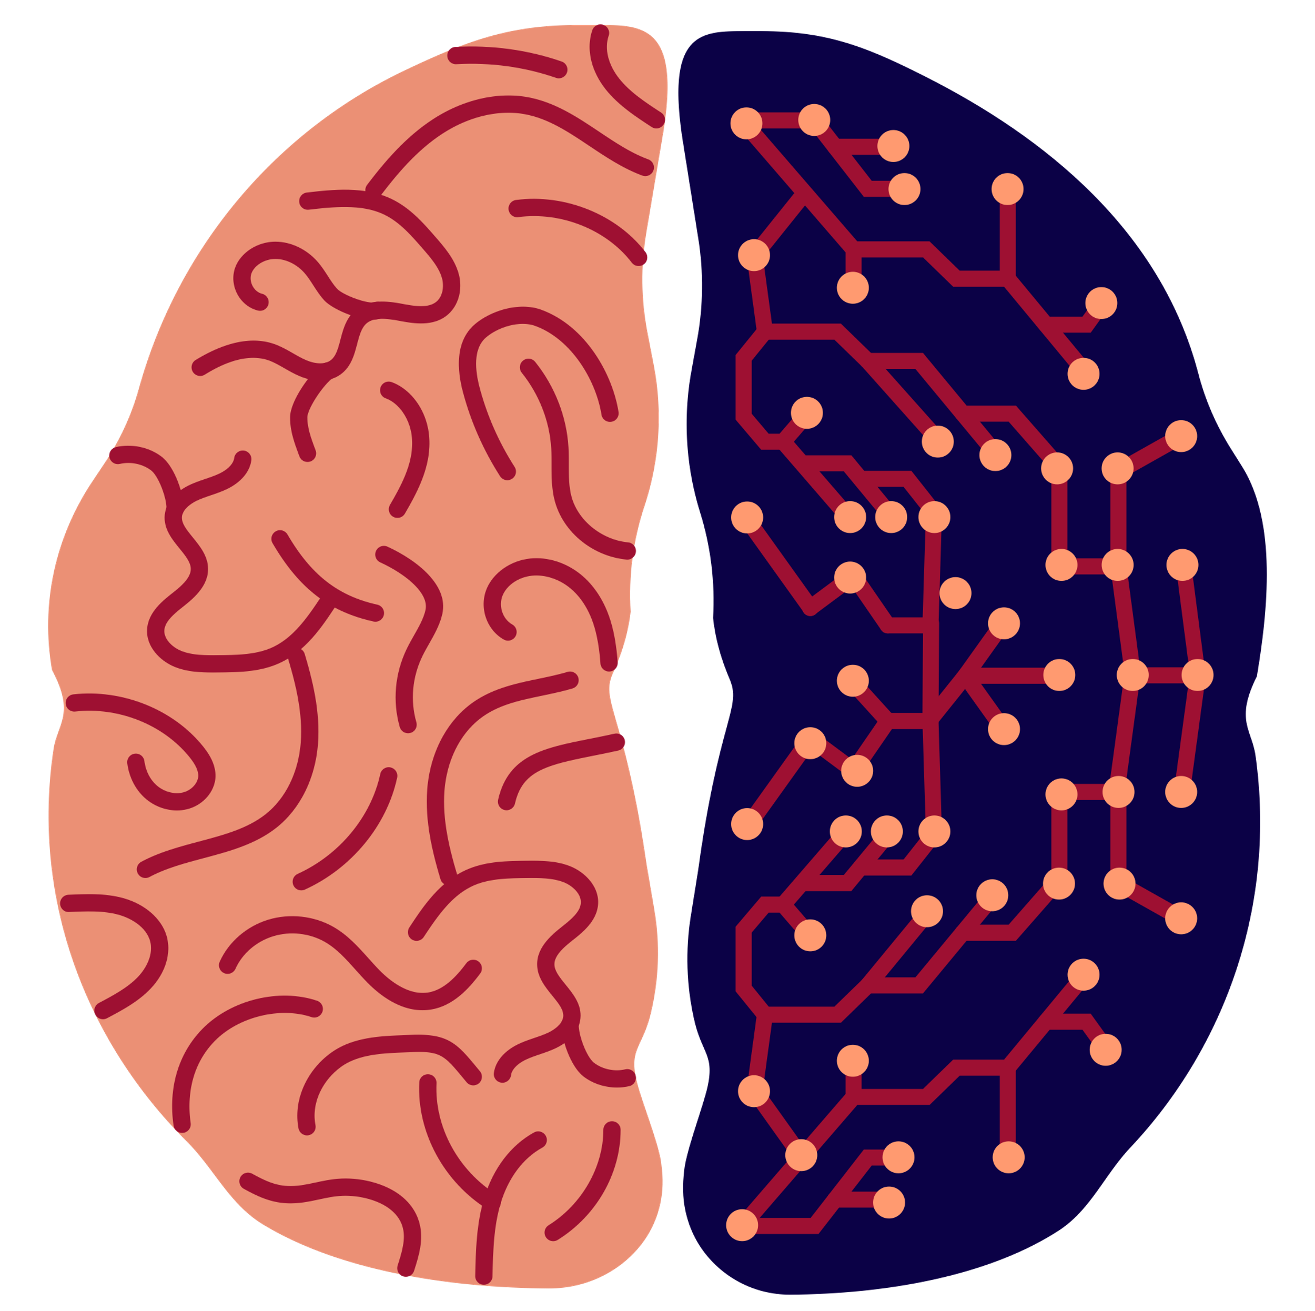
Are neural networks similar to the human brain?
Similarities
As seen in the beginning, the underlying model of an artificial neuron was inspired the ones ones in biology to describe neuronal activations
Like in the brain, the combination and orchestration of many single and relatively simple units allow to build extremely powerful models
However, there are many important differences:
Size
Topology
Activations
Efficiency
Learning
Very complex network with large-scale connections patterns
Based on biological physics, complex non linear dyn. system
Extremely low power consumptions and high efficiency
Able to generalize quickly and while learning topology changes
~ 86 billions neurons
~ 1-10k neurons, ~200 billions weights
Regular structure with links mostly between subsequent layers
Simple non-linear functions but of several types
Computations/learning requires large amount of energy
Backprop and optimization of non-convex function

Slide 11
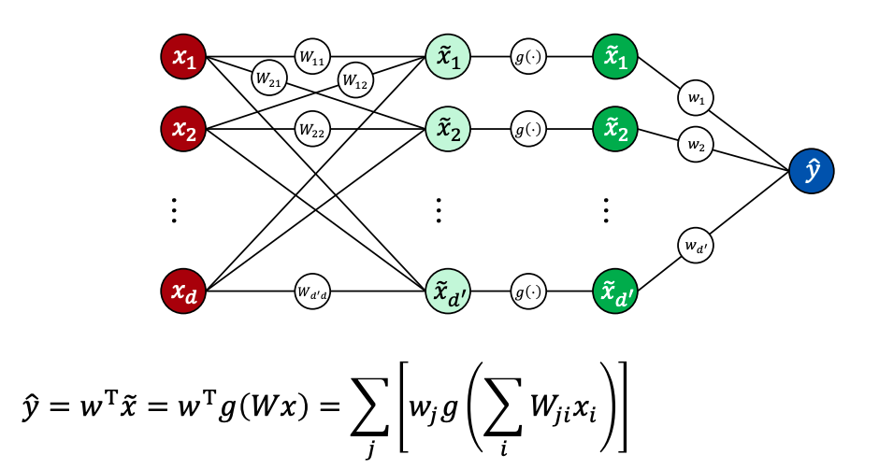
Combining more inputs / neurons

Slide 12
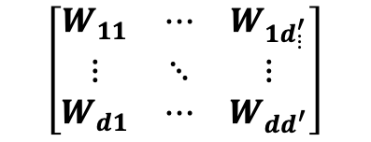
More details
Units out
Num features
$$\left[\begin{matrix}W_{11} & ⋯ & W_{1d_{⋮}^{′}} \\ ⋮ & ⋱ & ⋮ \\ W_{d1} & ⋯ & W_{dd^{′}}\end{matrix}\right]$$

Slide 13
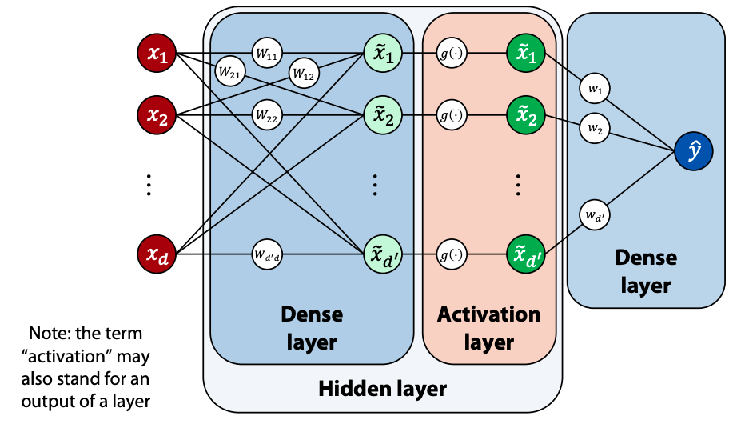
Terminology

Slide 14
Terminology: Simple MLP
Neurons

Slide 15
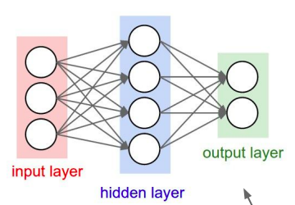
Terminology: Simple MLP
Fully Connected Layers
Credits: http://cs231n.stanford.edu/slides/2017/cs231n_2017_lecture4.pdf

Slide 16
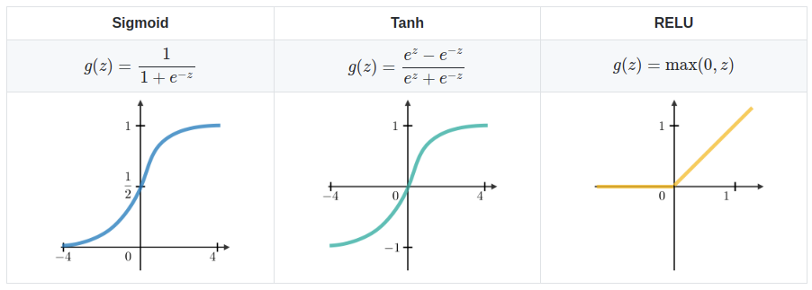
Activation functions
Activation functions can be placed also before the output layer
The output type determines which activation layer we need before the output

Slide 17
Universal Approximation Theorem (Cybenko, 1989)
“Neural Network can compute any function”
Universal Approximation Theorem
Universal approximation theorem for neural networks states that every continuous function that maps interval of real numbers can be approximated arbitrarily closely by a multi-layer perceptron with just one hidden layer.
Therefore
This does not mean we can compute any function but rather we can get approximations that is as good as we want
By increasing number of hidden units we can improve our approximation
BUT BE CAREFUL
We can get good approximations only for continuous functions: if functions are discontinuous (e.g. have sharp jumps) then approximation is difficult.

Slide 18
Universal Approximation Theorem (Cybenko, 1989)
“Neural Network can compute any function”
Universal Approximation Theorem
Universal approximation theorem for neural networks states that every continuous function that maps interval of real numbers can be approximated arbitrarily closely by a multi-layer perceptron with just one hidden layer.
Therefore
This does not mean we can compute any function but rather we can get approximations that is as good as we want
By increasing number of hidden units we can improve our approximation
BUT BE CAREFUL
We can get good approximations only for continuous functions: if functions are discontinuous (e.g. have sharp jumps) then approximation is difficult.
Recently (Zhou et al, 2017 and Kidger and Lyons, 2020) this has been extended for arbitrary depth!!!

Slide 19
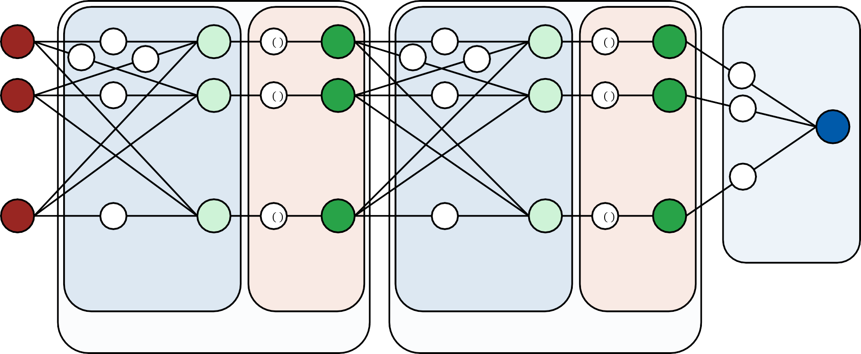






Deeper nets
‘multilayer perceptron’
𝑥₁
^{𝑊}11
𝑥'₁
𝑔 ⋅
${\tilde{x}}_{1}$'
$${W′}_{11}′$$
𝑥''₁
𝑔 ⋅
$\tilde{x}$''₁
^{𝑊}21
^{𝑊}12
$${W′}_{21}$$
$${W′}_{12}$$
𝑤₁
𝑥₂
^{𝑊}22
𝑥'₂
𝑔 ⋅
${\tilde{x}}_{2}$'
$${W′}_{22}′$$
𝑥''₂
𝑔 ⋅
$\tilde{x}$’’₂
𝑤₂
𝑦(
…
…
…
…
…
𝑤_{𝑑’’}
𝑥
𝑑
^{𝑊dd’}
𝑥'_{𝑑'}
𝑔 ⋅
${\tilde{x}}_{d^{′}}$'
$$W_{d^{′}d′′}^{′}$$
𝑥''_{d ’’}
𝑔 ⋅
$\tilde{x}$’’_{d’’}
Dense layer
Dense layer
Activation layer
Dense layer
Activation layer
Hidden layer
Hidden layer
In practice, stacking more hidden layers often reduces the number of neurons required to represent a given function

Slide 20
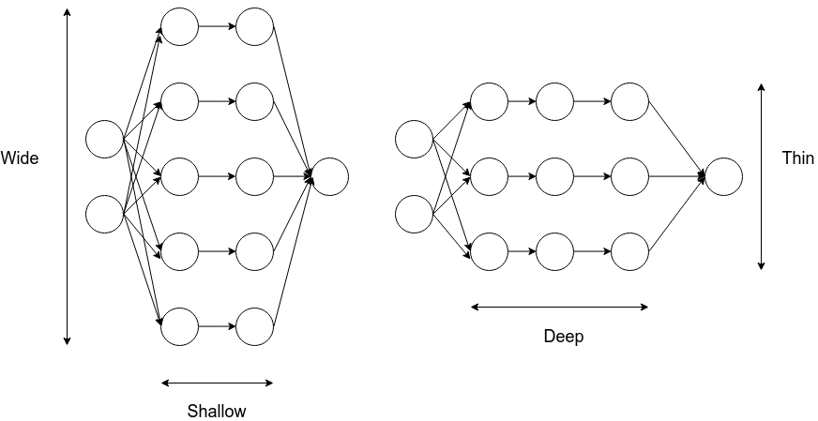
What are DEEP Neural Networks?

Slide 21
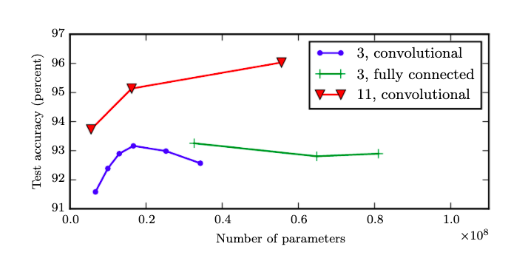
Why should we go deep?
Blue : Shallow model overfits after 20 million params
Red : Deep Model benefits from increasing number of layers
Increasing depth has more effect on learning of a model rather than increasing width of a layer
Goodfellow et al, Deep Learning, MIT Press, http://www.deeplearningbook.org

Slide 22
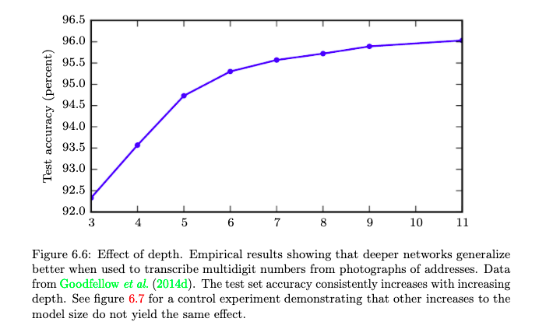
Why should we go deep?
Goodfellow et al, Deep Learning, MIT Press, http://www.deeplearningbook.org

Slide 23
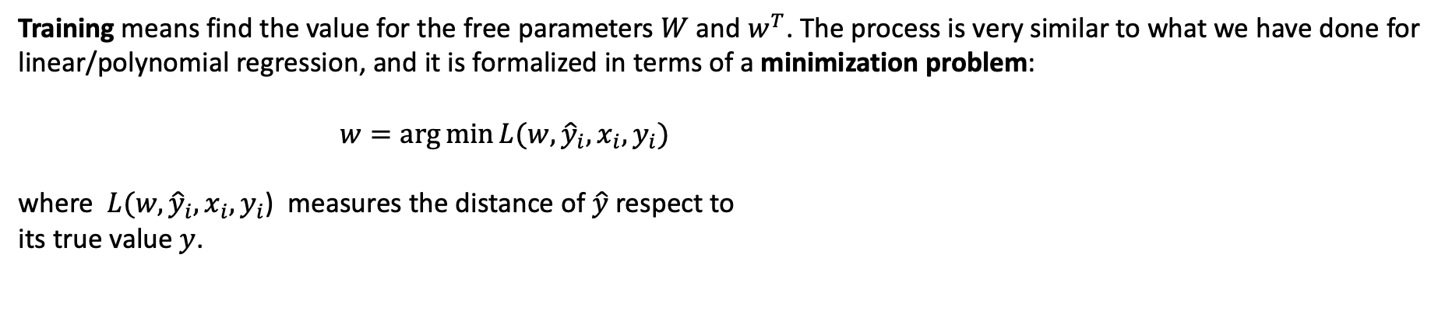
Training a neural network
Training means find the value for the free parameters $W$ and $w^{T}$. The process is very similar to what we have done for linear/polynomial regression, and it is formalized in terms of a minimization problem:
$w=\arg{\min{L(w,{\hat{y}}_{i},x_{i},y_{i})}}$
where $L(w, {\hat{y}}_{i},x_{i},y_{i}$) measures the distance of $\hat{y}$ respect to
its true value $y$.

Slide 24
Training a neural network
Training means find the value for the free parameters $W$ and $w^{T}$. The process is very similar to what we have done for linear/polynomial regression, and it is formalized in terms of a minimization problem:
$w=\arg{\min{L(w,{\hat{y}}_{i},x_{i},y_{i})}}$
where $L(w, {\hat{y}}_{i},x_{i},y_{i}$) measures the distance of $\hat{y}$ respect to
its true value $y$.
Parameters
Activation Function
The activation function generally makes the surface of the loss function non-convex
Fully Differentiable
The formulation is fully differentiable with respect to the weights: we can compute any derivative (see later backpropagation)

Slide 25
Training a neural network
Loss function L(w)
Global error made by the model when compared with the target
Depends on the weights w of the neural net

Slide 26
Training a neural network
Loss function L(w)
Global error made by the model when compared with the target
Depends on the weights w of the neural net
HOW TO FIND THE MINIMUM OF THIS FUNCTION?
Gradient descent

Slide 27
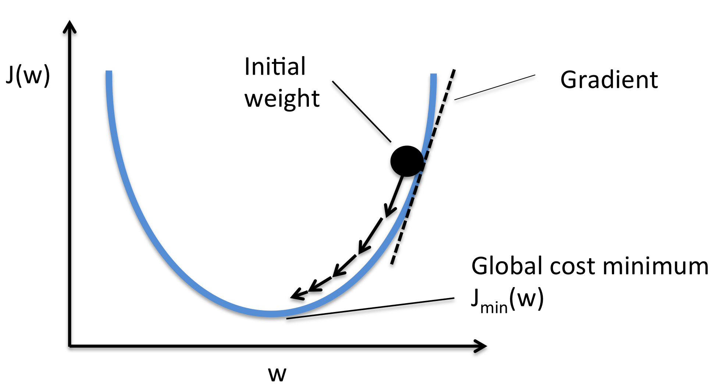
Gradient descent
Optimization algorithm: numerical method to search the minimum (or maximum) of a function

Slide 28
Gradient descent
Optimization algorithm: numerical method to search the minimum (or maximum) of a function
Iterative algorithm: update the weights iteratively in the (opposite) direction of the gradient

Slide 29
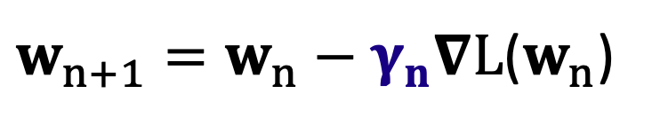
Gradient descent
Optimization algorithm: numerical method to search the minimum (or maximum) of a function
Iterative algorithm: update the weights iteratively in the (opposite) direction of the gradient
Learning rate 𝞬_{n}: size of each step (can be different for each iteration)
Must be chosen wisely: if too large, it may skip over the minimum, if too small, convergence may be very slow
$w_{n+1}=w_{n}−γ_{n}∇L$($w_{n}$)

Slide 30
Gradient descent
Optimization algorithm: numerical method to search the minimum (or maximum) of a function
Iterative algorithm: update the weights iteratively in the (opposite) direction of the gradient
Learning rate 𝞬_{n}: size of each step (can be different for each iteration)
Must be chosen wisely: if too large, it may skip over the minimum, if too small, convergence may be very slow
$w_{n+1}=w_{n}−γ_{n}∇L$($w_{n}$)
Each training step (i.e. each time the weights are updated using all the training data) is called EPOCH

Slide 31



How to solve these equations?
Some packages can help us:
These libraries implement for us backpropagation, a technique which allows an intelligent sequential computation of the gradient.
The gradient is computed ‘easily’ exploiting the network structure of the algorithm → computational graphs

