Slide 1

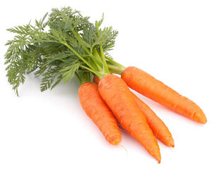
Machine Learning demystified
A classification wine case with R caret package
Carlos Godinho
February 2017

Slide 2
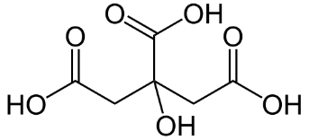
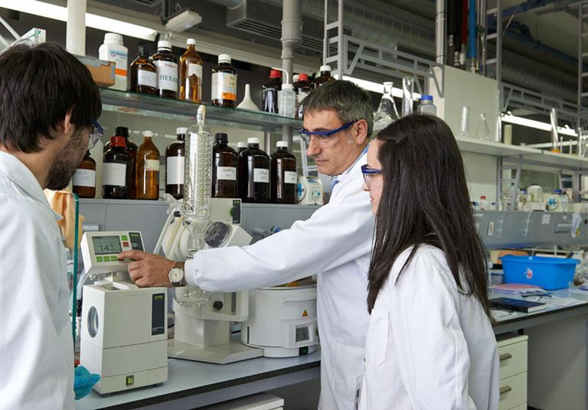


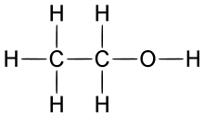

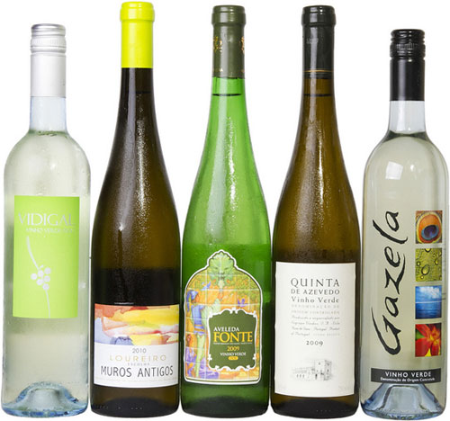
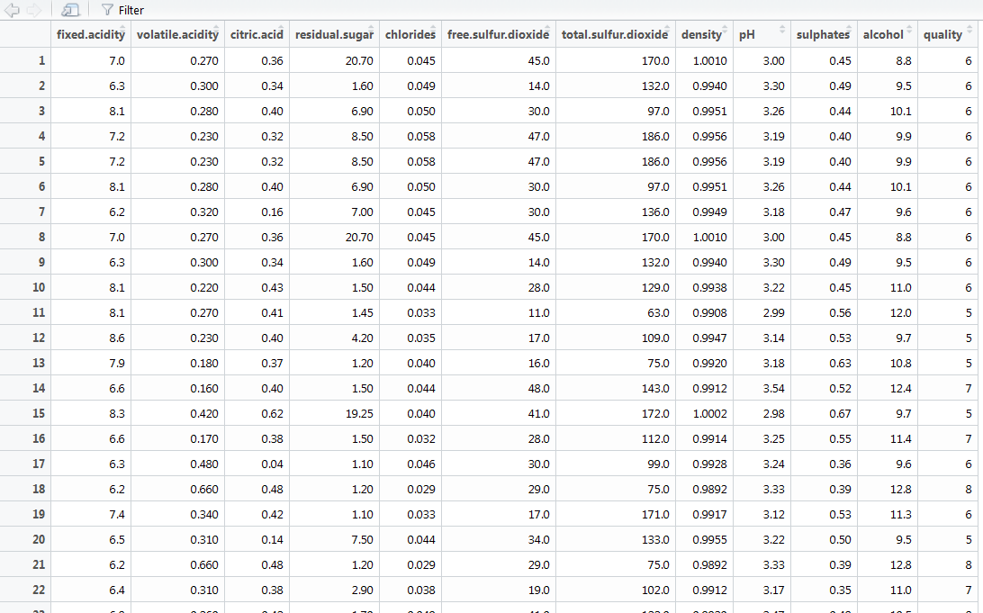
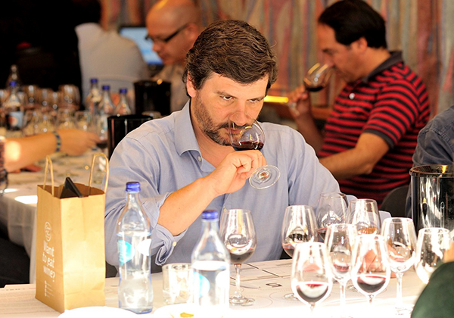

Step 1- Data Gathering
fixed acidity
volatile acidity
citric acid
residual sugar
chlorides
free sulfur dioxide
total sulfur dioxide
density
pH
sulphates
alcohol
Phyisical Properties
Dataframe
~ 5K
Inquire and collect data!
Grade

Slide 3
Step 2 – A question ….
How to calculate ….
Grade (quality)
… based on the physical properties?
Apply Machine Learning!

Slide 4


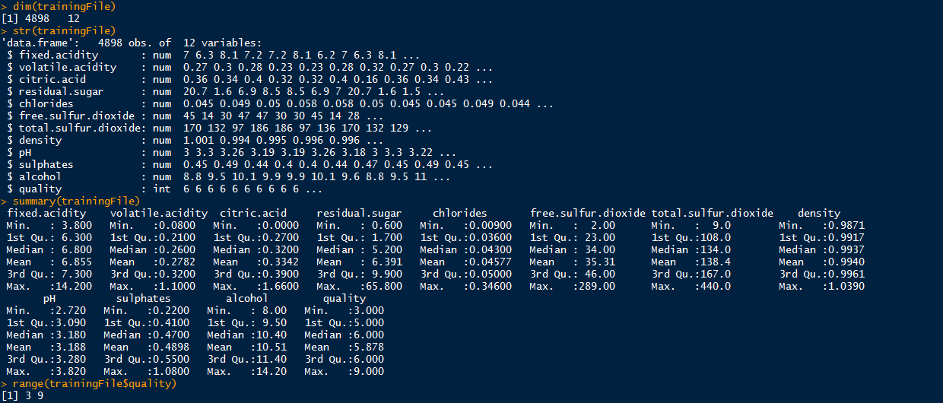
Step 3a – Exploratory Data Analysis with commands
Check data quality and patterns!

Slide 5
Step 3b – Exploratory Data Analysis with graphs
Check data quality and patterns!

Slide 6



Step 4 – Caret, a solution in R
http://topepo.github.io/caret/index.html
Data Partition
Pre processing
Feature handling
Train model
Predict
Evaluate Accuracy
Standard interface to use hundreds of ML models
_C_lassification _A_nd _RE_gression _T_raining

Slide 7


Demo
Random Forest

