Slide 1

Associate Data Analyst Internship
July–August 2025
TRACKING LEARNERS’ JOURNEY
THROUGH DATA
“A Dashboard-Driven Analysis for Strategic Engagement”
Presented By: Team 20

Slide 2


Our Team
Rabia Soomro
Prem Kumar
Nobel Noah Ratnam
Gowsalya Chellapandi
Team Lead
Database Manager
Content Curator
Project Manager
Keerthana Nagireddy
Nikhil Gupta
Yerraballe Lahari
Narrative Lead
Project Scribe
Project Scribe

Slide 3
What can 57,000 applications tell us about learners?

Slide 4
The Problem Statement
Why it Mattered?
Learner data was fragmented across 6 different sources
Engagement trends weren’t visible
Cohort behaviour lacked clarity

Slide 5
Data Universe
Following the Learner Journey
Learner_Raw
LearnerOpportunity_Raw
Cohort_Raw
CongnitoRaw_2
Opportunity_Raw
Marketing_Campaign_Data

Slide 6
Meet the Dashboard

Slide 7

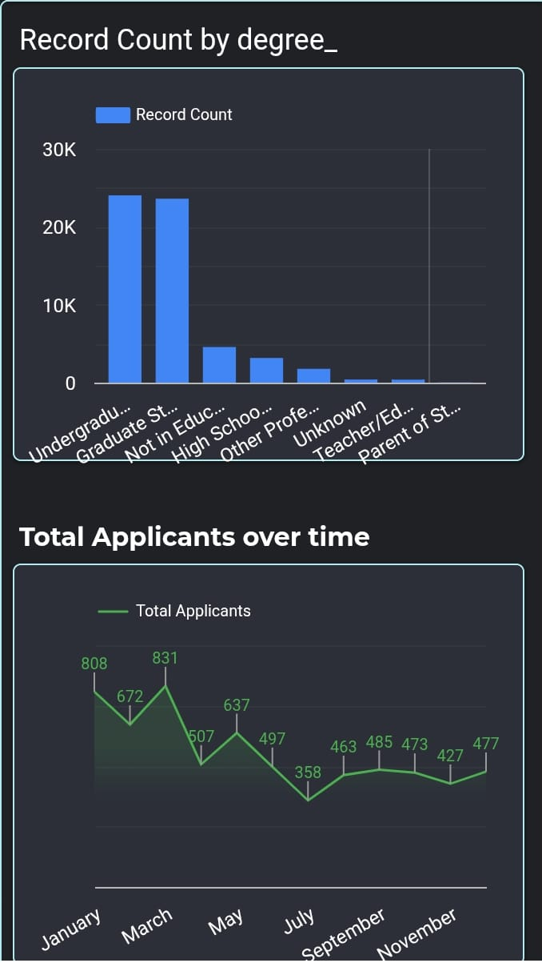
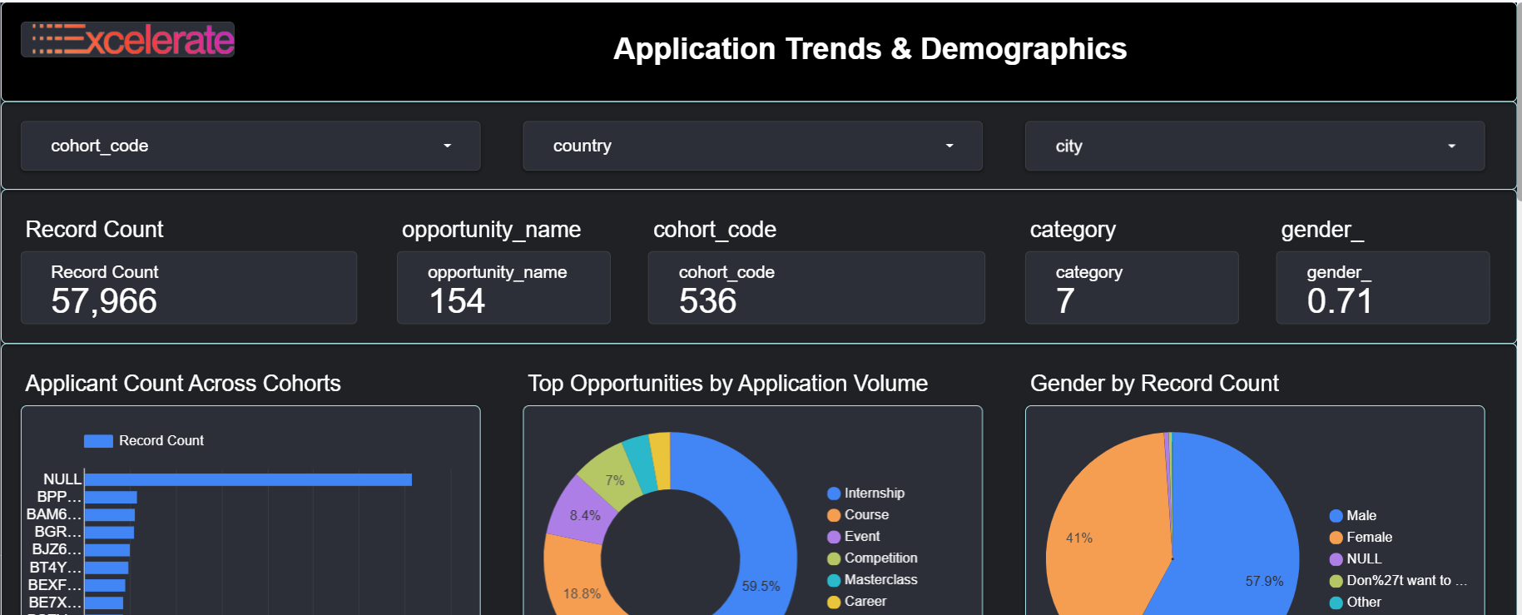
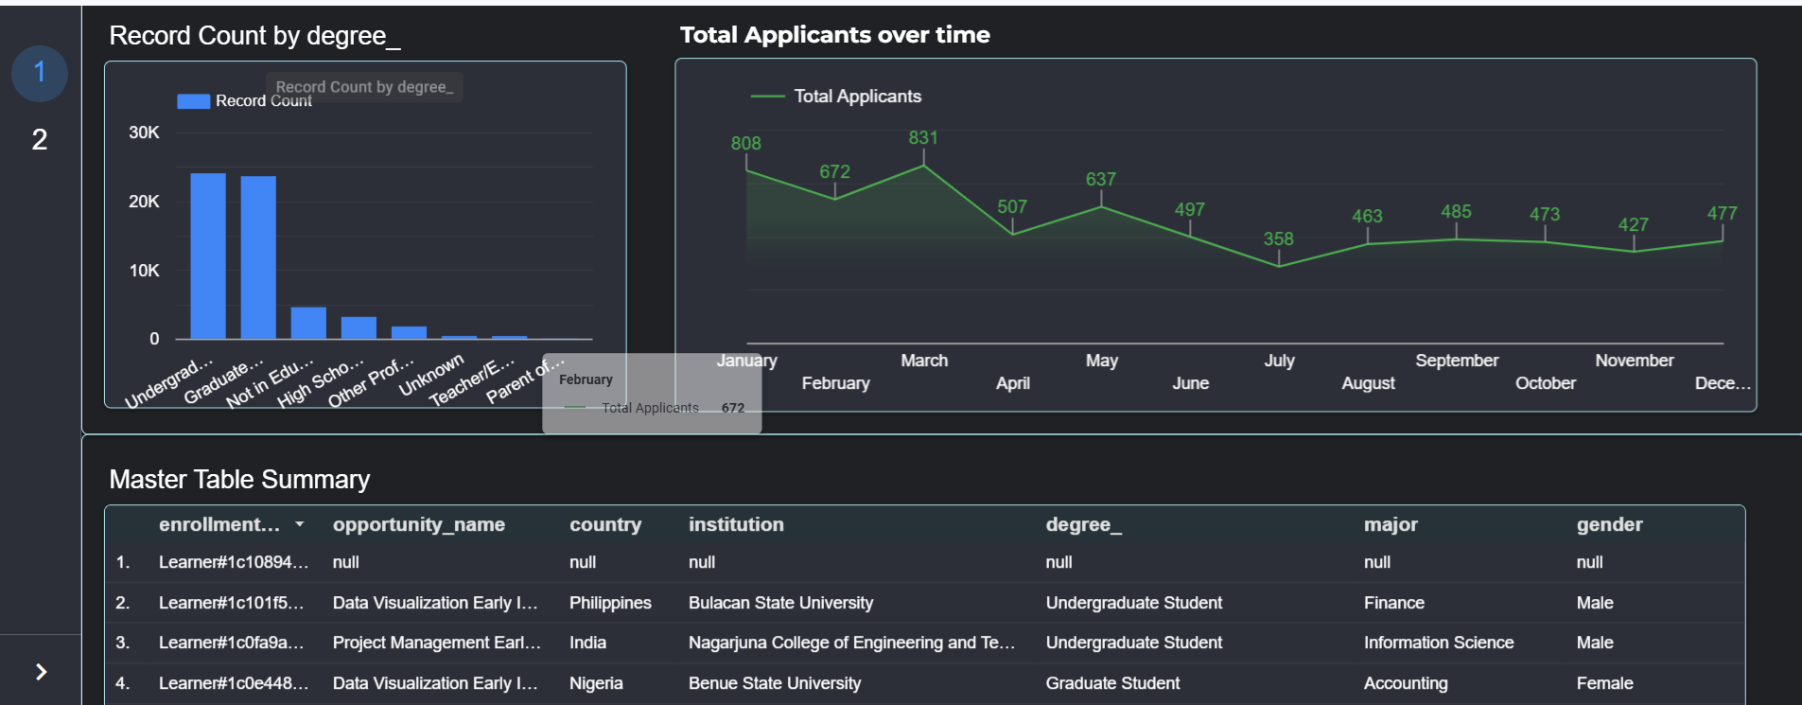
Responsive and Accessible
The dashboard adjusts to fit the context — laptop, phone, or anywhere in between.

Slide 8






Key Statistics
Record Count 57,966
Key Metrics Overview
Opportunity_Name
154
Record Count (57,966): This value represents the total number of application records in our database.
Opportunity Names (154): Reflects the number of distinct programs or openings available
Cohort_code 536
Cohorts (536): Shows how many unique cohort codes we track, indicating both the diversity of applicant groups.
Categories
7
Categories (7): There are seven distinct categories, which helps frame the different types of opportunities offered.
Gender Score (0.71): Aggregates gender data in the form of
a normalized score.
Gender
0.71
SLIDESMANIA.COM

Slide 9

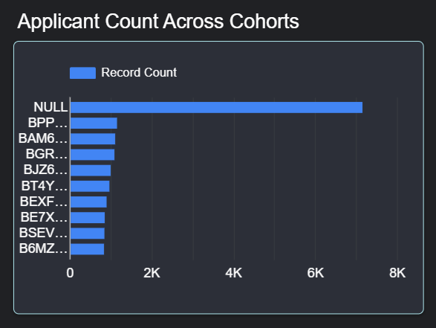
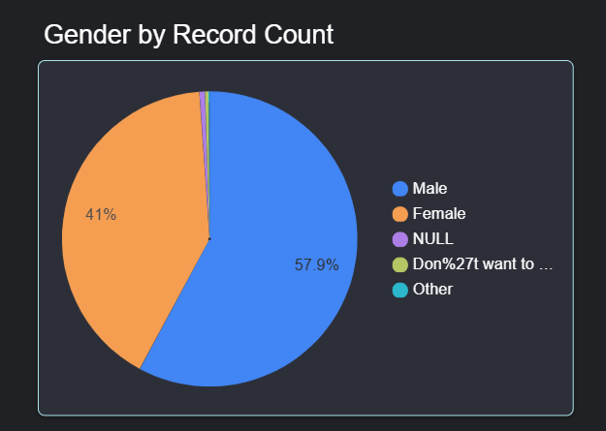
Over 7,000 applications had a "NULL" cohort, showing key data gaps
Specific cohorts like BPPMQ44, BAM6HBR, BGRQZ2N attracted high application volumes
These codes help identify the most engaging programs
Gender Balance:
57.9% male, 41% female, and <2% selected Other / Prefer not to say
Female participation shows promising progress toward gender inclusivity
SLIDESMANIA.COM

Slide 10
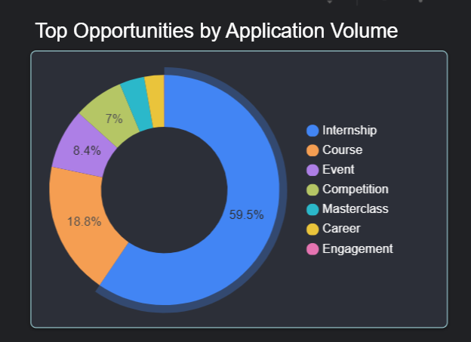
Top opportunities by Application Volume
Internship (59.5%): prefer internships, showing strong demand for practical experience.
Courses (18.8%): while other opportunity types attract fewer,
more specialized applicants.
Event (8.4%): Events engage a niche group, suggesting these are valued for networking or special experiences by a limited audience.
Competition (7%): Competitions attract motivated participants looking for challenge and recognition, though on a smaller scale.
Masterclass, Career & Engagement: These categories have
the fewest applications
SLIDESMANIA.COM

Slide 11
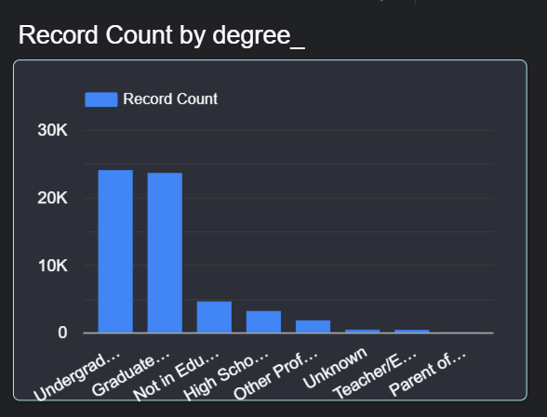
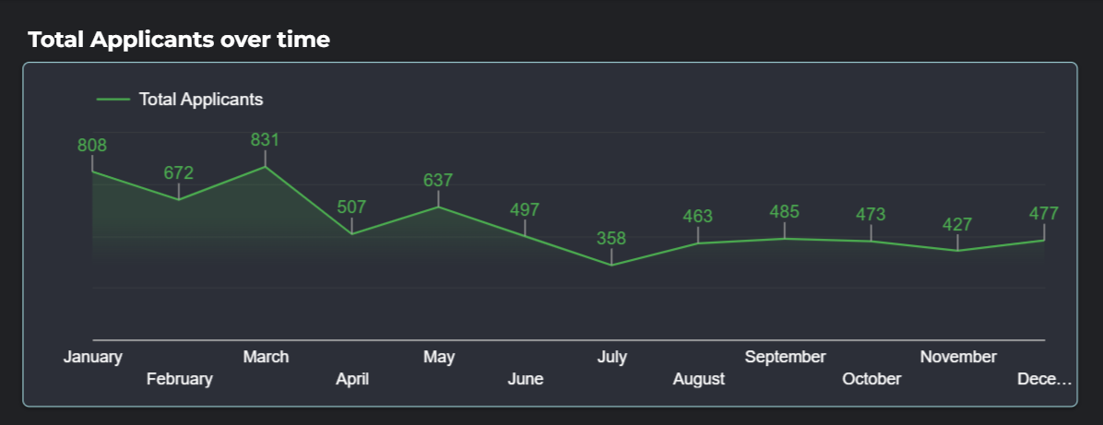
Students (UG & Grad) make up the vast majority of applicants
Non-student categories like professionals, teachers, and parents are rare
Confirms: our audience is primarily university learners
Monthly Trends:
Peak application volume: March (831 applicants)
Other high months: January (808) and May (637)
Lowest: July (358)
There’s a notable drop during the summer months,
reaching the lowest point in July (358)
SLIDESMANIA.COM

Slide 12

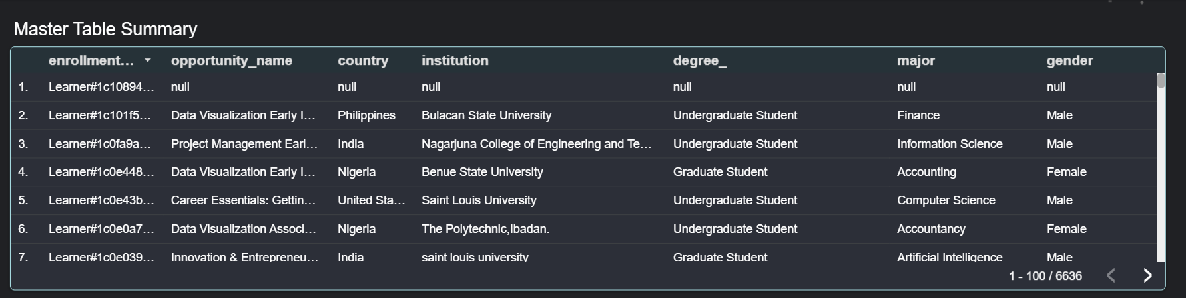
This table forms the foundation of our dashboard, enabling deep dives into specific groups and supporting all subsequent analytics and insights across the project.
SLIDESMANIA.COM

Slide 13
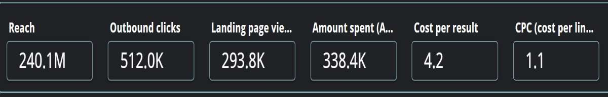
KEY INSIGHTS:
Overall Performance Summary
Reach: 240.1 million
Outbound Clicks: 512K
Landing Page Views: 293.8K
Amount Spent: 338.4K AED
Cost per Result: 4.2 AED
CPC (Cost per Click): 1.1 AED
This shows strong digital visibility
and good cost efficiency overall.
SLIDESMANIA.COM

Slide 14
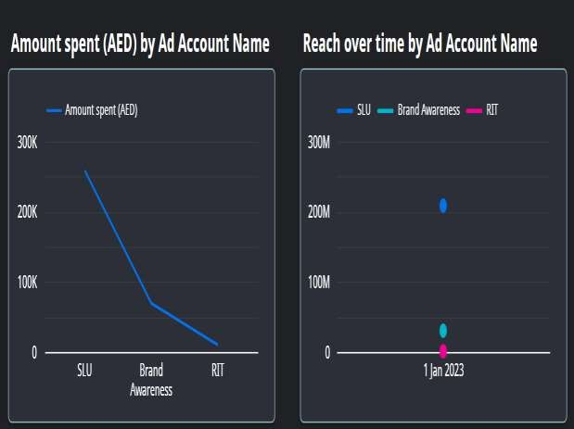
Spend vs. Reach by Account
SLU had the highest spend and highest reach (~300K AED, 200M+ reach).
Brand Awareness and RIT campaigns had significantly lower spend and reach.
Insight: SLU is delivering the most ROI in terms of exposure. Brand Awareness and RIT might need revised targeting or budget adjustments.
SLIDESMANIA.COM

Slide 15
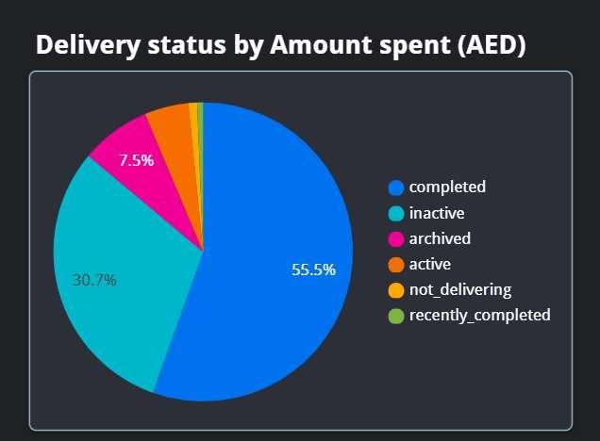
Campaign Delivery Status
55.5% of the campaigns are completed.
30.7% are inactive, and 7.5% are archived.
Note: Nearly 40% of campaigns are not active, suggesting inefficiencies in follow-through or execution.
SLIDESMANIA.COM

Slide 16
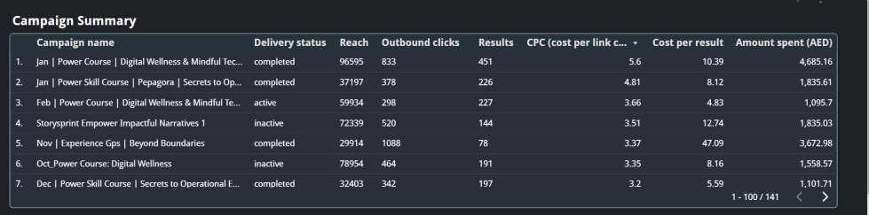
Campaign Summary Deep Dive
Top campaign by performance:
Jan | Power Course | Digital Wellness had highest reach (96,595) and results (451).
Feb | Power Course had the best cost per result (4.83 AED) among active campaigns.
Insight: January and February campaigns were well-optimized. February campaign was cost-efficient, whereas November campaign had high CPC (3.37 AED) and high cost per result (47.09 AED).
SLIDESMANIA.COM

Slide 17
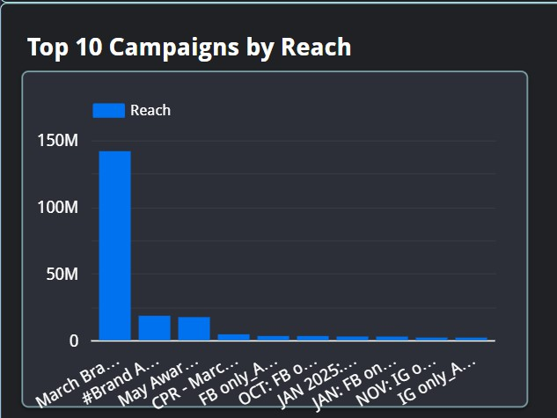
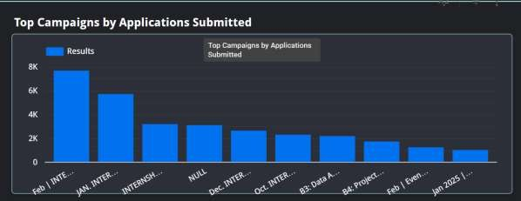
Top Campaigns by Metrics
Top Campaigns by Reach
March Brand Awareness Campaign was a standout with 150M+ reach – dominating the chart.
Top Campaigns by Results (Applications Submitted)
Feb | INTERNSHIP and JAN | INTERNSHIP led with 8K and 6K+ submissions, respectively.
These campaigns should be replicated or scaled, as they
proved highly effective.
SLIDESMANIA.COM

Slide 18
Conclusion
From raw data to real insights
Unified 57,000+ applications across multiple datasets
Revealed key trends: cohort gaps, internship demand, gender progress
Built a responsive dashboard for real-time decision-making
Foundation for data-driven engagement strategies
SLIDESMANIA.COM

Slide 19
Thank you!
From raw records to real insights — this was our learner journey.
-Team 20

