Slide 1
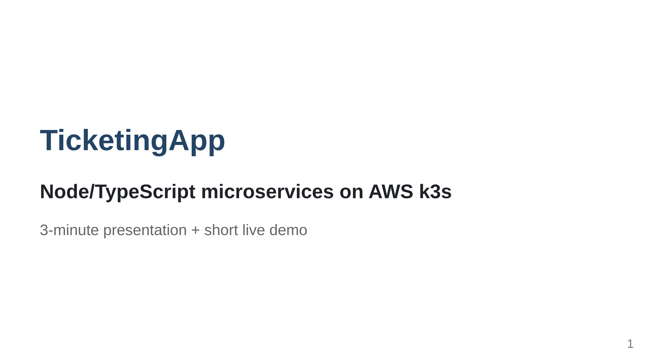
Notes:
Timing: 10s. Say: "This is my TicketingApp: a small ticket marketplace built as microservices. The point of the project is not only the app UI, but proving that the same Kubernetes-style deployment can run locally and in AWS."

Slide 2
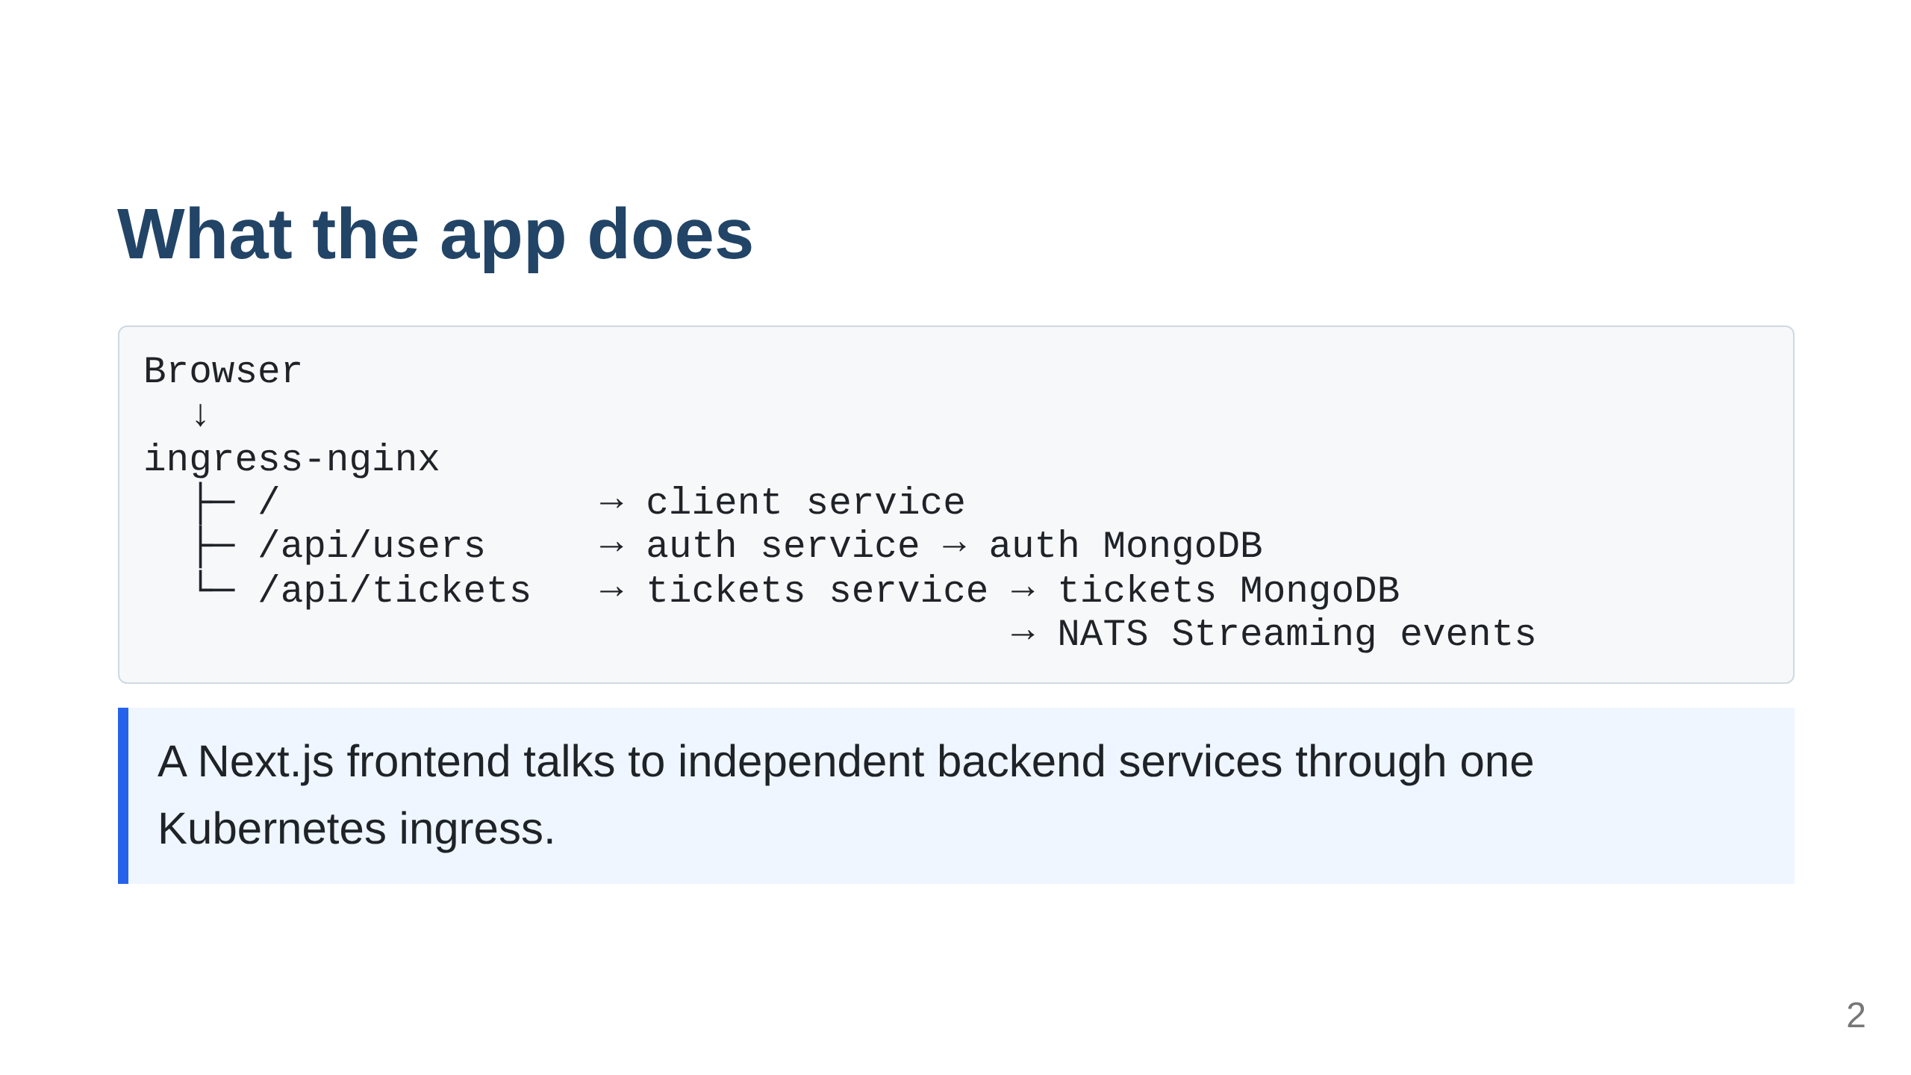
Notes:
Timing: 20s. Say: "The frontend, auth API, and tickets API are separate deployable services. Ingress routes browser traffic to the right service. Each service owns its data store, and ticket changes publish events through NATS Streaming."

Slide 3
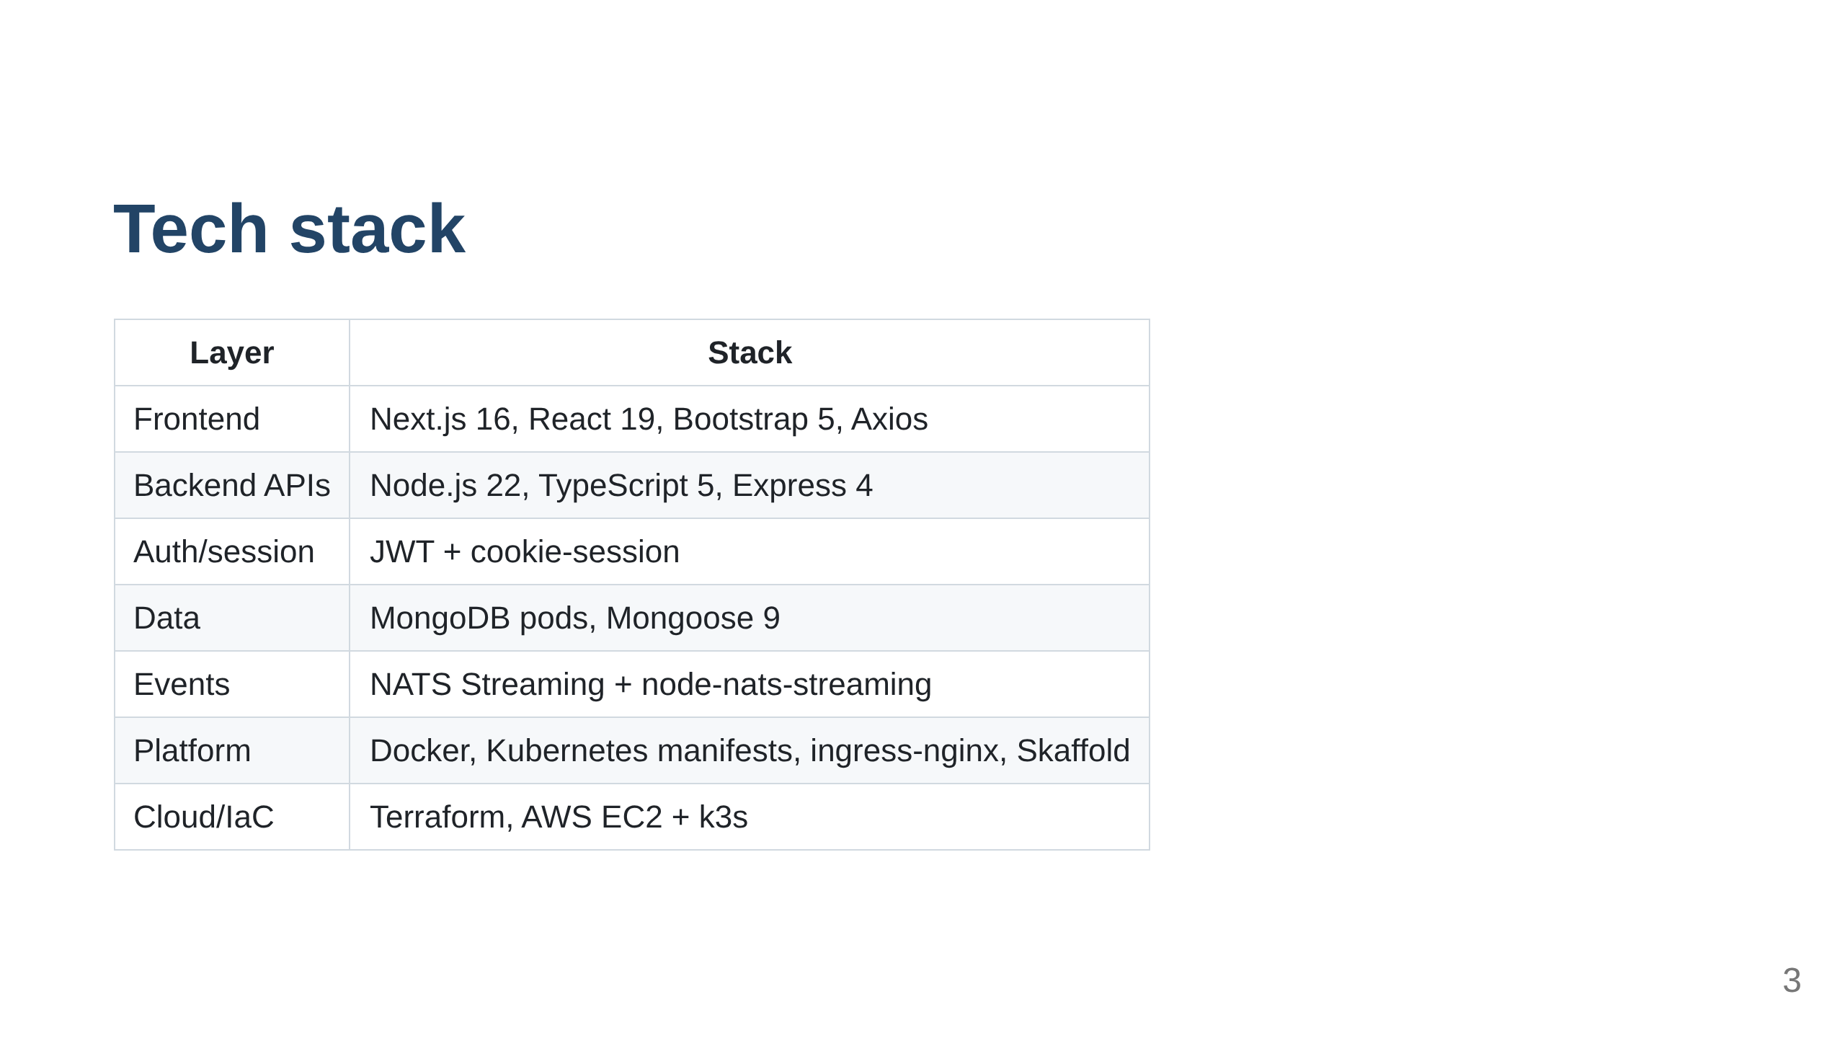
Notes:
Timing: 30s. Say: "The common theme is TypeScript end to end. The shared @ccgtickets/common package keeps errors, middleware, validation and event types consistent across services. Locally I use Docker Desktop Kubernetes and Skaffold; on AWS the same shape runs in k3s."

Slide 4
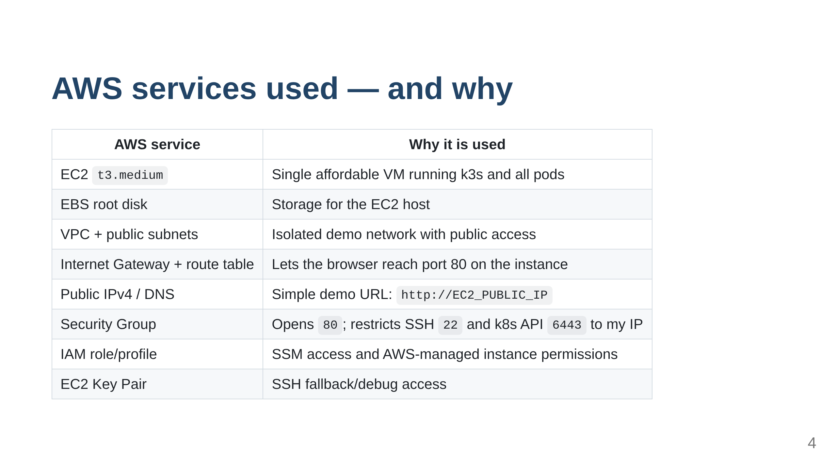
Notes:
Timing: 35s. Say: "The AWS design is intentionally small. Terraform creates the network, access rules, IAM profile and EC2 instance. k3s is installed by user data, then a bootstrap script deploys ingress-nginx and the app manifests. The goal is to demonstrate cloud deployment without adding managed services before they are needed."

Slide 5
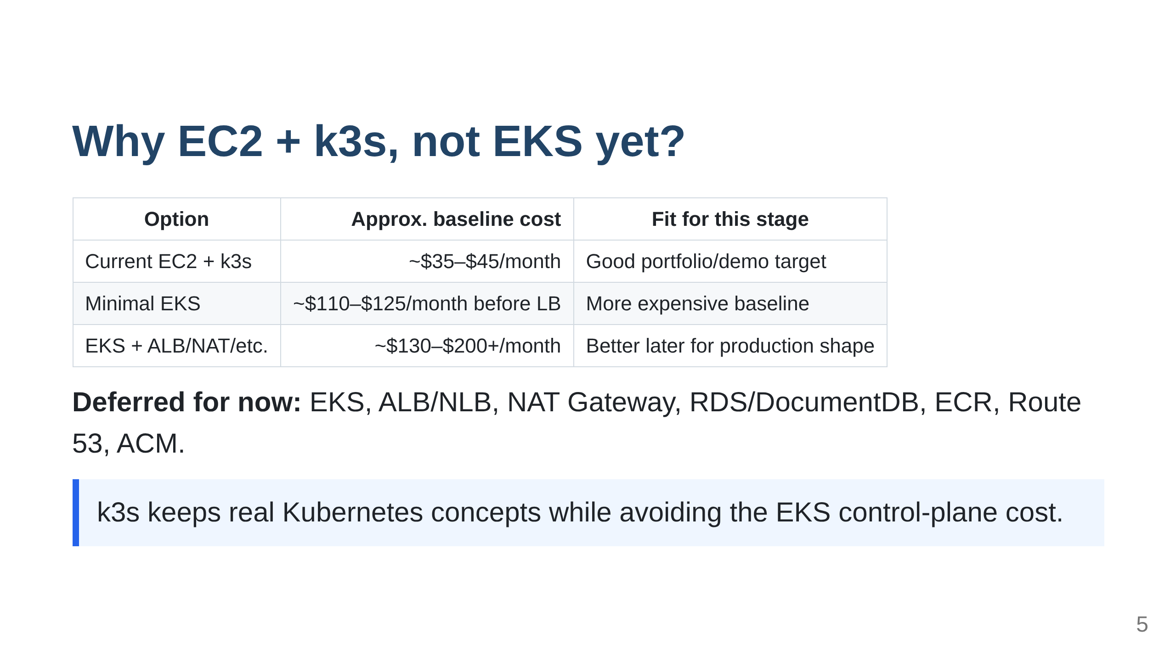
Notes:
Timing: 25s. Say: "EKS is the right direction once I need managed control planes, multi-AZ nodes, AWS load balancer integration, IRSA and team operations. For a demo, k3s proves the deployment path at much lower cost. The tradeoff is that this is not highly available and not production-ready."

Slide 6
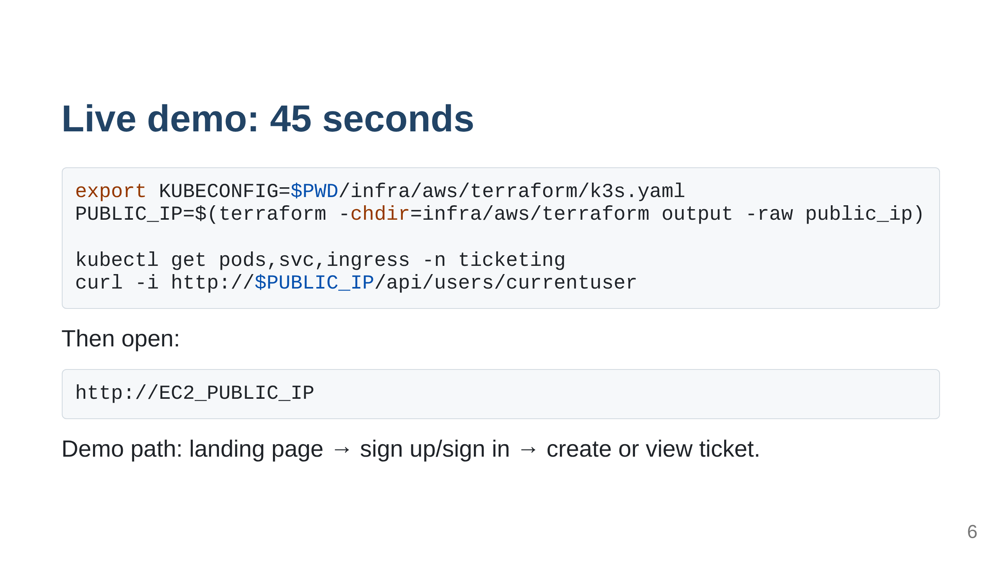
Notes:
Timing: 45s. Say: "First I show the Kubernetes resources are running. Then I hit the current-user API to prove ingress reaches the auth service. Finally I open the frontend, sign in, and show the app working through the public EC2 IP."

Slide 7
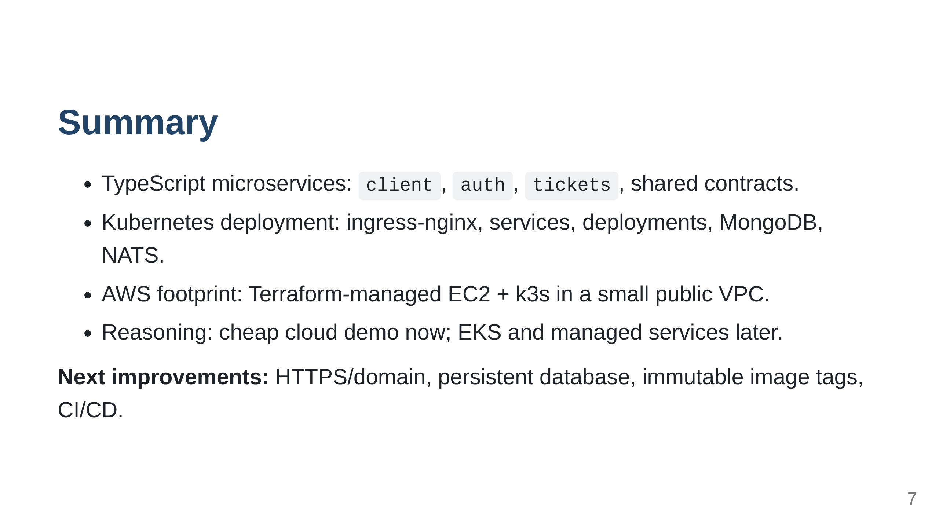
Notes:
Timing: 15s. Say: "In short: this repo shows the path from local Kubernetes development to a real AWS-hosted Kubernetes demo, while keeping the architecture and the cost appropriate for the current stage."

