Slide 1
Hit or Flop?
Predicting Track Success
Notes:
Today we are talking about how we can predict a track’s success before it is released.

Slide 2
Problem Statement
Marketing a track is an expensive process
Is there a way to tell which tracks will be successful?
Notes:
Marketing and promotion is a huge drain on resources, and failed tracks can represent huge amounts of wasted capital. We need to have a reliable way of predicting which tracks will succeed to guide our promotional costs.

Slide 3
Business Value
Decrease marketing budget
Increase the impact of hits
Increase profit
Notes:
Let’s talk about the goals of this project.
We are trying to cut our marketing costs. We don’t want to be heavily promoting flops.
We want to focus our efforts on hits. We want to put all of our energy into making hits as big as they can be.
We want to increase our profit. As always, the goal at the end of the day is to generate as much revenue as we can.

Slide 4
Methodology
31,000+ Tracks obtained from Spotify.
Measured features such as duration,
energy, and danceability.
Built multiple classification models to test.
Notes:
31,234 Tracks obtained from spotify. Each track was analyzed in regards to several features. We then built five different models to process these features and classify tracks as hits or flops. We then tried to fine-tune each model by adjusting parameters. Here are the models we ended up with.

Slide 5
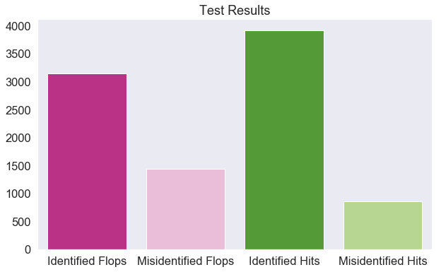
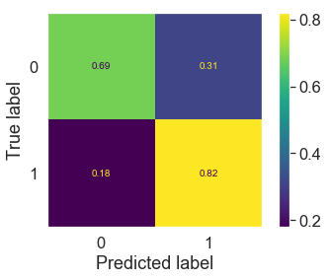
Final Models - Logistic Regression
Notes:
Logistic regression takes our features and calculates the probability that the track is a hit or flop, then separates the two classes based on that probability.
75.9% Efficacy in separating hits from flops.
Correctly identified 82% of hits, but only 69% of flops.
Good baseline model.

Slide 6
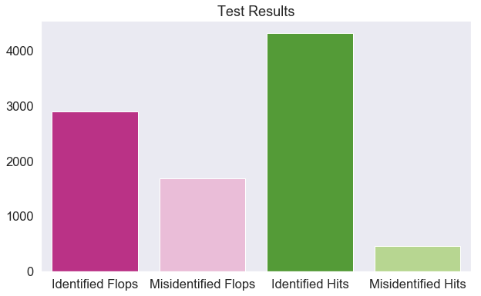
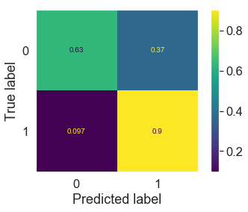
Final Models - K-Nearest Neighbors
Notes:
The KNN model assigns each data point a theoretical position in space, then calculates the closest ‘neighbors’ (other points) to that point. Then based on how many neighbors are hits, the model assigns that point as hit or flop.
79% efficacy of separating hits from flops.
90% of hits correctly identified, but only 63% of flops.
Best model for predicting hits, but worst for predicting flops.

Slide 7
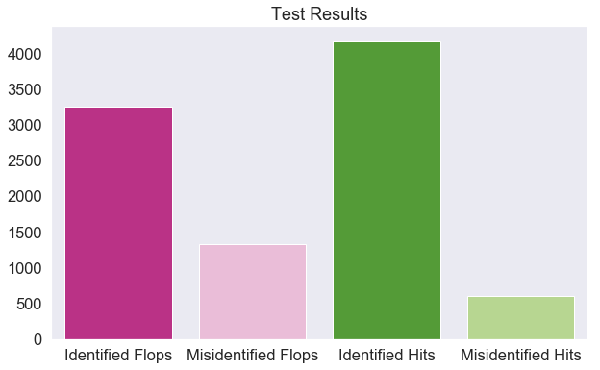

Final Models - Support Vector Machine
Notes:
SVM models assign each data point a theoretical space similar to a KNN model, but instead of looking at neighbors, the SVM model tries to draw a line that completely separates the two sides. It labels all points on one side as hits, and the other as flops.
80% efficacy in separating hits from flops.
87% of hits correctly identified, 71% of flops correctly identified.
Best overall model.

Slide 8
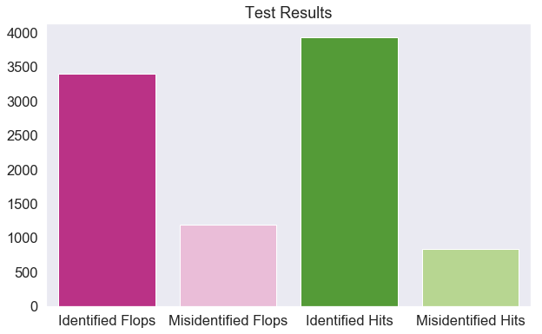

Final Models - Random Forest
Notes:
A random forest model takes all data points and separates them on certain criteria. Then it takes those resulting sets and separates them again. It continues this process until it can’t distinguish between the sets or a designated depth is reached. All resulting sets are then labelled as hits or flops.
78.4% efficacy in separating hits from flops.
82% of hits identified correctly, 74% of flops correctly identified.
Good model overall and best model for predicting flops.

Slide 9


Final Models - Adaboost
Notes:
Adaboost combines many low-level classification techniques, and gradually improves on each before ultimately classifying each datapoint as a hit or flop. Effectively, it learns from each model, then improves it for the next iteration.
78.7% efficacy in separating hits from flops.
86% of hits correctly identified, but only 70% of flops.
Serviceable model, but the SVM is more accurate overall, the random forest is better at identifying flops and the KNN is better at identifying hits.

Slide 10
Best Features
Instrumentalness
Acousticness
Notes:
We also assessed how important each feature was to our two best models. Each of these models put the most importance on how instrumental and how accoustic the track sounded. Other key features, though in different orders between the model were energy, danceability and duration.

Slide 11
Recommendations
Use SVM Model
Use Random Forest when needed
Look for optimal features
Notes:
How should we use these results moving forward? First off we should be using the SVM model to analyze all tracks we record to get a sense of whether the track will succeed. This will allow us to optimize our marketing strategies. Alternatively, we can use our random forest model if we want to take a more conservative approach to marketing. When using this model, we may miss out on promoting some of our hits, but we will be less likely to waste money promoting flops. And finally, we should be looking for tracks that showcase our important features. We should be primarily looking for instrumental music with acoustic sounds, preferably that are danceable with high energy.

Slide 12
Future Work
Testing model on genres of music
Include artist statistics
Train models on more recent music
Notes:
And finally, let’s talk about how we can expand on our models.
First, I would like to test the model on different genres of music. I imagine that there are large differences on what makes a country song a hit as opposed to an opera aria, and training our models on these genres will help us identify the differences.
Second, I would like to include statistics on the artists. Including information such as instrument types or vocal timbres could also further help us refine the results of our models, and help us search for talent to record.
Finally, I would like to train the models on a larger quantity of recent music. While the dataset that we worked with gives us a good sense of what makes a hit across generations, the music industry has distinct trends and recent music will reflect what is popular now.

Slide 13
Thank
You!
Notes:
Thank You!
Questions?

Slide 14
Appendix - Stats
Trained five models:
Logistic Regression - Train AUC .755, Test AUC .759
K-nearest neighbors - Train AUC .807, Test AUC .790
SVM - Train AUC .820, Test AUC .800
Random Forest - Train AUC .790, Test AUC .784
Adaboost - Train AUC .790, Test AUC .787
Attempted to use PCA, but accuracy suffered
Logistic Regression - Train acc .695, Test acc .699
K-nearest neighbors - Train acc .804, Test acc .720
SVM - Train acc .760, Test acc .751
Random Forest - Train acc .999, Test acc .756
Adaboost - Train acc .726, Test acc .732
Notes:
Statistics for our final models.

Slide 15
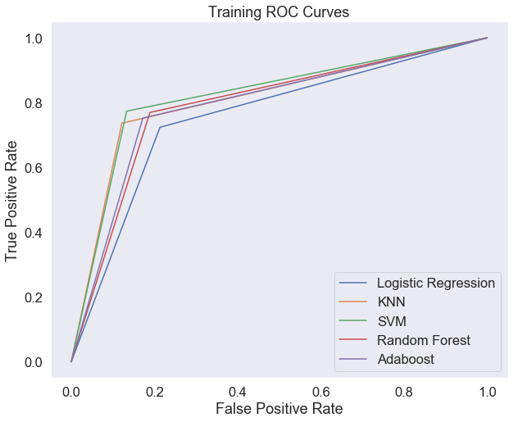
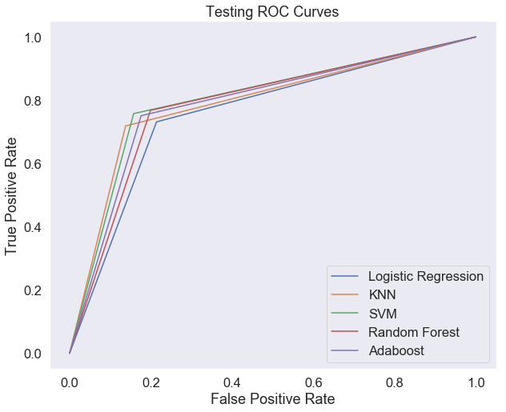
Appendix - ROC Curves
Notes:
The ROC curves for each model for both training and test sets. The SVM just beats out the other models on the test set.

Slide 16
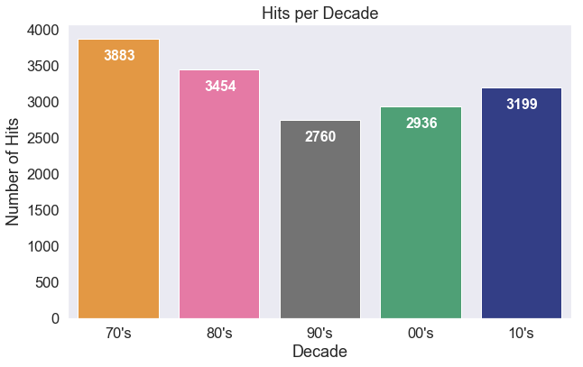
Appendix - Hit Distribution
Distribution of hits by decade
Notes:
The number of hits for each decade of data that we used.

Slide 17
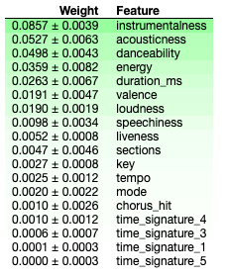
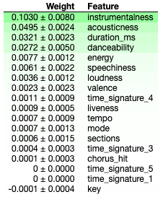
Appendix - Features
SVM Best Features
Random Forest Best Features
Notes:
The importance of each feature in our two recommended models.

