Slide 1

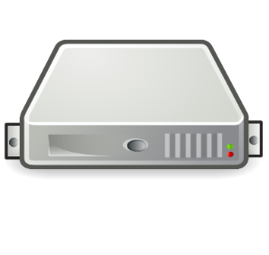
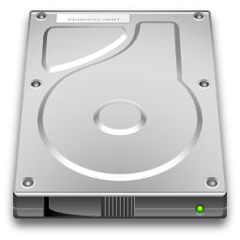

less3
<3 Less3 Server
Local Disk Storage
AWS SDK

