Slide 1
Predicting Default Payments of Credit Card Clients
--Chengle huang

Slide 2
Outline
Problem
Data Preparation
Feature Selection
Modeling
Evaluation
Conclusion

Slide 3
Problem
For banks, risk management and default detection has been a crucial challenge in issuing credit cards.
To reduce the financial loss of clients' default, banks need to find a way to determine appropriate given credit for each client depends on their history information.
Classification models may help banks more accurately predict default payment.

Slide 4
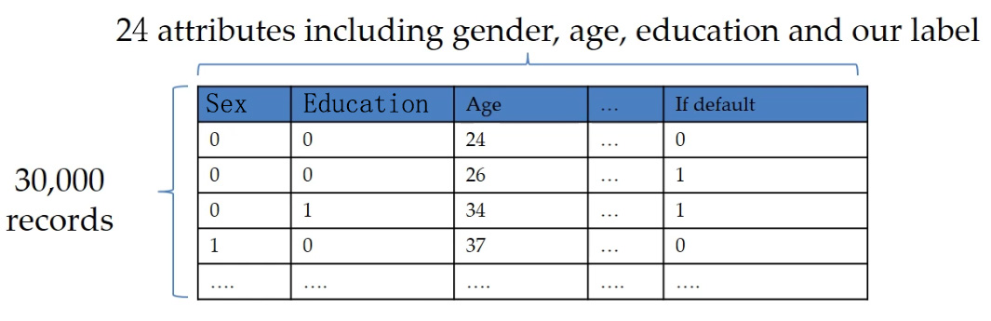
Data Preparation
The credit card issuer has gathered information on 30000 customers.
The dataset contains information on 24 variables, including demographic factors, credit data, history of payment, as well as information on the outcome: did the customer default or not?

Slide 5

Feature Selection
The feature selection process removes redundant and irrelevant features to improve model performance, which reduces the probability of overfitting.
Best-first Search:
The best-first search algorithm implements a greedy hill climbing algorithm but allows for backtracking and expansion of previously evaluated nodes.
In a greedy hill-climbing search, for a machine learning algorithm such as SVM, a feature set of size n and a feature subset F,

Slide 6
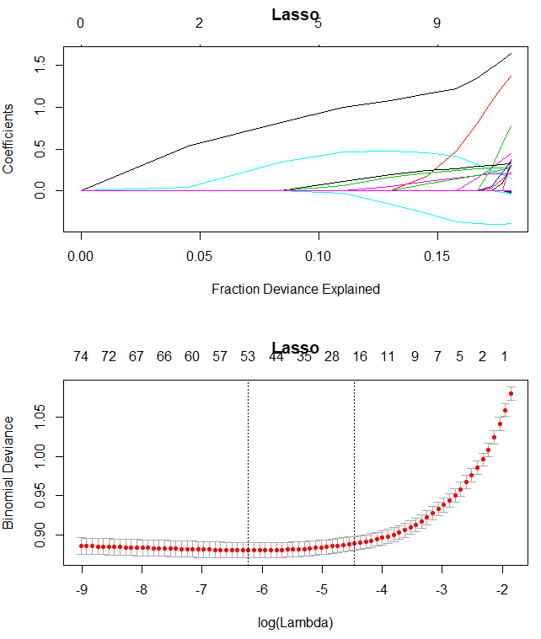
Feature Selection
Lasso
1se lambda:
0.01154642
Using the selected features by lasso in logistic regression method.

Slide 7
Models
Logistic regression is used to describe data and to explain the relationship between one dependent binary variable and one or more independent variables.
Support vector machine (SVM) is trying to maximize the distance between margins for a decision boundary separating the default and non-default instances in hyper-dimensional space.
Random Forest is a bagging technique which divide the data into several portions, use a relatively weak classification tree to process, and then combine them.

Slide 8
Logistic Regression
Selected Variables:
LIMIT_BAL, PAY_0, PAY_2, PAY_3, PAY_4, PAY_5, PAY_6, and PAY_ATM1
Performance:
Accuracy : 0.8155
Sensitivity : 0.39162
Specificity : 0.95266

Slide 9
SVM
Selected Variables:
LIMIT_BAL, PAY_0, PAY_AMT6
Kernel: Linear
Cost: 100
Performance:
Accuracy : 0.8143
Sensitivity : 0.37542
Specificity : 0.95627

Slide 10
Random Forest
Full Set variables
Performance:
Accuracy : 0.814
Sensitivity : 0.4341
Specificity : 0.9369

Slide 11
Comparison
 | Error Rate | Accuracy | Specificity | Sensitivity
Logistic | 0.1845 | 0.8155 | 0.95266 | 0.39162
SVM | 0.1856 | 0.8143 | 0.95627 | 0.37542
Random Forest | 0.186 | 0.814 | 0.9369 | 0.4141
Highest Accuracy: Logistic model
Highest Specificity: SVM Model
Sensitivity: Very low for All model

Slide 12
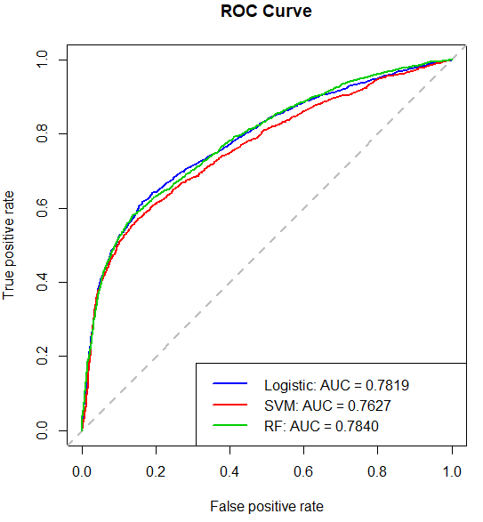
Evaluation
Higher AUC value means greater performance
for models.
RF> Logistic > SVM
Base on AUC, random forest has the best performance.

Slide 13
Conclusion
Classification model is powerful for default payments prediction.
For imbalanced dataset, the accuracy for models may be not a good measure to evaluate the performances. AUC value is better.
ROC curves could visually demonstrates the performance of models. A good sensitivity-specificity trade-off may significantly improve the model performance.

