Slide 1

Behavioral and Product Analysis of Online Retail Data

Slide 2

OUTLINE
1. Business Goal
2. Data Overview
3. Data Preparation
4. Results
Visualization – Charts
Dashboard
5. Key Insights & Recommendations
6. Conclusion
What are we analyzing and why?
Key columns used
Cleaning steps
Feature creation

Slide 3
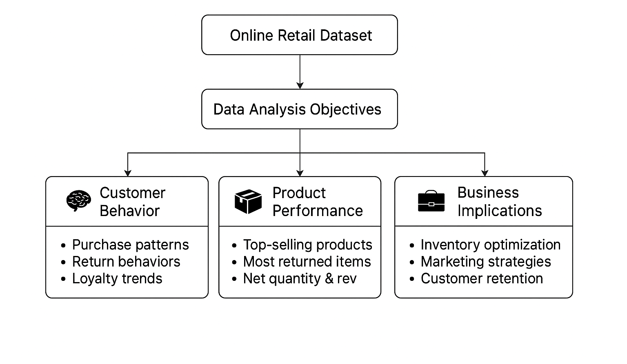
Business Goal
What are we analyzing
why

Slide 4
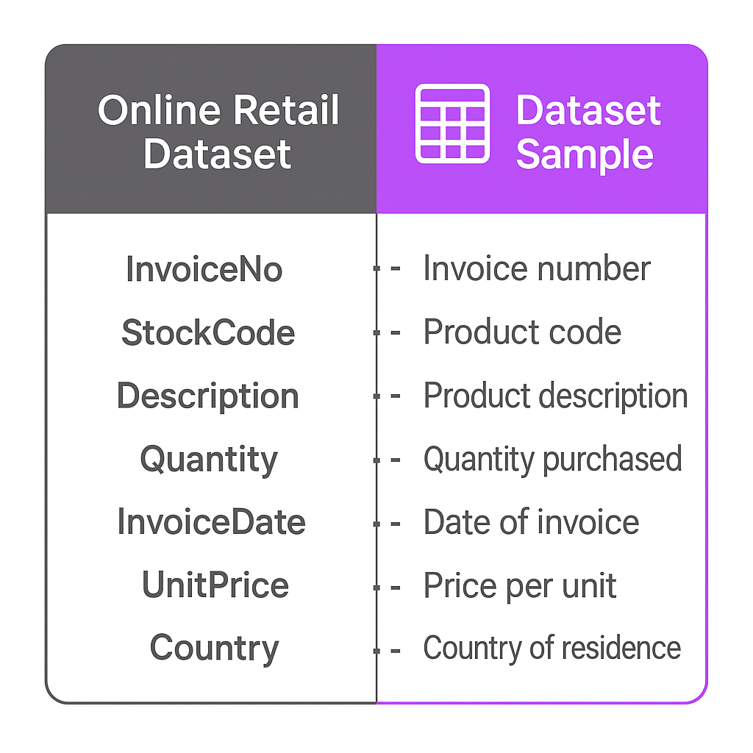
Data Overview

Slide 5



Data Preparation

Slide 6



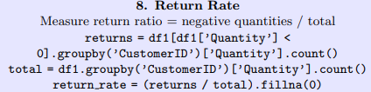
Data Preparation

Slide 7
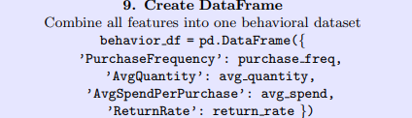
Data Preparation

Slide 8
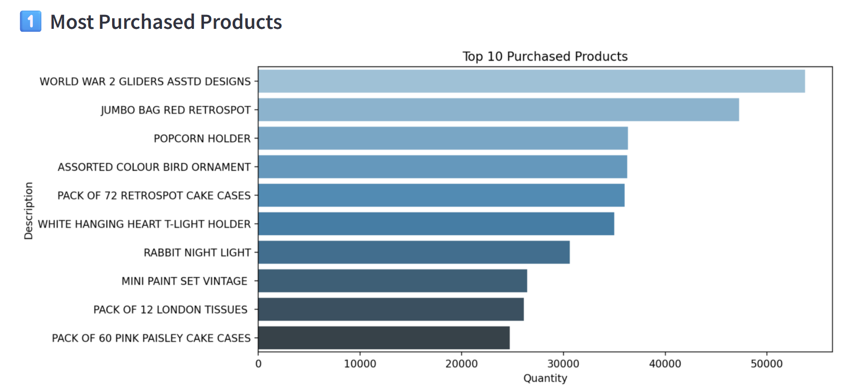
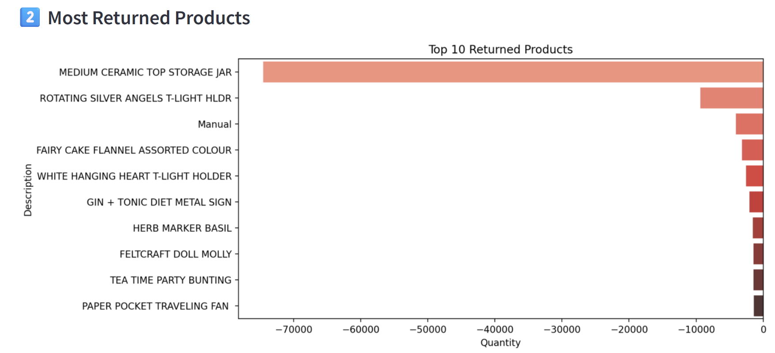
Results

Slide 9
Key Insights & Recommendations
Key Insights
Recommendations
World War 2 Gliders Asstd Designs leads sales volume, followed by Jumbo Bag Red Retrospot and Popcorn Holder.
Medium Ceramic Top Storage Jar shows exceptionally high return volumes, significantly impacting net sales.
Overlap between top-sellers and high-return items suggests potential quality, fit, or expectation issues.
Conduct root-cause analysis on high-return products to address defects, packaging, or product description gaps.
Implement stricter quality control for high-volume items.
Reassess stocking strategy for products with persistently high return rates.

Slide 10
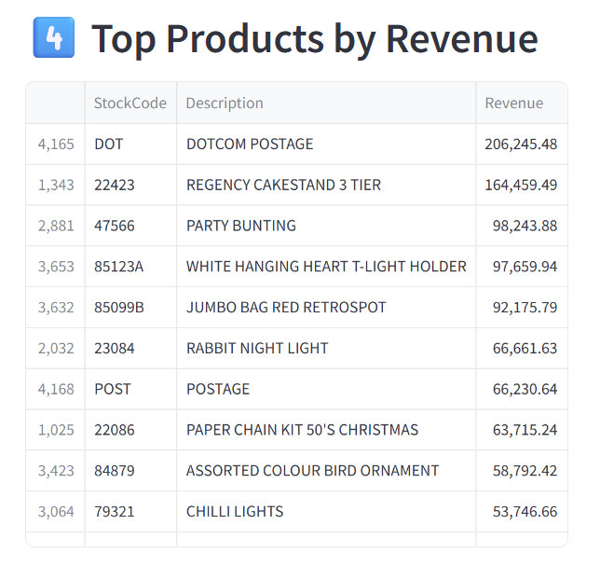
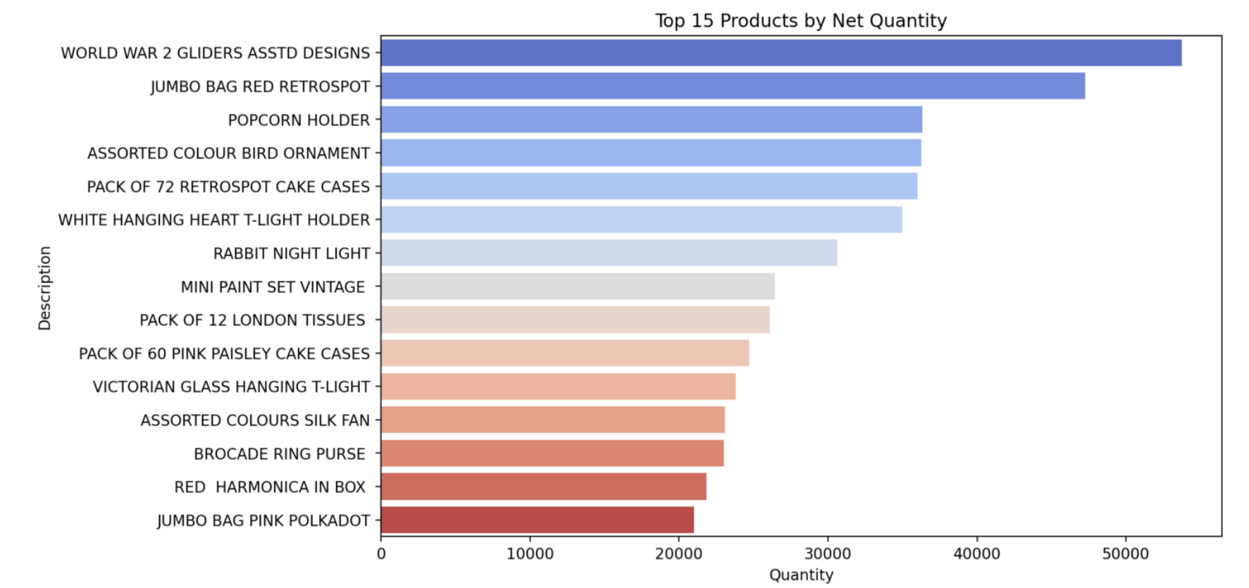
Results

Slide 11
Key Insights & Recommendations
Key Insights
Recommendations
Maintain inventory focus on high-demand, high-revenue overlap items (Jumbo Bag Red Retrospot, Rabbit Night Light).
Explore pricing optimization for high-revenue, low-volume products to maximize margins.
Promote top net-quantity sellers with competitive pricing to drive revenue growth.
World War 2 Gliders Asstd Designs leads in net quantity sold, indicating strong demand.
Jumbo Bag Red Retrospot ranks high in both net quantity and revenue, signaling a consistent bestseller.
White Hanging Heart T-Light Holder performs well in revenue despite mid-tier net quantity, suggesting strong pricing power.
Some high-revenue products (Dotcom Postage, Regency Cake Stand 3 Tier) are not in the top net quantity list, implying higher unit value but lower sales volume.

Slide 12
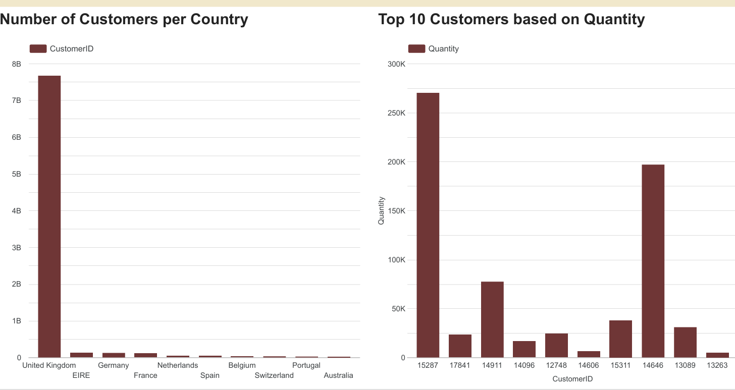
Results

Slide 13
Key Insights & Recommendations
Key Insights
Recommendations
The United Kingdom dominates the customer base, indicating a strong domestic market focus.
Two customers (15287 and 14646) contribute a disproportionately high share of total quantity sold, showing dependency on a few high-volume buyers.
Remaining top customers have significantly lower purchase volumes, suggesting potential to diversify high-value accounts.
Strengthen relationships and offer loyalty incentives to key accounts to secure recurring sales.
Reduce dependency risk by targeting mid-tier customers for upselling and cross-selling.
Explore international market opportunities, starting with countries showing existing small but stable customer bases ( Germany, France, Netherlands)

Slide 14
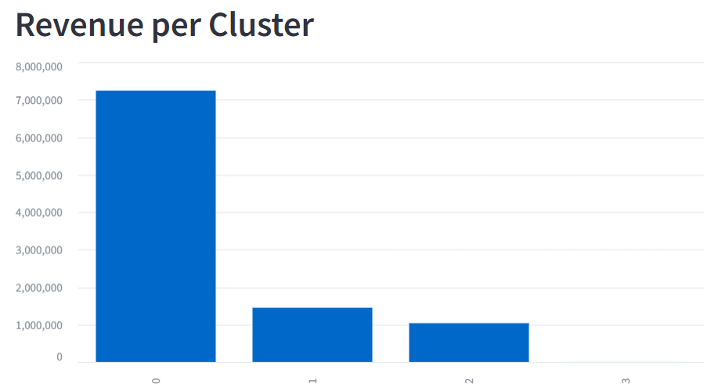
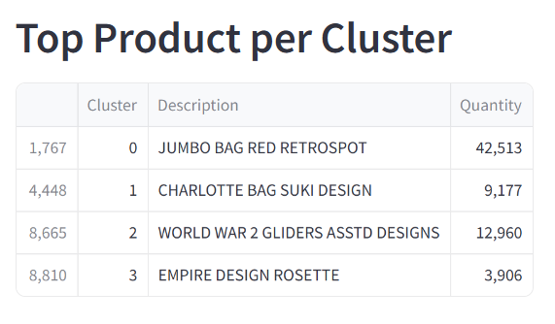
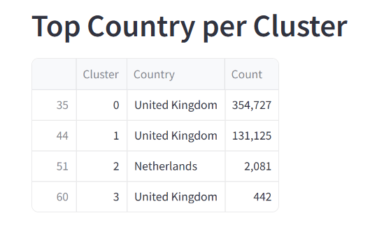
Results

Slide 15
Key Insights & Recommendations
Key Insights
Recommendations
Cluster 0 drives the majority of revenue.
Top product: JUMBO BAG RED RETROSPOT (42.5K units sold).
UK is the dominant market, especially in Clusters 0, 1 & 3.
Cluster 2 shows potential in Netherlands.
Focus on Cluster 0 : invest in top products and retention.
Strengthen UK market : optimize promotions and service.
Explore EU growth : start with Netherlands (Cluster 2).
Reassess Cluster 3 : low volume, needs review.

Slide 16
Conclusion
Market Concentration: Majority of customers are from the UK, indicating high dependence on a single market.
Key Customer Reliance: A small number of customers generate a significant share of total sales volume.
Product Performance: Sales are driven by a few top-performing products, while others show low or negative contribution.
Growth Opportunities: International markets are underdeveloped and represent potential expansion areas.

