Slide 1

App Store Management
Group Number 6
Team Members
Parvati Sohani 002743027
Chaitanya Inamdar 002778948
Vivek Hanagoji 002762662
Anupam Aditya 002920714

Slide 2
Overview
This project is designed for managing applications irrespective of any platform. The App Store will categorize applications based on different genres such as Art & Design, Social media, E-Books, Entertainment, Finance, Food & Drinks, Health & Fitness etc. This will be an interface for the users to install, uninstall, and update different versions of any application.
Business problems being addressed -
1. This App store will solve the problem of disorganized user application catalogue using the entity profile by which users can have multiple profiles through which all the apps will be segregated based on the user’s various purposes.
2. App store management also implements common rules and regulations for the Developers for creating and releasing applications via License entity which will address the issue of unlawful and illegal application developments.
3. Since users can have multiple profiles, App store database management can impose data restrictions to a certain profile to manage App accessibility.

Slide 3
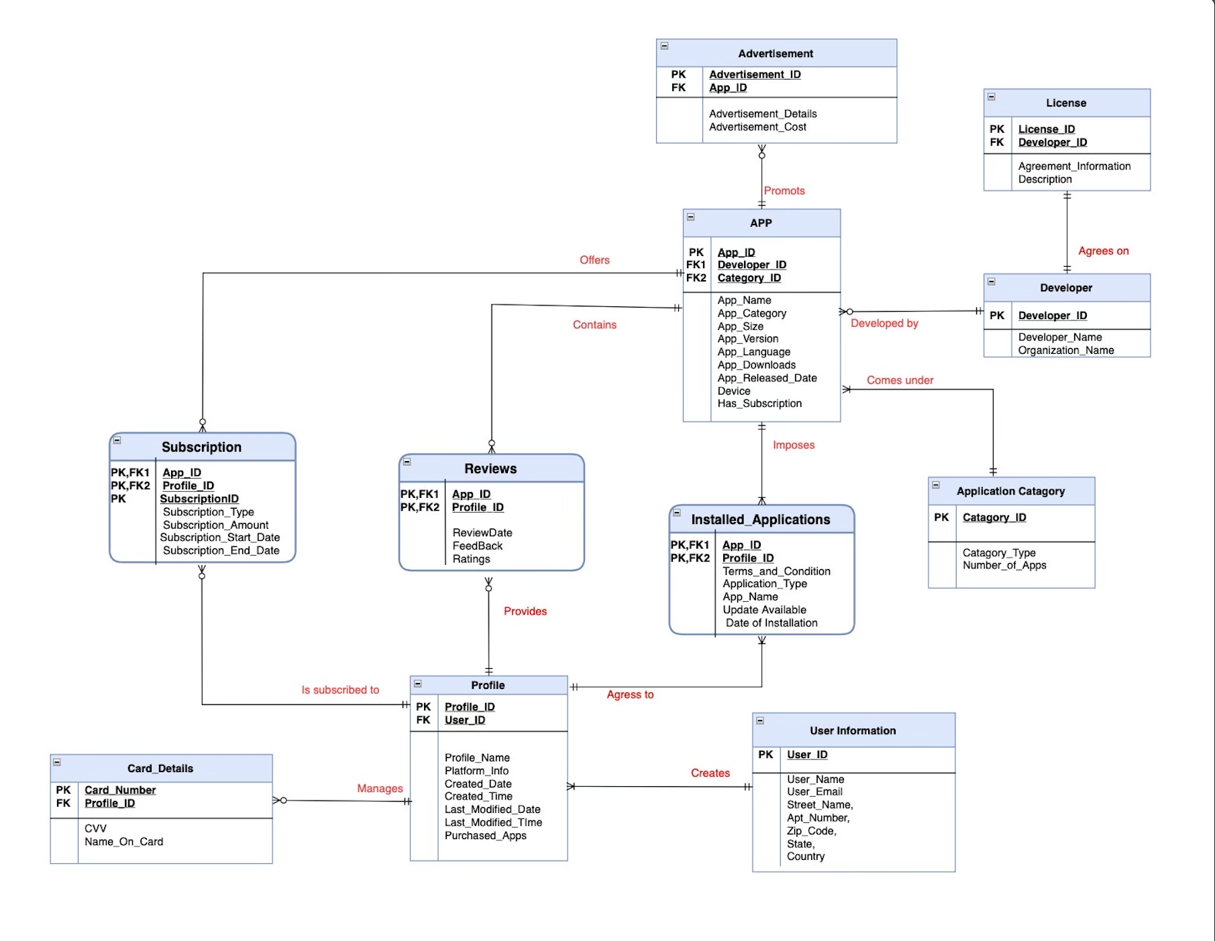
Final ERD
Entities -
App
Profile
User_information
Card_Details
Subscription
Reviews
Installed_Application
Application_category
Developer
License
Advertisement

Slide 4
Functionalities:
Stored Procedures
Get User Catalogue
Get Subscription Details
Encryption and Decryption for Card Details
UDF
Get Number of Downloads
UDF (Computed Column)
Average usage of Apps per Category
Triggers
App Changes
App Delete(Roll Back)
Non Clustered Indexes
App Name
User Name
No of Apps in Category
Advertisement Cost
App Store GUI
CRUD functionality
Views
Get Organization Report
Apps Performance

Slide 5
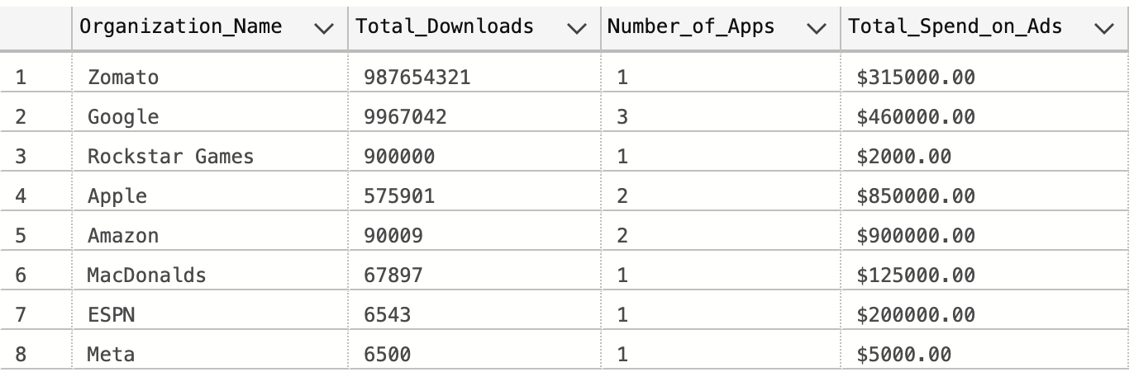
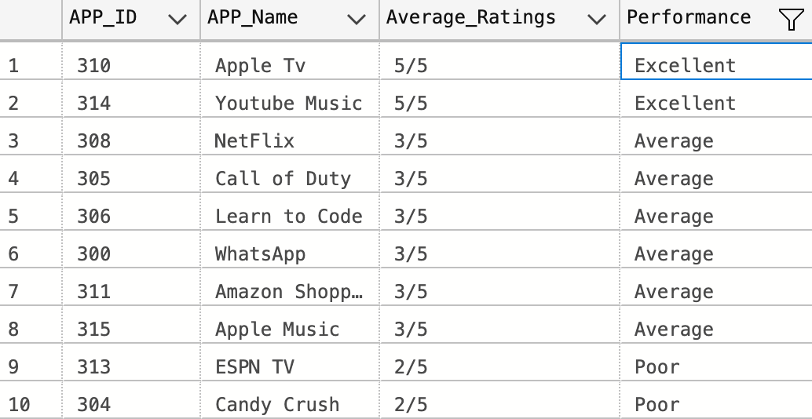
Database Implementation
Views
CREATE TABLE APP
(
APP_ID INT not null,
Developer_ID INT not null,
Catagory_ID INT not null,
App_Name Varchar(256) not null,
App_Catagory VARCHAR (30) CONSTRAINT App_Catagory_ck
CHECK (App_Catagory in ('Game','Education','Entertainment','Shopping','Social','Sports','Music','Food')) not null,
APP_Size Decimal(10,2) not null,
APP_Version Decimal (2,1) not null,
APP_Language VARCHAR (30) CONSTRAINT APP_Language_ck
CHECK (APP_Language in ('English','Hindi','Spanish','French','Portugese','Japanese','Chinese')) not null,
APP_Downloads INT not null,
APP_Released_Date DATE not null,
Device VARCHAR (30) CONSTRAINT Device_ck
CHECK (Device in ('Android','IPhone','Laptop','MacBook','IPad','Tablet')) not null,
Has_Subscription VARCHAR (10) CONSTRAINT Has_Subscription_ck
CHECK (Has_Subscription in ('Yes','No')) not null,
constraint APP_PK primary key (APP_ID),
constraint Developer_ID_FK foreign key (Developer_ID) references DEVELOPER(Developer_ID),
constraint Catagory_ID_FK foreign key (Catagory_ID) references APPLICATION_CATAGORY(Catagory_ID)
)
Go
CREATE VIEW OrganizationReport
AS
SELECT x.Organization_Name,sum(x.APP_Downloads) as Total_Downloads,count(x.Catagory_Type) AS Number_of_Apps,'$'+ cast(sum(z.Advertisement_Cost) AS varchar(50)) as Total_Spend_on_Ads from
(select c.APP_ID,Organization_Name,c.APP_Downloads,d.Catagory_Type from
(select * from APPLICATION_CATAGORY) d
inner join
(select a.APP_ID,b.Developer_ID,b.Organization_Name,a.Catagory_ID,a.APP_Downloads from
(select * from APP) a
inner JOIN
(select * from DEVELOPER)b
on a.Developer_ID = b.Developer_ID) c on d.Catagory_ID = c.Catagory_ID) x
inner JOIN
(select * from ADVERTISEMENT) z on x.APP_ID = z.APP_ID group by x.Organization_Name
select * from OrganizationReport ORDER by Total_Downloads DESC
CREATE VIEW AppPerformance
AS
select b.APP_ID,a.APP_Name,count(b.Ratings) as total_Ratings,cast(sum(b.Ratings)/count(b.Profile_ID) as varchar) + '/5' as Average_Ratings ,
CASE
WHEN sum(b.Ratings)/count(b.Profile_ID) <= 2 Then 'Poor'
WHEN sum(b.Ratings)/count(b.Profile_ID) =3 THEN 'Average'
WHEN sum(b.Ratings)/count(b.Profile_ID) =4 THEN 'Good'
ELSE 'Excellent'
END AS Performance
from
(select * from APP)a
inner JOIN
(select * from REVIEWS)b on a.APP_ID = b.APP_ID group by b.APP_ID,a.APP_Name;

Slide 6
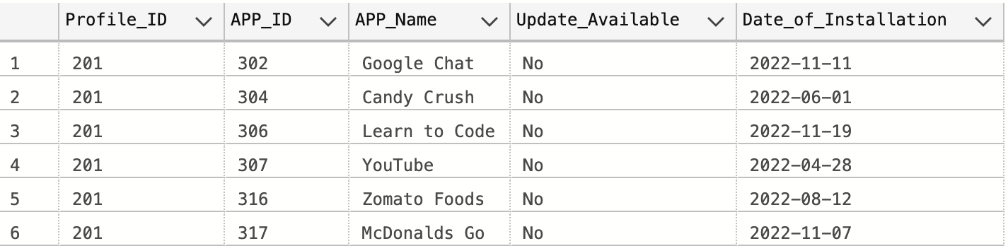
Stored Procedures
Create proc getSubscriptionDetails @UserName VARCHAR (30)
AS
BEGIN
select u.USER_NAME,p.profile_Name, a.App_Name, s.subscription_Type, '$' + Cast(s.Subscription_Amount as Varchar(30)) as Subscription_Amount, s.Subscription_Start_Date, s.Subscription_End_Date
from User_Profile p left join User_Information u on u.user_ID = p.User_ID
join subscription s on p.profile_ID = s.profile_ID join App a on a.App_ID = s.App_ID
where u.USER_NAME = @UserName
END
EXEC getSubscriptionDetails Chaitanya
CREATE PROCEDURE GetUserCatalogue @Profile_ID INT
AS
BEGIN
select z.Profile_ID,z.APP_ID,z.APP_Name,z.Update_Available,x.Subscription_Type,z.Date_of_Installation from
(SELECT APP_ID,Profile_ID,Subscription_Type FROM Subscription)x
INNER JOIN
(SELECT a.Profile_ID,b.APP_ID,b.APP_Name,a.Update_Available,a.Date_of_Installation FROM
(SELECT * FROM installed_Apps)a
INNER JOIN
(SELECT * FROM App)b on a.APP_ID = b.APP_ID and a.Profile_ID = @Profile_ID
)z on x.APP_ID = z.APP_ID or x.Profile_ID = z.Profile_ID
END
EXEC GetUserCatalogue 201

Slide 7
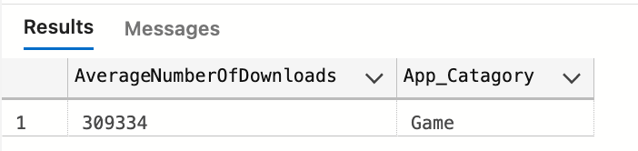
Trigger
User Defined Function
CREATE TABLE [dbo].[AppAudit](
[AppAuditID] int not null primary key identity(1,1),
[App_ID] [char](4) NOT NULL,
[App_Name] [varchar](100) NOT NULL,
[App_Catagory] [varchar](100) NOT NULL,
[Old_Name] [varchar](100),
[New_Name] [varchar](100) NULL,
[Action] char(10),
[ActionDate] datetime
)
GO
CREATE TRIGGER APPCHANGE
ON dbo.APP
FOR UPDATE
AS
BEGIN
declare @action char(10)
IF UPDATE(APP_NAME)
SET @action = 'Update'
INSERT INTO [AppAudit] ( [App_ID] ,[App_Name] ,[App_Catagory],[Old_Name],[New_Name],[Action],[ActionDate] )
SELECT d.App_ID,d.APP_Name,d.App_Catagory,d.APP_Name,i.APP_Name, @action, GETDATE()
FROM DELETED d join INSERTED i on d.App_ID = i.App_ID
END
Update APP SET App_Name = 'WeChat' WHERE APP_ID = '300'
Create FUNCTION AvgNumberOfDownloads( @App_catagory VARCHAR(30))
RETURNS Table As
Return
SELECT (sum(a.App_Downloads)/ac.Number_of_Apps) As AverageNumberOfDownloads , a.App_Catagory
from App a left join APPLICATION_CATAGORY ac on a.Catagory_ID = ac.Catagory_ID
WHERE a.App_Catagory = @App_catagory
group by a.App_Catagory, ac.Number_of_Apps ;
GO
select * from AvgNumberOfDownloads('Game');

Slide 8
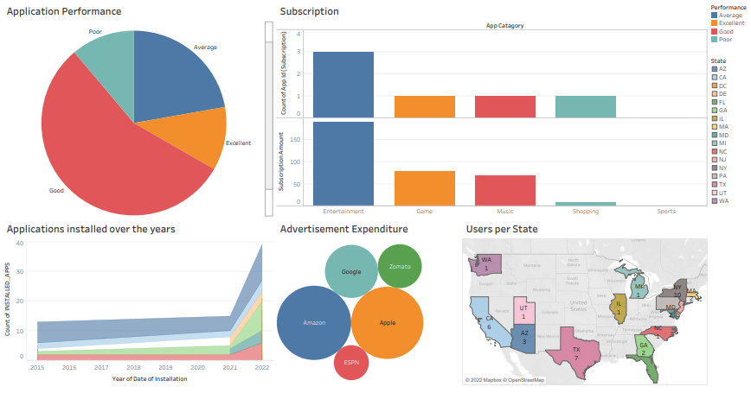
Data visualization

Slide 9
Thank You For Listening

