Slide 1

Task scheduling and Management Tool
presented By : VU21CSEN0100995 - Harshitha
VU21CSEN0100010 - Shashi Kiran
VU21CSEN0100379 - Lishanth
VU21CSEN0101475 - Adithya Srinivas
VU21CSEN0100086 - Chaitanya Patnaik

Slide 2
2
OVERVIEW
Abstract
Completed tasks
Introduction
Implementation
Add new task
Thank You
Active tasks
Larana University | 2024

Slide 3
1
ABSTRACT
The Class Schedule and Task Management Tool is an integrated web application designed to help students and educators effectively organize their academic schedules and manage their tasks. This tool provides a centralized platform where users can create, view, and modify their class schedules alongside managing tasks, assignments, and deadlines.

Slide 4
3
INTRODUCTION
Our tool is designed to address these challenges by providing a centralized, user-friendly platform that seamlessly integrates class scheduling with task management. By leveraging this innovative solution, users can organize their academic schedules, prioritize tasks, and stay on top of their responsibilities, ultimately enhancing productivity and academic success.

Slide 5
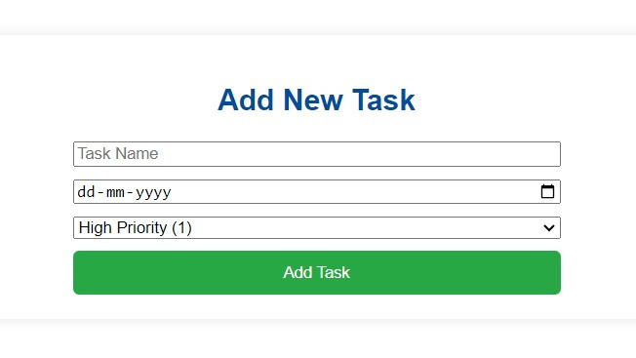
5
ADDING A TASK
In this section a new task can be added by giving the task name an setting the deadline and the priority

Slide 6
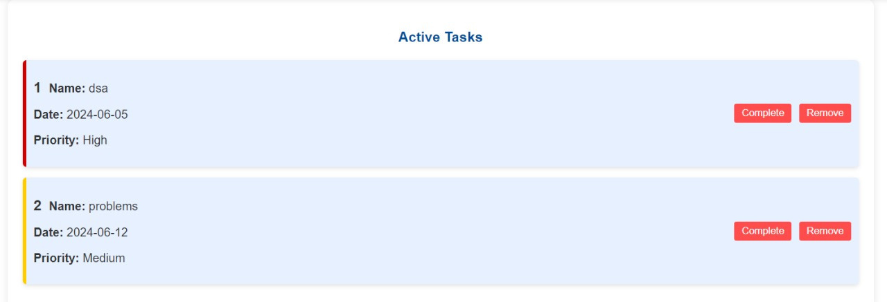
6
ACTIVE TASKS
In this field you can check the tasks that should be completed in time

Slide 7
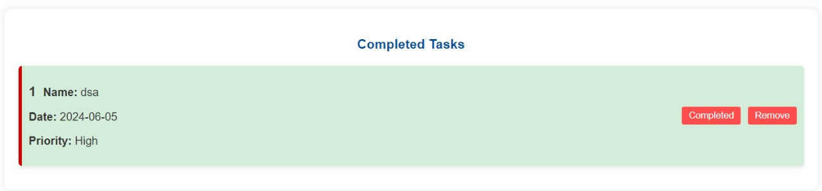
7
COMPLETED TASKS
In this field you can check for the tasks you have completed

Slide 8
8
IMPLEMENTATION
languages used :
HTML
CSS
JS.

Slide 9
THANK YOU

