Slide 1

MOVIE/TV SHOW RECOMMENDATION SYSTEM
REG.NO:2200090045
2200090054
2200033037

Slide 2
ABSTRACT
The Movie/TV Show Recommendation System is an innovative web-based platform designed to offer users highly personalized suggestions for movies and TV shows, taking into account their individual preferences and viewing history. By harnessing the power of collaborative filtering algorithms and advanced machine learning techniques, the system adeptly analyzes user behavior to deliver targeted recommendations that align with their entertainment tastes

Slide 3
RECOMMENDATIONS FOR MOVIE/TV SHOWS
Data Collection and Storage: Collect data about movies and TV shows, including attributes like genre, cast, director, release year, and user ratings. You'll also need user data such as viewing history, ratings, and preferences. Store this data in a structured database.

Slide 4
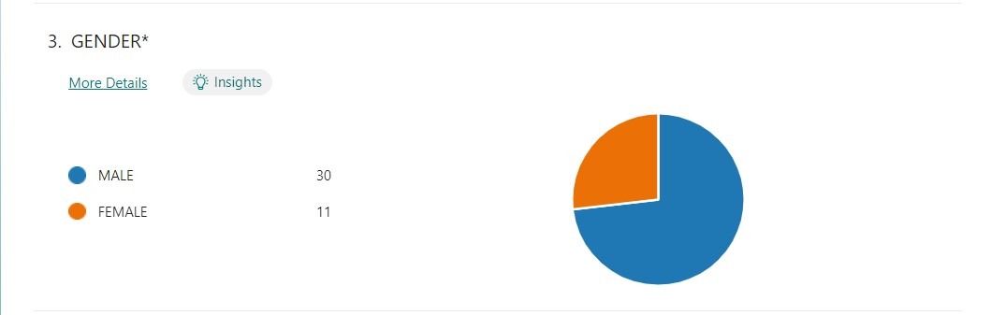
REPONSES FOR MOVIE/TV SHOWS

Slide 5
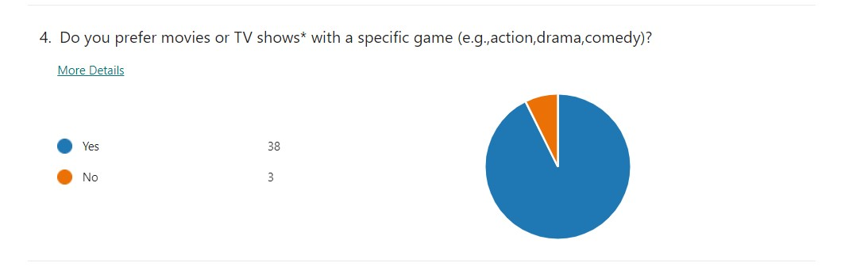

Slide 6
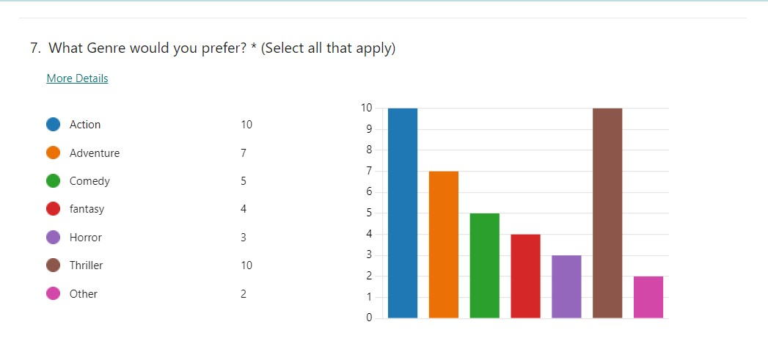

Slide 7
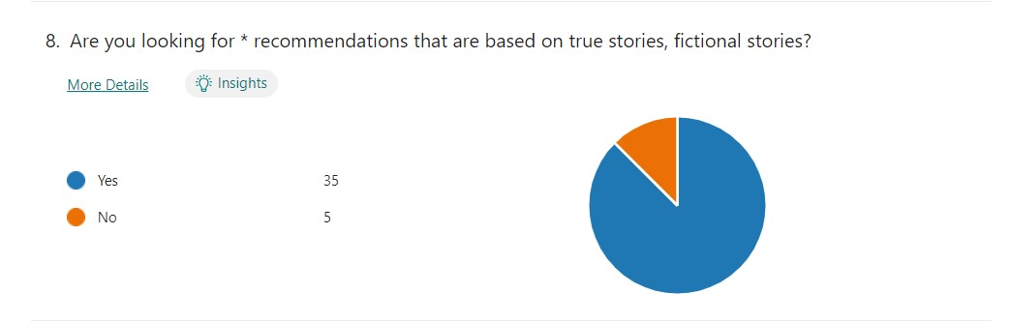

Slide 8
