Slide 1
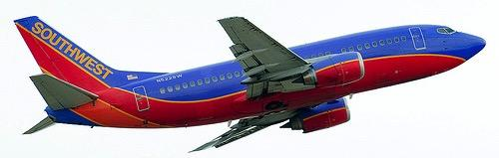
SWA ACCOUNT UPDATE
08-JUL-15

Slide 2
Lonestar
Demo

Slide 3
SWA June STARTERS!
Role | Name | Staffing Office | Working Office | Start Date | Team
PM | Tamara Nicholl-Smith | Dallas | Dallas | 6/1/2015 | Mobile - Core
Dev | Vinicius Fernandes de Jesus | Porto Alegre | Porto Alegre | 6/1/2015 | Carioca
Dev | Yang Den Liu | Chengdu | Chengdu | 6/1/2015 | Mobile - iOS
BA | Vrushali Patil | Dallas | Dallas | 6/8/2015 | Looney Tunes
Dev | Zhewu Zhou | Chengdu | Chengdu | 6/12/2015 | Mobile - Web
Dev | Nic Cheneweth | Dallas | Dallas | 6/15/2015 | Infrastructure
Dev | Aleksander Serafimoski | Chicago | Dallas | 6/29/2015 | Mobile - API

Slide 4
SWA June ROLLOFFS!
Role | Name | Staffing Office | Working Office | End Date | Team
XD | Doug Stuart | Dallas | Dallas | 6/5/2015 | Mobile - Core
QA | Apryl Gordy | New York | Dallas | 6/11/2015 | Mobile - Core
BA | Suzanne Scott | San Francisco | Dallas | 6/11/2015 | Mobile - Core
Dev | Kristene Brown | San Francisco | Dallas | 6/11/2015 | Mobile - iOS
Dev | Maryum Styles | San Francisco | Dallas | 6/11/2015 | Mobile - Core
BA | Nikki Appleby | Chicago | Dallas | 6/11/2015 | Mobile - Core
Dev | Ao Zhu | Beijing | Dallas | 6/11/2015 | Mobile - Android
Dev | Yuqing Huang | Beijing | Dallas | 6/11/2015 | Mobile - iOS
Dev | Andrew Shaw Care | Toronto | Dallas | 6/11/2015 | Mobile - Web
BA | Roshan Pourabdollah | San Francisco | Dallas | 6/11/2015 | Mobile - Core
Dev | Tanuj Mathur | New York | Dallas | 6/11/2015 | Mobile - Web
Dev | Amber Houle | Chicago | Dallas | 6/12/2015 | Looney Tunes
Dev | Rui Li | Chengdu | Chengdu | 6/12/2015 | Mobile - Web
Dev | Scott Robinson | Sydney | Chengdu | 6/12/2015 | Mobile - Core
Dev | Jinzhong Cai | Chengdu | Chengdu | 6/12/2015 | Mobile - Web
Dev | Jing Guo | Chengdu | Chengdu | 6/12/2015 | Mobile - Web
XD | Casper Li | Beijing | Chengdu | 6/12/2015 | Mobile - Core
Dev | Jinglei Wang | Chengdu | Chengdu | 6/12/2015 | Mobile - Web
Dev | Li Luo | Chengdu | Chengdu | 6/12/2015 | Mobile - Android
Dev | Siyang Li | Chengdu | Chengdu | 6/12/2015 | Mobile - Android
Dev | Zhen Tang | Chengdu | Chengdu | 6/12/2015 | Mobile - Android
Dev | Juan Du | Xi'an | Chengdu | 6/12/2015 | Mobile - Web
Dev | James Spargo | Dallas | Dallas | 6/19/2015 | Mobile - Web
Dev | Coleman Beasley | San Francisco | Dallas | 6/19/2015 | Mobile - Web
Dev | Josh Howell | Chicago | Dallas | 6/19/2015 | Mobile - Web
Dev | George Pradhan | Dallas | Dallas | 6/19/2015 | Mobile – Web

Slide 5
DELIVERY STATUS
Project | Status | Trend | Comment
DCE (transformation) |  |  | Engagement proceeding as scheduled. Extended through Q3.
Aircraft Ops & Maintenance |  |  | ODS is wrapping up on a positive trend. Turn is moving into R2. Gate is getting to a steady state and resolving scope issues.
Mobile |  |  | iOS team hit their targets this sprint. Team is trending to a steady state. Likely delivery early Fall with a TW financial investment.
APT (enterprise tools) |  |  | Last release showed much improvement.
Pass Bureau |  |  | Project on schedule
Lonestar |  |  | TW teams have delivered their initial deliverables (only Lonestar teams that have). Teams moving on to new Lonestar work.

Slide 6
LET’S DO THE NUMBERS…..
135 People (Down from 152)
~3.1M per month (Up from ~2.5M)
58%ish Gross Margin
In May SWA was the top grossing account in all of ThoughtWorks!
Notes:
Don't know the GM, but can't imagine it changed.
We were likely still the top grossing account in June, but that will change beginning this month. We only got part of the Mobile hit in June. Lost more to come in July.

Slide 7
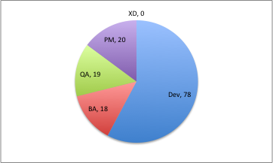
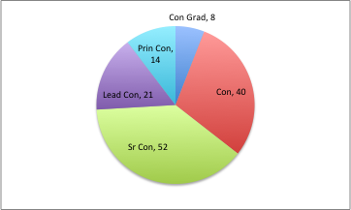
ACCOUNT STATS
By Role
By Grade

Slide 8
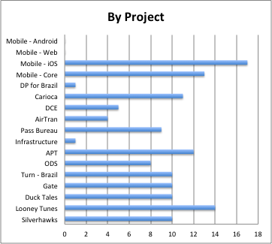
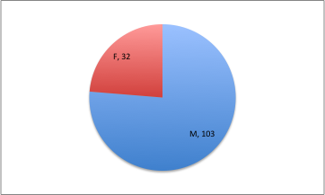
ACCOUNT STATS 2
By Gender
M = 76%
F = 24%

Slide 9
Polling Results
From June 8 2015 Account Meeting

Slide 10
What would you like to know more about in these account meetings?
Raw data | Theme / Action
Potential new work @ SWA | Theme: Account strategy / Project roadmap
New work at SWA
New projects
Portifolio updates. What projects are coming next?, Are we growing too fast ?
 | Action: Look for something on this theme at the August account meeting
Where we are in the path that we plan to run inside SWA
Long term strategy for TW@SWA
plana for the account
High level client perception
SWA financial results

Slide 11
What would you like to know more about in these account meetings?
Raw data | Theme / Action
What are the highlights that some teams are making? | Theme: Project / Team status, health and highlights Action: 1) These topics will be addressed as each team will have a chance to showcase their project. July = Lonestar August = Mobile 2) Will be re-working the SWA mytw page to allow for projects to put status info on their sub-page
recent victories from each team and from the cst itself
Project statuses; progress, targets, changes, etc
Mobile work
Vision and TW involvement
More detailed team/project health metrics,
Gauging happiness and satisfaction of teams/team members?
More detailed team/project health metrics,

Slide 12
What would you like to know more about in these account meetings?
Raw data | Theme / Action
Progress in QMO transformation | Theme: Transformation Action: Transformation will have a sub-page on SWA mytw. We will Post transformation status report weekly. Any other questions, see: Hal Stiles – overall transformation John Kordyback – QMO transformation Nic Cheneweth – Infrastructure transformation
Talk about transformation as an overall effort and the challenges with it.
Transformation roadmap
Transformation efforts at Southwest

Slide 13
What would you like to know more about in these account meetings?
Raw data | Theme / Action
Roadblocks | Need a bit more direction here.
Recent exits, | CST will be publishing New Starters and Roll-offs monthly starting with May.
Possibilities for rotations | Standard = 1 year commitment Core team = more
What's in the msa | Greg
Upcoming events | Post your team events to the SWA Account calendar.

Slide 14
What would you change to improve your experience?
Raw data | Theme
Work remote, VPN Access!! | Theme: Working conditions, tools Action: Brandon has sent out a survey on remote working tools. Have you responded? VPN – have you followed the access instructions? Network and mifis - ????
Work remote one week out of 4
Better remote connectivity
Better team rooms
Fix the network?,
Worse Internet in HQ would be nice
Wifi speed
The mi-fi scene, Mifi at work

Slide 15
What would you change to improve your experience?
Raw data | Theme
SWA | Theme: SWA / TW Relationship Action: Greg?
More influence with swa, More support from SWA management, Partners instead of vendor
Less SWA politics

Slide 16
What would you change to improve your experience?
Raw data | Theme / Action
The project | Talk to your PM
More accessible CST | PMs are working to get monthly time with the CST
Better gender ratio | Hmmm, working on it.
More team bonding | Talk to your PM or plan something.
Social gathering, | Account or Project or both?
Bring more US TW'rs to Brazil | Visa restrictions
,Shift to Mingle | Probably not

Slide 17
QUESTIONS?
For questions or suggestions
Contact us: SWA-cst@thoughtworks.com

