Slide 1
UNEPI Dashboard Project Spec

Slide 2
Outstanding Issues
Who is owning the upload process?
Can we confirm that the format of every file we upload will remain the same?
Do we have approval to display this data AND pull it from DHIS2?

Slide 3
Coverage

Slide 4
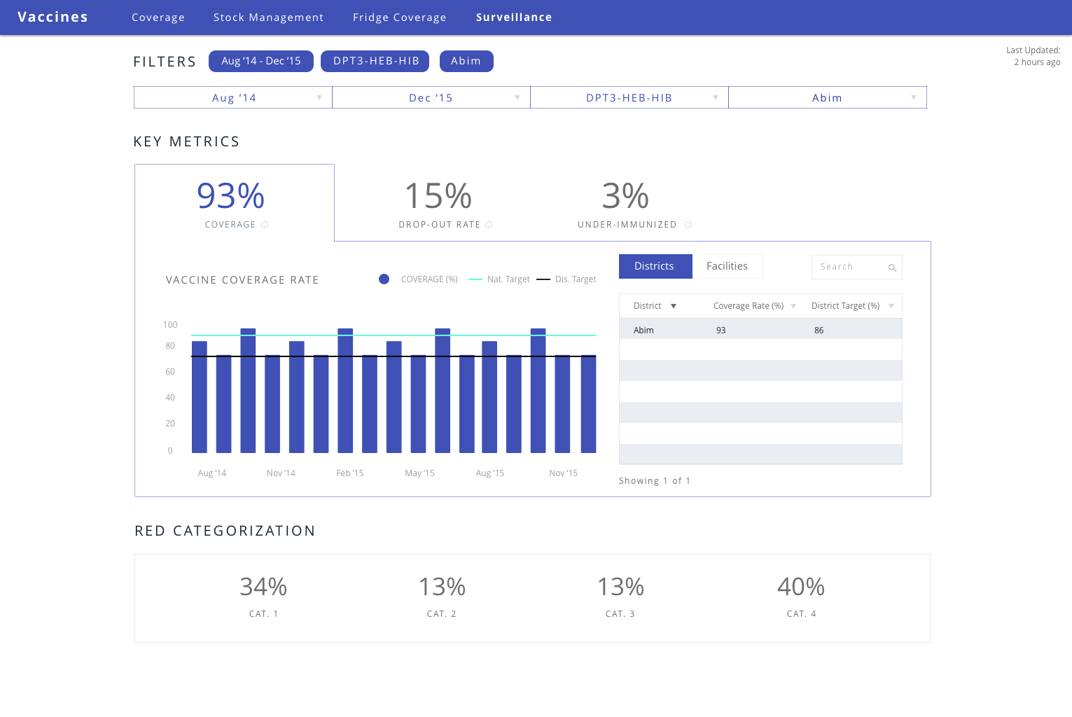

Slide 5
Clarifications
By default, we show one vaccine at a time (DPT3)
Default date filter is last 3 months
Red Categorization is computed for each vaccine. Average of time domain chosen
Key metric (the 2 big numbers on top) shows the metric as an average across the selected months. The date filter affects the graph because Aug – Oct will be shown on the x-axis.
District and national targets input manually via Admin. If not input, then they don’t show.

Slide 6
UNEPI Feedback (New)
New mapping for DHIS2 data
Coverage, Dropout, Under-Immunized as key metrics * Vaccines to map
Need line for national and district TARGET
Change DPT to DPT-HEP-HIB
Check if data is available on DHIS2 API

Slide 7
 | Indicators | Reference files | How to calculate | Data mapping
1 | Coverage | Coverage | * % listed by month by district for a given vaccine | Coverage workbook => sheets listed by month/ year => Column G, J, R, W, AD, AM, AX,
 |  |  | BCG, Measles, OPV3, DPT3, PCV, TT - Pregnant, TT - Not Pregnant
2 | Drop-Out Rate
 |  | Coverage | * Drop out rate listed by district by month (some vaccines don't have a listed drop out rate, so if the vaccine is selected the metric will be "n/a") | Coverage workbook => sheets listed by month/ year => Column L, Y, AO, AZ
 |  |  | * BCG and Measles have same drop out rate * Polio doesn't have drop out rate * PCV doesn't have drop out rate | * BCG and Measles have same drop out rate * Polio doesn't have drop out rate * PCV doesn't have drop out rate

Slide 8
Stock Management

Slide 9
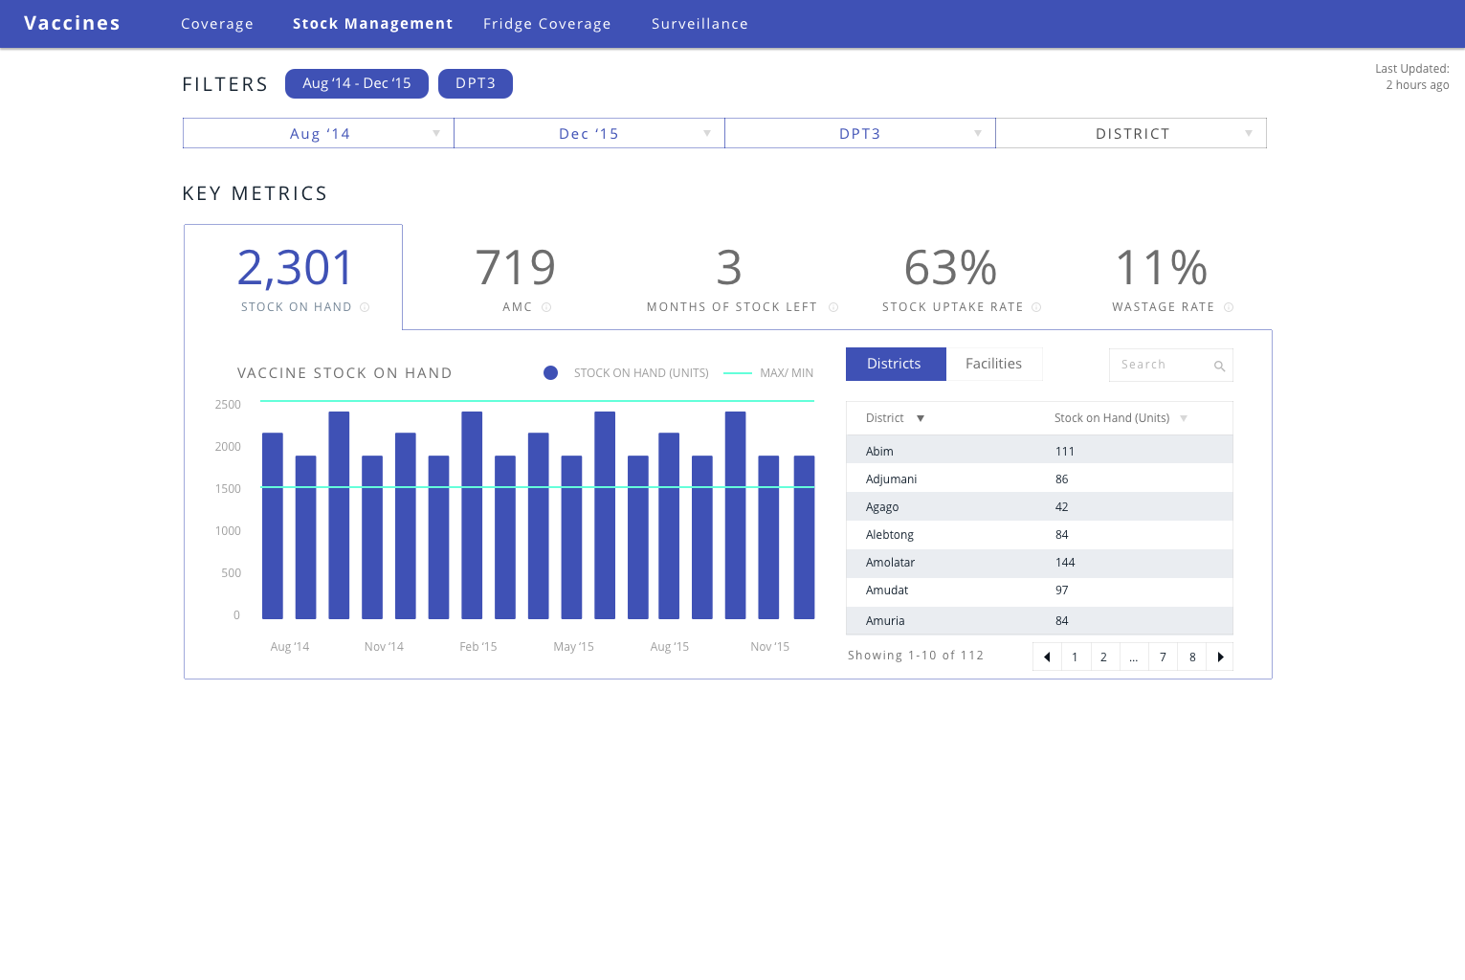

Slide 10
Clarifications
Default date filter is last 3 months
Months of stock remaining should be rounded to whole number (always round down, so 2.99 > 2)
AMC = 3 month, simple average (total consumption / 3)
Stock uptake rate = quantity consumed / quantity received
Key metric (the 4 big numbers on top) shows the metric for the most recent month (so if you filter from Aug – Oct, it will show Oct). The date filter affects the graph because Aug – Oct will be shown on the x-axis.
Months of stock remaining = Stock on Hand / AMC
Gas should be in product filter:
Need full list from George:
Max/ Min stock on hand available by district, will need to manually be put in. If it’s not put in for any time period filtered, then it doesn’t show up. Need admin level input form for this (just max is input for each product for each district, then George will provide the calc to get the min amount)
When no districts are filtered, max and min are average of all max and mins, unless George provides an overall max/ min recommendation

Slide 11
UNEPI Feedback (New)
Add gas to product filter (already in excel as LPG worksheet)
Add wastage rate as key metric
Add line on stock on hand for min and max (available by district)
Will need to manually input on an annual basis (calendar year)
Need input form for this to input max for every district for every product
George to provide formula to calculate min from this

Slide 12
 | Indicators | Reference files | How to calculate | Data mapping
1 | Stock on Hand | District Balances and orders | * stock balance in column for each district | Find total from columns C:K in the sheet for each month
2 | AMC
 |  | District Balances and orders | * stock balance for latest month selected (in from date filter) + stock balance for prior two months / 3 | Find total from columns C:K in the sheet for each month
3 | Months of Stock Remaining
 |  | District Balances and orders | * Stock balance for latest month divided by AMC (current balance + preceeding 2 months / 3)
4 | Stock Uptake Rate
 |  | Distribution | * Total vaccine consumed per district / total vaccine distributed to district | Ex. DPT => (Coverage Workbook => (Sum District Total in Column T, U , V)) / (Distribution Workbook => Find corresponding month in column G-R and district row)
 |  | Coverage | if Coverage workbook has 0, 1, 2, etc. sum the totals to get the coverage total
 |  |  |  | topv = polio

Slide 13
Cold Chain / Fridge Coverage

Slide 14
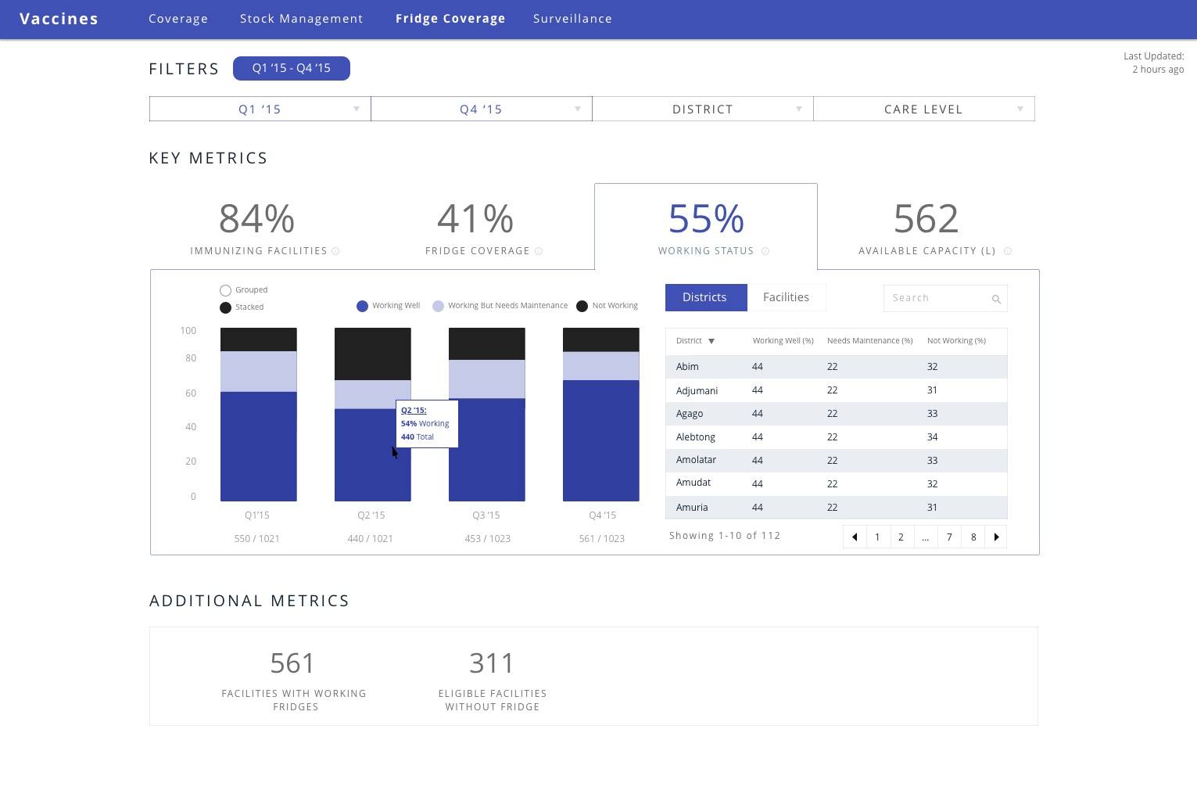

Slide 15
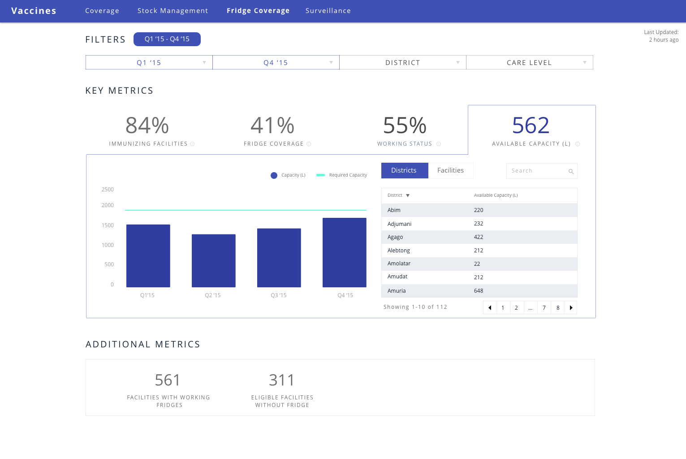

Slide 16
Clarifications
Default filter is last 4 quarters
Key metric (the 4 big numbers on top) shows the metric for the most recent month (so if you filter from Aug – Oct, it will show Oct). The date filter affects the graph because Aug – Oct will be shown on the x-axis.
Data will be updated on a quarterly basis
Fridge capacity charts should be simple bar graphs with line for required amount (provided yearly, doesn’t show if not provided)

Slide 17
UNEPI Feedback (New)
Rename entire section “Fridge Coverage”
Show tooltip with calculation for each major metric
Jalia to update mapping
Working Status:
Working well is on bottom of bar graph
Hover to see percentage
Need to see absolute total as well in graph and on top bar. Logan to update graph
Remove freezer capacity
Change fridge capacity to “Available Capacity (L)”
Available vs required (stacked bar graph)
New metric (1st on the list)
“Immunizing Facilities”
Absolute number is most helpful (but would like to show %)
Add at bottom:
# of eligible facilities w/o fridges

Slide 18
 | Indicators | Reference files | How to calculate | Data mapping
1 | Cold chain coverage | TBL_FACILITIES | ∘ (Sum of facilities with fridges/sum of all facilities)*100 | Sum of facilities with fridges => TBL_INV_REF => sum of unique codes of Column B (ft_facility_code)
 |  | TBL_INV_REF |  | Sum of all facilities => TBL_FACILITIES => sum of all codes of Column A (ft_facility_code)
 |  | TBL_FACILITIES | To be able to get data by care level, I have included the mapping for care level. | Facility level => lookup value of column G in TBL_FACILITIES (ft_facility_code) and find corresponding level name in Column B of TBL_FACILITY_TYPE (ft_name)
 |  | TBL_FACILITY_TYPE
2 | Working status | TBL_INV_REF | ∘ (sum of CCE working well/total sum of CCE)*100 | Sum of CCE working well => TBL_INV_REF => sum of all CCE with number (1) in column W (fi_operating_cond)
 |  |  | ∘ (sum of CCE working but need maintenance/total sum of CCE)*100 | Sum of CCE working well => TBL_INV_REF => sum of all CCE with number (2) in column W (fi_operating_cond)
 |  |  | ∘ (sum of CEE not working/total sum of CCE)*100 | Sum of CCE working well => TBL_INV_REF => sum of all CCE with number (3) in column W (fi_operating_cond)
 |  |  |  | Total sum of CCE => TBL_INV_REF => total number of all codes in column D (ft_library_id)
 |  | TBL_FACILITIES | To be able to get data by care level, I have included the mapping for care level. | Facility level => lookup value of column G in TBL_FACILITIES (ft_facility_code) and find corresponding level name in Column B of TBL_FACILITY_TYPE (ft_name)
 |  | TBL_FACILITY_TYPE
3 | Refrigerator Capacity | TBL_INV_REF | ∘ Refrigerator capacity = Sum of refrigerator capacity of all working well + Working but needs maintenance fridges | Refrigerator capacity => TBL_INV_REF => sum of values in column O (fn_net_volume_4deg) for CCE with number (1) or (2) in Column W (fi_operating_cond)
 |  | TBL_FACILITIES | To be able to get data by care level, I have included the mapping for care level. | Facility level => lookup value of column G in TBL_FACILITIES (ft_facility_code) and find corresponding level name in Column B of TBL_FACILITY_TYPE (ft_name)
 |  | TBL_FACILITY_TYPE
3 | Freezer Capacity | TBL_INV_REF
 |  |  | ∘ Freezer capacity = Sum of freezer capacity of all working well + Working but needs maintenance fridges and freezers | Freezer capacity => TBL_INV_REF => sum of values in column T (fn_net_volume_20deg) for CCE with number (1) or (2) in Column W (fi_operating_cond)
 |  | TBL_FACILITIES | To be able to get data by care level, I have included the mapping for care level. | Facility level => lookup value of column G in TBL_FACILITIES (ft_facility_code) and find corresponding level name in Column B of TBL_FACILITY_TYPE (ft_name)
 |  | TBL_FACILITY_TYPE

Slide 19
Surveillance

Slide 20
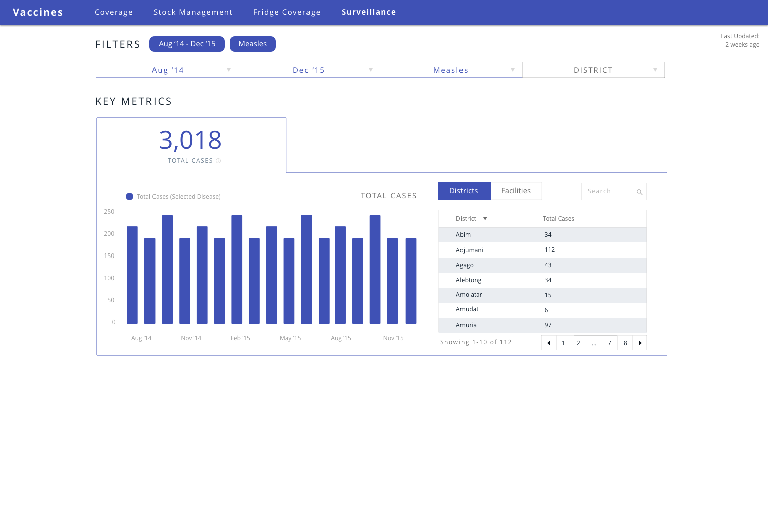

Slide 21
Clarifications
Default filter is current month going back 12 months
Key metrics (big number Total cases) is most recent month’s total

Slide 22
UNEPI Feedback (New)
Add more metrics including NNT, AFP, AFIS
George/ Jalia to clarify. Not scope for Phase 1

Slide 23
 | Indicators | Reference files | How to calculate | Data mapping
1 | Total Cases | Surveillance 1 | Monthly Caseload trend for Measles per district | MEASLES=>find district in column B=>Find date of on-set in column D=>Reporting HF column F=>Cases column I
 |  |  |  | [Classify by; Positive, Negative, Missing, Indeterminate]
 |  |  | Monthly Caseload trend for Rubella per district | MEASLES=>find district in column B=>Find date of on-set in column D=>Reporting HF column F=>Cases column H
 |  |  |  | [Classify by; Positive, Negative, Missing, Indeterminate]
 |  |  | Monthly Caseload trend for AFP per district | AFP cases=>AFP=>find district in column B=>OPV doses received col D=> Find date of on-set in column E=>Nearest HF column F=>Final cell culture results [2-Negative, 3-NPENT, Missing]
 |  | Surveillance 2 | National summary statistics: Tarnsform tabular data provided into graphs | Basic analysis _measles=>Find tables in column A to G=>Translate the data into graphical illustrations

