Slide 1

Pro App
WeTalk

Slide 2

WeTalk
Secured messaging and real time communication
WeTalk app will get authenticated with WeGuard app
Without authentication of weguard app, not able to open the wetalk app on the devices
Through wetalk app we can send messages to the All, Groups and Device level
ALL >> Messages will be send to all devices
GROUPS >> Messages will be send to the groups(ex: Kiosk/WM/WP/Cloned Policies)
Devices >> Messages will be send to only particular devices

Slide 3
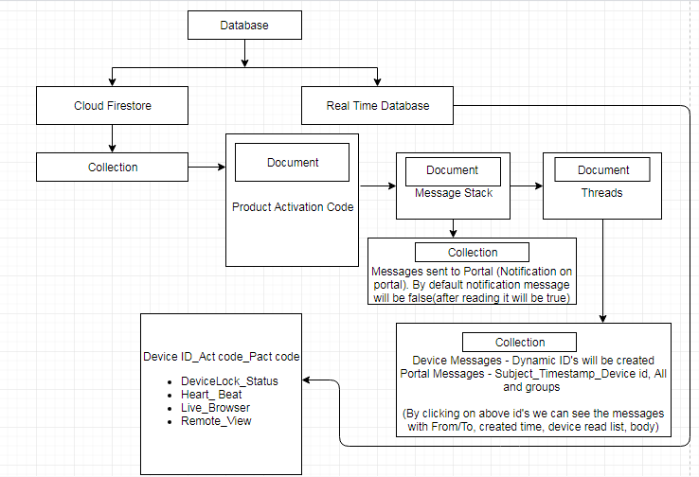
Backend Process

Slide 4
Message Stack and Threads
Send messages from devices to portal, it will generate dynamic id in collections under document.
Received message will be true after reading the messages (Default: false)
Messages to All from portal and reply from devices to portal, it will generate with subject_timestamp_all
Messages to Groups from portal and reply from devices to portal, it will generate with subject_timestamp_all (all instead of group)
Messages to Devices from portal and reply from devices to portal, it will generate with subject_timestamp_deviceid’s
Notification message will in false (default). After reading the messages from notifications it will be true

Slide 5
Speak Out and TTS Engine
Whenever a new message received from OPS, the app will start reading every message with high volume
If there are more than one message the app will queue all the messages and will speak messages one by one in an order
Users can also select languages for speak out feature.
Messages will speak in selected languages.
Listen the messages in any languages (select languages in wetalk setting screen)

Slide 6
Any Queries
?

Slide 7
Thank You..

