Slide 1
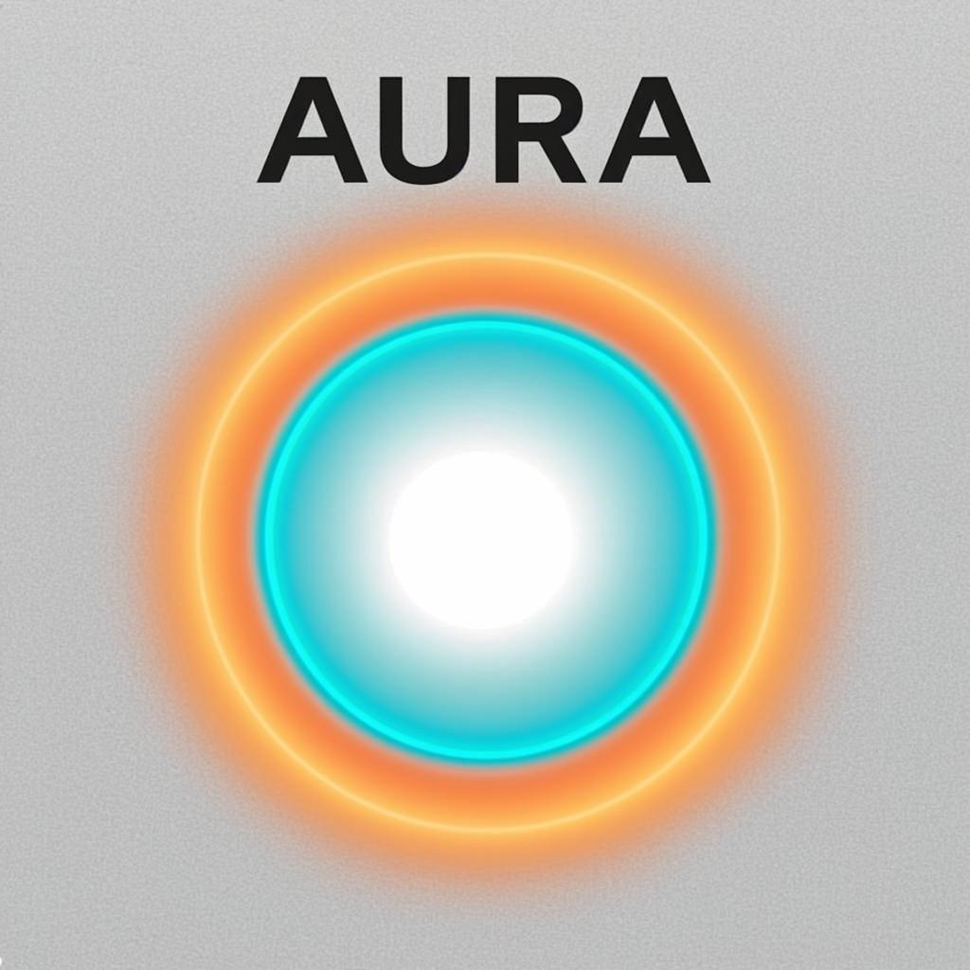
PROPOSAL · SUBMITTED TO GXS BANK · 2026
AURA
Adaptive Unified Risk Architecture
ONE MODEL OF YOU. EVERY RISK YOU'LL EVER BE.
20–30%
40–50%
~$50–80M
CREDIT LOSS REDUCTION
FRAUD LOSS REDUCTION
ANNUAL P&L IMPACT
PREPARED BY
Continuum Risk Labs Pte. Ltd.
SUBMISSION
21 August 2026
AURA · CONTINUUM RISK LABS
COVER
01 / 13

Slide 2
THE PROBLEM
Silos that bleed
For 70 years, banking has treated credit risk and fraud risk as two distinct sciences — different teams, different models, different data. The handoff points between them are precisely where losses compound today.
CREDIT TEAM
FRAUD TEAM
"Can they repay?"
"Will they repay?"
BLIND
SPOT
• Static PD models
• Quarterly refresh
• 12-month horizon
• Income / collateral
• Real-time ML
• Millisecond refresh
• Next-tx horizon
• Device / network
↓
~$487B global annual fraud + credit losses at the seams — and growing
AURA · CONTINUUM RISK LABS
01 · PROBLEM
02 / 13

Slide 3
THE INSIGHT
They were never separate
Credit default and fraud are the same phenomenon — the divergence between the customer you underwrote and the customer revealed by their behaviour — observed at different time horizons through different sensors.
TODAY'S LABEL
WHAT IT ACTUALLY IS
Credit default
A fraud that took 18 months to reveal itself
Bust-out fraud
A credit default compressed into 30 days
Application fraud
A credit model that was lied to at t=0
Transaction fraud
A creditworthiness event in 30 seconds
Strategic default
A credit customer who became first-party fraud
AURA · CONTINUUM RISK LABS
02 · INSIGHT
03 / 13

Slide 4
THE SOLUTION
One model.
Two time telescopes.
A living immune system.
AURA is the first risk system where the fraud model and the credit model are the same model — observed through different time telescopes — with an adversarial Arena that attacks itself 24/7 so real fraudsters discover the blind spots second.
UNIFIED EMBEDDING
PERSONAL DOPPELGÄNGER
COUNTERFACTUAL RL
ADVERSARIAL ARENA
AURA · CONTINUUM RISK LABS
03 · SOLUTION
04 / 13

Slide 5
ARCHITECTURE
Eight tightly-coupled layers
1
Unified Risk Embedding
256-dim global latent space
SPINE
2
Personal Doppelgänger
Per-customer generative twin · residual streamer
SPINE
3
Twin Strands (Capacity × Intent)
Two decoupled readouts of the same embedding
SPINE
4
Time-Telescope Heads
spike (sec) / shift (days) / drift (months)
SPINE
5
Counterfactual Replay Loop
Doubly-robust causal estimation on decisions
SPINE
6
The Arena
Adversarial agents attack live system in shadow
IMMUNE
7
Risk Field
Graph contagion across devices, merchants, geographies
IMMUNE
8
Action Layer
nudge → friction → reprice → interdict
IMMUNE
Layers 1–5 = Risk Continuum Spine · Layers 6–8 = Adaptive Immune System
AURA · CONTINUUM RISK LABS
04 · ARCHITECTURE
05 / 13

Slide 6
THE BREAKTHROUGH
Doppelgänger + Arena
LAYER 02
LAYER 06
Personal Doppelgänger
The Arena
A self-supervised generative twin per customer. Continuously predicts their next state and streams the residuals — where reality diverges from expectation.
Continuously running adversarial agents — synthetic fraud rings, deepfake applicants, AI-built bust-out personas — attack the live system in a shadow environment. Every exploit becomes instant training signal.
TRAINING DATA: the 99% of behavioural signal both silos throw away.
WHAT "ADAPTIVE" MEANS: Not quarterly retraining — a live immune response.
WHY IT WINS: Detects change vs the customer's own past, not the population. Strictly more sensitive for bust-out, where the identity is real but the behaviour has shifted.
WHY NOW: Fraudsters now use generative AI. You cannot fight generative with static — only generative with generative.
AURA · CONTINUUM RISK LABS
05 · BREAKTHROUGH
06 / 13

Slide 7
WHY NOW · MARKET
Three forces converge in 2026
01
02
03
Causal ML tooling
Vector DBs + sequence models
Regulator openness
EconML, DoWhy, doubly-robust estimators make counterfactual training operationalisable at production scale.
256-dim real-time updates and millions of live generative twins are now computationally feasible.
MAS, EBA, OCC signal acceptance of continuously-learning models, provided a frozen shadow is maintained for audit.
US$12B
US$487B
US$84T
10×
TAM · ANNUAL SOFTWARE SPEND
ANNUAL FRAUD LOSSES
WEALTH TRANSFER BY 2045
FASTER MODEL DEPLOYMENT
Growing 14% YoY
Global FS
Digital-native HNW
vs siloed MRM
AURA · CONTINUUM RISK LABS
06 · WHY NOW
07 / 13

Slide 8
SEE IT WORK
Two scenarios, one engine
SCENARIO 01
SCENARIO 02
Mei, 34 — real person, real documents
Synthetic identity ring — 200 flawless deepfakes
Her doppelgänger detects: salary deposits landing later each month, three new digital credit accounts, top-ups to an unfamiliar e-wallet cluster, 2 a.m. sessions from a second device.
200 applications filed. Individually pristine. Collectively: all 200 doppelgängers share one residual signature — identical application micro-cadence, one device cluster, synchronised behaviour templates.
OLD WORLD: Fraud model says "legitimate". Credit score hasn't caught up.
RISK FIELD: Lights up as a cluster diverging from reality at once.
AURA: Medium-scale shift + intent manifold = early bust-out transition. Action: consolidation offer + limit adjustment. Loss prevented, customer saved.
OUTCOME: Ring killed at application — not at first missed payment.
WHY GXS SPECIFICALLY
GXS serves the thin-file customers the bureau can't price — gig workers, young earners, the underbanked. When there's no credit history, behaviour is the only signal, and AURA is a behaviour-first engine. GXS's digital-native data exhaust is exactly the fuel this system needs. This isn't a bolt-on; it's GXS's structural advantage weaponised.
AURA · CONTINUUM RISK LABS
07 · SEE IT WORK
08 / 13

Slide 9
BUSINESS MODEL
Aligned economics
We earn meaningfully only when GXS Bank's losses demonstrably fall. The first 90 days are at zero licence cost.
RECOMMENDED
SHADOW PILOT
BASE LICENSE
PERFORMANCE
90 days · Zero cost
Annual · Tiered by volume
% of verified loss reduction
Single product line
Divergence baseline
No production decisions
Proof before commitment
Platform access
Embedding + horizon heads
Regulatory shadow
Standard MRM support
Indexed to baseline
Audited quarterly
Aligns our P&L with yours
Capped at 3× base fee
AURA · CONTINUUM RISK LABS
08 · BUSINESS MODEL
09 / 13

Slide 10
PROJECTED IMPACT
Three-year P&L impact
Mid-sized bank · US$50B portfolio · Treated segments only
Credit loss reduction
Y1
10%
Y2
17%
Y3
25%
Fraud loss reduction
Y1
22%
Y2
35%
Y3
45%
False-positive reduction
Y1
6%
Y2
12%
Y3
20%
P&L impact (US$M)
Y1
20
Y2
45
Y3
65
YEAR 3 OUTCOME ~US$50–80M annual P&L impact
AURA · CONTINUUM RISK LABS
09 · IMPACT
10 / 13

Slide 11
IMPLEMENTATION ROADMAP
36 months · 4 phases · 1 gate per phase
01
0–6 mo
02
6–12 mo
03
12–24 mo
04
24–36 mo
Shadow
Time Telescopes
Loop + Arena
Genome + Action
Build embedding + doppelgängers on existing features. Run as shadow. Measure divergence.
Deploy horizon heads. Live decisions on next-tx + 30-day heads in low-risk segments.
Counterfactual replay loop + Arena live. Train on interventions and adversarial exploits.
Risk Field primary substrate. Action Layer live. Migrate shadow to graph-explainable.
EXIT CRITERION
EXIT CRITERION
EXIT CRITERION
EXIT CRITERION
Divergence baseline established
FP reduction ≥ 5%
Credit loss ↓ ≥ 10%
Full deployment · MRM sign-off
AURA · CONTINUUM RISK LABS
10 · ROADMAP
11 / 13

Slide 12
TEAM
The intersection that makes AURA possible
MC
Dr. Maya Chen
AP
Arjun Patel
CEO
CTO
Ex-CRO, DBS Consumer Bank. 18 yrs APAC retail credit. Led DBS model-risk transformation (2019–23).
Built fraud ML at Stripe & Paytm. Architected feature stores at 12M QPS. Stanford CS PhD candidate.
LP
Dr. Lena Petrova
MT
Marcus Tan
CHIEF SCIENTIST
HEAD OF REG ENGINEERING
Co-author, foundational doubly-robust counterfactual estimation paper (JMLR 2021). Ex-Microsoft Research NYC.
Ex-MAS regulator (TRM). Authored portions of the MAS model-risk notice. Ensures AURA ships audit-ready.
NOTE Names shown are placeholders — replace with actual founders prior to submission.
AURA · CONTINUUM RISK LABS
11 · TEAM
12 / 13

Slide 13
THE ASK
Ninety days. Zero risk.
01
90-day shadow deployment
Zero licence · single product line · establish divergence baseline
02
Executive sponsor
CRO or CDO level · convene credit, fraud, model-risk functions
03
3 years of historical decision data
With outcome labels · counterfactual training begins on day one
In return, we commit to a measurable reduction in combined credit and fraud losses within twelve months — or AURA reverts to GXS Bank at no cost.
AURA
CONTINUUM RISK LABS · 2026
AURA · CONTINUUM RISK LABS
12 · THE ASK
13 / 13

