Slide 1
Superstore Sales Dashboard
Task 4 – Data Analyst Internship
Created using Power BI

Slide 2
Dataset and Tools Used
- Dataset: Superstore Sales Data (Kaggle)
- Tool Used: Power BI Desktop
- Objective: Design an interactive business dashboard to track KPIs and uncover sales insights
- Duration: Completed in 1 day

Slide 3
KPIs Tracked & Visuals Used
**KPIs:**
- Total Sales
- Total Profit
- Average Profit per Order
- Orders Count
- Average Discount
- Total Customers
- Profit Margin (%)
**Visuals Used:**
- Bar Chart – Profit by Subcategory
- Funnel Chart – Orders → Sales → Profit
- Treemap – Positive Profit by Subcategory
- KPI Cards – Summary Metrics
- Slicers – Region and Order Date

Slide 4
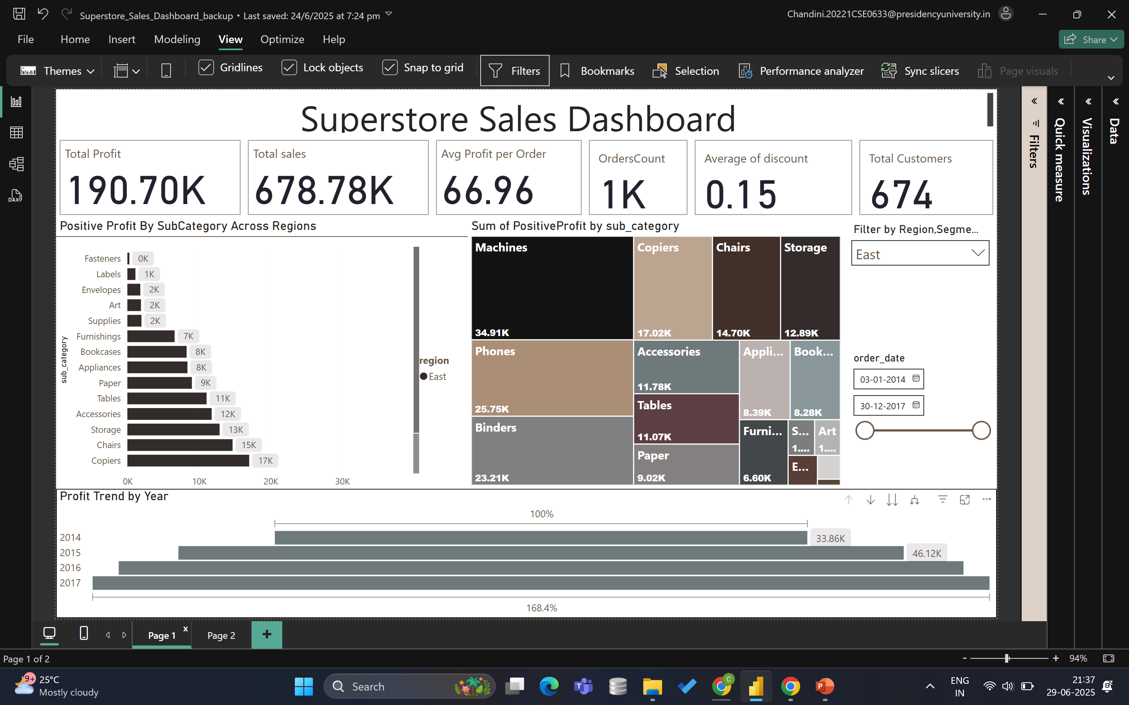
Power BI Dashboard Preview
📸 Paste your full dashboard screenshot here

Slide 5
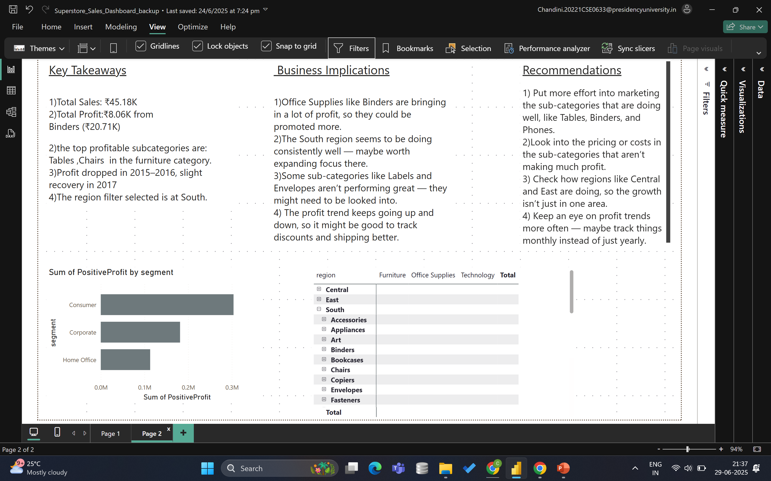

Slide 6
Insights & Recommendations
- Technology and Office Supplies drive highest profits
- Central and West regions perform best overall
- Discounts are well-controlled under 15% on average
- Funnel Chart shows healthy conversion from Orders to Sales to Profit
- Recommendation:
• Focus marketing on top-performing subcategories like Chairs and Phones
• Analyze low-margin items for pricing review

