Slide 1
Sentiment Analysis on Fire TV Stick (3rd Gen, 2021)
TEAM:
G Chandrakanth Naidu
Harsha R Raj Warsha Balla
Kishan G S

Slide 2
Business Problem: To analyse Fire Stick based on its Amazon Reviews
Objective:
The fundamental goal here is to get daily analysis of product such as emotions, sentiment etc . Using Amazon data.

Slide 3
Project Architecture / Project Flow
Data Extraction
EDA
Model Building
Model Evaluation
Feedback
Deployment

Slide 4
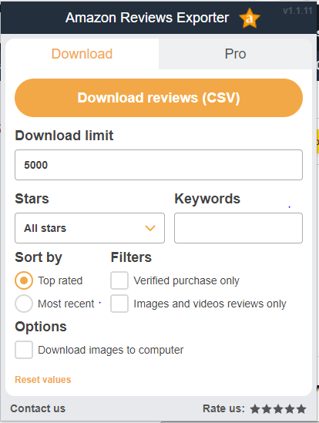
Data Extraction
We have used Amazon Review Export
simple tool for exporting product reviews from Amazon and downloading them into a .csv file.

Slide 5
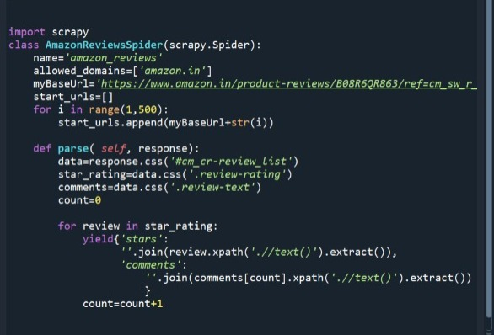
Data Extraction
Data Extraction using Scrapy

Slide 6
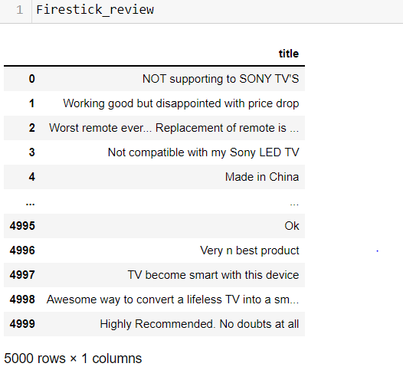
Data set
Reviews - 5000

Slide 7
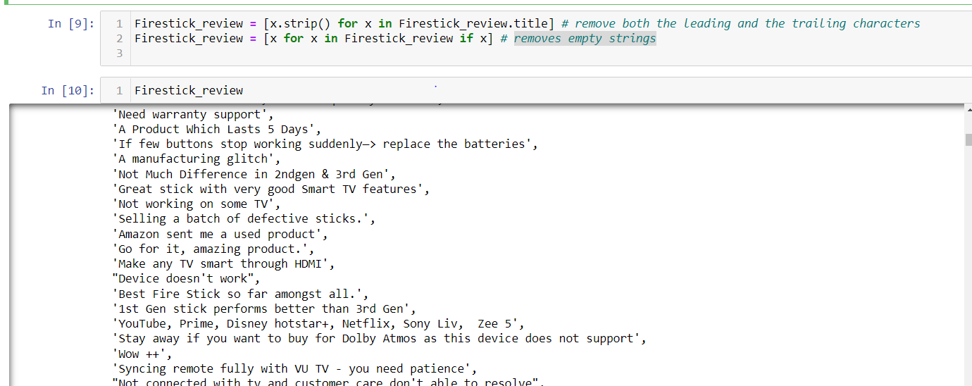
EDA
Converting all data into string
remove both the leading and the trailing characters
removes empty strings

Slide 8
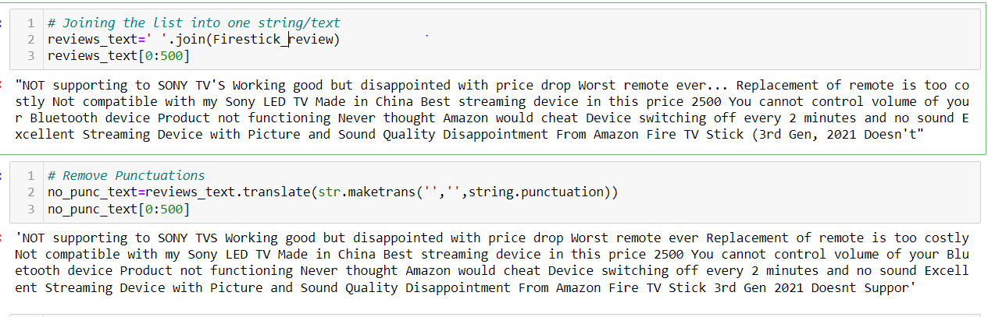
EDA
Joining the list into one string/text
Remove Punctuations

Slide 9
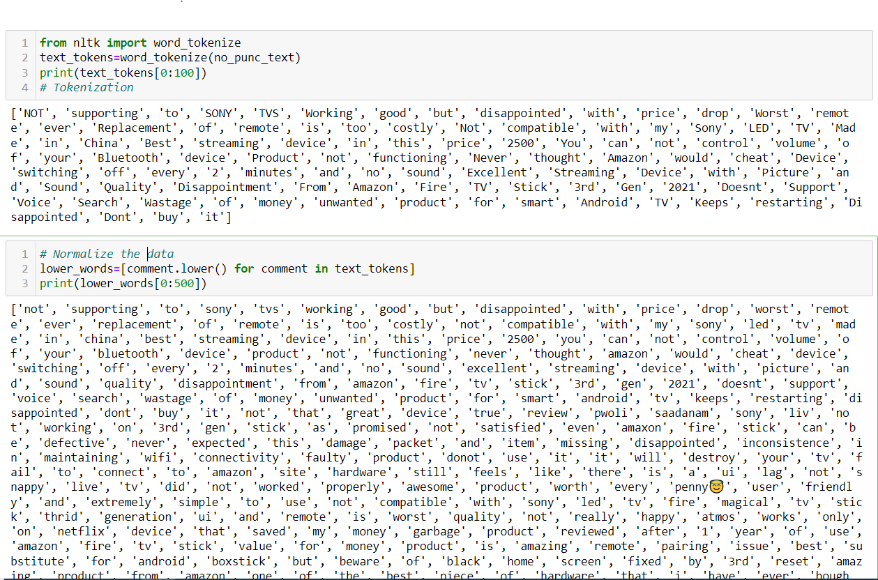
EDA
Tokenization
Normalize the data ( Convert into lower case)

Slide 10
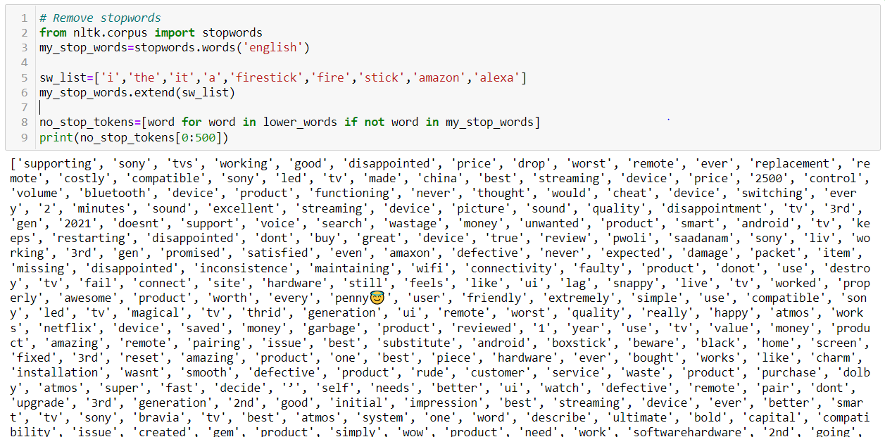
EDA
Total Words – 21428
Remove stopwords
Total Words After Removing Stop words - 14531

Slide 11
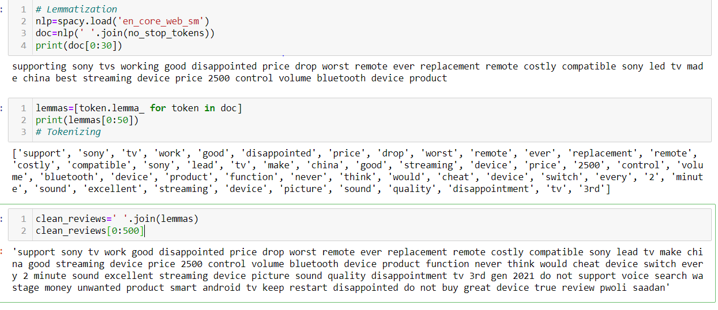
EDA
Lemmatization
Tokenizing Lemmas
Joining Lemmas

Slide 12
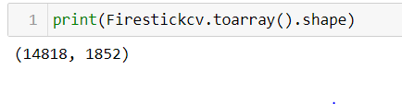
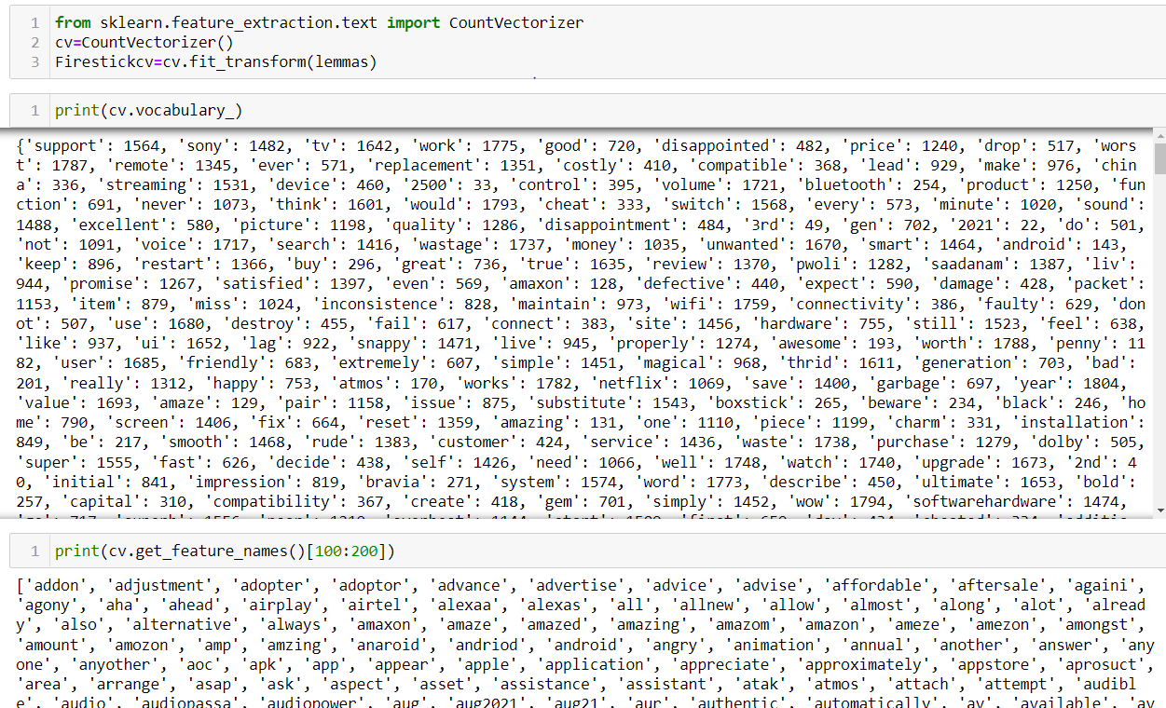
Feature Extraction
Using count vectorizer:

Slide 13
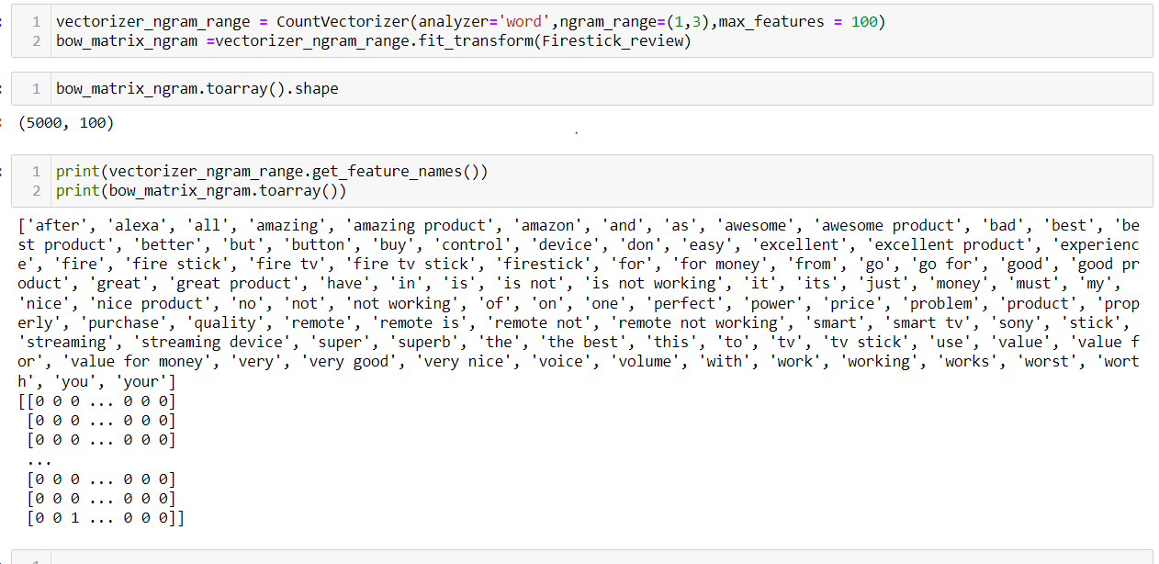
Feature Extraction
Including Bigrams and Trigrams

Slide 14
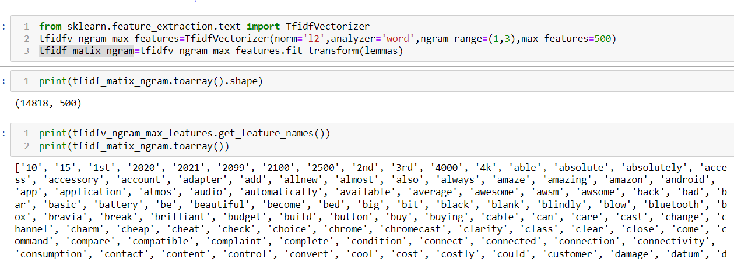
Feature Extraction
TF-IDF Vectorizer

Slide 15
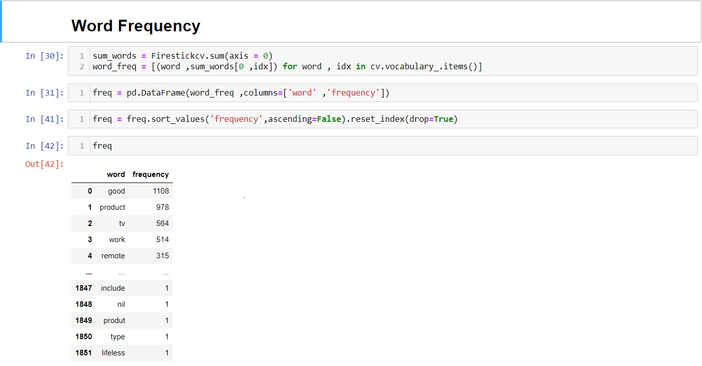
Word Frequency

Slide 16
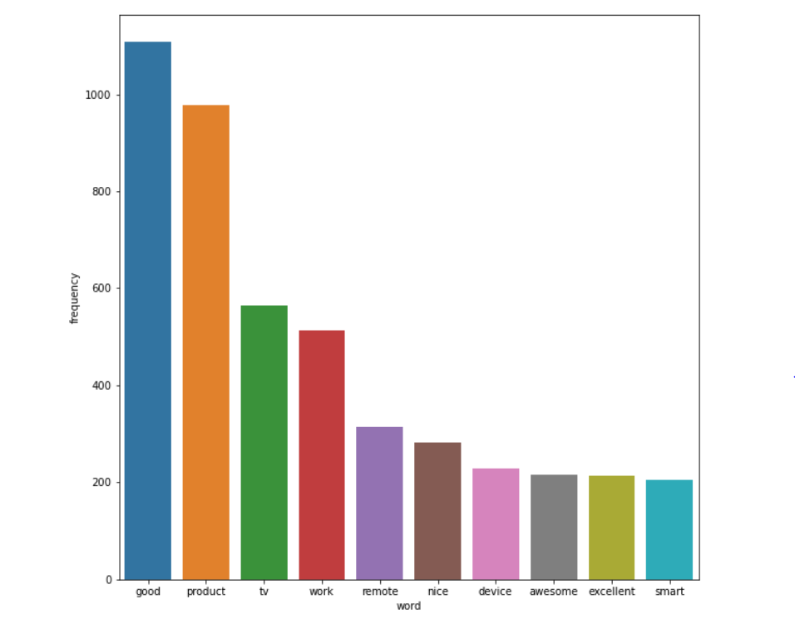
Word Frequency
Top 10 words

Slide 17
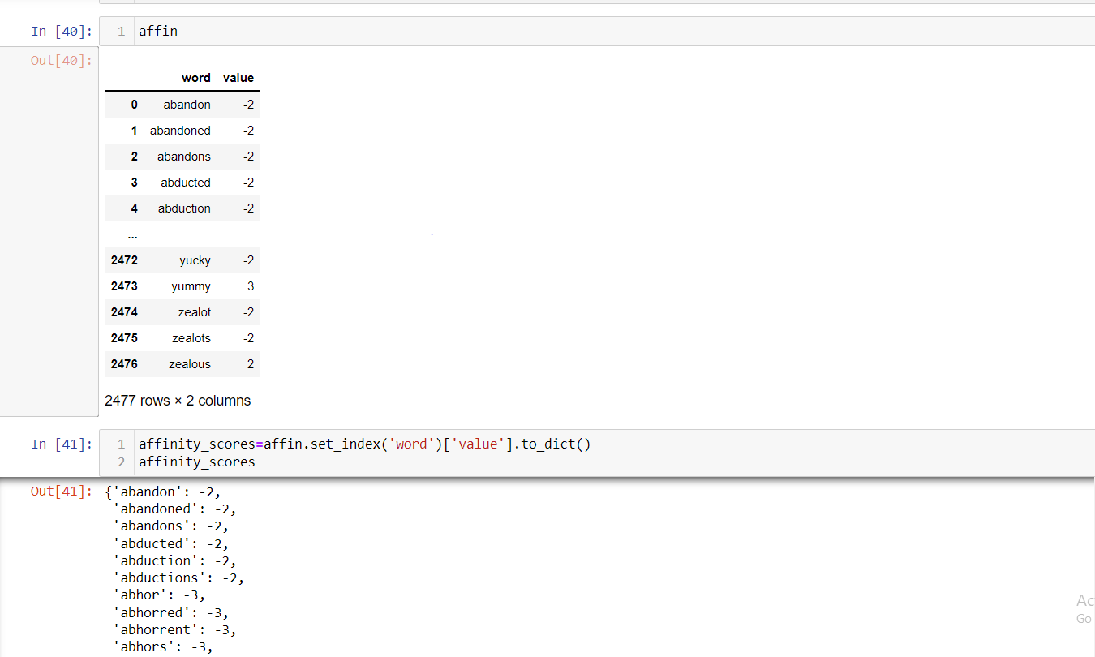
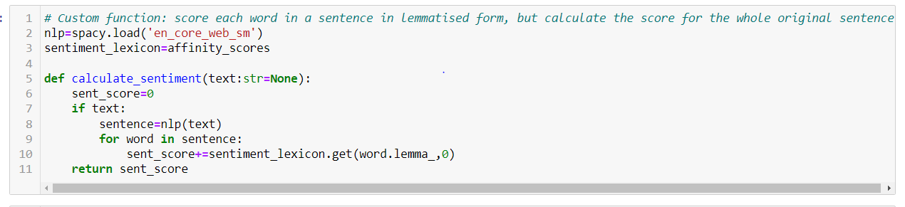
Sentiment Analysis
Sentiment Analysis using AFINN Dictionary

Slide 18
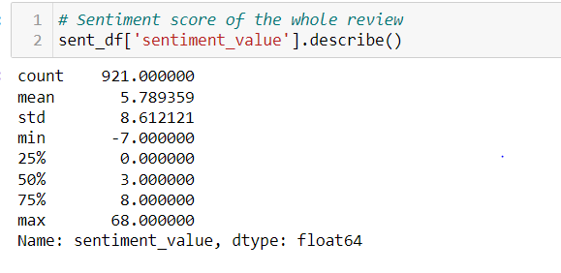
Sentiment Analysis
With Mean > 0 , indicates reviews are on Positive side

Slide 19
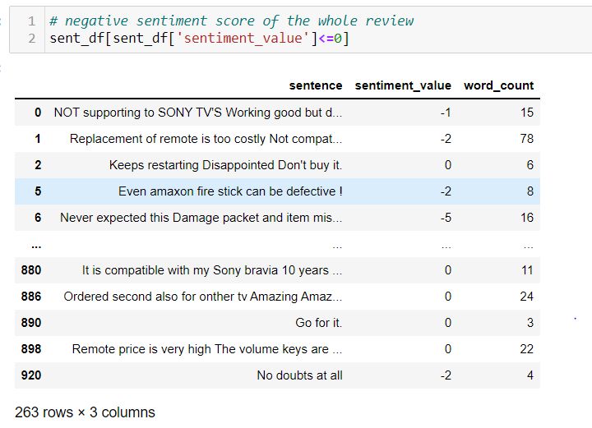
Sentiment Analysis
263 Sentences are having negative sentiment value

Slide 20
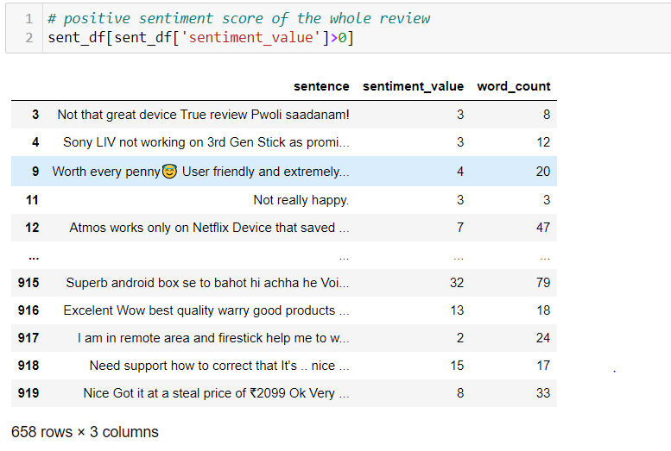
Sentiment Analysis
658 Sentences are having Positive sentiment value

Slide 21
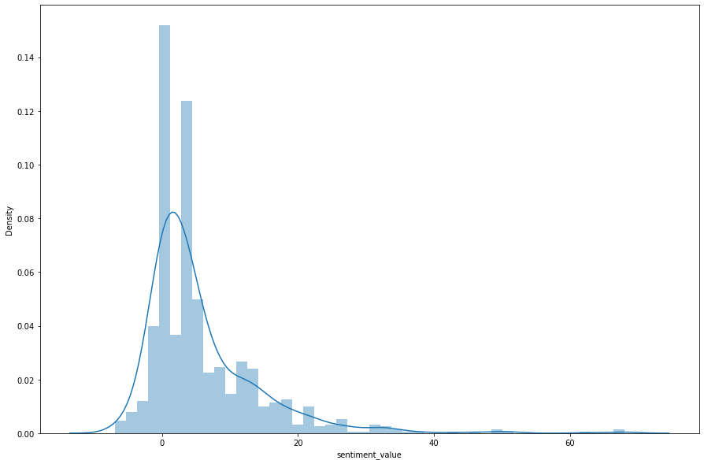
Sentiment Analysis
Plotting the sentiment value for whole review

Slide 22
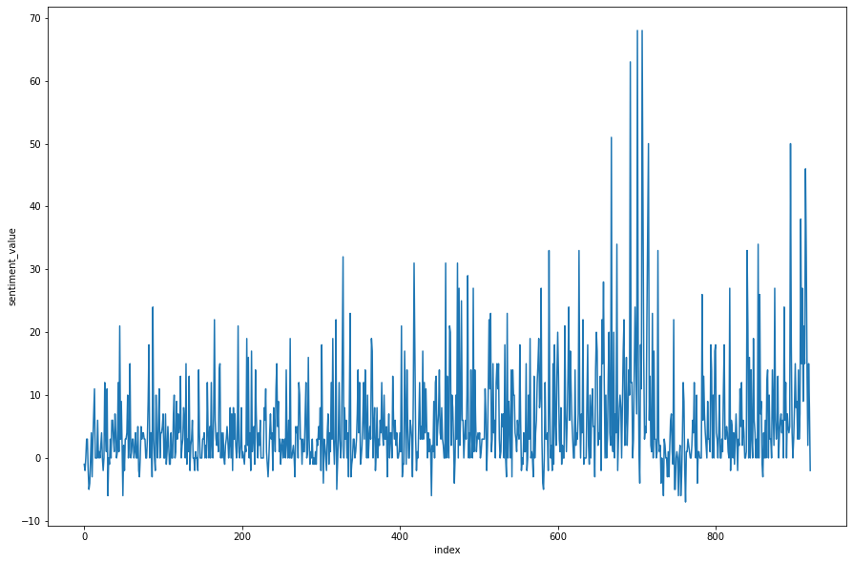
Sentiment Analysis
Plotting the line plot for sentiment value of whole review

Slide 23
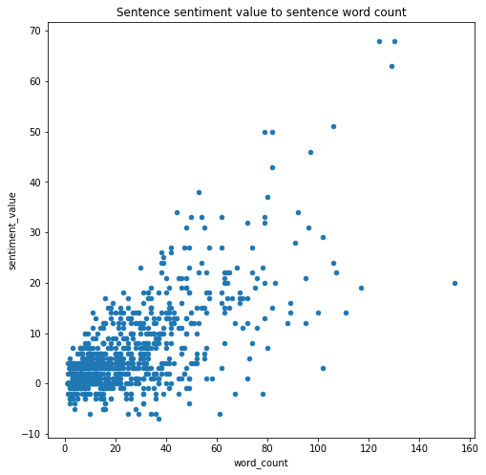
Sentiment Analysis

Slide 24
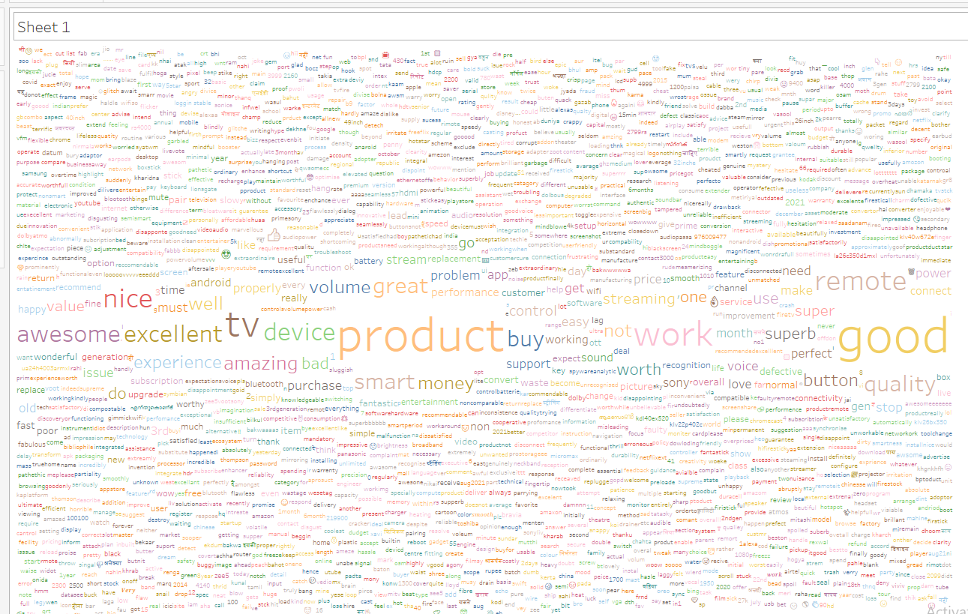
Word Cloud

Slide 25
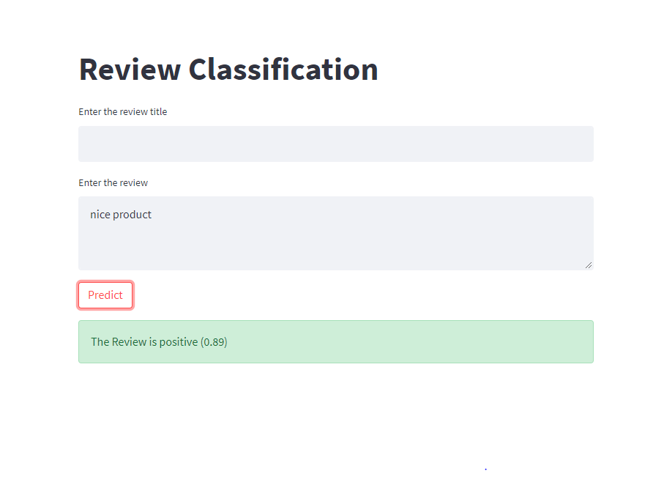
Deployment

