Slide 1
Medium Blog Post Category Classification
Lakshmi Ravi Chandu Kolusu

Slide 2
Project Summary
Medium is recognized as a dynamic and versatile online content platform that serves as a hub for diverse ideas and perspectives
Allows users to share knowledge and engage in discussions across various domains.
Content growth highlights the essential need for effective categorization to uphold a user-friendly and accessible environment.
Objective: Develop a solution that can automatically categorize blog content based on the textual features in their titles and subtitles
Method: Experiment with different text classification models using text mining techniques learned in class

Slide 3
Data Description
Dataset | Source | Reference Link | Rows | Columns
Medium Post Titles | Kaggle | Medium Post Titles (kaggle.com) | 126,418 | 4
Variable | Variable Name | Description | Type
Target | Category | Category of the Medium Blog Post | Str
Input | Title | Title of the Medium Blog Post | Str
Input | Subtitle | Description of the Medium Blog Post | Str

Slide 4
Data Manipulation
Dataset Overview:
Total of 93 Categories
Varying Data Points per Category, Ranging from Thousands to Hundreds
Culture: 5070 vs Venture-Capital: 39
Data Selection Criteria:
Aimed to Choose 12 Categories for Training
2 Key Factors Considered for Selection:
Categories with More than 1,000 Rows
Assess the level of generality, comprehensiveness, or distinctiveness of each category
Exclusion Criteria:
Omit Narrow or Highly Specific Categories
Ex: 'election-2020,' 'blockchain,' 'productivity,' 'creativity,' 'freelancing,' 'android-development,' 'ios-development'

Slide 5
Data Manipulation
12 Category Selections:
 | Category | Count
1 | Culture | 5,070
2 | Politics | 4,777
3 | Business | 3,738
4 | Health | 2,624
5 | Economy | 2,605
6 | Science | 2,477
 | Category | Count
7 | Environment | 2,388
8 | Travel | 2,191
9 | Music | 2,100
10 | Sports | 1,925
11 | Film | 1,890
12 | Food | 1,821

Slide 6
Model Building
Model Selection Criteria: i.) ROC of Test data & ii.) Misclassification rate
Model Refinement:
Stemming: Reduced the words to their root form (e.g., blog and blogs to blog) to consolidate related terms into one representation.
Synonym Handling: Treated equivalent terms (e.g., tv and television) as synonyms to further reduce the number of unique terms.
Filtering Common and Rare Terms: Eliminated very common words (by using default sas stop list & head of the zipf plot) and that might not carry significant meaning and extremely rare words (tail of the Zipf plot) to reduce the noise.
Concept Linking: Assessing concept links between terms to identify and filter out terms that do not have strong associations with the main categories. Filtered 86 terms and are added to stoplist by adjusting keep column of term filter viewer in text filter node.
Manual adjustment of topic term cutoff values
Data partition ratio adjustment (tried different combinations)
Text Cluster Resolution Adjustment

Slide 7
Model Selection
Iterations:
1st | Text classification based on the 'Subtitle' field
2nd | Text classification based on the ‘Title’ + 'Subtitle' field Combining two text fields to increase classification accuracy.
3rd | 2nd iteration + Undersampling Implementing data balancing techniques across categories to optimize the overall results.
4th | 2nd iteration + reducing the number of category from 12 to 5. 'culture', 'politics', 'business', 'health', 'economy'
5th | Generating dummy variables to transform the multi-class classification problem into a binary classification problem.
6th | 2nd iteration + selecting different 5 categories. 'politics', 'economy', 'science', 'music', 'sports'

Slide 8
Comparison: The Best Results of Each Iteration
Iter. No. | Model | ROC |  |  | Misclassification Rate
 |  | Train | Validation | Test | Train | Validation | Test
6th | Gradient Boosting - Mutual Info | 0.961 | 0.956 | 0.962 | 0.192 | 0.237 | 0.215
6th | Regression - Mutual Info | 0.963 | 0.958 | 0.961 | 0.197 | 0.226 | 0.206
2nd | Regression - Mutual Info | 0.923 | 0.897 | 0.915 | 0.419 | 0.447 | 0.428
4th | Regression - Mutual Info | 0.921 | 0.907 | 0.911 | 0.306 | 0.327 | 0.318
3rd | Regression - Mutual Info | 0.918 | 0.895 | 0.911 | 0.412 | 0.429 | 0.429
5th | Regression - Entropy | 0.910 | 0.908 | 0.902 | 0.137 | 0.134 | 0.137
1st | Regression - Mutual Info | 0.86 | 0.832 | 0.852 | 0.549 | 0.565 | 0.556

Slide 9
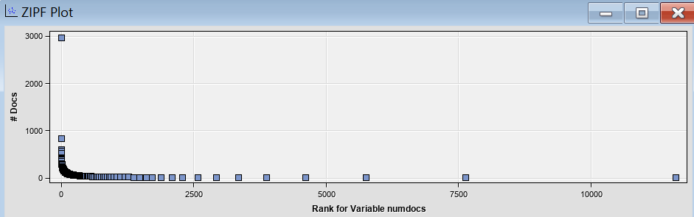
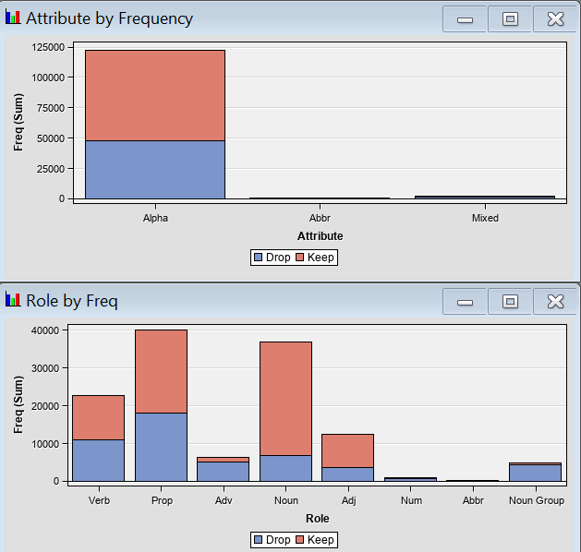
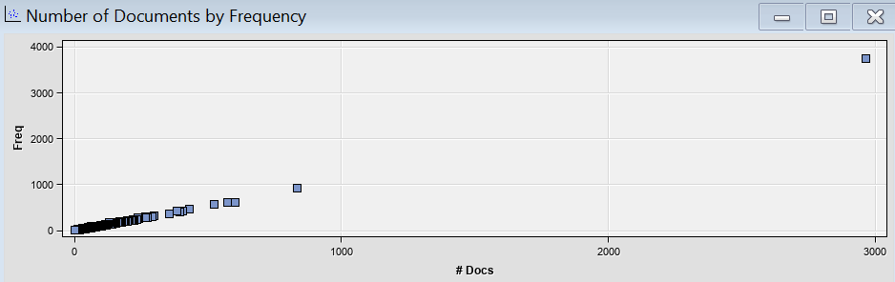
Final Model
Data Partition | Train (60) Valid (20) Test (20) | Text Cluster | SVD Resolution: low max SVD dimension: 100 No. of SVD generated: 46
Text Filter | Freq Weighting: Log Term Weight: Mutual Information | Text Topic | Topic generated: 39 Auto generation: 25 User generation: 14
<Text Filter Node Result>

Slide 10
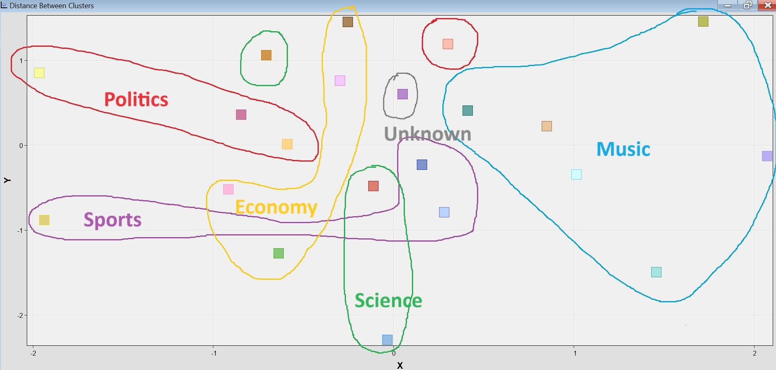
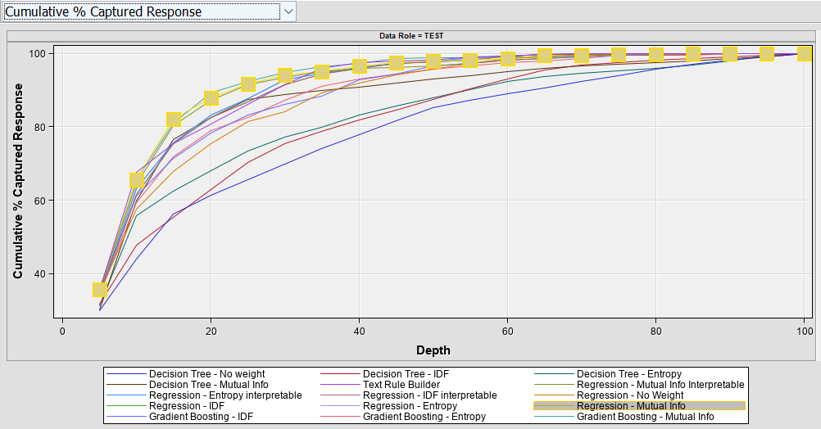
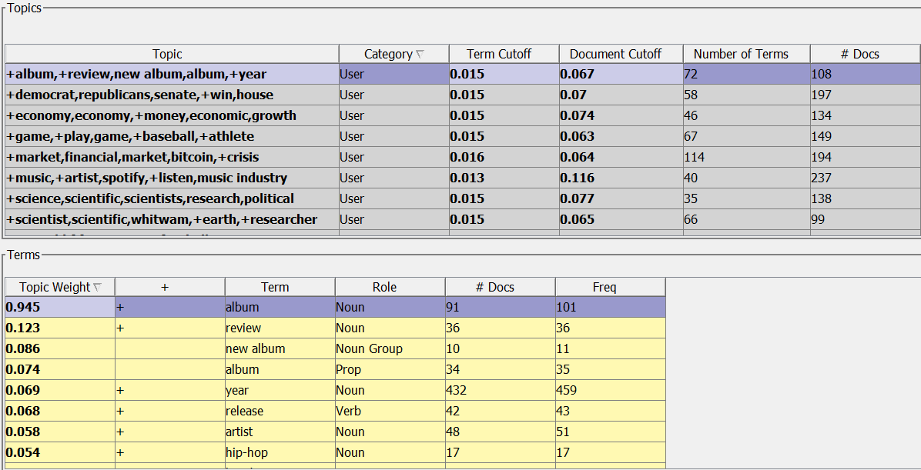


Final Model
<Distance Between Clusters>
<Cumulative % Captured Response>
<Topic Viewer>

Slide 11
Conclusion
Final Model: ROC = 0.961 Misclass Rate = 0.206
Limitations:
Information Bias - inherent biases in the data from biases of people creating the articles due to a lack of moderate opinions
Restriction of Categories - both number and variety
Suggested Next Steps
Changing the Stop list
Further reducing the number of categories
Refine and reduce the parameters of the model

Slide 12

Thank you

Slide 13
Appendix

Slide 14
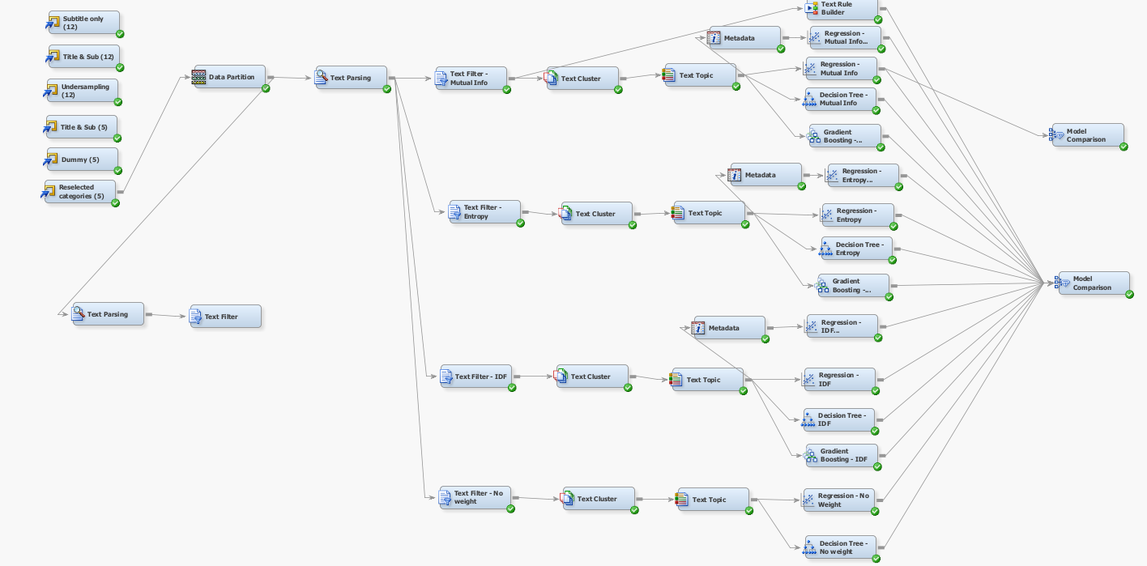
Project Diagram

Slide 15
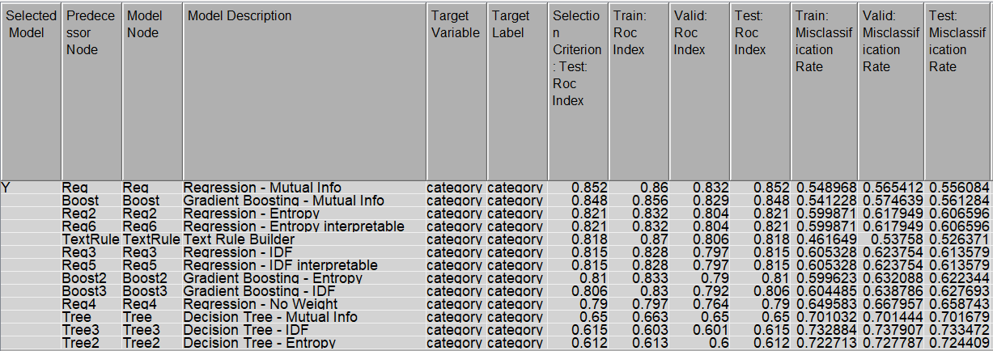
Model: 1st Iteration
Best: Regression - Mutual Info/ ROC: 0.852/ Misclassification rate: 0.556

Slide 16
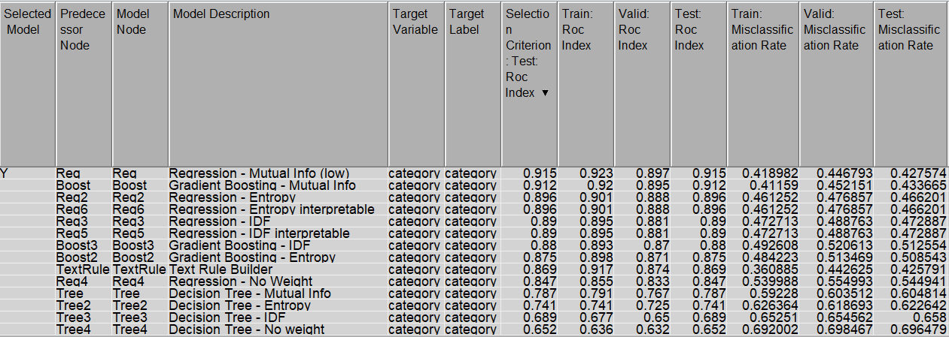
Model: 2nd Iteration
Best: Regression - Mutual Info/ Test ROC: 0.915/ Misclassification rate: 0.428

Slide 17
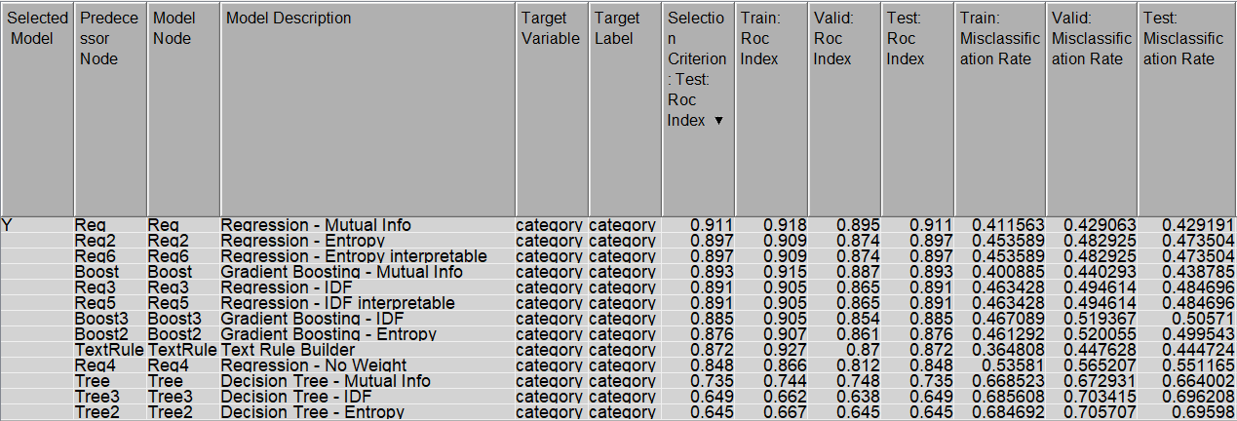
Model: 3rd Iteration
Best: Regression - Mutual Info, Test ROC: 0.911, Misclassification rate: 0.429

Slide 18
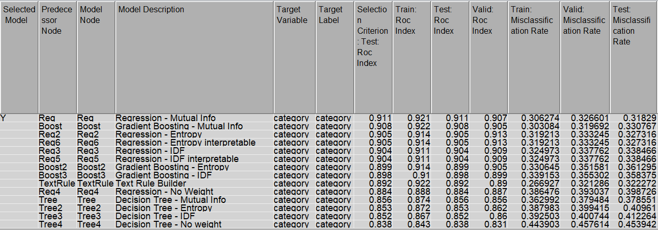
Model: 4th Iteration
Best: Regression - Mutual Info, Test ROC: 0.911, Misclassification rate: 0.318

Slide 19
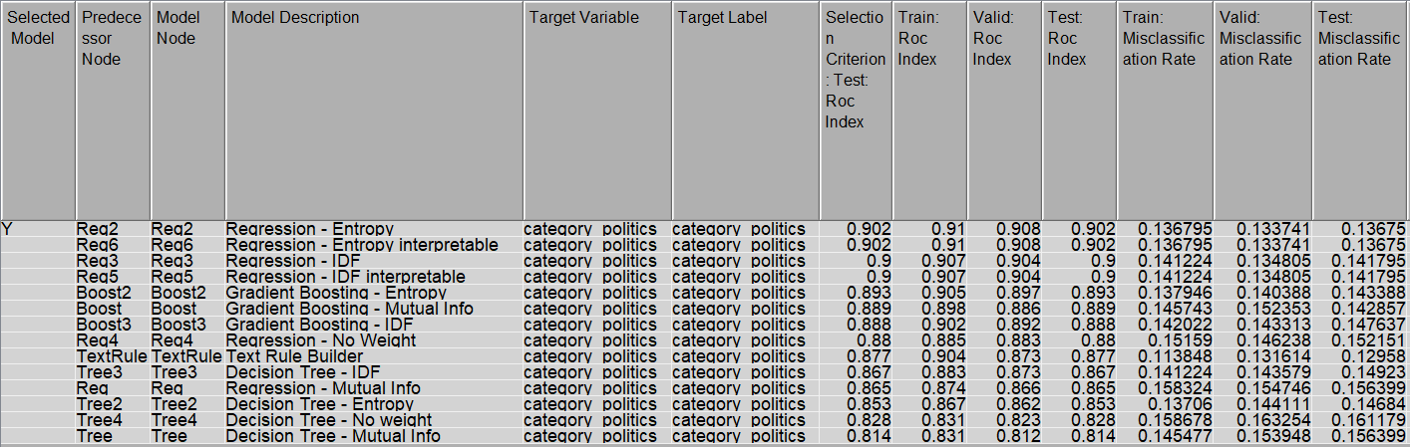
Model: 5th Iteration
Best: Regression - Entropy, Test ROC: 0.902, Misclassification rate: 0.137

Slide 20
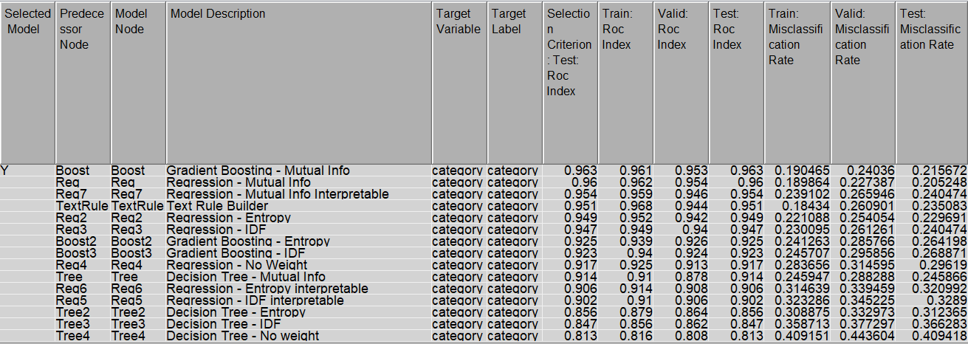
Model: 6th Iteration
Best: Regression - Mutual Info, Test ROC: 0.961/ Misclassification rate: 0.206

