Slide 1
Species traits and habitat quality drive differences in fish densities between visual survey techniques: implications for coral reef monitoring design George et al.
Figures

Slide 2
Model Plot

Slide 3
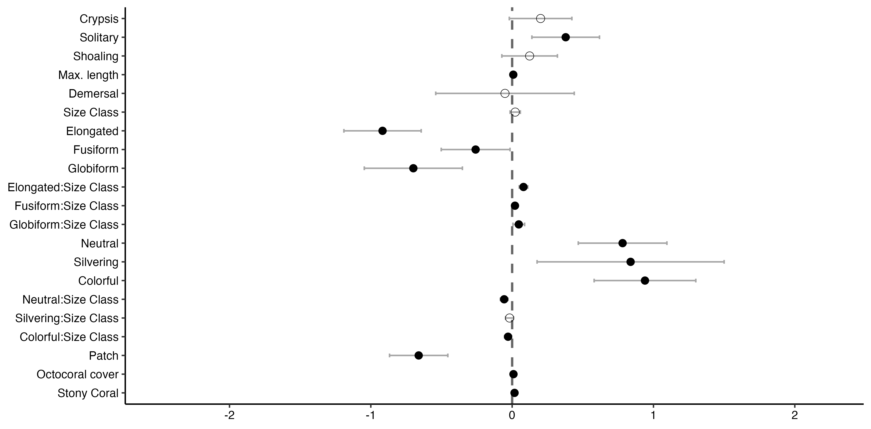
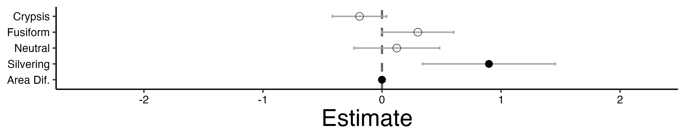
Aggregation
schooling
benthic
Shape
compressiform
Species Traits
Coloration
camouflage
Habitat Traits
continuous
Species Traits
anguilliform
Coloration
camouflage
Habitat Traits

Slide 4
SVC vs. Belt Fish Trait Plot

Slide 5
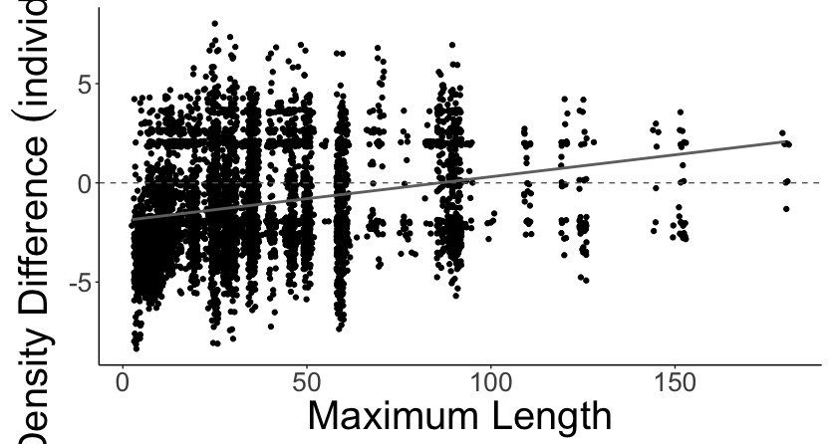
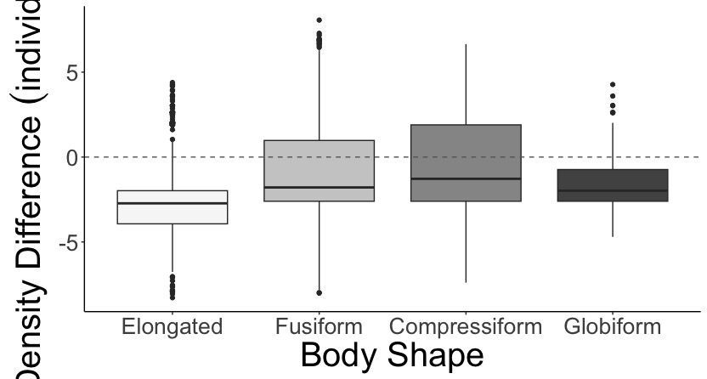
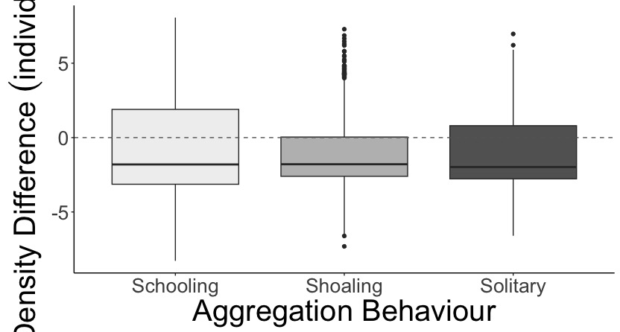
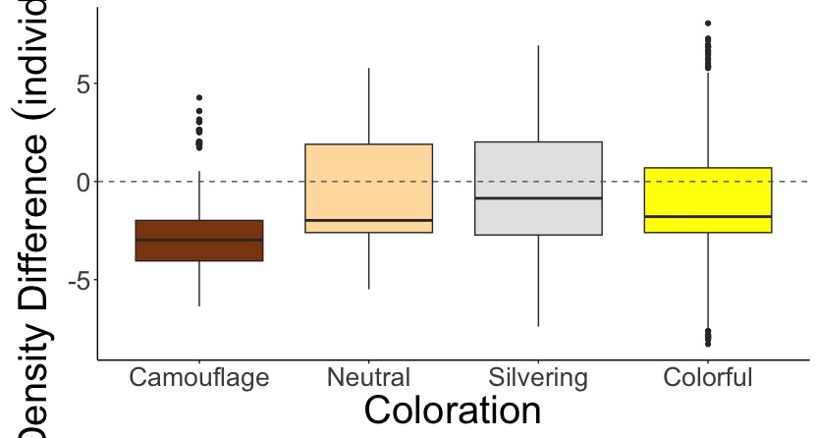
A.
B.
estimate = 0.008
z-value = 4.07
p < 0.01
a
b
c
d
SVC Density Greater
SVC Density Greater
Belt Density Greater
Belt Density Greater
Log Density Difference (individuals/m²)
C.
a
a
a
D.
a
b
b
c
SVC Density Greater
SVC Density Greater
Belt Density Greater
Belt Density Greater

Slide 6
SVC vs. Belt Interactions Plot

Slide 7
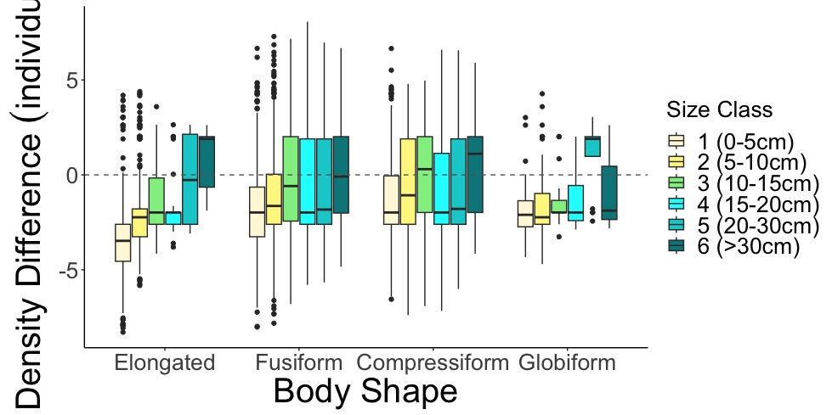
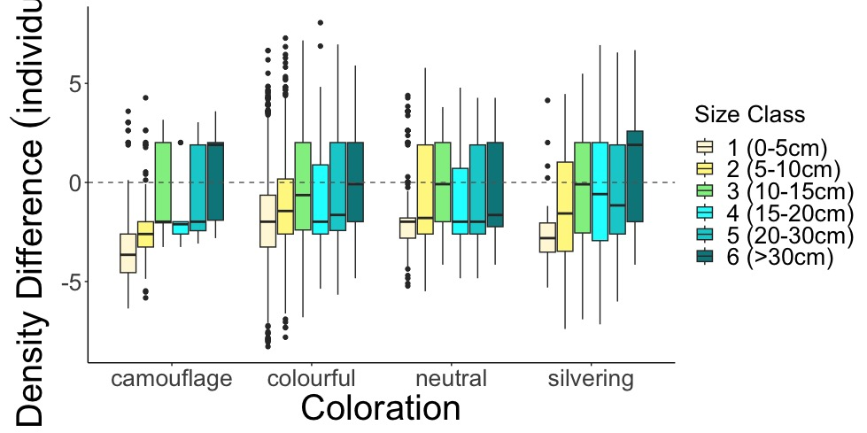
A.
SVC Density Greater
Belt Density Greater
Log Density Difference (individuals/m²)
B.
SVC Density Greater
Belt Density Greater

Slide 8
Heat Plot

Slide 9
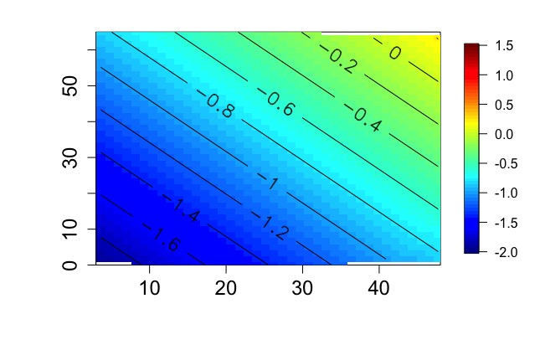
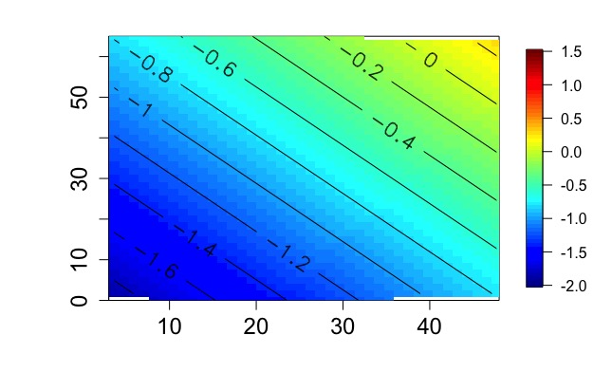
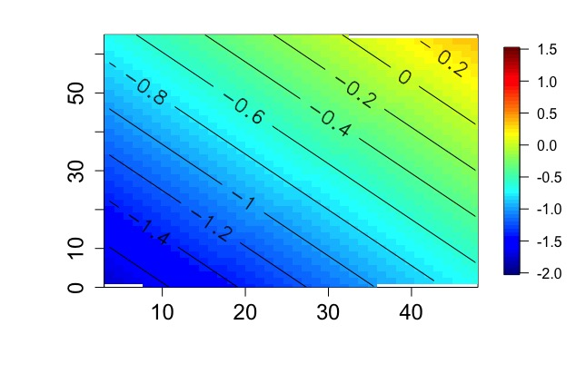
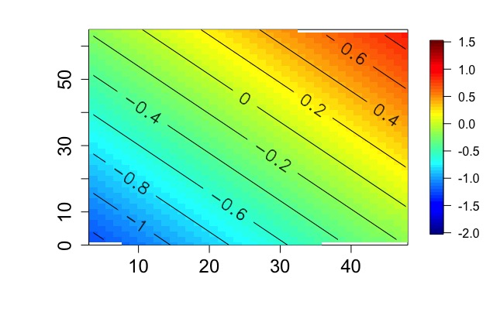
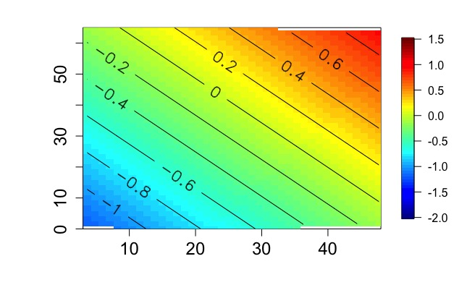
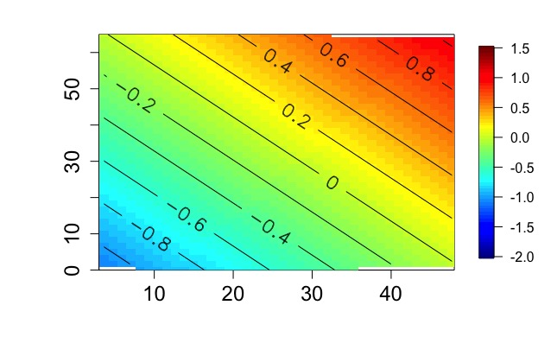
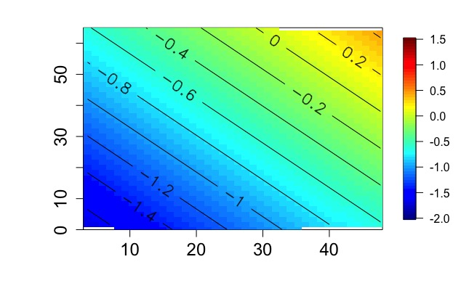

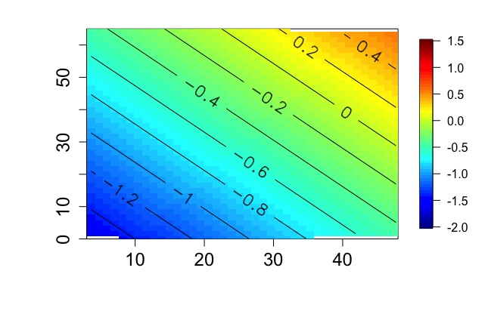
Neutral
Silvering
Colorful
A.
B.
C.
SVC Density Greater
Elongated
Belt Density Greater
D.
E.
F.
SVC Density Greater
Stony Coral Cover (%)
Fusiform
Log Density Difference (individuals/m²)
Belt Density Greater
G.
H.
I.
SVC Density Greater
Globiform
Belt Density Greater
Fish Size (cm)

Slide 10
SVC vs. Belt Habitat Traits Plot

Slide 11
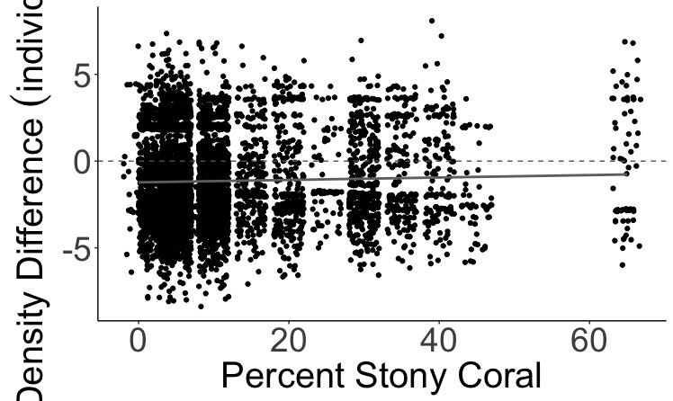
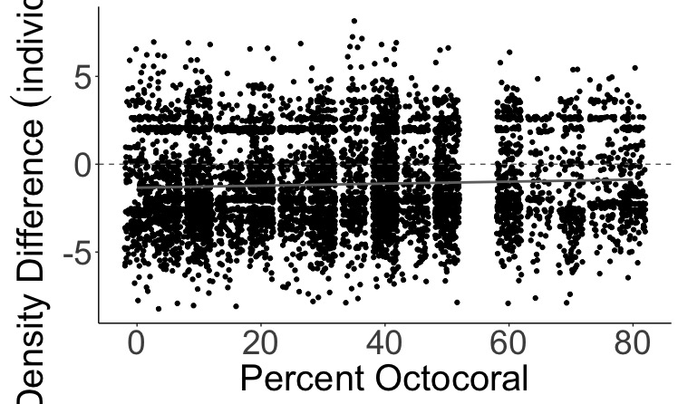
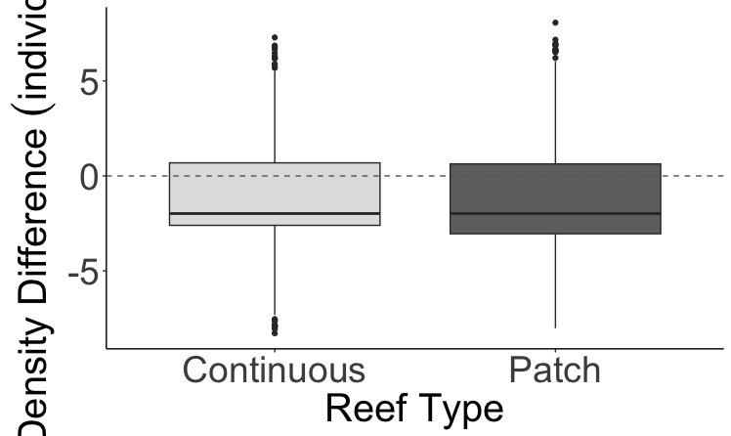
A.
SVC Density Greater
estimate = 0.017
z-value = 4.89
p < 0.01
Belt Density Greater
B.
SVC Density Greater
Log Density Difference (individuals/m²)
estimate = 0.009
z-value = 5.95
p < 0.01
Belt Density Greater
C.
a
b
SVC Density Greater
Belt Density Greater

Slide 12
SVC vs. Roving Traits Plot

Slide 13
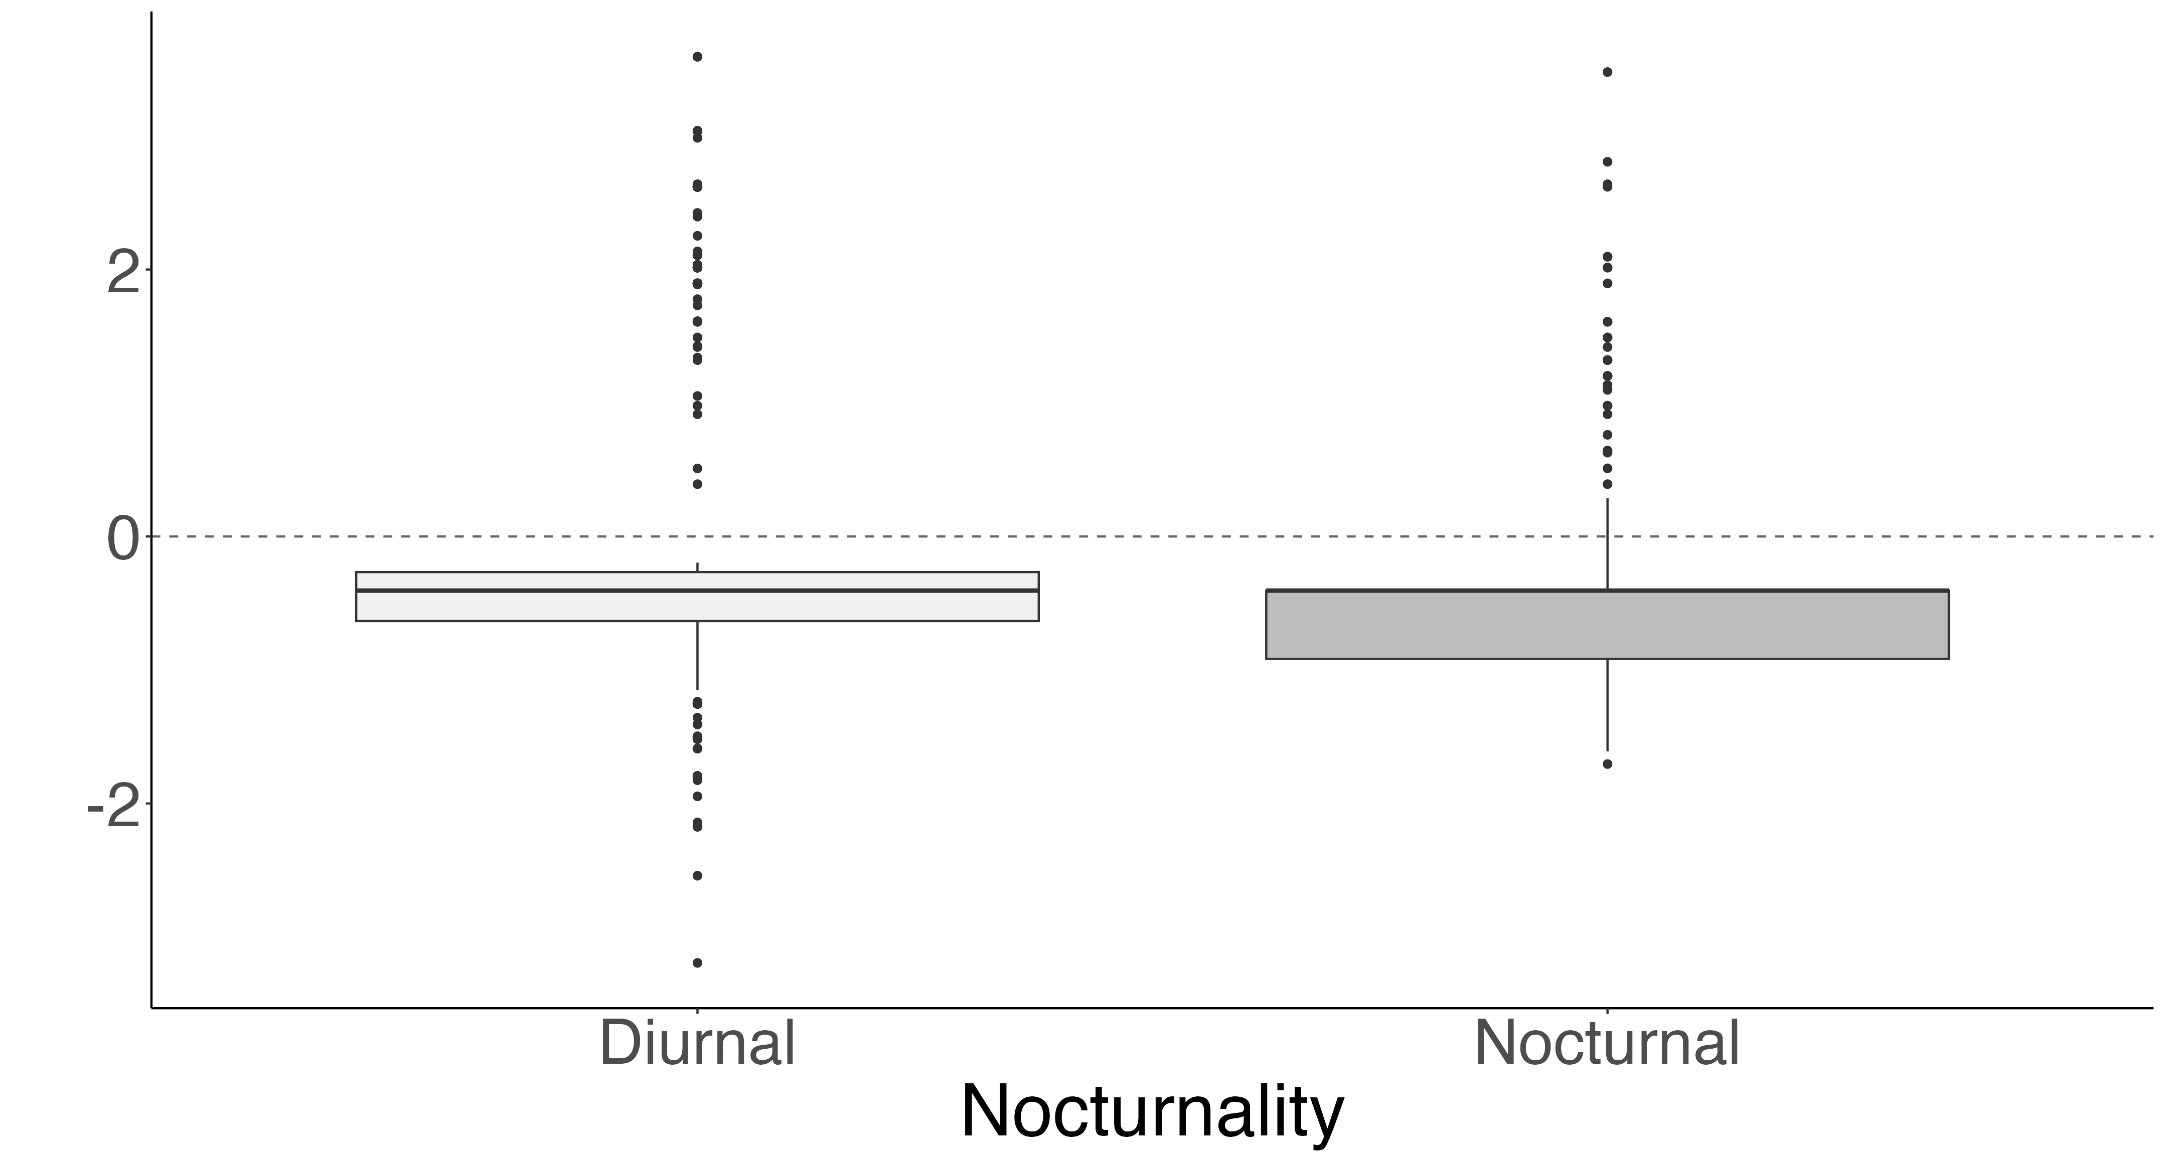
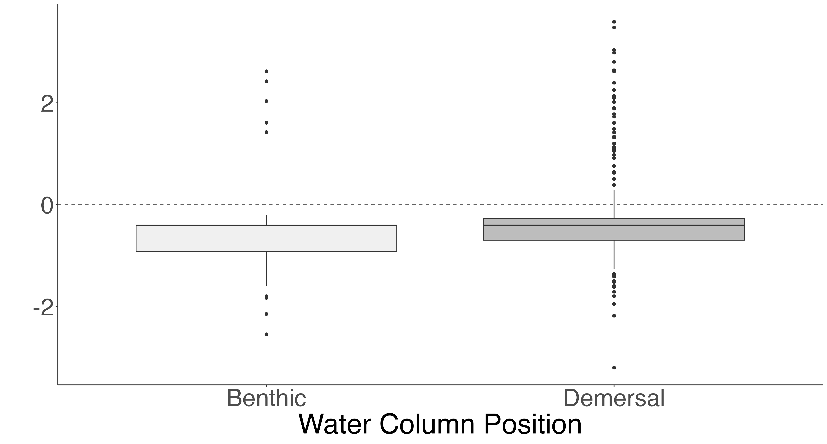
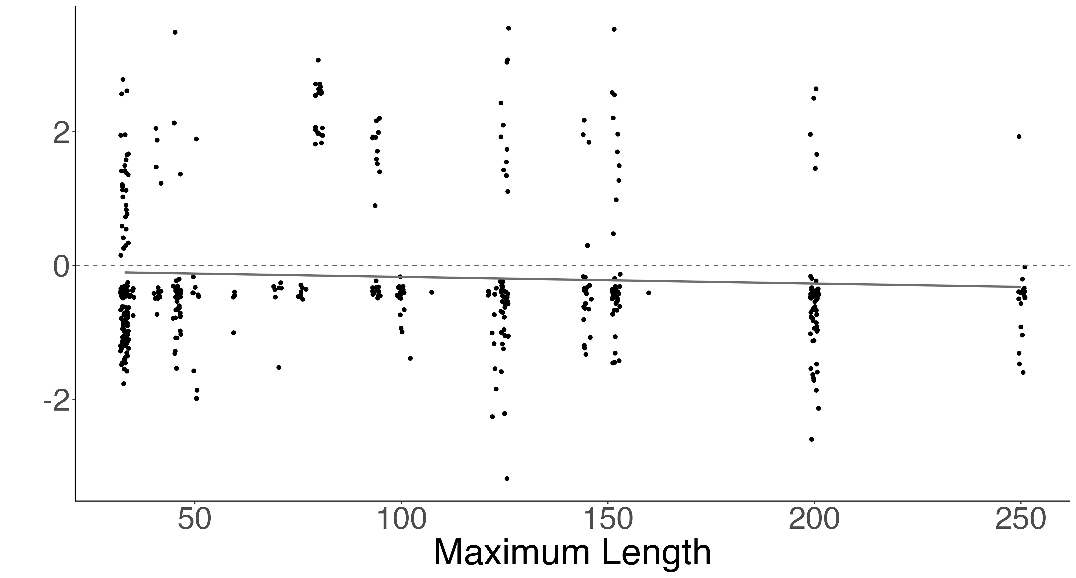
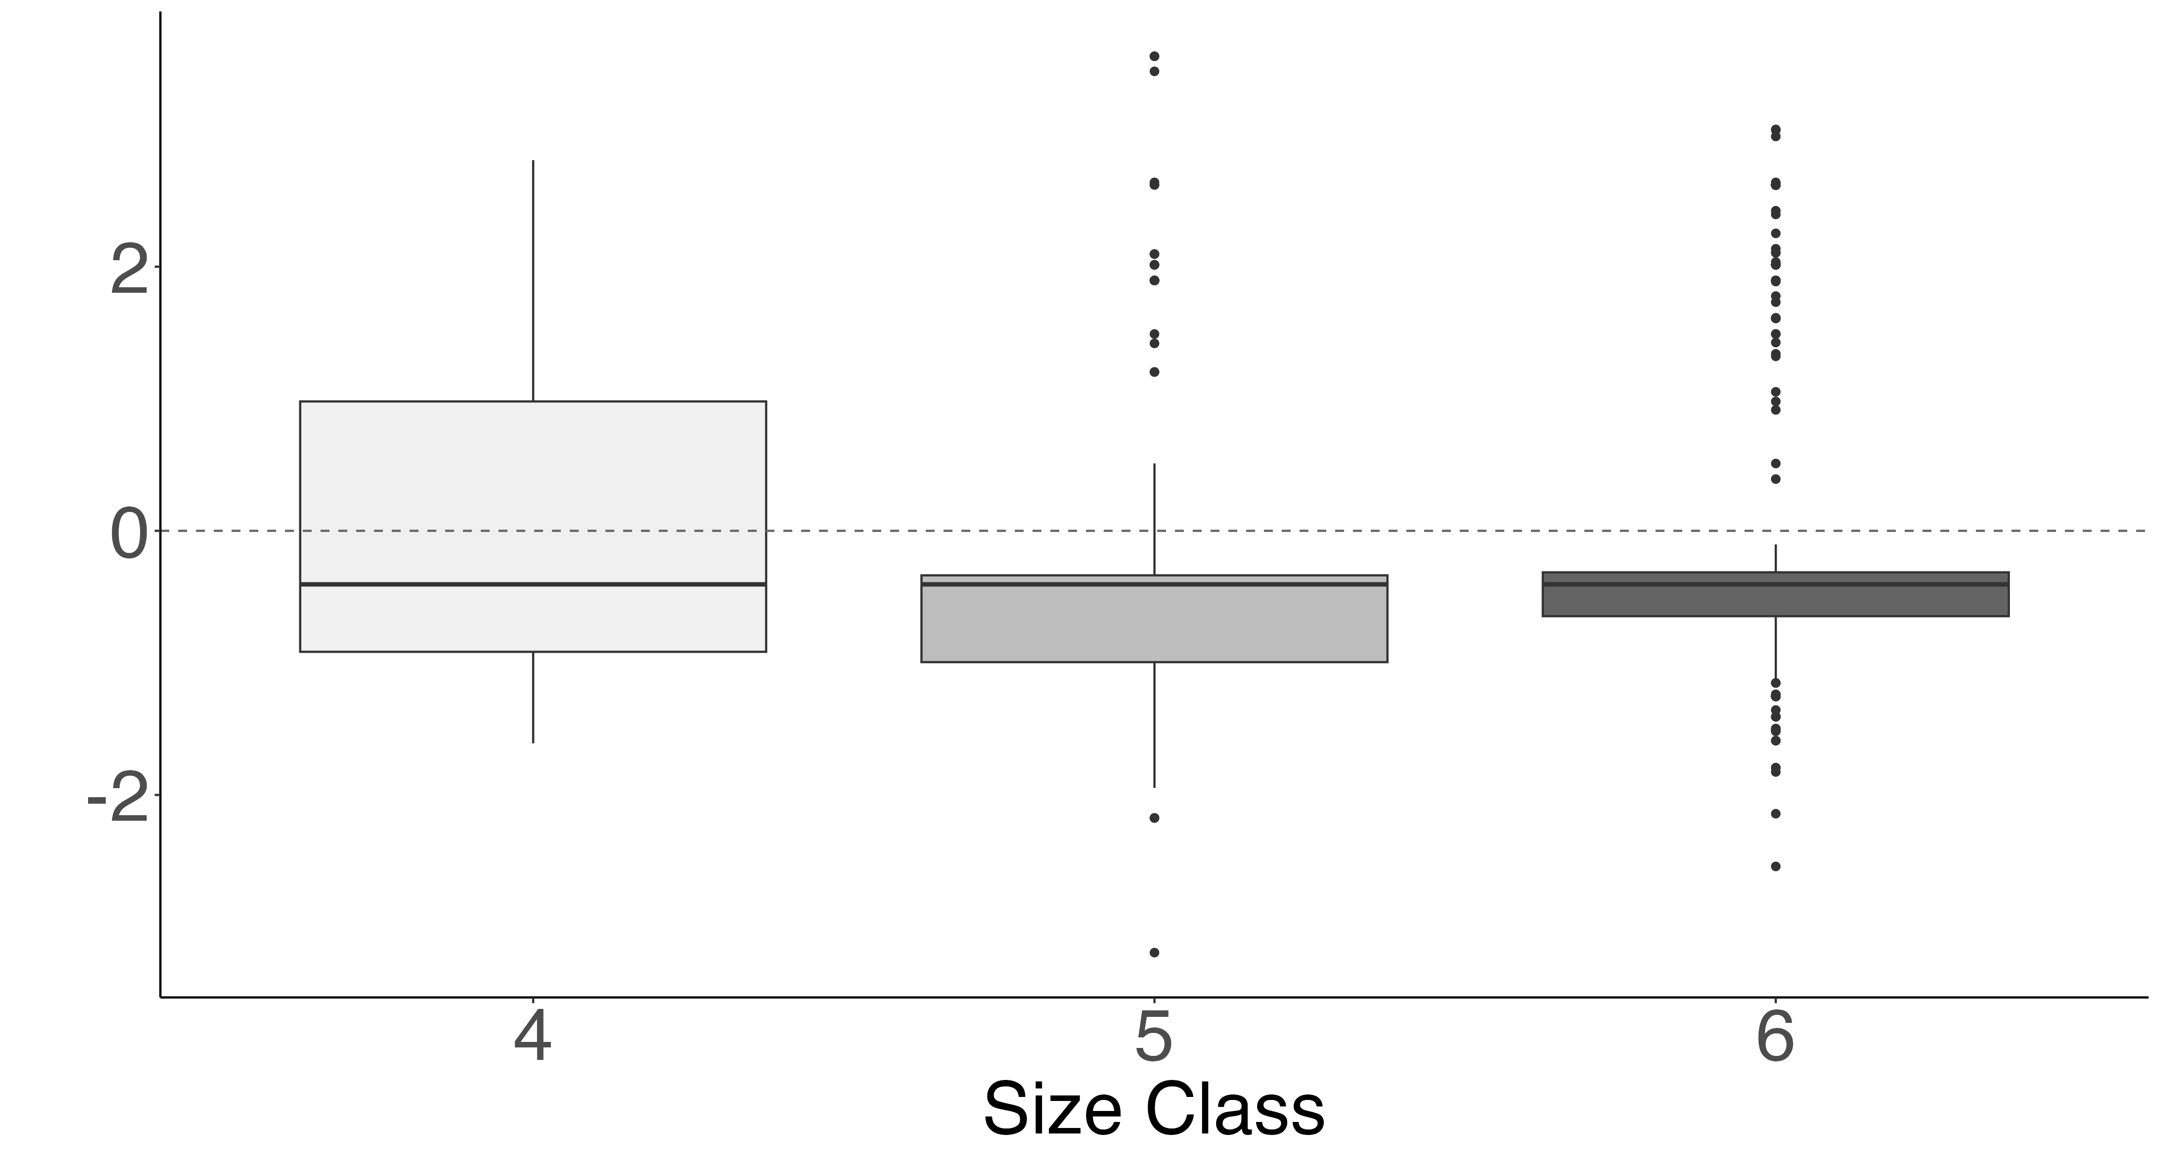
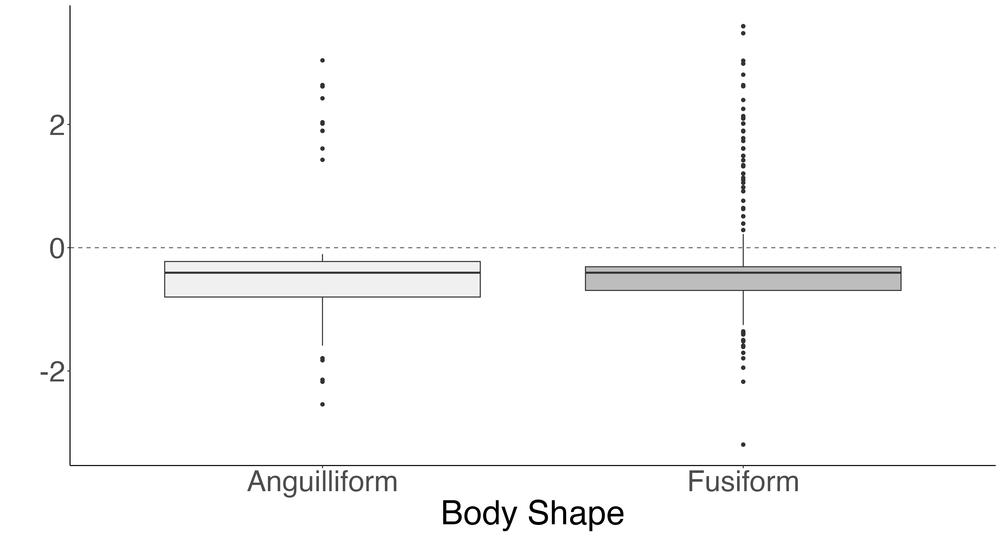
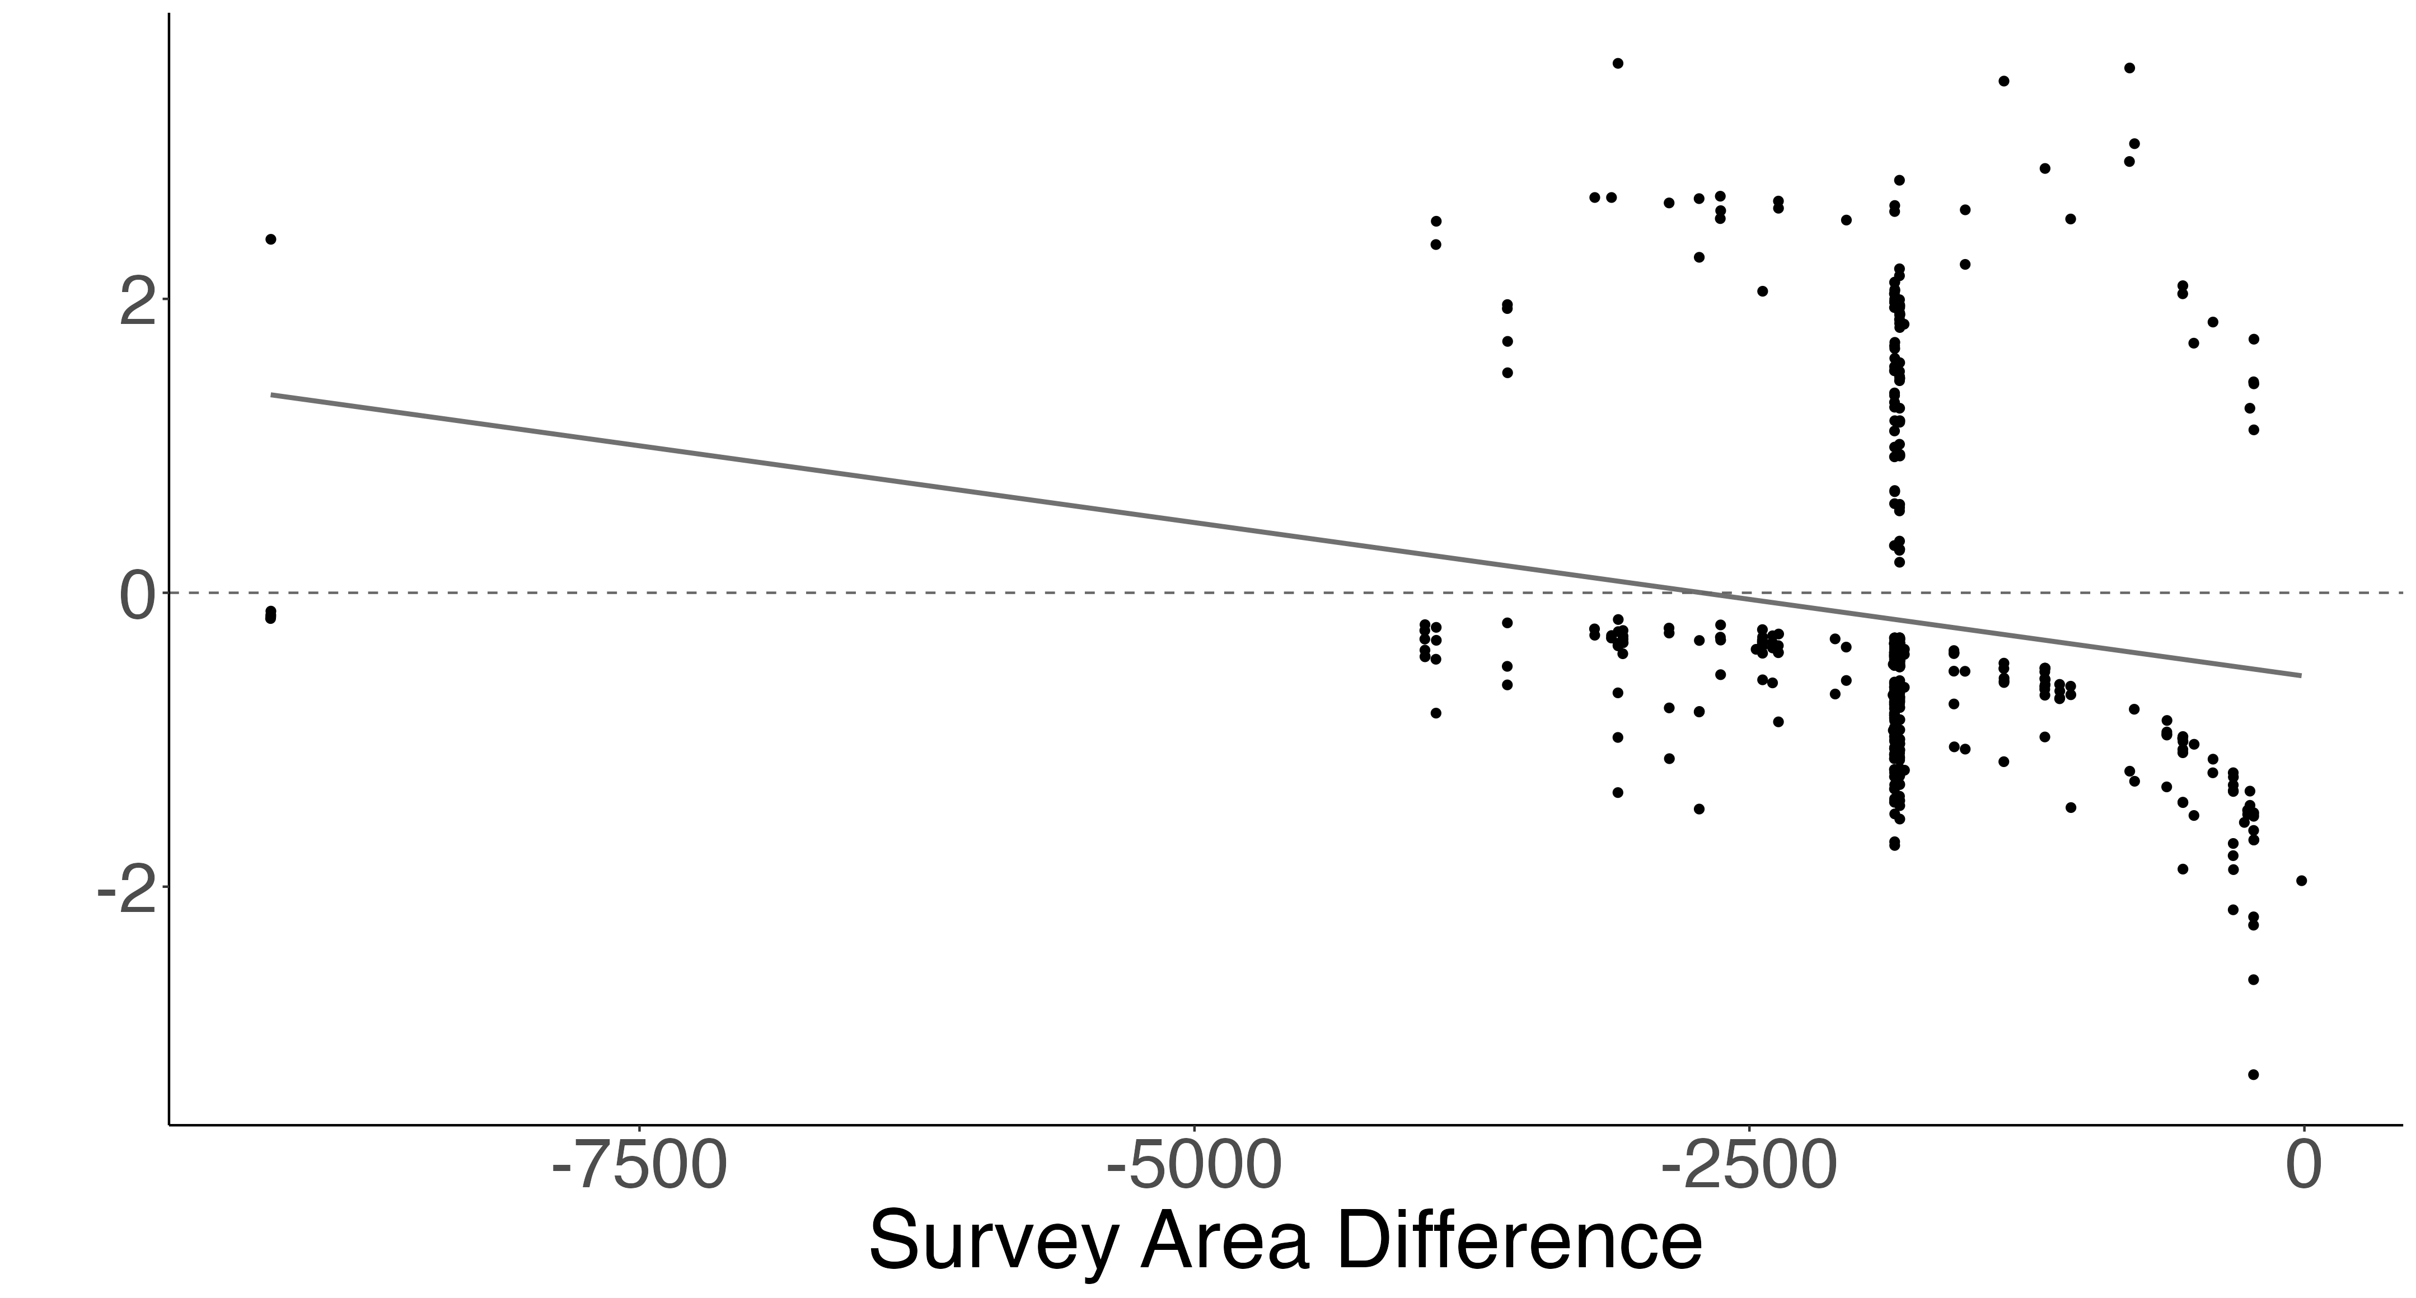
A.
a
b
B.
b
SVC Density Greater
a
SVC Density Greater
Roving Density Greater
Roving Density Greater
C.
estimate = 0.005 z-value = 4.67 p < 0.01
D.
a
SVC Density Greater
a
a
SVC Density Greater
Log Density Difference (individuals/m²)
Roving Density Greater
Roving Density Greater
E.
a
F.
estimate < 0.001 z-value = 4.64 p < 0.01
a
SVC Density Greater
SVC Density Greater
Roving Density Greater
Roving Density Greater

Slide 14
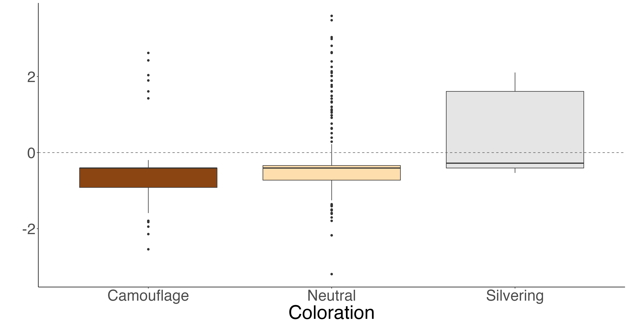
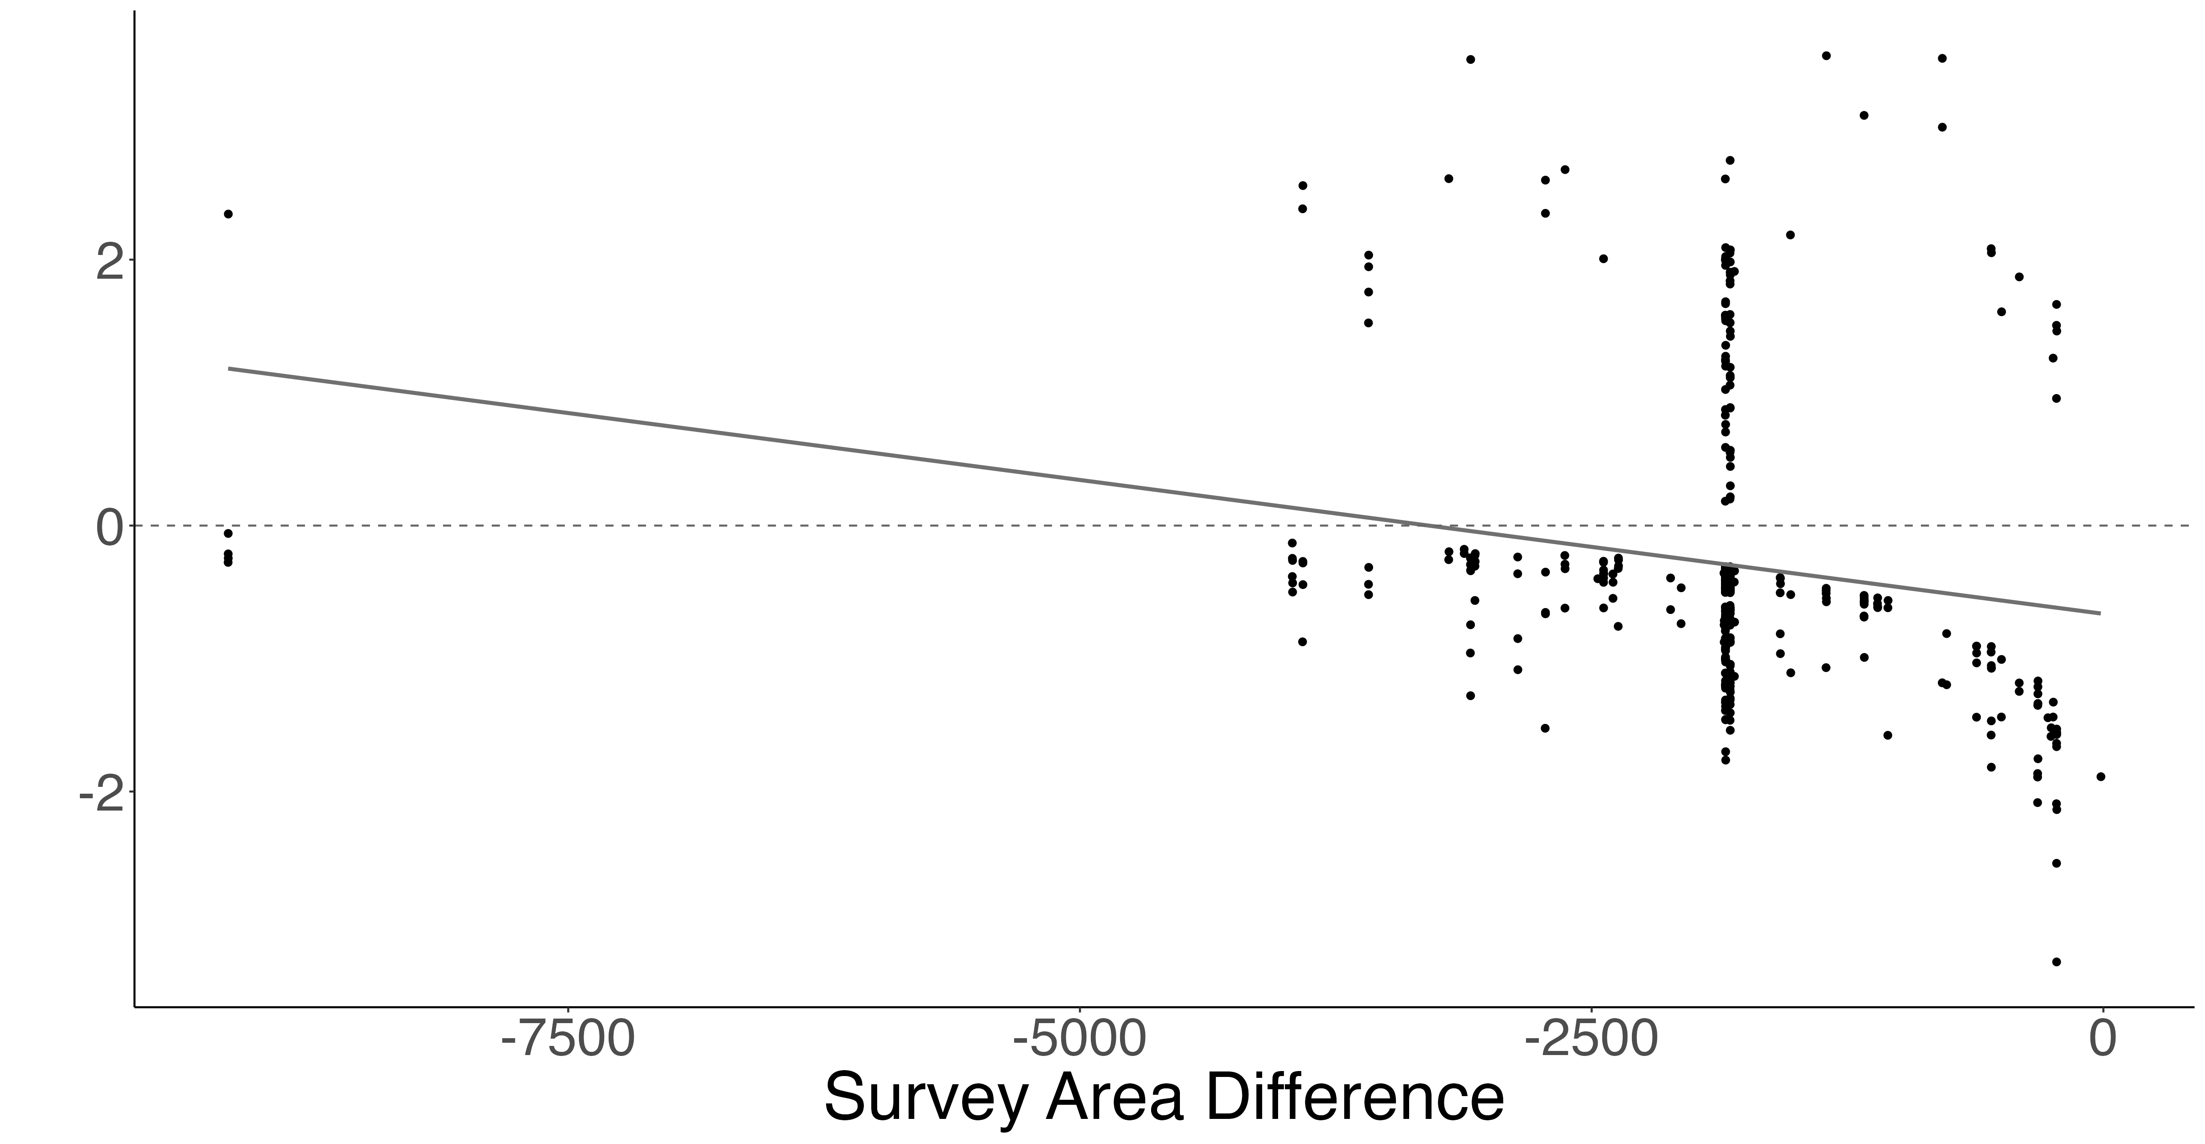
A.
a
a
b
SVC Density Greater
Roving Density Greater
Log Density Difference (individuals/m²)
B.
SVC Density Greater
estimate < 0.001
z-value = 4.703
p < 0.01
Roving Density Greater

Slide 15
SVC vs. Belt Diagnostic Plots

Slide 16
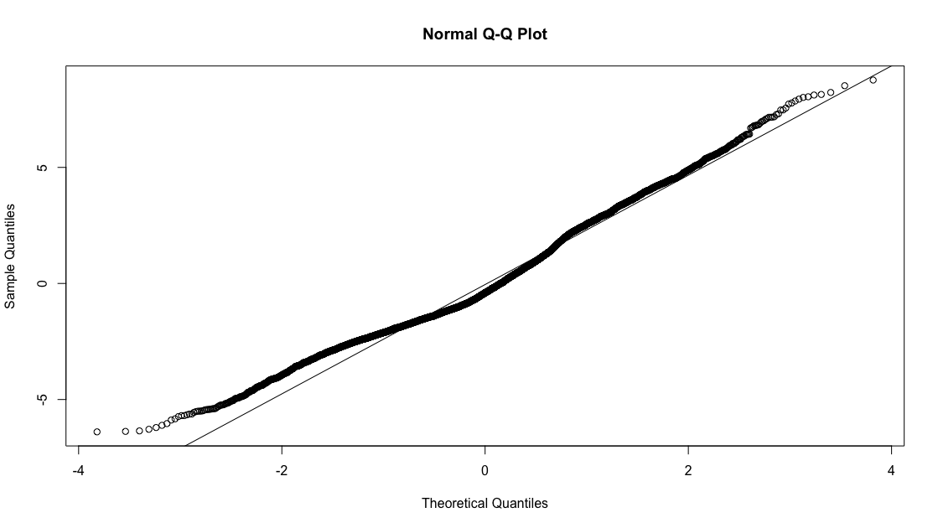
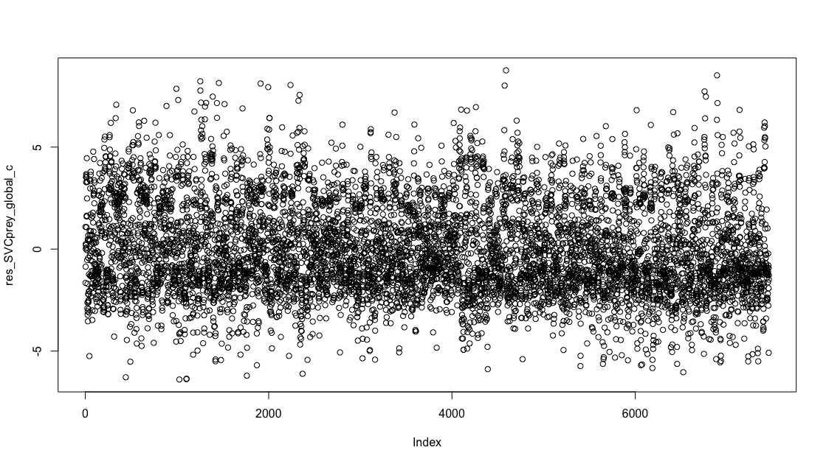
A.
B.

Slide 17
SVC vs. Roving Diagnostic Plots

Slide 18
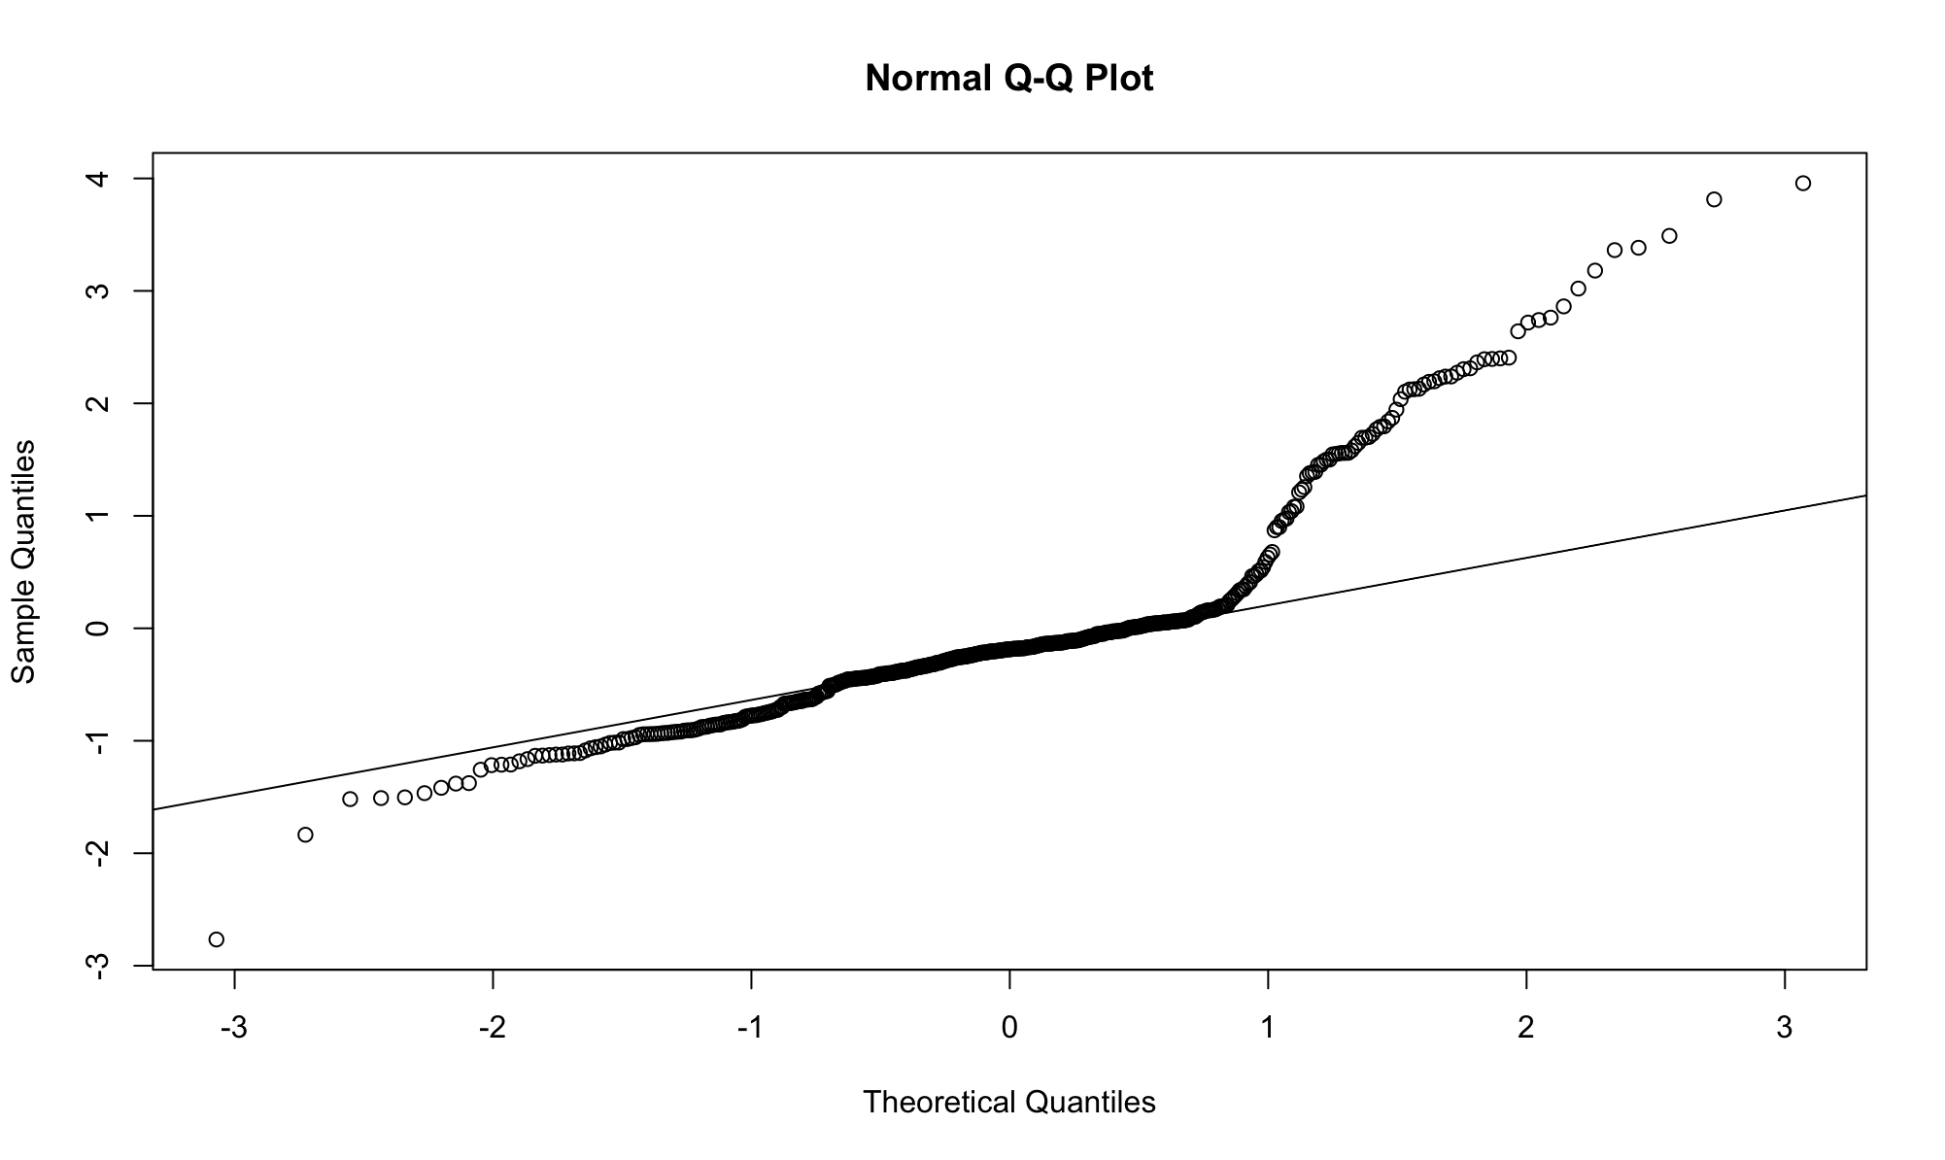
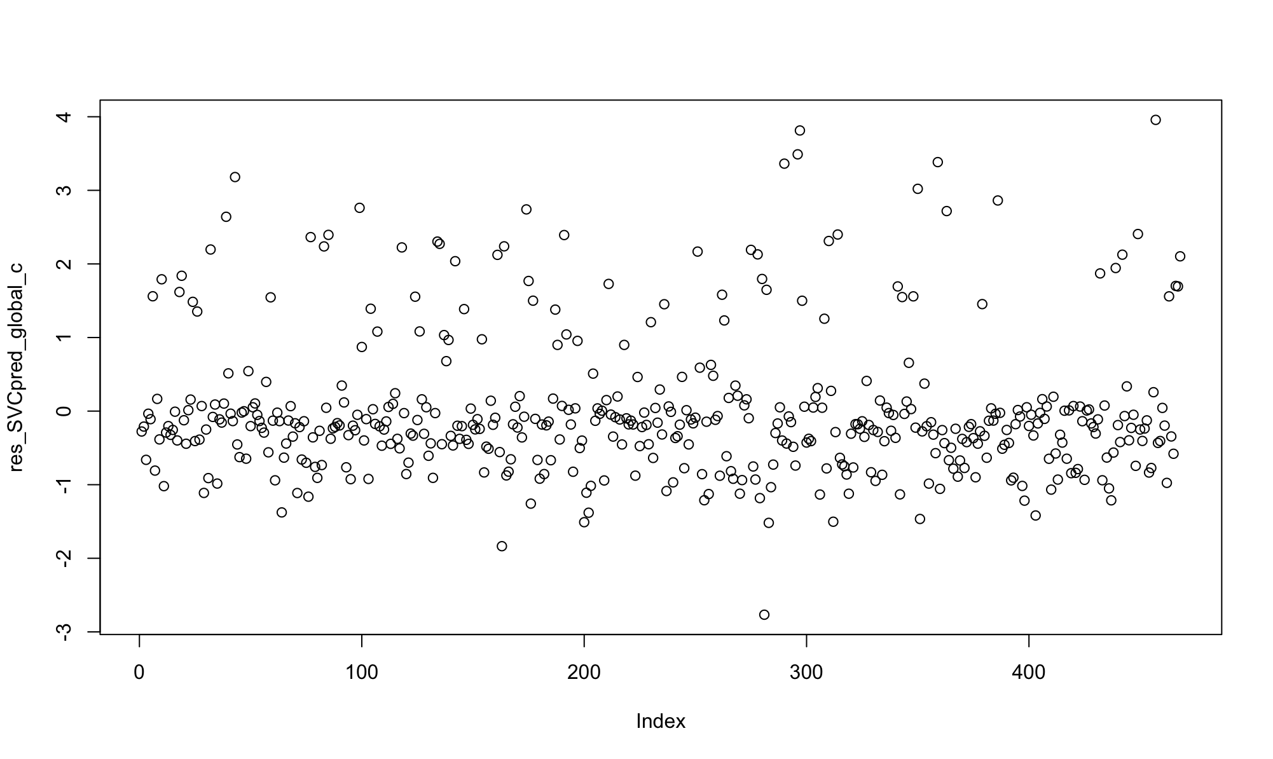
A.
B.

