Slide 1
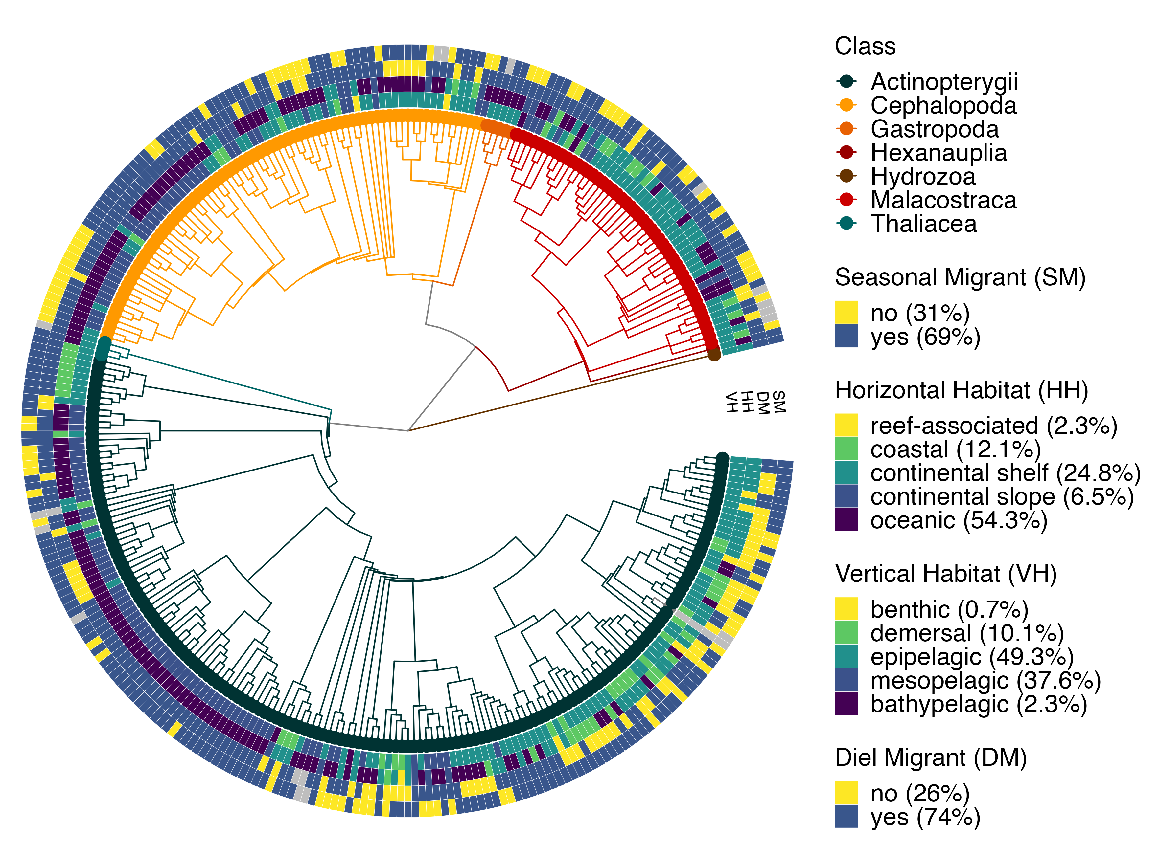
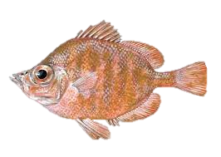
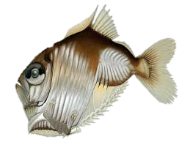
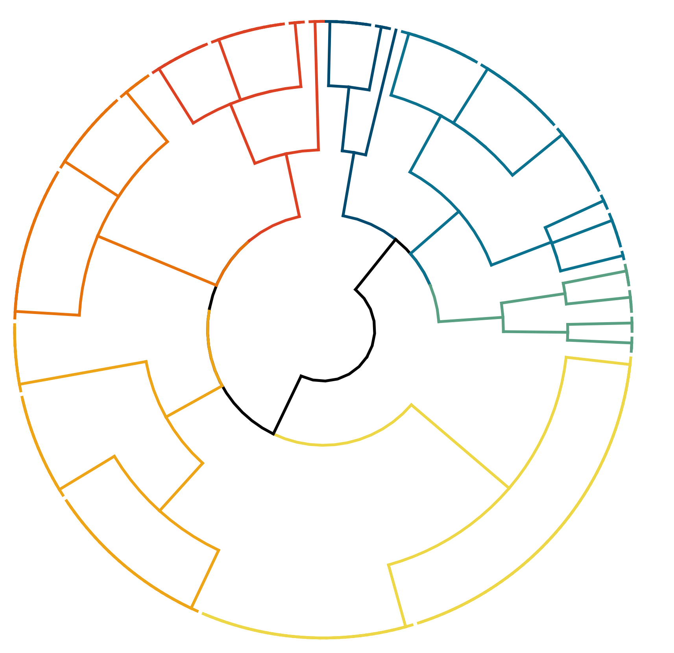
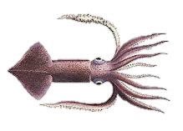
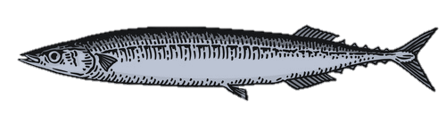
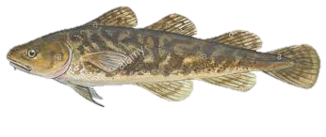
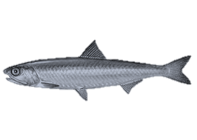
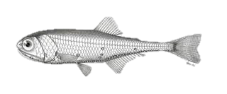
a)
b)
#7 Resident shelf taxa
(n = 28)
#1 Non-diel migrating mesopelagics
(n = 12)
#6 Seasonal shelf taxa (n = 44)
#3 Coast & shelf epipelagics (n = 51)
7
1
6
3
4
#4 Coast & shelf demersals
(n = 14)
5
2
#5 Oceanic epipelagics
(n = 55)
#2 Diel migrating mesopelagics (n = 88)

