Slide 1
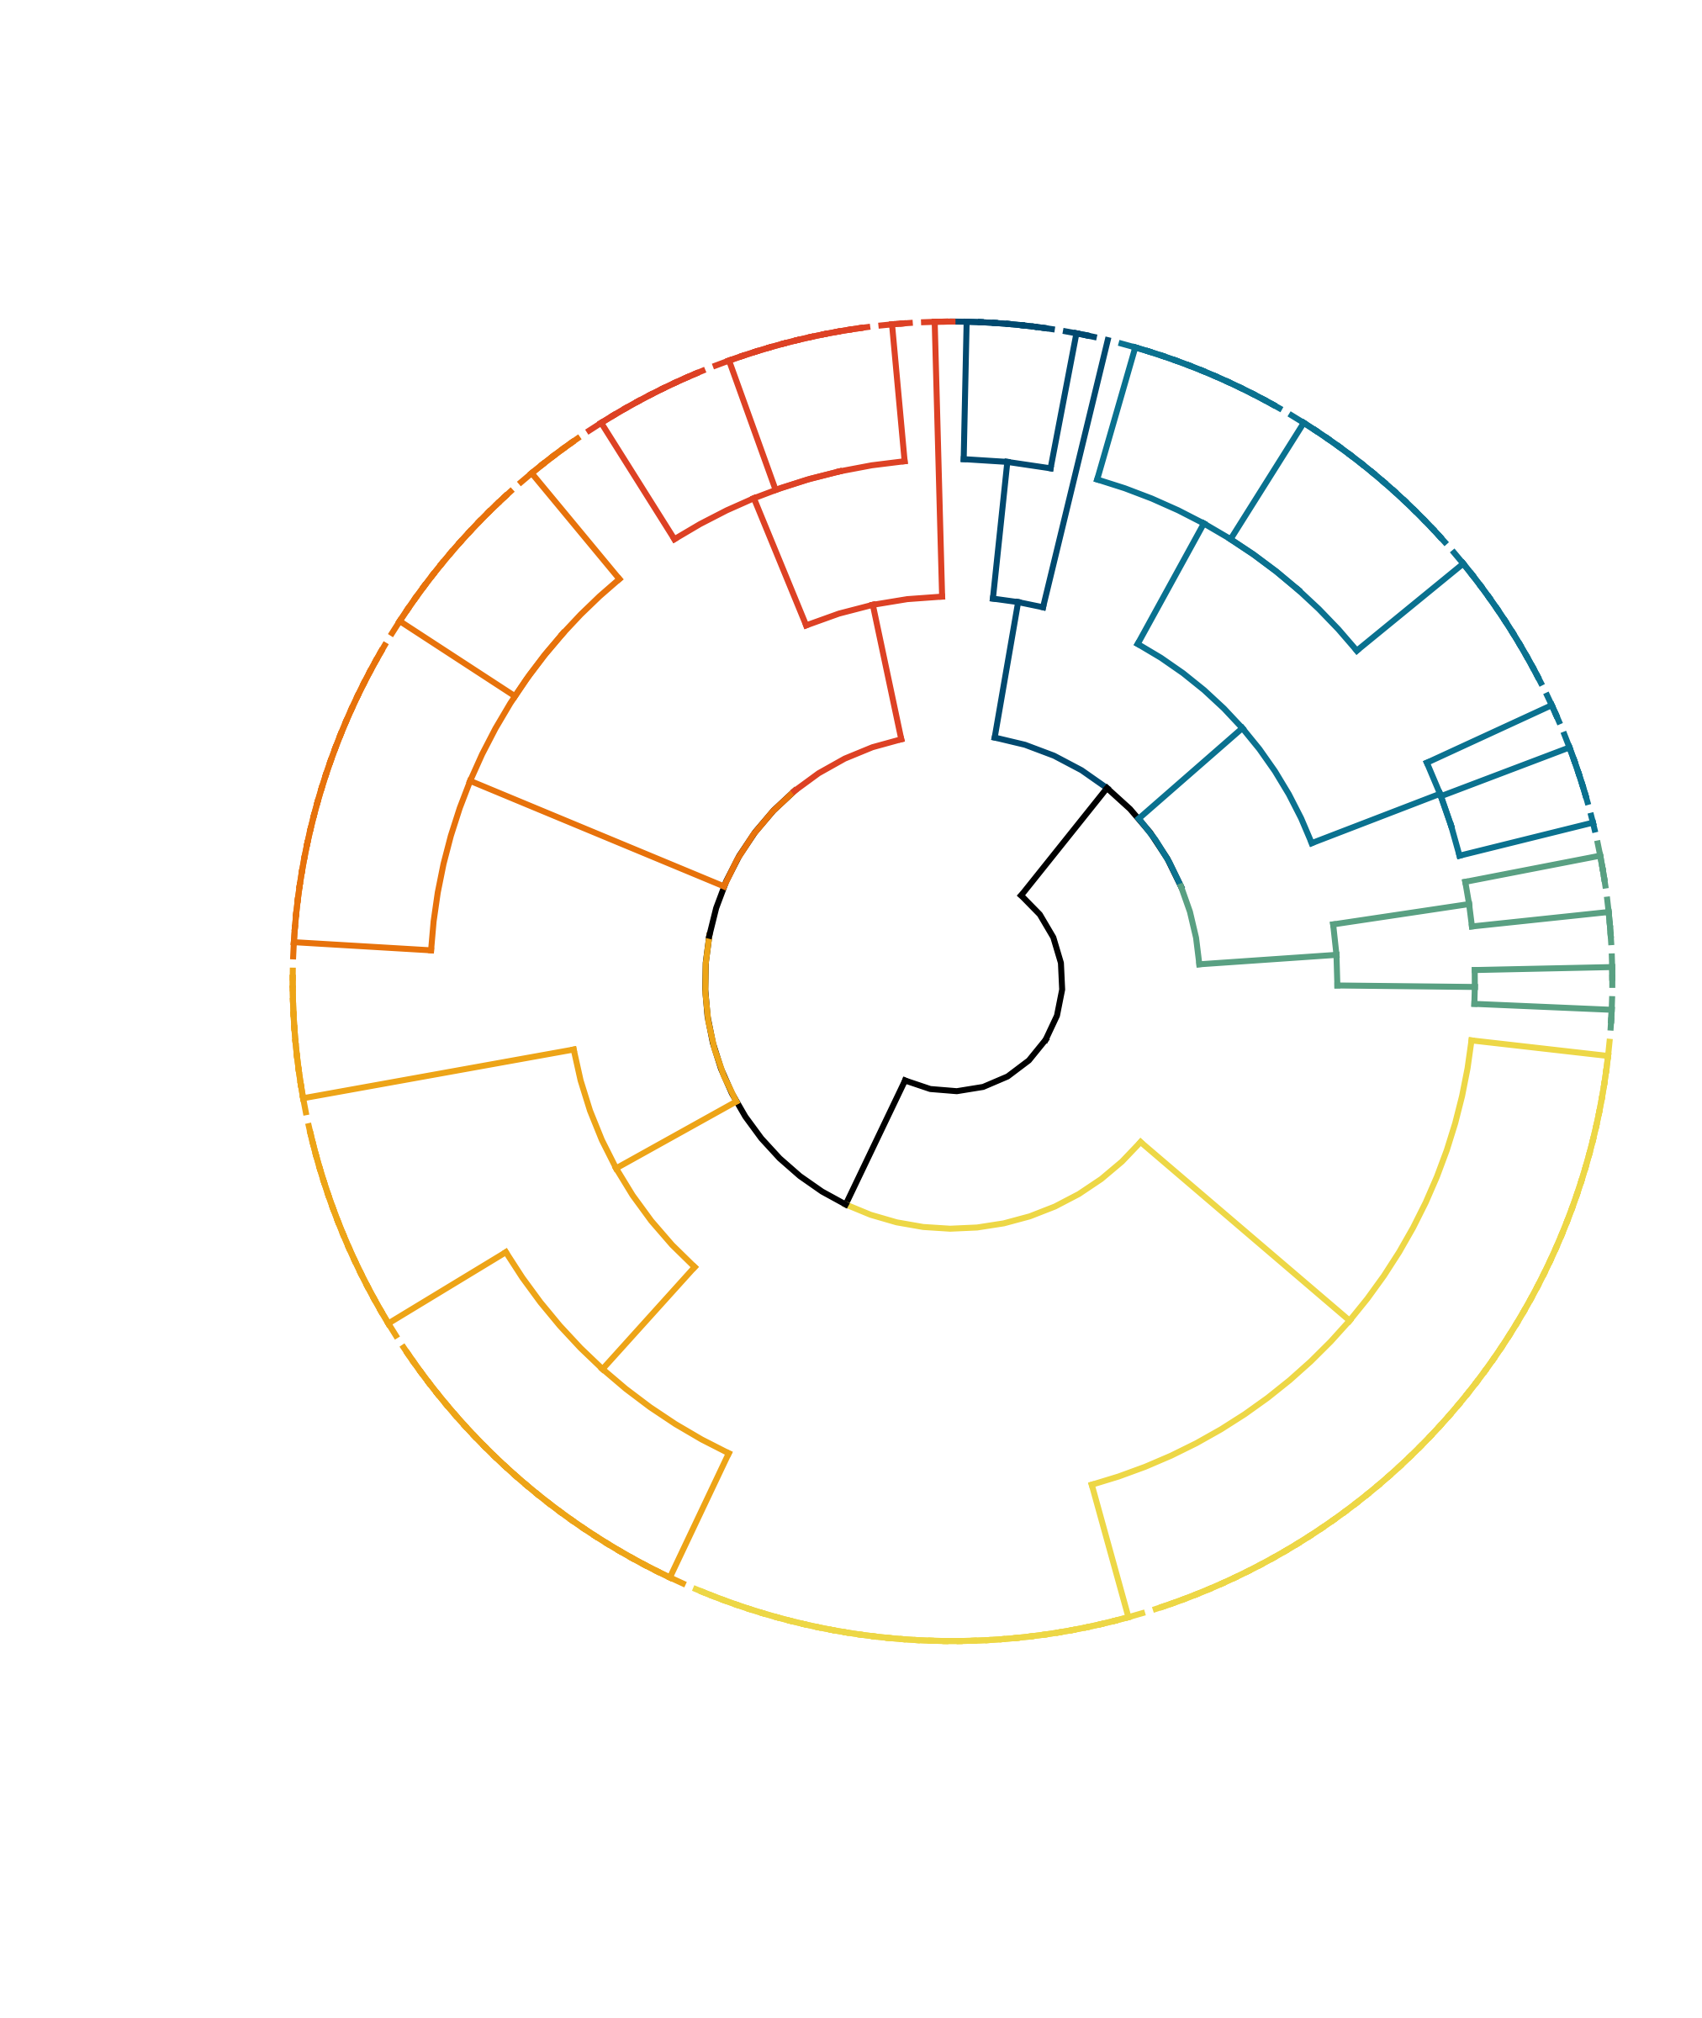
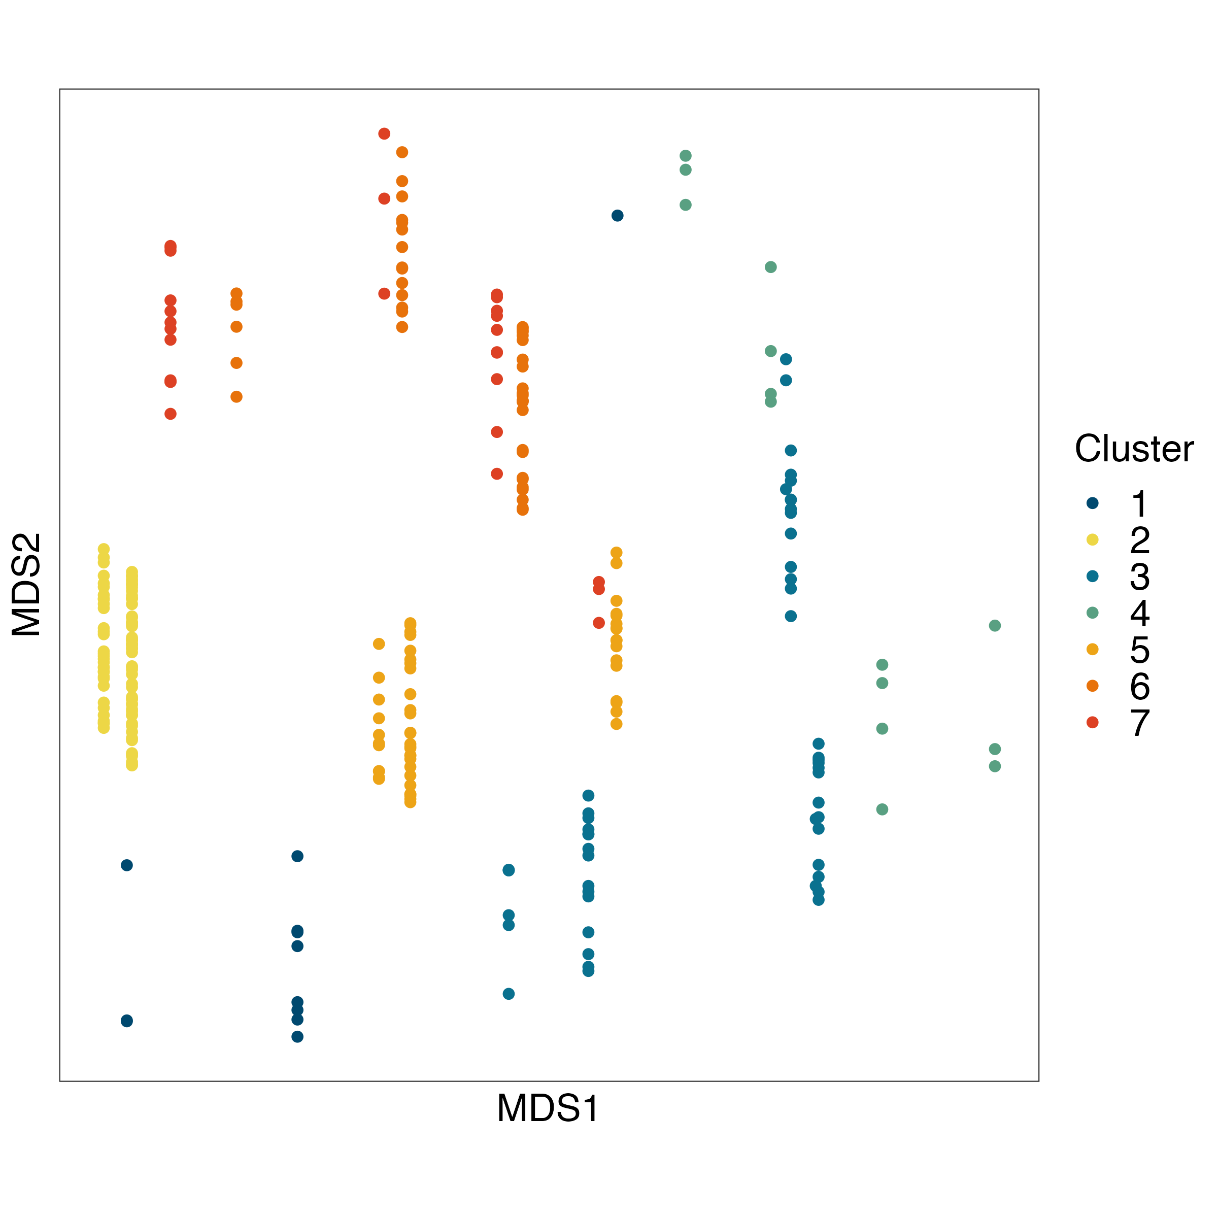
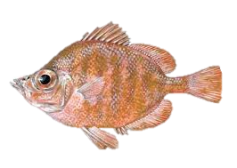
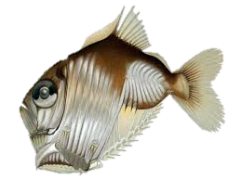
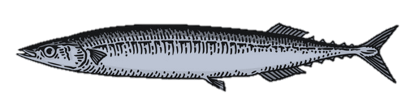
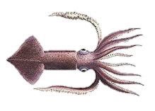
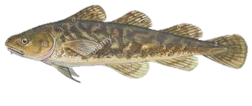
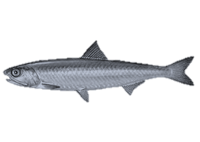
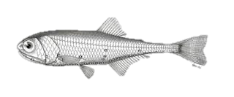
a)
#1 Non-diel migrating mesopelagics
(12)
b)
#7 Resident shelf taxa
(28)
#3 Coast & shelf epipelagics (51)
#6 Seasonal shelf taxa (44)
7
1
#4 Coast & shelf demersals
(14)
3
6
4
5
2
#5 Oceanic epipelagics
(55)
#2 Diel migrating mesopelagics (88)
Notes:
Most taxa were seasonal unless specified here as “resident” (#3).
Most were schooling and juvenile taxa, and these traits were not included in analyses.

Slide 2
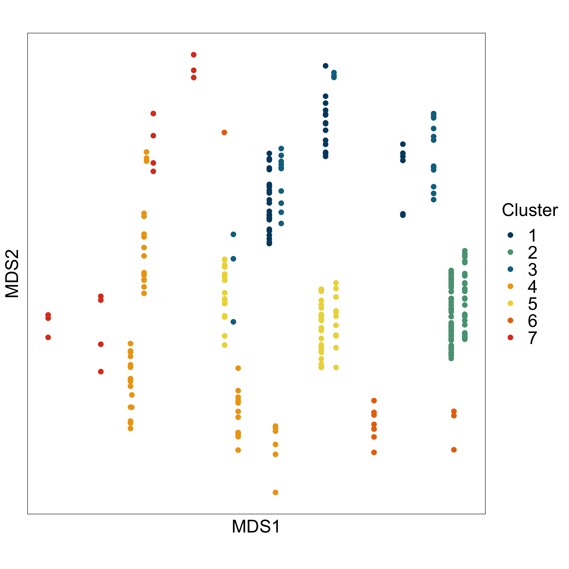
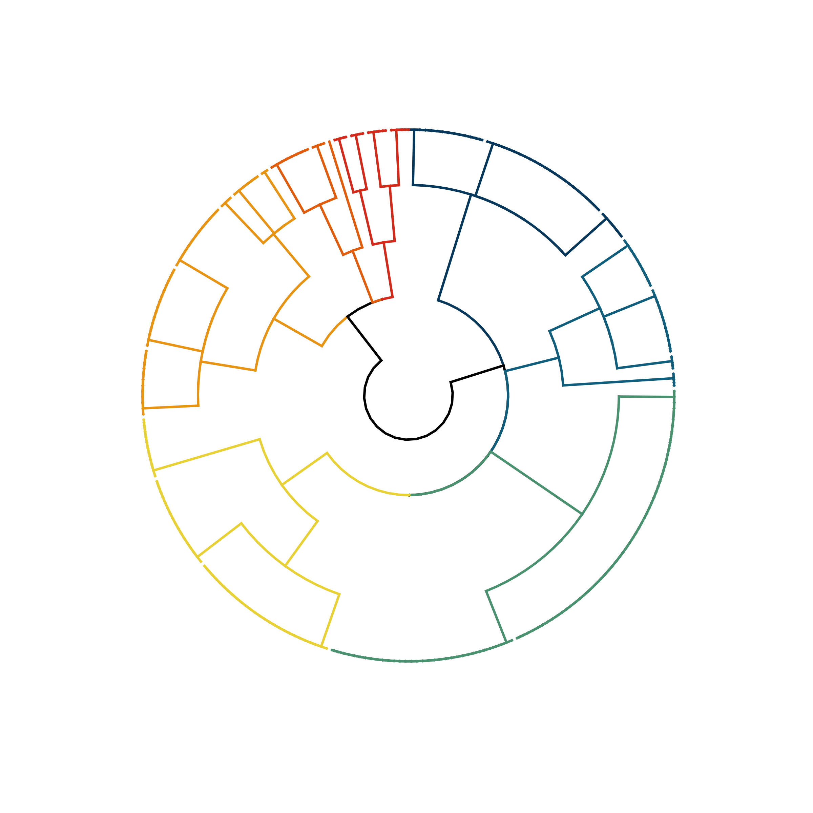
a)
b)
Coast & shelf demersals
(14)
Non-diel migrating mesopelagics
(12)
Seasonal shelf taxa
(44)
6
7
1
Resident shelf taxa
(28)
Coast & shelf epipelagics (51)
4
3
5
2
Offshore & oceanic epipelagics
(55)
Diel migrating mesopelagic
(88)
Notes:
Most taxa were seasonal unless specified here as “resident” (#3).
Most were schooling and juvenile taxa, and these traits were not included in analyses.

Slide 3
#7 Resident shelf taxa
(28)
#1 Non-diel migrating mesopelagics
(12)
#3 Coast & shelf epipelagics (51)
#6 Seasonal shelf taxa (44)
7
1
#4 Coast & shelf demersals
(14)
3
6
4
5
2
#5 Oceanic epipelagics
(55)
#2 Diel migrating mesopelagics (88)
Notes:
Most taxa were seasonal unless specified here as “resident” (#3).
Most were schooling and juvenile taxa, and these traits were not included in analyses.

Slide 4
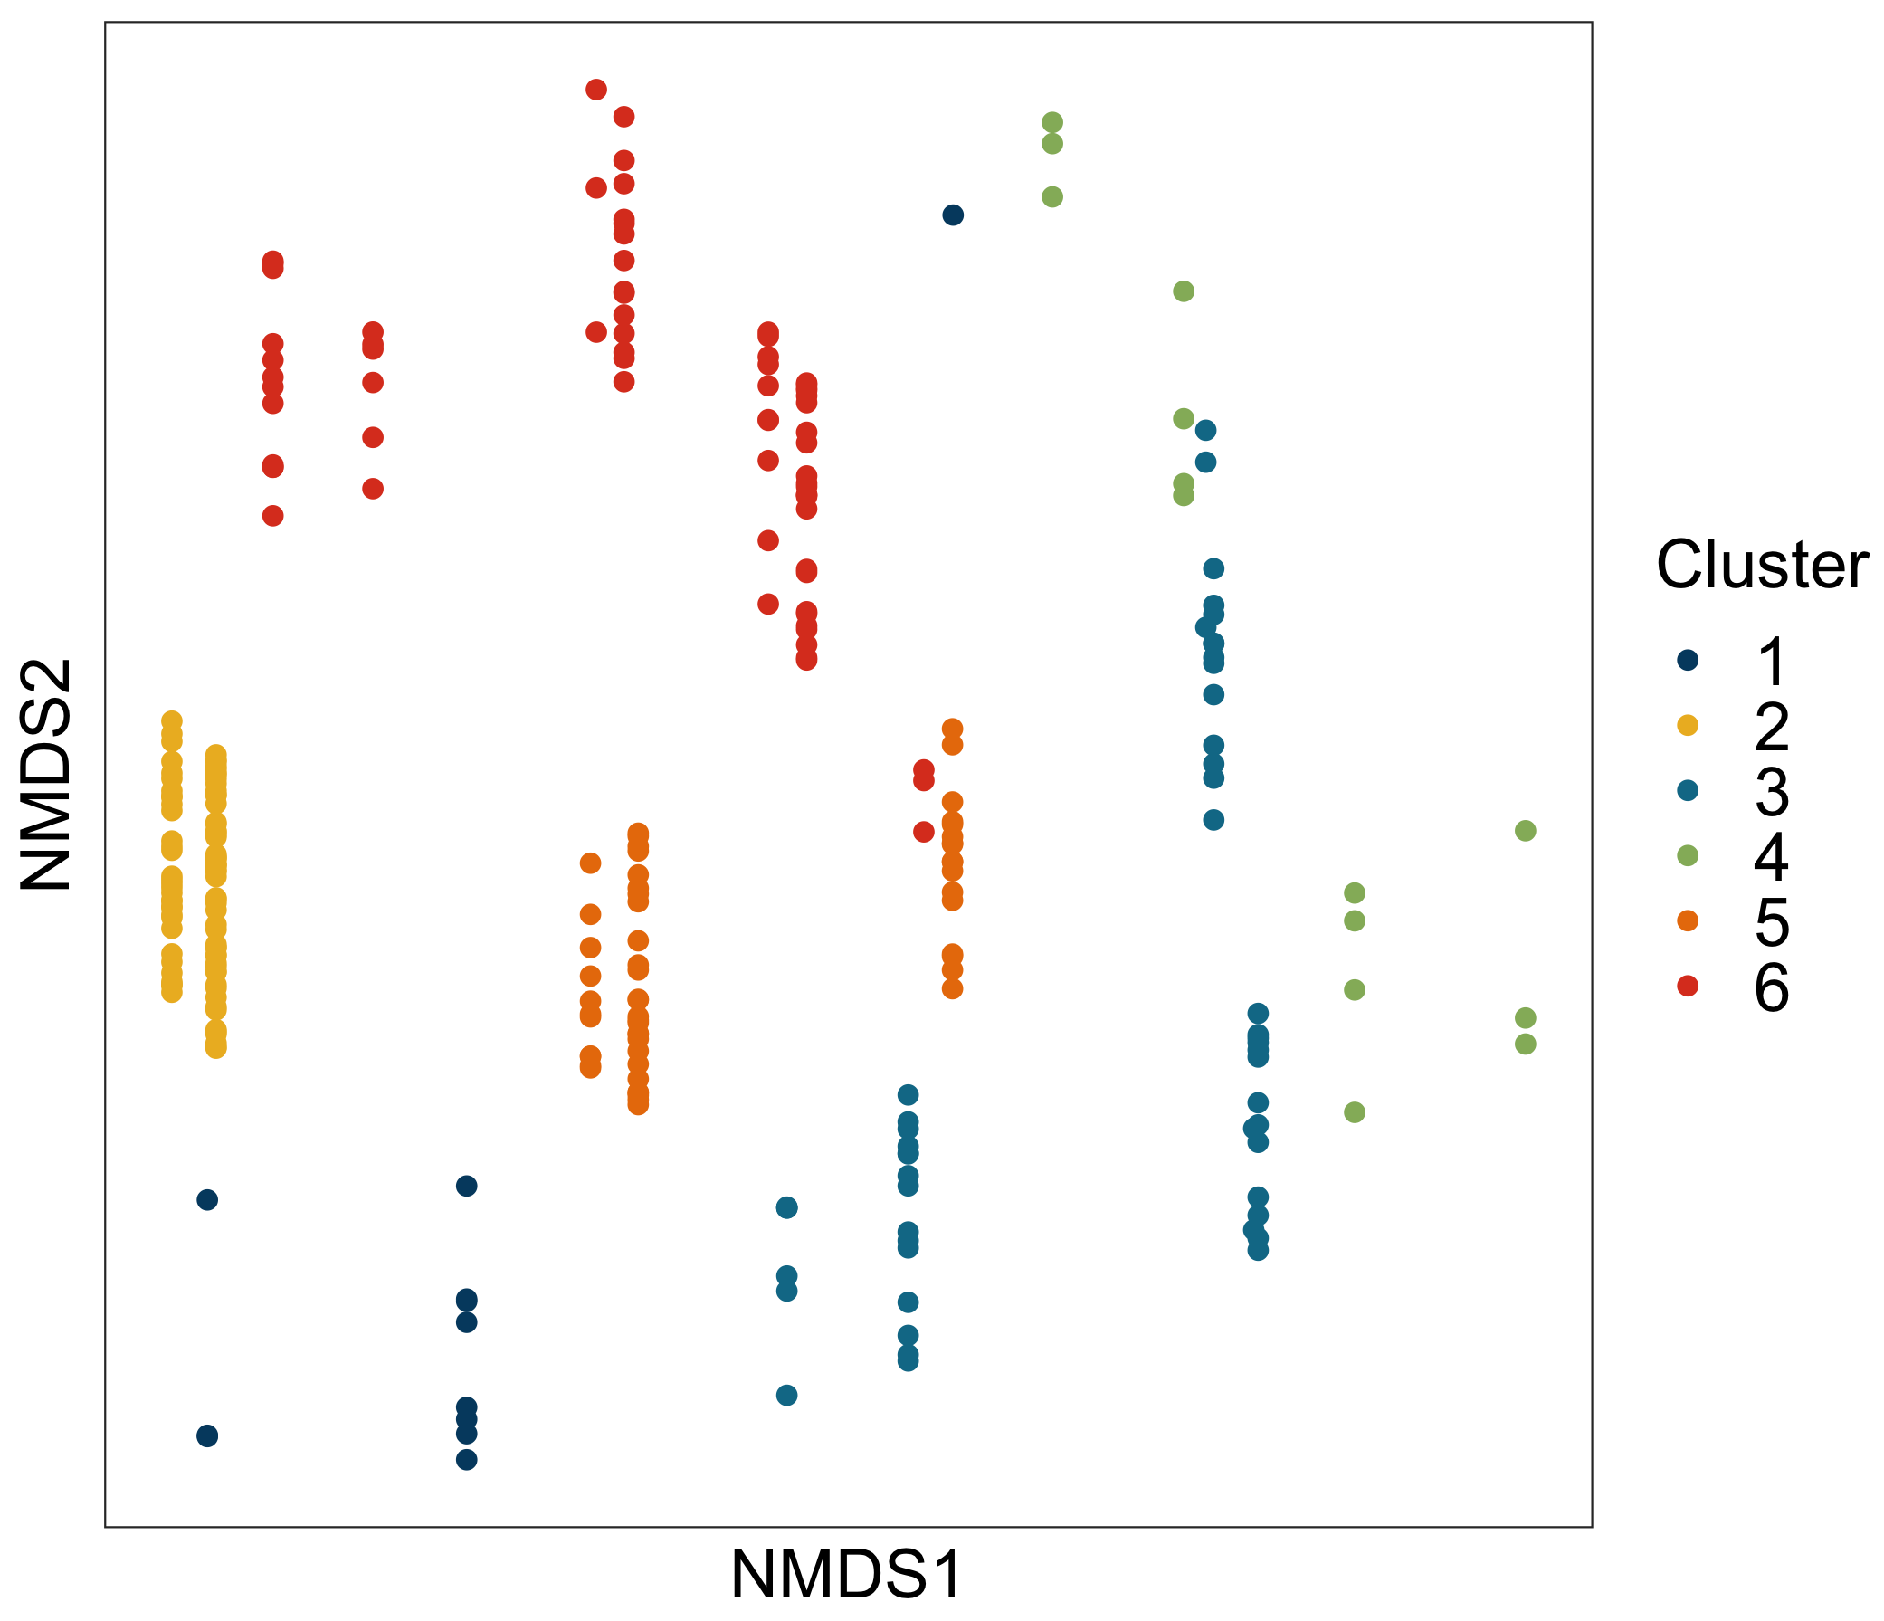
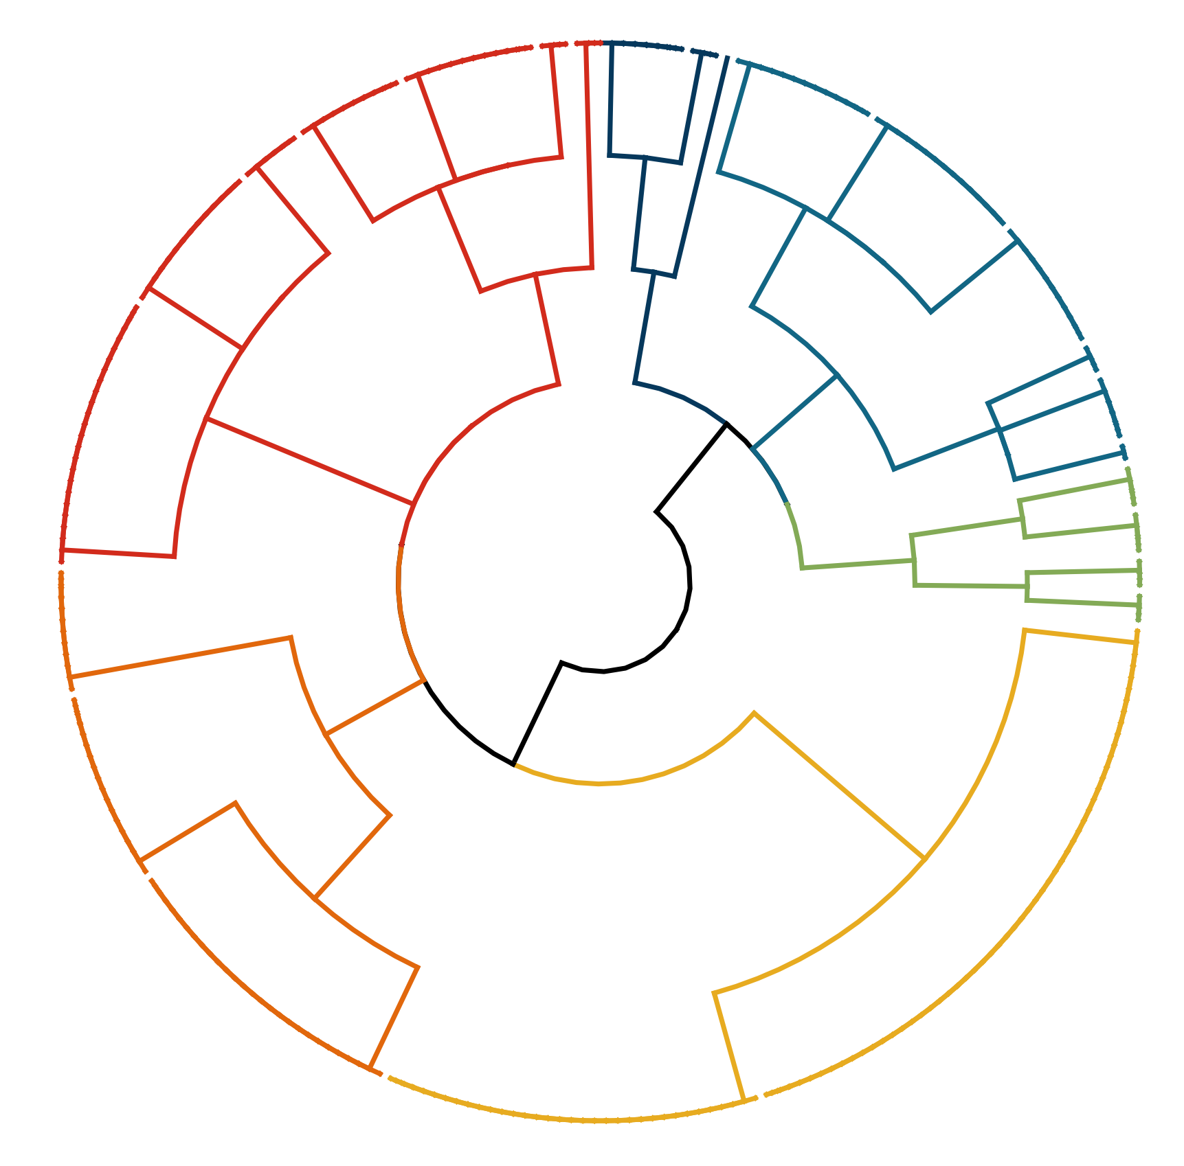
Non-diel migrant mesopelagics
(12)
a)
b)
Diel migrating continental shelf taxa
(72)
Seasonal, coast & shelf epipelagics
(53)
1
6
3
4
Coast & shelf demersals
(14)
5
2
Diel migrating, oceanic epipelagics
(55)
Diel migrating mesopelagic
(88)
Notes:
USE!!! PROBABLE TRAITS, k = 8, DIVISIVE with NMDS PLOT

