Slide 1
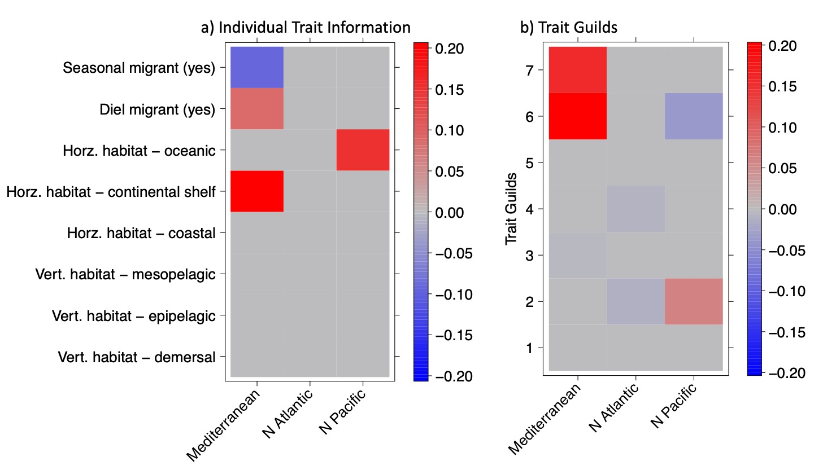
Trait Guild Key:
7 = resident continental shelf
6 = seasonal continental shelf
5 = oceanic epipelagics
4 = coastal & shelf demersals
3 = coastal & shelf epipelagics
2 = diel migrating mesolpelagics
1 = non-diel migrating mesopelagics

