Slide 1
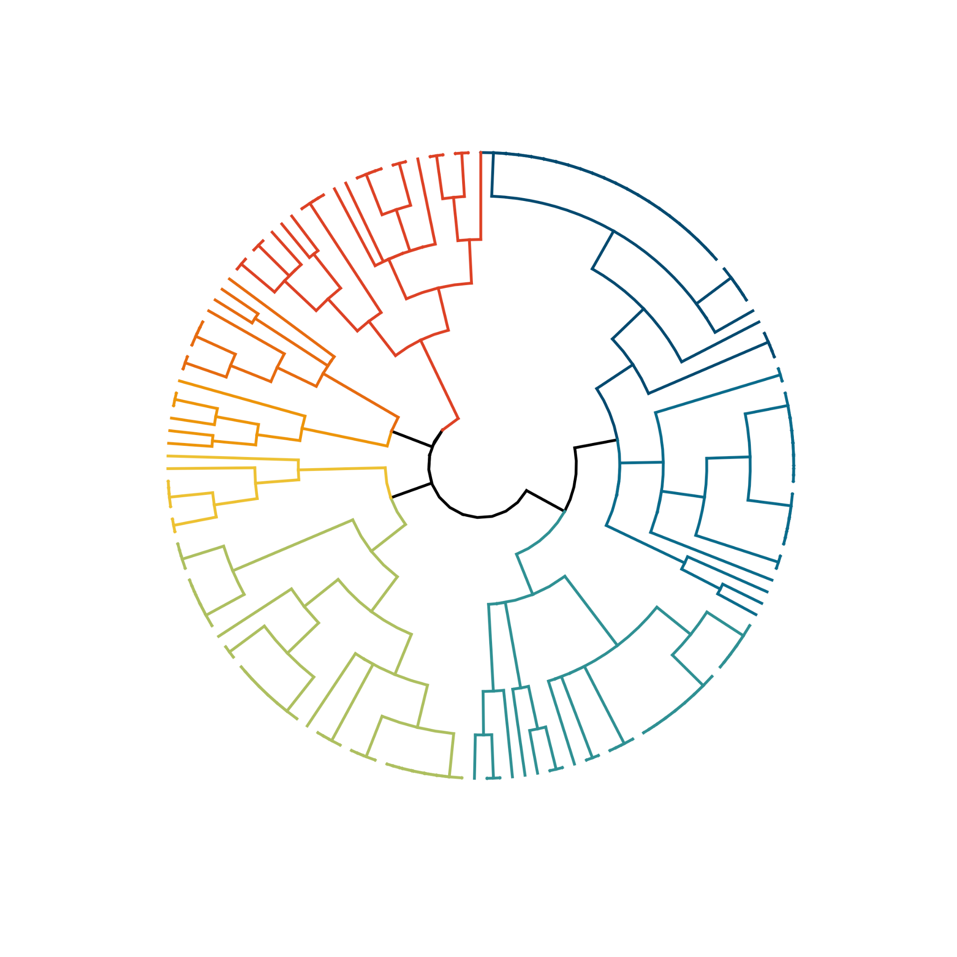
Juvenile, seasonal shelf & coastal spp.
Adult, schooling, seasonal, diel migrant, mesopelagic spp.
Adult, schooling, seasonal & shelf spp.
8
6
1
Adult, solitary, resident & benthic spp.
2
8
7
Juvenile, oceanic, pelagic, schooling, seasonal & diel migrant spp.
Juvenile, seasonal, schooling & coastal epipelagic spp.
3
5
Shelf & coastal, schooling, seasonal, diel migrant spp.
Oceanic, mesopelagic, diel migrant spp.
Notes:
USE!!! PROBABLE TRAITS, k = 8, DIVISIVE

Slide 2
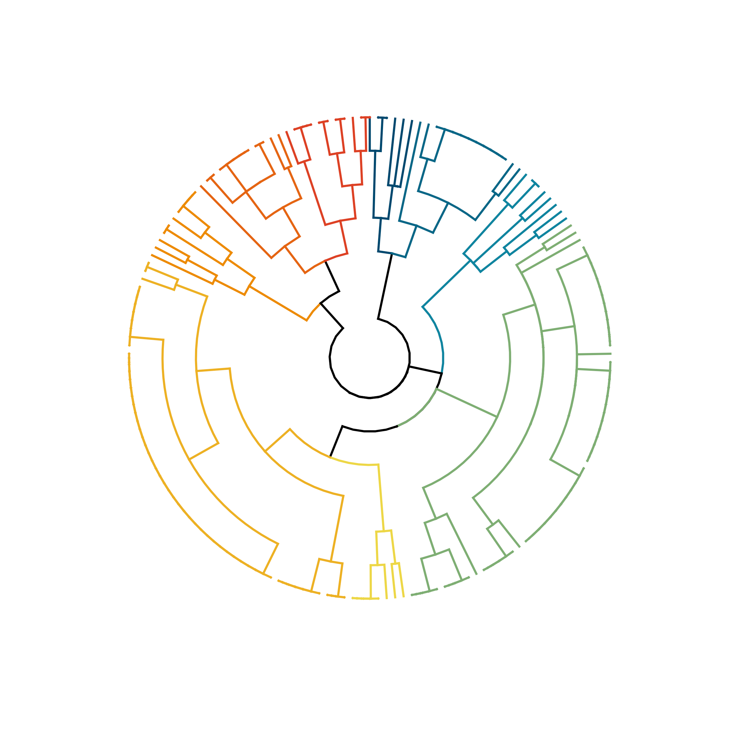
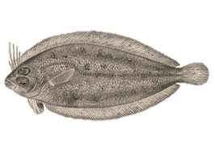
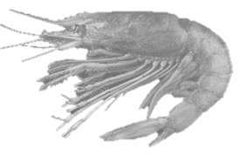
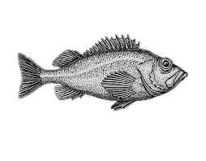
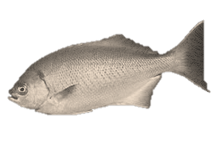
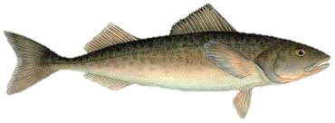
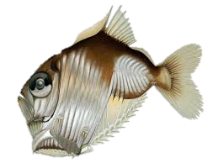
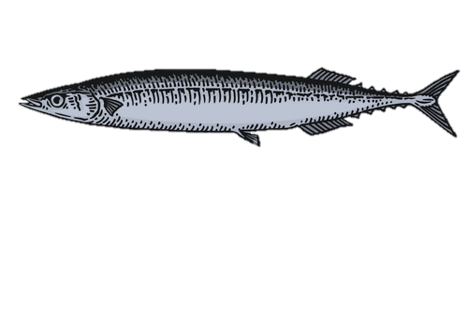
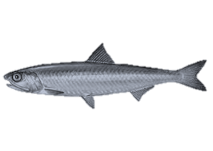
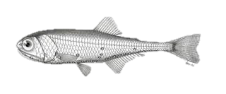
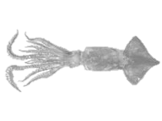
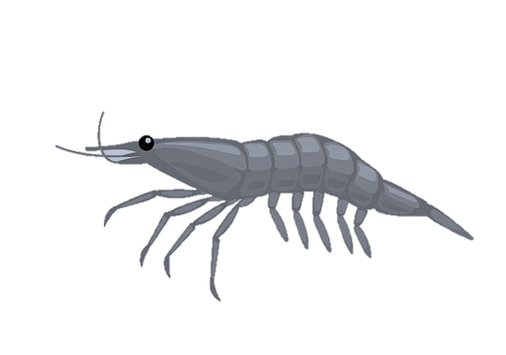
Albacore prey cluster dendrogram – adult habitat use + gregarious (binary) traits – agglomerative (average k = 9) Jul 2020
Solitary, benthic reef to shelf residents
Schooling continental slope, diel & seasonal migrants
Schooling, demersal reef to shelf demersal residents
Schooling shelf & coast, diel migrant & demersal
Solitary shelf & offshore non-migratory epipelagics
9
4
5
Solitary & seasonal, diel migrant, benthic reef to shelf
8
6
3
1
2
Schooling, migratory and seasonal shelf to offshore epipelagics
Schooling offshore mesopelagic diel migrants
7
Schooling shelf epi-mesopelagic, diel migrants
Notes:
ADULT TRAITS, k = 9, old version

Slide 3
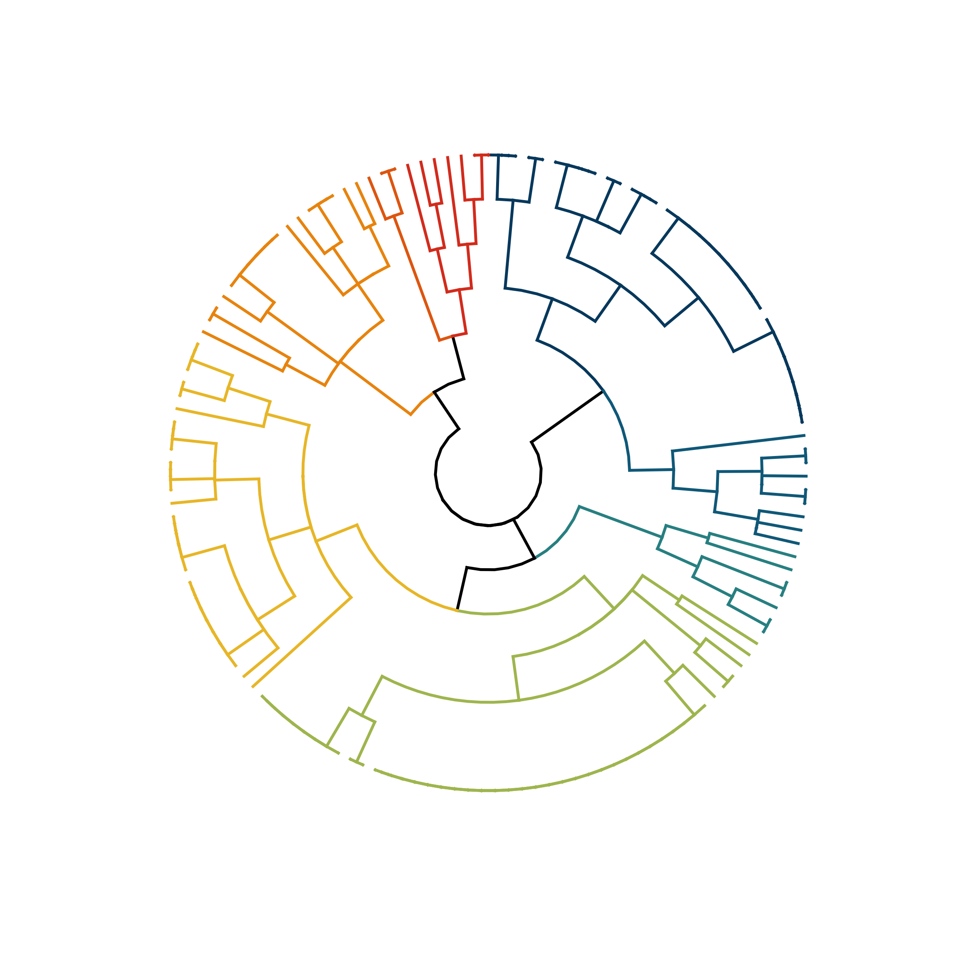
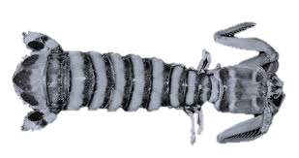
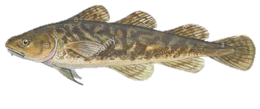
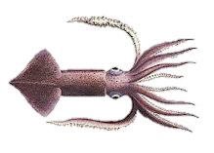
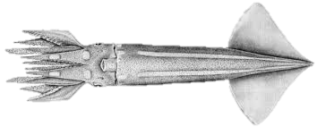
Benthic continental shelf diel migrants
Solitary, benthic reef residents
8
Schooling migratory, offshore and coastal epipelagics
Schooling, seasonal continental shelf demersal
2
4
6
5
Schooling coastal to shelf epipelagics
Schooling continental shelf diel migrants
3
7
1
Solitary shelf & offshore epipelagics
Schooling, diel migrant offshore mesopelagics
Notes:
PROBABLE TRAITS, k = 8, old version

Slide 4
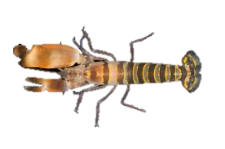
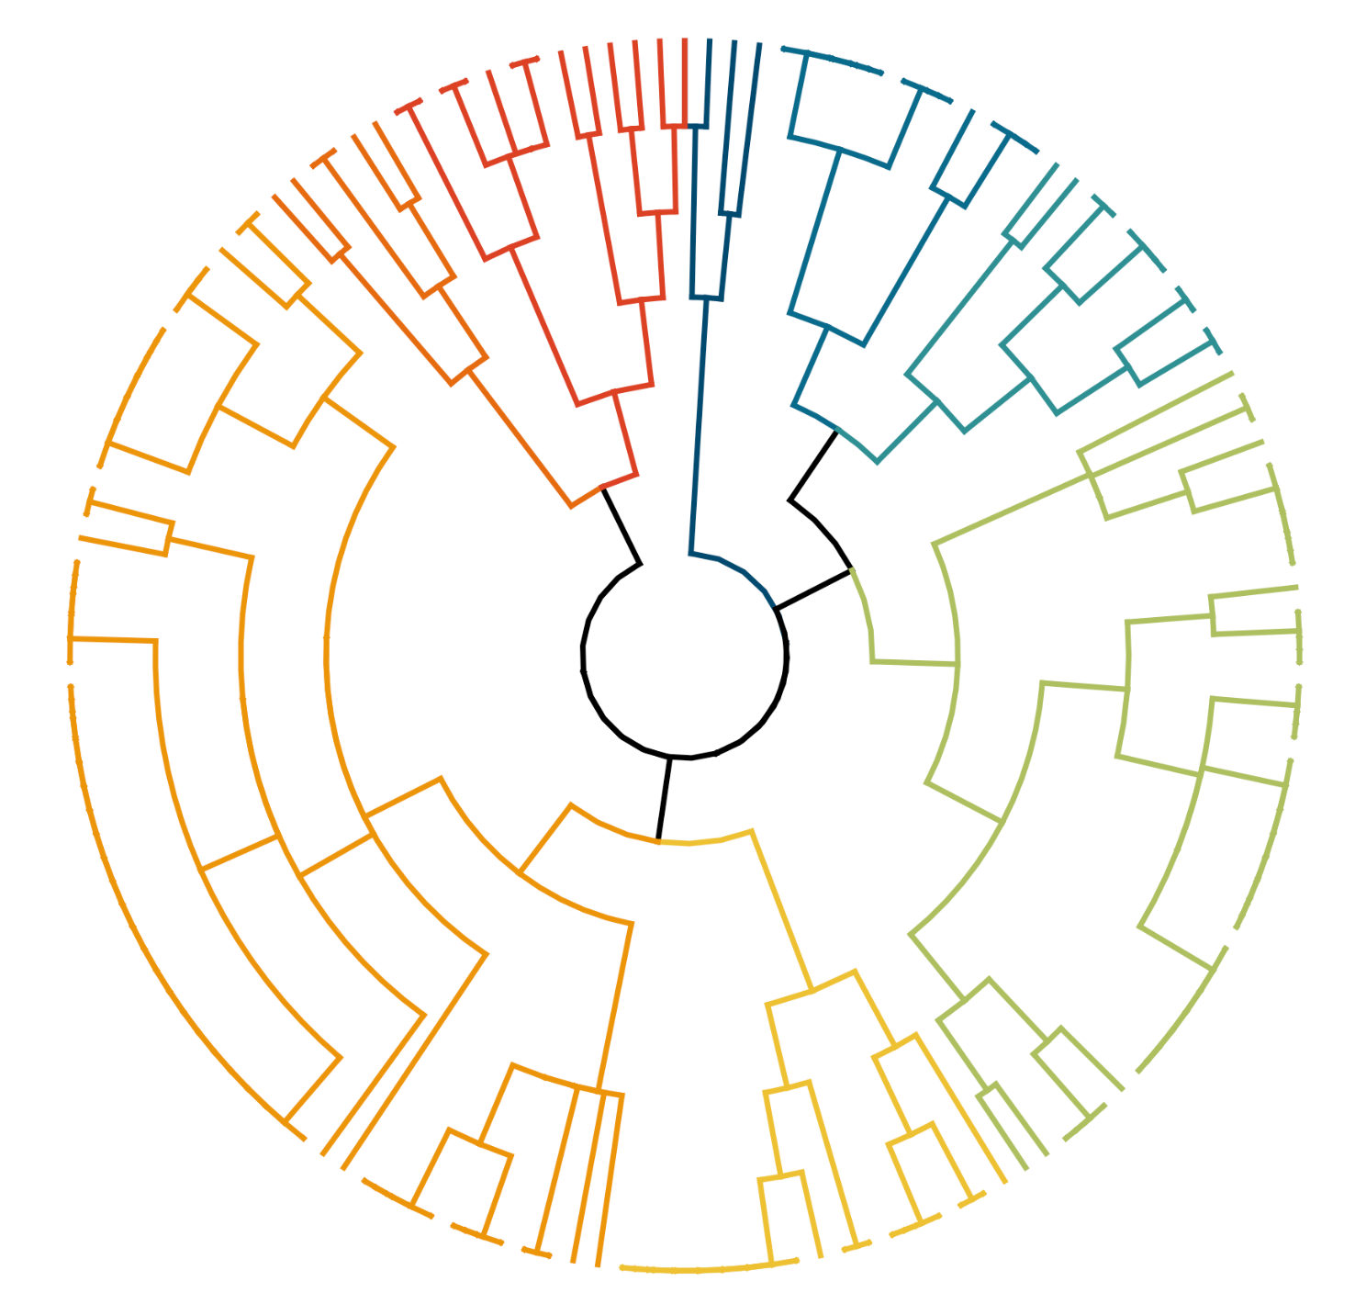
Benthic, adult, resident spps.
Coastal & shelf, schooling and juvenile resident spp.
4
Schooling migratory, offshore and coastal epipelagics
2
6
5
Schooling, seasonal, diel migrants, oceanic meso- & epipelagics
Schooling coastal to shelf epipelagics
1
7
8
Solitary shelf & offshore epipelagics
1
Schooling, diel migrant offshore mesopelagics
DO NOT USE – issue with clusters participants
Schooling continental shelf diel migrants
Notes:
PROBABLE TRAITS, k = 8, AGGLOMERATIVE

