Slide 1
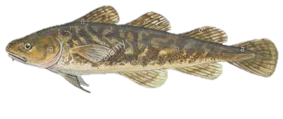
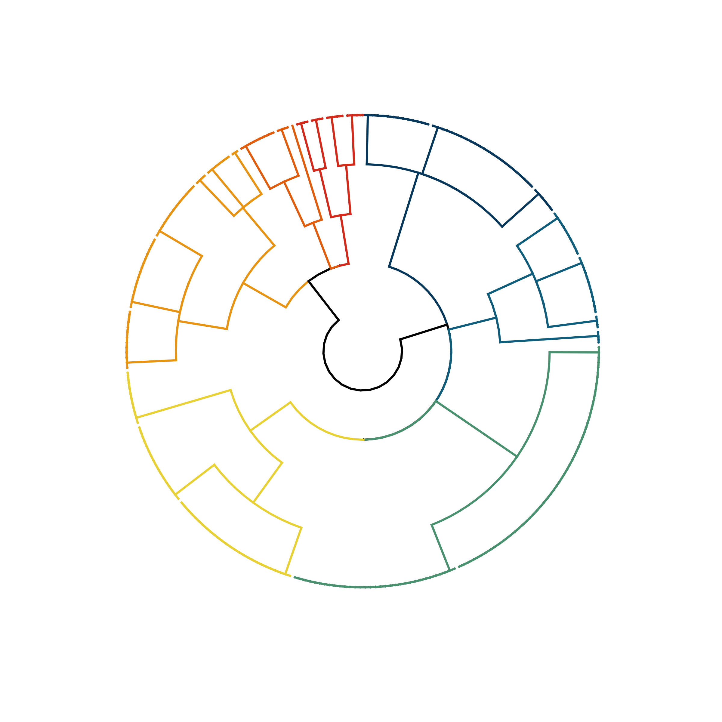
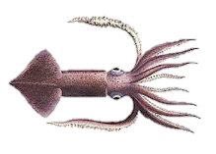
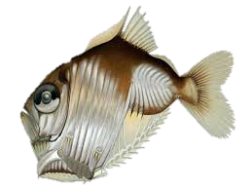
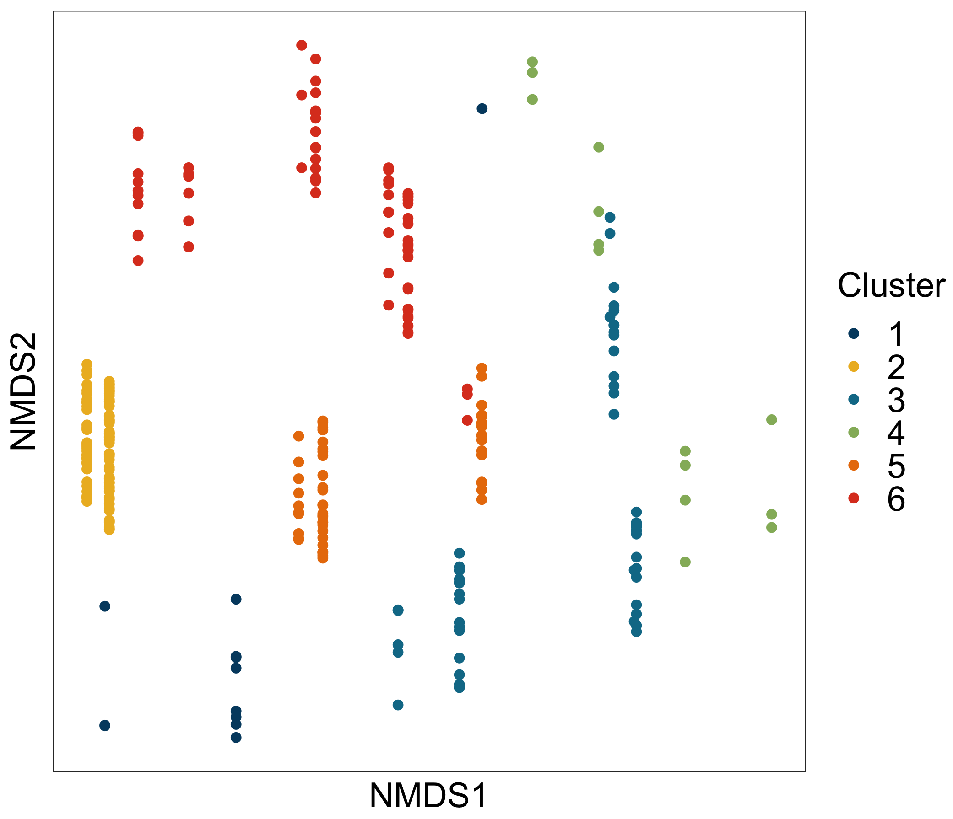
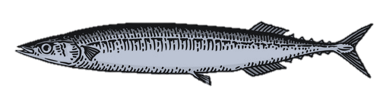
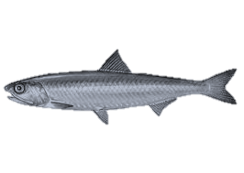
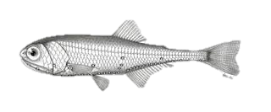
a)
Coast to shelf demersals
(14)
Seasonal & diel migrant, continental shelf broad
(44)
b)
Non-diel migrant mesopelagics
(12)
6
Resident diel migrant, coast to shelf epipelagics
(28)
Seasonal & non-diel migrating coast to shelf epipelagics
(51)
7
1
4
3
5
2
Seasonal & diel migrating oceanic epipelagics
(55)
Seasonal & diel migrant, oceanic mesopelagics
(88)
Notes:
USE!!! PROBABLE TRAITS, k = 8, DIVISIVE with NMDS PLOT

Slide 2
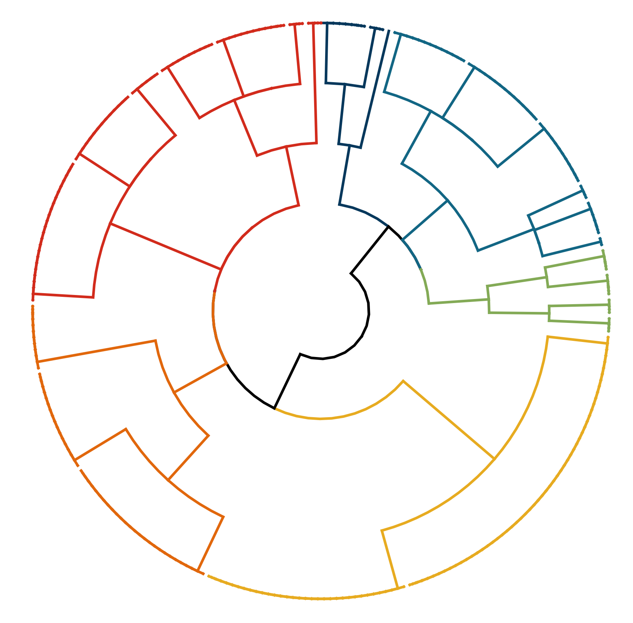
Non-diel migrant mesopelagics
(12)
a)
b)
Diel migrating continental shelf taxa
(72)
Seasonal migrant, coast to shelf epipelagics
(53)
1
6
3
4
Coast to shelf demersals
(14)
5
2
Seasonal & diel migrating coastal pelagics
(55)
Diel migrating mesopelagic
(88)
Notes:
USE!!! PROBABLE TRAITS, k = 8, DIVISIVE with NMDS PLOT

