Slide 1
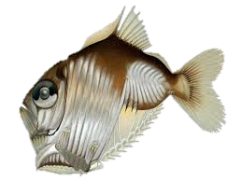
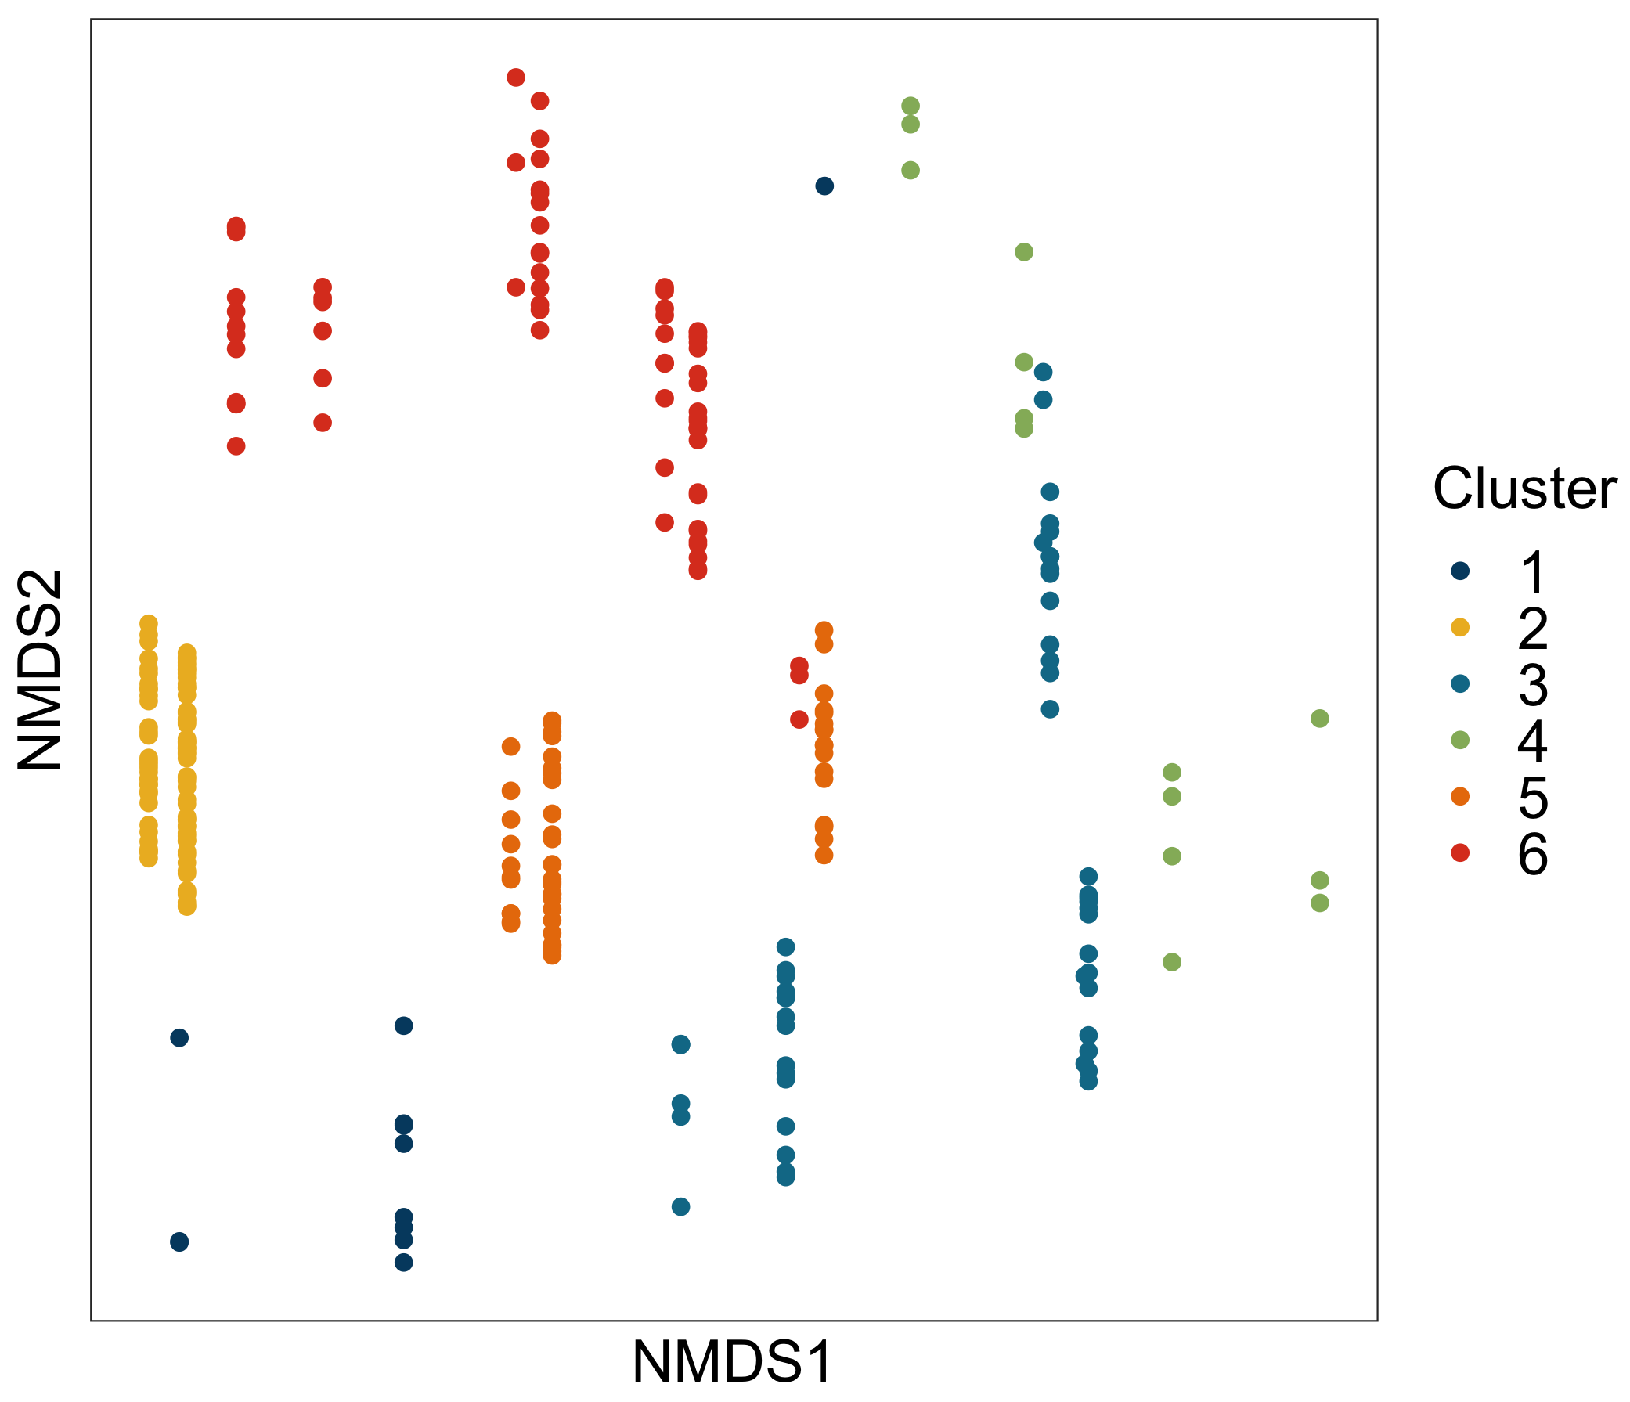
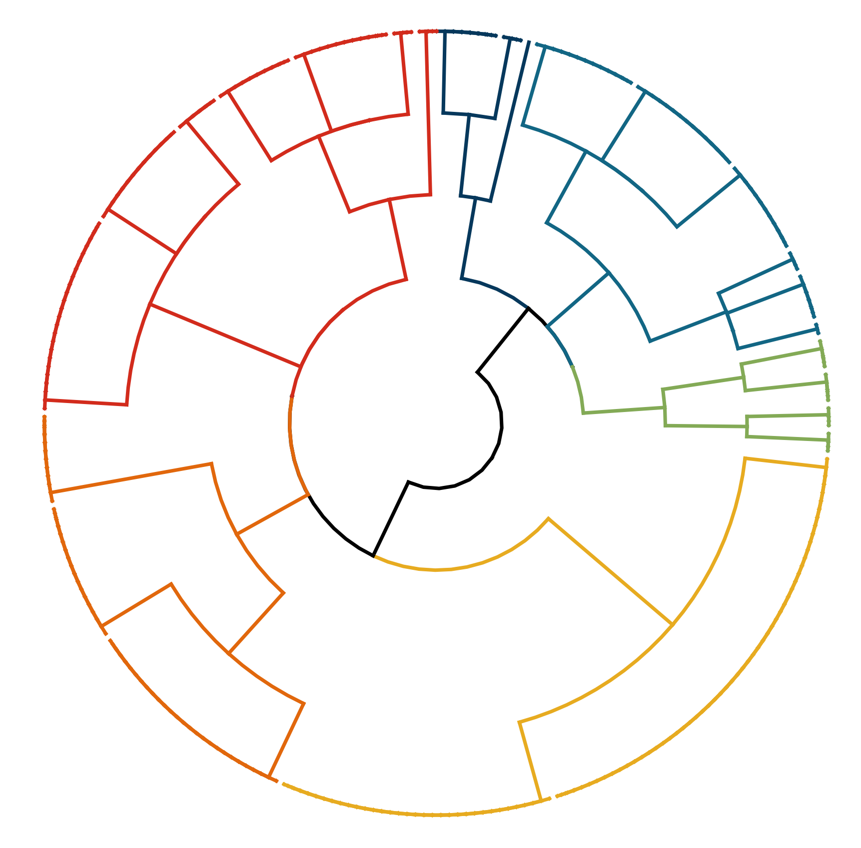
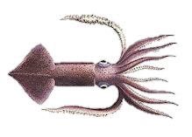
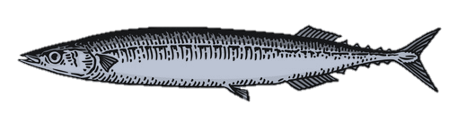
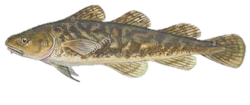
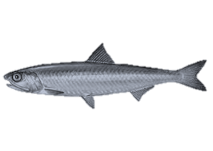
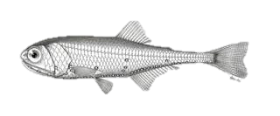
Non-diel migrant mesopelagics
(12)
a)
b)
Diel migrating continental shelf taxa
(72)
Seasonal migrant, coast to shelf epipelagics
(53)
1
6
3
4
Coast to shelf demersals
(14)
5
2
Seasonal & diel migrating coastal pelagics
(55)
Diel migrating mesopelagic
(88)
Notes:
USE!!! PROBABLE TRAITS, k = 8, DIVISIVE with NMDS PLOT

Slide 2
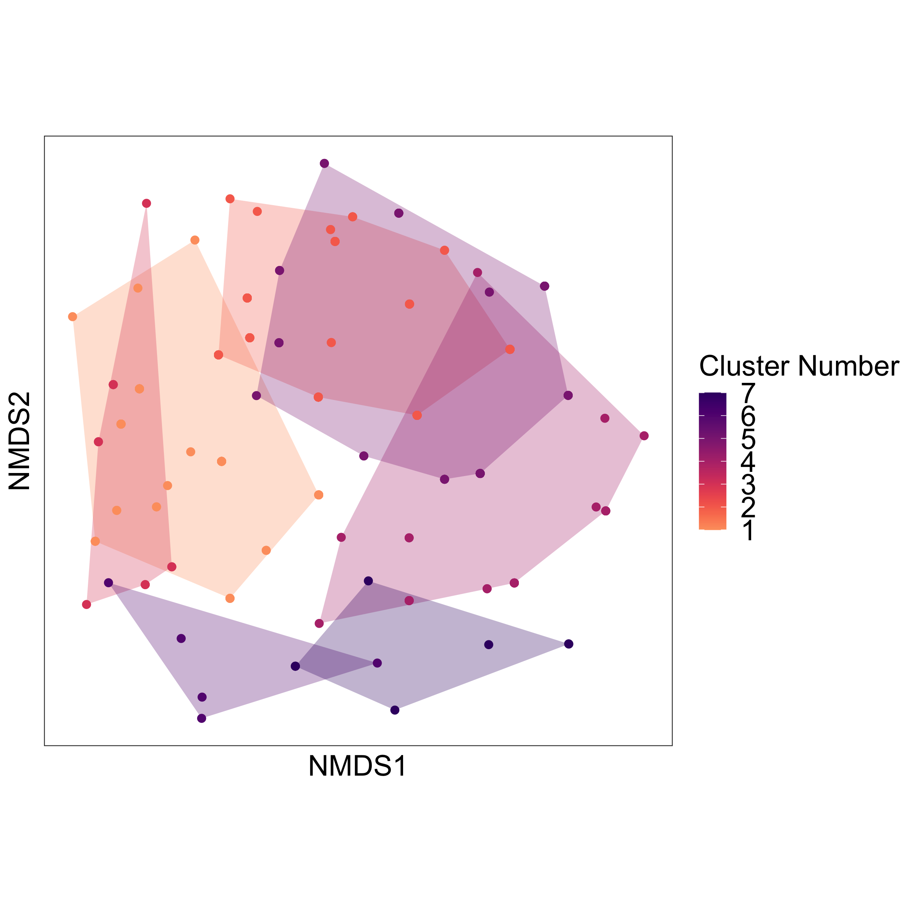
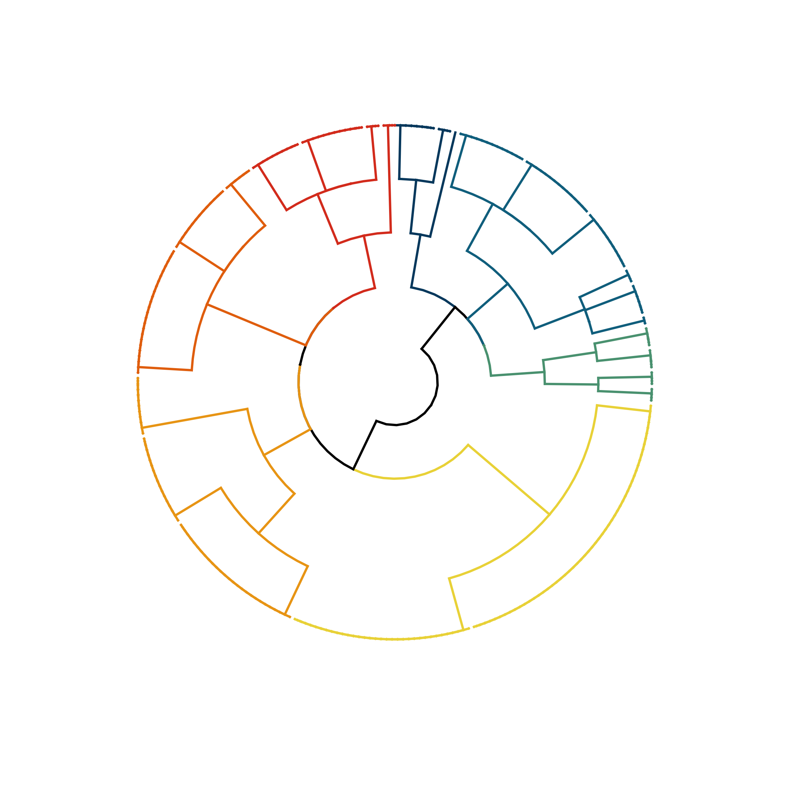
Non-diel migrant mesopelagics
(12)
a)
b)
Diel migrating continental shelf taxa
(72)
Seasonal migrant, coast to shelf epipelagics
(53)
1
6
3
4
Coast to shelf demersals
(14)
5
2
Seasonal & diel migrating coastal pelagics
(55)
Diel migrating mesopelagic
(88)
Notes:
USE!!! PROBABLE TRAITS, k = 8, DIVISIVE with NMDS PLOT

