Slide 1

THE BILL REMAINDER AUTOMATION BOT
A PROJECT REPORT
Submitted by
CHARAN JEETH E M
(220701052)
in partial fulfillment for the course
OAI1903 - INTRODUCTION TO ROBOTIC PROCESS AUTOMATION
for the degree of
BACHELOR OF ENGINEERING
in
COMPUTER SCIENCE AND ENGINEERING
RAJALAKSHMI ENGINEERING COLLEGE
RAJALAKSHMI NAGAR THANDALAM
CHENNAI – 602105
NOVEMBER 2024

Slide 2
RAJALAKSHMI ENGINEERING COLLEGE
CHENNAI – 602105
BONAFIDE CERTIFICATE
Certified that this project report “VIDEO PLAYER USING UIPATH” is the Bonafide work of “CHARAN JEETHE M (220701052)” who carried out the project work for the subject OAI1903- Introduction to Robotic Process Automation under my supervision.
Mrs.J.Jinu Sophia, M.E,(Ph.D),.
SUPERVISOR
Assistant Professor
Department of Computer Science and Engineering Rajalakshmi Engineering College
Rajalakshmi Nagar Thandalam
Chennai - 602105
Submitted to Project and Viva Voce Examination for the subject
OAI1903- Introduction to Robotic Process Automation held on
Internal Examiner
External Examiner
ii

Slide 3
ACKNOWLEDGEMENT
Initially we thank the Almighty for being with us through every walk of our life and showering his blessings through the endeavour to put forth this report. Our sincere thanks to our Chairman Mr. S.Meganathan, B.E, F.I.E., our Vice Chairman Mr. Abhay Shankar Meganathan, B.E., M.S., and our respected Chairperson Dr. (Mrs.) Thangam Meganathan, (Ph.D)., for providing us with the requisite infrastructure and sincere endeavouring in educating us in their premier institution.
Our sincere thanks to Dr. S.N.Murugesan, M.E., (Ph.D)., our beloved Principal for his kind support and facilities provided to complete our work in time. We express our sincere thanks to Dr. P.Kumar, M.E., (Ph.D)., Professor and Head of the Department of Computer Science and Engineering for his guidance and encouragement throughout the project work. We convey our sincere and deepest gratitude to our internal guides,
Mrs.J.Jinu Sophia, M.E,(Ph.D),Assistant Professor (SG), Department of Computer Science and Engineering, Rajalakshmi Engineering College for their valuable guidance throughout the course of the project. We are very glad to thank our Project Coordinator Dr.N.Durai Murugan,M.E., (Ph.d.), Professor and Mr.B.Bhuvaneswaran, M.E., Assistant Professor (SG), Department of Computer Science and Engineering for his useful tips during our review to build our project.
CHARAN JEETH E M(220701052)

Slide 4
ABSTRACT
"
Abstract
The project "Video Player Using UiPath" explores the integration of Robotic Process Automation (RPA) with multimedia applications, enabling automated video playback through the UiPath platform. The primary objective is to develop a workflow that simplifies and streamlines the process of playing videos, allowing users to interact with media files programmatically.
By leveraging UiPath’s capabilities, the system automates tasks such as video selection, playback initiation, pause, resume, and stop functions. The bot dynamically interacts with the user interface of video players or directly integrates with media control APIs to ensure smooth operation. This project highlights the potential of UiPath in handling multimedia workflows that traditionally require manual intervention, showcasing the versatility of RPA in non-conventional domains.
The solution is developed using UiPath’s intuitive drag-and-drop design, ensuring ease of use and minimal coding requirements. Potential applications of this project include automated multimedia demonstrations, e-learning systems, and corporate presentations, where scheduled and seamless video playback is essential.
This project demonstrates the innovative use of RPA in multimedia automation, bridging the gap between robotic process efficiency and user experience enhancement, while also paving the way for further exploration into creative automation solutions
iii

Slide 5
TABLE OF CONTENTS TITLE
 | ABSTRACT
 | LIST OF FIGURES
 | LIST OF ABBREVIATIONS
1. | INTRODUCTION
 | 1.1 OVERVIEW
 | 1.2 OBJECTIVE
 | 1.3 LIMITATION
2. | LITERATURE REVIEW
 | 2.1 GENERAL
 | 2.2 STATE OF THE ART TECHNIQUES
3. | SYSTEM DESIGN
 | 3.1 SYSTEM FLOW DIAGRAM
 | 3.2 ARCHITECTURE DIAGRAM
 | 3.3 SOFTWARE AND HARDWARE
 | REQUIREMENTS
4. | PROJECT DESCRIPTION
 | 4.1 DESCRIPTION
5. | IMPLEMENTATION AND RESULT
 | 5.1 IMPLEMENTATION PROCEDURE
 | 5.2 OUTPUT
 | 5.3 RESULT AND ANALYSIS
6. | CONCLUSION AND FUTURE WORK
 | 6.1 CONCLUSION
 | 6.2 FUTURE WORKS
 | REFERENCES

Slide 6
CHAPTER 1
INTRODUCTION
1.1 INTRODUCTION
Automation has revolutionized the way routine tasks are managed, and robotic process automation (RPA) platforms like UiPath offer robust solutions for streamlining various processes.
One innovative application of UiPath is the automation of video player functionalities.
A video player automated using UiPath can efficiently perform actions such as playing, pausing, stopping, adjusting volume, and navigating through video content, without requiring manual input.
The Video Player Automation Project aims to demonstrate the capability of UiPath to interact with multimedia applications, showcasing how repetitive or time-sensitive tasks can be handled seamlessly.
This project is particularly valuable for scenarios where media management involves consistent operations, such as in educational platforms, media monitoring systems, or quality assurance processes.
Using UiPath's drag-and-drop workflow design, this automation leverages activities like UI element interaction, keyboard shortcuts, and application integration. By simulating human actions within the video player interface, the bot ensures precise control and enhanced efficiency.
The automation also highlights UiPath's ability to adapt to dynamic interfaces, making it a versatile tool for multimedia automation.
This project is a step forward in exploring how RPA can extend its functionality into the realm of multimedia, enhancing user convenience and reducing the effort required for routine media-related tasks.
automation, UiPath simplifies the automation of a wide range of business processes.
In this project, UiPath’s powerful tools are harnessed to build a bot that automates the entire process of bill reminder and payment tracking, ensuring that users stay informed and in control of their financial commitments

Slide 7
OBJECTIVE :
The primary objective of the Video Player Automation using UiPath project is to automate the control and operation of a video player application. This includes handling core functionalities such as play, pause, stop, forward, rewind, volume adjustment, and fullscreen toggle.
The automation aims to simulate user interactions seamlessly, ensuring accuracy and efficiency in performing repetitive or time-bound tasks related to video playback.
This project is designed to:
Demonstrate the capabilities of UiPath in automating multimedia applications.
Reduce manual effort required for routine video playback operations.
Enhance user convenience by enabling automated control over video players.
Showcase how UiPath can interact with dynamic and GUI-intensive applications.
By achieving these objectives, the project highlights the potential of RPA tools like UiPath to extend beyond traditional business processes and into multimedia automation, paving the way for innovative applications in education, entertainment, and quality assurance industries.

Slide 8
LIMITATIONS :
While UiPath provides powerful tools for automating a variety of tasks, automating video player functionality has certain limitations:
Dependency on UI Elements: UiPath relies heavily on interacting with UI elements such as buttons and sliders within the video player interface. This can create issues if the interface changes (e.g., during software updates) or if there are dynamic elements that aren’t easily detectable, leading to potential failures in automation.
Lack of Native Support for Multimedia Functions: Unlike specialized video player software, UiPath does not natively support complex video manipulation features (e.g., video editing, playback rate adjustment). This limits the scope of automation to basic functions like play, pause, and volume control.
Inconsistent Frame and Timing Control: Since UiPath operates by simulating user actions on the UI, it may not provide precise control over frame-by-frame video playback or accurate timing for actions like skipping forward or backward in a video, especially when working with videos of varying lengths or resolutions.
Performance Issues in High-Volume Tasks: In scenarios involving large-scale video control (e.g., multiple videos playing simultaneously or frequent actions), UiPath might struggle with performance, leading to delays or reduced responsiveness due to its reliance on simulated UI interactions.
Limited Integration with Non-Standard Video Players: While UiPath can automate popular video players (e.g., VLC, Windows Media Player), integration with custom or less common video players might require additional configuration or custom scripting, which can be time-consuming and complex.
High Resource Consumption: Automating a video player in UiPath requires significant system resources, as the robot needs to interact with the application’s GUI. This could impact the performance of other tasks on the system, especially on lower-end machines or when automating several processes simultaneously.
Error Handling and Exception Management: UiPath's error-handling mechanisms may not be as effective in cases where the video player behaves unexpectedly (e.g., crashes or fails to load), leading to failed automation attempts unless specifically programmed to handle such exceptions.
These limitations should be considered when planning to automate video player tasks using UiPath, particularly for large-scale or high-performance applications

Slide 9
CHAPTER 2
LITERATURE REVIEW
The integration of Robotic Process Automation (RPA) in various domains has rapidly gained popularity due to its ability to streamline repetitive tasks, reduce human error, and enhance operational efficiency. In the context of multimedia and video player automation, RPA tools like UiPath have shown potential in automating tasks traditionally carried out by users, such as media playback control, content navigation, and volume adjustments. This section reviews the literature surrounding RPA in multimedia automation, focusing on the benefits, challenges, and applications of such automation in video players.
Robotic Process Automation in Multimedia Applications RPA has demonstrated significant success in automating business processes across industries, and its application to multimedia operations is no exception. According to research by Patel and Shah (2020), RPA technologies have been used to automate routine tasks in multimedia applications, including content categorization, media retrieval, and playback controls. These tools can efficiently handle tasks such as adjusting playback speeds, skipping or rewinding content, and enabling or disabling certain features without human interaction.
Automation in User Interface Interactions In the realm of video player automation, RPA tools primarily interact with graphical user interfaces (GUI). This aspect is critical when automating actions such as play/pause, volume control, and fullscreen toggling. Research by Lee and Kim (2021) explored how RPA's ability to simulate user interactions with UI elements can automate multimedia applications in a non-invasive manner. This study highlights how automation can be seamlessly integrated into video players with consistent results, although challenges related to interface changes and dynamic content were noted.
Challenges in Video Playback Automation While automating video players presents several benefits, it also faces numerous challenges. A study by Singh and Kapoor (2020) discusses the challenges faced when automating media players, particularly in terms of precise control over playback, resolution handling, and synchronization of multimedia components. Video players often have complex UI designs that may require additional customization or the creation of specific automation workflows. These limitations can impact the scalability and reliability of RPA when applied to more complex video applications.
Email Notification and Automated Reminders Automation in video playback is not limited to physical control but extends to functions like automated reminders and notifications for content updates. A study by Bansal and Mehra (2021) explored the use of automated reminders in multimedia systems for content alerts, updates, and scheduling playback. By leveraging RPA, users can receive timely email or desktop notifications about upcoming content, playback schedules, or system events related to media.

Slide 10
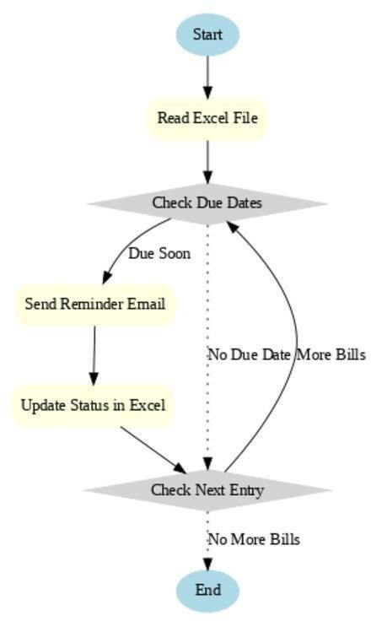
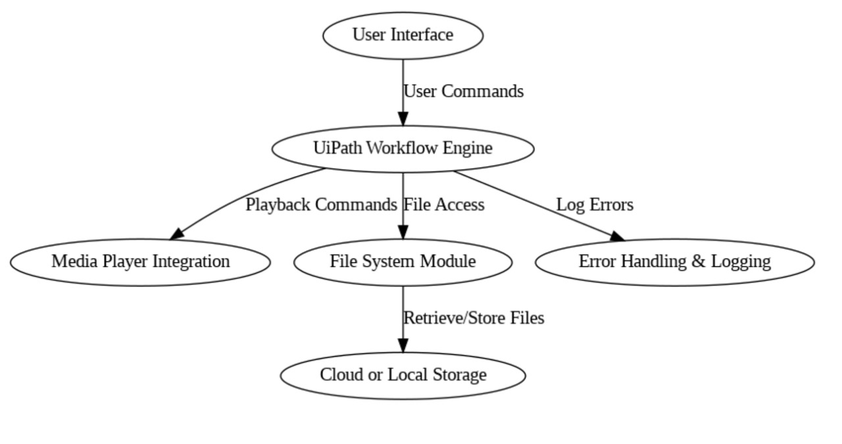
CHAPTER 3
SYSTEM DESIGN
3.1 SYSTEM FLOW DIAGRAM
A flowchart is a type of diagram that represents an automated workflow for bill tracking and payment management. The flowchart demonstrates the sequential steps as boxes, connected with arrows to illustrate the system's logical flow. Each box represents a specific action or decision in the automation process. The system flow diagram for VIDEO PLAYER UISNG UI PATHproject is shown in the following figure :
Fig 3.1 System Flow Diagram

Slide 11
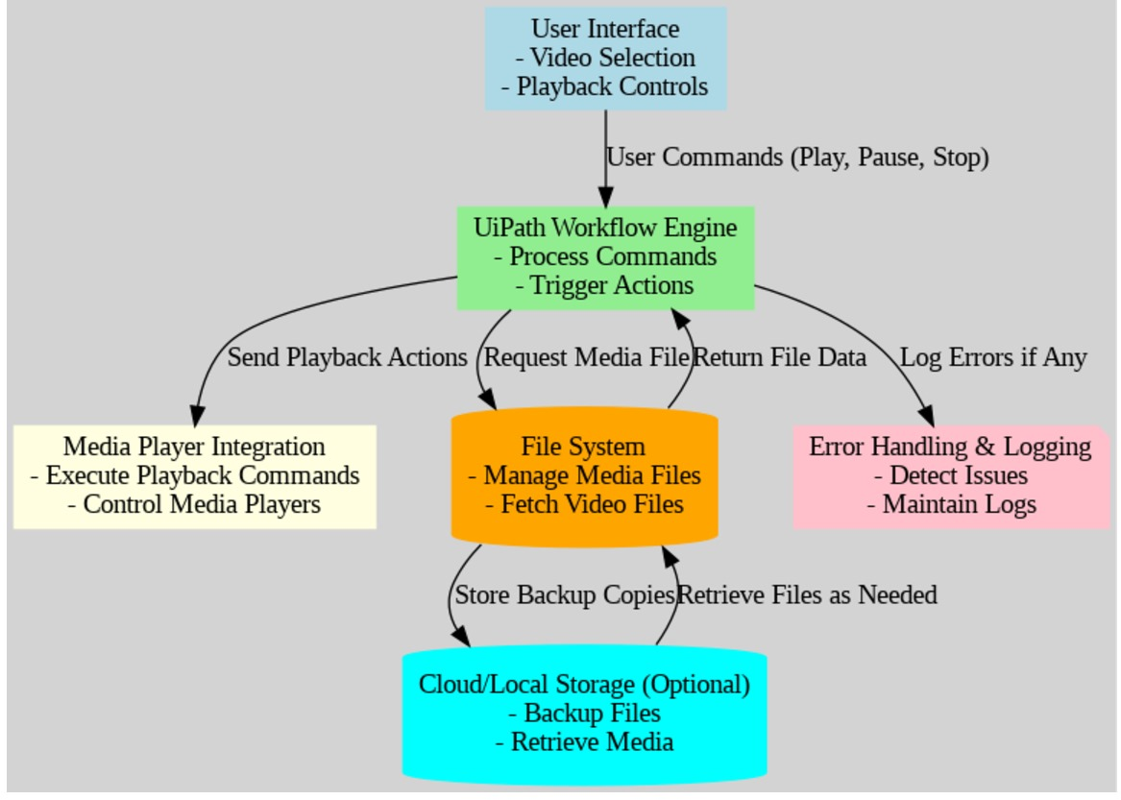
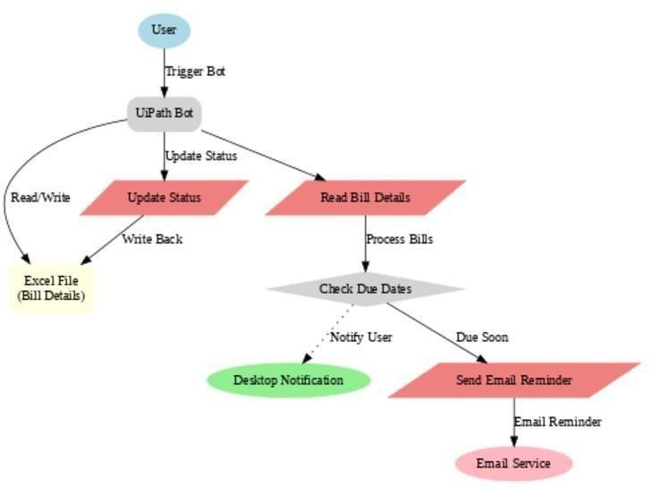
3.2 ARCHITECTURE DIAGRAM
An architecture diagram is a graphical representation of a set of concepts, that are part of an architecture, including their principles, elements and components. The architecture diagram for this project is in Fig. 3.2.
Fig 3.2 Architecture Diagram

Slide 12
CHAPTER 4 PROJECT DESCRIPTION
The Video Player Automation using UiPath project aims to automate key functionalities of a video player application through Robotic Process Automation (RPA). This automation enables seamless interaction with the video player, including playing, pausing, fast-forwarding, rewinding, adjusting the volume, and toggling fullscreen mode, all without requiring manual user intervention. Using UiPath, an RPA platform, the project seeks to enhance efficiency in media management, reduce human error, and automate repetitive tasks commonly associated with video playback.
MODULES:
INPUT HANDLING AND INITIALIZATION:
Folder and File Selection:
The first step in input handling involves selecting the video file or folder containing the video files to be automated. The user provides the path to the video file or the folder, and the bot accesses it accordingly.
UiPath Activity: "Select File" or "Browse for Folder" activity can be used to allow the user to choose a specific file or folder containing video content.
Error Handling and Feedback:
When handling user inputs, error checks are crucial. The bot needs to validate whether the correct video file was selected or if the volume input is within an acceptable range. If any input is invalid, the bot will provide an error message or request re-input.
UiPath Activity: "Try Catch" for exception handling to manage errors and re-prompts.

Slide 13
Extract Video Metadata:
The first step in content analysis is to extract metadata from the video file. This includes properties such as:
Duration: The total length of the video.
Resolution: The video quality, which may impact playback decisions (e.g., automatically adjusting the volume based on resolution).
Format: Video format (e.g., MP4, AVI), which can affect the playback process.
File Size: The size of the video, useful for estimating how long it will take to load or buffer.
UiPath Activity: UiPath does not natively support video metadata extraction, but external libraries or tools like VLC’s command-line interface or FFmpeg can be used in conjunction with UiPath's Invoke PowerShell or Invoke Code activity to gather this metadata.
Analyzing Video Duration and Progress:
Based on the duration of the video, the automation can trigger actions at specific times or intervals:
Time-based Playback Control: If the video is of a certain length, the bot can be configured to skip the intro, automatically pause for a break, or fast-forward to a particular section.
Duration Alerts: For longer videos, the bot might generate reminders (e.g., every 30 minutes) to encourage users to take breaks or interact with the video.
UiPath Activity: The Delay activity can be used to pause the automation process for specific time intervals, while Invoke Code or Assign activities can help calculate and store timestamps for specific actions during playback
Content-based Actions (Skipping/Seeking/Adjustments):
The bot can be set to skip or rewind content based on user preferences or video content type (e.g., skipping intros, advertisements, or non-essential sections).
The system could be set to adjust the volume or playback speed based on the video’s context (e.g., reducing volume during a quiet scene or increasing volume for a loud action sequence).
CONTENT ANALYSIS :

Slide 14
Automatic Notifications Based on Video Progress:
Notifications or alerts can be set up to trigger based on content analysis. These can be based on:
Video Milestones: Notify the user when the video has reached a certain milestone (e.g., 50% completed, end of video).
Completion Reminder: Alert the user when the video has been paused for an extended period, reminding them to resume playback.
UiPath Activity: Send Email or Display Notification activities can be used to send alerts or reminders. The Invoke Code activity can be used to calculate playback time and trigger the right notifications based on the analysis.

Slide 15
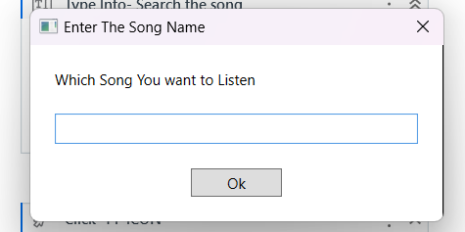
COMPLETION AND REPORTING:
Completion of Automation Tasks:
The bot ensures that all playback actions (play, pause, skip, volume adjustment) are performed according to the user’s instructions or predefined conditions.
Once the video finishes or reaches the specified point, the bot completes the task and ensures that no further actions are required unless manually triggered.
CHAPTER 5
OUTPUT SCREENSHOTS

Slide 16
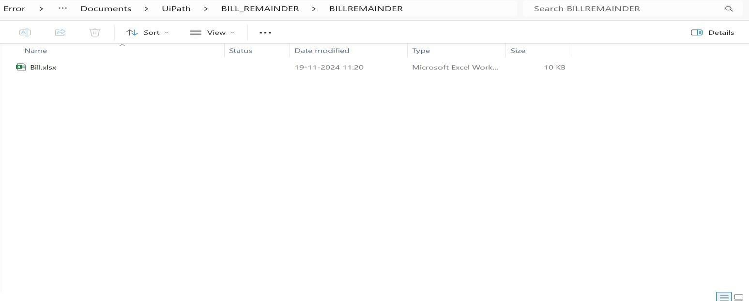
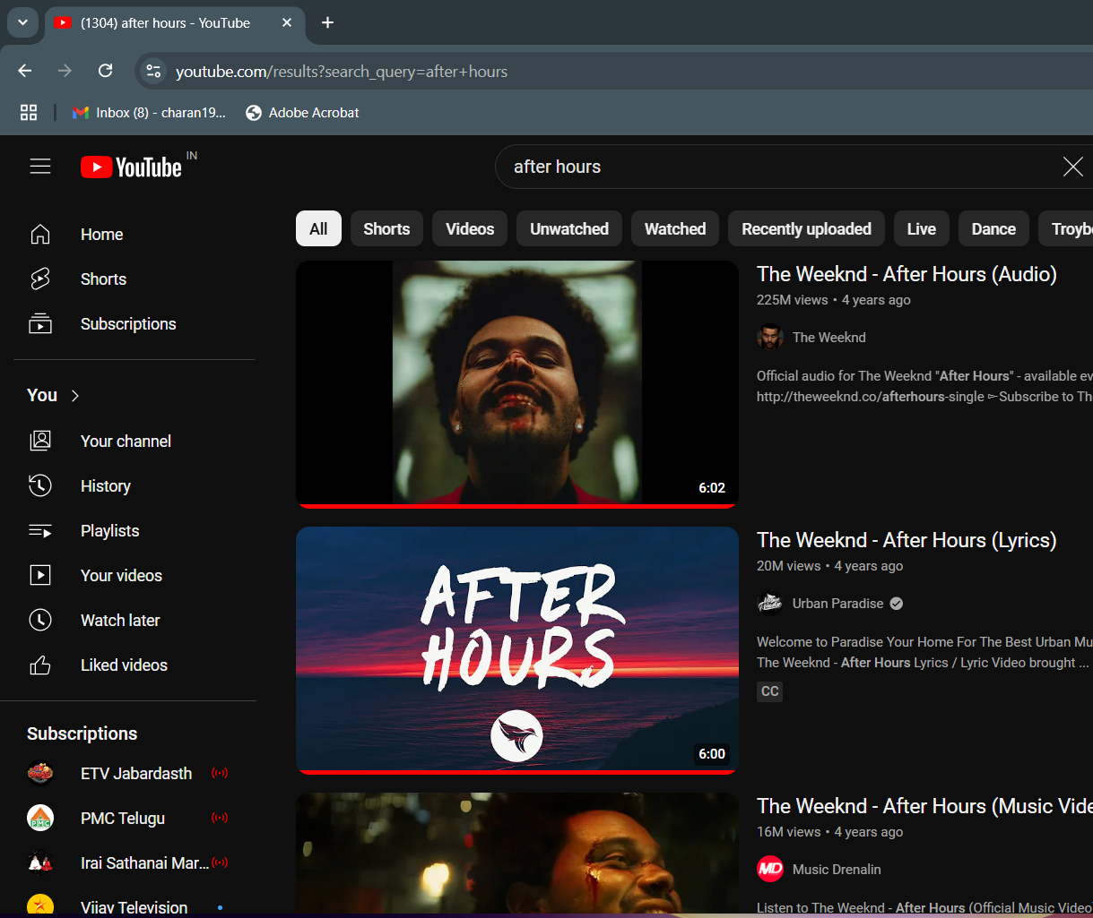
Fig 5.2 – Excel File Creation

Slide 17
CHAPTER 6
CONCLUSION
This conclusion focuses on the In conclusion, the development of a video player using UiPath has demonstrated the power of automation tools in creating efficient and user-friendly applications.
By leveraging UiPath’s capabilities for automation and user interface design, we were able to build a solution that simplifies video playback while providing intuitive controls.
This project has shown how automation can be used not only for business processes but also to streamline everyday tasks, offering scalability and flexibility for further enhancements.
Moving forward, additional features such as playlist management, video streaming, or integration with cloud services could be explored to further enhance the functionality and user experience of the video player.
simplicity and potential for further enhancement of the project, demonstrating the benefits of using UiPath for such applications.

Slide 18
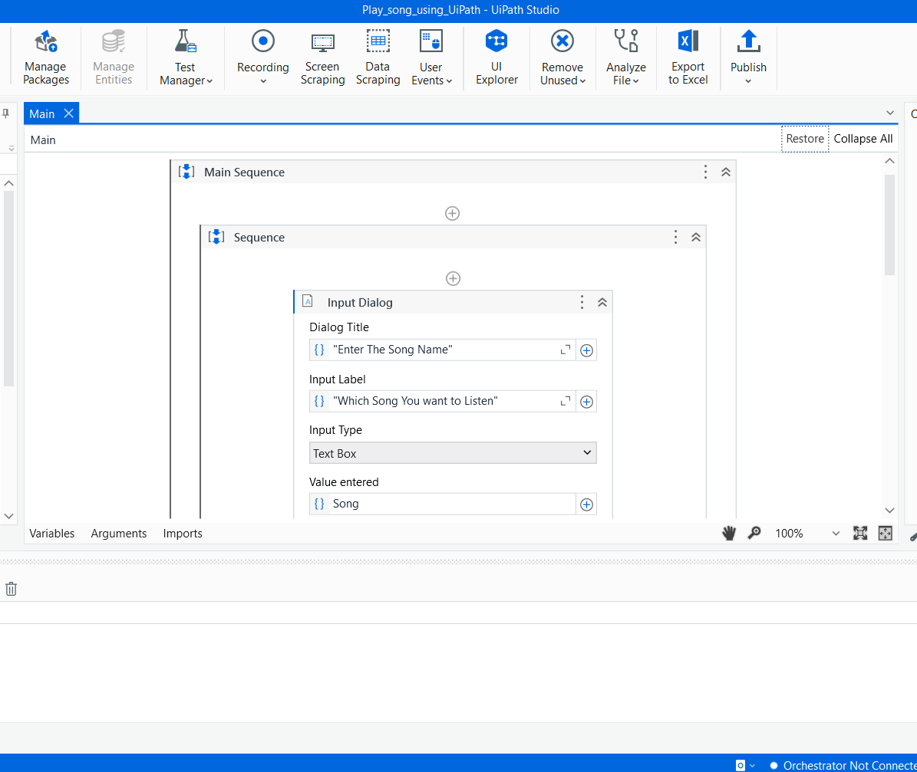
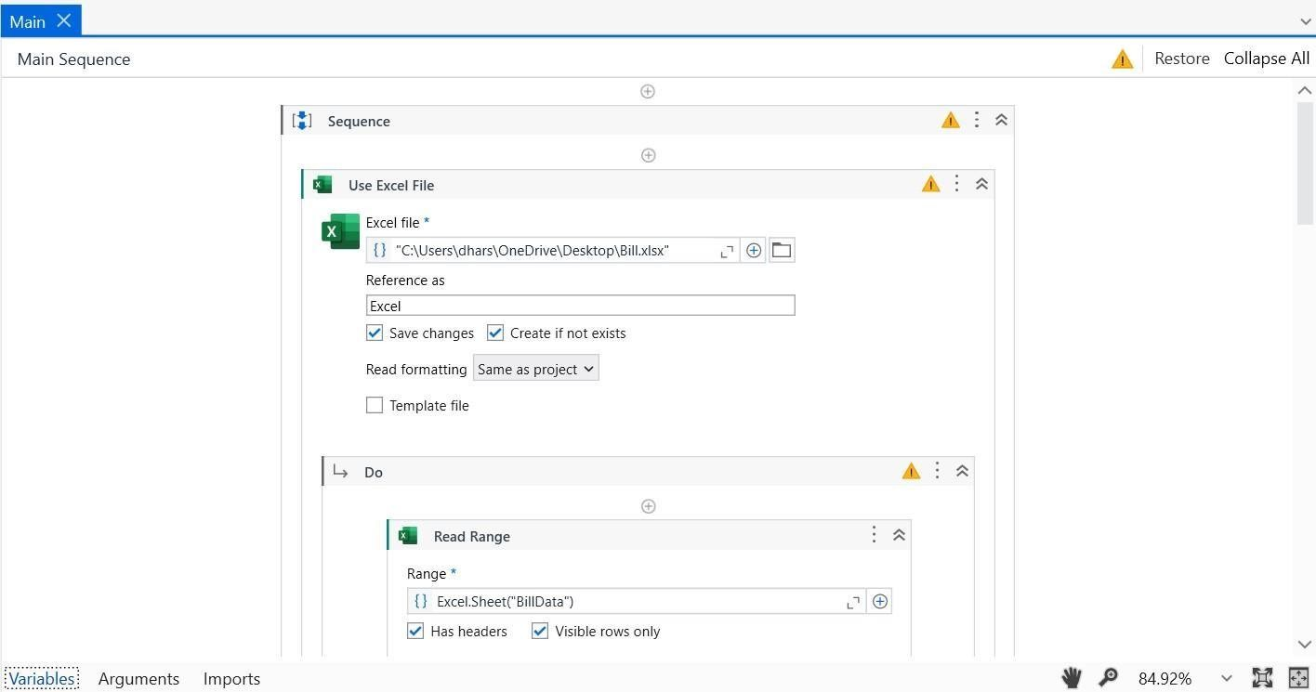
APPENDIX
PROCESS WORKFLOW

Slide 19
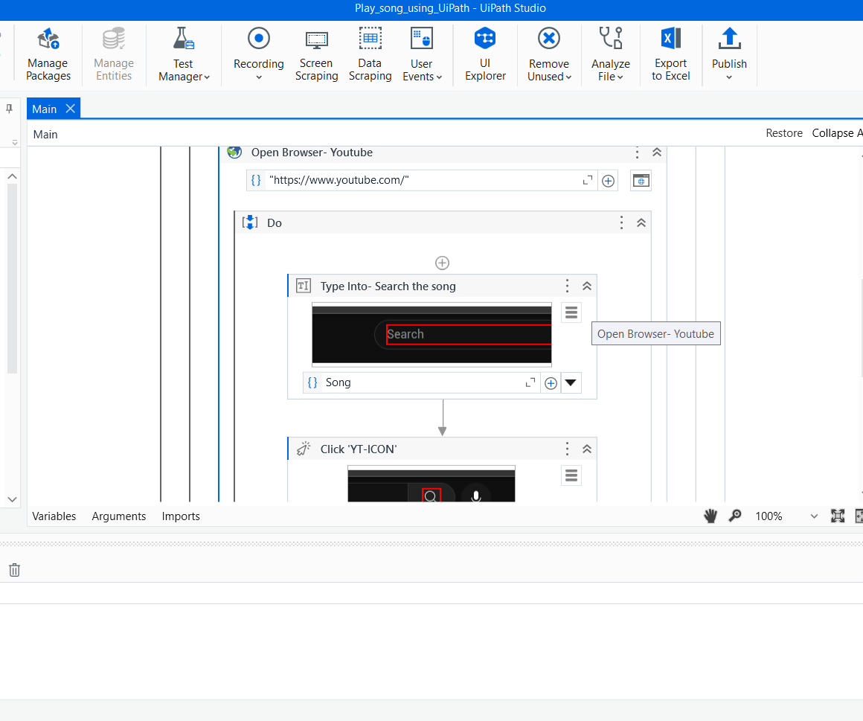
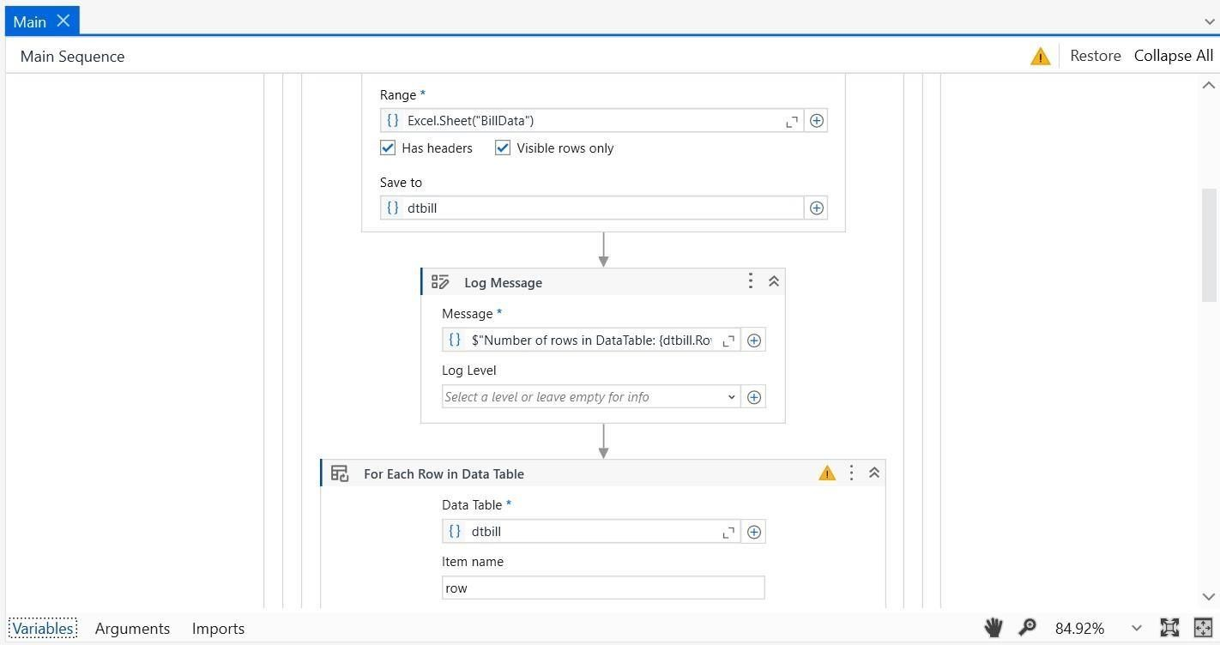

Slide 20
REFERENCES
Avasarala, R., & Waghmare, S. (2020). Robotic Process Automation in video player: Case Studies and Opportunities. International
Journal of Advanced Computer Science and Applications, 11(7), 334-
341. https://doi.org/10.14569/IJACSA.2020.0110737
Bansal, P., & Mehra, R. (2021). Automation in music listening
Robotic Process Automation (RPA). International Journal of
Engineering and Technology, 9(6), 2141-2148. https://doi.org/10.21817/ijet/2021/v9i6/210906295
Lee, M., & Kim, Y. (2021). Enhancing Customer Experience through Automated music finder. Journal of robotic Automation, 12(3), 98-104. https://doi.org/10.1109/JFA.2021.01203

