Slide 1

SDM
INSTITUE OF TECHNOLOGY
DATABASE MANAGEMENT SYSTEM
(BCS403)
Title : Agriculture farm management system.
Submitted by:
Bhuvan.B.S, Charan.H.S, Chetan.N.A, Farsheen Ahmed, Subramanya Naik.
Submitted to:
Ms.VeenaBhat.

Slide 2
INTRODUCTION:
The Agriculture Farm management system aims to simplify farm operations, improve resource utilization, and enhance productivity through structured data management.
This integrates various aspects of farm management, including crop planning, field management, irrigation scheduling, pest control, and farmer management.
farmer table maintains detail information about the farmers, including their contact information, assigned fields, and the crops they manage.
Crop table records essential details about the crops grown on the farm, such as planting and harvesting dates, crop types, and quantities harvested.
Field table provides information about the different fields on the farm, including field names, sizes, and the crops planted in each field.
Irrigation table tracks irrigation activities, including the dates and amounts of water used for each field.

Slide 3
Entities, Attributes and Key attribute:
Entities:
Farmers
Crops
Field
Irrigation
Pest
Attributes:
•Farmer_ID
•Name varchar
•ContactNum
•Email varchar
•Address varchar
•CropID,
•CropName
•QuantityHarvested
•FieldID
•FieldName
•IrrigationID
•IrrigationDate
•WaterUsed
•PestID
•PestName
•Treatment
KeyAttributes:
Farmer_ID
Crop_ID
Field_ID
Irrigation_ID
Pest_ID

Slide 4
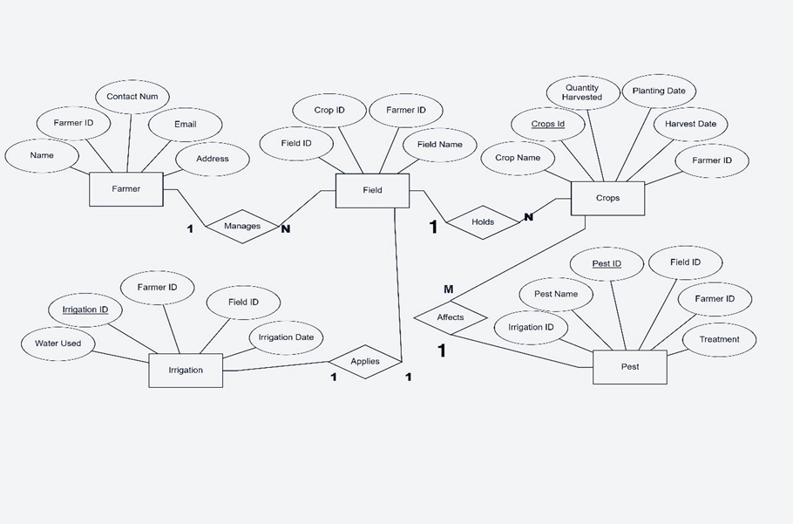
ER diagram:

Slide 5
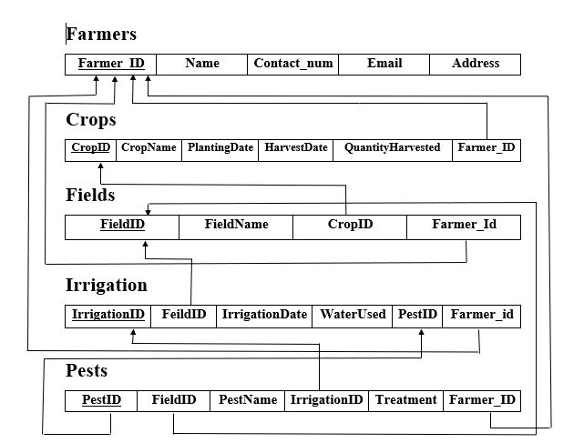
Schema diagram:

Slide 6
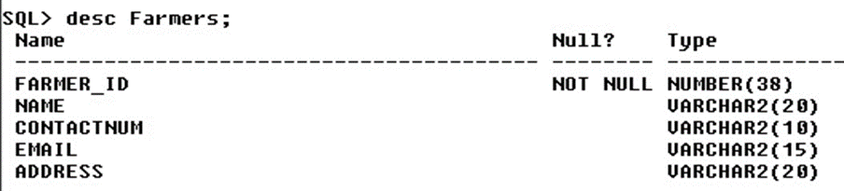
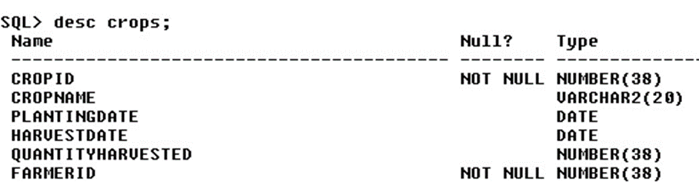
Tables:
Farmers table:
create table Farmers (
Farmer_ID int,
Name varchar(20),
ContactNum varchar(10),
Email varchar(15),
Address varchar(20),
primary key(Farmer_ID)
);
Crop table:
create table Crops (
CropID int,
CropName varchar(20),
QuantityHarvested int,
FarmerID int,
primary key(CropID,FarmerID),
foreign key (FarmerID) references Farmers(FarmerID)
);

Slide 7
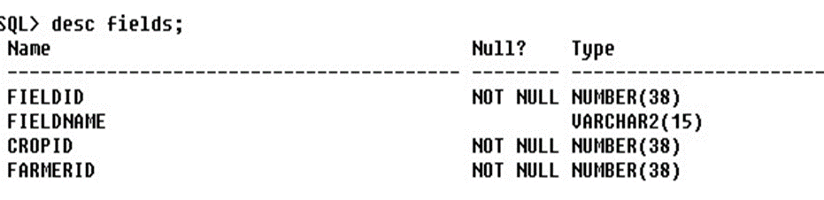
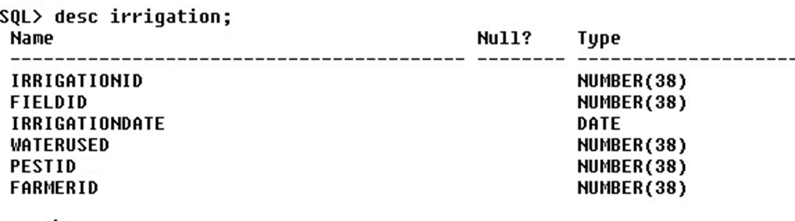
Tables:
Field table:
Create table Fields (
FieldID int,
FieldName varchar(15),
CropID int,
FarmerID int,
Irrigation table:
Create table Irrigation (
IrrigationID int,
FieldID int,
IrrigationDate date,
WaterUsed int,
PestID int,
FarmerID int,

Slide 8
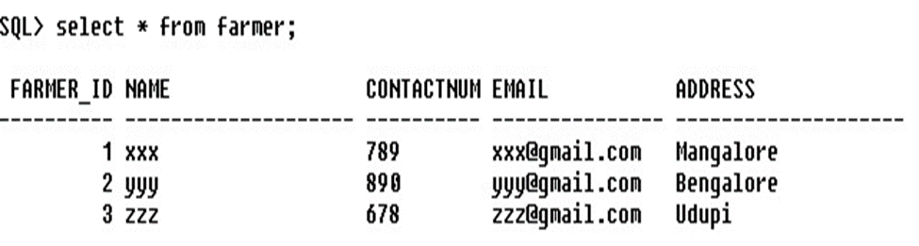
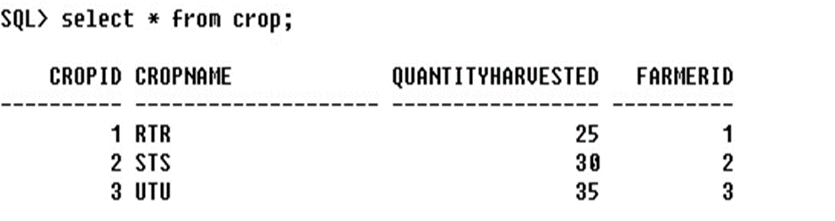
1.Query for inserting into Farmers:
2.Query for inserting into Crops:

Slide 9
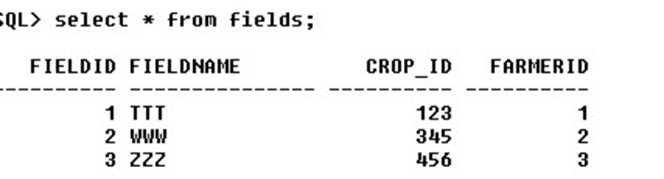
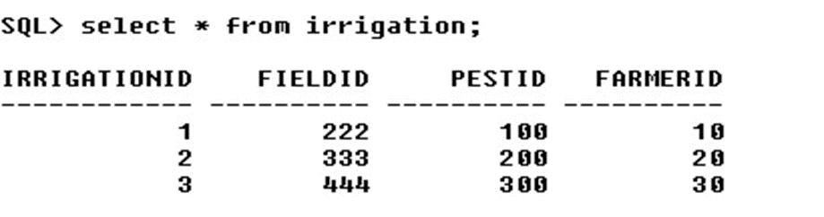
3.Query for inserting into Fields:
4.Query for inserting into Irrigation:

Slide 10
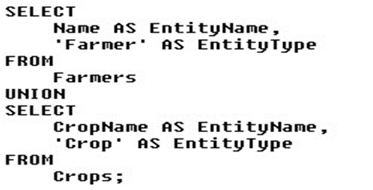
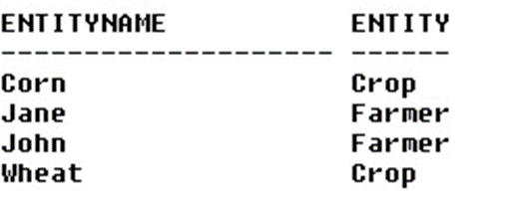
Sample Queries :
1.This query combines the names of farmers and the names of crops into a single result set.
Output:

Slide 11
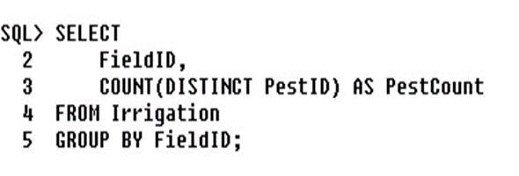

2. Count the number of distinct pests recorded for each field.
Output:

Slide 12
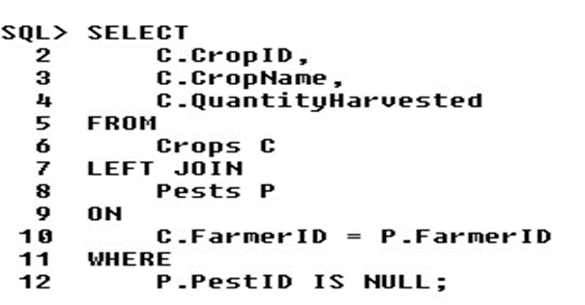

3. These queries demonstrate various ways to use the JOIN operator to link the Pests and Crops tables based on the FarmerID field.
Output:

Slide 13
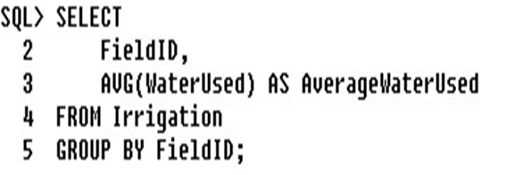
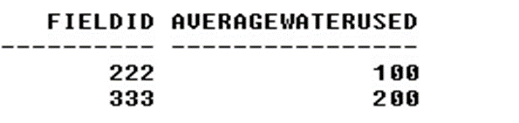
4. Calculate the average amount of water used for irrigation per field
Output:

Slide 14
Conclusion:
•Cost Savings: By optimizing resource usage (water, fertilizers, pesticides), farmers can reduce input costs while maximizing output, improving overall profitability.
•Environmental Sustainability: Implementing precision farming techniques minimizes environmental impact by reducing chemical usage, conserving water, and promoting soil health.
•Data-Driven Insights: Continuous monitoring and data analysis provide valuable insights into long-term trends and patterns, aiding in long-range planning and risk management.
•Empowerment of Farmers: Empowering farmers with technology fosters a more resilient agricultural sector, attracting younger generations to farming and ensuring its sustainability.
•Market Competitiveness: Adopting advanced agricultural technologies enhances competitiveness by producing high-quality crops consistently and meeting regulatory standards effectively.

Slide 15


