Slide 1
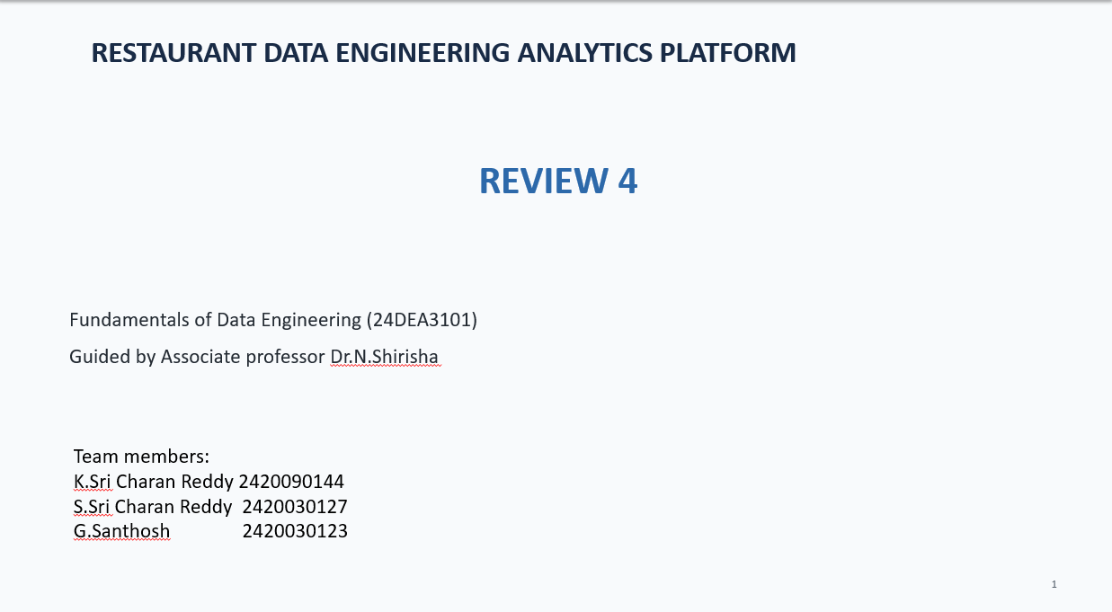

Slide 2
Comparison and Discussion
Restaurant Data Engineering Analytics Platform
The project combines batch processing, streaming, database storage, API access, and business intelligence.
The comparison focuses on how the proposed pipeline differs from a manual/traditional workflow.
The charts use the same side-by-side bar style as the reference image.
Project execution results are discussed separately from capability comparisons.

Slide 3
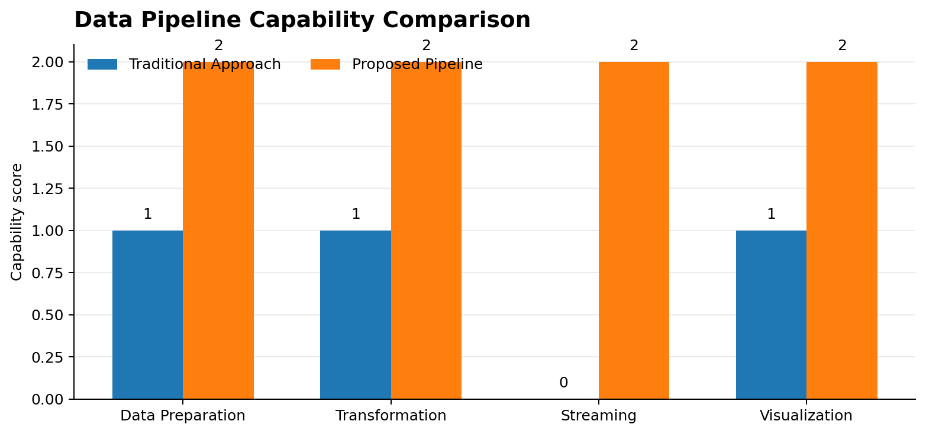
Comparison: Traditional Approach vs Proposed Pipeline

Slide 4
Traditional workflow mainly depends on manual preparation and individual analysis.
The proposed pipeline connects Python, PostgreSQL, Kafka, Spark, FastAPI, and Power BI.
The comparison is about available pipeline capabilities, not a measured speed benchmark.

Slide 5
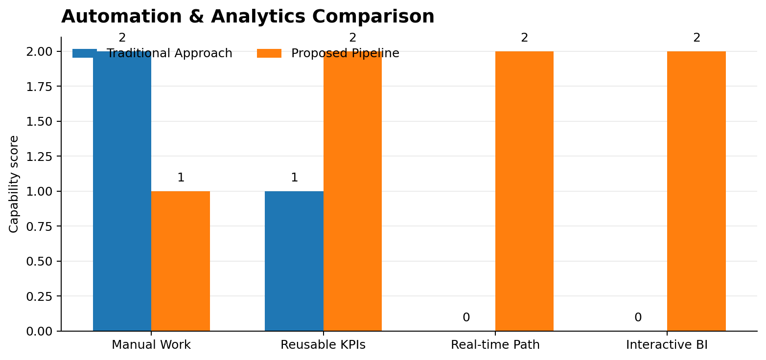
Comparison: Automation and Analytics

Slide 6
The proposed architecture supports reusable KPI tables and an API layer for downstream applications.
Kafka provides a streaming path while Spark performs transformation and aggregation.
Power BI provides interactive business-level reporting.

Slide 7
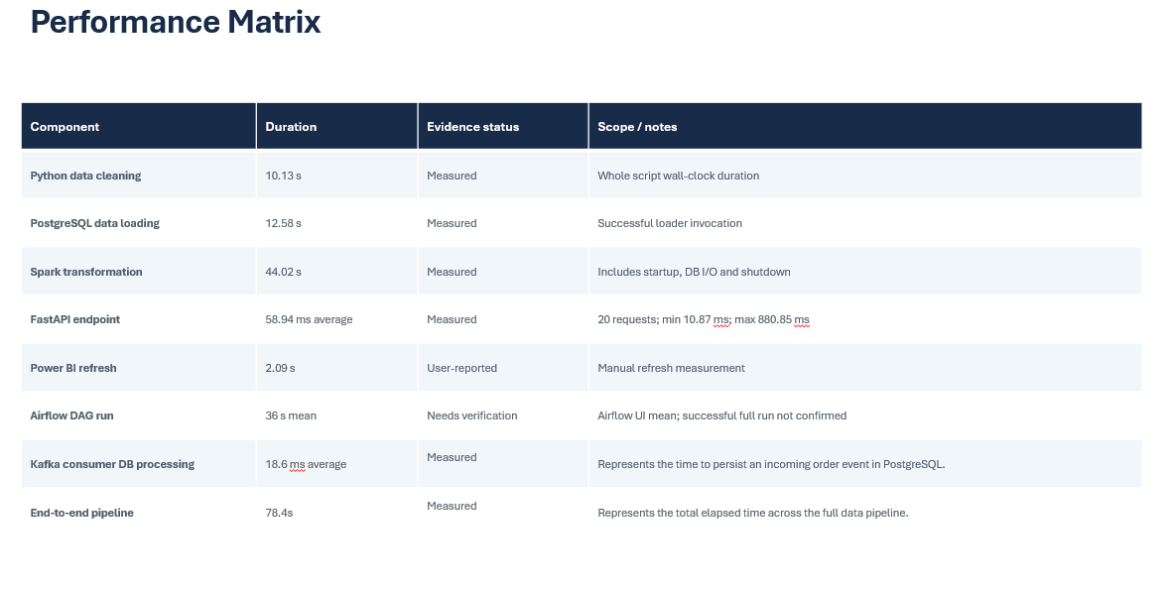

Slide 8
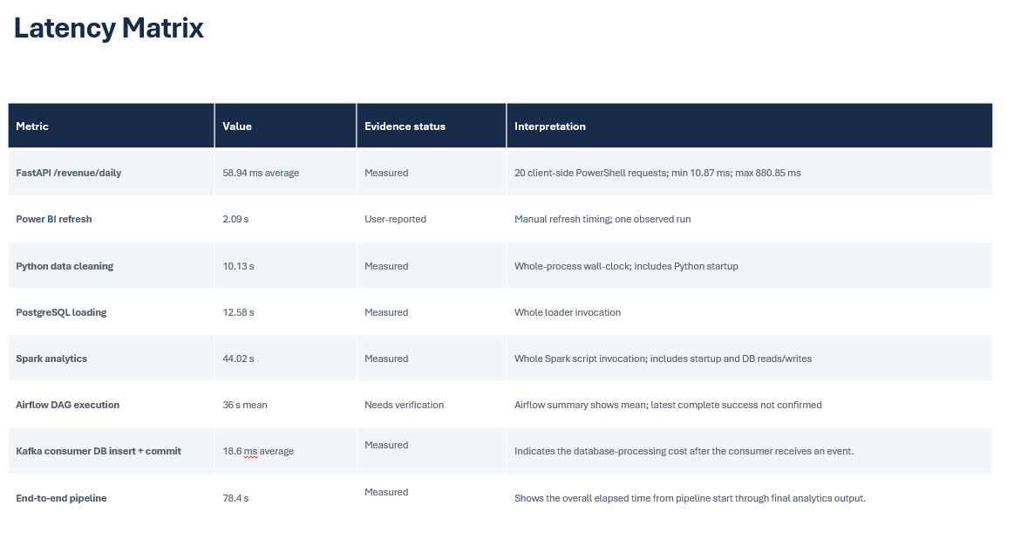

Slide 9
Discussion: Actual Project Results
The generated dataset contains 5,000 orders and 15,117 order items.
PostgreSQL stores the cleaned source data and the Spark-generated analytics tables.
FastAPI endpoints returned successful responses for top dishes, peak hours, and preparation performance.
Power BI displays KPI cards, daily revenue trends, top dishes, peak-hour orders, cancellations, and preparation metrics.

Slide 10
Discussion: End-to-End Execution
1
Python
Generate and clean restaurant data
2
PostgreSQL
Store structured data
3
Kafka
Send restaurant events through a topic
4
Apache Spark
Read, transform, aggregate, and write analytics
5
FastAPI
Expose analytics through REST endpoints
6
Power BI
Create interactive business dashboards

