Slide 1
DAnnoTAte
data re-use
- annotated -
Linking Words to the Web of Data

Slide 2
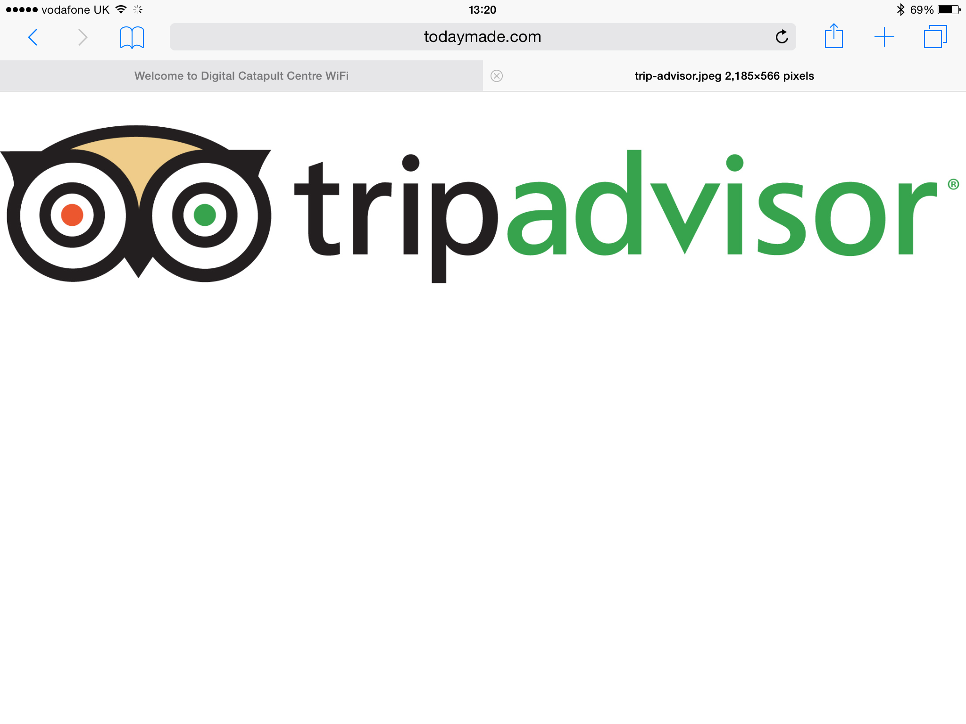
WHO ARE WE?
WE are the tripadvisor of datasets
WE give you a head start with understanding what the datasets are and what they are good for
An App For All Reasons

Slide 3
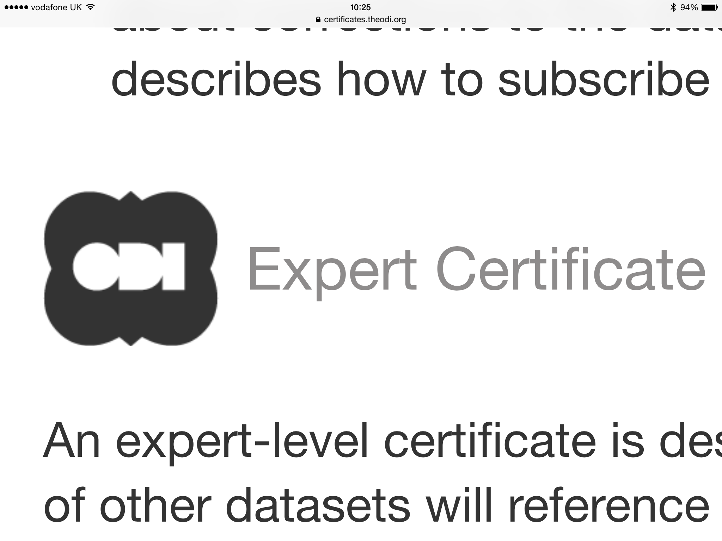
A BONUS
Social Requirements
….
You must publish a list of software tools and libraries that can be used with the data, whether those are created yourself or by other people. This helps give people a head start in using the data.

Slide 4
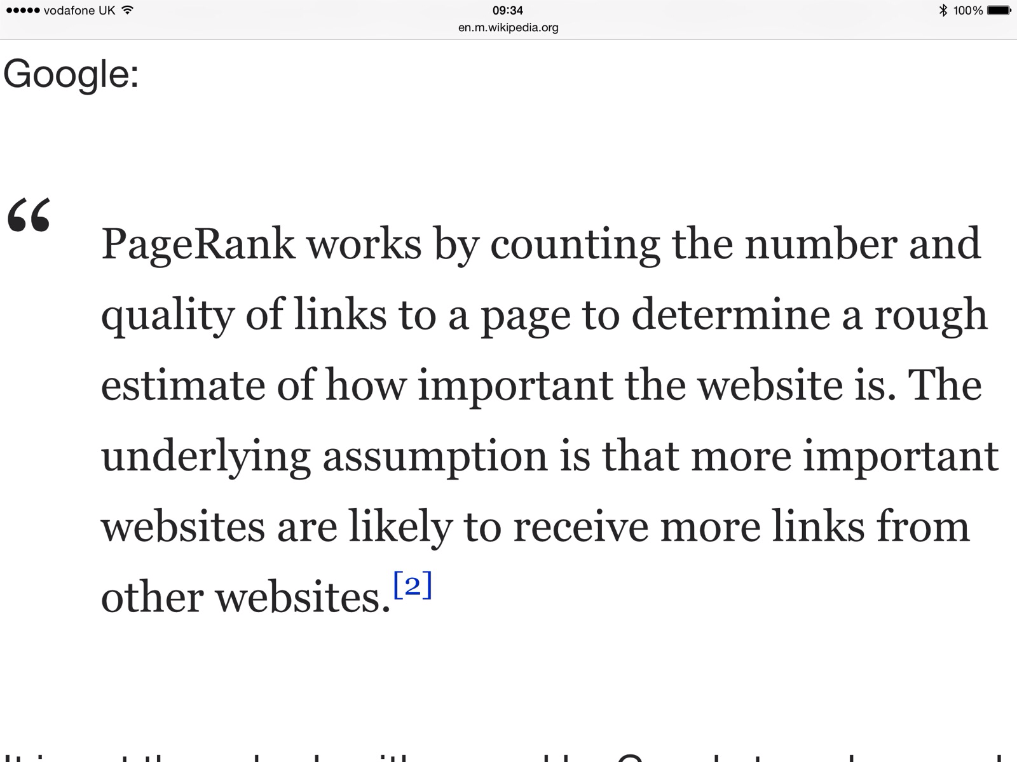
ADDED VALUE – re-use "impact factors"

Slide 5
Linked Data
… underpins the whole thing
CHARMe server hosts annotations about datasets
Datasets can be anywhere
Annotations can be federated anywhere on the web
…. So we are linking datasets from all over the world, based on how people are using them

Slide 6
We’ve created a demo site…
… but the whole point is that the same content can be used anywhere, or created from anywhere
Key new points:
Discover how others have used a dataset
Discover the dataset’s “impact factor”
Find datasets that are commonly used together

Slide 7
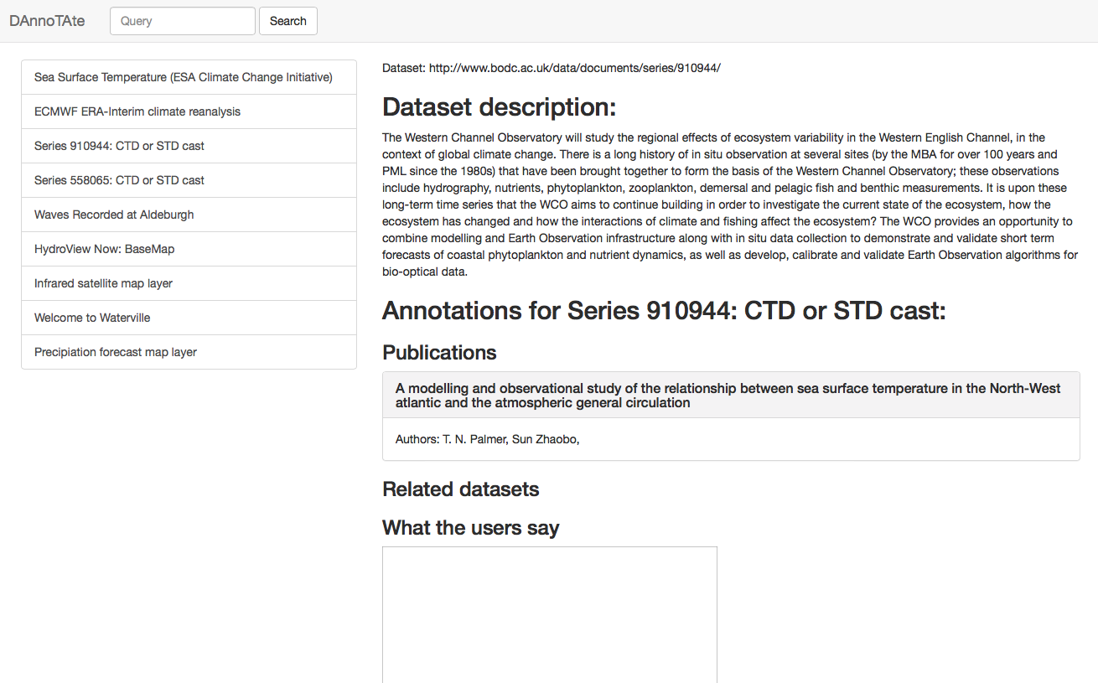

Slide 8
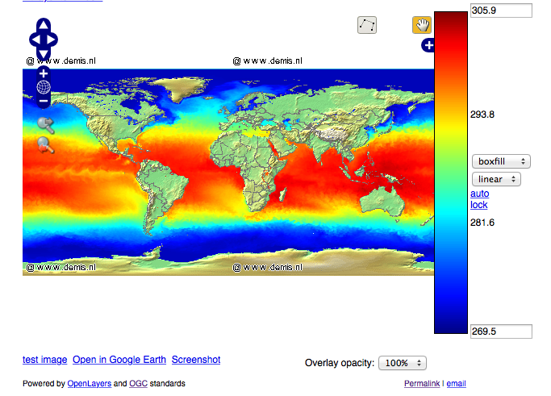

Slide 10
THE NEED
TripAdvisor for datasets (without the 5*)
Head start in using the data
TECHNICAL
Evaluation Metadata for re-used Data
REAL WORLD
Data always/usually collected for a purpose
Comes with specialist metadata (or it should)
This is specialist information about the data, collection and quality NOT the use (covered in reports, papers, websites etc)
Re-use by non specialists could add information about the data when it is used for another purpose – helps others
DAnnoTAte is about uses of the data not about the data per se – Provided by the re-user community

Slide 11
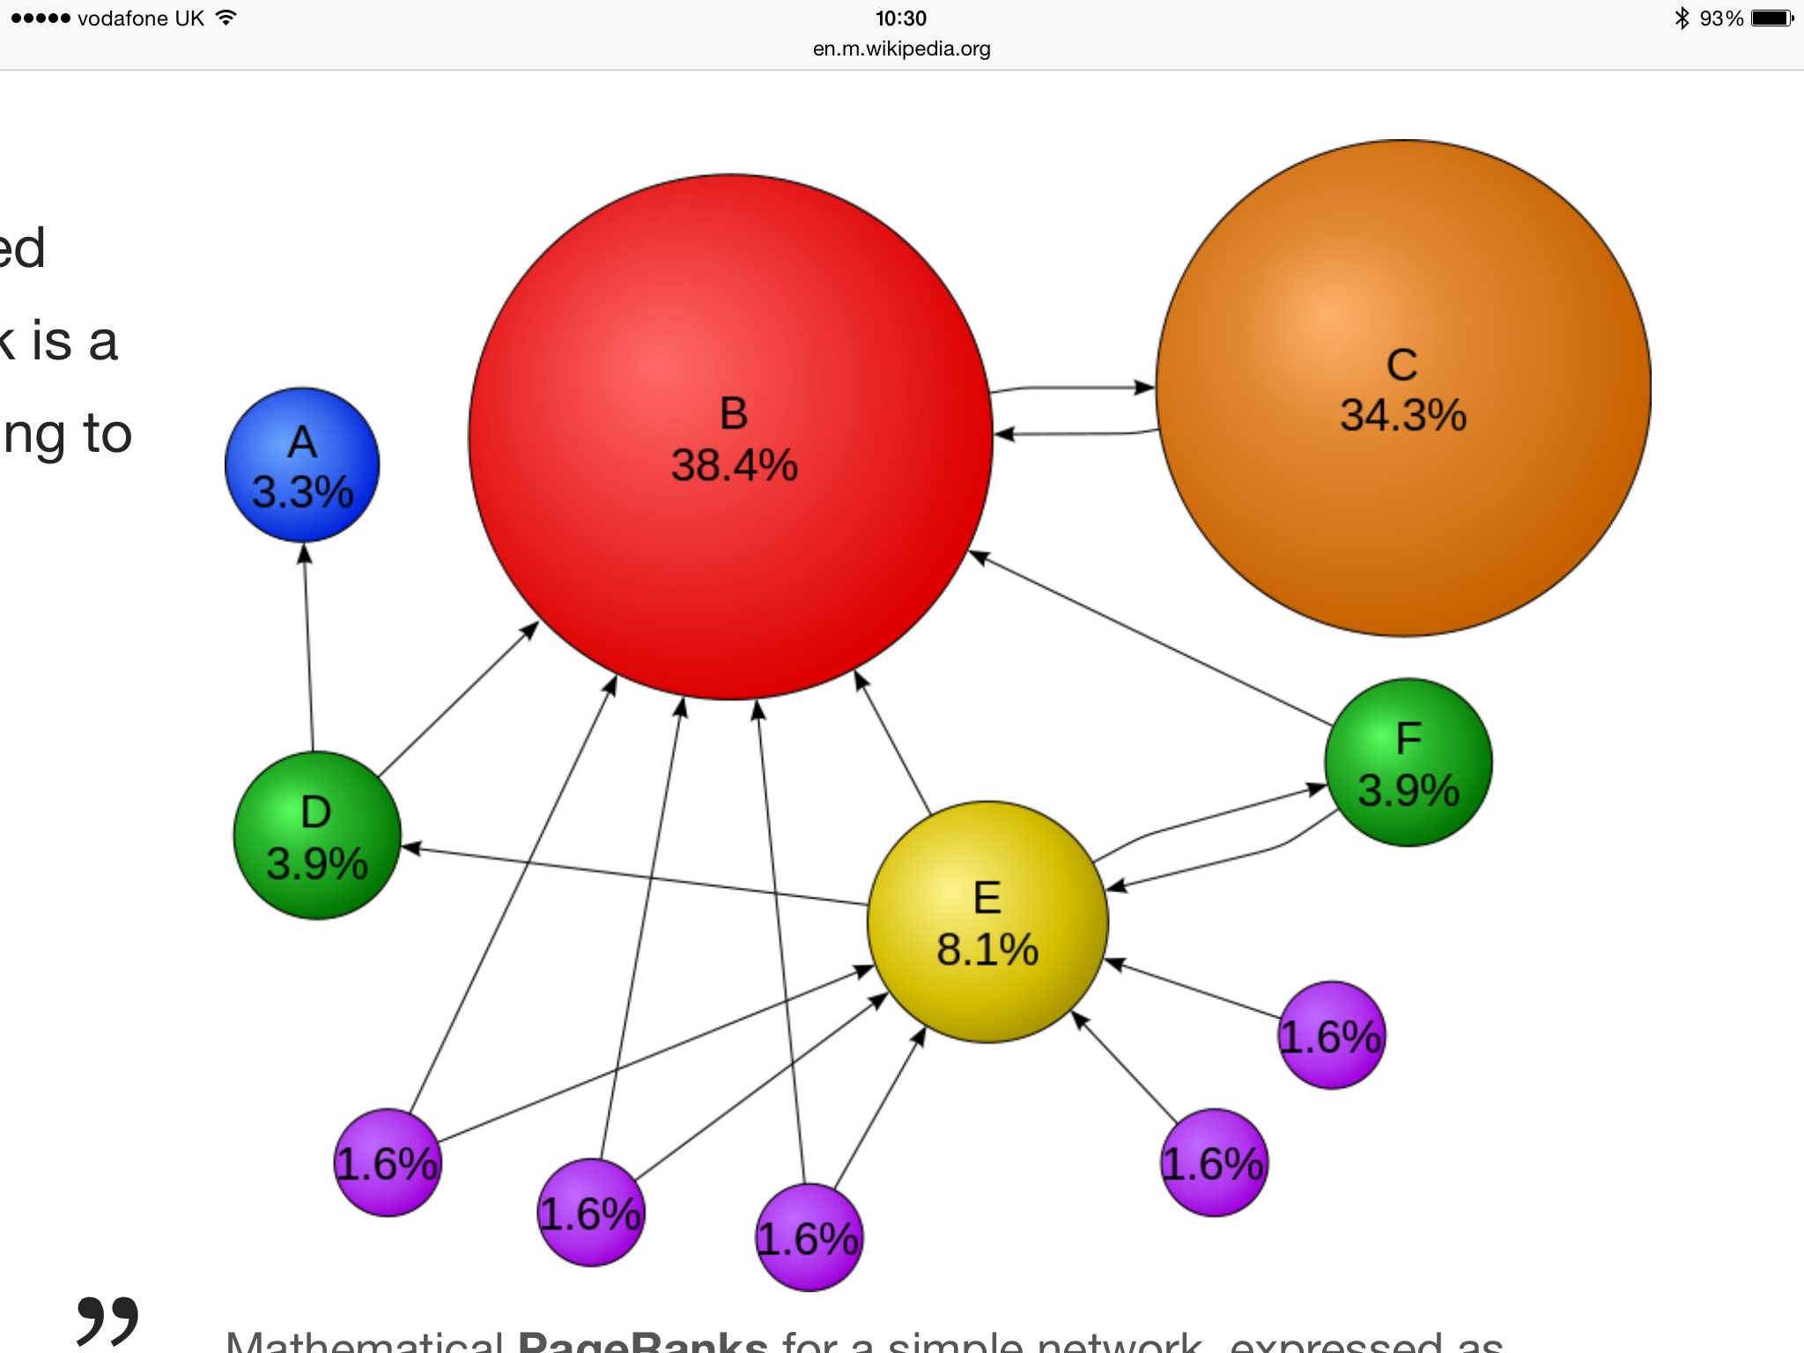
VISUALISATION – "CITATION INDEX"

Slide 12
EXAMPLE DATASETS & ANNOTATIONS
Gridded marine temperature data – climate change model data to link to jellyfish distribution model
ANNOTATION - Surface +/- 0.5C big picture stuff – scale an issue for jellyfish? Might be just right ie 10s of km
Coastal Network – citizens measuring daily
ANNOTATION - 100 years+ - coastal, surface, time series – good for change – limited for jellyfish predictions (start offshore – big scale) – does show hot years and peak timings around UK
SmartBuoy – continuous monitoring plus water samples – temperature, salinity, light, nutrients
ANNOTATION – points in N& Irish Seas – nutrients can drive algal blooms which can drive jellyfish explosions

