Slide 1
Predictive modeling for healthcare costs using Machine Learning
.

Slide 2
Abstract
Healthcare expenditure is a growing burden globally. This project focuses on using machine learning models such as regression, random forests, and CatBoost to predict healthcare costs. Using open datasets (SPARCS), we analyze demographic and clinical variables like diagnosis codes, severity, and length of stay. The project aims to improve transparency, aid patients and providers in cost planning, and support policy-making with data-driven insights.

Slide 3
Introduction
Healthcare costs are rising rapidly, expected to exceed $10 trillion globally by 2023. Transparency in costs empowers patients and providers, improves decision-making, and increases competition in healthcare markets. This project leverages machine learning to forecast healthcare costs with high accuracy using open healthcare datasets.

Slide 4
Literature Survey
Prior studies: Mostly focus on statistical models or specific diseases.
Challenges: Cost variation, lack of transparency, limited datasets.
ML in healthcare: Used for disease prediction, mortality analysis, and cost forecasting.
Limitations: Black-box models; need for interpretability.
Novelty: Use of interpretable ML models (CatBoost, RF, Decision Trees) with open datasets.

Slide 5
Algorithms/Modules
- Algorithms:
Regression
Decision Trees
Random Forests
CatBoost Regressor

Slide 6
Modules
- Modules:
Data Preprocessing (cleaning, encoding)
Feature Engineering (target encoding, cost transformation)
Model Training & Validation
Visualization (SHAP values, cost distributions)
Dashboard for results visualization

Slide 7
Architecture
The architecture includes:
1. Data Collection (SPARCS dataset)
2. Preprocessing (outlier removal, encoding)
3. Feature Engineering
4. ML Model Training (CatBoost, RF, DT)
5. Evaluation (R2 score, error distribution)
6. Visualization (dashboards, SHAP plots)
7. Insights & Decision Support

Slide 8
Data Flow Diagrams
Data Flow:
1. Input: Patient demographics, hospital data, diagnosis codes, severity
2. Preprocessing: Cleaning, transformation
3. ML Models: Regression, RF, CatBoost
4. Predictions: Healthcare cost estimation
5. Output: Dashboard, analytics, insights

Slide 9
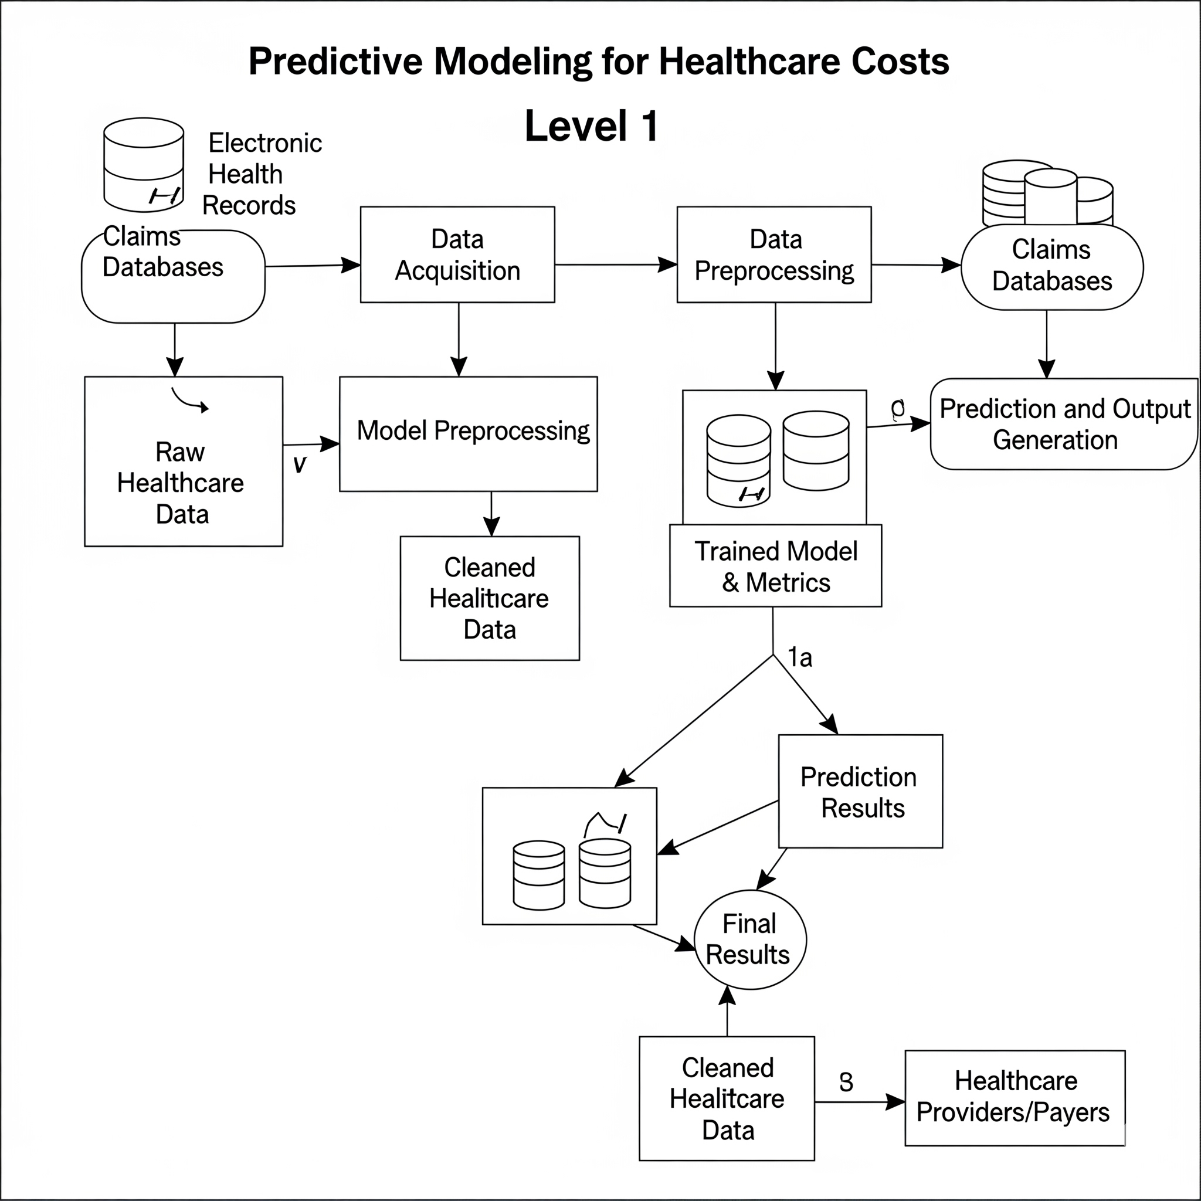
Data Flow Diagrams

Slide 10
Existing system
Relies heavily on raw healthcare data and traditional statistical techniques.
Most existing systems are disease-specific and cannot generalize across multiple procedures or patient demographics.
Limited adoption of advanced machine learning models.
Lack of interpretability, making results less useful for clinicians and policymakers.

Slide 11
Existing system
Absence of user-friendly dashboards for cost transparency.
Data limitations: Many systems depend on proprietary or closed datasets (e.g., Medicare only), restricting accessibility.
Poor support for large-scale predictive analytics and real-time integration with hospital systems.

Slide 12
Proposed System
Uses open healthcare datasets (SPARCS) for accessibility and reproducibility.
Incorporates modern ML models (CatBoost, Random Forest, Decision Trees) for higher accuracy.
Provides explainability using SHAP values, ensuring transparency in decision-making.
Achieves superior accuracy (CatBoost R2 ≈ 0.85), outperforming traditional models.

Slide 13
Proposed System
Comprehensive: Can predict costs across multiple diseases, demographics, and hospitals.
Interactive dashboard created for exploring predictions and cost distributions.
Scalable design for nationwide adoption and integration into hospital management systems.
Helps patients estimate procedure costs, hospitals optimize resources, and policymakers design better health policies.

Slide 14
Results
Best performing model: CatBoost Regressor (R2 = 0.85)
Key predictive features: APR DRG code, Severity of Illness, Length of Stay
Features like race and gender not significant
Visualizations: Cost distributions, SHAP plots, error analysis
Dashboard developed for interactive exploration

Slide 15
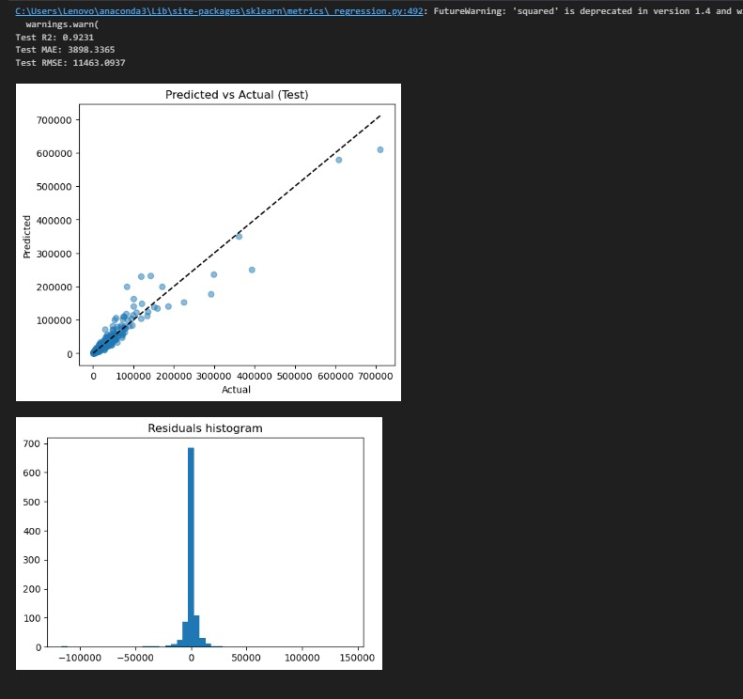
Results

Slide 16
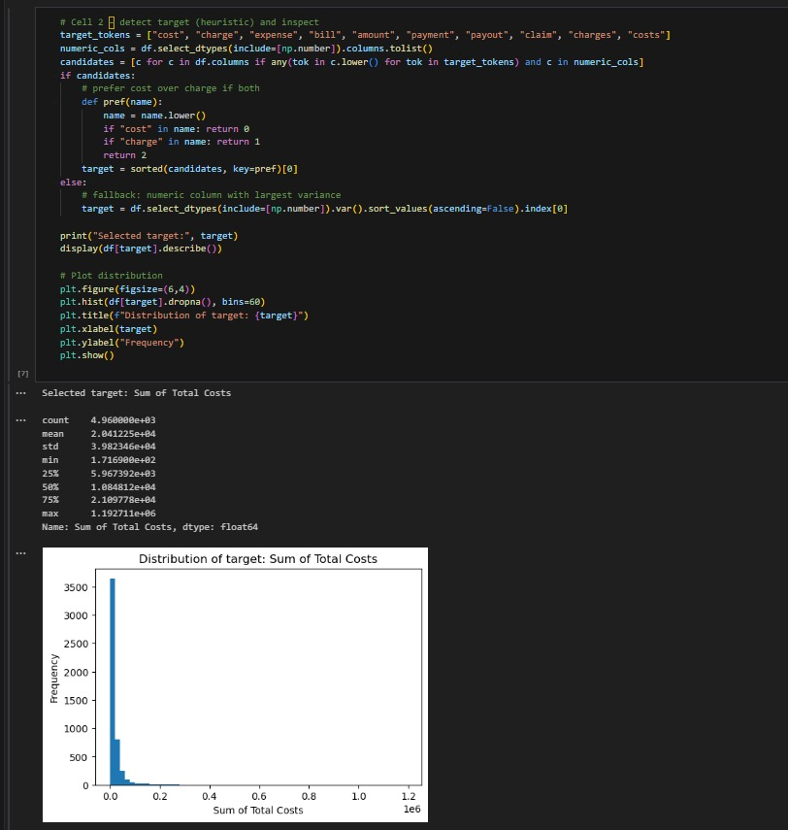
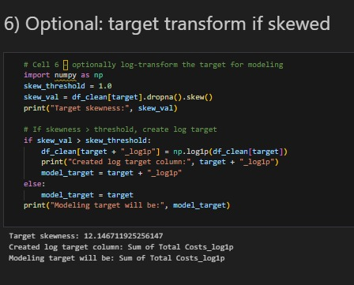
Results

Slide 17
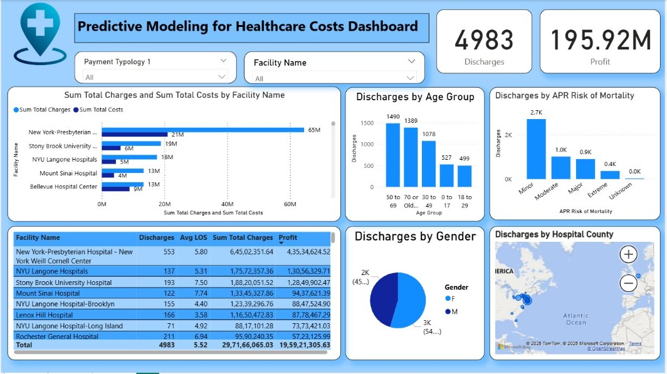
Results

Slide 18
Conclusion
Predictive modeling enables accurate healthcare cost forecasting
CatBoost performed best, followed by Random Forest
Improves transparency in healthcare pricing
Provides insights for patients, hospitals, and policymakers
Validated using real-world open healthcare data

Slide 19
Future Scope
- Extend to multi-state/national datasets
- Include comorbidities and patient vitals for improved accuracy
- Real-time integration with hospital management systems
- Development of patient-facing apps for cost estimation
- Policy-driven research for global adoption

Slide 20
References
1. Rao A.R., Jain R., Singh M., Garg R. (2024). Predictive interpretable analytics models for forecasting healthcare costs using open healthcare data. Healthcare Analytics, 6, 100351.
2. Rajpurkar et al. (2017). Deep learning for healthcare applications.
3. Rubinger et al. (2020). Importance of interpretability in AI for healthcare.
4. Budiman et al. (2021). Predicting hospital performance using Random Forests.

Slide 21
References
5. Espinosa et al. (2019). Predictive models for actuarial planning in healthcare.
6. Tools & Datasets: Python (Scikit-Learn, CatBoost, SHAP), SPARCS dataset, Power BI dashboards.
7. Related works on transparency in healthcare pricing and predictive analytics in medical decision-making.

Slide 22


