Slide 1


















概率图模型
$$γ$$
$$γ$$
可观测变量
$$α$$
$$γ$$
$$r_{v}$$
$$β$$
$$η$$
$$α$$
$$r_{v}$$
$$β$$
$$η$$
$$α$$
$$γ$$
$$r_{j}$$
$$β$$
$$η$$
隐变量
超参数
$$s_{i}$$
$$τ_{i}$$
$$b_{i}$$
$$s_{v}$$
$$τ_{v}$$
$$b_{v}$$
$$s_{j}$$
$$τ_{j}$$
$$b_{j}$$
依赖关系
$$z_{i}^{v}$$
$$d_{ij}^{v}$$
$$z_{j}^{v}$$

Slide 2
评价能力
评价能力
被抽查的作业

Slide 3
被抽查的作业
评价能力
评审阶段
汇总得分
计算可靠性

Slide 4
























Review Ability
Students
Submissions
Selected
Submissions
Graded
Submissions
$$a_{1}$$
$$s_{1}$$
Randomly select c submissions
$$s_{1}$$
$$h_{1}$$
$$h_{1}$$
$$h_{1}$$
$$a_{2}$$
$$s_{2}$$
$$h_{2}$$
$$h_{2}$$
Teacher propose scores
$$h_{2}$$
Update
...
...
...
...
...
Peer Assessment Activity
$$a_{n}$$
$$s_{n}$$
$$h_{n}$$
$$h_{c}$$
$$h_{c}$$
Allocation Algorithm
Allocate l submissions to every student
...
Probability = MEDIAN
$$s_{1}$$
$$a_{1}$$
...
Probability = LOW
Allocation Algorithm
$$s_{2}$$
$$a_{2}$$
...
...
...
...
Probability = HIGH
Allocation Algorithm
$$s_{3}$$
$$a_{3}$$
l submissions allocated to student s₃

Slide 5
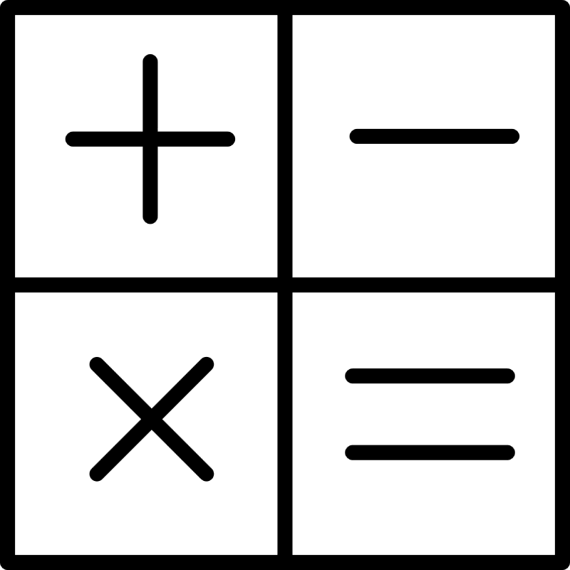

$$s_{1}$$
$$a_{1}$$
$$s_{2}$$
$$a_{2}$$
...
...
计算真实分数
更新评价能力
$$s_{3}$$
$$a_{3}$$

