Slide 1
Getting Started
Prof. Stan Wine

Slide 2
From the U.S. Bureau of Labor Statistics
http://www.bls.gov/ooh/computer-and-information-technology/home.htm
SJW

Slide 3
Highlights From the Syllabus
Read the Syllabus (see Course Docs/Content Areas/Syllabus)
Schedule, reading assignments, etc. can be found there
Please checked the syllabus before asking questions about the course format, tests, homework, etc.
My answer will usually be “check the syllabus.”
3
SJW

Slide 4
Highlights From the Syllabus
Text: Computer Networks 5th Edition by Tanenbaum
I make extensive use of Blackboard
Slides
Lab assignments
Lists of typos and errors
Information about exams
NY Times articles
Advisories
Check email and Announcements frequently
4

Slide 5
Questions You’ll Be Able to Answer
What are the fundamental principles of computer networks?
What hard problems must they solve?
What design strategies have proven valuable?
How does the Internet work?
What really happens when you “browse the web”?
What are TCP/IP, DNS, HTTP, NAT, VPNs, 802.11 etc. anyway?
5

Slide 6
Questions You’ll Be Able to Answer
How is society impacted by the availability of networks?
What is the difference between analog and digital transmission?
Why is DSL or cable Internet service so much faster than a dial up modem?
Why are phone calls made over the Internet (VOIP) so much less expensive than calls made over the traditional phone network?
Why are the cable companies offering phone service and the telephone companies spending billions to offer cable TV service?
6

Slide 7
Questions You’ll Be Able to Answer
Whether you would be interested in working in the networking field?
7

Slide 8
Course is About Principles, Not Products
Principles are fundamental and don’t change
Products are short-lived and are replaced
Once you know the principles, you can understand any product
8

Slide 9
Highlights From the Syllabus
A word to the wise:
This is a challenging course which introduces a plethora of acronyms and jargon
Memorization is not a strategy for success or deep learning - the key is to understand the material
Read assigned material before you come to class – use the lecture as an opportunity to clarify any points in the text which you did not understand
Then reread the material until it makes perfect sense to you – meaning everything makes sense and there are no questions or seeming contradictions
Treat the material as a puzzle in which all the pieces must fit together
SJW

Slide 10
Highlights From the Syllabus
Grading
Exam material will be derived from both the reading assignments and from material covered in the lectures.
Quiz 20%
Midterm 20%
Final 30%
Labs 20%
Attendance 10%
Adjusted for participation

Slide 11
Highlights From the Syllabus
Attendance:
I reserve the right to drop any student who has more than four absences
Academic integrity:
I have zero tolerance for any offenses
Lab Assignments:
Conducted on personal machines
Books on reserve:
Numerous books available in library

Slide 12
Highlights From the Syllabus
Announcements of class cancellations
You will be notified via Baruch email and by posting an announcement on Blackboard
Electronic Devices:
Laptops permitted to facilitate note taking only
Turn off smartphones, etc.
Let’s take a tour of the Blackboard site…
Ready to start?
SJW

Slide 13
Goals and Motivation
Source: University of Washington Coursera MOOC Introduction to Computer Networks CS 461, based on Computer Networks text by Tanenbaum and Wetherall.
1-1-goals-motivation.ppx

Slide 14
Introduction Chapter 1
Uses of Computer Networks
Network Hardware
Network Software
Reference Models
Example Networks
Network Standardization
Metric Units
Revised: August 2011
14
Notes:
Gray units can be optionally omitted without causing later gaps

Slide 15
Digital Convergence
The notion that telecommunications, the Internet, television, and computers will come together in a single, digitized communications network. It is the ability of different network platforms (i.e., cable and telephony) to carry essentially similar kinds of services.
Smartphones – convergence of mobile phone with mobile computer

Slide 16
Uses of Computer Networks
Computer networks are collections of autonomous computers, e.g., the Internet (a network of networks)
They have many uses:
Business Applications »
Home Applications »
Mobile Users »
These uses raise:
Social Issues »
This text covers networks for all of these uses
and embedded computing devices such as the Nest thermostat – “The Internet of Things”
Distributed system – a software system built on top of a network, used to present the independent computers as a single coherent system to users, e.g., the Web.
16
Notes:
Contrast computer networks with distributed systems, in which a model on top of the network is used to present the independent computers to users as a single coherent system, e.g., the Web.

Slide 17
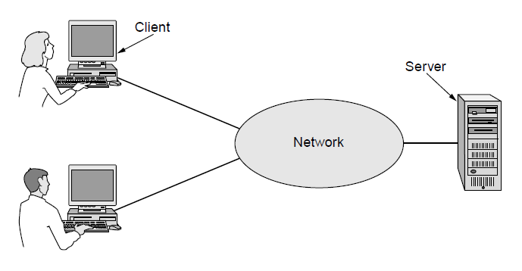
Business Applications
Companies use networks and computers for resource sharing with the client-server model:
Other popular uses are communication, e.g., email, VoIP, and e-commerce
request
response
Notes:
Resource sharing was initially about physical resources, such as printers, but is now often about access to information, such as a file server.
The Web is an example of client-server computing.

Slide 18
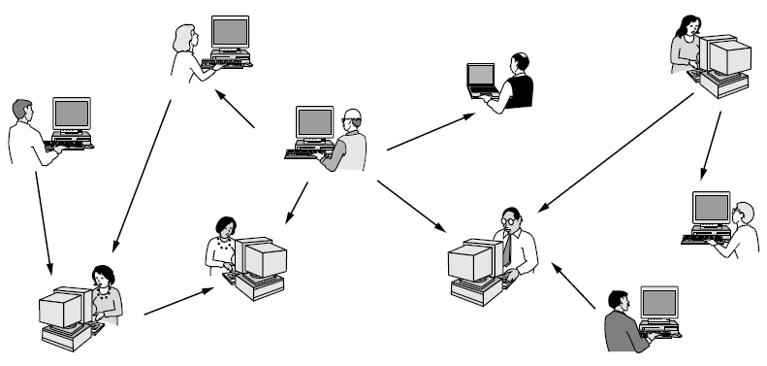
Home Applications
Homes contain many networked devices, e.g., computers, TVs, connected to the Internet by cable, DSL, wireless, etc.
Home users communicate, e.g., social networks, consume content, e.g., video, and transact, e.g., auctions
Some applications use the peer-to-peer model in which there are no fixed clients and servers:
Peer-to-peer:
Napster, Kazaa, BitTorrent
Copyright infringement, sharing of public domain music, family photos & movies, public domain software packages
Notes:
P2P contrasts with client-server. Why is it under home applications? Because unlike cloud there is no need to have a business run dedicated infrastructure for the app to work.
Napster, Kazaa, BitTorrent, LimeWire
Copyright infringement, sharing of public domain music, family photos & movies, public domain software packages

Slide 19
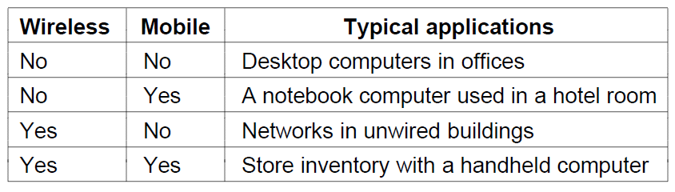
Mobile Users
Tablets, laptops, and smart phones are popular devices; Wi-Fi hotspots and 3G and 4G cellular provide wireless connectivity.
Mobile users communicate, e.g., voice and texts, consume content, e.g., video and Web, and use sensors, e.g., GPS.
Wireless and mobile are related but different:
Fixed wireless (satellite TV) and mobile wireless (phone)
Notes:
Laptop sales outpaced desktop sales in 2010, and there are many more mobile phones (but not smart phones) than personal computers.

Slide 20
Other Mobile Technologies
M-commerce: text messages used to pay for small purchases (e.g., vending machines)
Near Field Communications (NFC) uses RFID to interact with a reader (e.g., contactless payment systems, electronic ticket systems)
Sensor systems (track wind, temperature, tides, people sneaking across borders), parking meters

Slide 21
Social Issues
Network neutrality – no network restrictions
Content ownership, e.g., DMCA takedowns
Anonymity and censorship
Privacy, e.g., Web tracking and profiling
Surveillance by NSA
Theft, e.g., botnets and phishing
21
Notes:
In the US, DMCA (Digital Millennium Copyright Act) takedowns are automated notices sent by content owners to parties they believe are inappropriately putting copyrighted content online. They instruct the party to take down the content or face legal measures.

Slide 22
Social Issues
Information “Haves and Have-nots” (the “digital divide”)
“E-rate” part of Universal Service Fund
Provides subsidies for Internet service to schools and libraries
Censorship
The U.S. is a leading location for “hate” web sites
First Amendment provides freedom of speech
“hate” literature and goods
The “Great Firewall of China” blocks
NY Times, Bloomberg News
Facebook, Twitter
Gmail

Slide 23
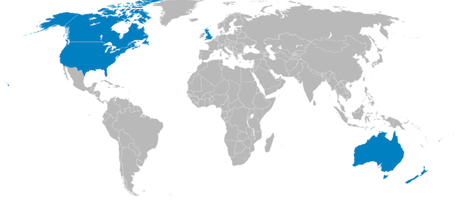
Social Issues
Privacy
Should the U.S. government be able to intercept communications?
The FBI has a tool (originally known as “Carnivore”) which can be installed at an ISP and whose purpose is to enable it to tap email messages
Snowden revelations about widespread surveillance by NSA and the “Five Eyes”

Slide 24
Politics
Totalitarian or authoritarian governments seek to limit transmission of information
China, Viet Nam, Singapore, Saudi Arabia and most Middle Eastern countries, Iran, Cuba, Tunisia, North Korea and other countries restrict access to the Internet or other communications sources

Slide 25
Politics
In China:
30,000 or more Internet police monitor traffic, Web sites and blogs for political and other offending content (NY Times 10/1/08)
Web sites are blocked
Searches for topics such as “human rights”, “Taiwan”, “democracy”, “Tiananmen Square” return sanitized results or none at all
Text messages are filtered (Tom-Skype, the Chinese Skype client IMs are filtered – NY Times 10/2/08)

Slide 26
Politics
In China:
The “Great Firewall of China”
As of 2005, search engines and portals must stop posting their own commentary and make available only opinion pieces generated by government-controlled newspapers and news agencies.

Slide 27
Politics
In China:
MSN and Yahoo censor searches and blogs, identify users to authorities
In Congressional hearings, the portals state that they must obey local laws, and their presence tends to drive openness in the host society
2013, The Guardian: “According to a judicial interpretation issued by China's top court and prosecutor, people will be charged with defamation if online rumors they create are visited by 5,000 Internet users or reposted more than 500 times. That could lead to three years in jail, state media reported …”

Slide 28
Politics
In China:
March 2009: China blocks access to YouTube for two weeks after video of Chinese police beating handcuffed Tibetan protesters appears.
NY Times 3/23/09
2013: NY Times and Bloomberg News blocked after reporting on extraordinary wealth of prime minister’s family
His mother, a school teacher, is worth >$100 million

Slide 29

Russia Follows China’s Footsteps
“Bloggers law” - any site with > 3,000 visitors daily considered a media outlet, responsible for the “accuracy” of information published
Bloggers must register with authorities
Similar to Chinese rule concerning 5,000 visits or 500 reposts
New law (Feb. 1, 2014): gave government the power to block websites; immediately used against critics
April 2014: Putin says CIA originally set up the Internet and is continuing to develop it

Slide 30
Politics
In Iran:
Beginning on election day, government blocks access to cellphone transmission, text-messaging and some websites; attempts to jam BBC Persian service satellite TV
Iran completely drops off Internet for a period of time
Social networking sites such as Facebook, blogs, YouTube, Twitter used to spread information
Twitter may be accessible through texting from cellphone (SMS), IM, browser or app
The “Arab Spring”
Social networking an important force in organizing and publicizing protests

Slide 31
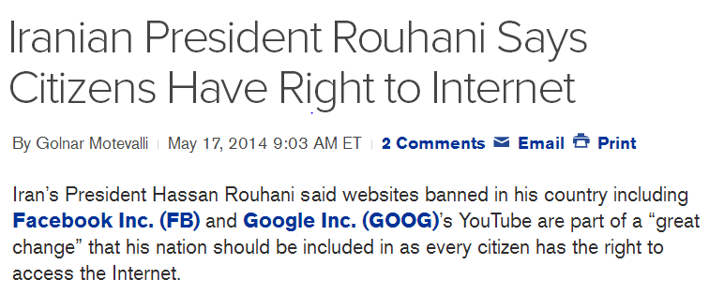
Iran

Slide 32
Privacy
Until recently, Google retained search logs for 18 months
European privacy laws much stricter than our own
Google's Street View offers ground-level, 360-degree views of streets in some 50 cities in the United States and cities in France, Spain, Italy and Japan.
In one case, a woman was shown sunbathing and in another a man was pictured exiting a strip club in San Francisco.
In Germany, taking photographs for the service violates privacy laws.

Slide 33
Network Neutrality – a New Concern
Network Neutrality - the concept that all network traffic should be considered to be “equal,” i.e., certain traffic should not be given preference.
How Net Neutrality Works (NY Times) 2:53
John Oliver on Net Neutrality (Last Week Tonight ) 13:17
2/26/2015: FCC issues new rules which reclassify ISPs from information services to telecommunications services, or public utilities
No fast lanes
Content may not be blocked
Mobile data services also covered

Slide 34
Network Neutrality – a New Concern
2005: The Bells proposed to share the burden of upgrading their networks with the companies sending the most data
They want to charge extra for a “fast lane”
Lots of objections
2007: Comcast, the largest cable service provider, slows the traffic of users of the peer-to-peer BitTorrent protocol because a small percentage of users were consuming an inordinate amount of bandwidth.
Consumer groups complained to F.C.C.
2008: F.C.C. rules against Comcast

Slide 35
Network Neutrality – a New Concern
ISPs would not be able to block web sites or apps
But does not forbid paid prioritization
For mobile Internet access, may not block web sites but can block access to apps or services unless they compete with their own voice and video services, such as Skype

Slide 36
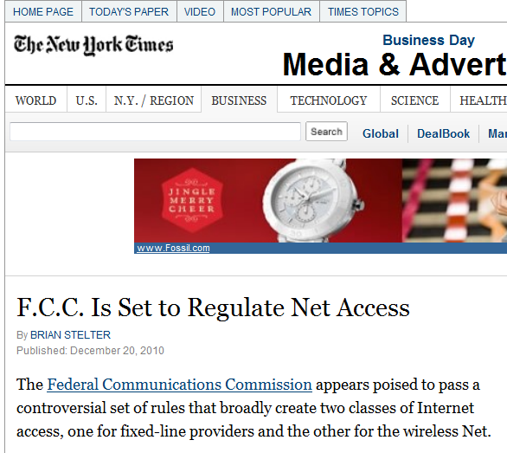
Network Neutrality
Idea is to promote development of new mobile services such as:
health care monitoring
advanced educational services
entertainment and gaming options

Slide 37
Network Neutrality
ISPs would not be able to block producers of online content or offer a paid “fast lane”
Exceptions: for Internet access over cellphone networks, and for potential new services that broadband providers could offer, such as:
health care monitoring
advanced educational services
new entertainment and gaming options

Slide 38
Intellectual Property
Digital Millennium Copyright Act
Spam
75% of world’s email is spam!
See http://www.messagelabs.com/intelligence.aspx
Phishing

Slide 39
Cybersecurity
Worms, viruses
Botnets
Phishing
Denial of Service Attacks
Cyberwar?
Huge demand for cybersecurity professionals
Consider taking CSci 493.75

Slide 40
Network Hardware
Networks can be classified by their scale:
Scale | Type
Vicinity | PAN (Personal Area Network) »
Building | LAN (Local Area Network) »
City | MAN (Metropolitan Area Network) »
Country | WAN (Wide Area Network) »
Planet | The Internet (network of all networks)
A network of networks is an internet
Example: The Internet
40
Notes:
An “internetwork” is any larger network made up of smaller component networks. The “Internet” (with a capital I) is the set of all connected networks.

Slide 41
Terminology
Broadcast links and point-to-point links
Unicasting, broadcasting and multicasting
41

Slide 42
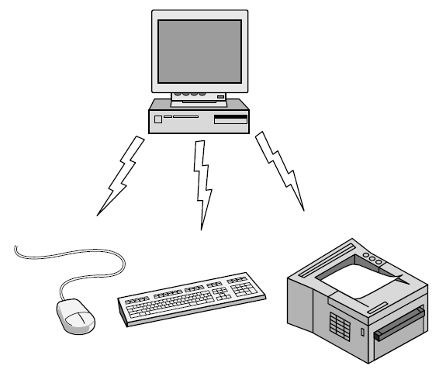
Personal Area Network
Connect devices over the range of a person
Example of a Bluetooth (wireless) PAN:
42

Slide 43
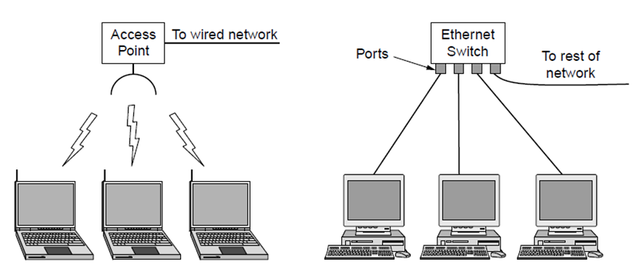
Local Area Networks
Connect devices in a home or office building
Privately owned; small geographic area
Wireless LAN
with 802.11
Wired LAN with
switched Ethernet
LANs broadcast frames

Slide 44
LANs
Wired:
Copper or optical fiber
Low delay; low error rate
Speeds from 100 Mbps to 10 Gbps
Uses IEEE 802.3 Ethernet
Classic Ethernet or switched
May use Virtual LAN (VLAN) technology

Slide 45
LANs
Wireless:
Access point (wireless router, base station)
Uses 802.11 (Wi-Fi)
Speeds from 11 Mbps to 54 Mbps
Effective range 100 meters

Slide 46
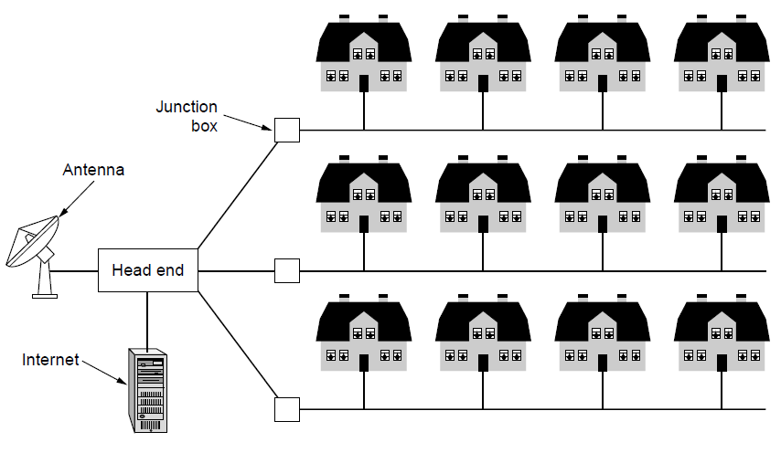
Metropolitan Area Networks
Connect devices over a metropolitan area
Example MAN based on cable TV:
46
Notes:
This is a common way in which home subscribers obtain access to the Internet in the US.

Slide 47
MANs
Cable TV networks
FIOS
IEEE 802.16 WiMAX
Metro Ethernet/Carrier Ethernet/Wide Area Ethernet

Slide 48
WANs
Cover a large geographic area
Transmission lines and switching elements
Subnet:
originally referred to lines and switches
Now also refers to network addressing at the LAN level
Hosts and subnet may have different owners
May use leased lines or Internet connections

Slide 49
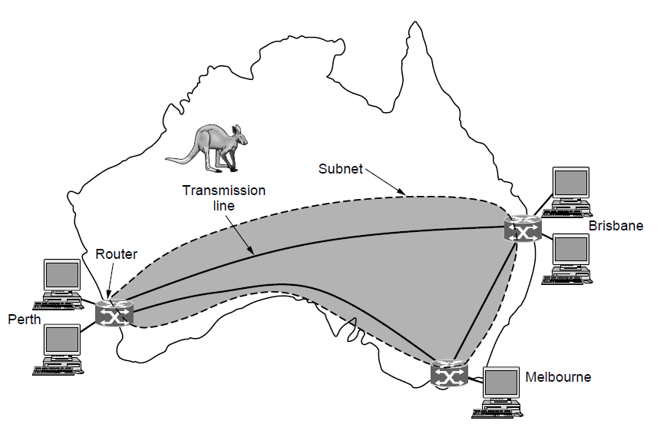
Wide Area Networks (1)
Connect devices over a country
Example WAN connecting three branch offices:
Notes:
The company probably leases the transmission lines (since most companies do not have their own lines).

Slide 50
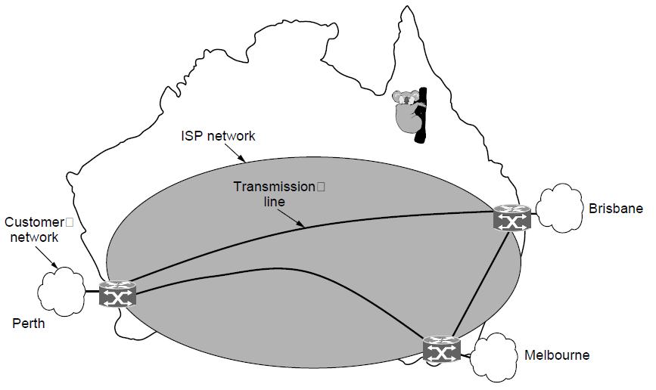
Wide Area Networks (2)
An ISP (Internet Service Provider) network is also a WAN.
Customers buy connectivity from the ISP to use it.
Notes:
Now the company/customer buys service from an ISP who uses its own lines to deliver packets.

Slide 51
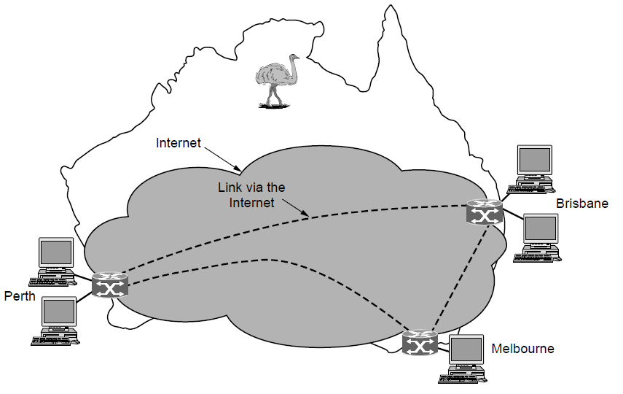
Wide Area Networks (3)
A VPN (Virtual Private Network) is a WAN built from virtual links that run on top of the Internet.
Notes:
Now the company/customer uses the Internet (might be multiple ISPs) for connectivity. The links are virtual in the sense that they refer to some path via the Internet rather than a particular transmission line.

Slide 52
Network Software
Protocol layers »
Design issues for the layers »
Connection-oriented vs. connectionless service »
Service primitives »
Relationship of services to protocols »

Slide 53
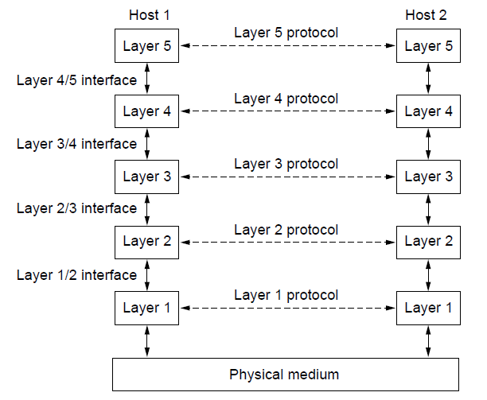
Protocol Layers (1)
Protocol layering is the main structuring method used to divide up network functionality.
Each protocol instance talks virtually to its peer
Each layer communicates only by using the one below
Lower layer services are accessed by an interface
At bottom, messages are carried by the medium
53

Slide 54
Network Software
Networks organized as a stack of layers or levels
Each layer offers services to higher layers
Protocols – an agreement between communicating parties
Determines syntax, semantics and timing
Peers: Corresponding layers on different machines
Adjacent layers communicate through an interface

Slide 55
Network Software
Network architecture: A set of layers and protocols
Protocol stack: a list of the protocols used by a certain system
Layer n entity prepends a header to a message (there may also be postpended trailer)

Slide 56
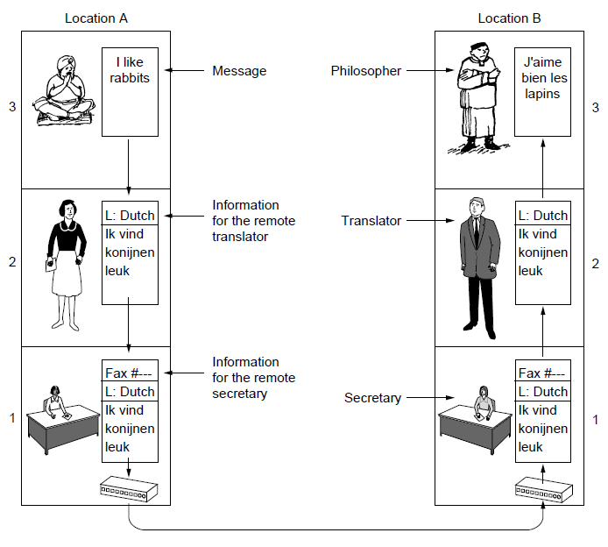
Protocol Layers (2)
Example: the philosopher-translator-secretary architecture
Each protocol at different layers serves a different purpose

Slide 57
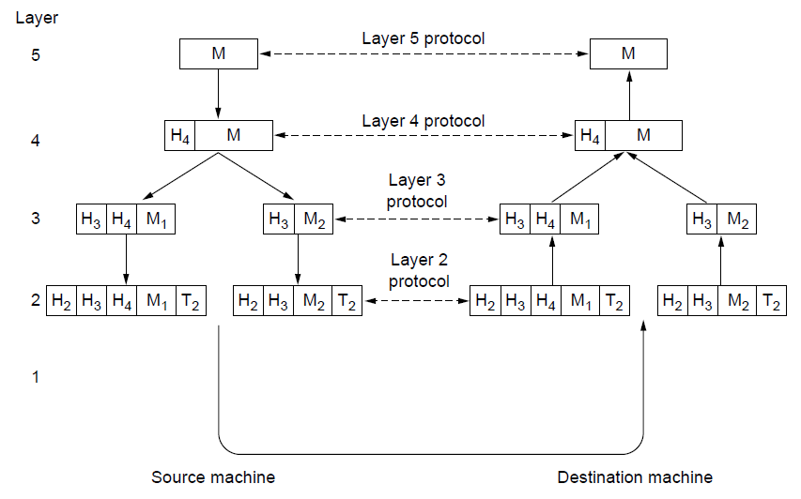
Protocol Layers (3)
Each lower layer adds its own header (with control infor-mation) to the message to transmit and removes it on receive
Layers may also split and join messages, etc.
Layer 5 Protocol Data Unit (PDU)
The message (or PDU) of layer n becomes the payload of layer n+1
Layer 4 PDU
Layer 3 PDU
Layer 2 PDU

Slide 58
Design Issues for the Layers
Each layer solves a particular problem but must include mechanisms to address a set of recurring design issues
Issue | Example mechanisms at different layers
Reliability despite failures | Codes for error detection/correction (§3.2, 3.3) Routing around failures (§5.2)
Network growth and evolution | Addressing (§5.6) and naming (§7.1) Protocol layering (§1.3)
Allocation of resources like bandwidth | Multiple access (§4.2) Congestion control (§5.3, 6.3)
Security against various threats | Confidentiality of messages (§8.2, 8.6) Authentication of communicating parties (§8.7)
58
Notes:
The point is that there are some issues that are not wholly the responsibility of any one layer, and they crop up again and again in the text. For example, reliability is often considered a key function of the transport layer (i.e., making transport reliable) yet reliability mechanisms also appear in other layers (error codes in the link layer, routing around failures in the network layer, and replication at the application layer).

Slide 59
Design Issues
Reliability
Error detection (and possibly correction)
Routing
Addressing
Bandwidth sharing: statistical multiplexing

Slide 60
Design Issues
Flow control
Congestion
Real-time delivery
Quality of Service (QoS)
Confidentiality, integrity and authentication

Slide 61
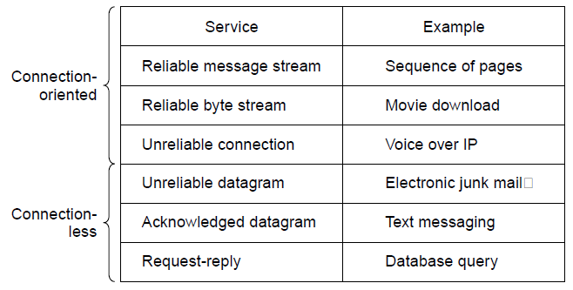
Connection-Oriented vs. Connectionless
Service provided by a layer may be either:
Connection-oriented, must be set up for ongoing use (and torn down after use), e.g., phone call
Connectionless, messages are handled separately, e.g., postal delivery
Notes:
TCP provides a reliable bytestream service at the Transport layer, IP provides unreliable datagram service at the Network layer.
More examples: RTP (used to carry VoIP data) provides unreliable connection service; 802.11 (WiFi) provides acknowledged datagram service; Ethernet provides unreliable datagram service.

Slide 62
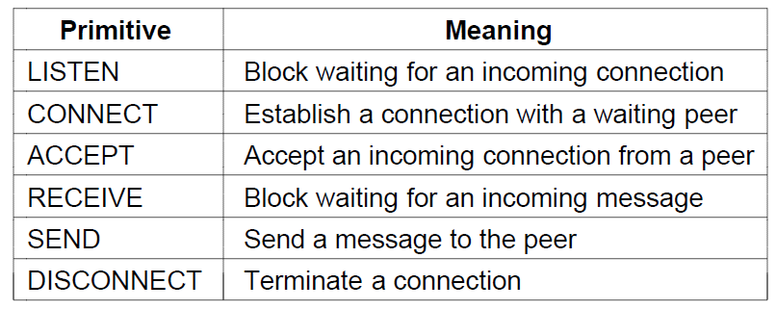
Service Primitives (1)
A service is provided to the layer above as primitives
Hypothetical example of service primitives that may provide a reliable byte stream (connection-oriented) service:
Simplified version of Berkeley sockets interface

Slide 63
Service Primitives (2)
Hypothetical example of how these primitives may be used for a client-server interaction
Client
Server
LISTEN (0)
CONNECT (1)
Connect request
ACCEPT
(2)
Accept response
RECEIVE
SEND
Request for data
(3)
RECEIVE
SEND (4)
Reply
DISCONNECT (5)
Disconnect
DISCONNECT (6)
Disconnect
Notes:
The primitives are called at the client and server by the higher layer using the service. The layer implements the primitives by sending messages using the services of the lower layer; these messages are assumed to be reliable for simplicity and the lower layer service is not otherwise described.
This is similar to the way that simple Web browsers and Web servers work today.

Slide 64
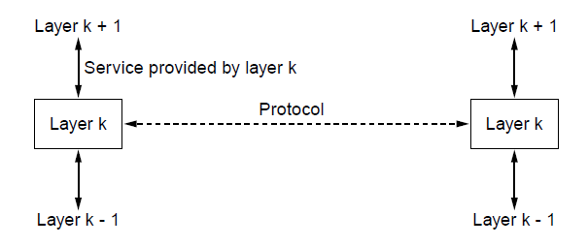
Relationship of Services to Protocols
Recap:
A layer provides a service to the one above [vertical]
A layer talks to its peer using a protocol [horizontal]
64

Slide 65
Reference Models
Reference models describe the layers in a network architecture
OSI reference model »
TCP/IP reference model »
Model used for this text »
Critique of OSI and TCP/IP (not covered)»

Slide 66
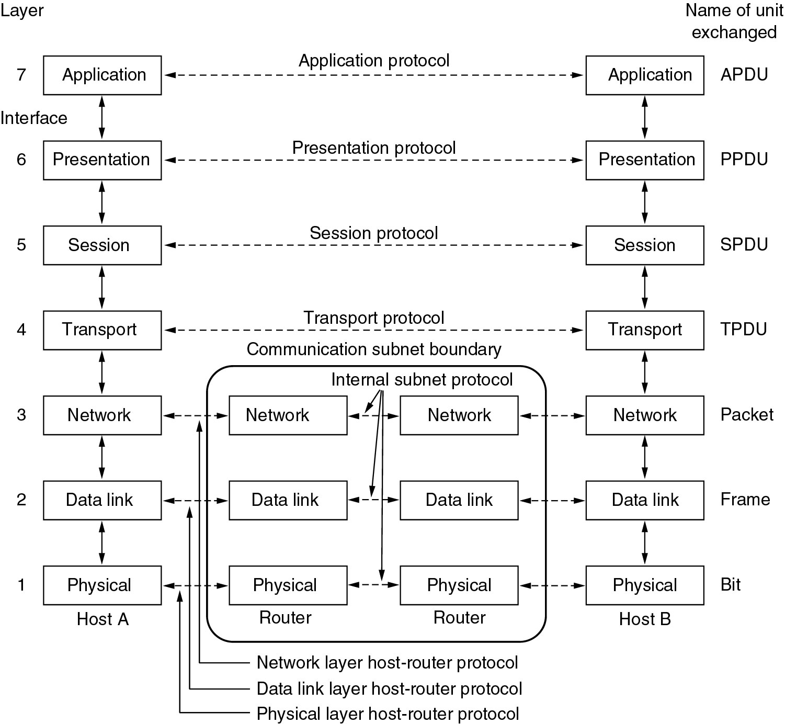
Reference Models
The OSI reference model
Fig 1.20
Layers 1 - 3 are chained (p. 44)
Layers 4 - 7 are end-to-end

Slide 67
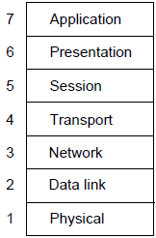
OSI Reference Model
A principled, international standard, seven layer model to connect different systems
– Provides functions needed by users
– Converts different representations
– Manages task dialogs
– Provides end-to-end delivery
– Sends packets over multiple links
– Sends frames of information
– Sends bits as signals

Slide 68
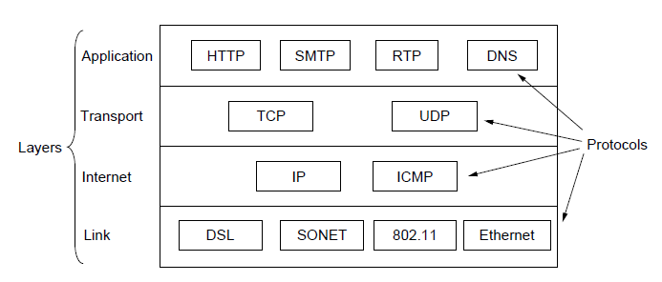
TCP/IP Reference Model
A four layer model derived from experimentation; omits some OSI layers and uses the IP as the network layer.
Lots of choices
IP is the “narrow waist” of the Internet
Lots of choices
Protocols are shown in their respective layers
Notes:
The comment about the narrow waist refers to the fact that the network layer of the Internet is IP (Internet Protocol) such that the network layer is called the “Internet” layer. The significance is that all Internet devices speak IP, which provides a point of interoperability that enables innovation both above (new applications and transports) and below (new link technologies).

Slide 69
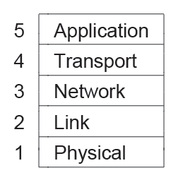
Model Used in this Book
It is based on the TCP/IP model but we call out the physical layer and look beyond Internet protocols.
Message
Segment
A hybrid of the OSI and TCP/IP models
Packet
Frame
(and on a test)
69

Slide 70
Critique of OSI & TCP/IP
OSI:
Very influential model with clear concepts
Models, protocols and adoption all bogged down by politics and complexity
TCP/IP:
Very successful protocols that worked well and thrived
Weak model derived after the fact from protocols

Slide 71
Example Networks
The Internet »
3G mobile phone networks (slides hidden)»
Wireless LANs (slides hidden)»
RFID and sensor networks (slides hidden)»

Slide 72
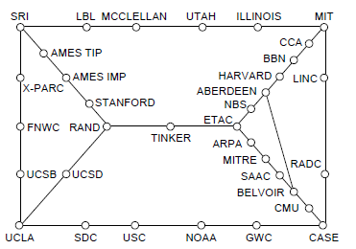
Internet (1)
Before the Internet was the ARPANET, a decentralized, packet-switched network based on Baran’s ideas.
Nodes are IMPs, or early routers, linked to hosts
56 kbps links
ARPANET topology in Sept 1972.
72
Notes:
Decentralized or fully distributed is a contrast to the hierarchical telephone network that came beforehand. Unlike the telephone network, blowing up a single important node will not break the network or large portions of it.

Slide 73
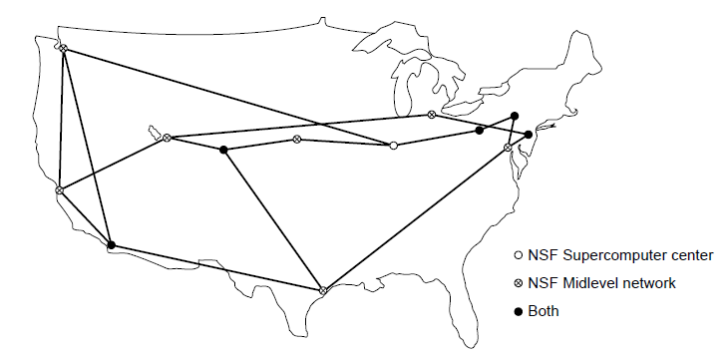
Internet (2)
The early Internet used NSFNET (1985-1995) as its backbone; universities connected to get on the Internet
T1 links (1.5 Mbps)
NSFNET topology in 1988
73
Notes:
NSFNET was an academic research network growing out of CSNET that was created so that universities without DoD contracts could participate. It was initially connected to the ARPANET by gateways, and later took over the central role as the “backbone of the Internet”, i.e., the network through which packets passed on their way between parties connected to different parts of the Internet.

Slide 74
Internet (3)
The modern Internet is more complex:
ISP networks serve as the Internet backbone
ISPs connect or peer to exchange traffic at IXPs
Within each network routers switch packets
Between networks, traffic exchange is set by business agreements
Customers connect at the edge by many means
Cable, DSL, Fiber-to-the-Home, 3G/4G wireless, dialup
Data centers concentrate many servers (“the cloud”)
Most traffic is content from data centers (esp. video)
The architecture continues to evolve
74
Notes:
ISP = Internet Service Provicer, IXP = Internet eXchange Point

Slide 75
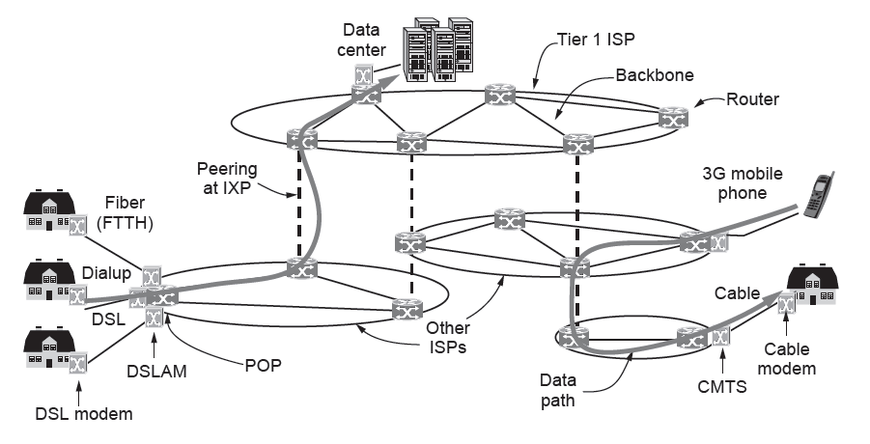
Internet (4)
Backbone networks and networks of a similar size exchange traffic on a “settlement-free” basis, i.e., without charging each other.
Backbone ISPs charge lower-tier networks for “transit services” which connect the lower-tier networks to other networks.
For a good discussion of IXPs, see:
Promoting the use of Internet Exchange Points (IXPs)
Note: The term “IXP” has replaced “NAP”
Architecture of the Internet

Slide 76
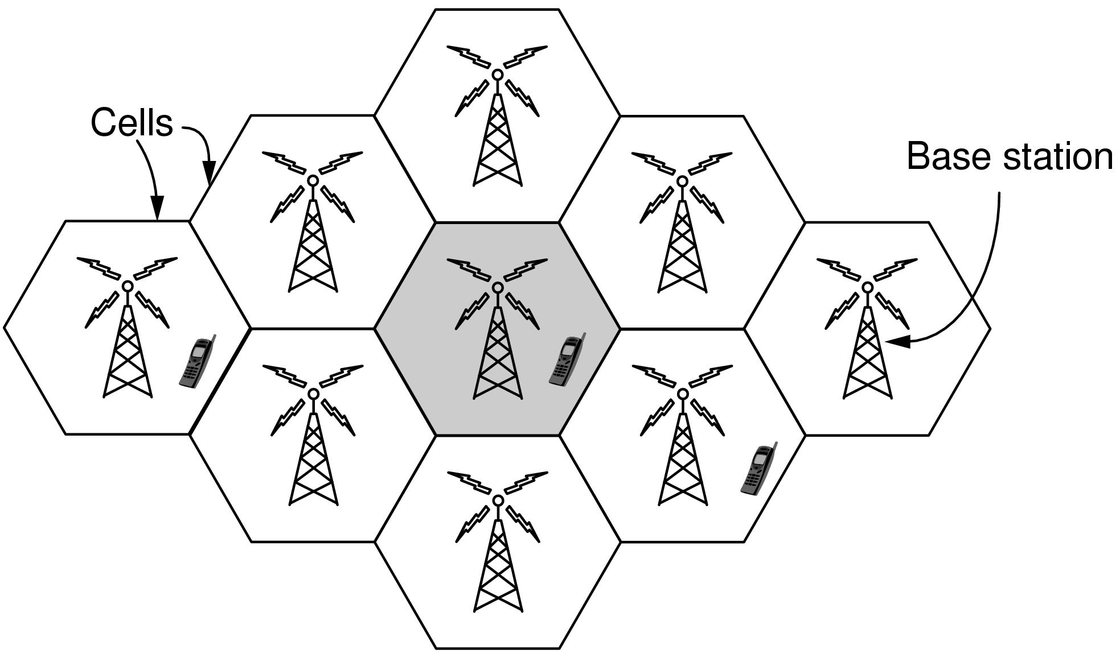
3G Mobile Phone Networks (1)
3G network is based on spatial cells; each cell provides wireless service to mobiles within it via a base station
76

Slide 77
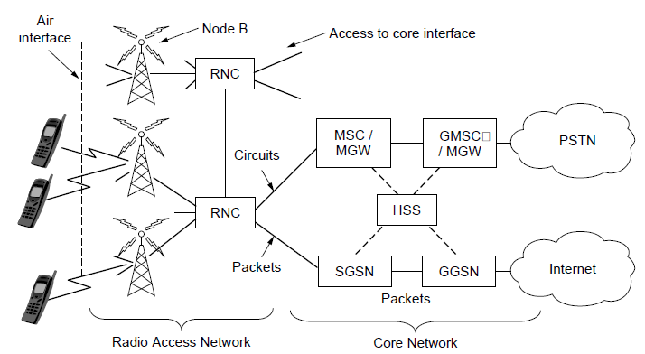
3G Mobile Phone Networks (2)
Base stations connect to the core network to find other mobiles and send data to the phone network and Internet

Slide 78
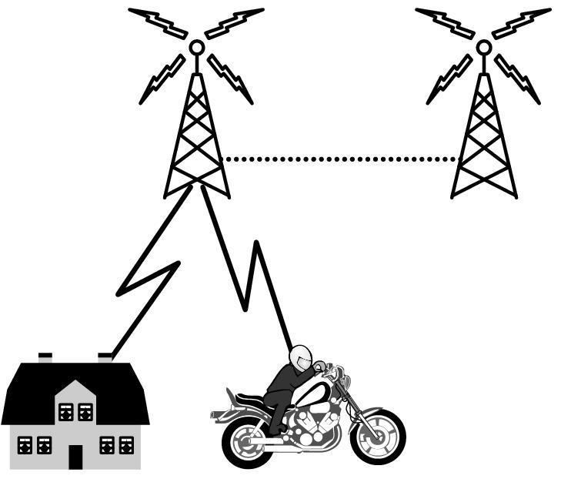
3G Mobile Phone Networks (3)
As mobiles move, base stations hand them off from one cell to the next, and the network tracks their location
Handover
78

Slide 79
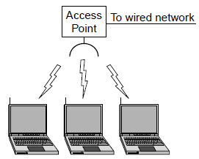
Wireless LANs (1)
In 802.11, clients communicate via an AP (Access Point) that is wired to the rest of the network.
79

Slide 80
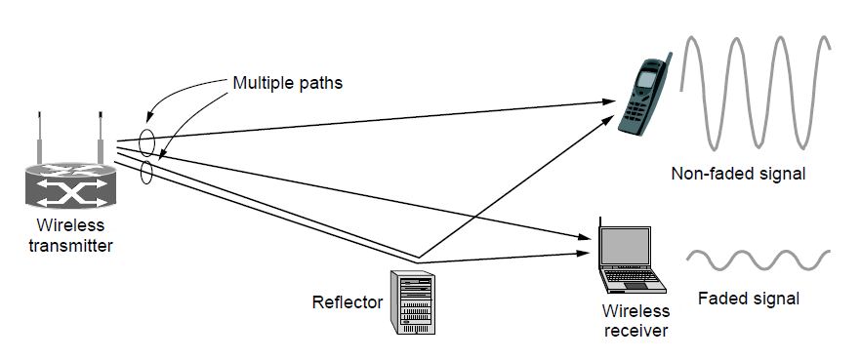
Wireless LANs (2)
Signals in the 2.4GHz ISM band vary in strength due to many effects, such as multipath fading due to reflections
requires complex transmission schemes, e.g., OFDM
80

Slide 81
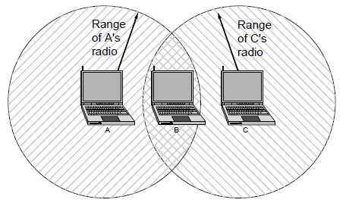
Wireless LANs (3)
Radio broadcasts interfere with each other, and radio ranges may incompletely overlap
CSMA (Carrier Sense Multiple Access) designs are used
81
Notes:
Both broadcast and different ranges are complications that do not exist for point-to-point wired links.

Slide 82
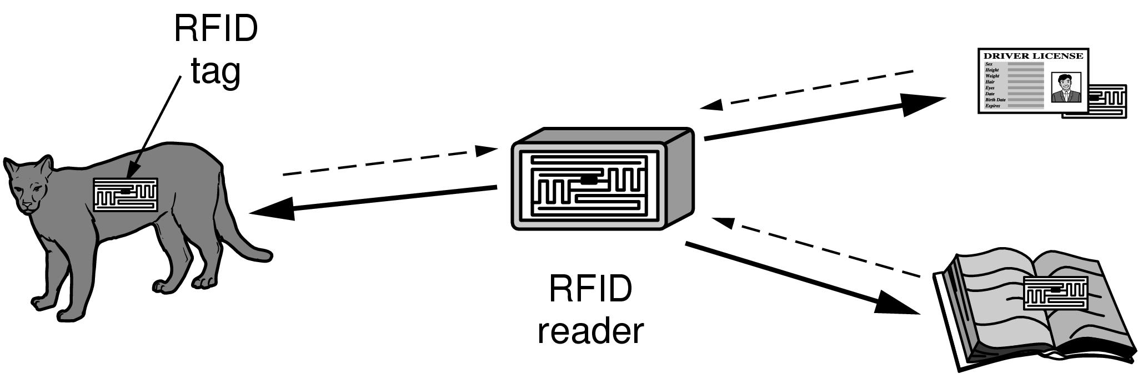
RFID and Sensor Networks (1)
Passive UHF RFID networks everyday objects:
Tags (stickers with not even a battery) are placed on objects
Readers send signals that the tags reflect to communicate
82

Slide 83
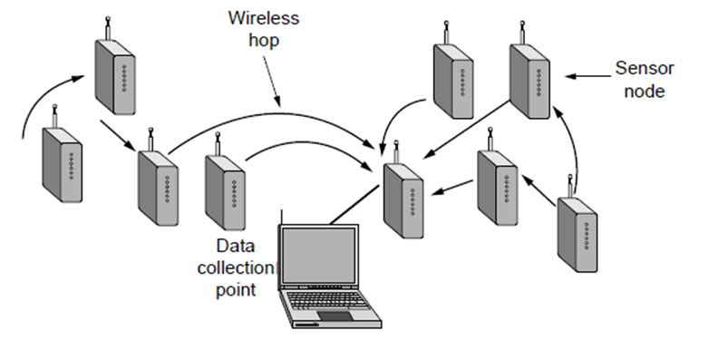
RFID and Sensor Networks (2)
Sensor networks spread small devices over an area:
Devices send sensed data to collector via wireless hops
83

Slide 84
Network Standardization
Standards ensure that systems can interconnect with and interoperate with each other
De facto (“By fact”) established by popular use (e.g., TCP/IP computer interconnection protocols)
De jure (“By right”) established by standards organizations and expert committees (e.g., Ethernet designated 802.3 by IEEE)
These are Open standards
Proprietary Company-based standards (e.g., Microsoft Windows operating system)
Open Available to anyone who wants to study or implement them (e.g., TCP/IP)

Slide 85
Network Standardization
Standards define what is needed for interoperability
Some of the many standards bodies:
Body | Area | Examples
ITU | Telecommunications | G.992, ADSL H.264, MPEG4
IEEE | Communications | 802.3, Ethernet 802.11, WiFi
IETF | Internet | RFC 2616, HTTP/1.1 RFC 1034/1035, DNS
W3C | Web | HTML5 standard CSS standard
85

Slide 86
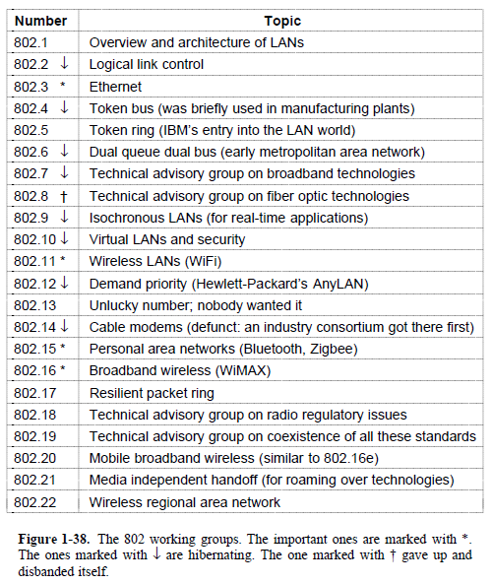
Network Standardization

Slide 87
Network Standardization
Students should read remaining material on this topic

Slide 88
Metric Units
The main prefixes we use:
Use powers of 10 for rates, powers of 2 for storage
E.g., 1 Mbps = 1,000,000 bps, 1 KB = 1024 bytes
“B” is for bytes, “b” is for bits
Prefix | Exp. | prefix | exp.
K(ilo) | 10³ | m(illi) | 10⁻³
M(ega) | 10⁶ | μ(micro) | 10⁻⁶
G(iga) | 10⁹ | n(ano) | 10⁻⁹
88
Notes:
You’ll also see kbps and KB. The lowercase k in kbps is for historical reasons.

Slide 89
End
Chapter 1

