Slide 1
The Data Link Layer Chapter 3
Data Link Layer Design Issues
Error Detection and Correction
Elementary Data Link Protocols
Sliding Window Protocols
Example Data Link Protocols
Revised: August 2011
Notes:
Gray units can be optionally omitted without causing later gaps

Slide 2
The Data Link Layer
Responsible for delivering frames of information over a single link
Handles transmission errors and regulates the flow of data
Application
Transport
Network
Link
Physical

Slide 3
Data Link Layer Design Issues
Frames »
Possible services »
Framing methods »
Error control »
Flow control »

Slide 4
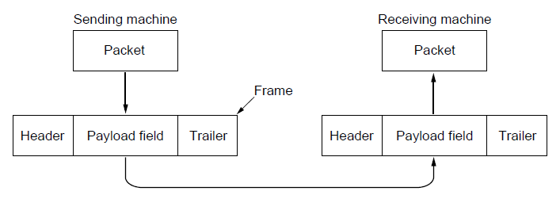
Frames
Link layer accepts packets from the network layer, and encapsulates them into frames that it sends using the physical layer; reception is the opposite process
Network
Link
Virtual data path
Physical
Actual data path

Slide 5
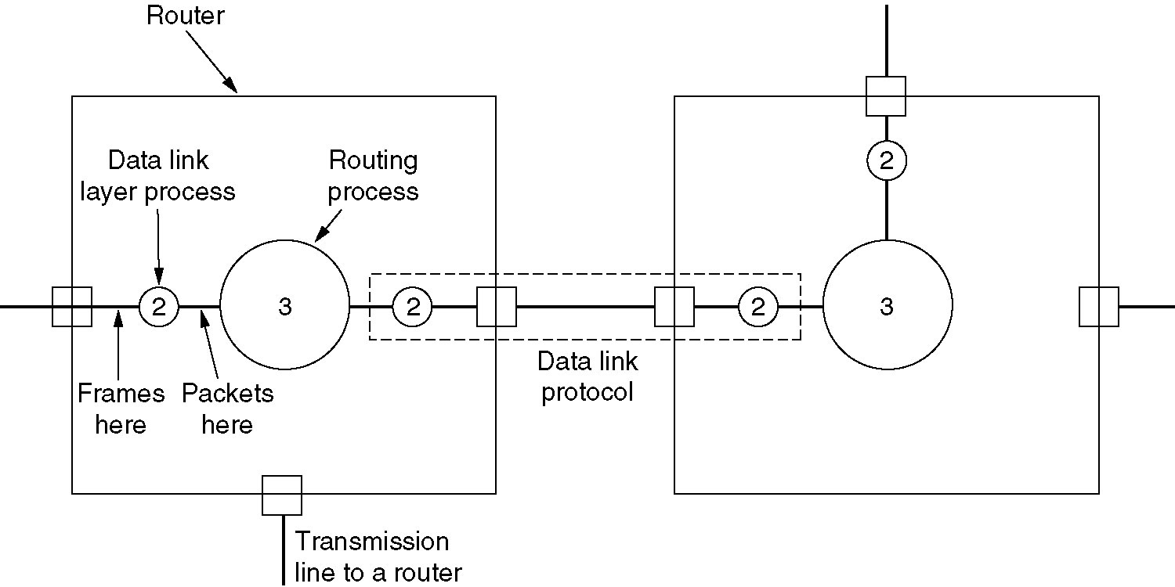
Placement of the data link protocol
Placement of the data link protocol.
Slide from 4th Edition

Slide 6
Possible Services
Unacknowledged connectionless service
Frame is sent with no connection / error recovery
Ethernet is example (why?)
Acknowledged connectionless service
Frame is sent with retransmissions if needed
Example is 802.11 (why?)
Acknowledged connection-oriented service
Connection is set up; rare
Common in past

Slide 7
Framing Methods
Byte count »
Flag bytes with byte stuffing »
Flag bits with bit stuffing »
Physical layer coding violations
Use non-data symbol (such as an unused 4B/5B code) point to indicate frame

Slide 8
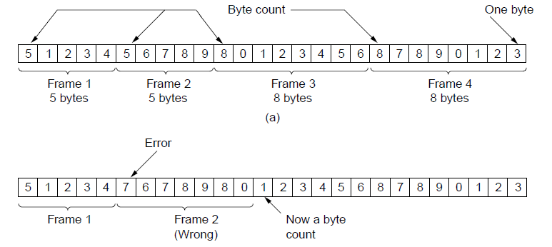
Framing – Byte count
Frame begins with a count of the number of bytes in it
Simple, but difficult to resynchronize after an error
Expected
case
Error
case

Slide 9
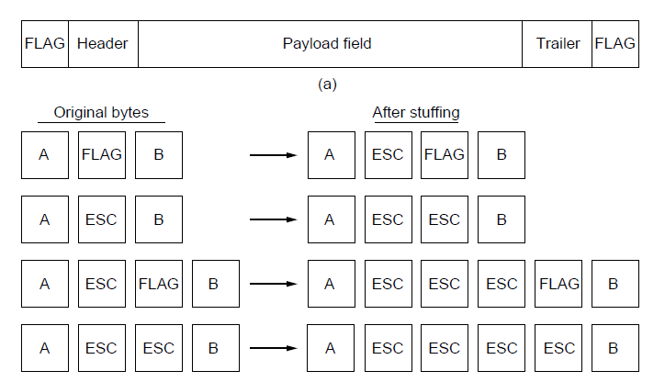
Framing – Byte stuffing
Special flag bytes delimit frames; occurrences of flags in the data must be stuffed (escaped)
Longer, but easy to resynchronize after error
Used in PPP
Frame
format
Need to escape extra ESCAPE bytes too!
Stuffing
examples

Slide 10
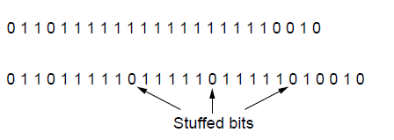
Framing – Bit stuffing
Stuffing done at the bit level:
Frame flag has six consecutive 1s (not shown)
On transmit, after five 1s in the data, a 0 is added
On receive, a 0 after five 1s is deleted
Used in HDLC (formerly commonly used)
Data bits
Transmitted bits
with stuffing

Slide 11
Error Control
Error control repairs frames that are received in error
Requires errors to be detected at the receiver
Typically retransmit the unacknowledged frames
Timer protects against lost acknowledgements
Detecting errors and retransmissions are next topics.
Notes:
We’ll get to this later in the chapter (error detection/correction, and elementary data link protocols)

Slide 12
Flow Control
Prevents a fast sender from out-pacing a slow receiver
Receiver gives feedback on the data it can accept
Rare in the Link layer as NICs run at “wire speed”
Receiver can take data as fast as it can be sent
(Why is link layer implemented in a NIC?)
Flow control is a topic in the Link and Transport layers.
Notes:
We’ll get to this later in the chapter (sliding window protocol) but note that flow control is mostly the responsibility of the Transport layer in practice (e.g., TCP)

Slide 13
Error Detection and Correction
Error codes add structured redundancy to data so errors can be either detected, or corrected.
Error correction codes:
Hamming codes »
Binary convolutional codes »
Reed-Solomon and Low-Density Parity Check codes
Mathematically complex, widely used in real systems
Error detection codes:
Parity »
Checksums »
Cyclic redundancy codes »

Slide 14
Error Bounds – Hamming distance
Code turns data of n bits into codewords of n+k bits
Hamming distance is the minimum bit flips to turn one valid codeword into any other valid one.
Example with 4 codewords of 10 bits (n=2, k=8):
0000000000, 0000011111, 1111100000, and 1111111111
Hamming distance is 5
Bounds for a code with distance:
2d+1 – can correct d errors (e.g., 2 errors above)
d+1 – can detect d errors (e.g., 4 errors above)
Notes:
Why can a code with distance d+1 detect up to d errors? Because errors are detected by receiving invalid codewords (like 0101010101 for the example). If there are d+1 or more errors then one valid codeword may be turned into another valid codeword and there is no way to detect that an error has occurred.
Why can a code with distance 2d+1 detect up to d errors? Because errors are corrected by mapping a received invalid codeword to the nearest valid codeword, i.e., the one that can be reached with the fewest bit flips. If there are more than d bit flips, then the received codeword may be closer to another valid codeword than the codeword that was sent. For example, sending 0000000000 with 2 flips might give 1100000000 which is closest to 0000000000, correcting the error. But with 3 flips 1110000000 might be received, which is closest to 1111100000, which is still an error.

Slide 15
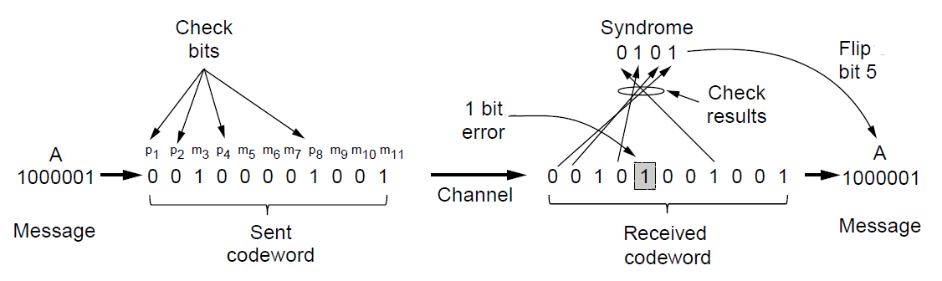
Error Correction – Hamming code
Hamming code gives a simple way to add check bits and correct up to a single bit error:
Check bits are parity over subsets of the codeword
Recomputing the parity sums (syndrome) gives the position of the error to flip, or 0 if there is no error
(11, 7) Hamming code adds 4 check bits and can correct 1 error

Slide 16
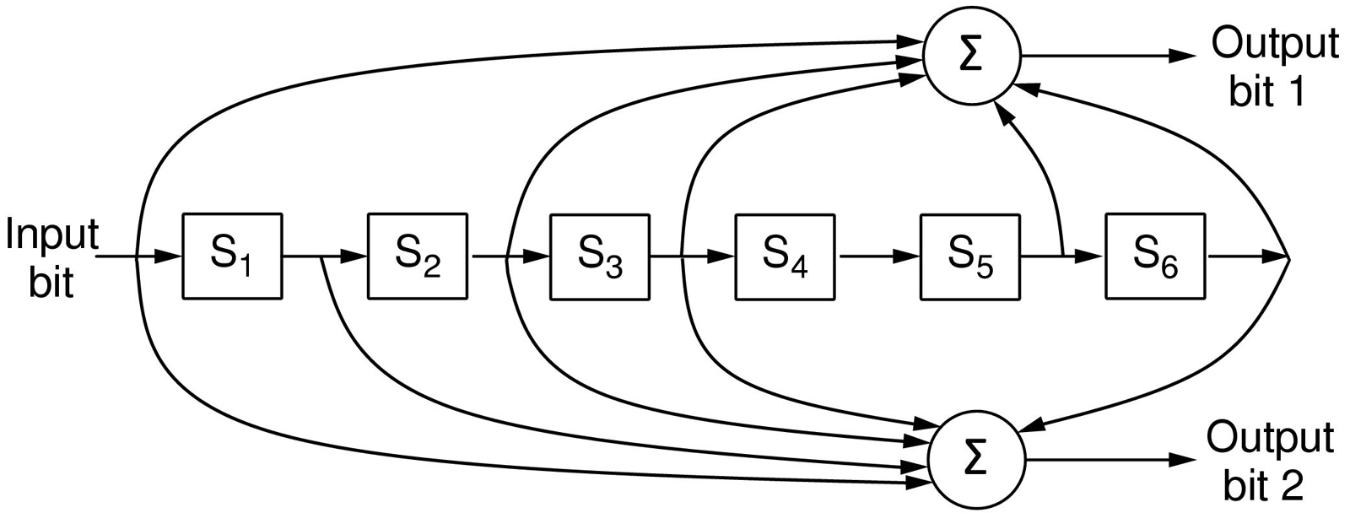
Error Correction – Convolutional codes
Operates on a stream of bits, keeping internal state
Output stream is a function of all preceding input bits
Bits are decoded with the Viterbi algorithm
… 1 1 1
…
0 1 1
1 0 1
Popular NASA binary convolutional code (rate = ½) used in 802.11

Slide 17
Error Detection – Parity (1)
Parity bit is added as the modulo 2 sum of data bits
Equivalent to XOR; this is even parity
Ex: 1110000 → 11100001
Detection checks if the sum is wrong (an error)
Simple way to detect an odd number of errors
Ex: 1 error, 11100101; detected, sum is wrong
Ex: 3 errors, 11011001; detected sum is wrong
Ex: 2 errors, 11101101; not detected, sum is right!
Error can also be in the parity bit itself
Random errors are detected with probability ½

Slide 18
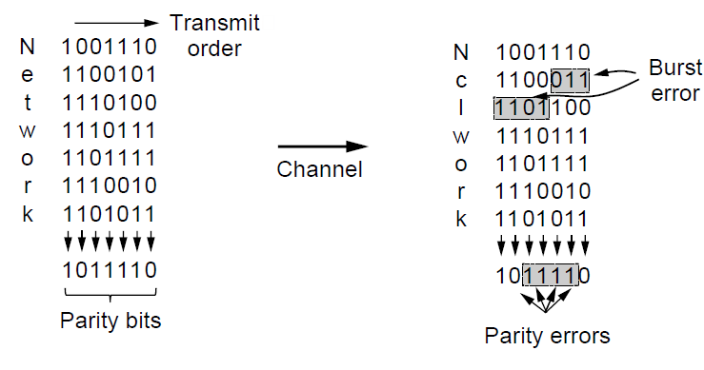
Error Detection – Parity (2)
Interleaving of N parity bits detects burst errors up to N
Each parity sum is made over non-adjacent bits
An even burst of up to N errors will not cause it to fail
A burst lasts from the first bit in error to the last bit in error

Slide 19
Error Detection – Checksums
Checksum treats data as N-bit words and adds N check bits that are the modulo 2^{N} sum of the words
Ex: Internet 16-bit 1s complement checksum
Properties:
Improved error detection over parity bits
Detects bursts up to N errors
Detects random errors with probability 1-2^{N}
Vulnerable to systematic errors, e.g., added zeros

Slide 20
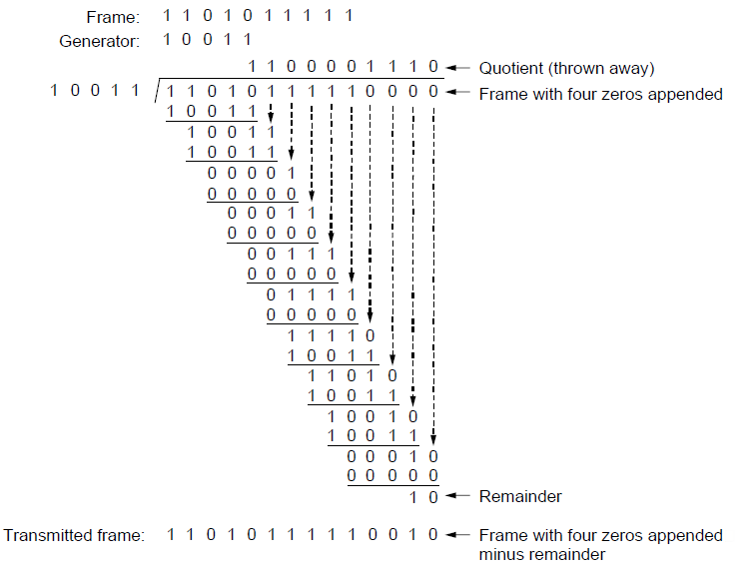
Error Detection – CRCs (1)
Adds bits so that transmitted frame viewed as a polynomial is evenly divisible by a generator polynomial
Start by adding 0s to frame and try dividing
Generator polynomial G(x) = x⁴ + x + 1
Add r zero bits to the low-order end of the frame, where r = degree (4 in this case) of G(x)
Offset by any reminder to make it evenly divisible

Slide 21
Error Detection – CRCs (2)
Based on standard polynomials:
Ex: Ethernet 32-bit CRC is defined by:
Computed with simple shift/XOR circuits
Stronger detection than checksums:
E.g., can detect all double bit errors
Not vulnerable to systematic errors
Has property that all bursts of 32 bits or less are detected as well as all bursts affecting an odd number of bits.

Slide 22
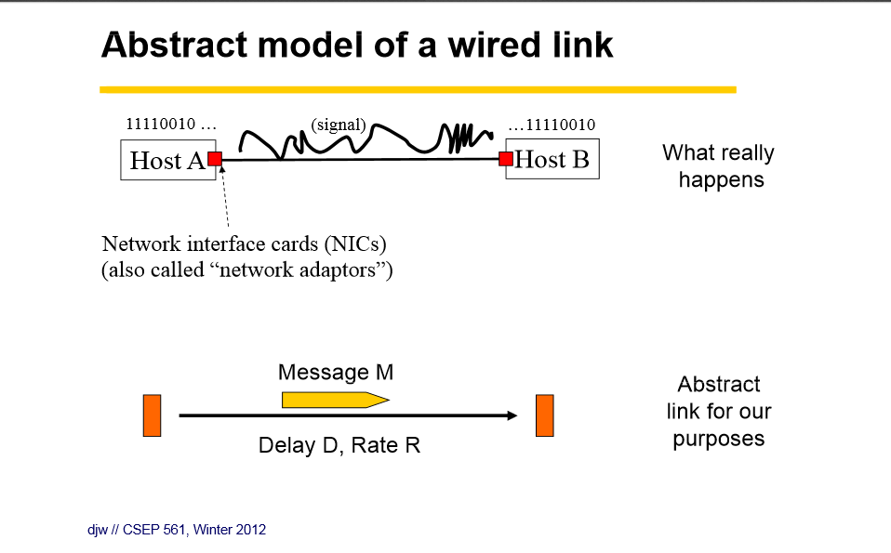

Slide 23
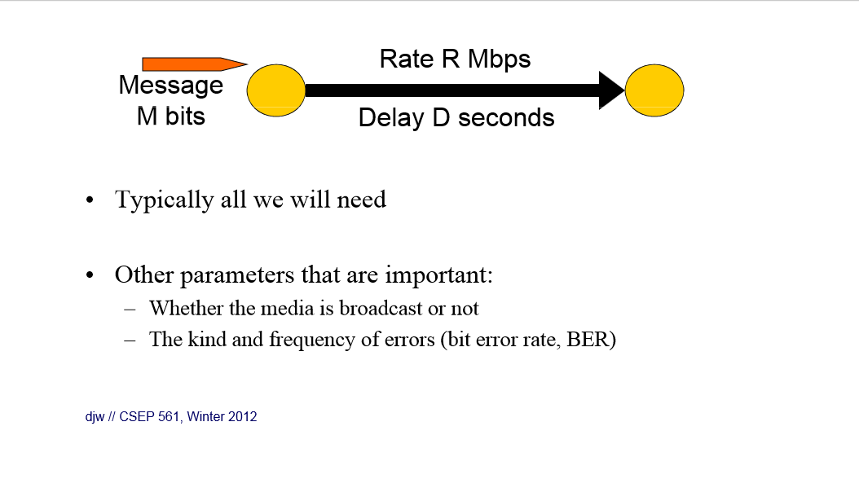

Slide 24
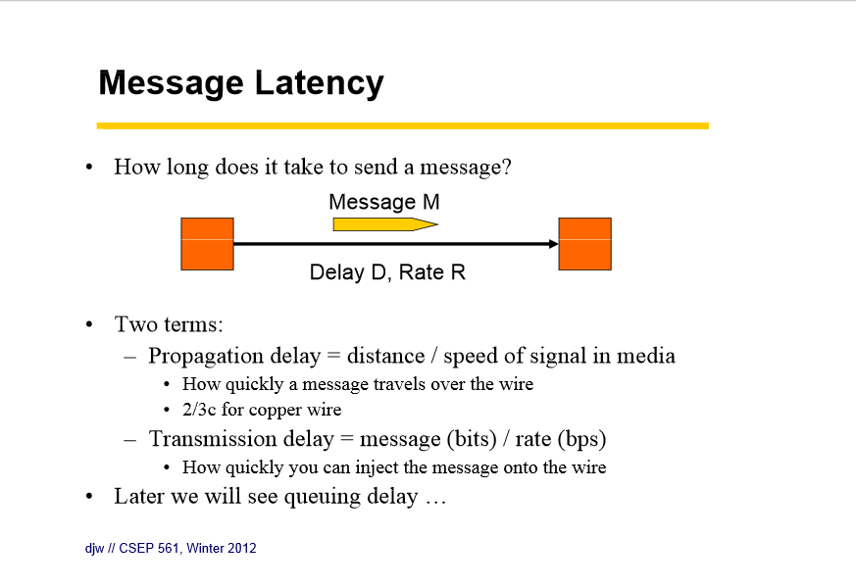

Slide 25
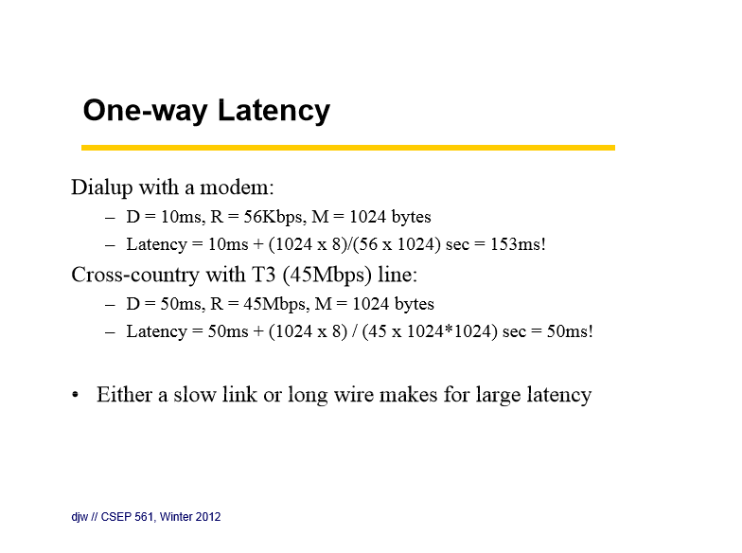
Long time to put the bits on the slow link
Long transit delay

Slide 26
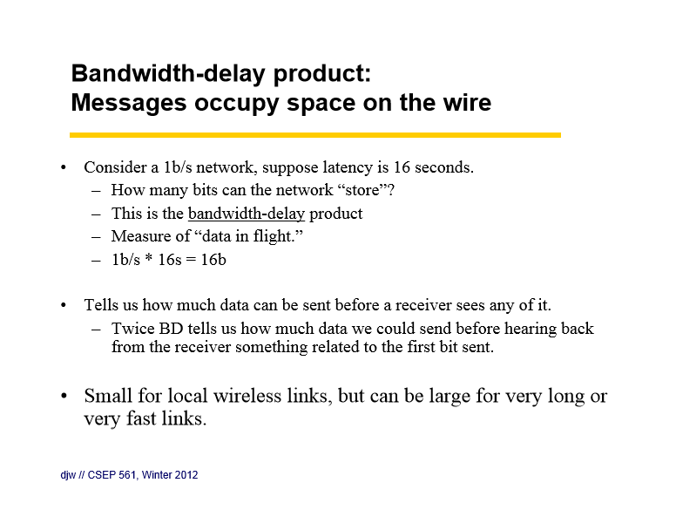

Slide 27
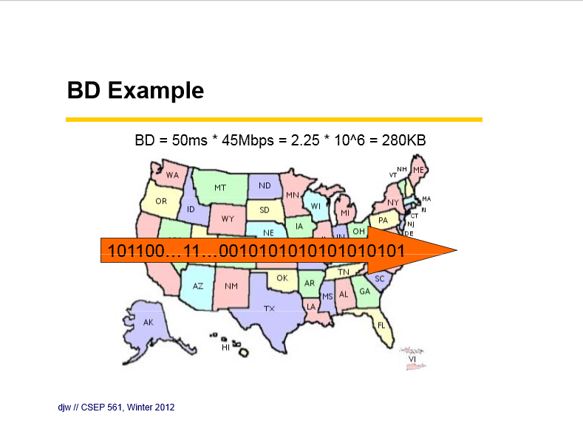
Assuming a 50 ms. coast-to-coast transit latency, and a T-3 (45 mbps) line, it takes 2,225,000 bits (280 KB of data) to fill the pipe, i.e. the line is transmitting bits for 50 msec at 45 mbps.

Slide 28
Another Bandwidth Delay Example (3.4.2)
Consider a link having one-way transit delay of 250 msec. (satellite), a frame size of 1,000 bits and a speed of 50 kbps.
Time in msec.
0 20 270 520
Time to write 1,000-bit message on 50 kbps line
One-way transit delay of 250 msec. (twice for round trip)
If using stop-and-wait, efficiency is 20/520 = 4%
SJW

Slide 29
Elementary Data Link Protocols
Link layer environment »
Utopian Simplex Protocol »
Stop-and-Wait Protocol for Error-free channel »
Stop-and-Wait Protocol for Noisy channel »

Slide 30
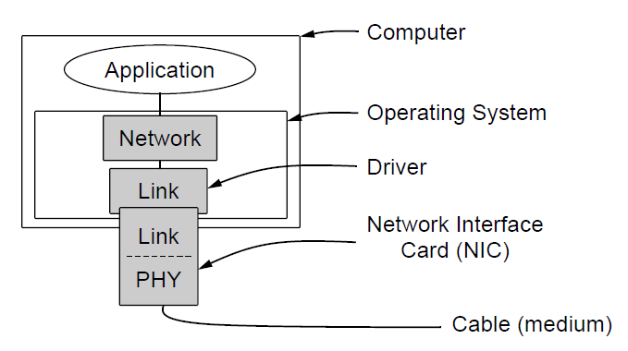
Link layer environment (1)
Commonly implemented as NICs and OS drivers; network layer (IP) is often OS software
Why is the network layer implemented as part of the
OS while the link layer is
Implemented on a separate card?

Slide 31
Link layer environment (2)
Link layer protocol implementations use library functions
See code (protocol.h) for more details
Group | Library Function | Description
Network layer | from_network_layer(&packet) to_network_layer(&packet) enable_network_layer() disable_network_layer() | Take a packet from network layer to send Deliver a received packet to network layer Let network cause “ready” events Prevent network “ready” events
Physical layer | from_physical_layer(&frame) to_physical_layer(&frame) | Get an incoming frame from physical layer Pass an outgoing frame to physical layer
Events & timers | wait_for_event(&event) start_timer(seq_nr) stop_timer(seq_nr) start_ack_timer() stop_ack_timer() | Wait for a packet / frame / timer event Start a countdown timer running Stop a countdown timer from running Start the ACK countdown timer Stop the ACK countdown timer

Slide 32
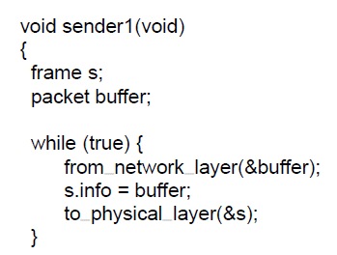
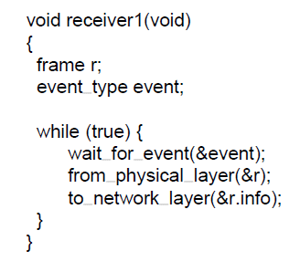
Utopian Simplex Protocol
An optimistic protocol (p1) to get us started
Assumes no errors, and receiver as fast as sender
Considers one-way data transfer
That’s it, no error or flow control …
}
Sender loops blasting frames
Receiver loops eating frames
Notes:
This is essentially what Ethernet does – just blast packets and receive as quickly as possible

Slide 33
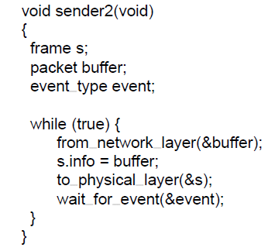
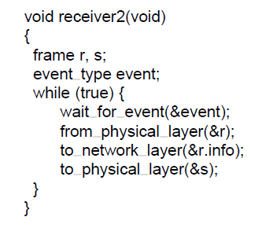
Stop-and-Wait – Error-free channel
Protocol (p2) ensures sender can’t outpace receiver:
Receiver returns a dummy frame (ack) when ready
Only one frame out at a time – called stop-and-wait
We added flow control!
Sender waits to for ack after passing frame to physical layer
Receiver sends ack after passing frame to network layer
Notes:
This is an intermediate protocol in which we’ve dealt with one issue (flow control) but not another (error control). It is instructive, but does not represent any real protocol (as it will deadlock if there are errors).

Slide 34
Stop-and-Wait – Noisy channel (1)
ARQ (Automatic Repeat reQuest) adds error control
Receiver acks frames that are correctly delivered
Sender sets timer and resends frame (if no ack)
For correctness, frames and acks must be numbered
Else receiver can’t tell retransmission (due to lost ack or early timer) from new frame
For stop-and-wait, 2 numbers (1 bit) are sufficient
Notes:
ARQ is also called PAR (Positive Acknowledgement with Retransmission)

Slide 35
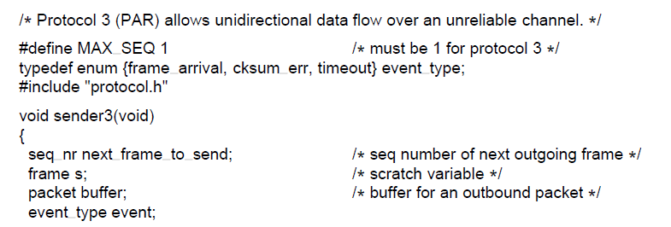
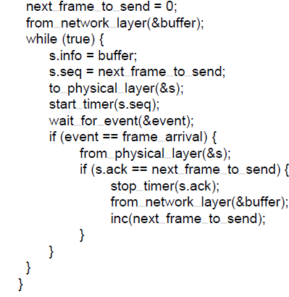
Stop-and-Wait – Noisy channel (2)
{
Sender loop (p3):
Send frame (or retransmission)
Set timer for retransmission
Wait for ack or timeout
If a good ack then set up for the next frame to send (else the old frame will be retransmitted)
Notes:
This is essentially what 802.11 does – stop-and-wait to handle wireless errors. There are differences in the details: 802.11 uses a larger sequence number (12 bits) and gives up after a limited number of retransmissions (retries).

Slide 36
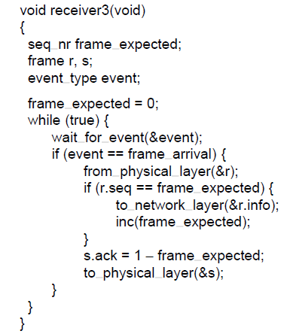
Stop-and-Wait – Noisy channel (3)
Receiver loop (p3):
Wait for a frame
If it’s new then take it and advance expected frame
Ack current frame

Slide 37
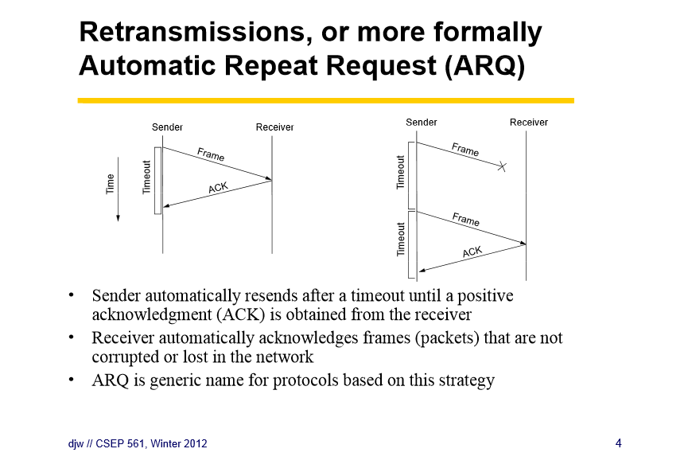

Slide 38
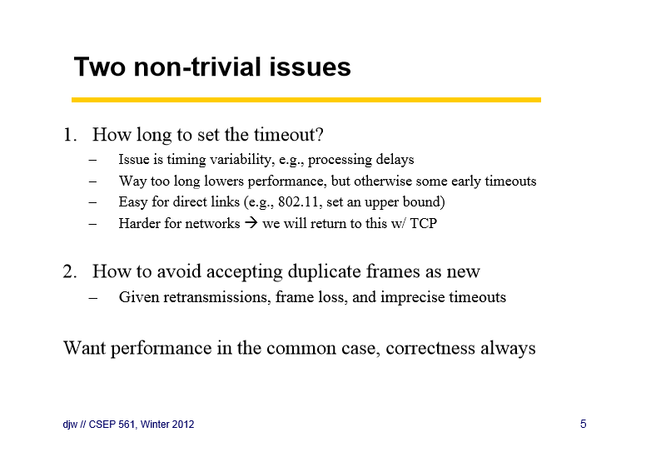

Slide 39
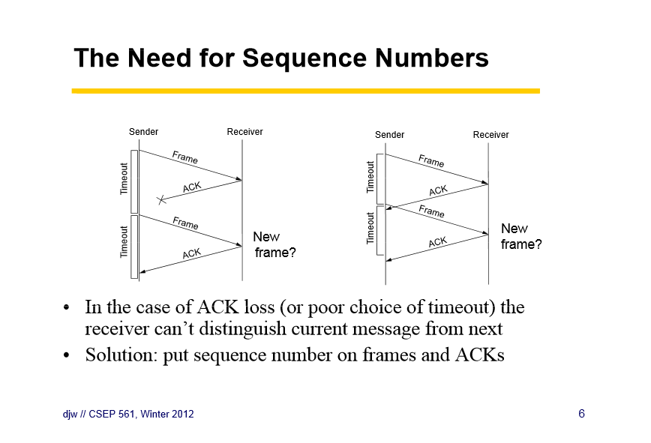

Slide 40
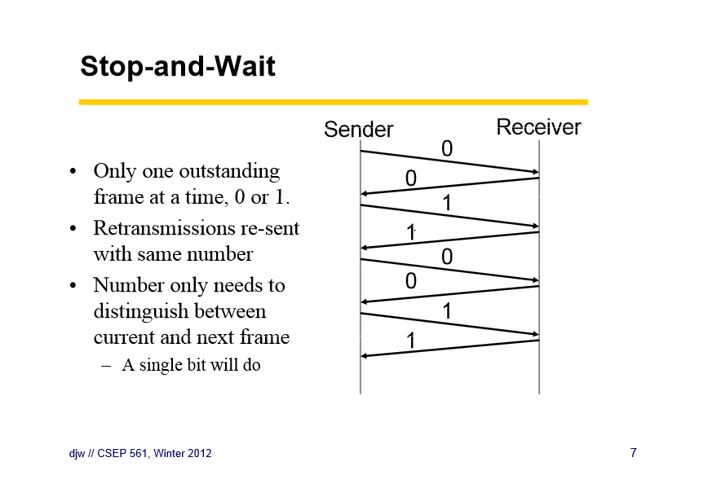

Slide 41
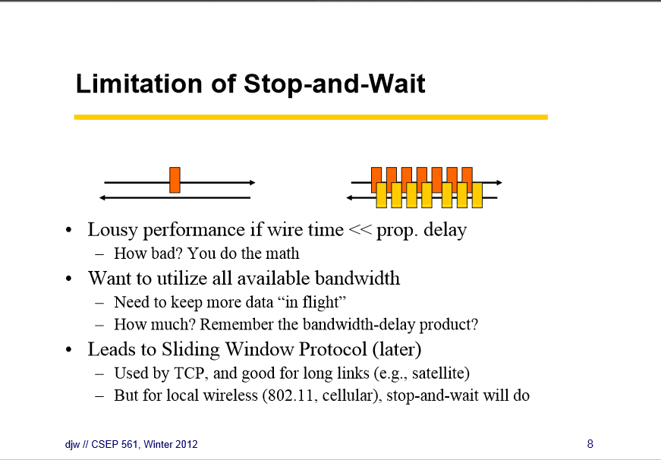

Slide 42
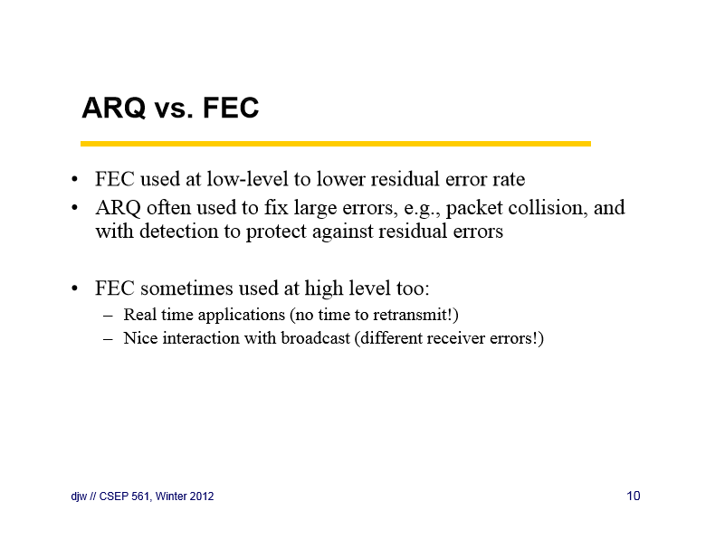

Slide 43
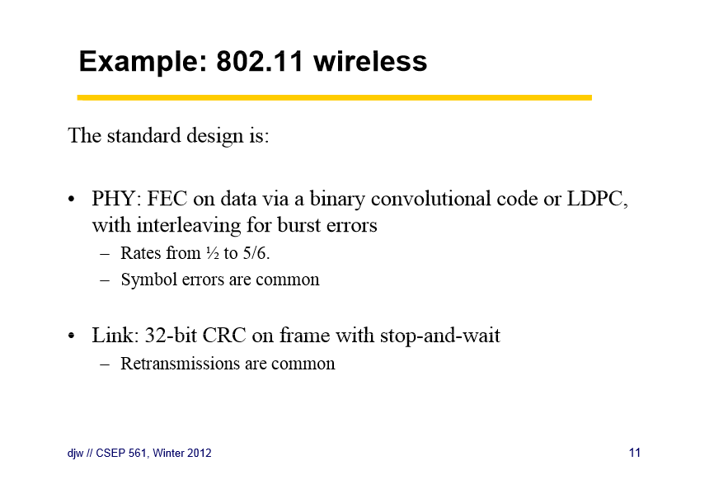

Slide 44
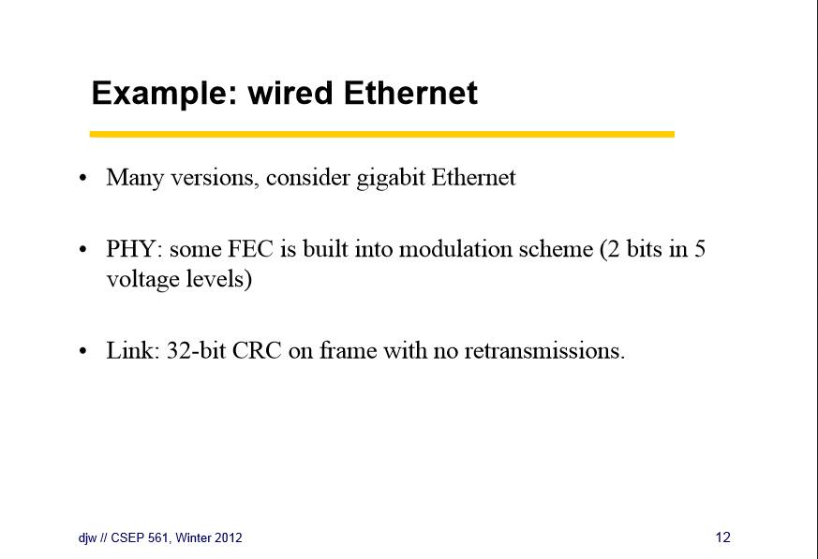

Slide 45
Sliding Window Protocols
Sliding Window concept »
One-bit Sliding Window »
Go-Back-N »
Selective Repeat »

Slide 46
Sliding Window concept (1)
Sender maintains window of frames it can send
Needs to buffer them for possible retransmission
Window advances with next acknowledgements
Receiver maintains window of frames it can receive
Needs to keep buffer space for arrivals
Window advances with in-order arrivals

Slide 47
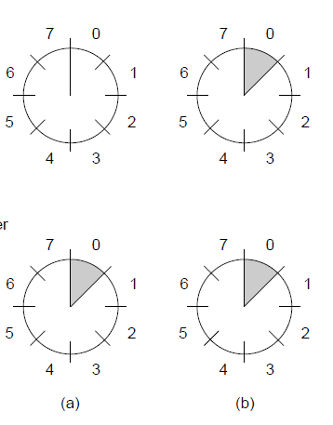
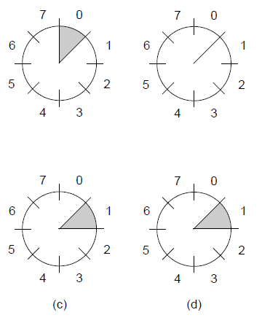
Sliding Window concept (2)
A sliding window advancing at the sender and receiver
Ex: window size is 1, with a 3-bit sequence number.
Sender
Receiver
At the start
First frame is sent
First frame is received
Sender gets first ack

Slide 48
Sliding Window concept (3)
Larger windows enable pipelining for efficient link use
Stop-and-wait (w=1) is inefficient for long links
Best window (w) depends on bandwidth-delay (BD)
Want w ≥ 2BD+1 to ensure high link utilization
Why +1?
Pipelining leads to different choices for errors/buffering
We will consider Go-Back-N and Selective Repeat
Notes:
Pipelining means that there are multiple frames outstanding in the network at any instant.
For stop-and-wait, imagine a link from Seattle to Amsterdam that has a 500ms round-trip time. It doesn’t matter how fast the link is in bits/sec, stop-and-wait will only let it run at two packets per second.

Slide 49
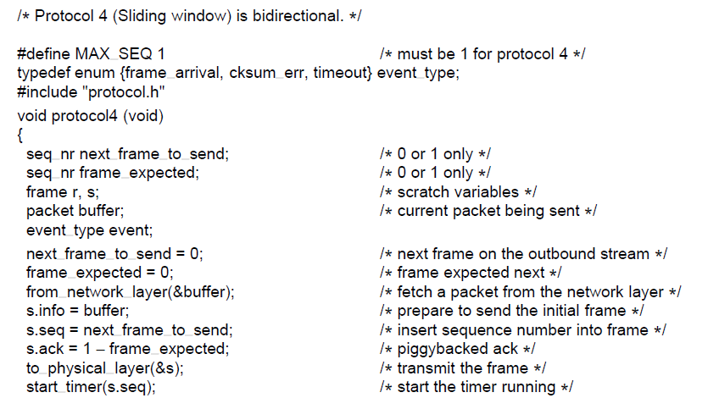
One-Bit Sliding Window (1)
Transfers data in both directions with stop-and-wait
Piggybacks acks on reverse data frames for efficiency
Handles transmission errors, flow control, early timers
{
Each node is sender and receiver (p4):
Prepare first frame
Launch it, and set timer
. . .
Notes:
Shows a basic implementation of a sliding window for w=1 handling error/flow control for us to build on

Slide 50
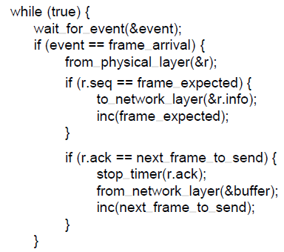
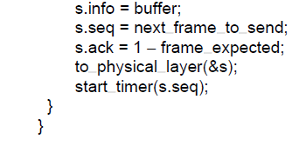
One-Bit Sliding Window (2)
. . .
Wait for frame or timeout
If a frame with new data then deliver it
If an ack for last send then prepare for next data frame
(Otherwise it was a timeout)
Send next data frame or retransmit old one; ack the last data we received

Slide 51
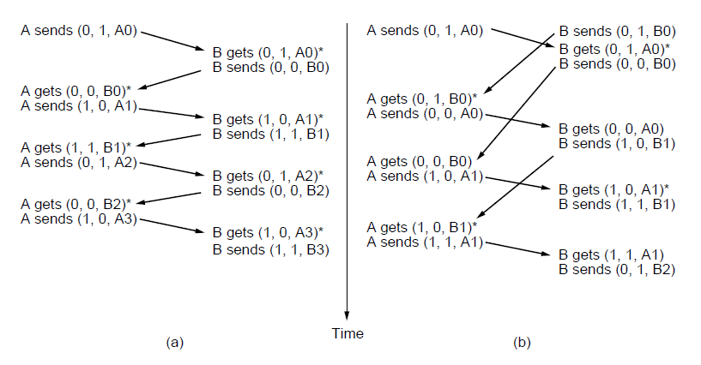
One-Bit Sliding Window (3)
Two scenarios show subtle interactions exist in p4:
Simultaneous start [right] causes correct but slow operation compared to normal [left] due to duplicate transmissions.
Time
Notation is (seq, ack, frame number). Asterisk indicates frame accepted by network layer .
Normal case
Correct, but poor performance

Slide 52
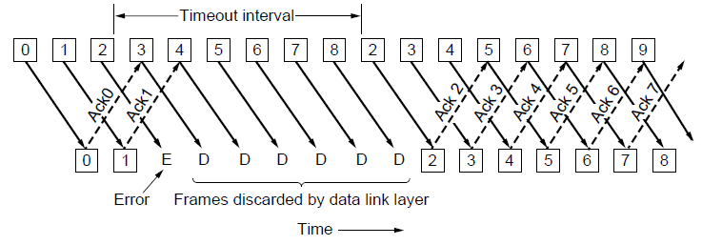
Go-Back-N (1)
Receiver only accepts/acks frames that arrive in order:
Discards frames that follow a missing/errored frame
Sender times out and resends all outstanding frames

Slide 53
Go-Back-N (2)
Tradeoff made for Go-Back-N:
Simple strategy for receiver; needs only 1 frame
Wastes link bandwidth for errors with large windows; entire window is retransmitted
Implemented as p5 (see code in book)

Slide 54
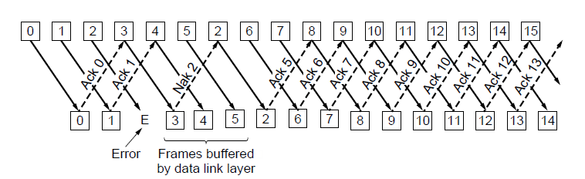
Selective Repeat (1)
Receiver accepts frames anywhere in receive window
Cumulative ack indicates highest in-order frame
NAK (negative ack) causes sender retransmission of a missing frame before a timeout resends window

Slide 55
Selective Repeat (2)
Tradeoff made for Selective Repeat:
More complex than Go-Back-N due to buffering at receiver and multiple timers at sender
More efficient use of link bandwidth as only lost frames are resent (with low error rates)
Implemented as p6 (see code in book)
Notes:
What happens if the NAK is lost, or if multiple data frames are lost per round-trip time? The retransmission timer goes off and transmission restarts from the acknowledgement point. To be more tolerant of these situations more acknowledgement information needs to be returned (more NAKs, a bit vector of the frames received beyond the cumulative ack, etc.)

Slide 56
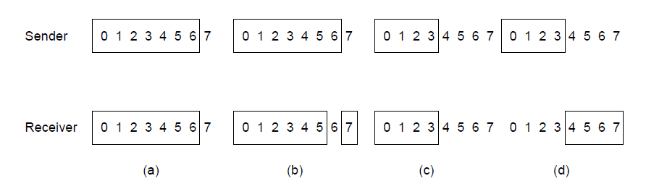
Selective Repeat (3)
For correctness, we require:
Sequence numbers (s) at least twice the window (w)
Error case (s=8, w=7) – too few sequence numbers
Correct (s=8, w=4) – enough sequence numbers
Originals
Retransmits
Originals
Retransmits
New receive window overlaps old – retransmits ambiguous
New and old receive window don’t overlap – no ambiguity
The next window consists of frames 7 through 5 (w=7), so 6 not in window

Slide 57
Example Data Link Protocols
Packet over SONET »
PPP (Point-to-Point Protocol) »
ADSL (Asymmetric Digital Subscriber Loop) »

Slide 58
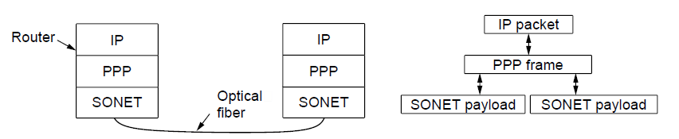
Packet over SONET
Packet over SONET is the method used to carry IP packets over SONET optical fiber links
Uses PPP (Point-to-Point Protocol) for framing
Protocol stacks
PPP frames may be split over SONET payloads

Slide 59
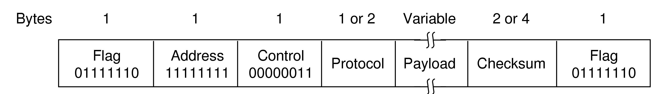
PPP (1)
PPP (Point-to-Point Protocol) is a general method for delivering packets across links
Framing uses a flag (0x7E) and byte stuffing
“Unnumbered mode” (connectionless unacknow-ledged service) is used to carry IP packets
Errors are detected with a checksum
b’cast addr
0x21 for IPv4
IP packet
header
Similar to older HDLC protocol

Slide 60
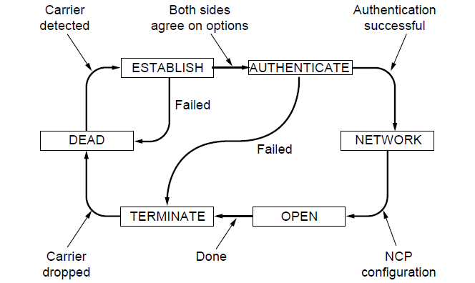
PPP (2)
A link control protocol brings the PPP link up/down
State machine for link control

Slide 61
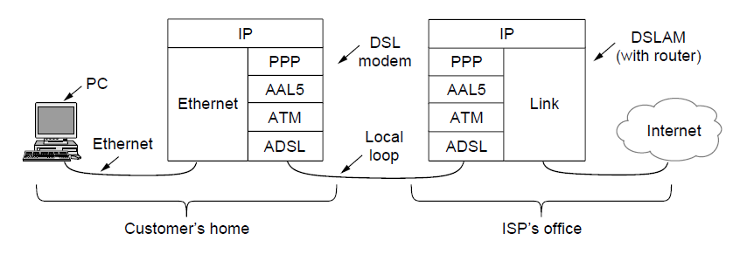
ADSL (1)
Widely used for broadband Internet over local loops
ADSL runs from modem (customer) to DSLAM (ISP)
IP packets are sent over PPP and AAL5/ATM (over)

Slide 62
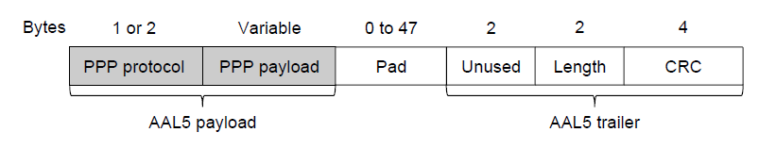
ADSL (2)
PPP data is sent in AAL5 frames over ATM cells:
ATM is a link layer that uses short, fixed-size cells (53 bytes); each cell has a virtual circuit identifier
AAL5 is a format to send packets over ATM
PPP frame is converted to a AAL5 frame (PPPoA)
AAL5 frame is divided into 48 byte pieces, each of which goes into one ATM cell with 5 header bytes
Notes:
Re ATM: ATM was a major technology in the 1990s that was hyped to win in the convergence of the Internet and telecommunications, but IP won instead. The short, fixed-size cells give flexibility (can mix voice and data without having the voice wait for a whole data packet). ATM is now used in niches such as ADSL and WAN links.

Slide 63
End
Chapter 3

