Slide 1
Medium Access Control Sublayer Chapter 4
Channel Allocation Problem
Multiple Access Protocols
Ethernet
Wireless LANs
Broadband Wireless
Bluetooth
RFID
Data Link Layer Switching
Revised: August 2011
Notes:
Gray units can be optionally omitted without causing later gaps

Slide 2
The MAC Sublayer
Responsible for deciding who sends next on a multi-access link
An important part of the link layer, especially for LANs
Application
Transport
Network
Link
Physical
MAC is in here!

Slide 3
Channel Allocation Problem (1)
For fixed channel and traffic from N users
Divide up bandwidth using FDM, TDM, CDMA, etc.
This is a static allocation, e.g., FM radio
This static allocation performs poorly for bursty traffic
Allocation to a user will sometimes go unused

Slide 4
Channel Allocation Problem (2)
Dynamic allocation gives the channel to a user when they need it. Potentially N times as efficient for N users.
Schemes vary with assumptions:
Assumption | Implication
Independent traffic | Often not a good model, but permits analysis
Single channel | No external way to coordinate senders
Observable collisions | Needed for reliability; mechanisms vary
Continuous or slotted time | Slotting may improve performance
Carrier sense | Can improve performance if available

Slide 5
Multiple Access Protocols
ALOHA »
CSMA (Carrier Sense Multiple Access) »
Collision-free protocols »
Limited-contention protocols »
Wireless LAN protocols »

Slide 6
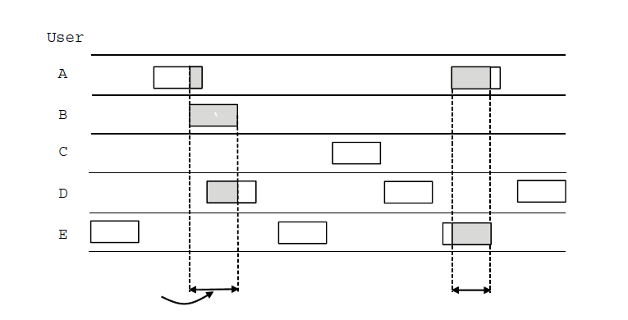
ALOHA (1)
In pure ALOHA, users transmit frames whenever they have data; users retry after a random time for collisions
Efficient and low-delay under low load
`
User
A
B
C
D
E
Collision
Collision
Time

Slide 7
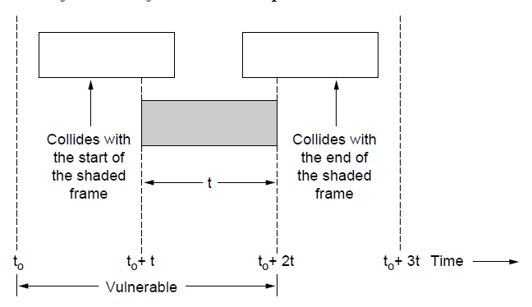
ALOHA (2)
Collisions happen when other users transmit during a vulnerable period that is twice the frame time
Synchronizing senders to slots can reduce collisions

Slide 8
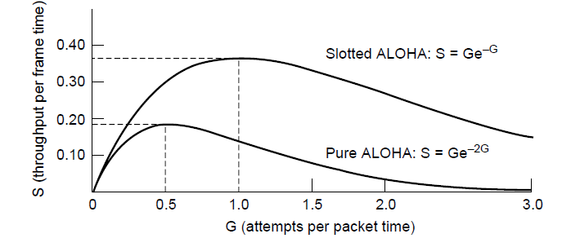
ALOHA (3)
Slotted ALOHA is twice as efficient as pure ALOHA
Low load wastes slots, high loads causes collisions
Efficiency up to 1/e (37%) for random traffic models

Slide 9
CSMA (1)
CSMA improves on ALOHA by sensing the channel!
User doesn’t send if it senses someone else
Variations on what to do if the channel is busy:
1-persistent (greedy) sends as soon as idle
Nonpersistent waits a random time then tries again
p-persistent sends with probability p when idle
Notes:
802.11 uses a refinement of p-persistent CSMA

Slide 10
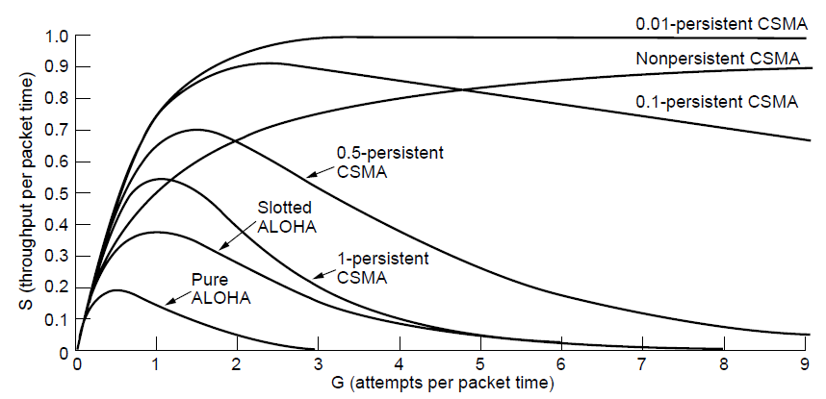
CSMA (2) – Persistence
CSMA outperforms ALOHA, and being less persistent is better under high load

Slide 11
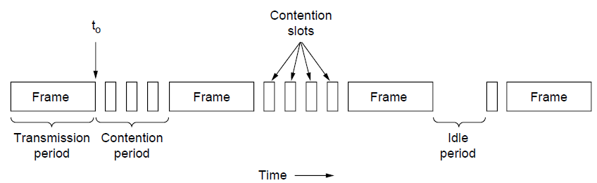
CSMA (3) – Collision Detection
CSMA/CD improvement is to detect/abort collisions
Reduced contention times improve performance
Collision time is much shorter than frame time

Slide 12
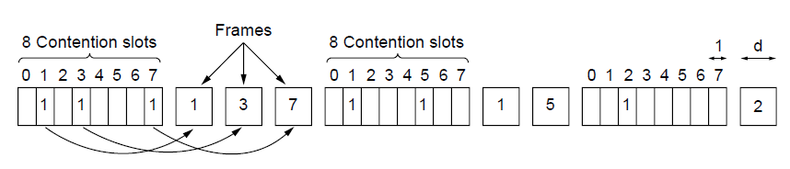
Collision-Free (1) – Bitmap
Collision-free protocols avoid collisions entirely
Senders must know when it is their turn to send
The basic bit-map protocol:
Sender set a bit in contention slot if they have data
Senders send in turn; everyone knows who has data

Slide 13
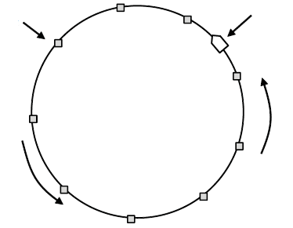
Collision-Free (2) – Token Ring
Token sent round ring defines the sending order
Station with token may send a frame before passing
Idea can be used without ring too, e.g., token bus
Token
Station
Direction of
transmission

Slide 14
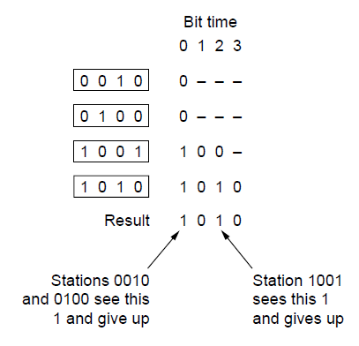
Collision-Free (3) – Countdown
Binary countdown improves on the bitmap protocol
Stations send their address in contention slot (log N bits instead of N bits)
Medium ORs bits; stations give up when they send a “0” but see a “1”
Station that sees its full address is next to send

Slide 15
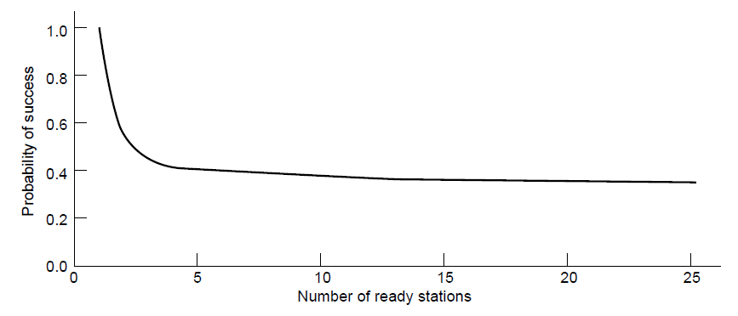
Limited-Contention Protocols (1)
Idea is to divide stations into groups within which only a very small number are likely to want to send
Avoids wastage due to idle periods and collisions
Already too many contenders for a good chance of one winner

Slide 16
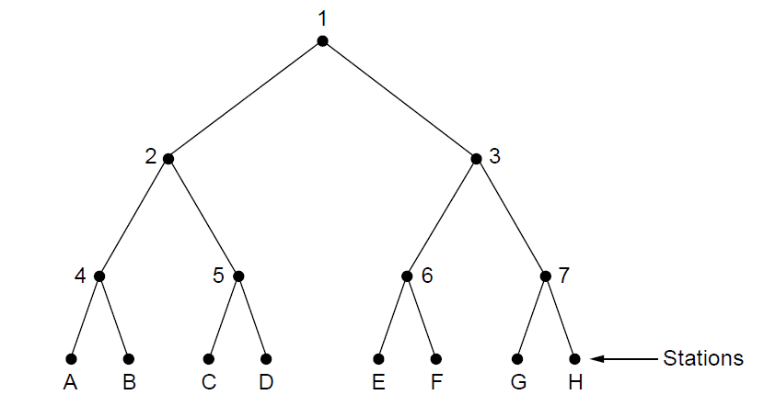
Limited Contention (2) –Adaptive Tree Walk
Tree divides stations into groups (nodes) to poll
Depth first search under nodes with poll collisions
Start search at lower levels if >1 station expected
Level 0
Level 1
Level 2

Slide 17
Wireless LAN Protocols (1)
Wireless has complications compared to wired.
Nodes may have different coverage regions
Leads to hidden and exposed terminals
Nodes can’t detect collisions, i.e., sense while sending
Makes collisions expensive and to be avoided

Slide 18
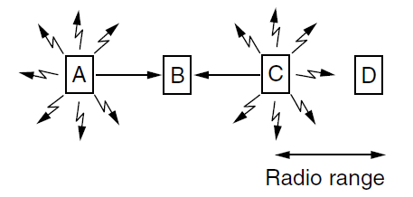
Wireless LANs (2) – Hidden terminals
Hidden terminals are senders that cannot sense each other but nonetheless collide at intended receiver
Want to prevent; loss of efficiency
A and C are hidden terminals when sending to B
Hidden = can’t hear each other

Slide 19
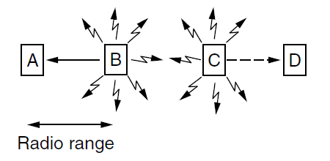
Wireless LANs (3) – Exposed terminals
Exposed terminals are senders who can sense each other but still transmit safely (to different receivers)
Concurrency desirably; improves performance
B → A and C → D are exposed terminals
B and C are exposed (to each other)

Slide 20
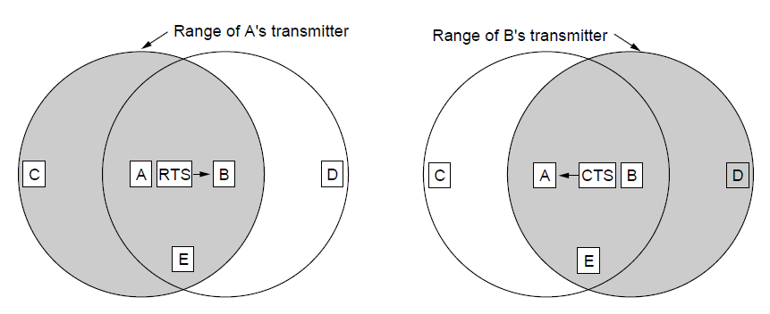
Wireless LANs (4) – MACA
MACA protocol grants access for A to send to B:
A sends RTS to B [left]; B replies with CTS [right]
A can send with exposed but no hidden terminals
A sends RTS to B; C and E hear and defer for CTS
B replies with CTS; D and E hear and defer for data
Notes:
This protocol solves the issue of expensive collisions too, since the RTS/CTS are short packets – if there is a collision it will be brief, not as long as a data frame.

Slide 21
Wireless LANs (4) – MACA
MACA protocol grants access for A to send to B:
A sends RTS to B [left]; B replies with CTS [right]
A can send with exposed but no hidden terminals
If D transmitted, it would interfere with A’s transmission to B
Range of D’s transmitter
B and A are exposed while A→ C and B → D
A sends RTS to B; C and E hear and defer for CTS
B replies with CTS; D and E hear and defer for data
Range of E’s transmitter
E and D are hidden terminals when sending to B
Notes:
This protocol solves the issue of expensive collisions too, since the RTS/CTS are short packets – if there is a collision it will be brief, not as long as a data frame.

Slide 22
Ethernet
Classic Ethernet »
Switched/Fast Ethernet »
Gigabit/10 Gigabit Ethernet »

Slide 23
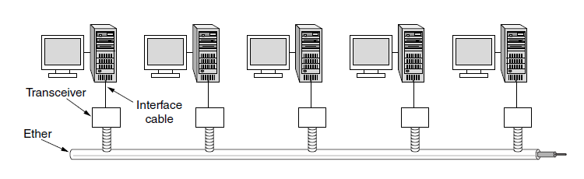
Classic Ethernet (1) – Physical Layer
One shared coaxial cable (bus) to which all hosts attach
Up to 10 Mbps, with Manchester encoding
Hosts ran the classic Ethernet protocol for access
bus
The transceiver senses the medium (busy/idle/collision?) and reads and writes bits to it.
This function is now part of the NIC.

Slide 24
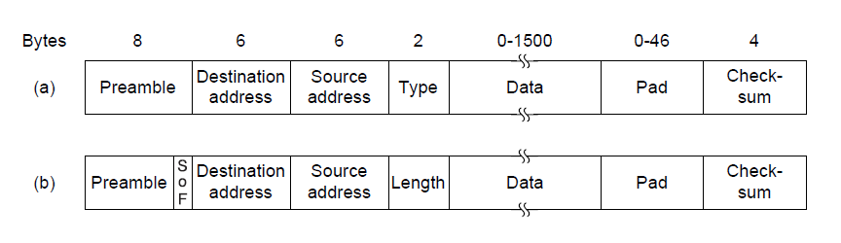
Classic Ethernet (2) – MAC
MAC protocol is 1-persistent CSMA/CD (greedy)
Random delay (backoff) after collision is computed with BEB (Binary Exponential Backoff)
Frame format is still used with modern Ethernet
Ethernet
(DIX)
IEEE 802.3
Minimum frame size = 64 bytes, maximum = 1,518 bytes
Notes:
1-persistent (greedy) means sends as soon as idle

Slide 25
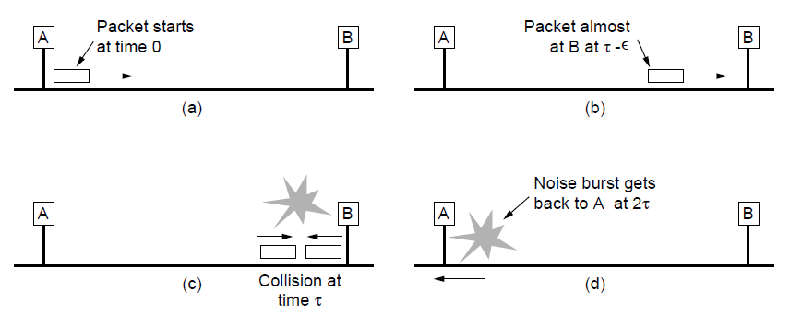
Classic Ethernet (3) – MAC
Collisions can occur and take as long as 2τ to detect
τ is the time it takes to propagate over the Ethernet
Leads to minimum packet size for reliable detection

Slide 26
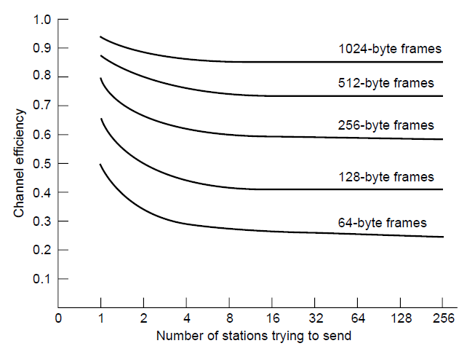
Classic Ethernet (4) – Performance
Efficient for large frames, even with many senders
Degrades for small frames (and long LANs)
10 Mbps Ethernet,
64 byte min. frame

Slide 27
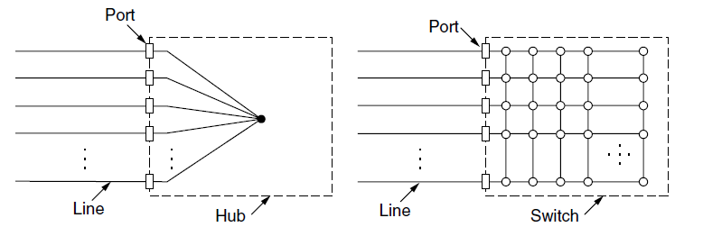
Switched/Fast Ethernet (1)
Hubs wire all lines into a single star-wired CSMA/CD domain
Switches isolate each port to a separate domain
Much greater throughput for multiple ports
No need for CSMA/CD when using full-duplex lines
Logical bus
Hub is a logical bus which repeats (copies) any bits it sees on one port to all of the other ports

Slide 28
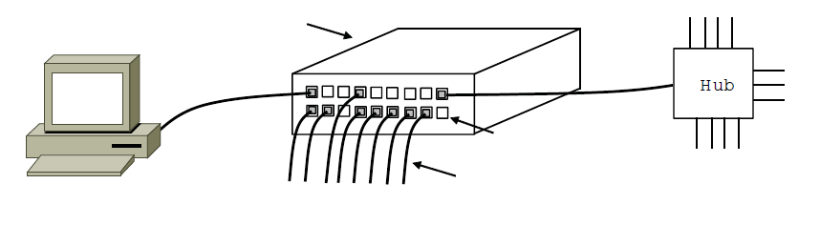
Switched/Fast Ethernet (2)
Switches can be wired to computers, hubs and switches
Hubs concentrate traffic from computers
More on how to switch frames in 4.8
Switch
Hub
Switch ports
Twisted pair

Slide 29
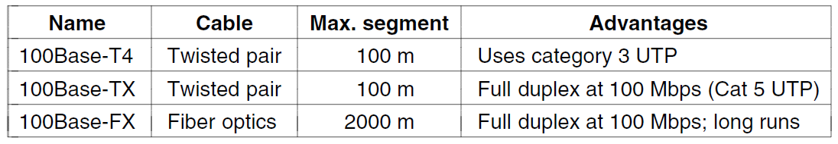
Switched/Fast Ethernet (3)
Fast Ethernet extended Ethernet from 10 to 100 Mbps
Twisted pair (with Cat 5) dominated the market
100Base-TX uses two of the four wire pairs in the cable, i.e., one pair of conductors in each direction for full duplex

Slide 30
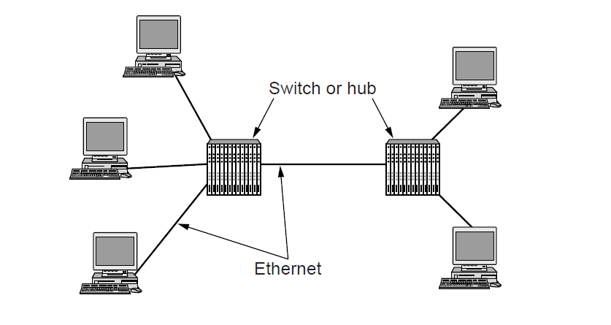
Gigabit / 10 Gigabit Ethernet (1)
Switched Gigabit Ethernet is now the garden variety
With full-duplex lines between computers/switches

Slide 31
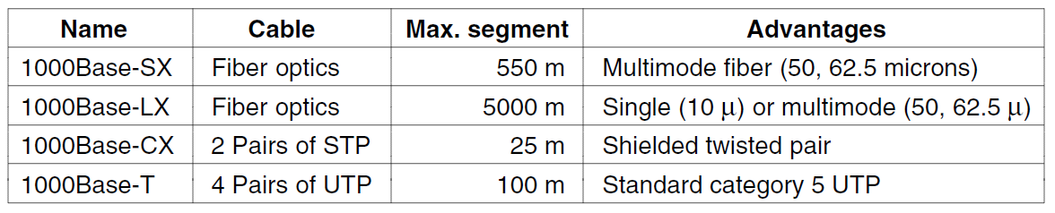
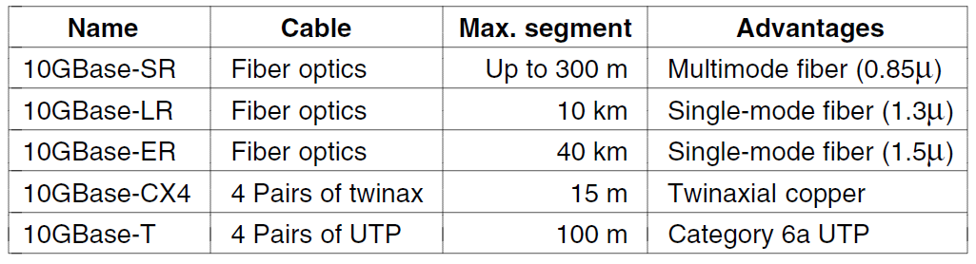
Gigabit / 10 Gigabit Ethernet (1)
Gigabit Ethernet is commonly run over twisted pair
10 Gigabit Ethernet is being deployed where needed
40/100 Gigabit Ethernet is under development

Slide 32
Wireless LANs
802.11 architecture/protocol stack »
802.11 physical layer »
802.11 MAC »
802.11 frames »

Slide 33
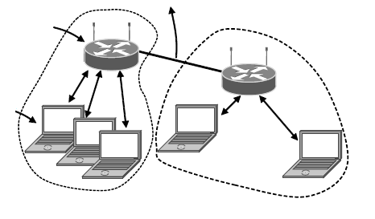
802.11 Architecture/Protocol Stack (1)
Wireless clients associate to a wired AP (Access Point)
Called infrastructure mode; there is also ad-hoc mode with no AP, but that is rare.
To Network
Access Point
Client

Slide 34
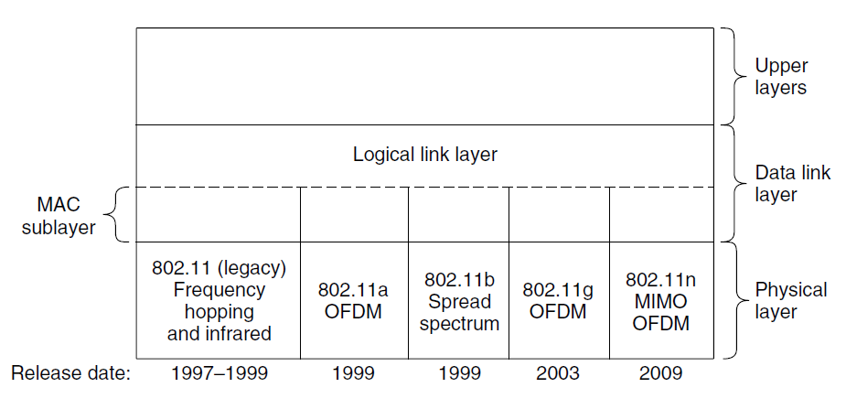
802.11 Architecture/Protocol Stack (2)
MAC is used across different physical layers

Slide 35
802.11 physical layer
NICs are compatible with multiple physical layers
E.g., 802.11 a/b/g
Name | Technique | Max. Bit Rate
802.11b | Spread spectrum, 2.4 GHz | 11 Mbps
802.11g | OFDM, 2.4 GHz | 54 Mbps
802.11a | OFDM, 5 GHz | 54 Mbps
802.11n | OFDM with MIMO, 2.4/5 GHz | 600 Mbps

Slide 36
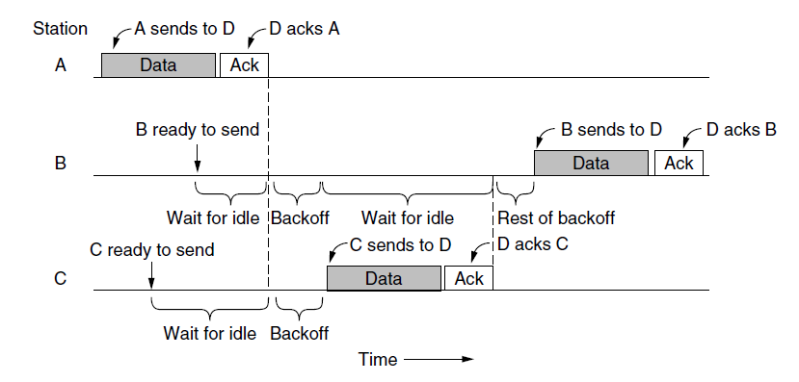
802.11 MAC (1)
CSMA/CA inserts backoff slots to avoid collisions
MAC uses ACKs/retransmissions for wireless errors

Slide 37
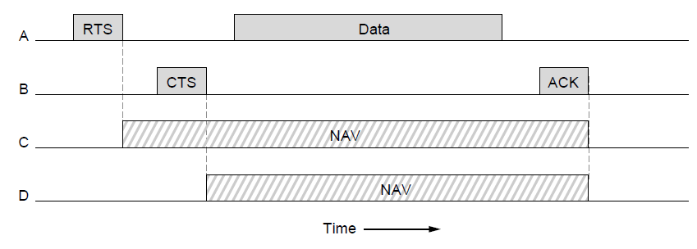
802.11 MAC (2)
Virtual channel sensing with the NAV and optional RTS/CTS (often not used) avoids hidden terminals

Slide 38
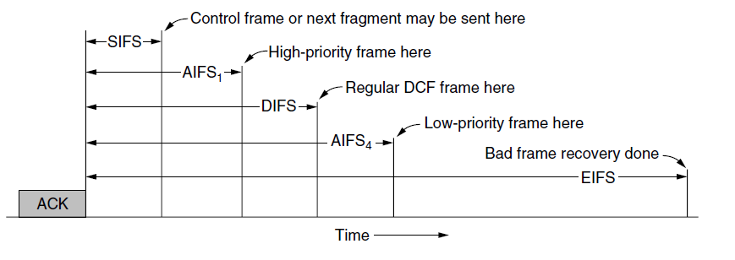
802.11 MAC (3)
Different backoff slot times add quality of service
Short intervals give preferred access, e.g., control, VoIP
MAC has other mechanisms too, e.g., power save

Slide 39
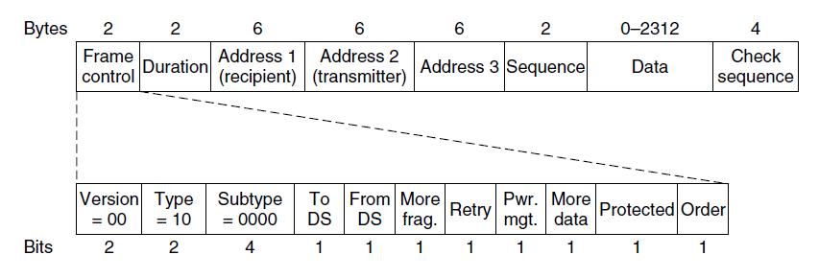
802.11 Frames
Frames vary depending on their type (Frame control)
Data frames have 3 addresses to pass via APs

Slide 40
Broadband Wireless
802.16 Architecture / Protocol Stack »
802.16 Physical Layer »
802.16 MAC »
802.16 Frames »

Slide 41
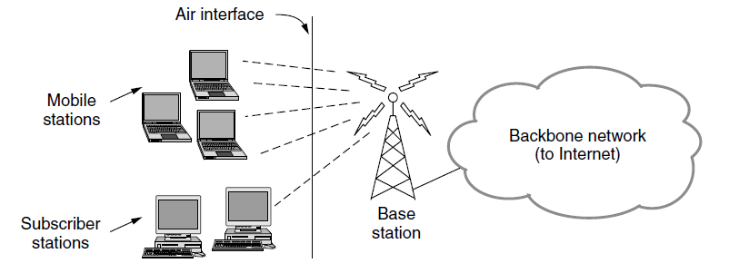
802.16 Architecture/Protocol Stack (1)
Wireless clients connect to a wired basestation (like 3G)

Slide 42
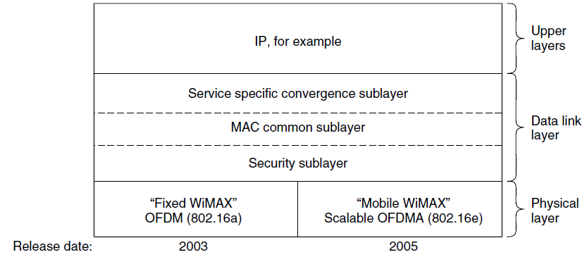
802.16 Architecture/Protocol Stack (2)
MAC is connection-oriented; IP is connectionless
Convergence sublayer maps between the two

Slide 43
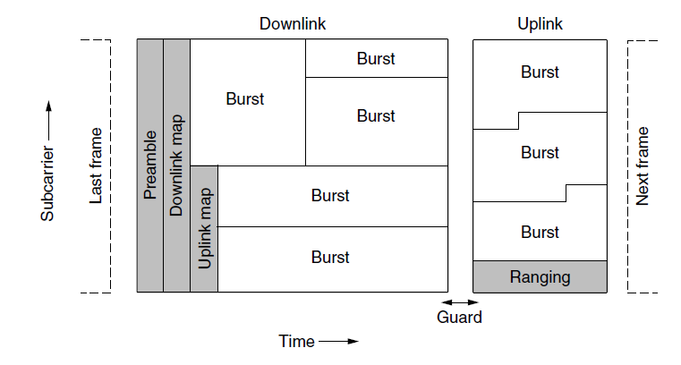
802.16 Physical Layer
Based on OFDM; base station gives mobiles bursts (subcarrier/time frame slots) for uplink and downlink

Slide 44
802.16 MAC
Connection-oriented with base station in control
Clients request the bandwidth they need
Different kinds of service can be requested:
Constant bit rate, e.g., uncompressed voice
Real-time variable bit rate, e.g., video, Web
Non-real-time variable bit rate, e.g., file download
Best-effort for everything else

Slide 45
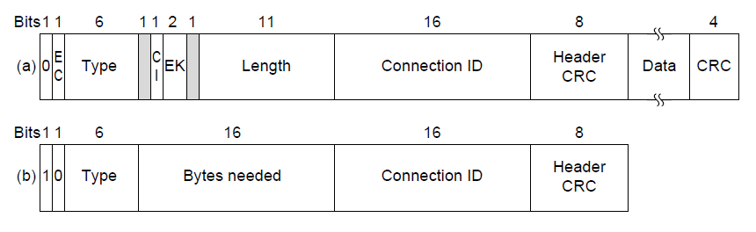
802.16 Frames
Frames vary depending on their type
Connection ID instead of source/dest addresses
(a)
(b)
(a) A generic frame. (b) A bandwidth request frame

Slide 46
Bluetooth
Bluetooth Architecture »
Bluetooth Applications / Protocol »
Bluetooth Radio / Link Layers »
Bluetooth Frames »

Slide 47
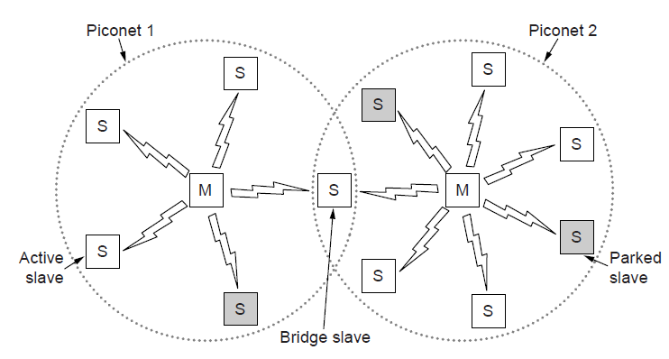
Bluetooth Architecture
Piconet master is connected to slave wireless devices
Slaves may be asleep (parked) to save power
Two piconets can be bridged into a scatternet

Slide 48
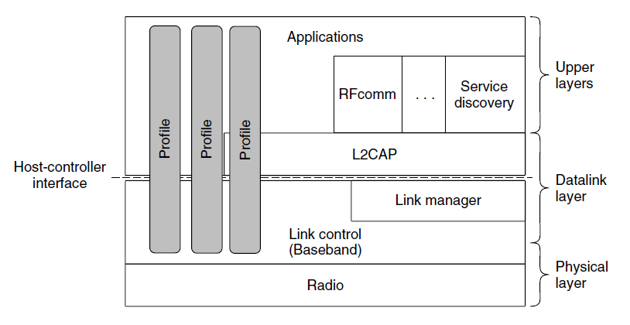
Bluetooth Applications / Protocol Stack
Profiles give the set of protocols for a given application
25 profiles, including headset, intercom, streaming audio, remote control, personal area network, …

Slide 49
Bluetooth Radio / Link Layers
Radio layer
Uses adaptive frequency hopping in 2.4 GHz band
Link layer
TDM with timeslots for master and slaves
Synchronous CO for periodic slots in each direction
Asynchronous CL for packet-switched data
Links undergo pairing (user confirms passkey/PIN) to authorize them before use

Slide 50
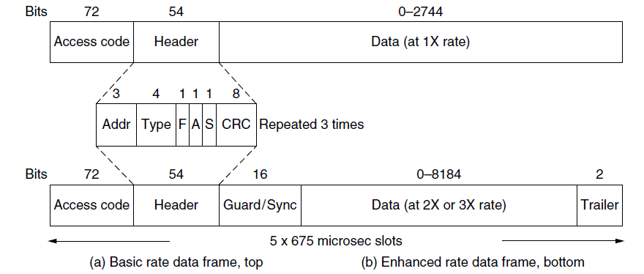
Bluetooth Frames
Time is slotted; enhanced data rates send faster but for the same time; addresses are only 3 bits for 8 devices
(a)
(b)
(a)
(b)

Slide 51
RFID
Gen 2 Architecture »
Gen 2 Physical Layer »
Gen 2 Tag Identification Layer »
Gen 2 Frames »

Slide 52
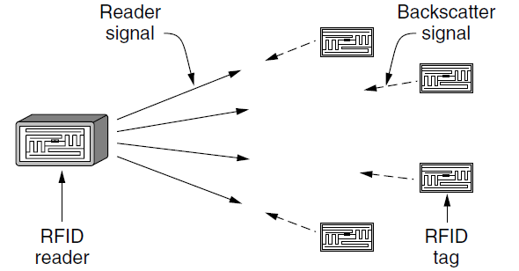
Gen 2 Architecture
Reader signal powers tags; tags reply with backscatter

Slide 53
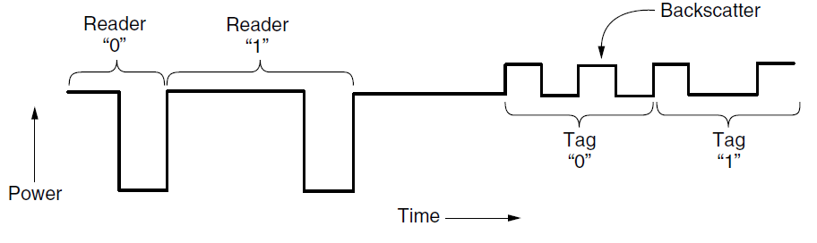
Gen 2 Physical Layer
Reader uses duration of on period to send 0/1
Tag backscatters reader signal in pulses to send 0/1

Slide 54
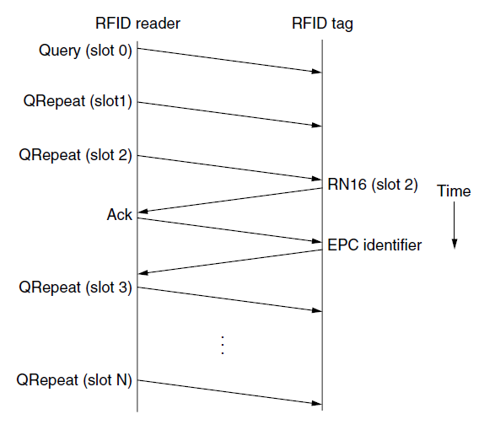
Gen 2 Tag Identification Layer
Reader sends query and sets slot structure
Tags reply (RN16) in a random slot; may collide
Reader asks one tag for its identifier (ACK)
Process continues until no tags are left

Slide 55
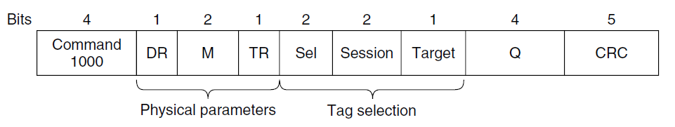
Gen 2 Frames
Reader frames vary depending on type (Command)
Query shown below, has parameters and error detection
Tag responses are simply data
Reader sets timing and knows the expected format
Query message

Slide 56
Data Link Layer Switching
Uses of Bridges »
Learning Bridges »
Spanning Tree »
Repeaters, hubs, bridges, .., routers, gateways »
Virtual LANs »

Slide 57
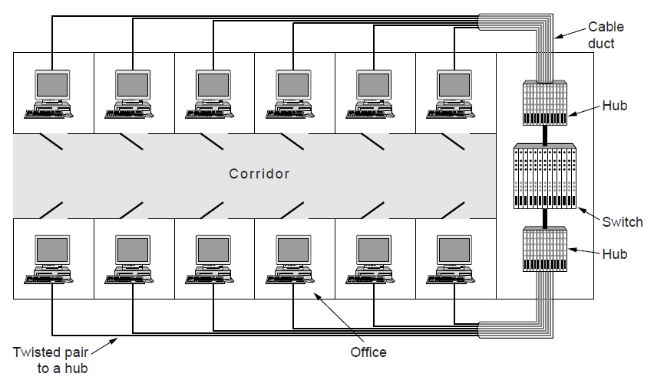
Uses of Bridges
Common setup is a building with centralized wiring
Bridges (switches) are placed in or near wiring closets
This is a premises or structured wiring system as seen in an office

Slide 58
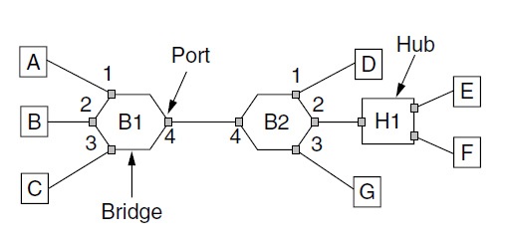
Learning Bridges (1)
A bridge operates as a switched LAN (not a hub)
Computers, bridges, and hubs connect to its ports

Slide 59
Learning Bridges (2)
Backward learning algorithm picks the output port:
Associates source address on frame with input port
Frame with destination address sent to learned port
Unlearned destinations are flooded (sent to all other ports)
Needs no configuration
Table entries time-stamped
Stale table entries dropped to allow changes
Bandwidth efficient for two-way traffic

Slide 60
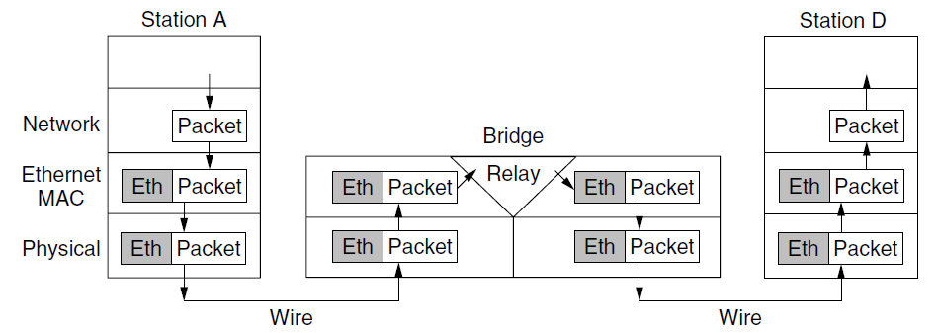
Learning Bridges (3)
Bridges extend the Link layer:
Use but don’t remove Ethernet header/addresses
Do not inspect Network header

Slide 61
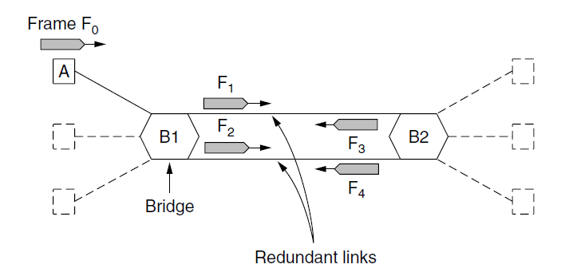
Spanning Tree (1) – Problem
Bridge topologies with loops and only backward learning will cause frames to circulate for ever
Need spanning tree support to solve problem

Slide 62
Spanning Tree (2) – Algorithm
Subset of forwarding ports for data is used to avoid loops
Selected with the spanning tree distributed algorithm by Perlman
I think that I shall never see
A graph more lovely than a tree.
A tree whose crucial property
Is loop-free connectivity.
A tree which must be sure to span.
So packets can reach every LAN.
First the Root must be selected
By ID it is elected.
Least cost paths from Root are traced
In the tree these paths are placed.
A mesh is made by folks like me
Then bridges find a spanning tree.
– Radia Perlman, 1985.

Slide 63
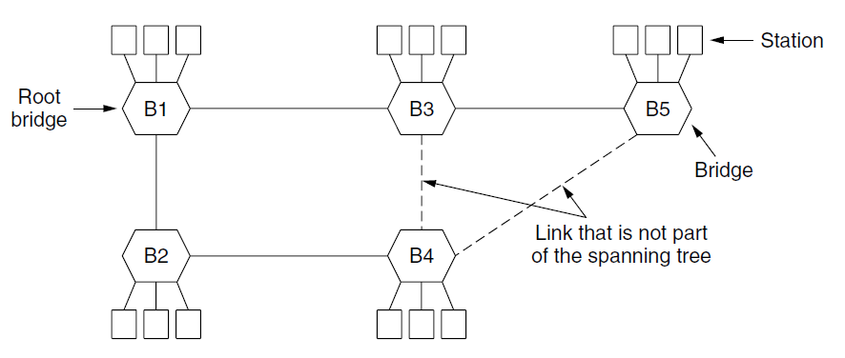
Spanning Tree (3) – Example
After the algorithm runs:
B1 is the root, two dashed links are turned off
B4 uses link to B2 (lower than B3 also at distance 1)
B5 uses B3 (distance 1 versus B4 at distance 2)

Slide 64
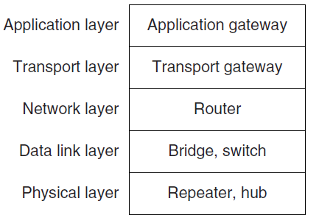
Repeaters, Hubs, Bridges, Switches, Routers, & Gateways
Devices are named according to the layer they process
A bridge or LAN switch operates in the Link layer

Slide 65
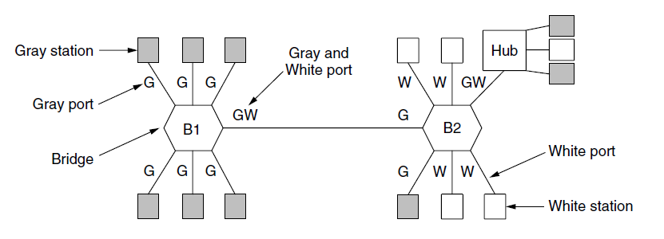
Virtual LANs (1)
VLANs (Virtual LANs) splits one physical LAN into multiple logical LANs to ease management tasks
Ports are “colored” according to their VLAN

Slide 66
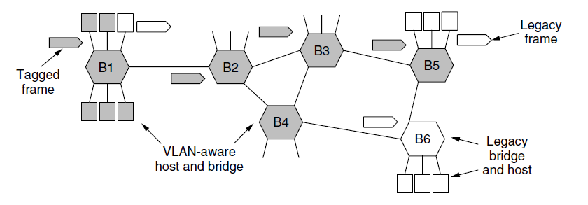
Virtual LANs (2) – IEEE 802.1Q
Bridges need to be aware of VLANs to support them
In 802.1Q, frames are tagged with their “color”
Legacy switches with no tags are supported

Slide 67
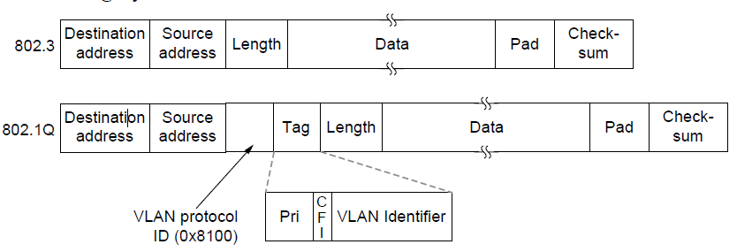
Virtual LANs (3) – IEEE 802.1Q
802.1Q frames carry a color tag (VLAN identifier)
Length/Type value is 0x8100 for VLAN protocol

Slide 68
End
Chapter 4

