Slide 1
Network Layer Chapter 5
Design Issues
Routing Algorithms
Congestion Control
Quality of Service
Internetworking
Network Layer of the Internet
Revised: August 2011
Notes:
Gray units can be optionally omitted without causing later gaps

Slide 2
The Network Layer
Responsible for delivering packets between endpoints over multiple links
Application
Transport
Network
Link
Physical

Slide 3
Why do we need a Network layer?
We can already build networks with links and switches and send frames between hosts …
Notes:
Cisco icon library

Slide 4
Shortcomings of Switches
Don’t scale to large networks
Blow up of routing table, broadcast
Table for all destinations in the world!
Flooding used to reach new destinations

Slide 5

Shortcomings of Switches (2)
Don’t work across more than one link layer technology
Hosts on Ethernet + 3G + 802.11 …
Can we play too?
Go away!
Notes:
AP from pixabay

Slide 6
Shortcomings of Switches (3)
Don’t give much traffic control - uses spanning tree
Want to plan routes / bandwidth / use all links
That was lame.

Slide 7
Network Layer Approach
Scaling:
Hierarchy, in the form of prefixes
Heterogeneity:
IP for internetworking
Bandwidth Control:
Lowest-cost routing
Later QOS (Quality of Service)

Slide 8
Routing vs. Forwarding
Routing is the process of deciding in which direction to send traffic
Network-wide issue (global) and expensive
Will cover later
Which way?
Which way?
Which way?

Slide 9
Routing vs. Forwarding (2)
Forwarding is the process of sending a packet on its way
Node process (local) and fast
Will cover now
Forward!
packet

Slide 10
Design Issues
Store-and-forward packet switching »
Connectionless service – datagrams »
Connection-oriented service – virtual circuits »
Comparison of virtual-circuits and datagrams »

Slide 11
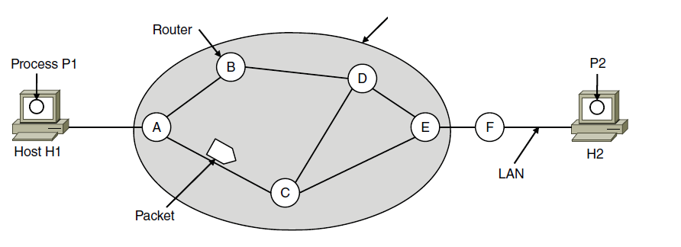
Store-and-Forward Packet Switching
Hosts send packets into the network; packets are forwarded by routers
ISP’s equipment
Customer Premise Equipment
Notes:
Routers treat packets as messages, receiving (storing) them and then forwarding them based on how the message is addressed.
For completeness, it is a process running on the host that sends the packet into the network and receives packets at the destination.

Slide 12
End-to-end Argument
Two opposing trains of thought:
Internet community (“Netheads”): networks are unreliable, network should be “dumb” (this is the end-to-end argument)
Networks should be connectionless; hosts should do error control
Intelligence should lie on the outside of the network
Enables the user to create any application
Telco community (“Bellheads”): networks should be reliable, devices should be “dumb”
We’ll decide what you need (a phone) and QoS (connection-oriented)
Intelligence should lie on the inside of the network
We’ll create applications, such as 800 service or call waiting
See “END-TO-END ARGUMENTS IN SYSTEM DESIGN” by Saltzer
Lily Tomlin as Ernestine on Laugh In
SJW

Slide 13
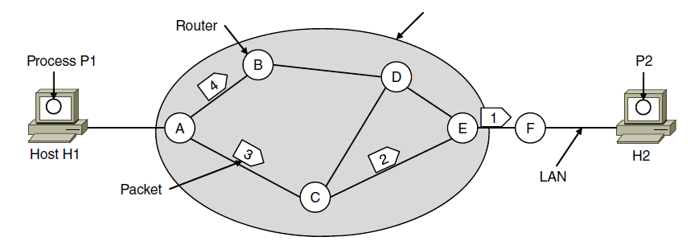
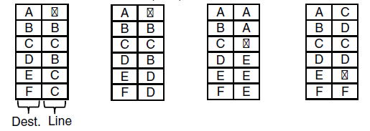
Connectionless Service – Datagrams
Packet is forwarded using destination address inside it
Different packets may take different paths
ISP’s equipment
A’s table (initially) A’s table (later) C’s Table E’s Table
Perhaps the A-C-E path becomes congested
Dest. Line
Notes:
This model is like the postal service – each letter is sent through the network independently.
Datagram is a packet that contains an absolute destination address; routers need only look up the destination address in a table to find the outgoing line to send the packet on its way.

Slide 14
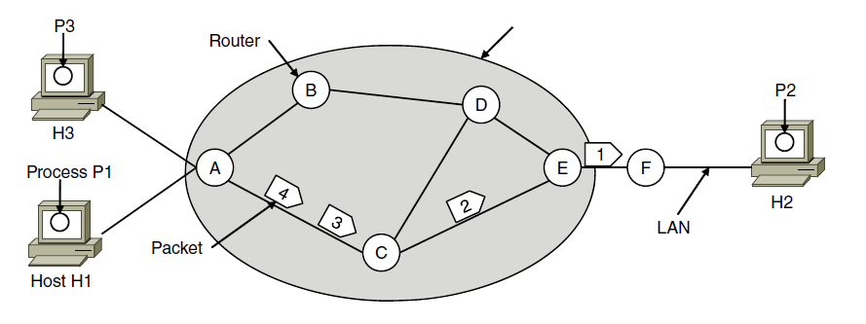

Connection-Oriented – Virtual Circuits
Packet is forwarded along a virtual circuit using tag inside it
Virtual circuit (VC) is set up ahead of time
ISP’s equipment
A’s table C’s Table E’s Table
In: Line Tag
Line Tag: Out
Example: MPLS used within ISP networks for QoS – an example of “creeping connectionism” see slide 149
Notes:
This model is like the telephone network.
Packets contain tags that are not full addresses; they only need to be unique at a given link and thus are re-written at each router from an incoming tag to an outgoing tag. The virtual circuit is set up with the tag mapping along the entire path. Then packets are sent along it. The packets will thus all follow the same path (and arrive in order).
“Virtual” refers to the fact that real/physical telephone circuits have both a path and a fixed bandwidth reservation of 64Kbps, whereas virtual circuits may have a variable bandwidth depending on how many VCs use a single link.
ISP networks frequently wrap an IP packet in an MPLS header having a connection identifier.

Slide 15
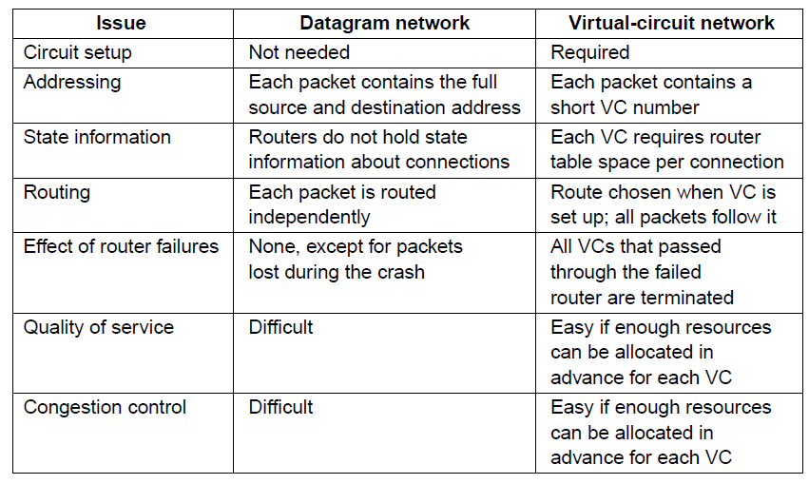
Comparison of Virtual-Circuits & Datagrams

Slide 16
Datagrams vs Virtual Circuits
Complementary strengths
Issue | Datagrams | Virtual Circuits
Setup phase | Not needed | Required
Router state | Per destination | Per connection
Addresses | Packet carries full address | Packet carries short label
Routing | Per packet | Per circuit
Failures | Easier to mask | Difficult to mask
Quality of service | Difficult to add | Easier to add

Slide 17
Internetworking
Internetworking joins multiple, different networks into a single larger network
How networks differ »
How networks can be connected »
Tunneling »
Internetwork routing »
Packet fragmentation »

Slide 18
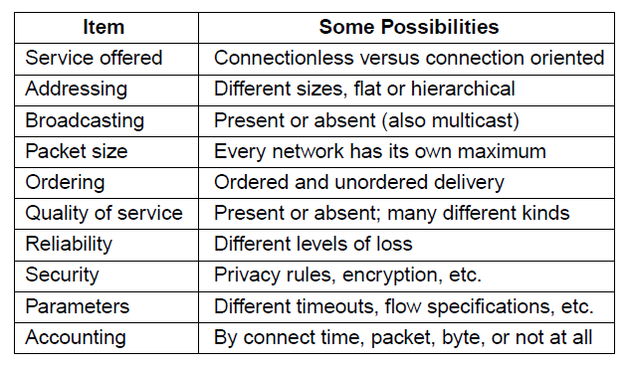
How Networks Differ
Differences can be large; complicates internetworking

Slide 19
Internet Reference Model
IP is the “narrow waist” of the Internet
Supports many different links below and apps above
5. Application
SMTP
HTTP
RTP
DNS
4. Transport
TCP
UDP
3. Internet
IP
Ethernet
3G
2/1. Link
Cable
DSL
802.11
Notes:
Repeat figure

Slide 20
IP as a Lowest Common Denominator
Suppose only some networks support QOS or security etc.
Difficult for internetwork to support
Pushes IP to be a “lowest common denominator” protocol
Asks little of lower-layer networks
Gives little as a higher layer service

Slide 21
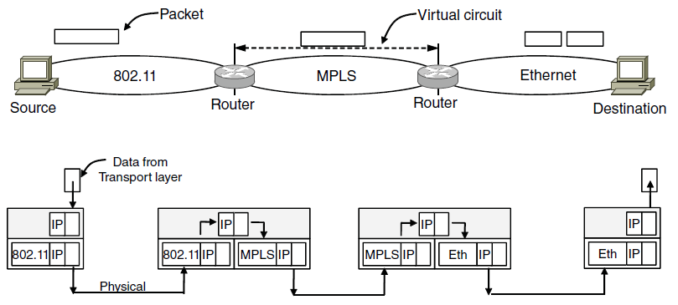
How Networks Can Be Connected
Internetworking based on a common network layer – IP
Packet mapped to a VC here
Common protocol (IP) carried all the way
Headers
Notes:
The top half of the figure shows the difficulties – a packet sent as a datagram may suddenly have to be sent over a virtual circuit, which requires some way to map between the two.
The bottom half shows the solution – a common network layer protocol, IP, carries addresses and other information that identify the endpoints across networks.

Slide 22
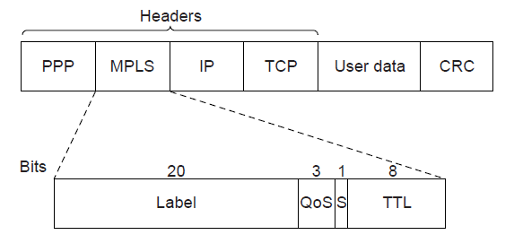
MPLS (Multi-Protocol Label Switching, §5.6.5)
A virtual-circuit like technology widely used by ISPs
ISP sets up circuits inside their backbone ahead of time
ISP adds MPLS label to IP packet at ingress, undoes at egress
PPP covered in Section 3.5
Notes:
CN5E slides #5-75

Slide 23
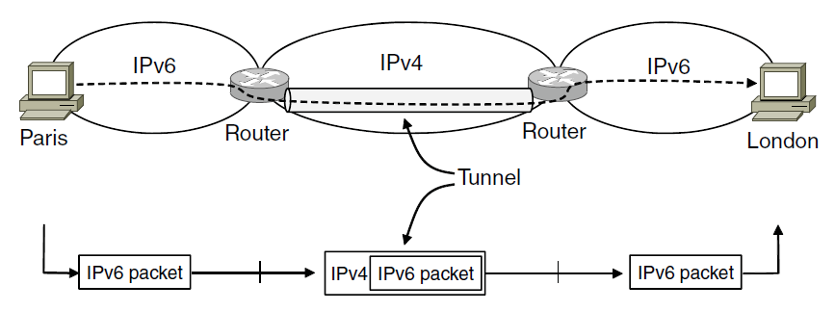
Tunneling (1)
Connects two networks through a middle one
Packets are encapsulates over the middle

Slide 24
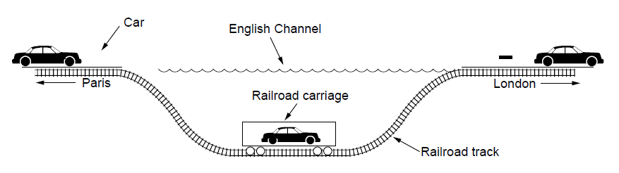
Tunneling (2)
Tunneling analogy:
tunnel is a link; packet can only enter/exit at ends

Slide 25
Packet Size Problem
Different networks have different maximum packet sizes or MTUs
(Path) MTU = Maximum Transmission Unit
E.g., Ethernet 1.5K, WiFi 2.3K
Prefer large packets for efficiency (why?)
But what size is too large?
Difficult because node does not know complete network path

Slide 26
Packet Size Solutions
Fragmentation
Split up large packets in the network if they are too big to send
Classic method, but dated
Discovery
Find the largest packet that fits on the network path and use it
IP uses today instead of fragmentation

Slide 27
IPv4 Fragmentation
Routers fragment packets that are too large to forward
Receiving host reassembles to reduce load on routers
Fragment!
Reassemble!
Fits on first link
Notes:
Cisco icon library

Slide 28
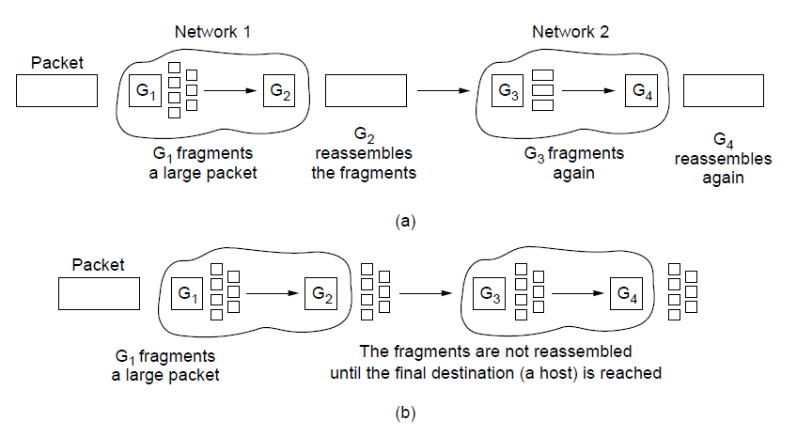
Packet Fragmentation (1)
Networks have different packet size limits for many reasons
Large packets sent with fragmentation & reassembly
G₁ fragments
G₂ reassembles
G₃ fragments
G₄ reassembles
Transparent – packets fragmented / reassembled in each network
… destination will reassemble
G₁ fragments
Non-transparent – fragments are reassembled at destination

Slide 29
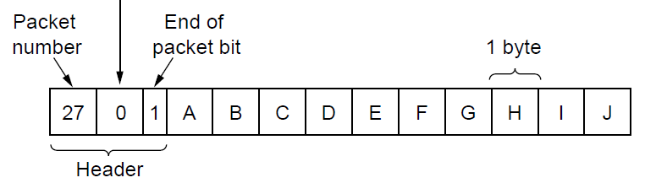
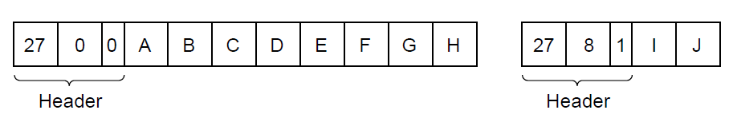
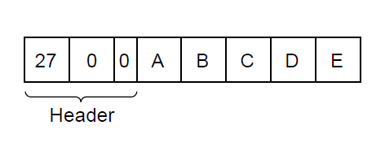
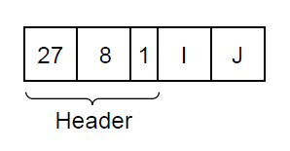
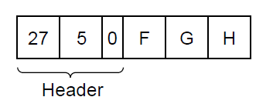
Packet Fragmentation (2)
Example of IP-style fragmentation:
Packet
number
Start
offset
End
bit
Original packet:
(10 data bytes)
Fragmented:
(to 8 data bytes)
Re-fragmented:
(to 5 bytes)

Slide 30
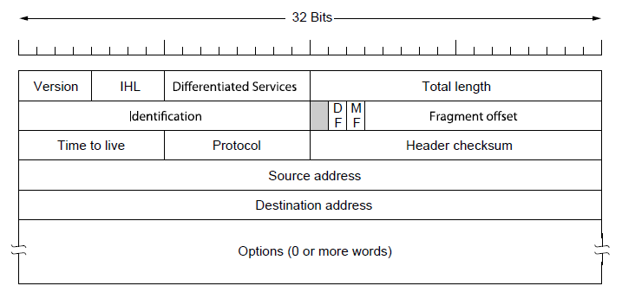
IPv4 Fragmentation Fields
Header fields used to handle packet size differences
Identification, Fragment offset, MF/DF control bits
Even things that seem like they should be simple may be complicated; see RFC 5864, the standard for the Identification field
The Maximum Datagram Lifetime (MDL) is two minutes, related to the recommended reassembly timeout.
Payload (e.g., TCP segment)
Notes:
CN5E slides #5-62, repeat

Slide 31
IPv4 Fragmentation Procedure
Routers split a packet that is too large:
Typically break into large pieces
Copy IP header to pieces
Adjust length on pieces
Set offset to indicate position
Set MF (More Fragments) on all pieces except last
Receiving hosts reassembles pieces:
Identification field links pieces together, MF tells receiver when it has all pieces

Slide 32
IPv4 Fragmentation (3)
ID = 0x12ef
Data Len = 2300
Offset = 0
MF = 0
Before
MTU = 2300
ID = 0x12ef
Data Len = 1500
Offset = 0
MF = 1
ID = 0x12ef
Data Len = 800
Offset = 1500
MF = 0
After
MTU = 1500
MTU size typically 1,460 bytes. Why? Ethernet max data size = 1,500 bytes less IP header (20 bytes) and TCP header (20 bytes) = 1,460 bytes

Slide 33
IPv4 Fragmentation (4)
It works!
Allows repeated fragmentation
But fragmentation is undesirable
More work for routers, hosts
Tends to magnify loss rate
If a fragment is lost, the whole packet is lost – why?
Security vulnerabilities too (can you think of what this might be?)

Slide 34
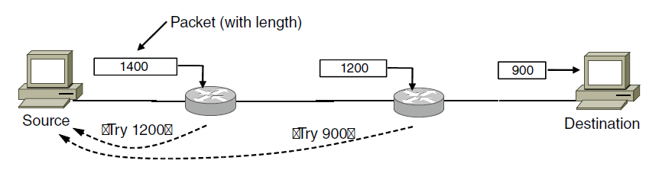
Packet Fragmentation (3)
Path MTU Discovery avoids network fragmentation
Routers return MTU (Max. Transmission Unit) to source and discard large packets
Packet with “Don’t Fragment” bit set
Try 1200
Try 900
ICMP Destination Unreachable Message (packet too big)
Path MTU depends on the path, so can change over time
Search is ongoing because path changes

Slide 35
Network Layer in the Internet (1)
IP Version 4 »
IP Addresses »
IP Version 6 »
Internet Control Protocols »
Label Switching and MPLS »
OSPF—An Interior Gateway Routing Protocol »
BGP—The Exterior Gateway Routing Protocol »
Internet Multicasting »
Mobile IP »

Slide 36
Network Layer in the Internet (2)
IP has been shaped by guiding principles:
Make sure it works
Keep it simple
Make clear choices
Exploit modularity
Expect heterogeneity
Avoid static options and parameters
Look for good design (not perfect)
Strict sending, tolerant receiving
Think about scalability
Consider performance and cost
Notes:
Very much an open working design that has favored simplicity and practical engineering considerations rather than design by committee.

Slide 37
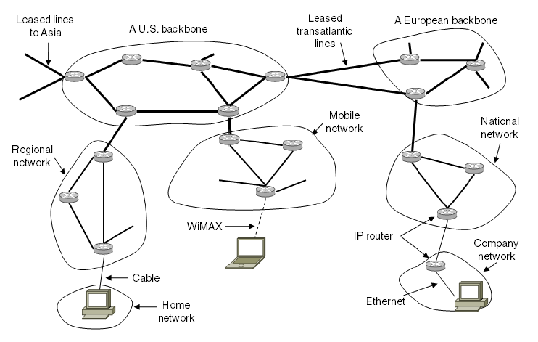
Network Layer in the Internet (3)
Internet is an interconnected collection of many networks that is held together by the IP protocol

Slide 38
IP Version 4 Protocol (1)
IPv4 (Internet Protocol) header is carried on all packets and has fields for the key parts of the protocol:
Used with ICMP
QOS and ECN*
RFC 3514
Don’t Fragment/More Fragments
<= 64 KB
When fragmenting
To forward to
4.3 billion addresses
# of 32-bit words in header; typically = 5
Options are not commonly used
Remember the CRC? So, why have a header checksum? Why must it be computed at each node? Hint: Look at fields above
*QoS = Quality of Service ECN = Explicit Congestion Notification

Slide 39
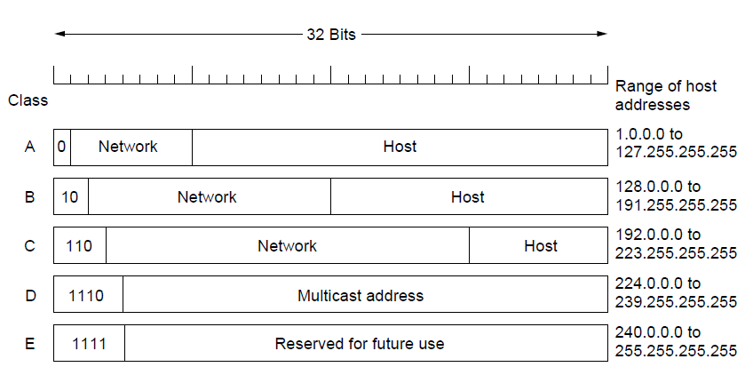
IP Addresses (5) – Classful Addressing
Old addresses came in blocks of fixed size (A, B, C)
Carries size as part of address, but lacks flexibility
Called classful (vs. classless) addressing
Notes:
This is just history. Prefixes are variable size, which is much more flexible and suits different kinds of usage, but now the prefix length needs to be carried separately by the routing protocols because it is not part of the address.

Slide 40
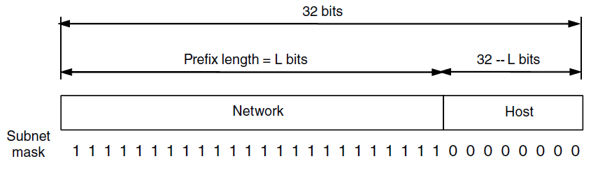
IP Addresses (1) – Prefixes
Addresses are allocated in blocks called prefixes
Prefix is determined by the network portion
Has 2^{L} addresses aligned on 2^{L} boundary
CIDR notation: address/length, e.g., 18.0.31.0/24
Classless Interdomain Routing
Routing protocols carry prefix length to routers, which use it to apply subnet mask
Variable length
Dotted decimal notation: 80D00297 is written as 128.208.2.151
Prefix: the lowest IP address in the block and the length of prefix in bits

Slide 41
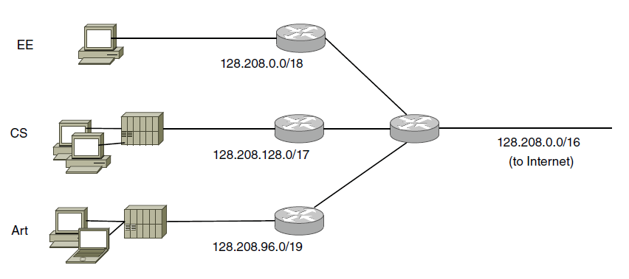
IP Addresses (2) – Subnets
Looks like a single prefix outside the network
Subnetting splits host portion of address into subnet and host parts
See slide 44 and “How the router decides which subnet a packet should be routed to” in Handouts subfolder.
through 128.208.63.255
through 128.208.255.255
ISP gives network
a single prefix
through 128.208.191.255
Network divides it into subnets internally
Notes:
Check the size of the different subnets:
Prefix has 2^16=32K addresses, CS subnet is largest, 2^15=16K addresses, EE subnet has 2^14=8K addresses, Art has 2^13=4K addresses.
There are 4K addresses left over. What is the prefix? It is found by writing the address ranges out to see that 128.208.64.0/19 is left.
Can the prefix lengths just be changed between EE/CS/Art? No, then blocks of size 2^N would not always be aligned on a 2^N boundary.

Slide 42
Dividing a Block
network 128.208
Host 0.0
65,536 addresses from 128.208.0.0 to 128.208.255.255
10000000 11010000 XXXXXXXX XXXXXXXX
←---- /16 prefix ----→ ←- 65,536 addresses-→ net mask: 255.255.0.0
CS: 10000000 11010000 1XXXXXXX XXXXXXXX
←---- /17 prefix ----→ ½ block to CS subnet mask: 255.255.128.0
EE: 10000000 11010000 00XXXXXX XXXXXXXX
←---- /18 prefix ----→ ¼ block to EE subnet mask: 255.255.192.0
Art: 10000000 11010000 011XXXXX XXXXXXXX
←---- /19 prefix ----→ 1/8 block to Art subnet mask: 255.255.224.0
Un: 10000000 11010000 010XXXXX XXXXXXXX
←---- /19 prefix ----→ 1/8 block Unassigned subnet mask: 255.255.224.0
32,768 addresses from 128.208.128.0 to 128.208.255.255
16,384 addresses from 128.208.0.0 to 128.208.63.255
8,192 addresses from 128.208.96.0 to 128.208.127.255
8,192 addresses from 128.208.64.0 to 128.208.95.255.

Slide 43
Dividing a Block (2)
10000000 = 128
11000000 = 192
11100000 = 224
11110000 = 240
11111000 = 248
11111100 = 252
11111110 = 254
11111111 = 255
10000000 = 128
01000000 = 64
00100000 = 32
00010000 = 16
00001000 = 8
00000100 = 4
00000010 = 2
00000001 = 1
128.209.0.0
128.208.255.255
CS
128.208.128.0
11111111 = 255
01111111 = 127
00111111 = 63
00011111 = 31
00001111 = 15
00000111 = 7
00000011 = 3
00000001 = 1
Art
128.208.127.255
128.208.96.0
UA
128.208.95.255
128.208.64.0
128.208.63.255
EE
128.208.0.0
IP address

Slide 44
Routing a Packet
Packet arrives for 128.208.2.151 – where to send it?
AND with each of these subnet masks, search for a match on prefix
 | CS | EE | Art
Subnet mask | 255.255.128.0 | 255.255.192.0 | 255.255.224
Prefix | 128.208.128.0 | 128.208.00.0 | 128.208.96.0
128.208. 2.151
255.255.128. 0
128.208. 0. 0
= 128.208.128.0
128.208. 2.151
255.255.192. 0
128.208.0.0
= 128.208.0.0
128.208. 2.151
255.255.224. 0
128.208.0.0
= 128.208.96.0
Matches 128.208.0.0, so send it to EE LAN
Subnet mask for Un = 255.255.224 but Prefix = 128.208.64.0

Slide 45
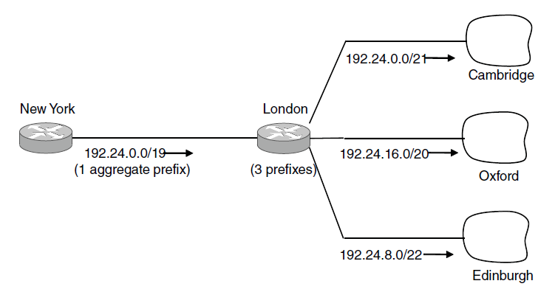
IP Addresses (3) – Aggregation
Aggregation joins multiple IP prefixes into a single larger prefix to reduce routing table size
ISP advertises
a single prefix
ISP customers have different prefixes
Notes:
Same mechanism as subnets, just a different motivation (of reducing the size of routing tables instead of making it easier to use the block of addresses you have).

Slide 46
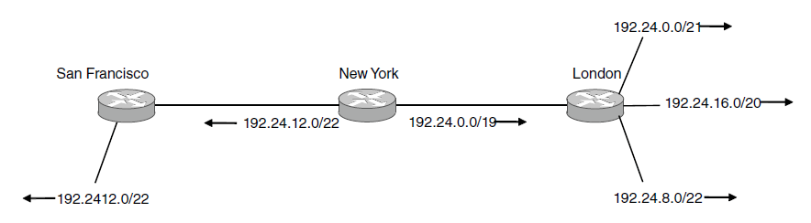
IP Addresses (4) – Longest Matching Prefix
Packets are forwarded to the entry with the longest matching prefix or smallest address block
Complicates forwarding but adds flexibility
Except for this part!
Main prefix goes this way
.
Notes:
At New York, the LMP rule makes it easy to add an exception to go elsewhere to reach part of a prefix. Without it, we would have had to split the prefix up into its components and give a route for each component.

Slide 47
Longest Matching Prefix (2)
192.24.63.255
More
specific
Prefix | Next Hop
192.24.0.0/18 | D
192.24.12.0/22 | B
D
/18
192.24.15.255
B
/22
192.24.12.0
192.24.6.0 →
192.24.14.32 →
192.24.54.0 →
D
192.24.0.0
IP address

Slide 48
IP Forwarding
IP addresses on one network belong to the same prefix
Node uses a table that lists the next hop for IP prefixes
Prefix | Next Hop
192.24.0.0/18 | D
192.24.12.0/22 | B
A
D
B
C

Slide 49
Host/Router Distinction
In the Internet:
Routers do the routing, know which way to all destinations
Hosts send remote traffic (out of prefix) to nearest router
Not for my network? Send it to the router
It’s my job to know which way to go …

Slide 50
Host Forwarding Table
Give using longest matching prefix
0.0.0.0/0 is a default route that catches all IP addresses
Prefix | Next Hop
My network prefix | Send direct to that IP
0.0.0.0/0 | Send to my router
Means all (other) hosts (because no bits specified for the network portion of address)

Slide 51
Flexibility of Longest Matching Prefix
Can provide default behavior, with less specific prefixes
To send traffic going outside an organization to a border router
Can special case behavior, with more specific prefixes
For performance, economics, security, …

Slide 52
Performance of Longest Matching Prefix
Uses hierarchy for a compact table
Benefits from less specific prefixes
Lookup more complex than table
Was a concern for fast routers, but not an issue in practice these days

Slide 53
Internet Control Protocols (1)
IP works with the help of several control protocols:
DHCP assigns a local IP address to a host
Gets host started by automatically configuring it
Host sends request to server, which grants a lease
Also gets gateway, DNS and NTP server addresses, subnet mask, etc.
ARP finds Ethernet address of a local IP address
Glue that is needed to send any IP packets
Host queries an address and the owner replies
ICMP is a companion to IP that returns error info
Required, and used in many ways, e.g., for traceroute
Start with TTL = 1, get back Unreachable, then TTL = 2, etc.

Slide 54
Getting IP Addresses
Problem:
A node wakes up for the first time …
What is its IP address? What’s the IP address of its router? Etc.
At least Ethernet address is on NIC
Hey, where am I?

Slide 55
Getting IP Addresses (2)
Manual configuration (old days)
Can’t be factory set, depends on use
A protocol for automatically configuring addresses (DHCP)»
Shifts burden from users to IT folk
What’s my IP?
Use A.B.C.D

Slide 56
DHCP
DHCP (Dynamic Host Configuration Protocol), from 1993, widely used
It leases IP address to nodes
Provides other parameters too
Network prefix
Address of local router
DNS server, time server, etc.

Slide 57
DHCP Protocol Stack
DHCP is a client-server application
Uses UDP ports 67 (server), 68 (client)
DHCP
UDP
IP
Ethernet

Slide 58
DHCP Addressing
Bootstrap issue:
How does node send a message to DHCP server before it is configured?
Answer:
Node sends broadcast messages delivered to all nodes on the network
Broadcast address is all 1s
IP (32 bit): 255.255.255.255
Ethernet (48 bit): ff:ff:ff:ff:ff:ff

Slide 59
DHCP Messages (2)
Client
Server
discover
Broadcast
Memory aid: DORA
offer
Protocol also supports replicated servers for reliability
To renew an existing lease, an abbreviated sequence is used:
request, followed by ack
request
ack
Notes:
Icons from cisco icon library

Slide 60
Allocating Public IP Addresses
Follows a hierarchical process
IANA delegates to regional bodies (RIRs)
RIRs delegate to companies in their region
Companies assign to their customers/computers (later, DHCP)
Use the nslookup command to get the IP address and domain name of your DNS server.
Then use http://itools.com/tool/arin-whois-domain-search to obtain info from ARIN on the registration.
ARIN (US, Canada)
APNIC (Asia Pacific)
ISPs
Customers
IANA
(All IPs)
(DHCP)
RIPE (Europe)
Enterprises
Computers
LACNIC (Latin America)
AfriNIC (Africa)

Slide 61
Public / Private IP Addresses
Public IP addresses, e.g., 18.31.0.1
Valid destination on the global Internet
Must be allocated to you before use »
Mostly exhausted … time for IPv6!
Private IP addresses
Can be used freely within private networks (home, small company)
10.0.0.0/8, 172.16.0.0/12, 192.168.0.0/16
Need public IP address(es) and NAT to connect to global Internet

Slide 62
Sending an IP Packet
Problem:
A node needs Link layer addresses to send a frame over the local link
How does it get the destination link address from a destination IP address?
Uh oh …
My IP is 1.2.3.4
Notes:
Icons from cisco icon library

Slide 63
Address Resolution Protocol (ARP)
How do IP addresses get mapped into data link (Ethernet) addresses?
Broadcasts an ARP request saying “who owns IP address such-and-such?”
Broadcast also contains requester’s mapping, so all machines on subnet learn it
Owner responds with his MAC address
The original requester caches response
ARP is a layer-2 protocol – why do you think it is included in layer 2?

Slide 64
ARP Protocol Stack
ARP sits right on top of link layer
No servers, just asks node with target IP to identify itself
Uses broadcast to reach all nodes
ARP
Ethernet

Slide 65
ARP Messages (2)
Node
Target
request
Broadcast
Who has IP 1.2.3.4?
reply
I do at MAC address 1:2:3:4:5:6
Notes:
Icons from cisco icon library

Slide 66
ARP (Address Resolution Protocol)
Node uses to map a local IP address to its Link layer addresse
Link layer
Source
Ethernet
Dest.
Ethernet
Source IP
Dest.
IP
Payload …
From
NIC
From
DHCP
From
DNS (Chapter 7)
From ARP

Slide 67
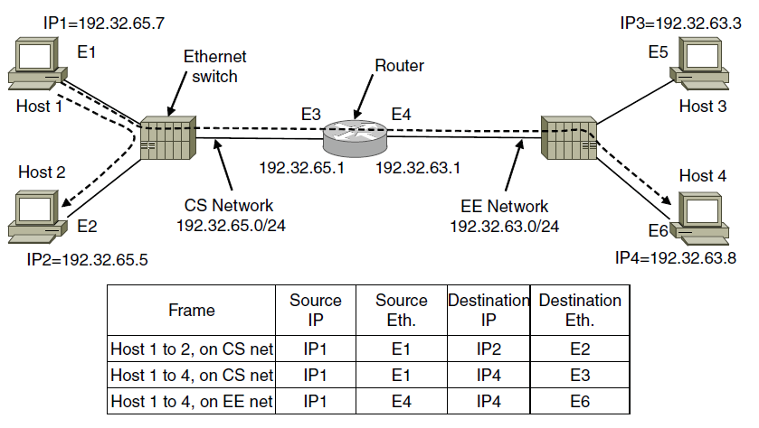
Internet Control Protocols (3)
ARP (Address Resolution Protocol) lets nodes find target Ethernet addresses [pink] from their IP addresses

Slide 68
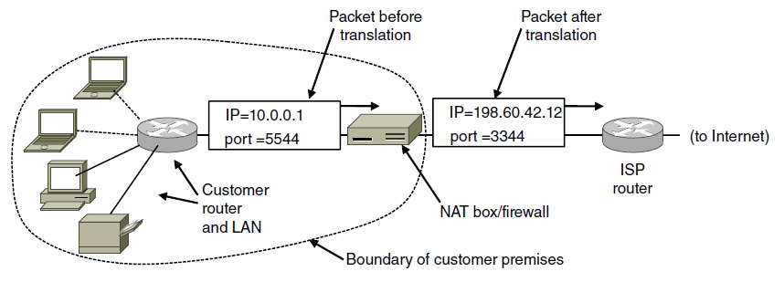
IP Addresses (6) – NAT
NAT (Network Address Translation) box maps one external IP address to many internal IP addresses
Uses TCP/UDP port to tell connections apart
Violates layering; very common in homes, etc.
Note error: page 454, fourth paragraph should read, “when a packet arrives….. the destination port in the TCP header is extracted”
Notes:
So Internet traffic sent to/from port 1111 might really be going to a computer A in the home while traffic sent to/from port 2222 to the same IP address might be going to a computer B.
The mapping in the NAT box is set up when a connection is established. A side-effect is that connections can only be made from inside the house to the Internet – you can’t run a server in your home without special configuration. This is a consequence of violating layering.

Slide 69
Topic
What happens when something goes wrong during forwarding?
Need to be able to find the problem
What happened?
Yikes!
XXXXXXX
Notes:
Cisco icons

Slide 70
Internet Control Message Protocol
ICMP is a companion protocol to IP
They are implemented together
Sits on top of IP (IP Protocol=1)
Provides error report and testing
Error is at router while forwarding
Also testing that hosts can use

Slide 71
ICMP Errors
When router encounters an error while forwarding:
It sends an ICMP error report back to the IP source address
It discards the problematic packet; host needs to rectify
Oh, now I see …
Report then toss it!
XXXXXXX
ICMP report
Notes:
Cisco icon library

Slide 72
ICMP Message Format
Each ICMP message has a Type, Code, and Checksum
Often carry the start of the offending packet as payload
Each message is carried in an IP packet
Notes:
Draw ICMP message format

Slide 73
ICMP Message Format (2)
Each ICMP message has a Type, Code, and Checksum
Often carry the start of the offending packet as payload
Each message is carried in an IP packet
Portion of offending packet, starting with its IP header
Src=router, Dst=A
Protocol = 1
Type=X, Code=Y
Src=A, Dst=B
XXXXXXXXXXXX
IP header
ICMP header
ICMP data

Slide 74
Example ICMP Messages
Name | Type / Code | Usage
Dest. Unreachable (Net or Host) | 3 / 0 or 1 | Lack of connectivity
Dest. Unreachable (Fragment) | 3 / 4 | Path MTU Discovery
Time Exceeded (Transit) | 11 / 0 | Traceroute
Echo Request or Reply | 8 or 0 / 0 | Ping
Testing, not a forwarding error: Host sends Echo Request, and destination responds with an Echo Reply

Slide 75
Traceroute
IP header contains TTL (Time to live) field
Decremented every router hop, with ICMP error if it hits zero
Protects against forwarding loops
Notes:
CN5E slides #5-62 (repeat)

Slide 76
Traceroute (2)
Traceroute repurposes TTL and ICMP functionality
Sends probe packets increasing TTL starting from 1
ICMP errors identify routers on the path
Local
Host
. . .
Remote
Host
1 hop
2 hops
3 hops
N-1 hops
N hops
Notes:
Icons from Cisco icon library, http://www.cisco.com/web/about/ac50/ac47/2.html.

Slide 77
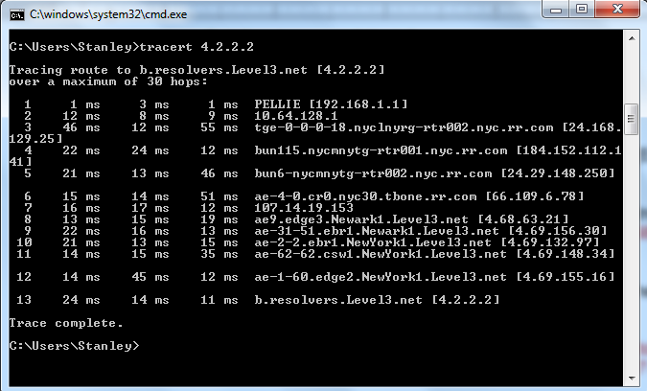
tracert

Slide 78
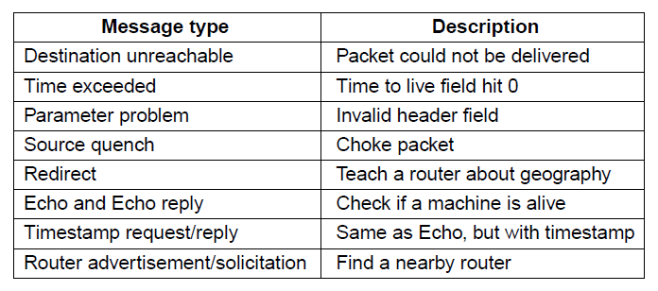
Internet Control Protocols (2)
Main ICMP (Internet Control Message Protocol) types:
*
**
* Also used by traceroute utility ** Used by ping command

Slide 79

What is a “Ping”?
http://www.youtube.com/watch?v=kBQ2ZhN30-c
PING: Packet INternet Grope
What does grope mean?
Japanese train station during rush hour
An anti-groping notice on the platform of the Odakyu subway line in Tokyo
SJW

Slide 80
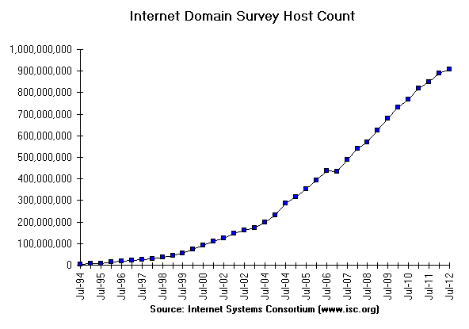
Internet Growth
At least a billion Internet hosts and growing …
And we’re using 32-bit addresses!
Notes:
Graph from http://www.isc.org/solutions/survey with permission via http://www.isc.org/solutions/survey/faq:
Can I have permission to reproduce your data or charts?
You have permission to reproduce our data provided that you mention the source as "Source: Internet Systems Consortium, Inc. (http://www.isc.org/)". However you must ask our permission to publish derivative works based on our data. In those cases you must say your data or charts are "Based on data from Internet Systems Consortium, Inc. (http://www.isc.org/)"

Slide 81

The End of New IPv4 Addresses
Now running on leftover blocks held by the regional registries; much tighter allocation policies
Exhausted
on 4/11
and 9/12!
ARIN
(US, Canada)
APNIC
(Asia Pacific)
ISPs
Companies
IANA
(All IPs)
RIPE
(Europe)
LACNIC
(Latin Amer.)
Exhausted
on 2/11!
AfriNIC
(Africa)
End of the world ? 12/21/12?
Notes:
Icon from openclipart

Slide 82
IP Version 6 to the Rescue
Effort started by the IETF in 1994
Much larger addresses (128 bits)
Many sundry improvements
Became an IETF standard in 1998
Nothing much happened for a decade
Hampered by deployment issues, and a lack of adoption incentives
Big push ~2011 as exhaustion looms

Slide 83
IP Version 6 (1)
Major upgrade in the 1990s due to impending address exhaustion, with various other goals:
Support billions of hosts
Reduce routing table size
Simplify protocol
Better security
Attention to type of service
Aid multicasting
Roaming host without changing address
Allow future protocol evolution
Permit coexistence of old, new protocols, …
Deployment has been slow & painful, but may pick up pace now that addresses are all but exhausted

Slide 84
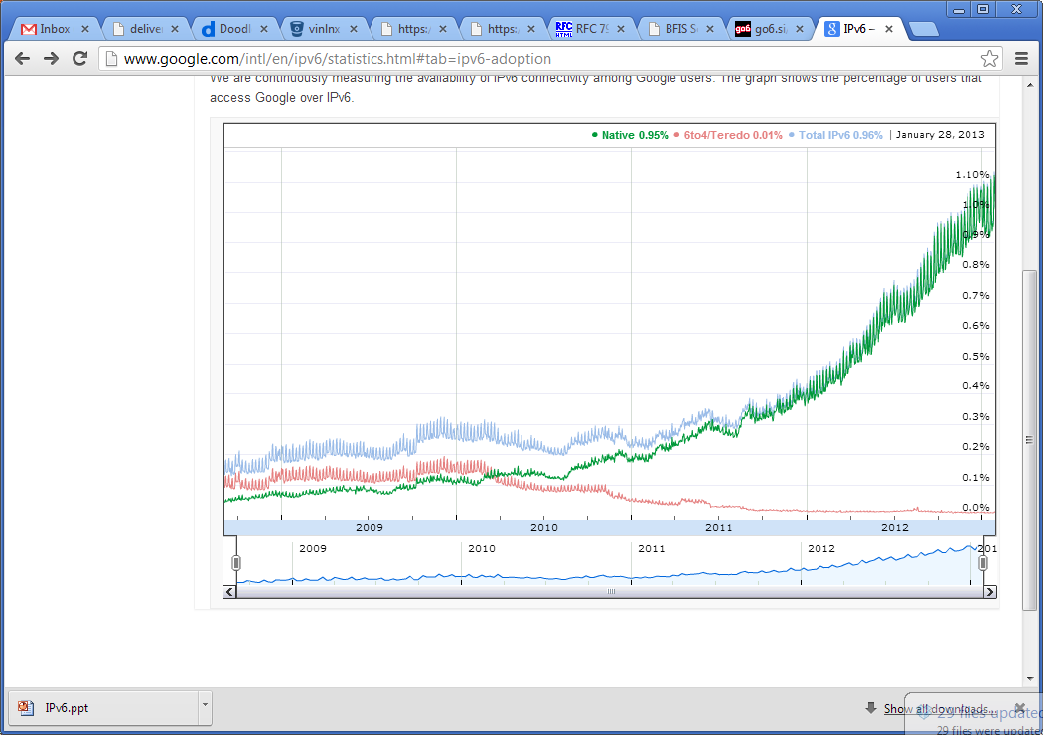

IPv6 Deployment
Time for
growth!
Percentage of users accessing Google via IPv6
Source: Google IPv6 Statistics, 30/1/13
Notes:
Graph from google public data graph, icon from isoc (public domain)

Slide 85
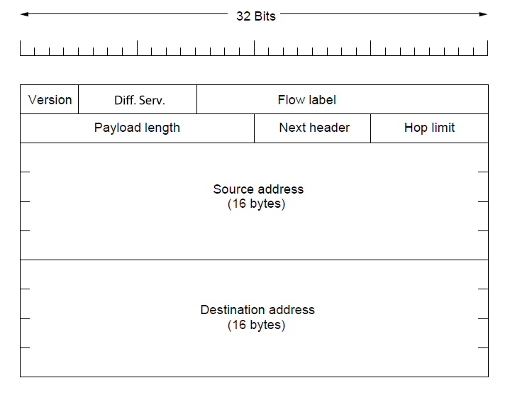
IP Version 6 (2 )
IPv6 protocol header has much longer addresses (128 vs. 32 bits) and is simpler (by using extension headers)
Why make the header simpler?
Class-of-service
VC-like properties
No fragmentation – MTU size determined dynamically
(3.4 X10³⁸ addresses)
IPV6 Adoption

Slide 86
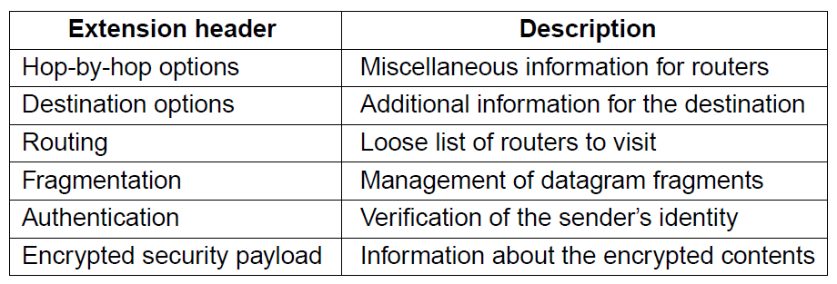
IP Version 6 (3)
IPv6 extension headers handles other functionality

Slide 87
IPv6
32 bits
Features large addresses
128 bits, most of header
New notation
8 groups of 4 hex digits (16 bits)
Omit leading zeros, groups of zeros
Ex: 2001:0db8:0000:0000:0000:ff00:0042:8329
→
Notes:
CN5E slides #5-71

Slide 88
IPv6 (2)
32 bits
Lots of other, smaller changes
Streamlined header processing
Flow label to group of packets
Better fit with “advanced” features (mobility, multicasting, security)
Notes:
CN5E slides #5-71

Slide 89
IPv6 Transition
The Big Problem:
How to deploy IPv6?
Fundamentally incompatible with IPv4
Dozens of approaches proposed
Dual stack (speak IPv4 and IPv6)
Translators (convert packets)
Tunnels (carry IPv6 over IPv4) »

Slide 90
Tunneling
Native IPv6 islands connected via IPv4
Tunnel carries IPv6 packets across IPv4 network
Notes:
CN5E slides #5-54

Slide 91
Tunneling (2)
Tunnel acts as a single link across IPv4 network
User
Tunnel
User
Notes:
Cisco icon library

Slide 92
Tunneling (3)
Tunnel acts as a single link across IPv4 network
Difficulty is to set up tunnel endpoints and routing
User
Tunnel
User
IPv6
IPv6
IPv6
IPv6
IPv6
IPv6
IPv4
IPv4
Link
Link
Link
Link
Link
Link
Native IPv6
Native IPv4
Native IPv6

Slide 93
Routing Algorithms (1)
Optimality principle »
Shortest path algorithm »
Flooding »
Distance vector routing »
Link state routing »
Hierarchical routing »
Broadcast routing »
Multicast routing »
Anycast routing »
Routing for mobile hosts »
Routing in ad hoc networks »
Notes:
Grayed out topics are optional and can be omitted without loss of continuity

Slide 94
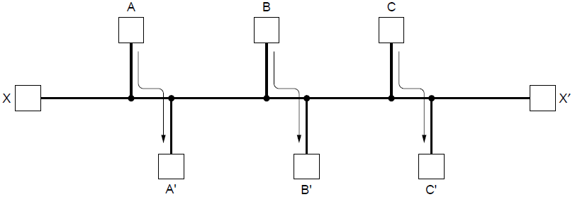
Routing Algorithms (2)
Routing is the process of discovering network paths
Model the network as a graph of nodes and links
Decide what to optimize (e.g., fairness vs efficiency)
Update routes for changes in topology (e.g., failures)
Forwarding is the sending of packets along a path via a lookup
Efficency (A-A’, B-B’, C-C’) vs. fairness X-X’?
Routes can be dynamic or static
Notes:
Distinguish routing from forwarding.
We focus on adaptive routing schemes that update routes in response to failures. Some traffic-aware schemes also adapt to changes in traffic, but we do not consider them in the algorithms that follow.
For the graph, the traffic demands are A->A’, B->B’, C->C’ and X->X’. What would be fair? For each flow the get the same amount of bandwidth. If all network links have unit capacity then we would give each flow ½ a unit of capacity. The total network traffic is then 2 units. What would be efficient? If we gave the X->X’ flow no bandwidth then we could give each of the other three flows 1 unit. The total network traffic is then 3 units. So it is more efficient, but it is not fair. So we will have to decide what we want to optimize.

Slide 95
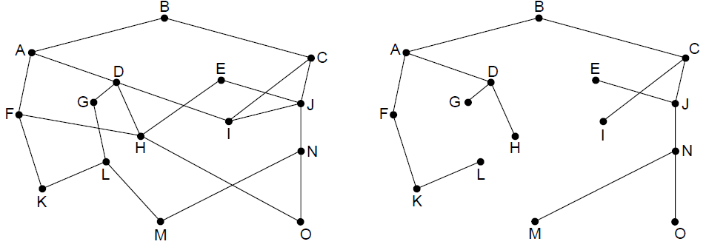
The Optimality Principle
Each portion of a best path is also a best path; the union of them to a router is a tree called the sink tree
Best means fewest hops in the example
B
Network
Sink tree of best paths to router B
Notes:
Proof by contradiction: if a portion of a best path is not a best path then there is something better. Substitute this better portion and you would have a better overall path, which cannot be the case if the overall path is a best path.
For sink trees, if there are multiple paths that are equally good, then one best path from one node to another is chosen at random. For example, H can be reached in 3 hops via H-D-A-B as shown, or by H-F-A-D (not shown). This is simple and useful as there is a single route from each router to each destination. If, instead, all equally best paths are kept then their union is a DAG (directed acyclic graph). This is a more general case that permits multiple paths from a router to a destination.

Slide 96
Shortest Path Algorithm (1)
Dijkstra’s algorithm computes a sink tree on the graph:
Each link is assigned a non-negative weight/distance
Shortest path is the one with lowest total weight
Using weights of 1 gives paths with fewest hops
Algorithm:
Start with sink, set distance at other nodes to infinity
Relax distance to other nodes
Pick the lowest distance node, add it to sink tree
Repeat until all nodes are in the sink tree
Notes:
The notion of weight generalizes distance to other cost metrics. Setting weights to be 1 gives paths with fewest hops. Setting weight to be distance gives paths that are shortest or lowest delay. Setting weight to be lower for higher capacity links favors higher capacity paths.

Slide 97
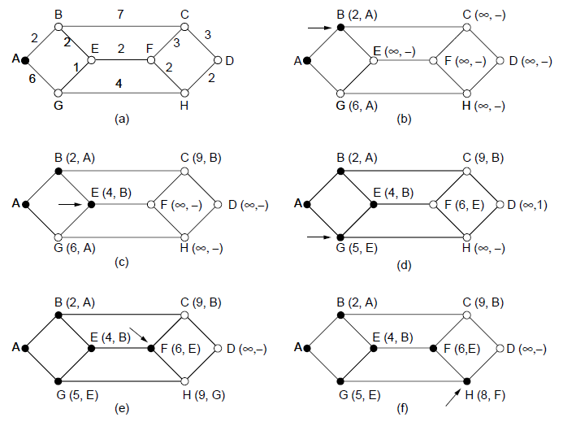
Shortest Path Algorithm (2)
A network and first five steps in computing the shortest paths from A to D. Pink arrows show the sink tree so far.

Slide 98
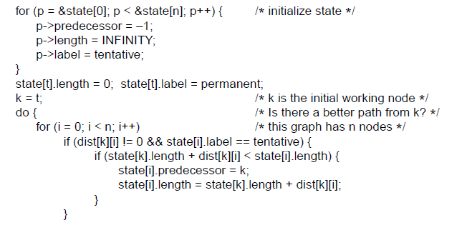
Shortest Path Algorithm (3)
. . .
Start with the sink, all other nodes are unreachable
Relaxation step. Lower distance to nodes linked to newest member of the sink tree
. . .

Slide 99
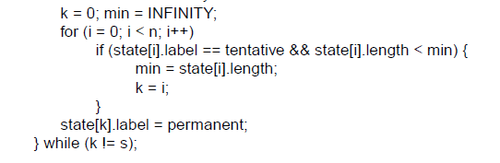
Shortest Path Algorithm (4)
. . .
Find the lowest distance, add it to the sink tree, and repeat until done
Notes:
This code keeps going until it reaches a sought-after destination node; if it continued until there were no tentative nodes then it would have found the entire sink tree.
The predecessor links can be reversed to find the path from t -> s instead of from s -> t. This is because the link has the same cost in each direction so paths are symmetrical (or the same in each direction).

Slide 100
Flooding
A simple method (recall the bridge) to send a packet to all network nodes
Each node floods a new packet received on an incoming link by sending it out all of the other links - robust
Nodes need to keep track of flooded packets to stop the flood; even using a hop limit can blow up exponentially
Useful as a building block for other algorithms that require more setup
Notes:
Note that flooding doesn’t actually find any routes that can be reused.

Slide 101
Distance Vector Routing (1)
Distance vector is a distributed routing algorithm
Shortest path computation is split across nodes
Router Information Protocol (RIP; routed daemon of Unix)
Algorithm: Each node
knows distance of links to its neighbors
advertises vector of lowest known distances to all destinations and shares with neighbors
uses received vectors to update its own
repeats periodically and on topology change; use Bellman-Ford algorithm to select route
Notes:
How long will it take to converge? The diameter of the network.

Slide 102
Distance Vector Routing
Hop count max is 15; limits diameter of networks (16 = unusable)
Various timers used
Route time-out (no update in 180 seconds; advertise as unreachable)
Flush route 60 seconds later (drop from tables)
Uses split horizon with poisoned reverse to address count-to-infinity problem (routers don’t advertise their best path to router they heard them from or advertise an infinite cost)

Slide 103
Distance Vector Routing
Uses UDP (connectionless)
Why do you think this choice was made?
Time to converge and scalability poor
Reacts rapidly to good news and slowly to bad news
Easily configured
Tells its neighbors about the world (“routing by rumor”
Use fading out

Slide 104
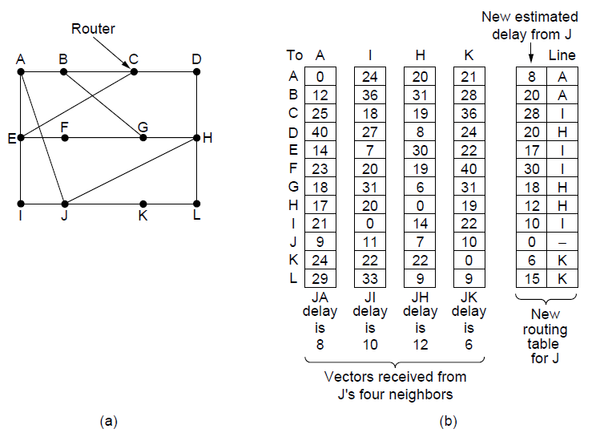
Distance Vector Routing (2)
Network
New vector for J
Vectors received at J from
Neighbors A, I, H and K

Slide 105
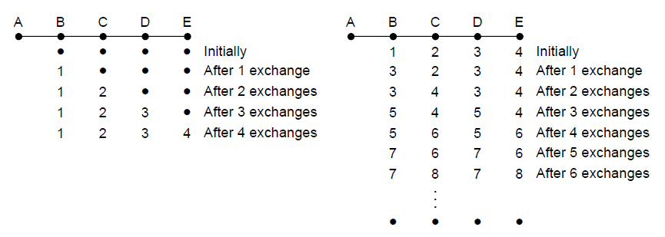
The Count-to-Infinity Problem
Failures can cause DV to “count to infinity” while seeking a path to an unreachable node
X
Good news of a path to A spreads quickly
“routing by rumor”
Bad news of no path to A is learned slowly
See notes for partial solution
Notes:
Partially addressed by: (1) split horizon - if C routes through B to get to A then C does not advertise its route to A to B and (2) poisoned reverse – if C routes through B to get to A then C advertises to B that its distance to A is infinity

Slide 106
Link State Routing (1)
Link state is an alternative to distance vector
More computation but simpler dynamics
Widely used in the Internet (OSPF, ISIS)

Slide 107
Link State Routing
Discover neighbors, learn network addresses through reachability protocol
Hello packet and response
sent every 10 seconds as “keep alive”
Set distance/cost metric to each neighbor
May be bandwidth or delay
Construct link state packet (advertisement) telling all it just learned about cost
Periodically and when a change occurs, send packet to, receive packets from other routers.

Slide 108
Link State Routing
Nodes learn full network graph, compute shortest path to every other router using Dijkstra, builds routing table
Routers receive first-hand information from peers
in distance vector, intermediate routers update their tables before sending their vector on
converges quickly
DV: router tells its neighbors about the world
LS: router tells the world about its neighbors
Can be segmented into regions, limiting scope of change and supporting larger networks

Slide 109
Distributing the Link State Packets
Issues that can occur when distributing LS packets
What if sequence numbers wrap?
Use large (32-bit) sequence number
If a router crashes, what sequence number to resume with?
If it restarts with 0, will be rejected as a duplicate
Can the router keep a record of the last sequence number used?

Slide 110
Distributing the Link State Packets
Issues that can occur when distributing LS packets
What if a sequence number is corrupted?
If sequence number 4 suffers a one-bit error, it could be received as 65,540 00000000000000100 → 10000000000000100
Packets 5 through 65,540 rejected!
Solution: include age (40) and decrement it each second and in each router when flooded; discard when 0
Have neighbor remind you of last seq # when you come back up
You send Hello packet with 0
He says 63,295, you resume with 63,296

Slide 111
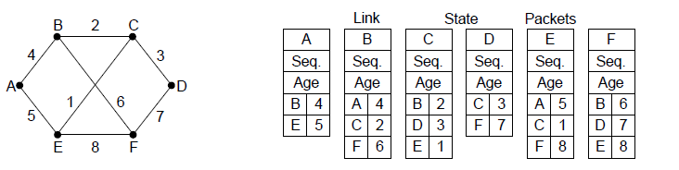
Link State Routing (2) – LSPs
LSP (Link State Packet) for a node lists neighbors and weights of links to reach them
Network
LSP for each node

Slide 112
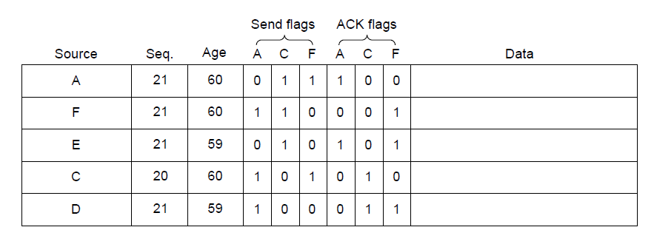
Link State Routing (3) – Reliable Flooding
Seq. number and age are used for reliable flooding
New LSPs are acknowledged on the lines they are received and sent on all other lines
Example shows the LSP database at router B
Notes:
In the example, B has links to A, C and F in the network. It received LSPs from A, C, and F directly and so acknowledged A, C, and F respectively and sent that LSP on both other links. But B received E and D on two links, so it acknowledged both and sent only on the third link.

Slide 113
Comparing Routers and Bridges
Router uses layer-3 hierarchical addresses
Table size proportional to number of subnets
End-system forwards data packet to router using router MAC address (must know address of gateway)
Bridge uses layer-2 flat addresses
Table size proportional to number of end-systems
Bridge sees and processes each frame; end-station doesn’t see bridge
Derived from website of Manfred Lindner, Vienna University of Technology

Slide 114
Comparing Routers and Bridges
Broadcasts not forwarded (to avoid stressing the WAN)
Independent of layer 2
Router is “gateway” to WAN
Can use redundant paths
Broadcasts flooded to maintain transparency
Dependent on layer 2
LANs not coupled to WANs because of high traffic (b’cast domain)
Uses spanning tree to avoid loops

Slide 115
Comparing Routers and Bridges
Router separates the network into multiple broadcast domains
Broadcast frames stopped at router
Slower (processing in software) but trend is to layer-3 switching
Address resolution (ARP) needed
Bridge separates a LAN into multiple collision domains but still 1 b’dcast domain
Broadcast frames flooded
Faster (processing in hardware)
No address resolution

Slide 116
Comparing Routers and Bridges
Location change requires adjustment of layer 3 address (but can use DHCP)
Location change does not require adjustment of address

Slide 117
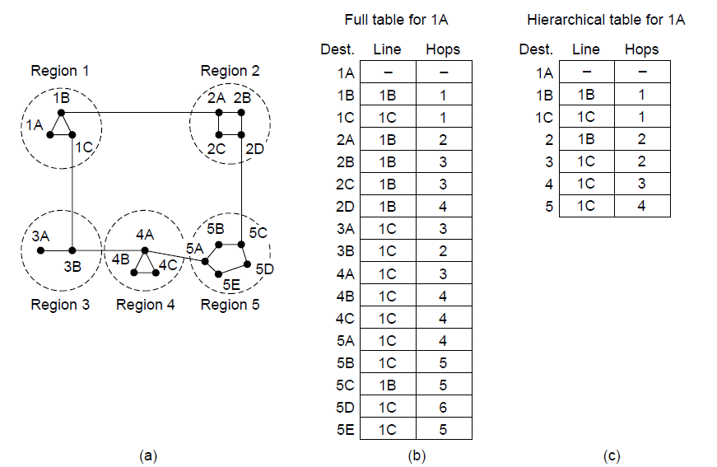
Hierarchical Routing
Hierarchical routing reduces the work of route computation but may result in slightly longer paths than flat routing
Best choice to reach nodes in 5 except for 5C
Notes:
Hierarchical routing is what you think it is, e.g., to reach a given telephone first head towards the right country, then the right city in the country, then the phone in the city.
Each node keeps only one entry per region for other regions, plus an entry for all nodes in the local region.
The advantages are smaller routing tables, smaller routing computations to run at nodes, and fewer/smaller messages to send to describe the network.

Slide 118
Broadcast Routing
Used to transmit stock prices, weather broadcasts, i.e., info that must go to a lot of places
Different approaches:
Reverse path forwarding:
Did broadcast packet arrive on link used to send packets toward the source? If so, it probably arrived on the best path and is first copy to arrive, so forward on all links
If the receiving router knows the spanning tree (it uses link state), just send on edges (links) of spanning tree
If not, discard as likely duplicate
Use sink tree (spanning tree)

Slide 119
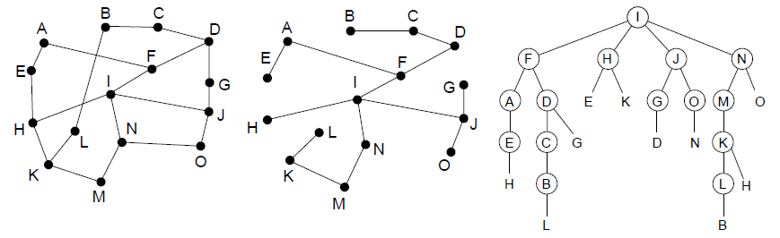
Broadcast Routing
Broadcast sends a packet to all nodes
RPF (Reverse Path Forwarding): send broadcast received on the link to the source out all remaining links
if not received on preferred link, packet discarded as likely duplicate
Alternatively, can build and use sink trees at all nodes
Network
Sink tree for I is efficient broadcast
RPF from I is larger than sink tree
Circled letter indicates arrival on preferred line
Notes:
Why use RPF? It requires only the regular (unicast) routing table at each node, such as built by distance vector, so it can be widely used. Sink trees are only available with a protocol that explicitly computes them such as link state. Note that broadcast with sink trees requires each node to compute all sink trees, since the broadcast is forwarded by looking up the sink tree for the source at each node, not a single broadcast tree for the network (as in the LAN spanning tree). However, using sink trees is more efficient since RPF over-sends. For example, D is reached from F (going down the sink tree), as well as from G (going out all remaining links).

Slide 120
Multicast Routing
Examples: Sports event, multiplayer game, Victoria’s Secret fashion show
Avoids sending traffic to nodes where not needed
Prune broadcast spanning tree to remove links that do not lead to multicast group members
Membership in multicast group determined by a separate algorithm
Multicast versions of OSPF and RIP used for pruning

Slide 121
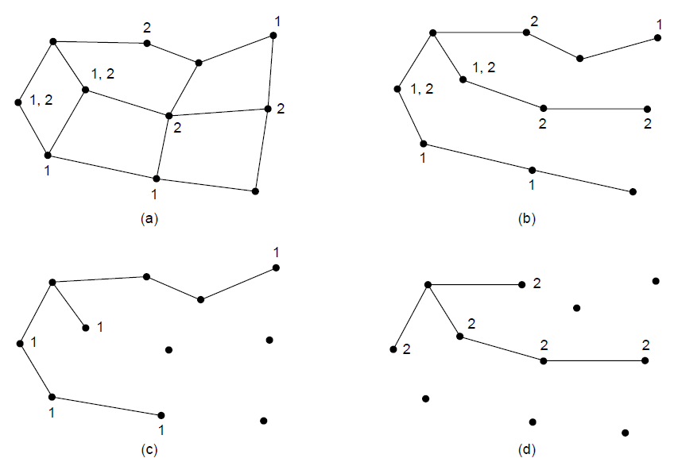
Multicast Routing (1) – Dense Case
Multicast sends to a subset of the nodes called a group
Uses a different tree for each group and source
S
Network with groups 1 & 2
Spanning tree from source S
S
S
Multicast tree from S to group 1
Multicast tree from S to group 2
Start with broadcast spanning tree, then prune links not belonging to members
Notes:
The example shows two of the multicast trees computed in the network. There are many more, the number of nodes times the number of groups. This is worth the effort when the group densely cover the network, i.e., most groups affect most nodes in the network so it makes sense for all nodes to build an efficient multicast tree.

Slide 122
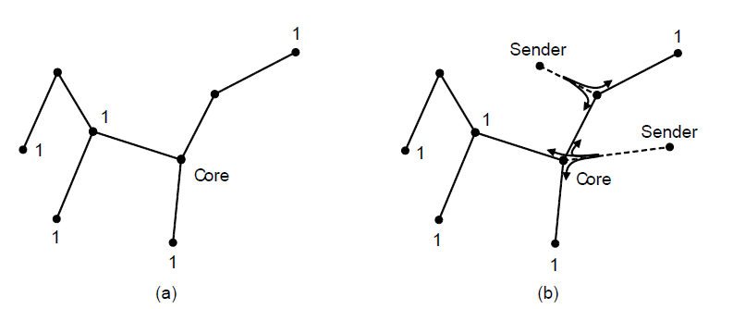
Multicast Routing (2) – Sparse Case
CBT (Core-Based Tree) uses a single tree to multicast
Tree is the sink tree from core node to group members
Multicast heads to the core until it reaches the CBT
p 1.
Sink tree from core to group 1
Multicast is sent to the core then down (right-most sender) or multicast at first router (top sender)
Routers agree on a core. Members send packet to core to build tree.
Notes:
Tradeoff is that CBT is less efficient than computing the spanning tree for each source to reach each group, but it is less work to scale to large networks and many groups. Now, with CBT, nodes that are not on the group spanning tree do not need to compute it and can simply send to the core node using their regular routing tables. This is a good tradeoff when the groups sparsely cover the network, i.e., there are many groups that most nodes do not need to know about.

Slide 123
Anycast Routing
Recall unicast, broadcast and multicast
Anycast – a packet is delivered to the nearest member of a group
Used in DNS and Content Delivery Networks (CDNs) such as Akami, CloudFlare and EdgeCast
All members of group have the same IP address
Normal routing protocols still work

Slide 124
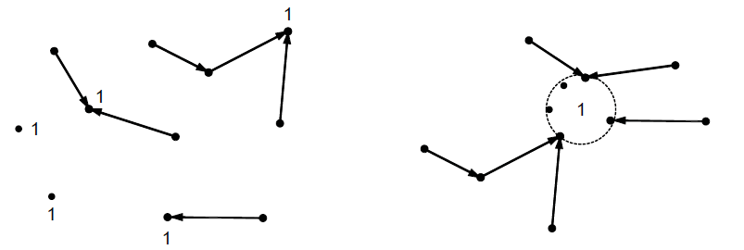
Anycast Routing
Anycast sends a packet to one (nearest) group member
Differs from regular routing - a node in many places
Anycast routes to group 1
Apparent topology of sink tree to “node” 1
Notes:
We will see later that anycast is used in practice to reach the nearest root DNS server.

Slide 125
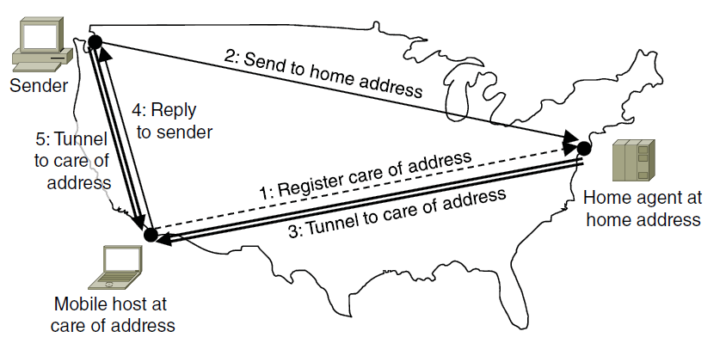
Routing for Mobile Hosts
Mobile hosts can be reached via a home agent
Fixed home agent tunnels packets to reach the mobile host; reply can optimize path for subsequent packets
No changes to routers or fixed hosts
Notes:
The tradeoff that is being made here is that the routing system that computes spanning trees is not being changed at all, but routes to reach mobile hosts can be circuitous when the mobile is far from home.

Slide 126
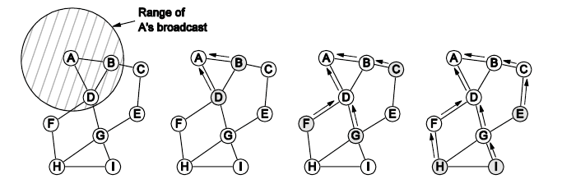
Routing in Ad Hoc Networks
The network topology changes as wireless nodes move
Routes are often made on demand, e.g., AODV (below)
A’s starts to find route to I
A’s broadcast reaches B & D
B’s and D’s broadcast reach C, F & G
C’s, F’s and G’s broadcast reach H & I

Slide 127
Congestion Control (1)
Handling congestion is the responsibility of the Network and Transport layers working together
We look at the Network portion here
Traffic-aware routing »
Admission control »
Traffic throttling »
Load shedding »

Slide 128
Congestion Control Algorithms
Can’t just keep adding buffer space – packets will timeout while in buffer and be retransmitted by source
Eliminating one bottleneck may just expose a different one
Congestion control – a global issue – making sure network is able to carry offered traffic
Flow control is between a particular sender and receiver

Slide 129
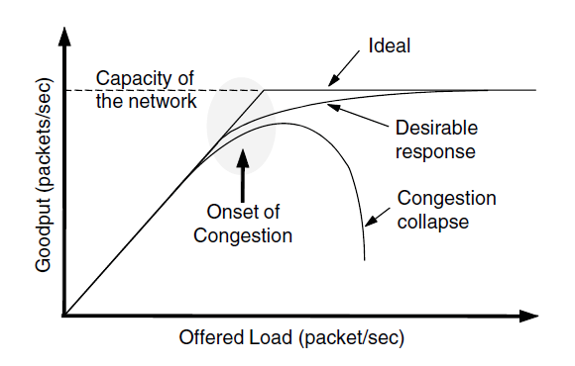
Congestion Control (2)
Congestion results when too much traffic is offered; performance degrades due to loss/retransmissions
Goodput: rate at which useful (not discarded due to congestion) packets are delivered
Goodput increases linearly with increasing load
a pathological condition
Notes:
As offered load increases, goodput should increase correspondingly until the capacity of the network is reached. Goodput will trail offered load because the load is bursty and queues will occasionally be too full and a packet will be discarded inside the network.
Congestion collapse can occur if the protocols are not carefully designed when nodes retransmit packets many times, believing that they have been lost, when copies of the packet are still in the network (in queues at routers) pending delivery. While throughput at a receiver may be high, goodput falls because multiple copies of the same packet are being received and after the first copy the bandwidth is wasted.
This really happened in the late 1980s as the Internet grew, and it lead to the design of modern TCP that includes congestion control mechanisms.

Slide 130
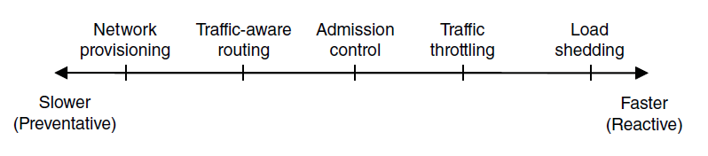
Congestion Control (3) – Approaches
Network must do its best with the offered load
Different approaches at different timescales
Nodes should also reduce offered load (Transport)
Notes:
Provisioning is simply sizing the network to fit the offered load, i.e., don’t build it too small, or with little West-to-East capacity if there is much West-to-East traffic.

Slide 131

Traffic-Aware Routing
Choose routes depending on traffic, not just topology
E.g., use EI for West-to-East traffic if CF is loaded
But take care to avoid oscillations
Notes:
Our previous routes only considered topology; this approach can get more traffic through the network.
If not careful, then routing can notice CF is busy and switch traffic over to use EI, only to later notice that EI is busy and switch traffic back to CF. There are various techniques to avoid this: 1) change routes only slowly, e.g., traffic engineering in which an external system sets weights and the routing system does not otherwise adapt; and 2) using multiple paths at once, e.g., both CF and EI.

Slide 132

Admission Control
Admission control allows a new traffic load only if the network has sufficient capacity, e.g., with virtual circuits
Can combine with looking for an uncongested route
Network with some congested nodes
Uncongested portion and route AB around congestion

Slide 133

Traffic Throttling
Congested routers signal hosts (choke packet) to slow down traffic
ECN (Explicit Congestion Notification) marks packets and receiver returns signal to sender
Optionally used in Internet (ECN bits of IP header and support in TCP)
Notes:
There are other designs, but this is the main one under deployment in the Internet. By marking existing packets using bits in the IP header, routers avoid sending additional packets at a time of congestion. Signal from receiver to sender is carried using a Transport protocol like TCP.

Slide 134


Load Shedding (1)
When all else fails, network will drop packets (shed load)
Can be done end-to-end (left) or link-by-link
Link-by-link (right) produces rapid relief
Wine: old better than new (ftp)
Milk: new better than old (MPEG video – periodic full frame, then deltas)
1
4
2
5
3
Apps must mark packets to indicate how important they are

Slide 135


Load Shedding (2)
1
End-to-end (right) takes longer to have an effect, but can better target the cause of congestion
5
2
6
3
7
4

Slide 136
Quality of Service
Application requirements »
Traffic shaping »
Packet scheduling »
Admission control »
Integrated services »
Differentiated services »

Slide 137

Application Requirements (1)
Different applications care about different properties
We want all applications to get what they need
.
“High” means a demanding requirement, e.g., low delay

Slide 138
Application Requirements (2)
Network provides service with different kinds of QoS (Quality of Service) to meet application requirements
Network Service | Application
Constant bit rate | Telephony
Real-time variable bit rate | Videoconferencing
Non-real-time variable bit rate | Streaming a movie
Available bit rate | File transfer
Example of QoS categories from ATM networks
Notes:
Video conferencing is variable bit rate because video is normally compressed, so the bit rate varies over time. Telephony is typically carried at a lower, fixed rate.

Slide 139

Traffic Shaping (1)
Traffic shaping regulates the average rate and burstiness of data entering the network
At flow setup, traffic pattern agreed
Called SLA
Traffic policed (controlled)
Lets us make guarantees
Shape traffic here

Slide 140
Traffic Shaping (2)
Token/Leaky bucket limits both the average rate (R) and short-term burst (B) of traffic
For token, bucket size is B, water enters at rate R and is removed to send; opposite for leaky.
to send
to send
Leaky bucket
(need not full to send)
Token bucket
(need some water to send)

Slide 141


Traffic Shaping (3)
Host traffic
R=200 Mbps B=16000 KB
Shaped by R=200 Mbps B=9600 KB
Shaped by R=200 Mbps B=0 KB
Smaller bucket size delays traffic and reduces burstiness
Notes:
For the host traffic the descriptor R=200 Mbps, B=16000KB is the smallest token bucket that can let the traffic pass unchanged. To compute this we work out R as the average rate over the time period, then given we find the smallest B such that the bucket size only just reaches zero at some point.

Slide 142

Packet Scheduling (1)
Packet scheduling divides router/link resources among traffic flows with alternatives to FIFO (First In First Out)
1
1
1
2
2
3
3
3
Example of round-robin queuing

Slide 143

Packet Scheduling (2)
Fair Queueing approximates bit-level fairness with different packet sizes; weights change target levels
Result is WFQ (Weighted Fair Queueing)
F_{i} = max(A_{i}, F_{i-1}) + L_{i}/W
Packets may be sent out of arrival order
Finish virtual times determine transmission order
Notes:
Virtual times are measured in rounds, where a round lets each input queue send 1 bit for weight 1, or W bits for weight W. The time to send a packet of length L is thus L/W. The formula says that the finish virtual time for a packet is the larger of its arrival time plus the time to send it, or the finish time of the previous packet in the same queue plus the time to send it.

Slide 144

Admission Control (1)
Admission control takes a traffic flow specification and decides whether the network can carry it
Sets up packet scheduling to meet QoS
Example flow specification

Slide 145

Admission Control (2)
Construction to guarantee bandwidth B and delay D:
Shape traffic source to a (R, B) token bucket
Run WFQ with weight W / all weights > R/capacity
Holds for all traffic patterns, all topologies
Notes:
Bandwidth is guaranteed at each router by setting a high enough weight on the flow; if this cannot be done then the flow must not be admitted.
Delay guarantees are more subtle and the bound is not given here. Essentially a burst of traffic can arrive at one router and be delayed but then it will not be delayed at other routers because it has already been shaped to be less bursty. So the total delay is something like the propagation delay plus B/R.

Slide 146
Integrated Services (1)
Design with QoS for each flow; handles multicast traffic.
Admission with RSVP (Resource reSerVation Protocol):
Receiver sends a request back to the sender
Each router along the way reserves resources
Routers merge multiple requests for same flow
Entire path is set up, or reservation not made

Slide 147

Integrated Services (2)
Merge
R3 reserves flow from S1
R3 reserves flow from S2
R5 reserves flow from S1; merged with R3 at H

Slide 148

Differentiated Services (1)
Design with classes of QoS; customers buy what they want
Expedited class is sent in preference to regular class
Less expedited traffic but better quality for applications

Slide 149

Differentiated Services (2)
Implementation of DiffServ:
Customers mark desired class on packet
ISP shapes traffic to ensure markings are paid for
Routers use WFQ to give different service levels

Slide 150
Label Switching and MPLS (1)
MPLS (Multi-Protocol Label Switching) sends packets along established paths; ISPs can use for QoS
Path indicated with label below the IP layer
Uses label as index into a table --→ fast lookup
MPLS used within ISP networks for QoS – an example of “creeping connectionism” (see slide 14)

Slide 151

Label Switching and MPLS (2)
Label added based on IP address on entering an MPLS network (e.g., ISP) and removed when leaving it
Forwarding only uses label inside MPLS network
Labels remapped at each hop, just like a VC
Multiple flows that have same characteristics and end at the same LAN router may use the same label
We call this a Forwarding Equivalency Class (FEC)

Slide 152
Internetwork Routing
Networks may use:
Different routing algorithms internally (RIP vs. OSPF)
Different routing metrics
May want to hide internal details
Within a network (intradomain), an Interior Gateway Protocol (usually a link state protocol) is used
Between networks (interdomain), an Exterior Gateway Protocol is used (Border Gateway Protocol in the Internet)
Each network is referred to as an Autonomous System (AS)

Slide 153


OSPF— Interior Routing Protocol (1)
OSPF computes routes for a single network (e.g., ISP)
Models network as a graph of weighted edges
Network:
Graph:
3
Broadcast LAN modeled as a well-connected node
Notes:
The broadcast LAN connecting routers (LAN 3) could be modeled as a mesh since it connects each of R3, R4 and R5 to all of the others. Instead, it is modeled as a node (LAN 3) to which the other nodes connect.

Slide 154

OSPF— Interior Routing Protocol (2)
OSPF divides one large network (Autonomous System) into areas connected to a backbone area
Helps to scale; summaries go over area borders

Slide 155

OSPF— Interior Routing Protocol (3)
OSPF (Open Shortest Path First) is link-state routing:
Uses messages below to reliably flood topology
Then runs Dijkstra to compute routes

Slide 156
BGP— Exterior Routing Protocol (1)
BGP (Border Gateway Protocol) computes routes across interconnected, autonomous networks
Key role is to respect networks’ policy constraints
A distance vector (path vector) protocol
Example policy constraints:
No commercial traffic for educational network
Never put Iraq on route starting at Pentagon
Choose cheaper network
Choose better performing network
Don’t go from Apple to Google to Apple
Notes:
Since different networks have different practices and goals we can’t reduce the preferred routes to a single weight number attached to links.

Slide 157

BGP— Exterior Routing Protocol (2)
Common policy distinction is transit vs. peering:
Transit carries traffic for pay; peers for mutual benefit
AS1 carries AS2↔AS4 (Transit) but not AS3 (Peer)
May be an IXP
Does not run BGP because is stub network

Slide 158

BGP— Exterior Routing Protocol (3)
BGP propagates messages along policy-compliant routes
Message has prefix, AS path (to detect loops) and next-hop IP (to send over the local network)

Slide 159
Internet Multicasting
Groups have a reserved IP address range (class D)
Membership in a group handled by IGMP (Internet Group Management Protocol) that runs at routers
Routes computed by protocols such as PIM:
Dense mode uses RPF with pruning
Sparse mode uses core-based trees
IP multicasting is not widely used except within a single network, e.g., datacenter, cable TV network.

Slide 160
Mobile IP
Mobile hosts can be reached at fixed IP via a home agent
Home agent tunnels packets to reach the mobile host; reply can optimize path for subsequent packets
No changes to routers or fixed hosts
Notes:
This is a repeat of earlier “routing for mobile hosts” which was modeled on the mobile IP protocol

Slide 161
End
Chapter 5

