Slide 1
Username
Password
LOGIN
ANTIQUE SCHOLARSHIPS

Slide 2
ADMIN
Scholars
Requirements
Announcements

Slide 3
ADMIN
Scholars
List
Loren Legarda
Show
10
entries
Search:
Create a new record
Rhodora Cadiao
Student No. | Last Name | First Name | M.I | School | Course | Year | Municipality | Status
144233 | Loyzaga | Diego | D. | SAC | BSIT | 3 | San Jose | Old
142333 | Gil | Enrique | E. | UA | BSAT | 4 | Pandan | New
Requirements
Edit
Del
Msg
Announcements
Edit
Del
Msg
Showing 1 to 10 of 50 entries
Previous
1
2
3
4
5
Next

Slide 4
ADMIN
Scholars
List
Loren Legarda
Show
10
entries
Search:
Create a new record
Rhodora Cadiao
Student No. | Last Name | First Name | M.I | School | Course | Year | Municipality | Status
140987 | Steffi | Steff | D. | SAC | BSIT | 3 | San Jose | Complete
146723 | Jinku | Jink | E. | UA | BSAT | 4 | Pandan | Incomplete
Requirements
Edit
Del
Msg
Announcements
Edit
Del
Msg
Showing 1 to 10 of 50 entries
Previous
1
2
3
4
5
Next

Slide 5
ADMIN
Scholars
List
Requirements
Show
10
entries
Search:
Create a new record
Loren Legarda
Student No. | Last Name | First Name | M.I | School | Course | Year | Municipality | Requirements’ Status
140987 | Steffi | Steff | D. | SAC | BSIT | 3 | San Jose | Complete
146723 | Jinku | Jink | E. | UA | BSAT | 4 | Pandan | Incomplete
Rhodora Cadiao
Edit
Del
Msg
Announcements
Edit
Del
Msg
Showing 1 to 10 of 50 entries
Previous
1
2
3
4
5
Next

Slide 6
ADMIN
Scholars
List
Requirements
Show
10
entries
Search:
Create a new record
Loren Legarda
Student No. | Last Name | First Name | M.I | School | Course | Year | Municipality | Requirements’ Status
140987 | Steffi | Steff | D. | SAC | BSIT | 3 | San Jose | Complete
146723 | Jinku | Jink | E. | UA | BSAT | 4 | Pandan | Incomplete
Rhodora Cadiao
Edit
Del
Msg
Announcements
Edit
Del
Msg
Showing 1 to 10 of 50 entries
Previous
1
2
3
4
5
Next

Slide 7
ADMIN
Scholars
Requirements
Title
Enter Title
Announcements
Subject
Enter Subject
Announcement
Compose…
Cancel
Post

Slide 8
ADMIN
Search…
Steffi Steff
Steffi Steff
Good Morning Sir. May I ask you sir why is it that my name is not included in the list for releasing of scholars this December 18?
December 16, 2017 11: 00am
Jinku Jinks
Diego Loyzaga
Nhika (Hamtic)
Good Morning Steffany. According to our record, you have incomplete requirements. Please submit your additional requirements to the ceero not later than December 22.
December 16, 2017 11: 05am

Slide 9
ADMIN
User Dashboard
Administrator (accounts)
Add new admin
Username | Password | School | Update | Delete | Message
Admin1 | admin1234 | SAC
Admin2 | admin3232 | UA-MAIN
Edit
Del
Msg
Edit
Del
Msg

Slide 10
ADMIN
User Dashboard
User Profile
Logout

Slide 11
ADMIN
Scholars
User Profile
Requirements
Logout
Announcements

Slide 12




ANTIQUE SCHOLARSHIPS
HOME
ABOUT
GRANT
SIGN IN
ANTIQUE SCHOLARSHIPS

Slide 13
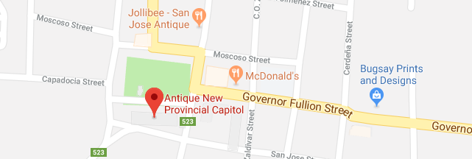
ANTIQUE SCHOLARSHIPS
HOME
ABOUT
GRANT
SIGN IN
Contact Us
Connect With Us
Full Name:
Phone:
+63901234568
Email:
ANTIQUESCHOLARSHIPS.COM
Phone Number:
Address:
Antique Provincial Capitol, San Jose De Buenavista, Antique, Philippines
Email:
Send

Slide 14
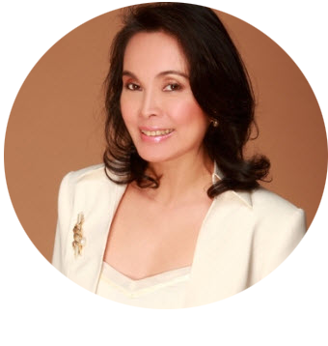
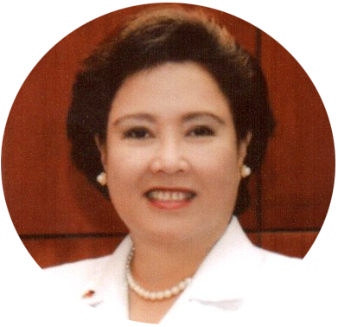
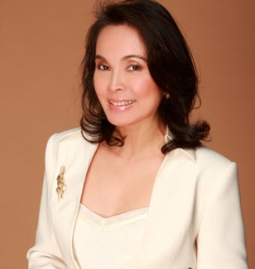

ANTIQUE SCHOLARSHIPS
HOME
ABOUT
GRANT
SIGN IN
Grant Sponsors
Loren Legarda
SENATOR
Lorna Regina Bautista Legarda is a Filipino environmentalist, cultural worker, journalist, and politician, notable as the only female to top two senatorial elections — 1998 and 2007. She has lineage from Antique province and Rizal province.

Slide 15
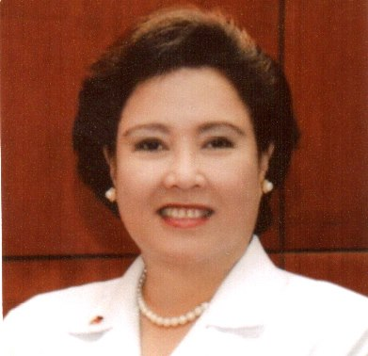
ANTIQUE SCHOLARSHIPS
HOME
ABOUT
GRANT
SIGN IN
Grant Sponsors
Rhodora Cadiao
Governor
Rhodora Cadiao is the current governor of Antique Province.

Slide 16
ANTIQUE SCHOLARSHIPS
HOME
ABOUT
GRANT
SIGN IN
Email
Password
LOGIN
Don’t have an account? Sign Up

Slide 17
ANTIQUE SCHOLARSHIPS
HOME
ABOUT
GRANT
SIGN IN
School ID
Last Name
First Name
School
Course
Year Level
Municpality
Password
Confirm Password
SIGN UP
Already have an account? LOGIN

Slide 18
STUDENT
HOME
CHAT
USER PROFILE
LOGOUT
Announcement for:
Schedule of Releasing
Activities
Meetings
Requirements
Deadlines

Slide 19
STUDENT
HOME
CHAT
USER PROFILE
Jinky Rose Galang
LOGOUT
Good Morning Sir.
8:01 am
Rexon Nodque
Good Morning. How can I help you?
8:02 am

Slide 20
STUDENT
HOME
CHAT
USER PROFILE
LOGOUT
Edit:
Personal Info
View Requirements
Account

