Slide 1
LAB3

Slide 2
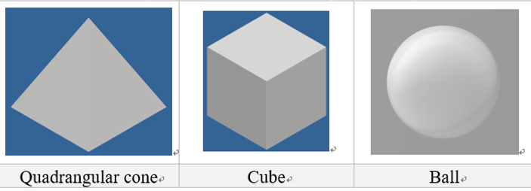
LAB3
demo on 2020/12/16
Load the two STL models(quadrangular cone and Cube) and define a Ball.
Load the file and display it on the screen using ray casting.
Setting parameters
The light source position at (x,y,z)=(-50,50,50)
The eye position at (x,y,z)=(50,50,50)
Ball position at (x,y,z)(you can define by yourself), radius= 5
Paint the cube red, ball green, quadrangular cone blue.
Due date : 2020 / 12 / 16

Slide 3
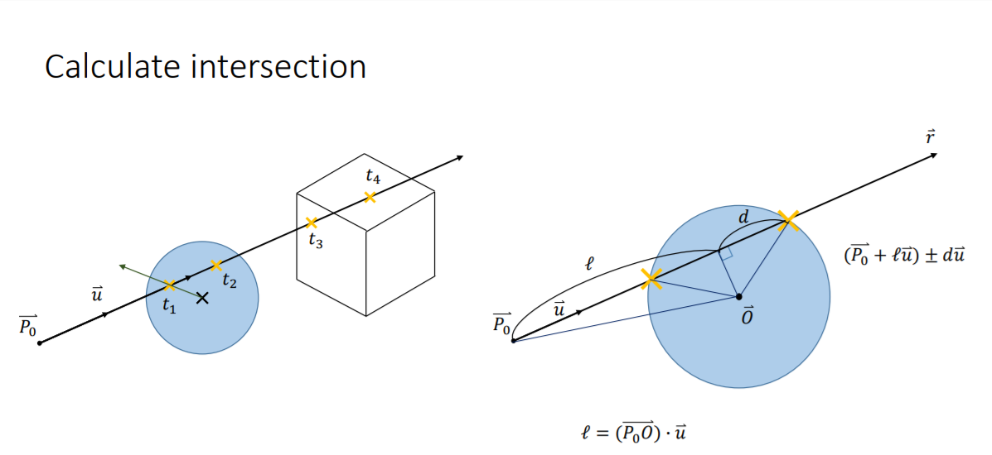
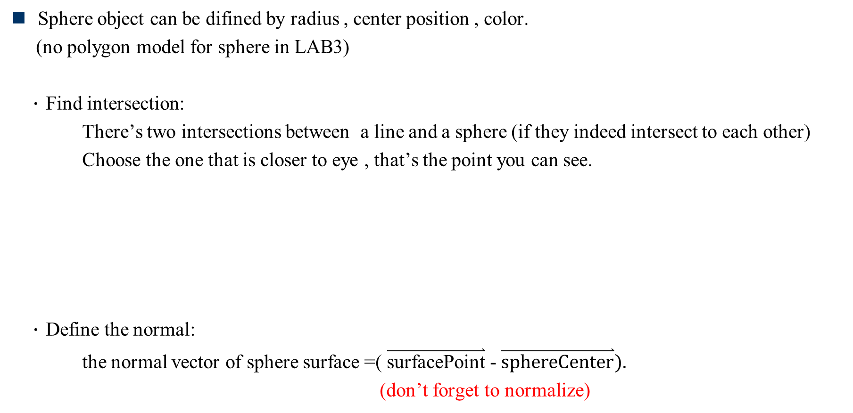
Ray-Casting for sphere object
Sphere object can be difined by radius , center position , color.
(no polygon model for sphere in LAB3)
．Find intersection:
There’s two intersections between a line and a sphere (if they indeed intersect to each other)
Choose the one that is closer to eye , that’s the point you can see.
．Define the normal:
the normal vector of sphere surface =( $\overset{⃑}{\text{surfacePoint}}$ - $\overset{⃑}{\text{sphereCenter}}).$
(don’t forget to normalize)

Slide 4
Ray-Casting for polygon object
You can see the math in class note pdf file(Page23~Page25)
(Professor will introduce this in the class)
Concept:
．Page23
Consider the polygon as a small region on a plane , so you can represent the polygon by plane equation.
You can use the way of finding the intersection between line and plane.
．Page24,Page25
Check if this intersection is in the small region(our polygon)

Slide 5
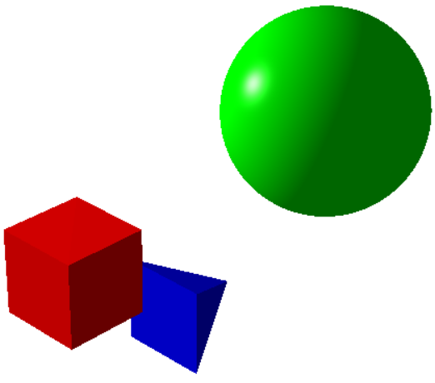
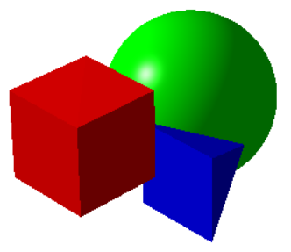
LAB3
The position you define for the sphere object should be overlapped with other objects.
Example:

