Slide 1
LAB3

Slide 2
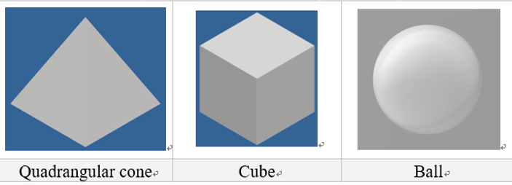
LAB3
demo on 2020/12/16
Load the two STL models(quadrangular cone and Cube) and define a Ball.
Load the file and display it on the screen using ray casting.
Setting parameters
The light source position at (x,y,z)=(-50,50,50)
The eye position at (x,y,z)=(50,50,50)
Ball position at (x,y,z)(you can define by yourself), radius= 5
Paint the cube red, ball green, quadrangular cone blue.
Due date : 2020 / 12 / 16

Slide 3
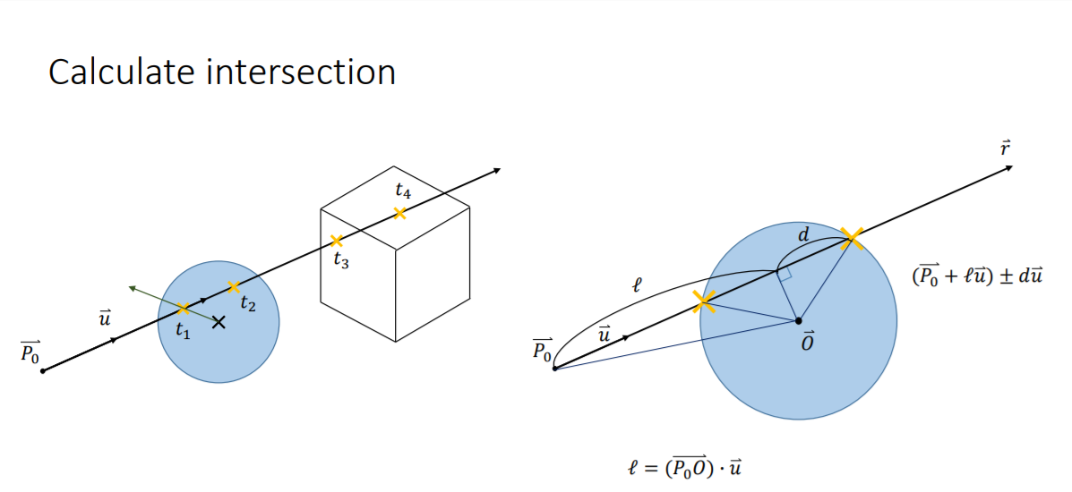
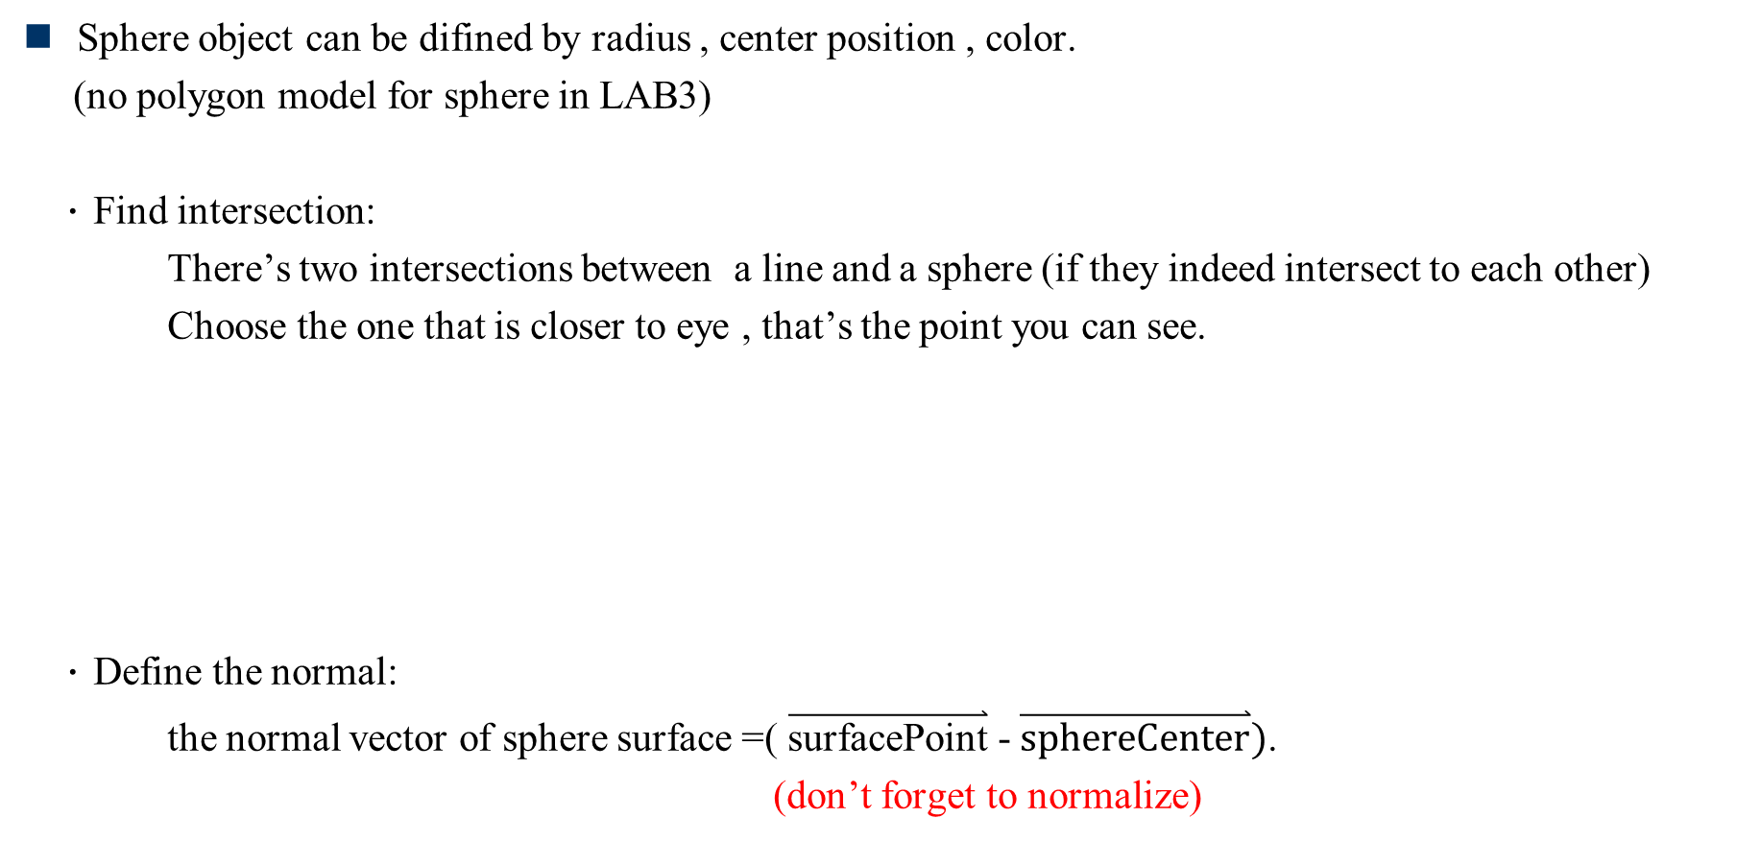
Ray-Casting for sphere object
Sphere object can be difined by radius , center position , color.
(no polygon model for sphere in LAB3)
．Find intersection:
There’s two intersections between a line and a sphere (if they indeed intersect to each other)
Choose the one that is closer to eye , that’s the point you can see.
．Define the normal:
the normal vector of sphere surface =( $\overset{⃑}{\text{surfacePoint}}$ - $\overset{⃑}{\text{sphereCenter}})$.
(don’t forget to normalize)

Slide 4
Ray-Casting for polygon object
You can see the math in class note pdf file(Page23~Page25)
(Professor will introduce this in the class)
Concept:
．Page23
Consider the polygon as a small region on a plane , so you can represent the polygon by plane equation.
You can use the way of finding the intersection between line and plane.
．Page24,Page25
Check if this intersection is in the small region(our polygon)

Slide 5
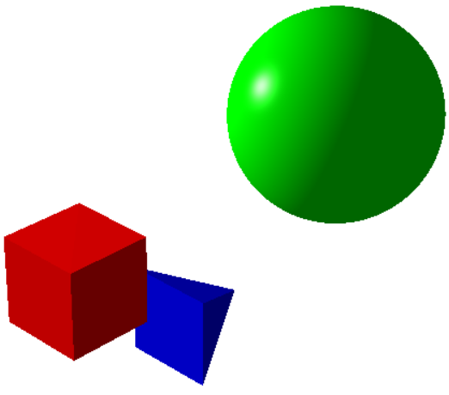
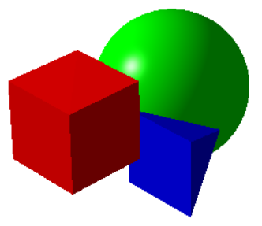
LAB3
The position you define for the sphere object should be overlapped with other objects.
Example:

Slide 6



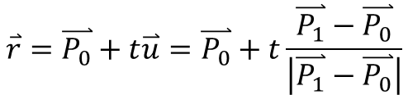







How to get pixel position $\vec{P_{1}}$？
Eye
coordinate
$$y$$
Ray cast
$$\hat{u}$$
$$P_{1}$$
$$z$$
$$\vec{P_{0}}=\vec{eye}$$
$$y$$
$$x$$
World
coordinate
f
$$\overset{⃑}{r}=\overset{⃑}{P_{0}}+t\overset{⃑}{u}=\overset{⃑}{P_{0}}+t\frac{\overset{⃑}{P_{1}}−\overset{⃑}{P_{0}}}{\left|\overset{⃑}{P_{1}}−\overset{⃑}{P_{0}}\right|}$$
$$x$$
$$z$$
$$\overset{⃑}{u}=\frac{\overset{⃑}{P_{1}}−\overset{⃑}{P_{0}}}{\left|\overset{⃑}{P_{1}}−\overset{⃑}{P_{0}}\right|}$$

Slide 7











Pixel position in world coordinate
width
$$v$$
$$y$$
$$1$$
$$z_{e}=focal length$$
$$x_{e}=？$$
$$−1$$
$$1$$
$$u$$
height
$$y_{e}=？$$
$$x$$
$$−1$$
canvass
Eye coordinate

Slide 8
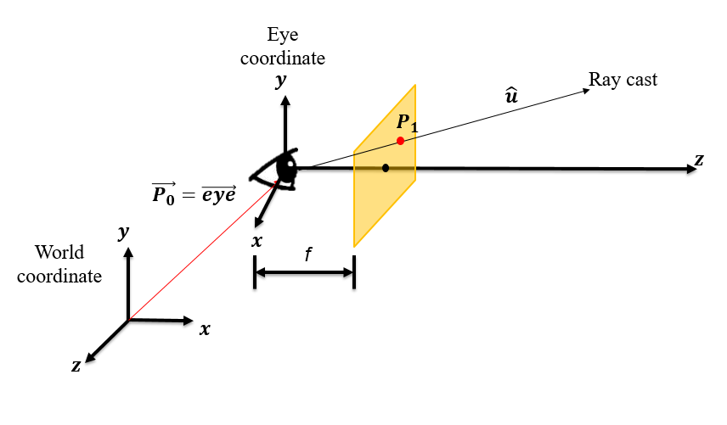


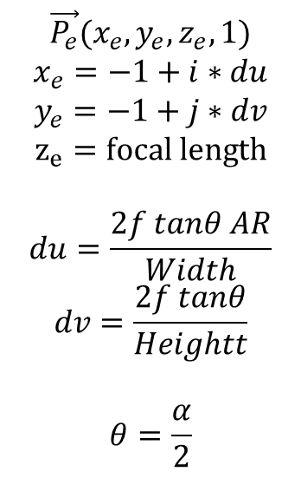






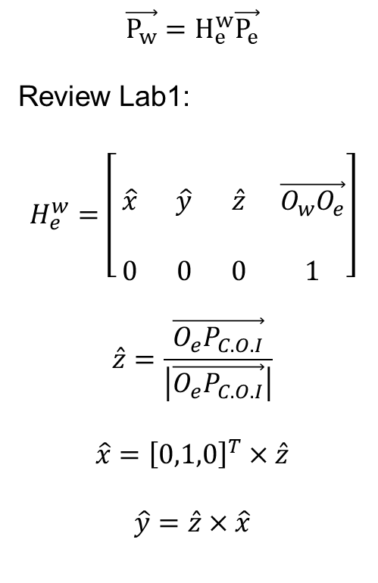
Pixel position in world coordinate
$$\vec{P_{e}}→\vec{P_{w}}$$
$$\vec{P_{w}}=H_{e}^{w}\vec{P_{e}}$$
Review Lab1:
$$H_{e}^{w}=\left[\begin{matrix} & & & \\ \hat{x} & \hat{y} & \hat{z} & \vec{O_{w}O_{e}} \\ & & & \\ 0 & 0 & 0 & 1\end{matrix}\right]$$
$$\hat{z}=\frac{\vec{O_{e}P_{C.O.I}}}{\left|\vec{O_{e}P_{C.O.I}}\right|}$$
$$\hat{x}={\left[0,1,0\right]}^{T}×\hat{z}$$
$$\hat{y}=\hat{z}×\hat{x}$$
$$\vec{P_{e}}(x_{e}, y_{e}, z_{e}, 1)$$
$$x_{e}=−1+i∗du$$
$$y_{e}=−1+j∗dv$$
$$z_{e}=focal length$$
$$du=\frac{2f tanθ AR}{Width}$$
$$dv=\frac{2f tanθ}{Heightt}$$
$$θ=\frac{α}{2}$$
$$v$$
$$1$$
$$−1$$
$$1$$
$$u$$
$$\vec{P_{e}}$$
$$dv$$
$$−1$$
$$du$$
Eye coordinate

Slide 9



t value
There may be many intersections in a ray, you have to compare them to get the closer position.
The t value must be $>0$, $t_{5}, t_{6}<0$, should be discard. (This problem will happen in LAB4.)
$$t_{4}$$
$$t_{3}$$
$$t_{2}$$
$$\overset{⃑}{u}$$
$$t_{1}$$
$$\overset{⃑}{P_{0}}$$
$$t_{5}$$
$$t_{6}$$

Slide 10
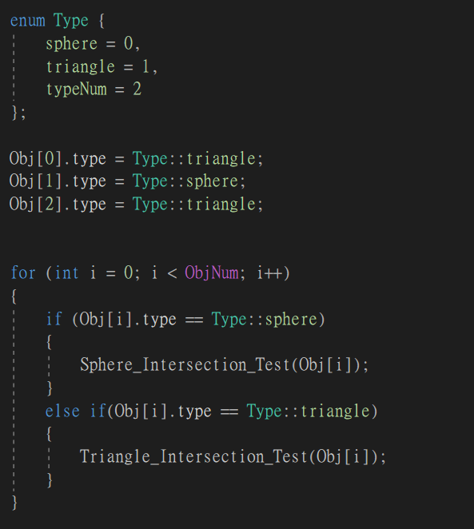
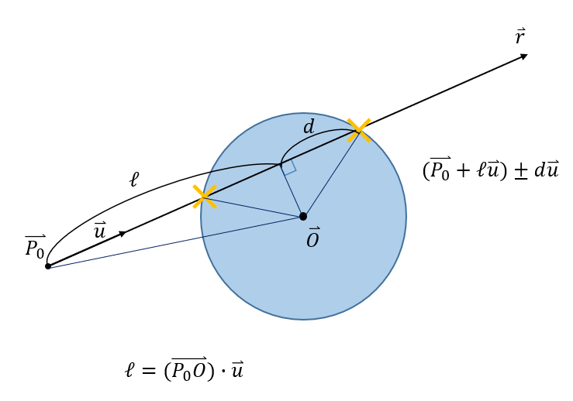
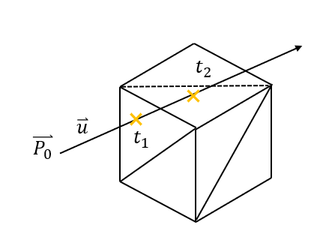
Define object type
Define object type, then you can do:
sphere intersection
triangle intersection.
Use enum to increase readability.
Triangle intersection
sphere intersection

Slide 11

shading
Set white if the light intensity $≥1.$
$(white: r=g=b=1$)

Slide 12

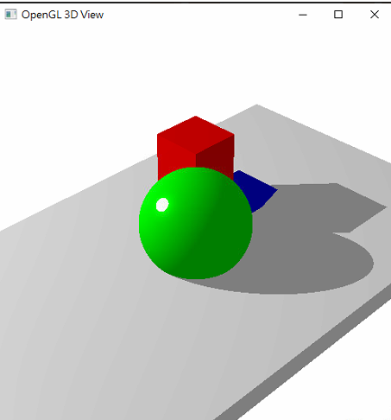
shadow
Fail to get light source!
Just give it ambient color.
Second
Ray cast
Ray cast

Slide 13
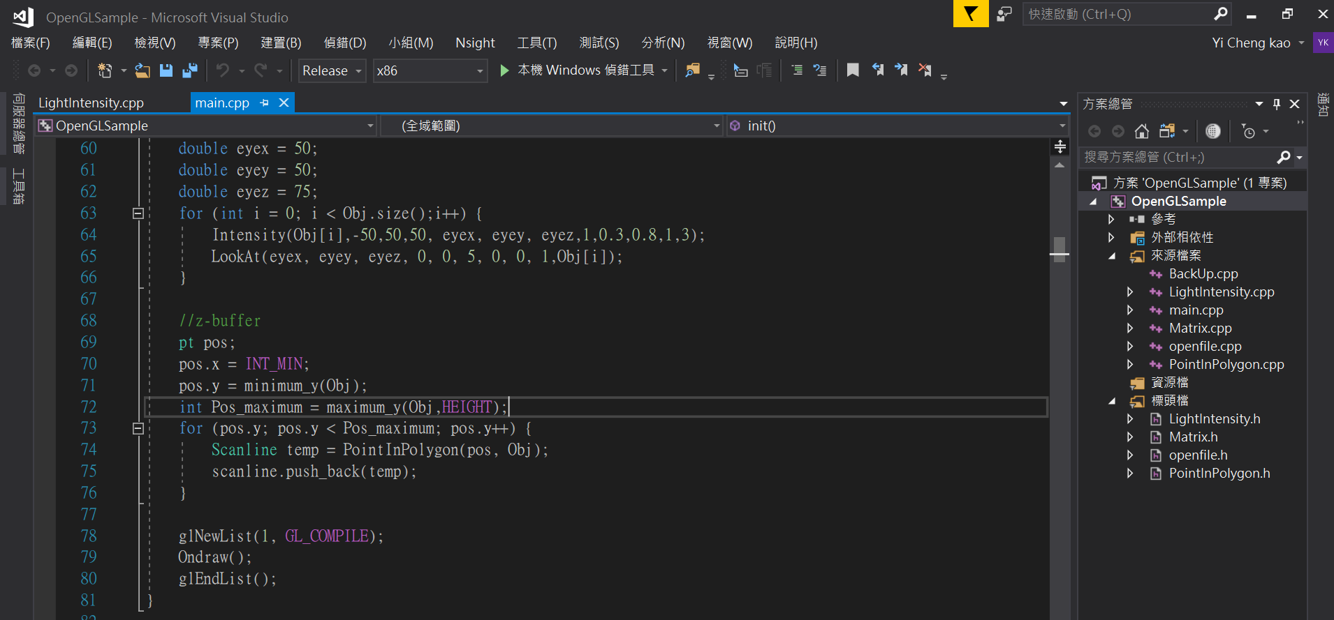
Demo suggestion
Use Release mode to demo for saving time.

Slide 14
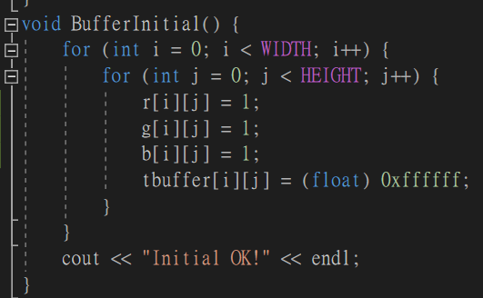
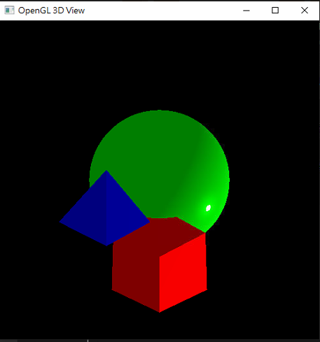
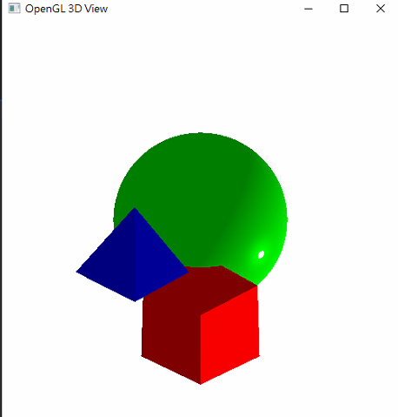
Demo suggestion
Initialize your buffer with white background.
Because it is not clear on the screen in classroom.

