Slide 1

COMP 3211 Group 35
CHEN Ziyang, Rocky 21095751d
LI Shuhang, Hubery 21102658d
YE Chenwei, Jesse 21103853d
HE Rong, Shawn 21101622d

Slide 2
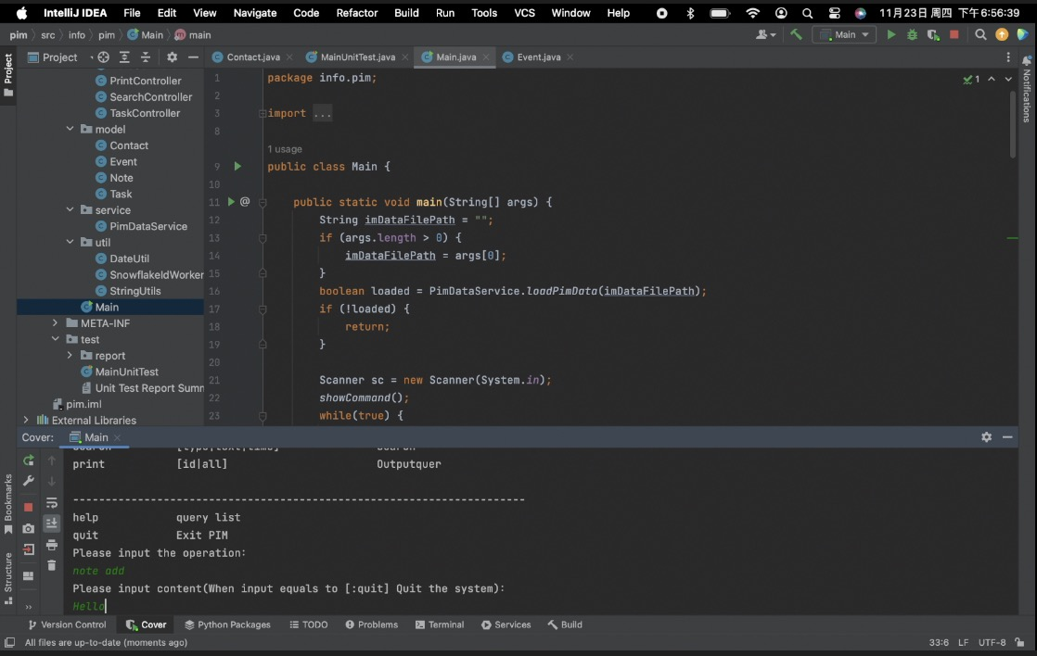
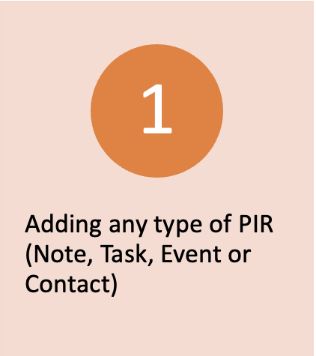
A group of closely related requirements

Slide 4
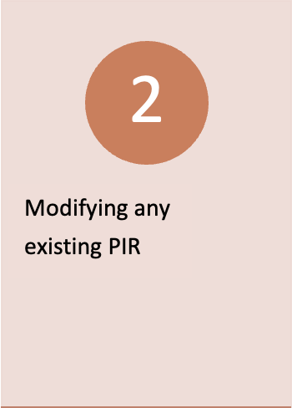
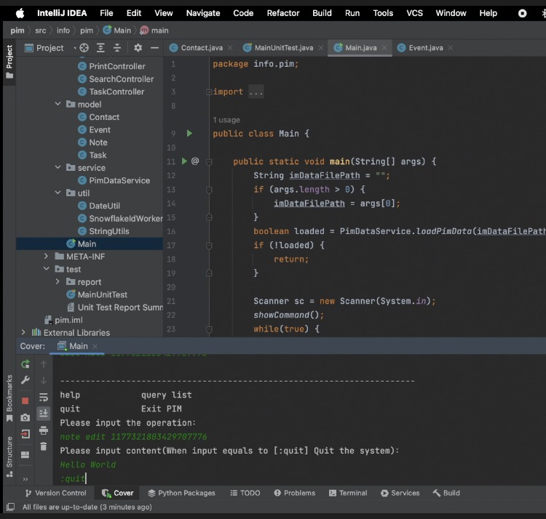

Slide 5
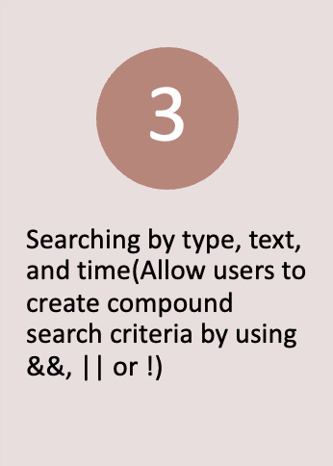
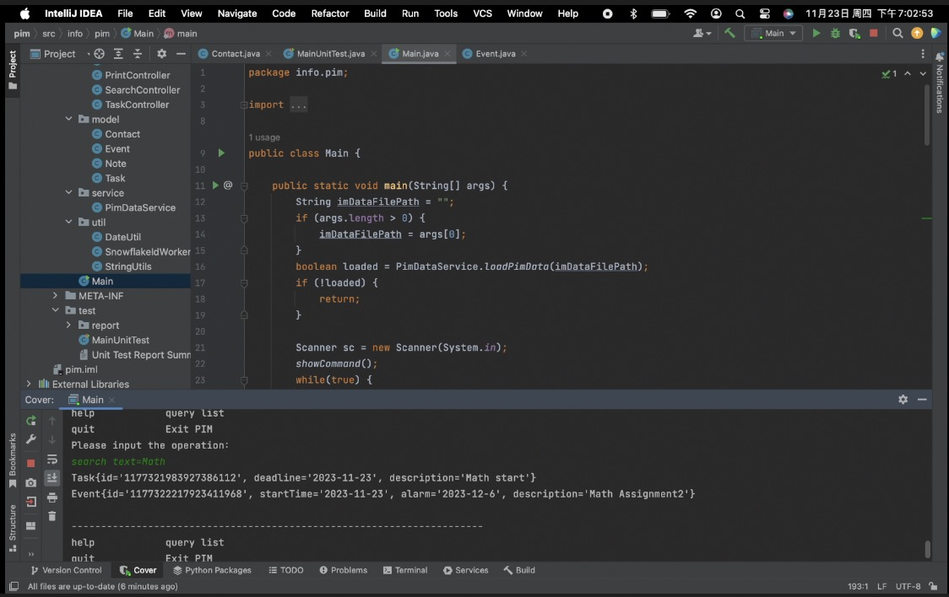

Slide 6
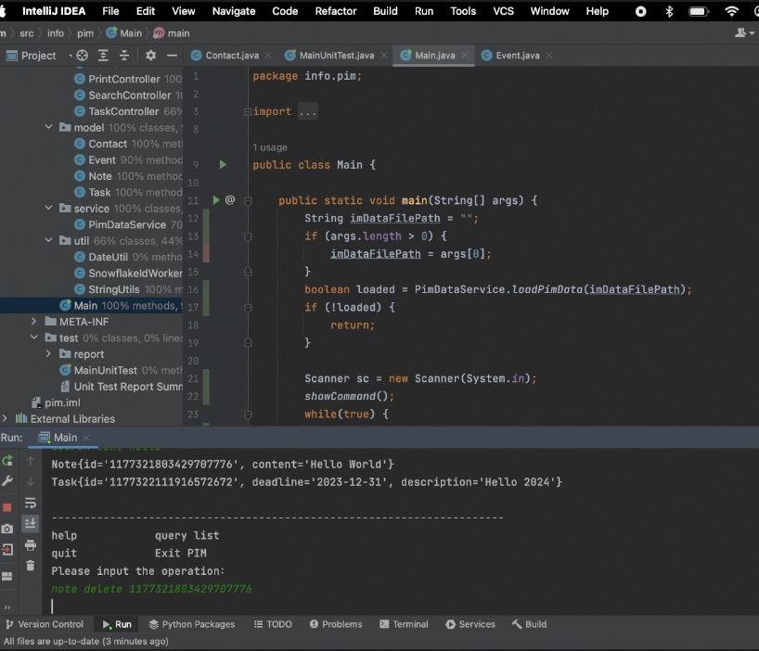
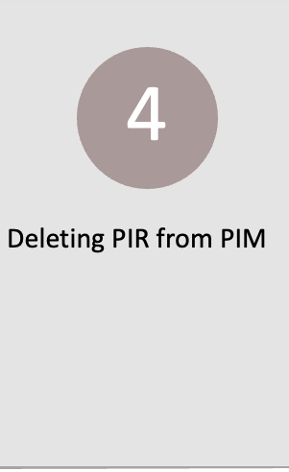

Slide 7
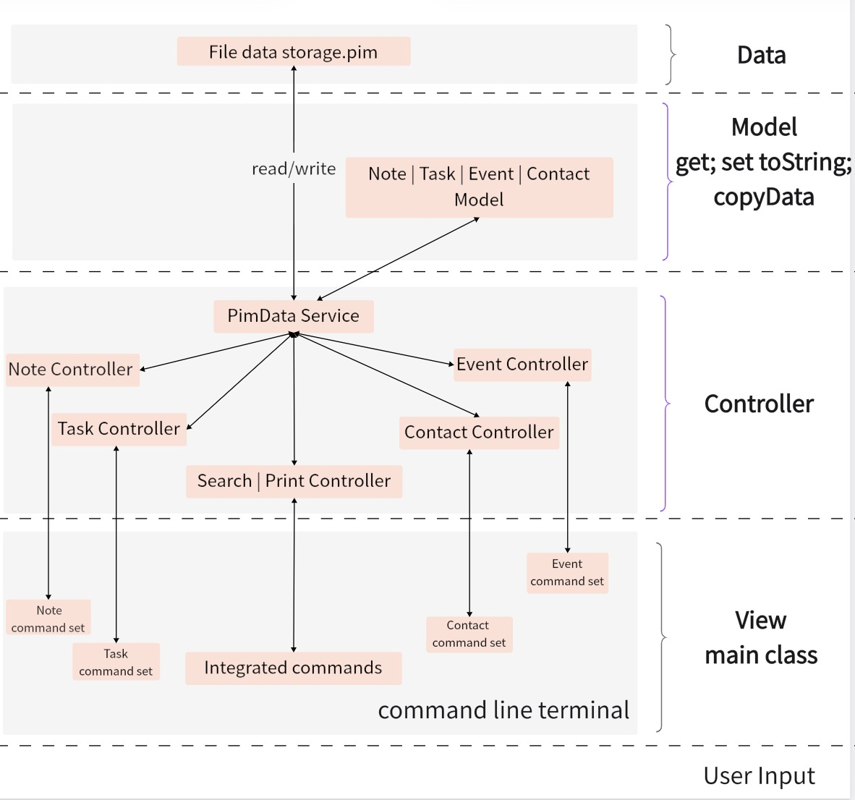
The design to support the group of requirements
We adopt the Model-View-Controller architecture pattern.

Slide 8
The design to support the group of requirements
We adopt the Model-View-Controller architecture pattern.
Model: Implements entity abstraction of data. The four model classes Note, Task, Event and Contact are defined in the info.pim.model package.

Slide 9
The design to support the group of requirements
We adopt the Model-View-Controller architecture pattern.
Model: Implements entity abstraction of data. The four model classes Note, Task, Event and Contact are defined in the info.pim.model package.
Controller: includes control classes and service classes. The control class accepts instructions from the view layer, performs some logical processing, and completes data access and update operations through the service class. Four controller classes are defined in the info.pim.controller package: NoteController, TaskController, EventController and ContactController. They process commands entered from the command line and update the model accordingly.

Slide 10
The design to support the group of requirements
We adopt the Model-View-Controller architecture pattern.
Model: Implements entity abstraction of data. The four model classes Note, Task, Event and Contact are defined in the info.pim.model package.
Controller: includes control classes and service classes. The control class accepts instructions from the view layer, performs some logical processing, and completes data access and update operations through the service class. Four controller classes are defined in the info.pim.controller package: NoteController, TaskController, EventController and ContactController. They process commands entered from the command line and update the model accordingly.
View (main): View is the command line interface that interacts with the user, receives system instructions input by the user, and returns the results of the instruction operations to the command line interface.

Slide 11
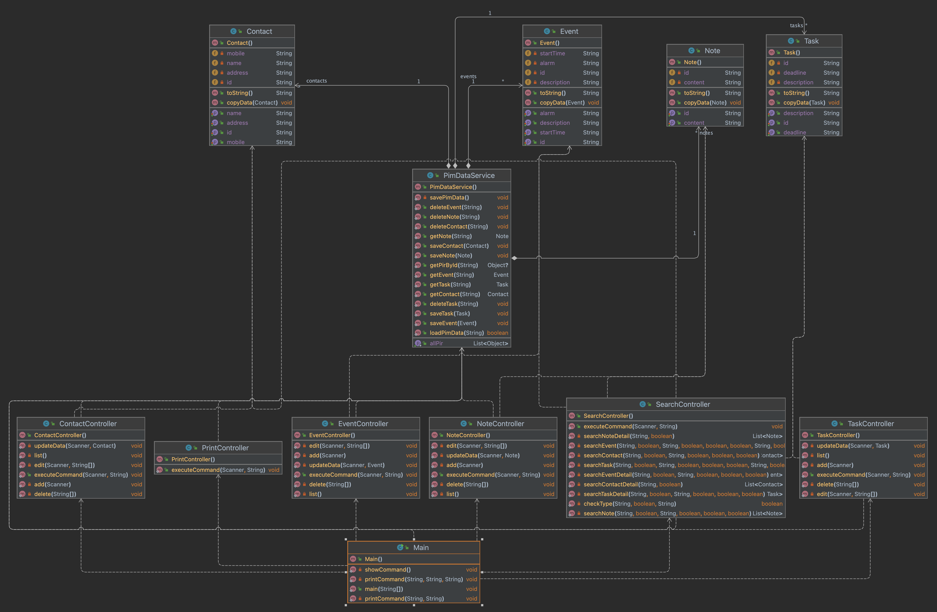
The green unlock icon represents "Public". The public modified class/property/method can be accessed from any location.
The red lock icon indicates "private”, it modified properties/methods can only be accessed within the same class.

Slide 12
Model part:
In the info.pim.model package, there are four classes: Note, Task, Event and Contact, which represent four different types of personal information records. Each class contains some fields and public getter and setter methods.

Slide 13
Service part:
Service component in the info.pim.service package, there is a PimDataService class, which contains static List type fields, such as notes, tasks, events and contacts, and corresponding management methods, such as loadPimData(), savePimData() and getNote() etc.

Slide 14
Controller part:
In the info.pim.controller package, there are multiple controller classes. Each controller has an executeCommand() method to handle user commands.

Slide 15
View (Main) part:
The Main class is the entry point and main user interaction interface of the entire application. Users can enter instructions in the command line to operate the PIM system.

Slide 16
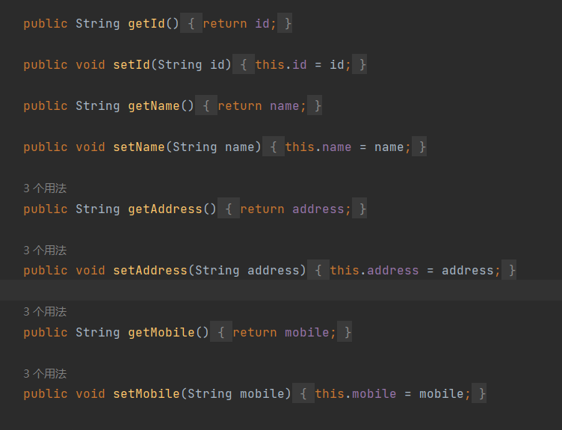
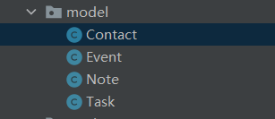
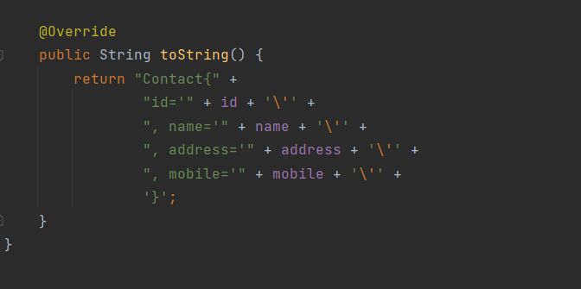
The strategy adopted when preparing high-quality unit tests for the relevant model code
The model contains four types of PIRs
The code for each type of PIR mainly consists of three parts: get(), set(), toString()

Slide 17
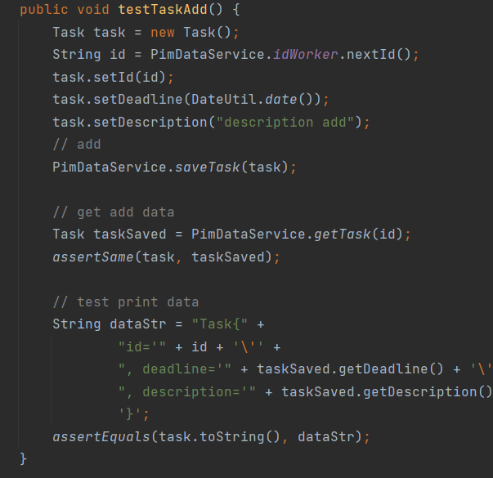
Comprehensiveness: Tests should cover all major functionality.
Isolation: Each unit test should be independent of other tests.
optimize test execution time

Slide 18

Thanks for listening!

