Slide 1
EE2802 - Machine Learning Term Project
Classification of plant diseases
CHENCHETY ABHISHEK
EE20BTECH11012

Slide 2
Contents
Introduction
Project Proposal
DataSet
Approach - ResNet
ResNet Model Summary
Approach - AlexNet
AlexNet Model Summary
Results
Qualitative
Quantitative
Metrics
Conclusion
Future Directions

Slide 3
Introduction
In the ever-evolving realm of agriculture, one of the most pressing challenges we face is the early detection of plant diseases and the implementation of effective prevention strategies. The timely identification of these diseases not only ensures the well-being of our crops but also plays a pivotal role in safeguarding our food security.
I would like to explore the power of machine learning, specifically classification models, to address this crucial issue. I want to explore the potential of technology and data-driven solutions in creating a resilient and disease-resistant agricultural future

Slide 4
Project Proposal
Plant Disease Detection and Classification Using Machine Learning
The agricultural sector is facing significant challenges due to the rapid spread of diseases among crops, leading to substantial yield losses. Timely detection and precise classification of these diseases are crucial for farmers to implement effective preventive measures and ensure sustainable agricultural practices.
Objectives: Early detection, Accurate Classification, Continuous learning
Methodology: Data Collection (Pre-defined Data set), Preprocessing and Feature Extraction, Model Development using Resnet and Alexnet architecture.
Outcomes: Classification model which can revolutionize plant disease detection and classification, ultimately supporting farmers in their efforts to ensure healthy and thriving crops.

Slide 5
Dataset
Actual dataset
I have taken a augmented dataset created from actual dataset.
Content:
Approximately 87,000 RGB images of healthy and diseased crop leaves.
Images are categorized into 38 different classes of plant diseases.
This is a recreated version of the original PlantVillage dataset, potentially with additional data or processing.
Structure:
The dataset is split into training (80%), validation (20%), and test (33) sets, preserving the directory structure for each.
This facilitates training and evaluating machine learning models for plant disease classification.

Slide 6
Approach using ResNet Architecture
Input:
Image (RGB, 224x224 pixels) from the PlantVillage dataset.
Model:
Residual Network (ResNet):
Convolutional layers with residual connections (skip connections) that bypass some layers and directly connect inputs to outputs.
Batch normalization and ReLU activation functions.
Pooling layers for downsampling.
Fully-connected layers for classification.
Output: Class label (one-hot encoded) for the plant disease in the image.

Slide 7
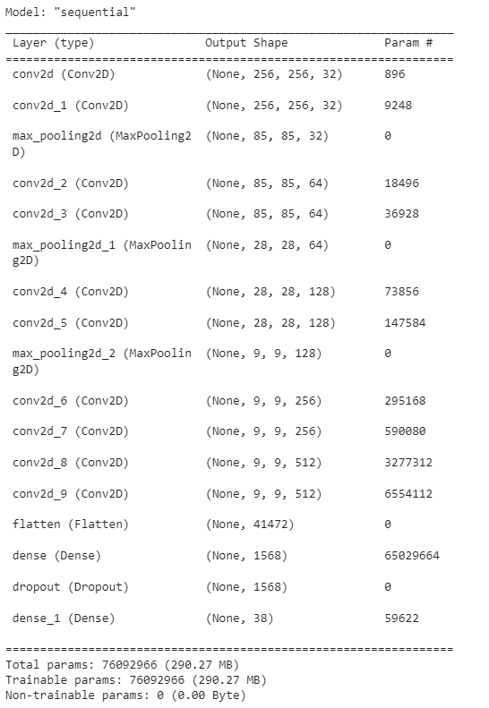
ResNet Model Summary
Input Shape: (256, 256, 3)
Convolutional Layers:
Multiple sets of 2 convolutional layers followed by max pooling.
Increasing filters: 32, 64, 128, 256, 512.
Various kernel sizes (3x3, 5x5), ReLU activation, same padding.
Dense Layers:
Dense layer with 1568 units and ReLU activation.
Dropout layer (50% dropout rate) for regularization.
Output layer: Dense with 38 units (softmax for classification).
Compilation:
Optimizer: Adam with LR=0.0001
Loss: Sparse categorical cross-entropy
Metrics: Accuracy

Slide 8
Approach using AlexNet Architecture
Input:
Image (RGB, 224x224 pixels) from the PlantVillage dataset.
Model:
AlexNet:
Stacked convolutional layers with increasing filter sizes and decreasing stride.
Local Response Normalization (LRN) layers for contrast normalization.
Pooling layers for downsampling.
Fully-connected layers for classification.
Output: Class label (one-hot encoded) for the plant disease in the image.

Slide 9
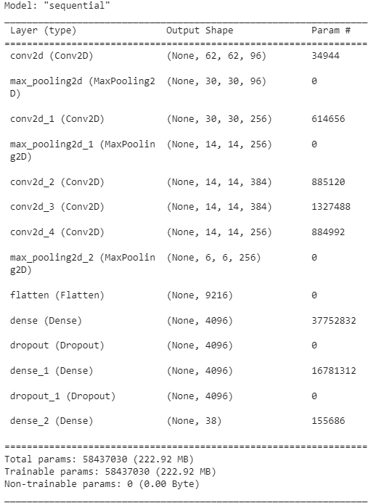
AlexNet Model Summary
Input Shape: (256, 256, 3)
Convolutional Layers:
Varying filter sizes: 96, 256, 384, 384, 256
Kernel sizes: 11x11, 5x5, 3x3
Pooling: Max Pooling used throughout with different sizes and strides
Dense Layers:
Two Dense layers with 4096 units and ReLU activation, each followed by 50% Dropout
Output Layer:
Dense layer with 38 units (softmax activation for classification)

Slide 10
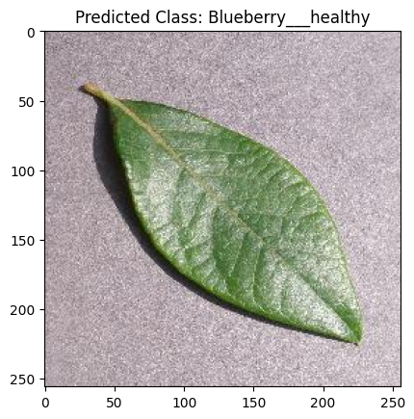
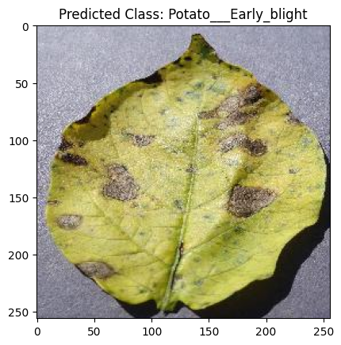
Qualitative Results
AlexNet
ResNet

Slide 11
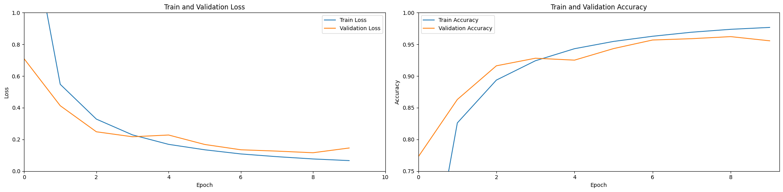
Quantitative Results
ResNet
For epoch = 10 Train Accuracy : 97.67 %
Test Accuracy : 95.56 %
Precision Score : 95.56 %
Recall Score : 95.56 %

Slide 12
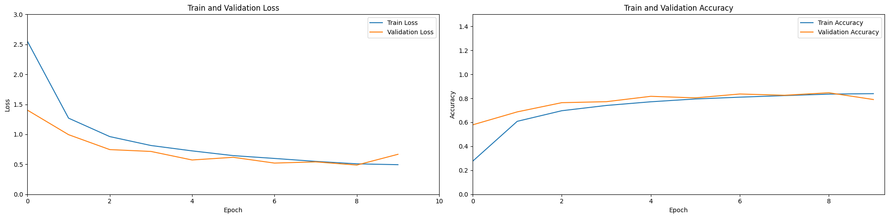
Quantitative Results
AlexNet
For epoch = 10 Train Accuracy : 83.91 %
Test Accuracy : 79.02 %
Precision Score : 79.02 %
Recall Score : 79.02 %

Slide 13
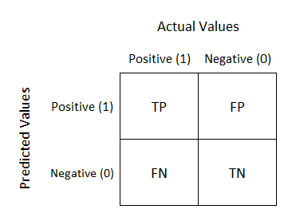
Metrics
The general metrics for classification problem are TPR, FPR, Precision, Recall, Confusion Matrices and Accuracy. As this is a Multi-Class Classification, I considered each disease to be independent and calculated these metrics.
Threshold generation using the following measures:
G-Mean = sqrt(Sensitivity * Specificity)
J = Sensitivity + Specificity – 1
F-Measure = (2 * Precision * Recall) / (Precision + Recall)

Slide 14
Conclusion
Image Classification with ResNet vs. AlexNet:
Smarter Architecture: ResNet understands pictures better due to its smarter design.
Deeper Learning: ResNet can learn more from images without confusion, going deeper into details.
Special Shortcuts: ResNet uses shortcuts that speed up learning and improve accuracy.
Better Performance: ResNet usually outperforms AlexNet in recognizing and understanding pictures.
Improved Memory: ResNet remembers learned information better, making it more efficient for image understanding.
(Ctnd..)

Slide 15
Conclusion
Plant Disease Classification with ResNet:
Smart Plant Diagnosis: ResNet is a powerful tool for identifying plant sickness.
Detailed Detection: It spots tiny details in leaves or crops to identify specific diseases.
Early Problem Detection: Helps farmers find issues early for better treatment.
Accurate Diagnosis: Enables accurate identification of plant diseases, aiding in proper care.
Improved Crop Health: Using ResNet assists in healthier crop growth by addressing diseases efficiently.
Project Link: EE2802-Term-Project

Slide 16
Future Directions
Addressing Class Imbalance:
Investigate techniques like data augmentation, oversampling, or transfer learning to improve model performance on underrepresented classes.
Enhancing Data Diversity:
Expand the dataset to include images of various plant parts and diverse environmental conditions, fostering better model generalization.
Improving Explainability:
Explore interpretable deep learning architectures or methods such as attention mechanisms or model visualization to enhance understanding and trust in model predictions.

