Slide 1

Problems
When you want to know the risk condition of a enterprise, you will find it:
Time-consuming
Dispersion of risk information
Lack of a comprehensive numerical risk indicator
Incomplete
Lack of ESG Information
Lack of Carbon risk in the future
Financial Info
Non-Financial Info
Notes:
能源行业
于源讲述问题（背景）
张志远引入公司

Slide 2
Riscube
Aggregate comprehensive risk information and provide a unified risk score.
Notes:
于源：总结

Slide 3


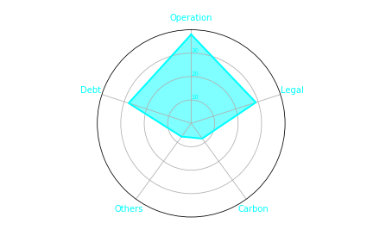



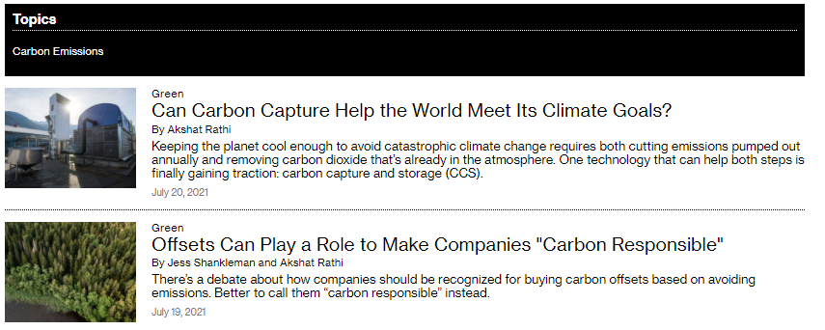
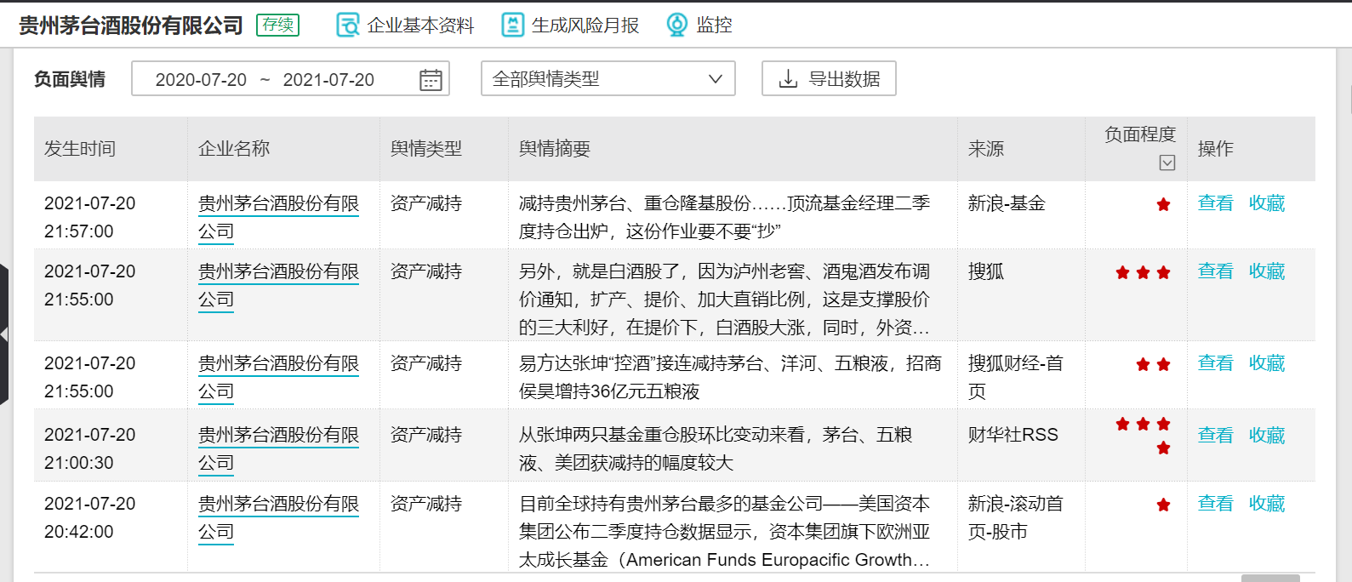
Our Solution
“Unicorn”
-Real-time risk monitoring
-ESG & carbon risk quantification
-Unified risk score
Heterogeneous data
Financial information
ESG information
Carbon-related events
Risk score
24
: Lack combination of ESG and risk
Global customer
: Lack of quantitative financial indicators
Comprehensive risk assessment
Diversified international investment
在政策优势，国家政策相符绿色金融，碳中和，关注度用高越来也重要。（过渡句）
应运而生
Notes:
Our Business model
.
Riscube can provide comprehensive risk assessment, diversified international investment and Personalized suggestion.
The friendly interface allows Riscube is available to customers from different countries
Riscube uses efficient AI-augmented core algorithm to monitor, crawl, and analyze risk features from numerous data in real-time. By quantifying these ESG information features and the rising carbon risk and including these into the risk assessment, RisCube can directly provide a more accurate overall risk score than the type of risk.
By comparison, the famous finance platform wind only supply ESG types as a reference, which are not included into risk assessment.
On the other hand, Bloomberg only provides the list of ESG information, It lacks of intuitive financial interpretation.
As a comprehensive risk assessment platform, Our vision is to run RiskCube as a unicorn.

Slide 4

Scan it and begin your RISCUBE trip with us!
Notes:
张志远：公司定位，提醒大家扫描参与演示

Slide 5
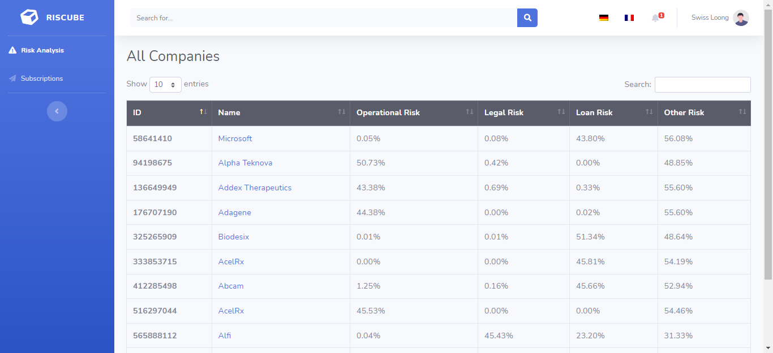
Riscube Home
Notes:
杨志飞：网页操作和介绍

Slide 6
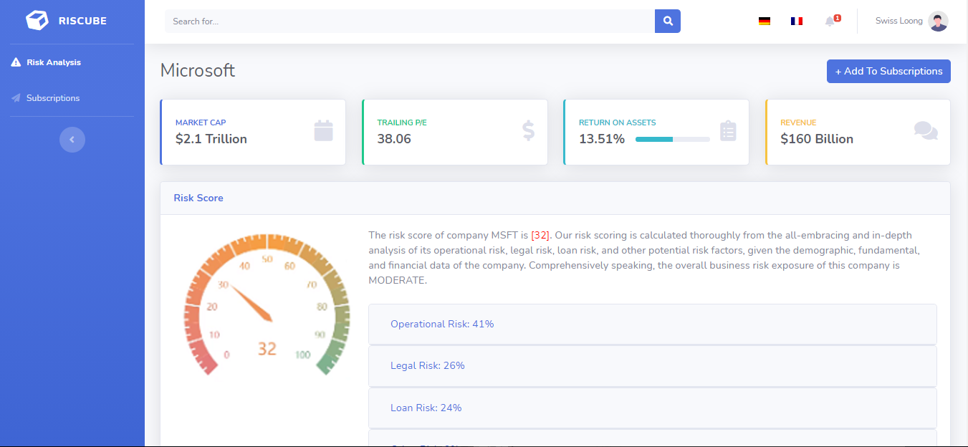
Detailed Info of a Company
Notes:
杨志飞：网页操作和介绍

Slide 7
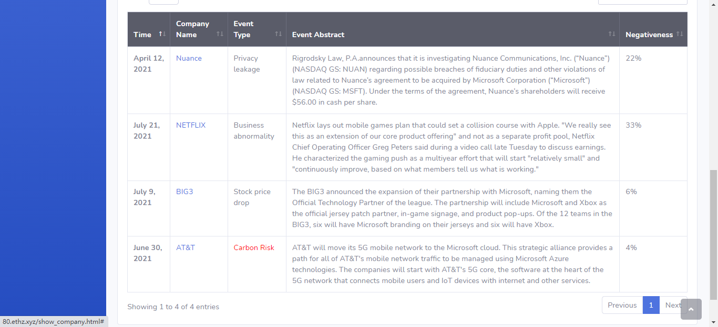
Potential Risk
Notes:
杨志飞：网页操作和介绍

Slide 8
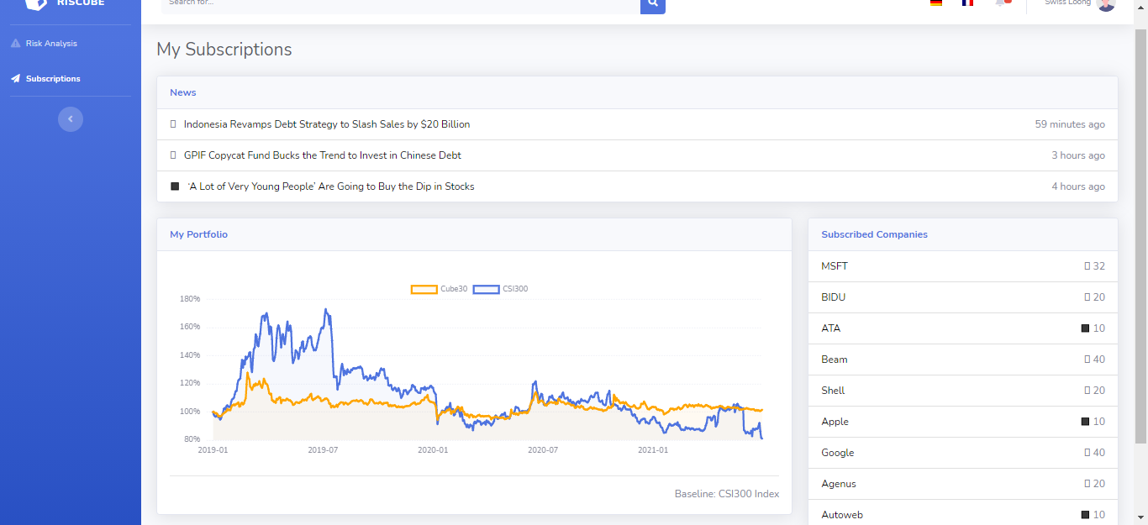
Subscription
Notes:
杨志飞：网页操作和介绍

Slide 9
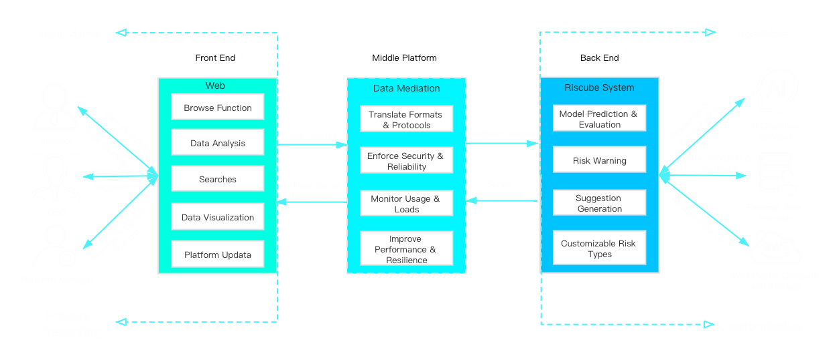
System Architecture
Notes:
于源讲述问题（背景）
张志远引入公司

Slide 10
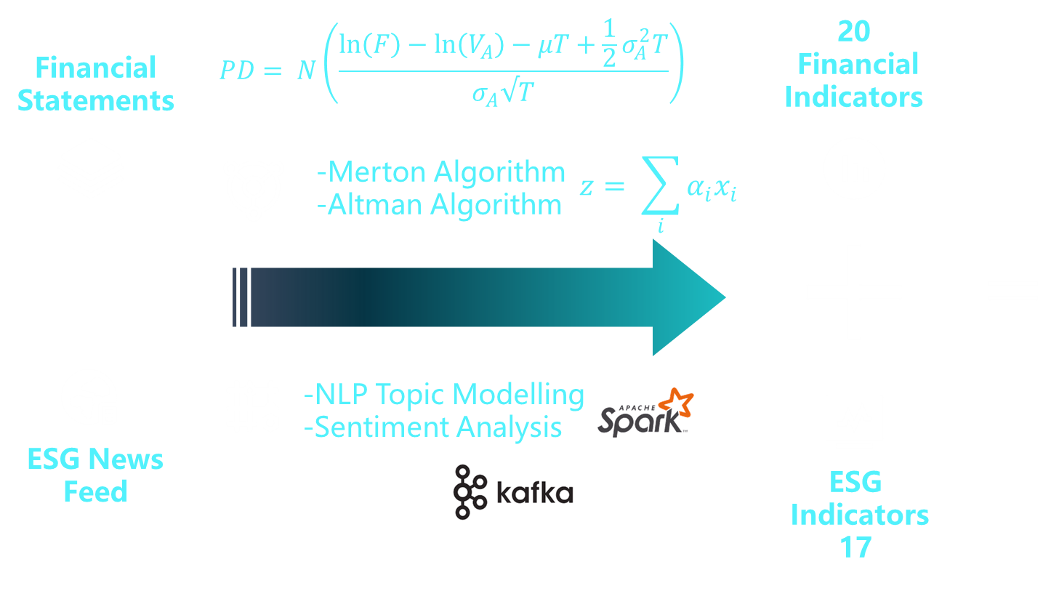










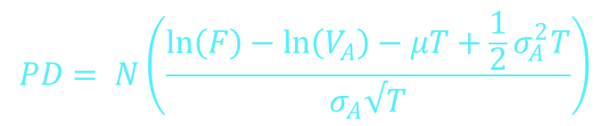
Risk Assessment Model——Risk-index-system
$$PD= N\left(\frac{\ln\left(F\right)−\ln\left(V_{A}\right)−μT+\frac{1}{2}σ_{A}^{2}T}{σ_{A}√T}\right)$$
20
Financial
Indicators
Financial
Statements
-Merton Algorithm
-Altman Algorithm
$$z= \sum_{i}{α_{i}x_{i}}$$
Comprehensive
ESG-contained
Risk-index-system
-NLP Topic Modelling
-Sentiment Analysis
ESG News Feed
ESG
Indicators
17
Notes:
简化解读公式这款块，不用五层都讲 step 1, step two,
Carbon risk 虽然只有能源板块能有 更具体一点，考虑了哪些碳

Slide 11
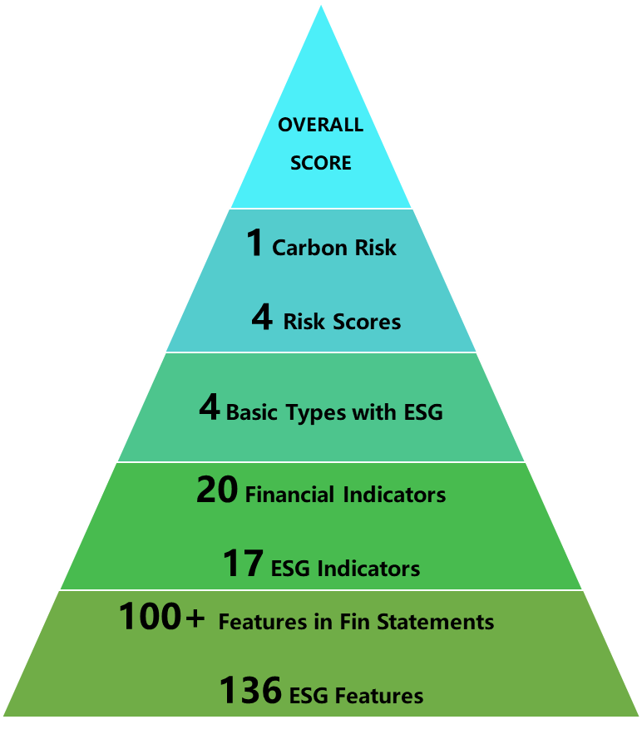
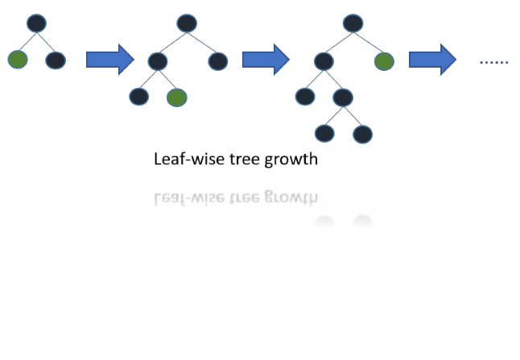



Risk Assessment Model——Overall Risk Score
S$=$ $\sum_{i}{w_{i}{(r，ESG)}_{i}}+R_{carbon}$
$$R_{carbon}=β_{0}c_{0}f\left(c_{1}\right)⋅(\sum_{i}{β_{i}c_{i}})$$
- Whether the business is involved in carbon emissions (C0)
- Whether they have carbon emission rights (C1)
- Current Carbon Emissions (C2)
- Certificate numbers(c3)
- Current Carbon Emission Policy (C4)
……
AI-driven algorithm:
$S′=f(Financial indicators, ESG indicators)$
Personalized customization：
Customer-defined risk types & special indicators!
Notes:
简化解读公式这款块，不用五层都讲 step 1, step two,
Carbon risk 虽然只有能源板块能有 更具体一点，考虑了哪些碳

Slide 12
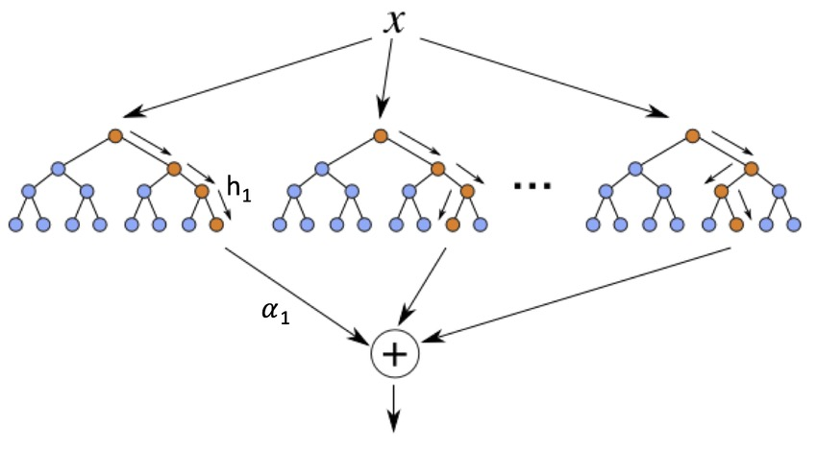
AI-Driven Algorithm: Gradient Boosting Machine
Tree Ensemble Algorithm
Feature Importance Interpretation
Tree ensembles is an explainable machine learning model that combines numerous weak learners into a strong predictor.
Notes:
王君领：算法介绍

Slide 13
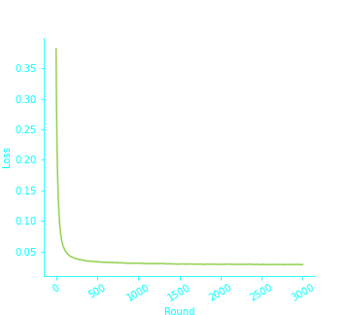
Excellent Quantitative Performance
Test accuracy vs Training rounds
43.1
Risk ratio of **coal Inc.
98.9%
95.5%
Test Accuracy | Recall | Precision | Cross_val_score
98.92% | 0.9891 | 0.9892 | 0.9049
Notes:
王君领：算法介绍

Slide 14
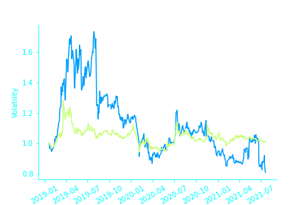
Application: Carbon Risk Informed Investment Portfolio
CSI 300
Cube 30
30 stocks selected according to the lowest risk scoring criteria
Cube 30
Riscube do help investors judge and avoid risks.
 | Volatility | Sharp Ratio | Max. Dropdown | Return rate
Cube 30 | 0.18 | 1.27 | -12.74% | 12.72%
CSI 300 | 0.34 | 1.31 | -21.83% | 12.21%
Notes:
王君领：算法介绍

Slide 15

Riscube
Machine
Intelligence
Excellent
Performance
Green
Finance
Use AI technology to bring reliable green finance and risk control services to the world
Bring comprehensive risk quantification to the world
Copyright 2021 Swiss Tech Loong Inc.
c
Notes:
于源：总结

