Slide 1


An Effective Investment Decision Making System.
Non-transparent
Black-box
Uninterpretable

Slide 2
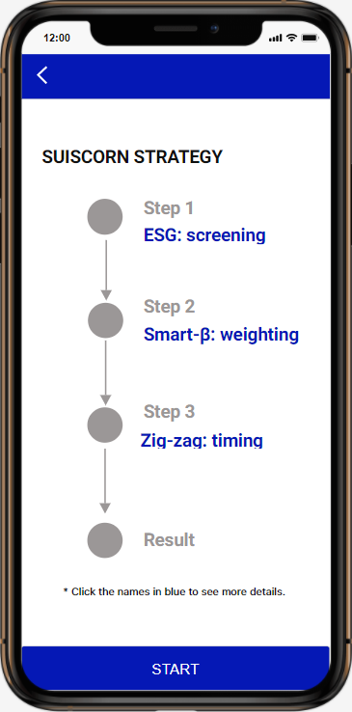
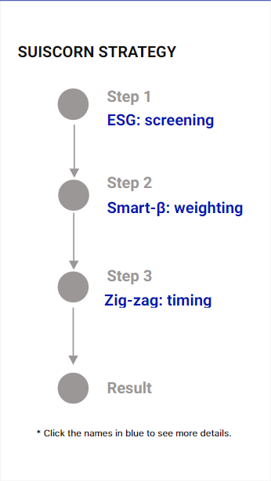
Methods of Suiscorn
Stock Screening – ESG
Investment Weighting – Smart beta
Robot Advisory– Zigzag function

Slide 3
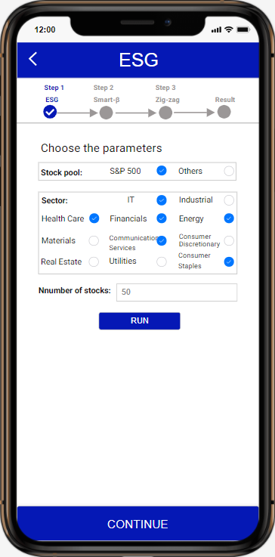
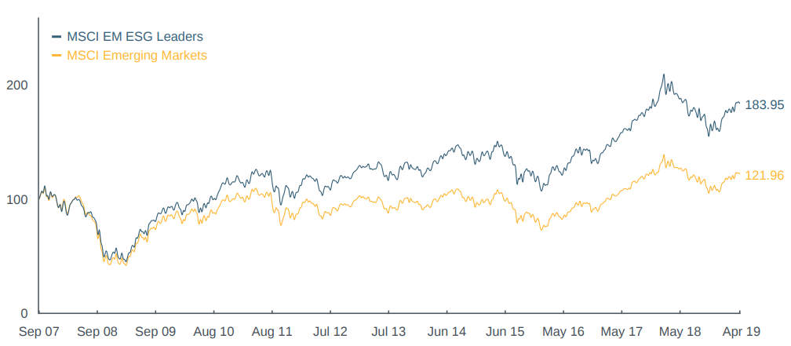
ESG
Environmental, Social and Governance
Companies with high ESG ratings outperform the market
Source: MSCI

Slide 4
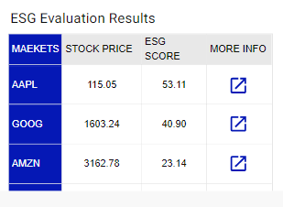
ESG screening
$$ESG score=E_{stock,t}\left(N\right)+S_{stock,t}\left(N\right)+G_{stock,t}(N)$$
t is time.
N is summarized from news.
E,S,G represent Environmental, Social and Governance, respectively.

Slide 5
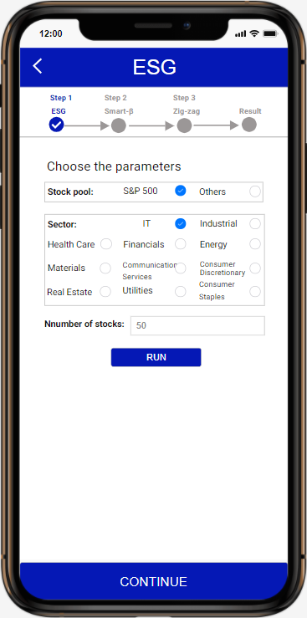
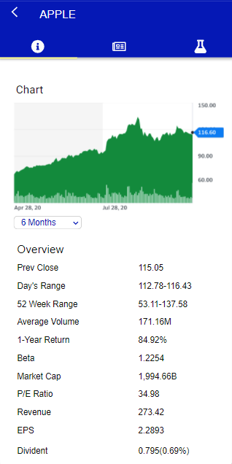
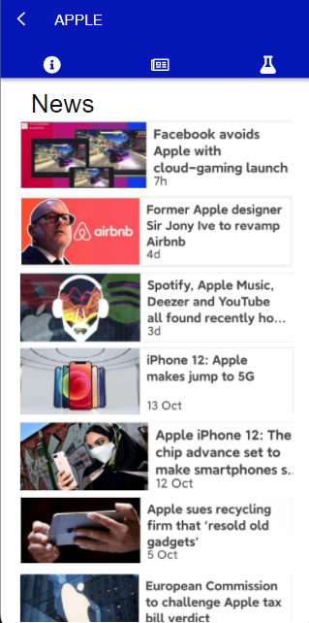

Slide 6
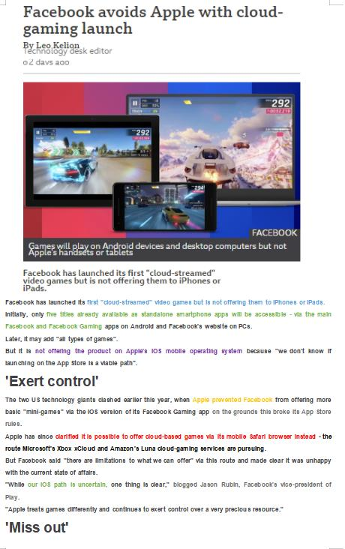
Unstructured
Semantic Analysis
Environmental
Named Entity Recognition
Social
Governance
Positive
Part-of-speech tagging
Negative
Structured

Slide 7
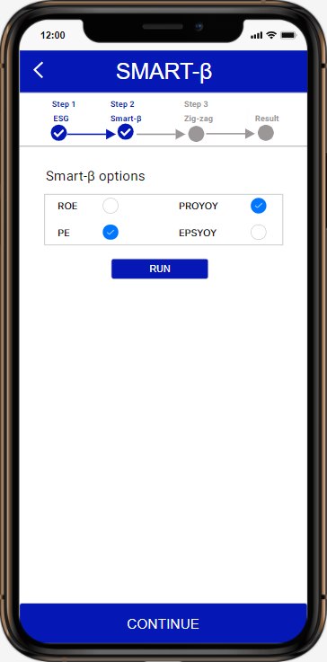

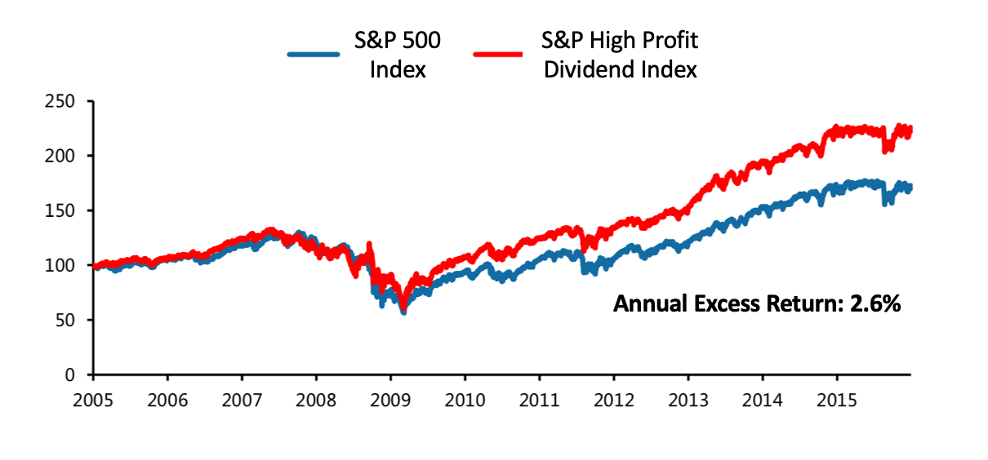
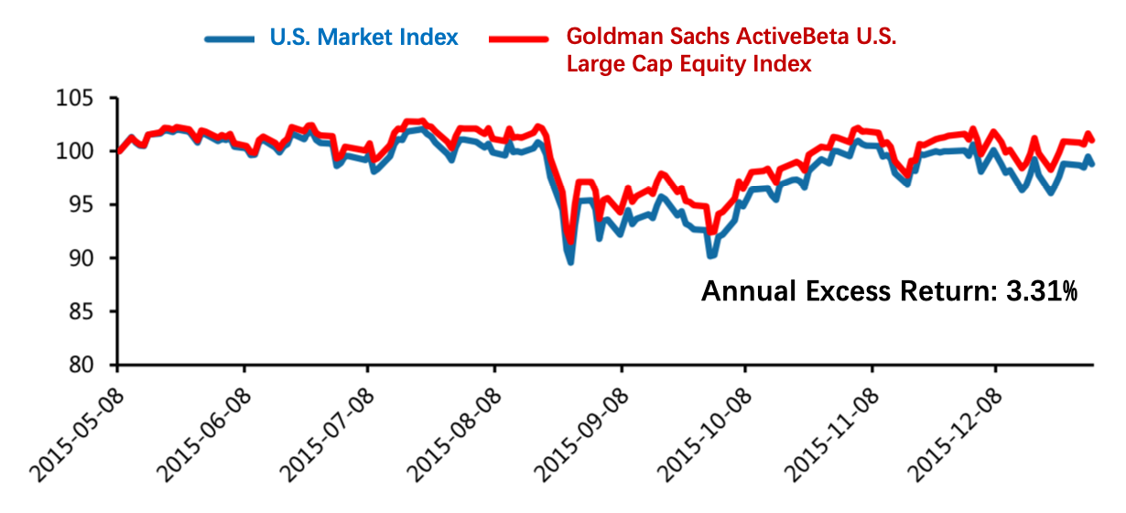
Smart-𝛽
An enhanced indexing strategy to exploit certain performance factors to outperform a benchmark index.
ADVANTAGE:
A blend of active and passive styles of management
More precise & diversified portfolio
Excess return
Single-factor weighting
Multi-factor weighting

Slide 8
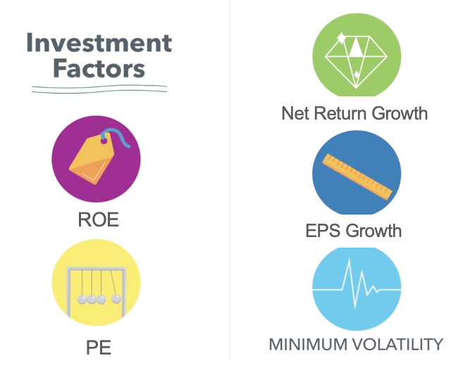
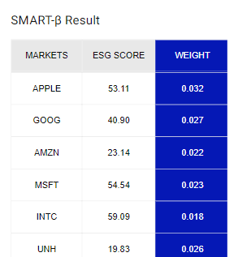
Suiscorn with Smart-𝛽
$Weight=G_{w}\left[\sum{f_{s}(V_{i})}\right]×$100 %
Standardization of investment factors
Stock Weighting Results
Where V_{i} stands for different smart- 𝛽 factors (ROE or PE, etc.), f_{s} is standardization process, G_{w} is weighting process.

Slide 9
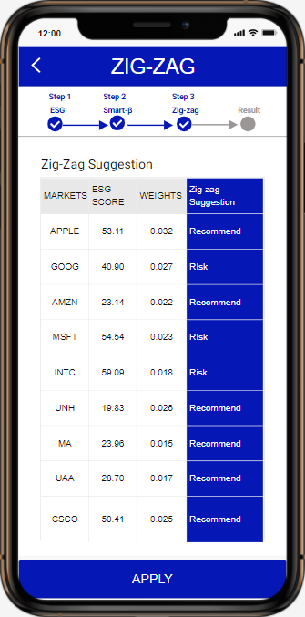
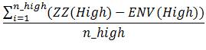
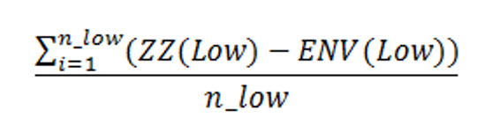
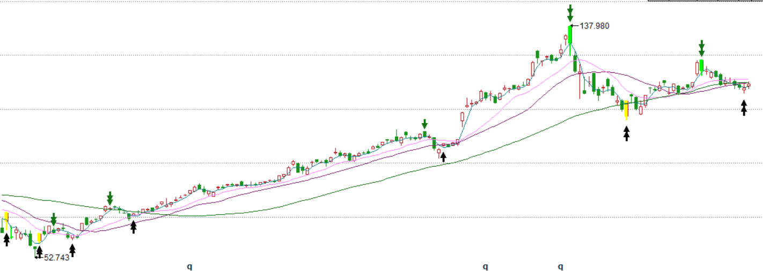
Zig Zag Function
Suiscorn gives the investment suggestion of the stock at the right time
Risk Warning Point
Recommended Buying Points

Slide 10
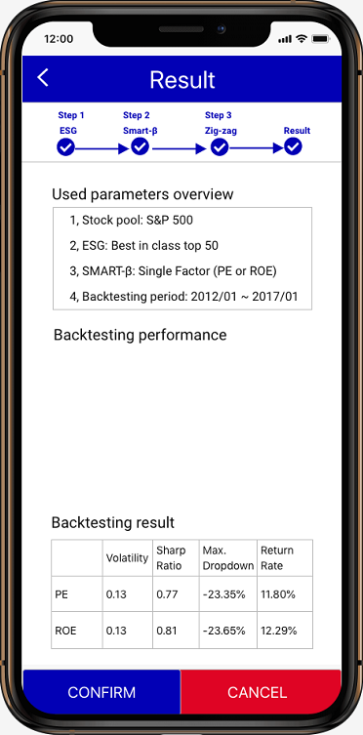
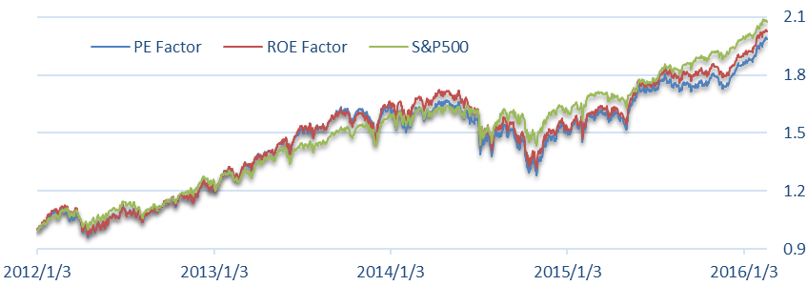
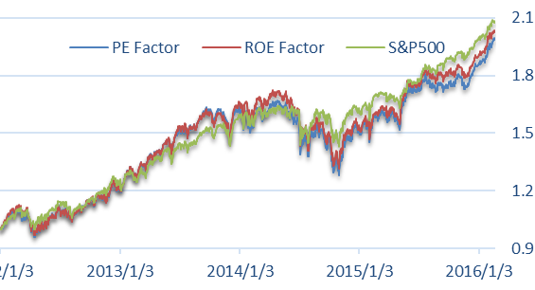
Back Test Performance
Stock pool: S&P 500
ESG: Best in class top 50
Smart-𝛽 : Single Factor (PE or ROE)
 | Volatility | Sharpe Ratio | Max.Dropdown | Return Rate
PE | 0.13 | 0.77 | -23.35% | 11.80%
ROE | 0.13 | 0.81 | -23.65% | 12.29%
S&P500 | 0.08 | 1.31 | -12.83 | 12.21%
Notes:
Comparing our portofolio return to S&P 500 index, Suiscorn picks up the stocks that could outperform the market and bring long-term return.

Slide 11
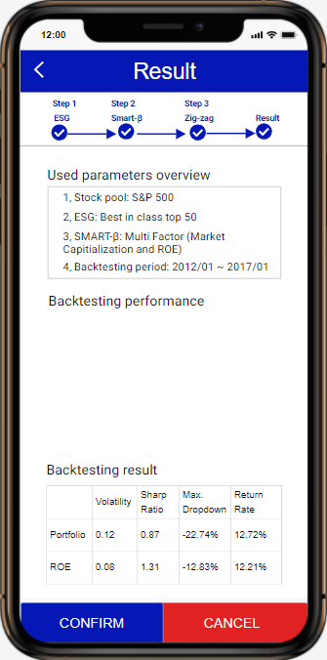
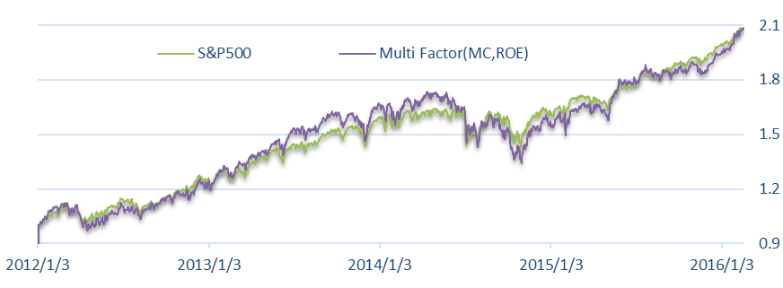
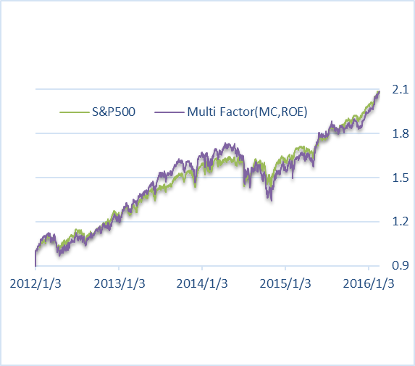
Back Test Performance
Stock pool: S&P 500
ESG: Best in class top 50
Smart-𝛽 : Multi-Factor (Market Capitalization and ROE)
 | Volatility | Sharpe Ratio | Max.Dropdown | Return Rate
Portfolio | 0.12 | 0.87 | -22.74% | 12.72%
S&P500 | 0.08 | 1.31 | -12.83 | 12.21%
Notes:
Comparing our portofolio return to S&P 500 index, Suiscorn picks up the stocks that could outperform the market and bring long-term return.

Slide 12
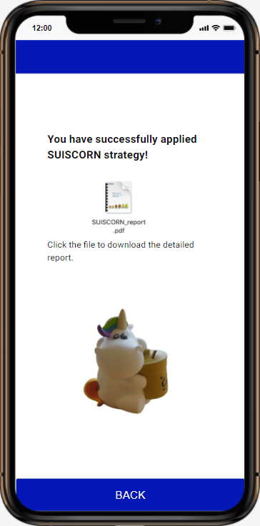
Abaci, A Better Capital.
We Aim to Serve Millions of Investors for a Better World.

