Slide 1

Prediction of Survival on the Titanic
Chenghao Wang, 12.01.2021

Slide 2
Menu
Background
Data visualization & feature engineering
Model training & testing

Slide 3
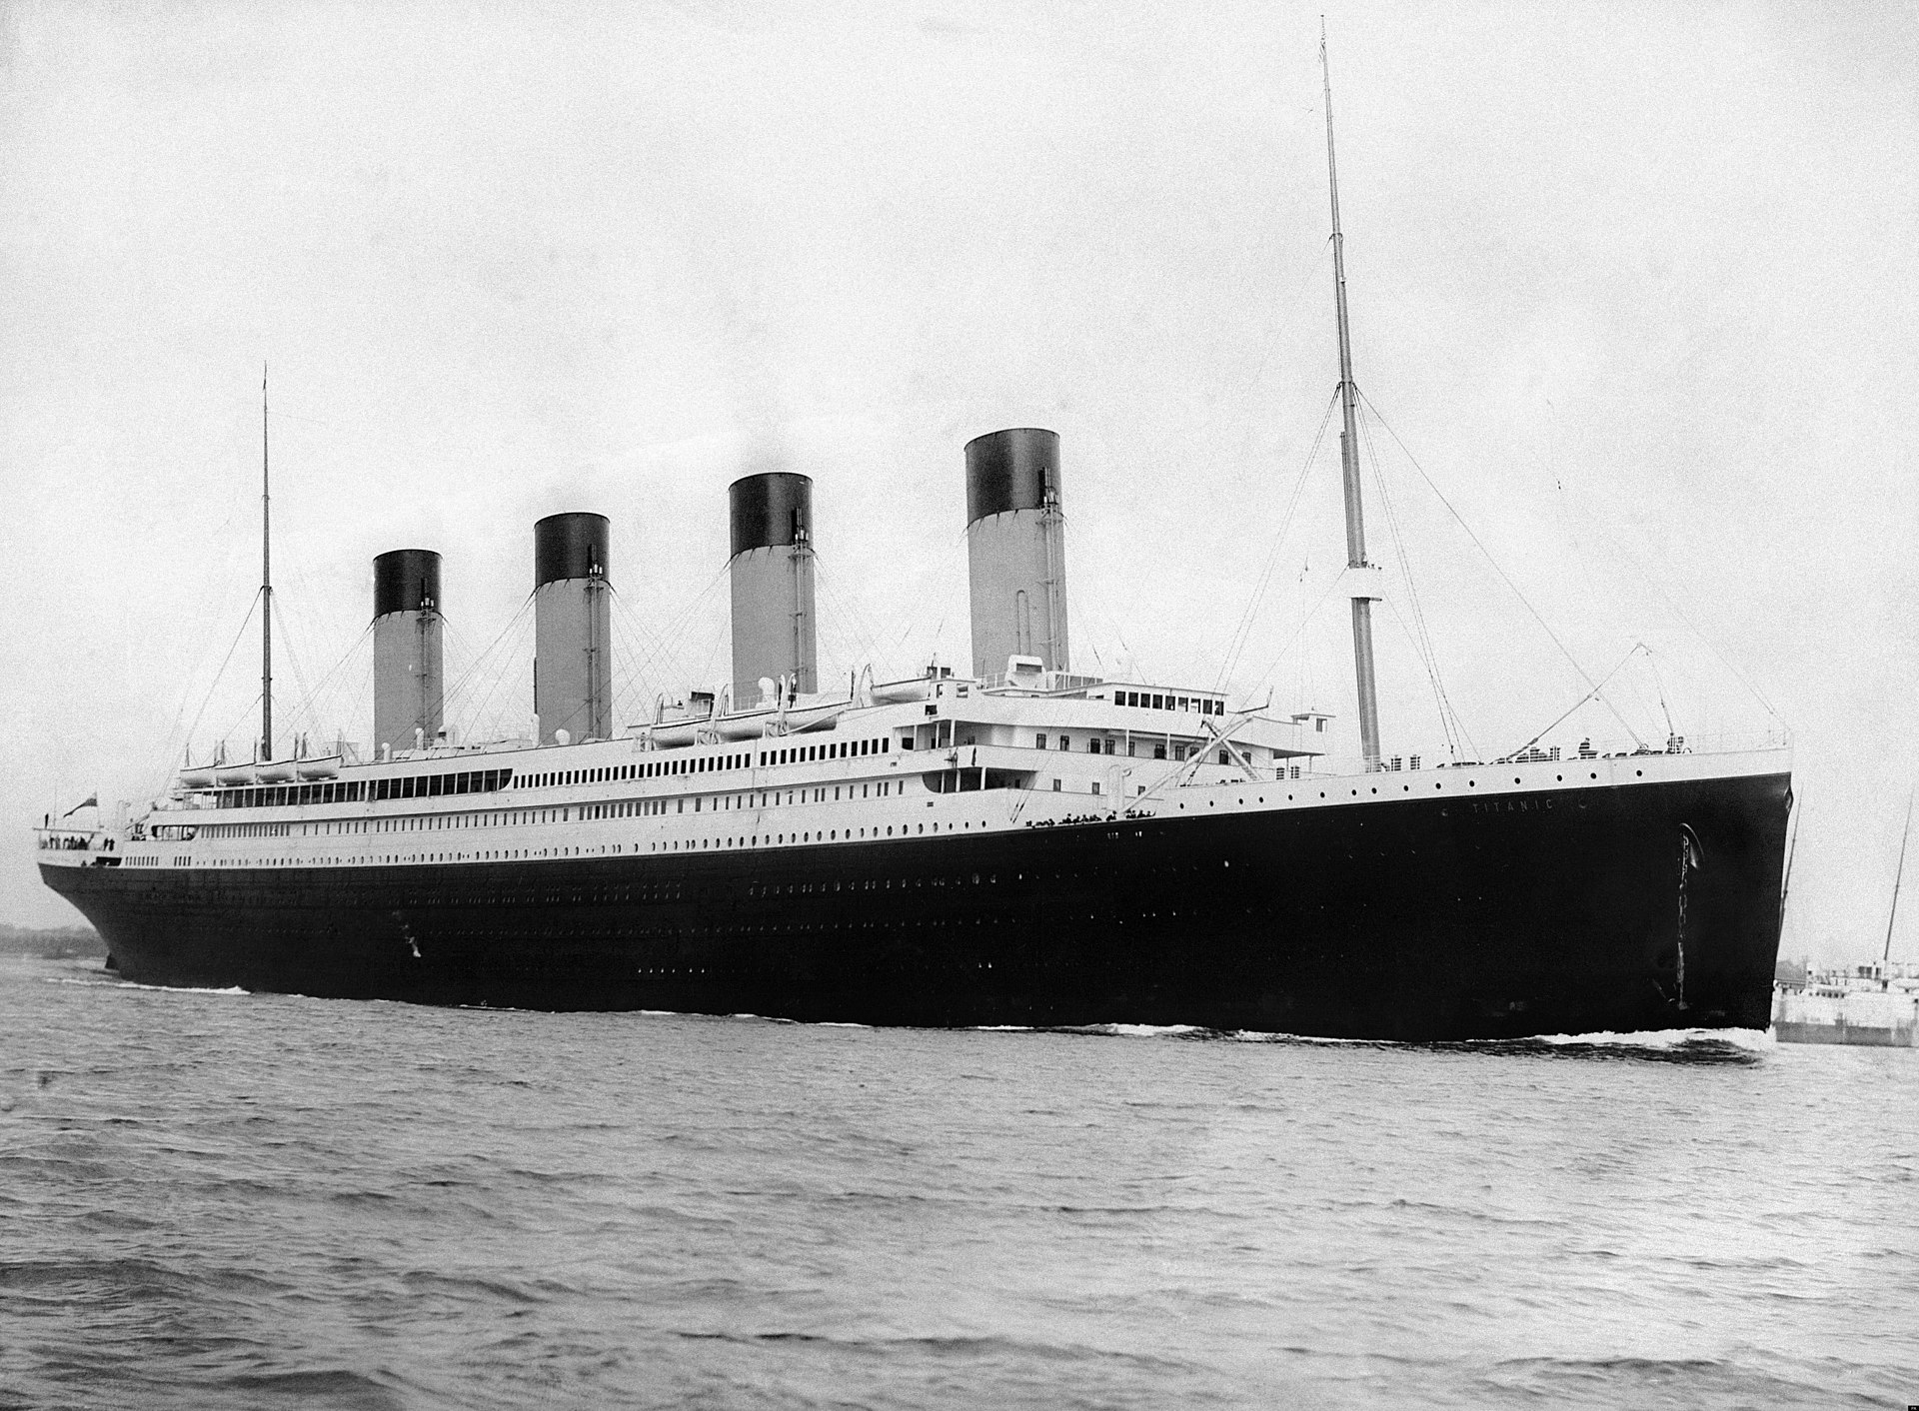
Background
On April 15, 1912, the Titanic sank in the North Atlantic Ocean due to colliding with an iceberg. Out of 2,224 passengers and crew, 1,502 were dead.
The dataset contains the information of 891 passengers as well as their survival status.

Slide 4
The task is to train a machine learning model on the given dataset and predict the survival status of another set of 418 passengers.
Codebook
Variable Definition Key
survival Survival 0 = No, 1 = Yes
pclass Ticket class 1 = 1st, 2 = 2nd, 3 = 3rd
name Passenger’ name
sex Sex
Age Age in years
sibsp # of siblings / spouses aboard the Titanic
parch # of parents / children aboard the Titanic
ticket Ticket number
fare Passenger fare
cabin Cabin number
embarked Port of Embarkation C = Cherbourg, Q = Queenstown, S = Southampton

Slide 5
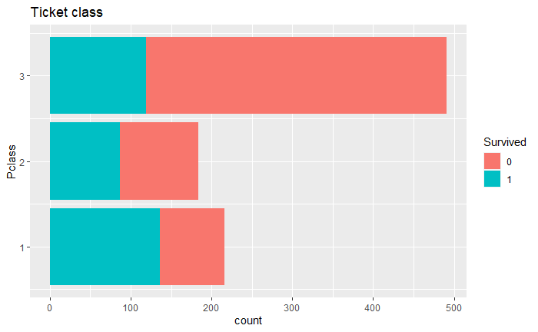
Data visualization

Slide 6
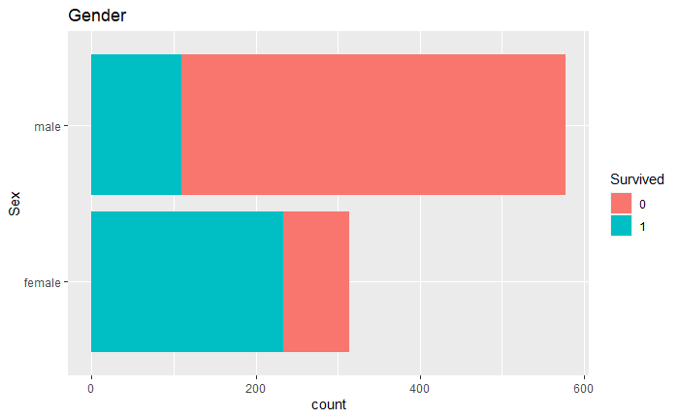

Slide 7
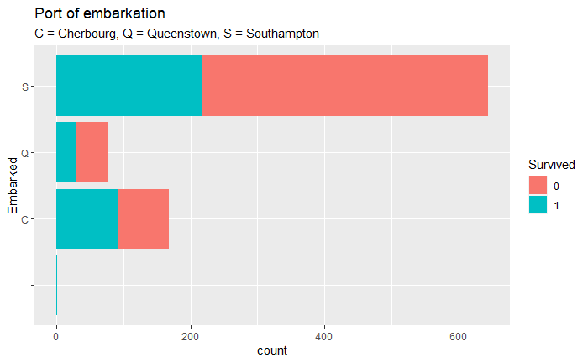

Slide 8
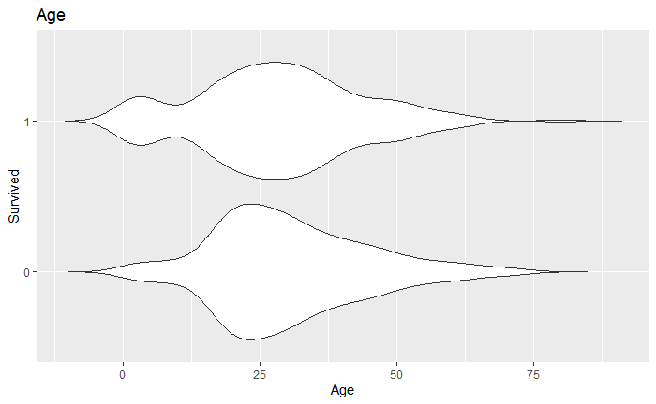

Slide 9
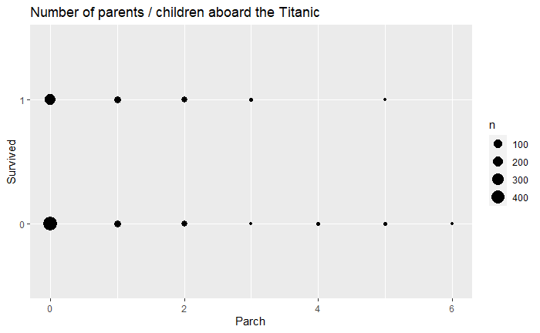
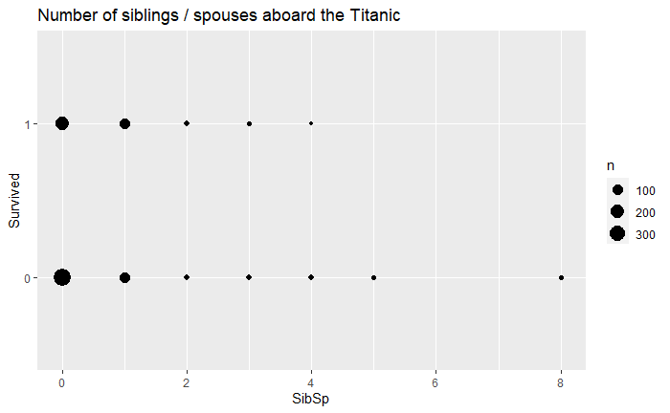

Slide 10
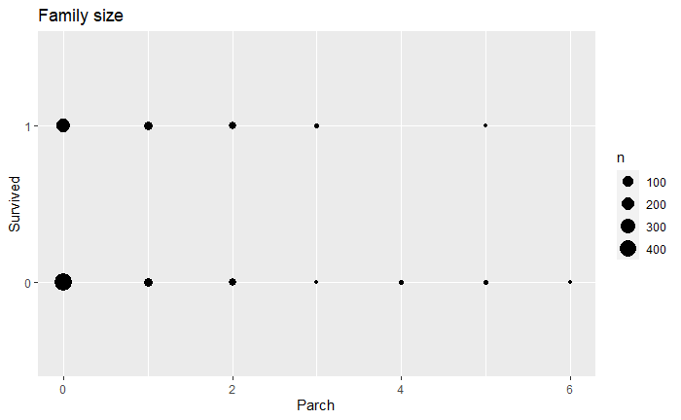
Family size= Number of siblings / spouses aboard the Titanic
+ Number of parents / children aboard the Titanic

Slide 11
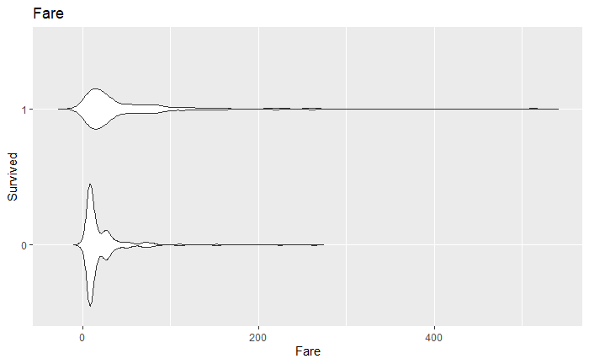
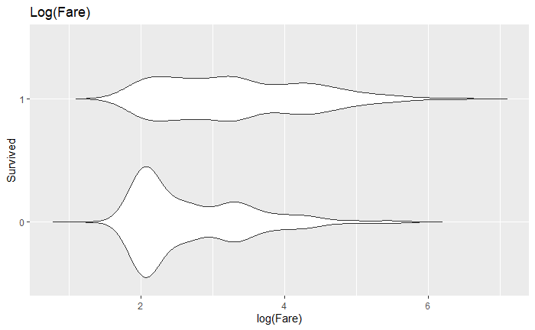

Slide 12
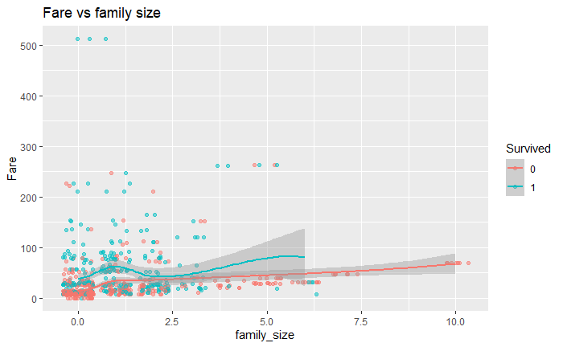

Slide 13
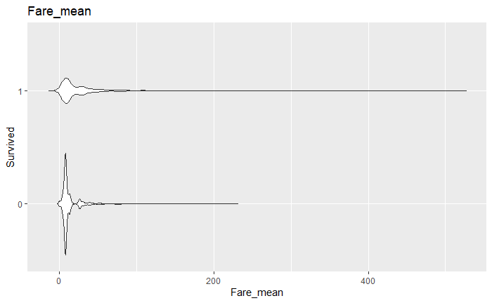
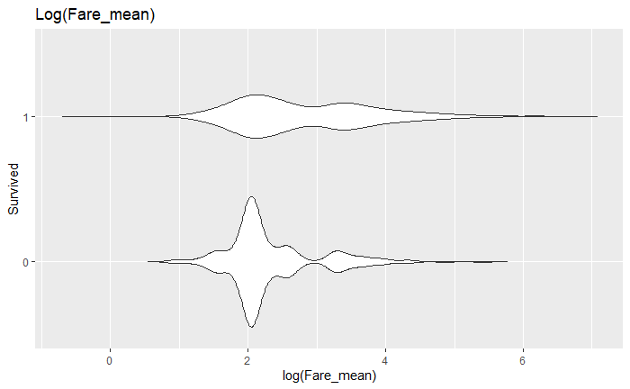
Fare mean=Fare/(family size + 1)

Slide 14
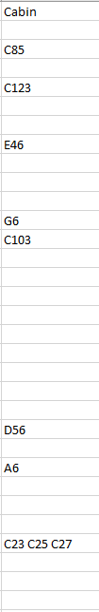
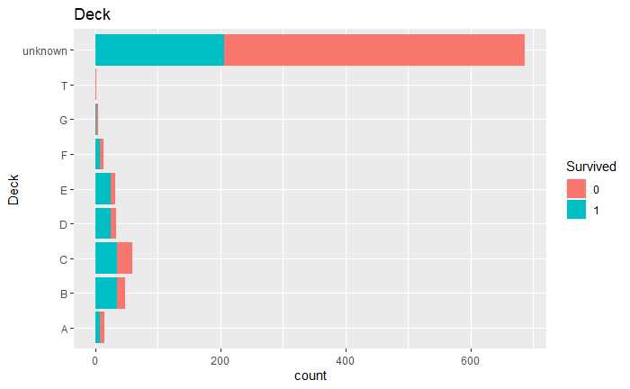
Cabin -> Deck by extracting the letter from Cabin

Slide 15
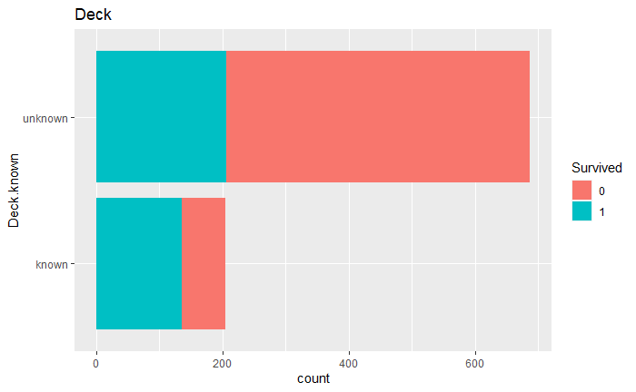

Slide 16
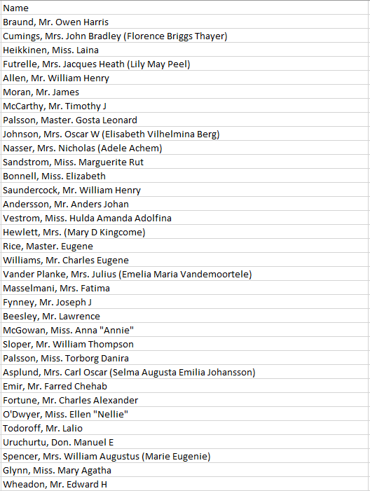
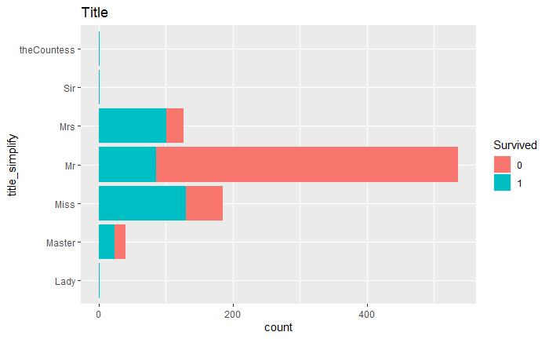
Extracting Title from Name

Slide 17
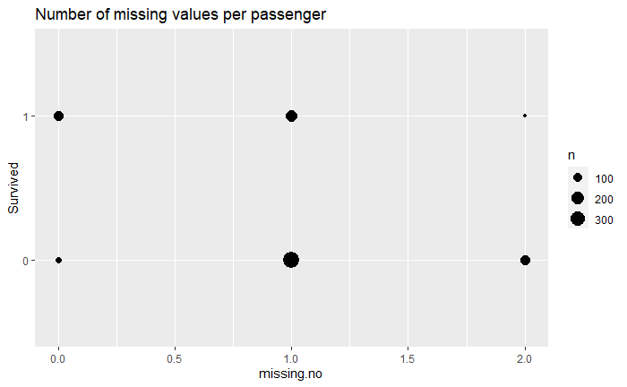
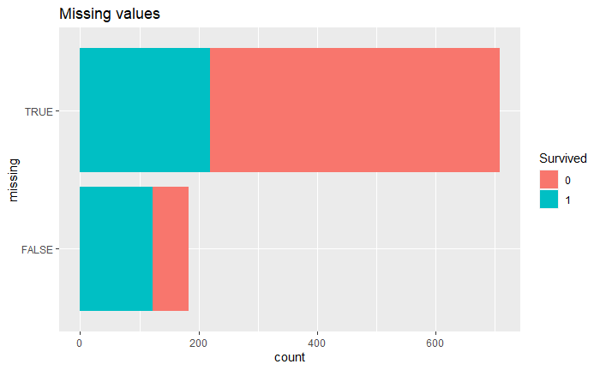
Missing values
Impute missing values by median (age, fare) or mode (Embarked)

Slide 18
Model Training and Testing
Features: "Pclass","Sex","Age","SibSp","Parch","Fare","Embarked","family_size","Fare_mean","missing“
Score:
Classification accuracy

Slide 19
Logistic regression
 | training | test
Logistic regression | 0.8025 | 0.77511

Slide 20
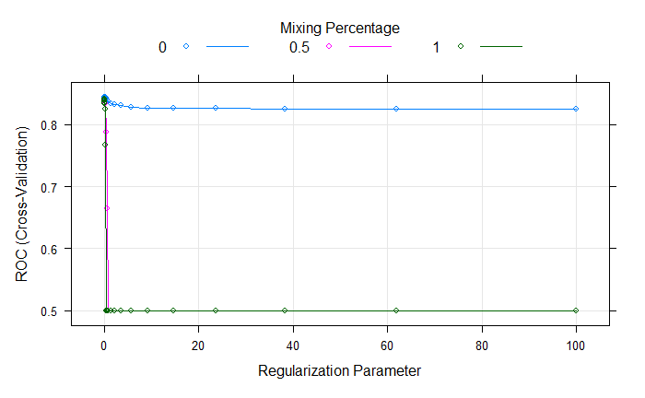
Regularized logistic regression
Choose the most regularized model such that error is within one standard error of the minimum.
 | training | test
Regularized logistic regression | 0.8047 | 0.77511

Slide 21
Random forest
1000 trees
 | training | test
Random forest | 0.8339 | 0.77990

Slide 22
Good luck with the finals!

