Slide 1
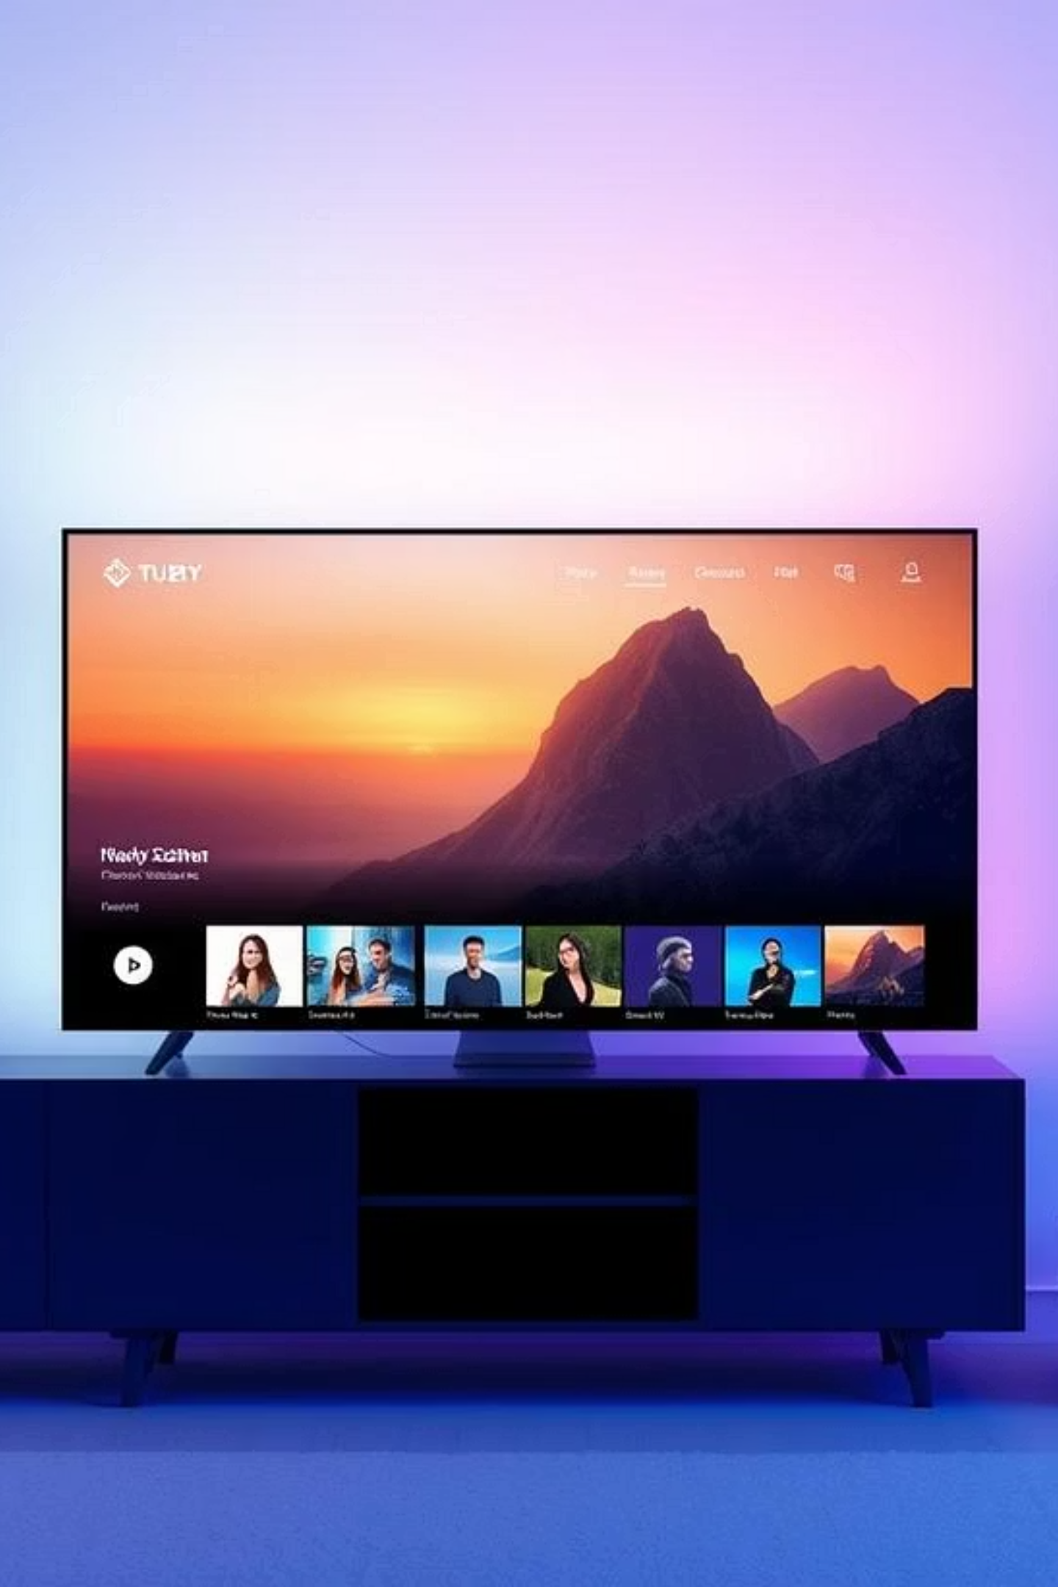
Data Analysis on Netflix Content…
A simple exploration of Netflix content data to understand trends, viewer preferences, and content strategies.

Slide 2
Introduction to
Netflix Data Analysis…
In this project, I analyzed Netflix content data to understand trends, viewer preferences, and content performance. Using the dataset, we explored details like genres, ratings, duration, and view counts to gain useful insights about what works best on the platform.

Slide 3
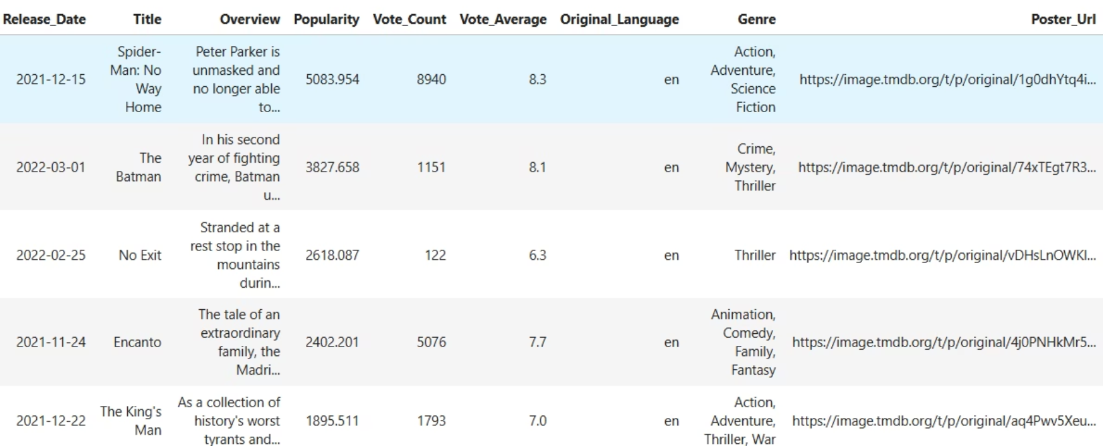
Dataset Overview…
The dataset contains various Netflix shows and movies with details like title, genre, rating, duration, views, and user scores. It helps us understand what kind of content is popular and how users interact with it.

Slide 4
Tools and Libraries Utilised…
Python – Used for all data analysis tasks
Pandas & NumPy – For handling and processing data
Matplotlib & Seaborn – To create graphs and visualizations
Jupyter Notebook – For writing and running code step-by-step
Scikit-learn – For any machine learning or prediction tasks

Slide 5
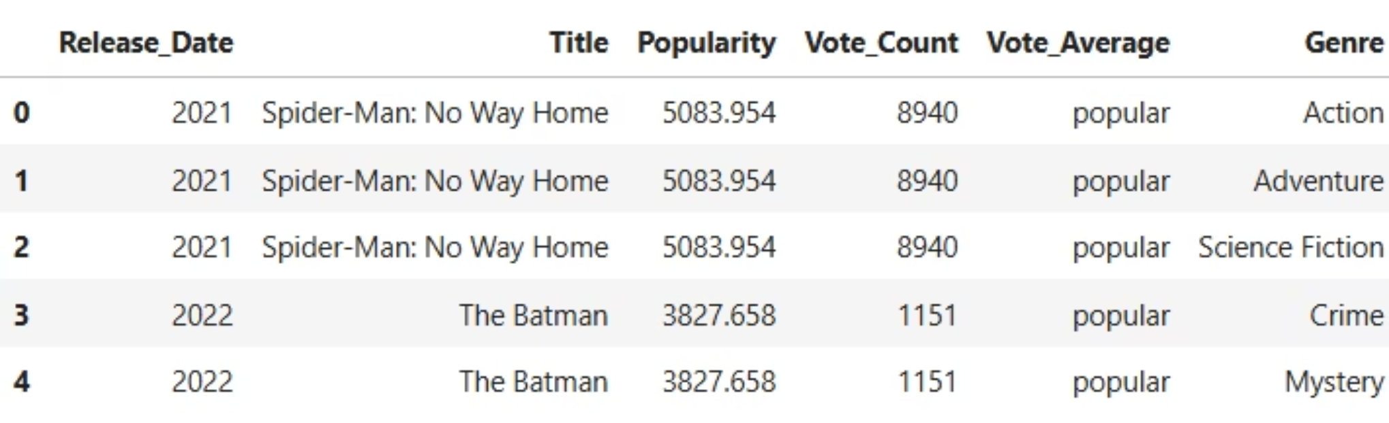
Data Preprocessing Steps…
I cleaned the data by removing duplicates and handling missing values. Dates were standardized, and empty fields like genre and rating were filled or fixed. New features like content age and decade categories were also added to help with better analysis.

Slide 6
Reference Questions Explored…
What is the most frequent genre of movies released on Netflix?
Which genre has the highest votes?
Which movie got the highest popularity? What’s its genre?
Which movie got the lowest popularity? What’s its genre?
Which year has the most filmed movies?

Slide 7
Analysis Questions Explored…
1.What are the top 5 most frequent gener on netflix?
2.Which genre has the lowest number of moves?
3.what are the top 10 most popular movies on netflix?
4.What is the oldest movie available on Netflix?
5.Which year received the highest average movies votes?
6.What is the correlation between popularity and number of votes?
7.What is the average number of movies release per year ?
8.Which Genre should Netflix focus on based on rising on popularity trends ?

Slide 8
Conclusion…
Netflix uses data to decide what content works best for different audiences. Our analysis showed trends in genres, popularity, and viewer preferences. In the future, more advanced models can help improve recommendations and understand viewers better.
Git Hub Link: https://github.com/CHENNAMSETTYGURUTEJA/Data-Analysis-on-Netflix-Content

