Slide 1
Build your first AI model
workshop
GDG Setif ｜ 15. 10. 2022

Slide 2



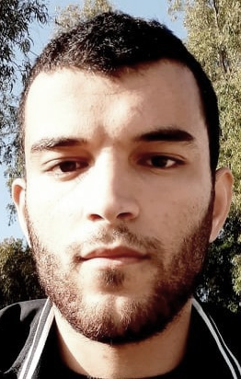
Nidhal Eddine CHENNI
ESI student – 4th year
Main interest:
Machine learning and deep learning problems
Optimization
High performance computing

Slide 3
Contents
01
Tools and installation
02
Introduction to python
03
Introduction to ML Libraries
04
Building a model from scratch

Slide 4
Thanks !

