Slide 1
Plant Disease Detection Using CNNs

Slide 2
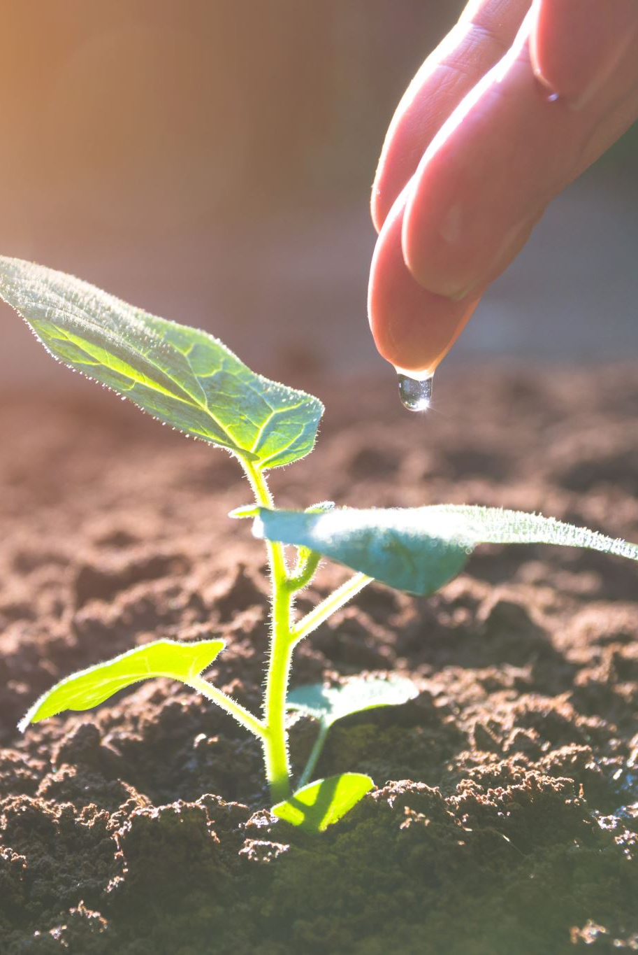
Why This Project?
Plant diseases cause 20-40% of global crop losses annually.
Traditional detection methods are slow and require expert knowledge.
CNNs offer a fast, accurate, and scalable solution.
Helping farmers detect diseases early can improve food security.

Slide 3
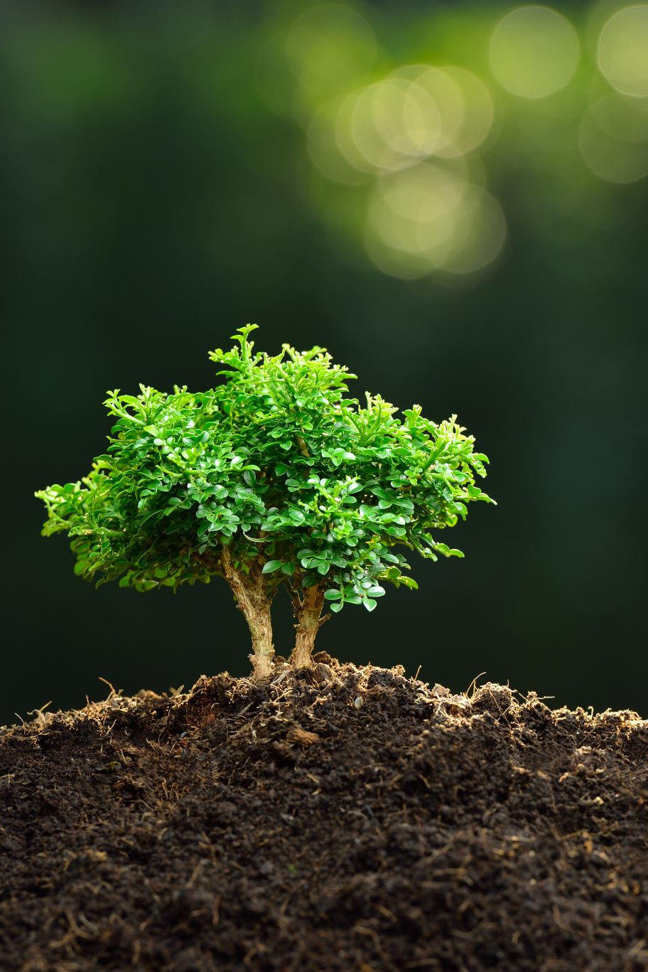
Research Questions
What are the most effective CNN architectures for plant disease detection?
How does data augmentation improve model performance?
What impact does transfer learning have on accuracy and training time?
How well does the model generalize to unseen plant species?

Slide 4
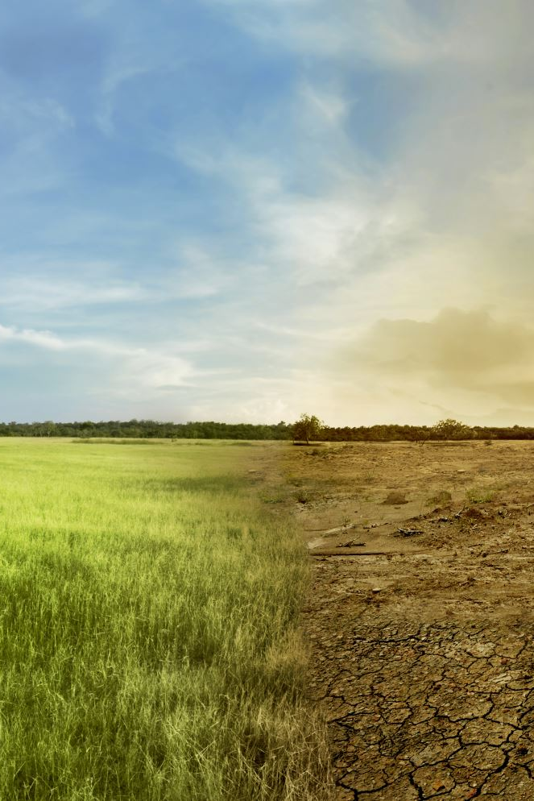
How This Project Helps Agriculture
Farmers can use mobile apps to scan leaves and detect diseases.
Early intervention reduces crop losses and increases yield.
Cost-effective alternative to traditional disease detection methods.
Potential for integration with precision agriculture technologies.

Slide 5
Dataset & Preprocessing Preprocessing
• Dataset: Plant Village with 54,305 labeled images.
Author: Mohith Singh 1804, 3 years ago.
• Preprocessing: Resize, normalize, and apply data augmentation (rotation, flipping, zooming).
• Splitting: 70% Training, 15% Validation, 15% Test.
• Example Diseases: Powdery Mildew, Rust, Mosaic Virus, Apple cedar is healthy.

Slide 6
Model Training & Evaluation
• Models: Custom CNN, VGG16, ResNet, InceptionV3.
• Training: Optimized with Adam optimizer, cross-entropy loss.
• Metrics: Accuracy, Precision, Recall, F1-score, Confusion Matrix.
• Hyperparameter tuning using Grid Search.

Slide 7
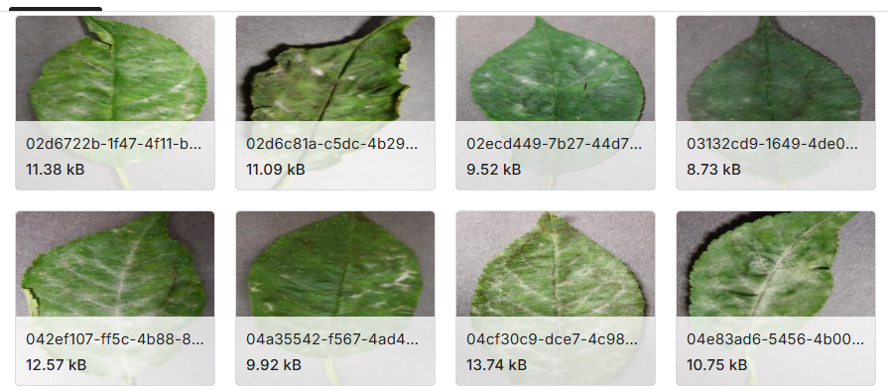
Example CNN Predictions

Slide 8
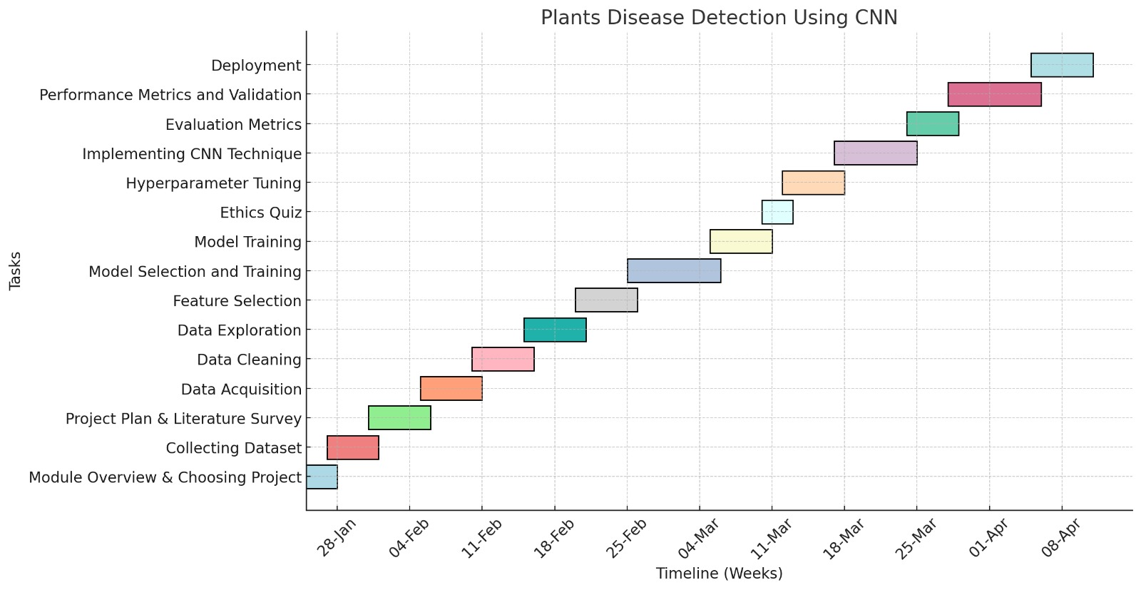
Project Timeline (Gantt Chart)

Slide 9
Ethical Considerationsdera
• Data Privacy: Ensures dataset contains no sensitive information.
• Bias: Addressing class imbalance for fair predictions.
• Transparency: Clear communication of model limitations.
• Compliance: Meets GDPR and ethical research standards.

Slide 10
GitHub & Resources
• Dataset: https://www.kaggle.com/datasets/plantvillage
• Research Papers & References.
• Contact & Future Collaboration Opportunities.

Slide 11
Conclusion & Future Work. & Future Work
• Developed a CNN model for plant disease detection.
• Demonstrated effectiveness using real-world data.
• Future Work: Expand dataset, deploy mobile app, enhance interpretability.
• Open to collaborations for further research.

