Slide 1
A Better Security and Multi-Factor Authentication
Kenjiro Taura
Information Technology Center

Slide 2
Data we can never leak …
Every single day, some 50,000 members of our university have
UTokyo Account (10-digits@utac.u-tokyo.ac.jp)
Google Account (@g.ecc.u-tokyo.ac.jp)
accessible from the Internet …
UTAS
ITC-LMS
Microsoft 365
Google Workspace
Zoom
WebEx
要有効化
UTokyo Account

Slide 3
Basics for a better protection
Never use easy-to-guess passwords
If you do, change it today!
Change it to a long and complex password (you can generate one by this)
Multi-Factor Authentication (today’s )

Slide 4
What is Multi-Factor Authentication (MFA)?
In general, it is a sign-in process that confirms two or more pieces of information the only claimed user can know or possess
password, phone, smartphone, biometrics, a special device, etc.
In practice, a sign-in process using “a password + one more thing”

Slide 5
Why MFA?
Without it, your password is guessed, and you are all over
MFA makes you much, much safer
A crude analogy: the probability your account is compromised, which might be like 0.001 without MFA, becomes 0.001 × 0.001 = 0.00001
Consolidate various service accounts into one and protect it strongly, thereby achieving both security and convenience

Slide 6
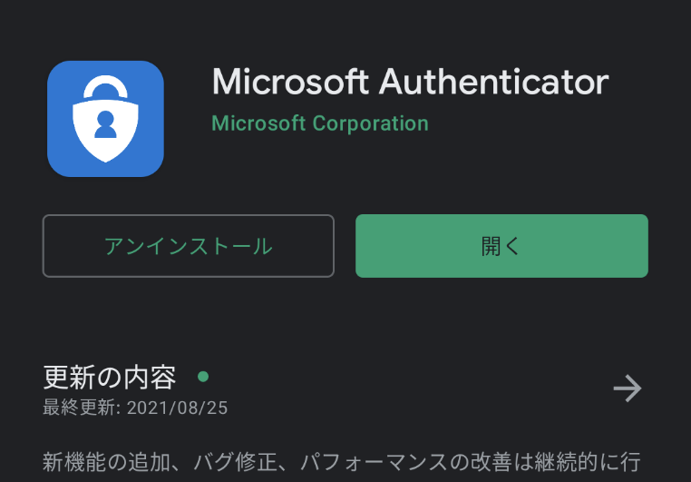
Isn’t MFA cumbersome?
Depends on the method, but the one using smartphone authenticator app is convenient
As easy as just opening your phone (particularly easy you are addicted anyways)
Demo: Microsoft Authenticator to login ITC-LMS
There is an iOS app, too

Slide 7
Methods other than Microsoft Authenticator
SMS (6 digits sent to your cell phone)
Voice phone (pick your phone and press #)
Cell phone
Home phone
Google authenticator, anyway
Like Microsoft Authenticator, but UTokyo Account works better with the Microsoft one
Please register at least one method besides Microsoft Authenticator, so you can change your smartphone safely

Slide 8
Will MFA be mandatory?
When the service starts on Sep 27, “strongly recommended”
Future: we wish to mandate it when everybody becomes ready for it
You will have enough time to prepare
We mandate it for new security-critical services associated with UTokyo Account
VPN (Chapter 3 by Tamatsukuri)

Slide 9
How to use them
Account | Multi-Factor Authentication | Change password
UTokyo | Turn it on (after Sep 27) https://utacm.adm.u-tokyo.ac.jp/webmtn/LoginServlet → and configure https://mysignins.microsoft.com/security-info?domain_hint=utac.u-tokyo.ac.jp | https://utacm.adm.u-tokyo.ac.jp/webmtn/LoginServlet
Google | https://myaccount.google.com/security | https://idm.ecc.u-tokyo.ac.jp/webmtn/sso-saml
We will make a summary page on utelecon soon

Slide 10
How to cancel it?
Don’t.
But if you have to …
The system cannot automatically allow it as doing so would defeat its purpose; we need to verify your identity offline
We accept cancellation requests via you → your respective office → utelecon
We appreciate a cooperation (forwarding requests) by department offices
Like routing password reset requests for UTokyo Account

Slide 11
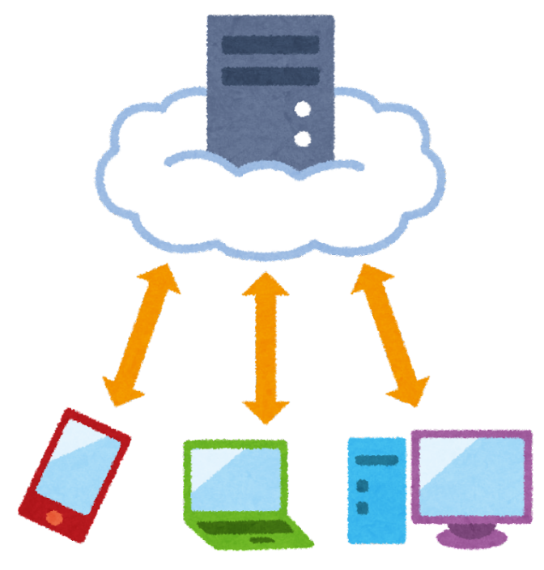
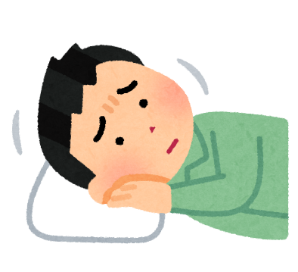
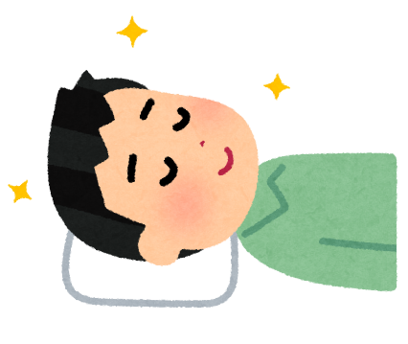
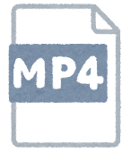
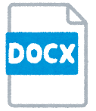
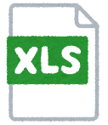
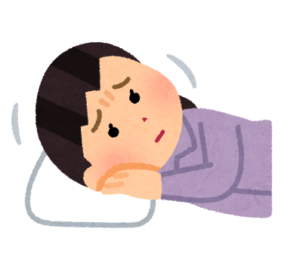
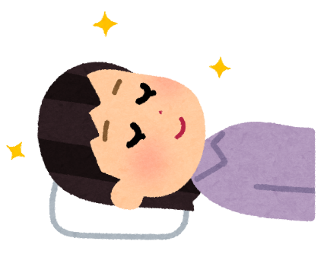
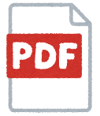

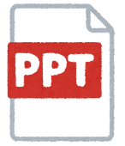
To sleep in piece …
Data are in … | The major threat | Precautions
cloud (UTokyo/Google Account) | password leak / break-in | strong passwords; MFA (smartphone, cell phone)
smartphone | physical loss | screen lock (biometric, PIN number)
PC | physical loss | disable auto-login, screen lock, encrypted drive
data
data
data …
MFA

Slide 12
Misc.
Review your shared docs on Google Drive, OneDrive (these are what you ought to protect)
Remove or cancel sharing when no longer necessary
Share with only specific people if practical
See also 在宅勤務のPC利用ガイド

