Slide 1
Patient Information System
Asteroid

Slide 2
Outline
Project review
Requirement Review
Design Cycle Review
Database Design
Logical design
Data sources
Database Optimization
Web Design & System demo

Slide 3
Project review
Problem Statement
Maintain the patient information in the hospital
Purpose
Treatment reference & evaluation
Potential Customer
Doctors, Nurses, Patients, and Researchers.

Slide 4
Design Cycle Review

Slide 5
E-R diagram： Our work

Slide 6
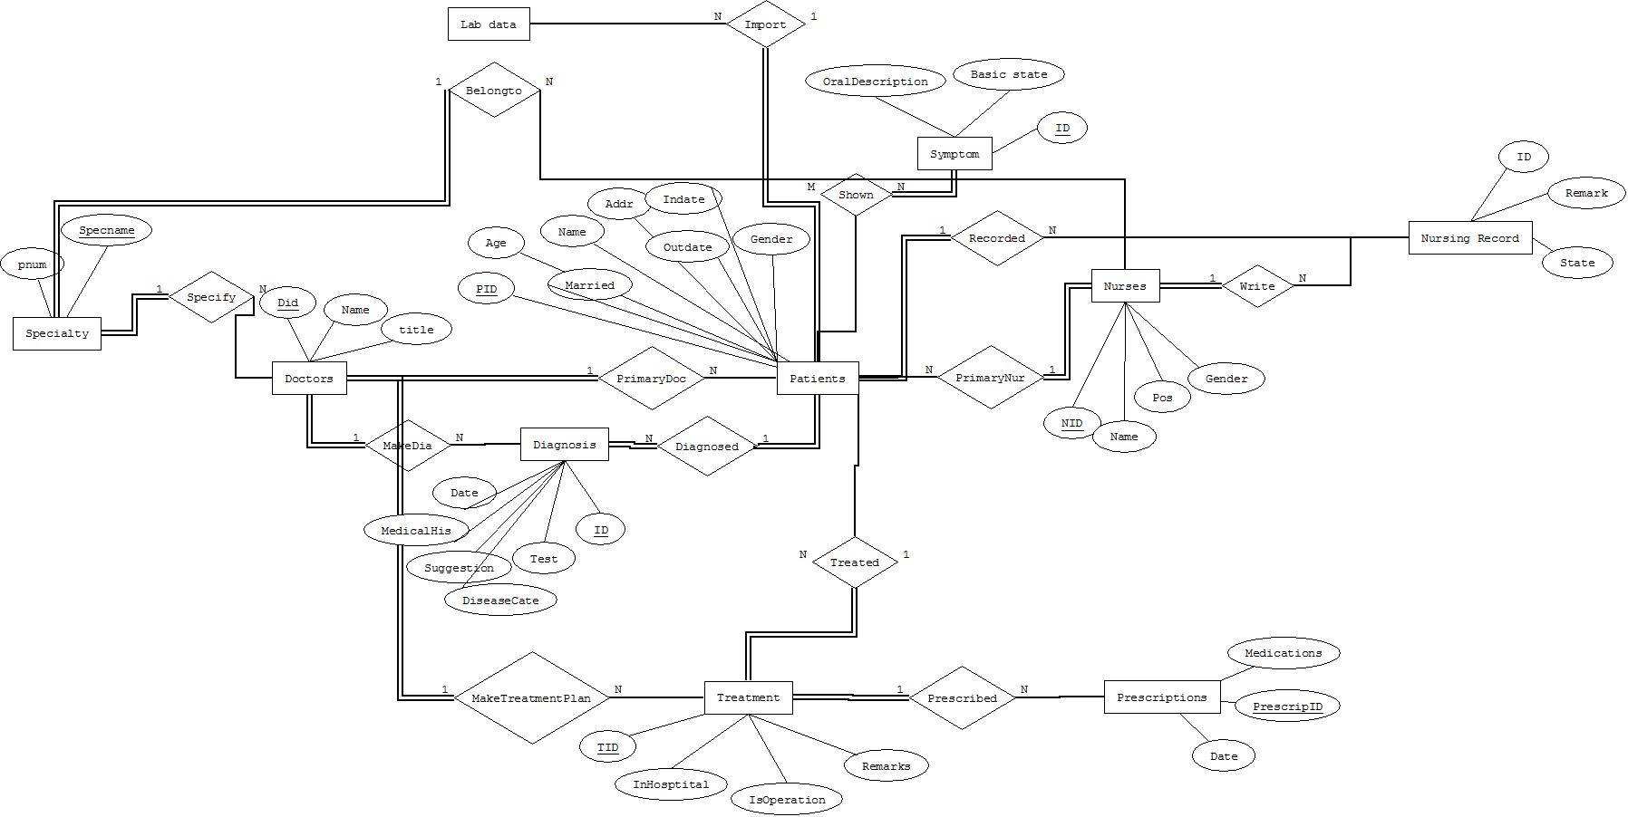

Slide 7
Logical Design: EER(Our work)

Slide 8
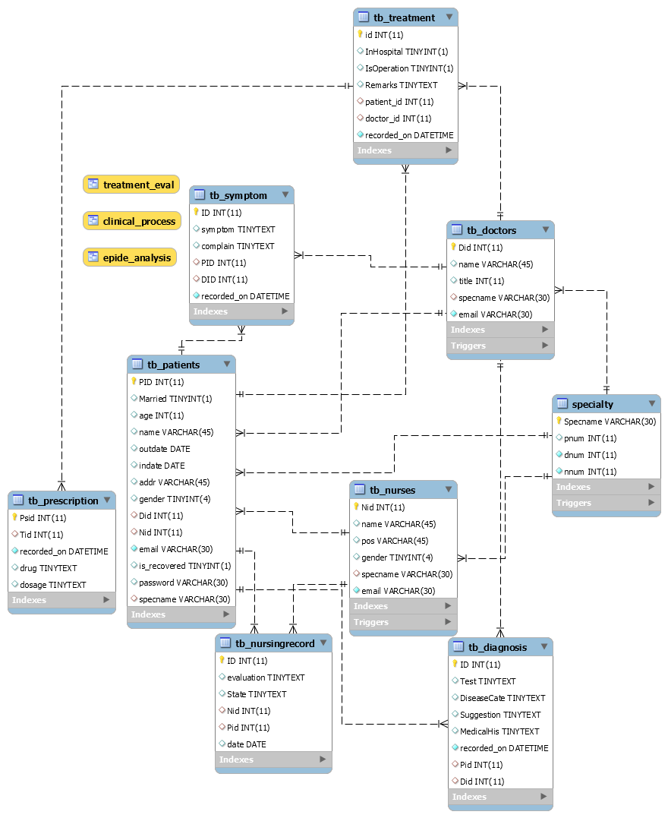

Slide 9
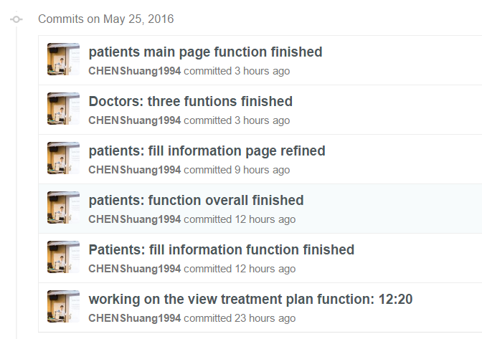
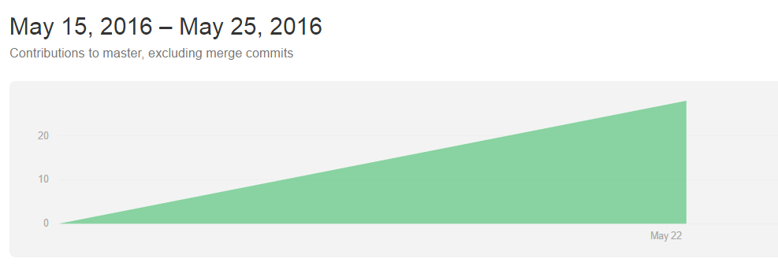
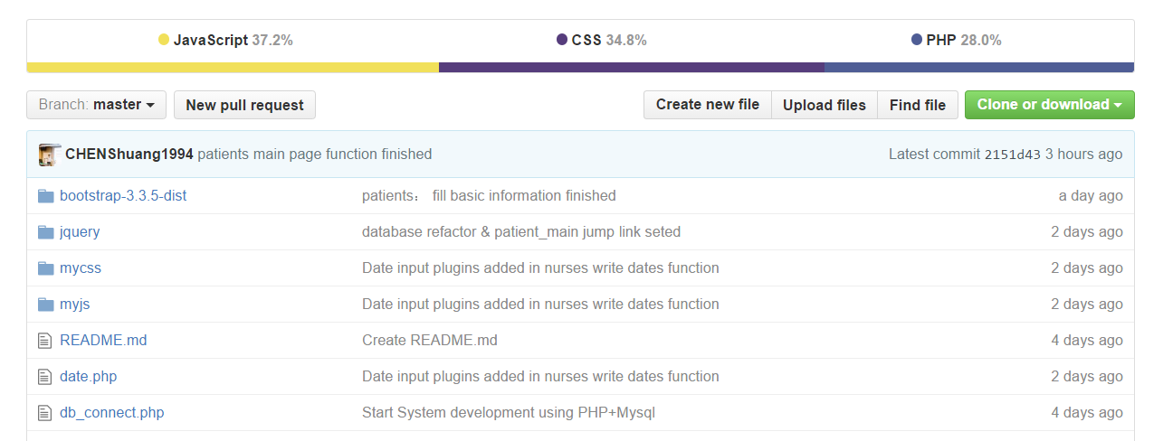
Database Schema
Github Link:
https://github.com/CHENShuang1994/Patient-Information-System/

Slide 10
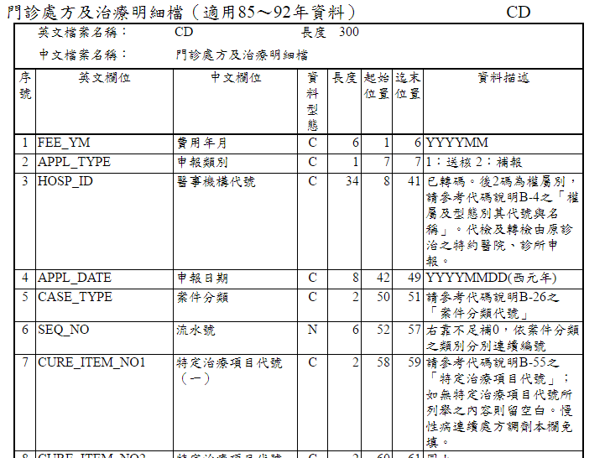
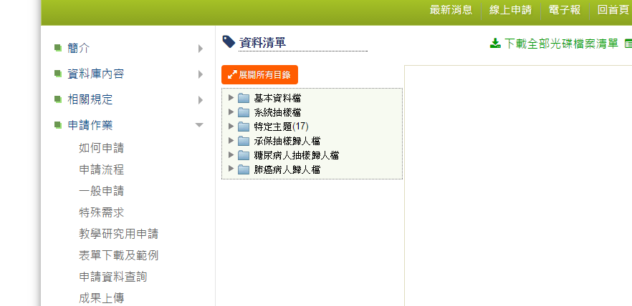
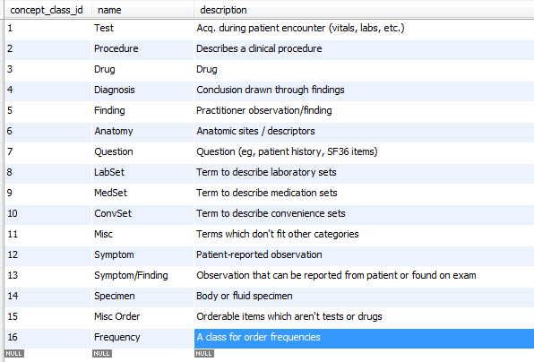
Data Sources
Public datasets
The OpenMRS demo dataset
Used by the OpenMRS project, but lacking of doctors’ order data.

Slide 11
Database Optimization
Triggers
Automatically updating the number of people in different speciality departments
keep the integrity constraints (Enable foreign key check)
Indexes
Primary keys
Frequently used attributes:
email in tb_doctors/ tb_nurses/tb_patients
Attention:
Never add indexes to frequently updated attributes

Slide 12
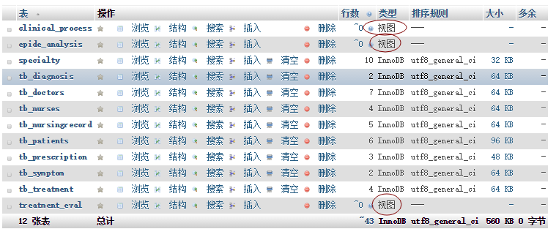
Database Optimization
Views
provide the outbound service considering the security issues.
Three views

Slide 13
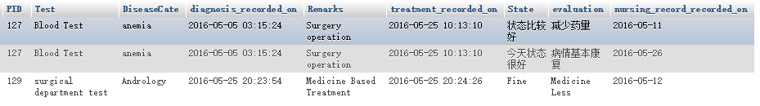
Database Optimization
Three views
clinical_process
epide_analysis
treatment_eval

Slide 14
Web Design & System demo
Development Environment:
PHP + Mysql
Demo ☺

Slide 15
Thanks Q & A

