Slide 1
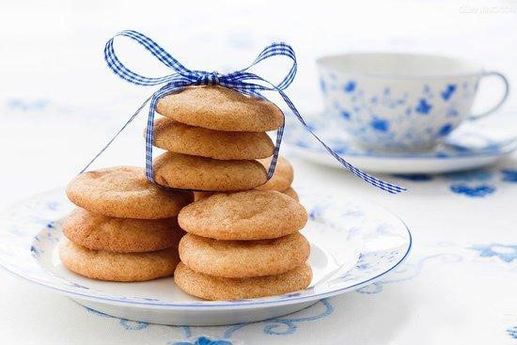

cookieman
2015KPMG
National Business Competition
Both Quantity and Quality

Slide 2
Agenda
PART 1 Industry Overview
PATT 2 Company Overview
PART 3 Analysis ＆ Strategy
Market Expansion
Market Promotion
Product Diversification
PART 4 Long Term View
3D Printing Cookie
Internet Plus

Slide 3
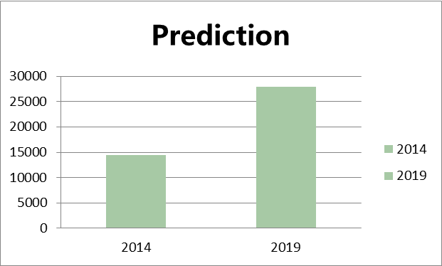



Industry
Strategy
Industry
Company Overview
Analysis & Strategy
Long-term View
India is a fast-developing market with stiff competition and high dependence on raw material
Condition of baked goods sector
1
Market size and growth
2
Features of baked goods sector
Low barriers to entry
Stiff competition
Rapid growth
Dependence on raw material
Trend to be premium
Market size
INR 14500million
＋14%
2014
92.4%
3
Main competitors
Account for 80% of retail sales

Slide 4
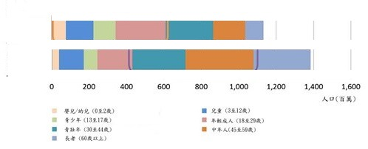
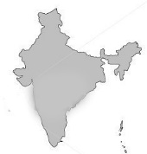
Industry
Strategy
Industry
Company Overview
Analysis & Strategy
Long-term View
There are more indulgent consumer spending in India due to more young people and more use of credit and debit cards
Condition of baked goods sector
A younger population
The means to spending
2012
Six times
2020
double
Comments
64% population in the work age group
Credit and debit card spending is popular
Retail infrastructure grow substantially
More indulgent consumer spending
A lucrative market
Source :Internet World Statas

Slide 5
Industry
Strategy
Industry
Company Overview
Analysis & Strategy
Long-term View
Financial performance indicates that Cookie Man are above breakeven
Equity multiplier
Cookie man
Britannia
ITC
Revenue：profit&cost
Comments
244920
221275
By comparison , equity multiplier is low.
Revenue slightly increases every year , but gross profit margin decreases year by year.
Liquidity ratio keeps at 2,which is appropriate.
Cost has grown substantially.
202270
Company should increase the financing and use the leverage principle to increase net profit ,expand sales and reduce the cost.
EBT
COGS
operating&selling cost
Source :http://tinyurl.com/orianacn

Slide 6
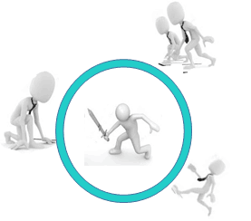
Industry
Strategy
Industry
Company Overview
Analysis & Strategy
Long-term View
Cookie man should differentiate and focus on the freshly baked segment based on competitive analysis.
Porter's Five Forces Model
What Cookie Man should do
Potential entrants:
Easy to entry
Numerous Potential entrants
Supplier:
Supplier dominant
Industry competitors:
Britannia&Parle&ITC
Customer:
Diverse choice
Low loyalty
Substitute:
Numerous & low price substitute
Close contract with customs
Many competitors with high market share and economy of scale, plan to foray into premium segment.
No fierce competition in the freshly baked premium segment.
The range and price of Main competitor
Range +
Britannia
Parle
ITC
Recommend ：Strategy of product differentiation
Range -
Cookie man
price -
price +
Source :Internet World Statas

Slide 7

Industry
Strategy
Industry
Company Overview
Analysis & Strategy
Long-term View
Three issues Cookie man have to face and issues’ meaning
Condition of baked goods sector
Second issue:
increase reach
how to attract
more consumers
First issue:
grow organically
how to expand
2
1
Third issue:
explore new product lines
how to position the brand
3

Slide 8
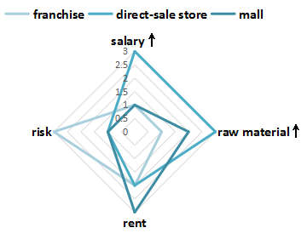
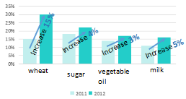
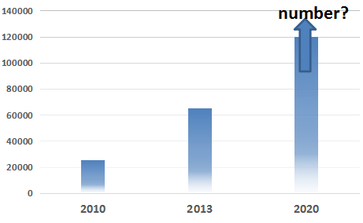
Industry
Company Overview
Analysis & Strategy
Long-term View
Market Expansion
Strategy 1 : Add mall channel and franchising model.
The Comparition between three ways
The cost changing of Cookie Man
Reasons:
Franshise owner cares more about the raw material saving for its own profit than others.
No need to pay salary for franchise owners reduces the cosy greatly.
Franchise would bring more risks to the brand if it hurt consumers' benefit.
The Price of Raw material
risk
The change of Salary
Conclusion
With the cost of raw material,store rent and clerk salary increasing,direct-sale store can no longer be the only way of selling.
A better balance has to be reached.Strategies are required to be put forward separately.
Source : Case

Slide 9

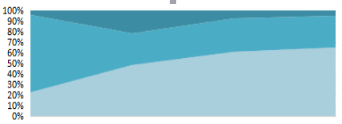
Industry
Company Overview
Analysis & Strategy
Long-term View
Analysis & Strategy
Market Expansion
Strategy 1 : Add mall channel and franchising model.
Sold in malls: Agency
Franchise store: More and more sufficient owners
Store
mall
Three kinds of stores
More franchise means:
Getting higher market share
To Avoid the side-effect to the brand
More strict requirements of franchise owner have to be adopted such as personality.
To balance three kinds of stores:
Mother shop gains best while express should be reoriented.
less
more
Retail sales 2015
Retail sales 2014
Why cooperate with agency?
More audience
More impulse buying
People may buy something they occasionally see but actually don‘t need in the mall
Will people buy the product when they see the product in the mall?
Only when people know the brand,they’ll probably buy the products
When the brand has been known to the majority,choose agency like Lulu to replace more stores.
Or,build up the brand first.
margin distribution
ammount
Direct-sale store
To deal with the salary increasing:
Reduce staff properly
Select employee more carefully
Use machines as labor force.
To deal with the cost of raw material:
Improve produce efficiency by invest more on technology
R
aw
ma
t
e
r
i
a
l
Sa
l
ary
Source : YinduAbc.com:

Slide 10
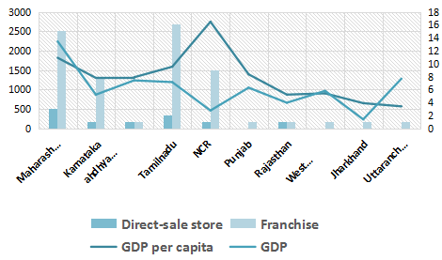
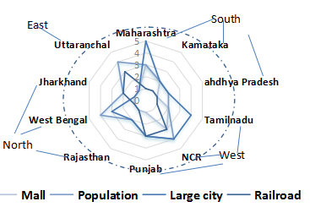
Industry
Company Overview
Analysis & Strategy
Long-term View
Market Expansion
Strategy 2 : Develop region-specific strategy to suit local conditions.
Railroad:
Transation ability
Travelers
Mall:
Agency decition
shopping habit
Economy and the layout now
Population:
Consumers
Labor force
Big cities:
Infrastructure
Different situation in different India states
GDP:
Income
The ability of comsuption and investment
The amount of stores:
Market saturation and market Development
Source : YinduAbc.com

Slide 11
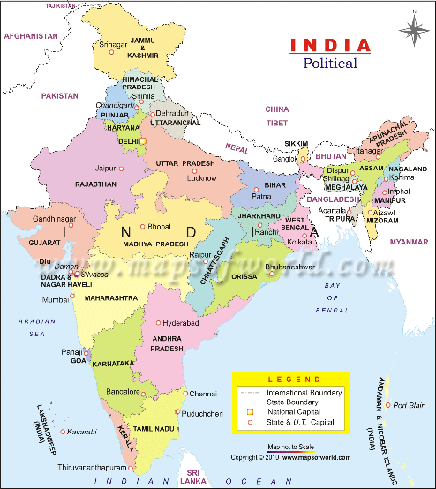
Industry
Company Overview
Analysis & Strategy
Long-term View
Market Expansion
Strategy 2 : Develop region-specific strategy to suit local conditions.
Consider all of the information
North:
Give priority to direct-sale store to build up the brand
Focus on some tier-1andtier-Ⅱespecially satellite city such as Ghaziabad.
East:
Consider sale agency to open the market.
Setting lower franchise fee to improve expansion speed.
West:
Carefully choose franchise owner
to limit the Expansion and avoid internal fierce competition
Consider the corporation with agency like Amazon
South:
Develop more franchise but not too much to deal with the market saturation.
Source : YinduAbc.com

Slide 12
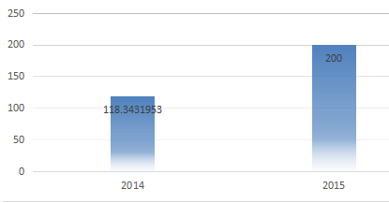
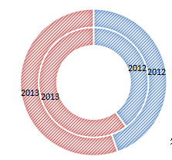

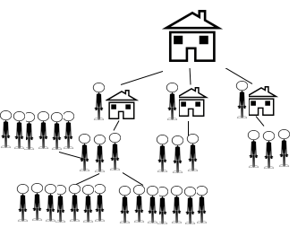
Industry
Company Overview
Analysis & Strategy
Long-term View
Analysis & Strategy
Market Promotion
Strategy 3 : Establish the APP and BBS to cater to the customers’ emotional needs.
Value of online payment industry (billion dollars)
The propotion of people shopping online within a year and in three months
Why entering the online market?
Consumer becoming younger,shopping online will be accepted wildly
Convenience appears to be more important for shopping
Store rent increasing, a store online attracts more applicant
within three months
in a year
Why make the franchise online decision?
Host office
Recommendation:
Both franchise in real store and online store makes work report to the head office.
Each store connects with several local online franchisee
Each online franchisee connects with at least a fixed group of customers.
How to make franchise
online work better?
Deal with the inventory of real stores ,especially mother shop
The transition fee won't be high for the local connection
More chances to earn profit make the position of franchise owner more attractive
With more and more centers,Cookie man would cover more and more markets!
Franchise In Real Stores
Franchise Online
Source : YinduAbc.com:

Slide 13


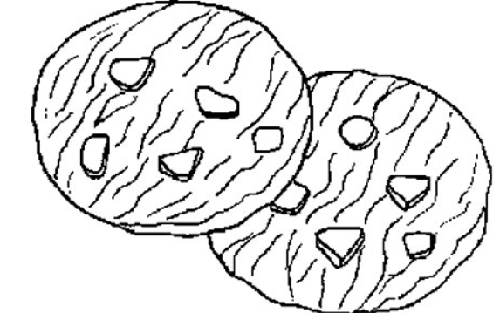

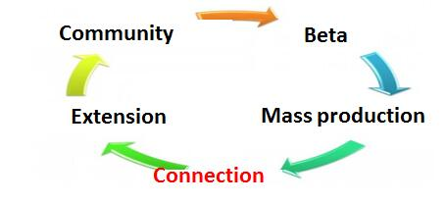
Industry
Company Overview
Analysis & Strategy
Long-term View
Market Promotion
Strategy 3 : Establish the APP and BBS to cater to the customers’ emotional needs.
Reasons to establish APP and BBS
What we want from APP and BBS
250 million
Internet user
Connect with customers better and build our culture
APP
64%
Annual increase rate of Internet retail
Offer their opinions about new products
Share using experience
Point out shortcomings
20 million
Buy on the Internet
BBS can attain more emotional appeals from customers by less cost and handle complaints at once.
Develop product accurately and sniper marketing
Provide show platform
Publish star product
Provide information about baking, balanced diet and company.
Operation pattern
Source: Internet World Statas

Slide 14
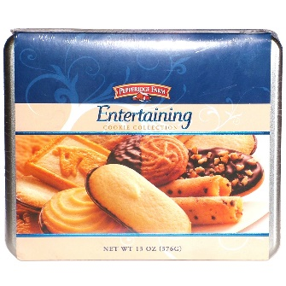
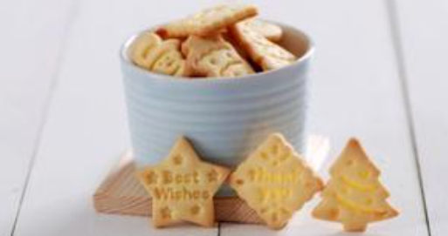


Industry
Company Overview
Analysis & Strategy
Long-term View
Strategy 3 : Cater to Customers
Use experiential marketing and fancy package to further boost sales
Experiential marketing
Strategy specializing in gift-giver
Cookie Man can hold parenting activities like DIY cookies.
Through this kind of activities, we can not only grow our social influence, but also pass on our enterprise faith, like green and healthy to the customers.
For enterprise buyers, launch assorted gifts with fancy package. We can even print the company logo on it.
For individual buyers, launch fractional package and present exquisite cards to whom want to send them as a present.
Cookie Man can also hold new product announcement just like Apple.
If the customers like them, they will buy it. Or, the company will know that at once and save the cost of market survey.
Source : Official website

Slide 15
Industry
Company Overview
Analysis & Strategy
Long-term View
Strategy 3 : Cater to Customers
Develop new kinds of cookies for people with obesity and diabetes
Rates of obesity and diabetes are rising
People with diabetes can also eat roughage cookie
According to a research, when concentrate/roughage ratio in cookie is 3:1, people with diabetes can enjoy this kind of cookie without side effects induced by roughage.
Therefore, cookie made from roughage is worth a try.
Roughage can prevent weight increasing
An example of cookie made from roughage
weight
Contrast
Fed with wheat drum
Fed with corn
Source : CNKI retrieval platform

Slide 16


Industry
Company Overview
Analysis & Strategy
Long-term View
Strategy 3 : Cater to Customers
Focus on healthy cookie and develope cookie with medicinal value
growth in the living standard
the aggravation of environment pollution
the rapidly aging populations
High pressure of work and life
Eating disorders & imbalanced nutrition
People pay more attention to health
Exercise & eat dietary supplements
Buy health food
40.8%
44.3%
Not eat breakfast on time
Not eat lunch on time
Huge market demand for health cookie
A cookie rich in nutrition for teenagers.
A cookie maintain your beautie for ladies.
A cookie have medicinal value for old man.
53.8%
41.8%
Not eat dinner on time
imbalanced nutrition
build brand and Increase profit
Source : CNKI retrieval platform

Slide 17




Industry
Company Overview
Analysis & Strategy
Long-term View
Strategy 3 : Cater to Customers
Add drinks to the menu to convert their shops into one-stop shops
The three largest bake food com-
panies all sell drinks in their shops.
Advantages of drinks
Convenience
Fit with cookies
Cheap but profitable
Import of coffee is increasing and
output of coffee is reducing in India.
Sales of coffee in India
million dollars
230 million$
is the coffee market sales in 2014 and it will be 410 million$
in 2017 in India.
1000
branch offices
are opened
EVERY YEAR
in India.
Since popular drinks and cookies can increase mutual sales volume, it’s the right time
for the R&D department of Cookie Man to develop some kinds of drinks like coffee.
Source : Official website

Slide 18


Industry
Company Overview
Analysis & Strategy
Long-term View
Furure Aim
Unique , Healthy , Stand out through the competition
Online , Offline , Be the leader of the industry

Slide 19

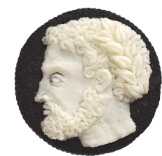
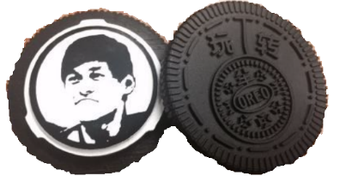


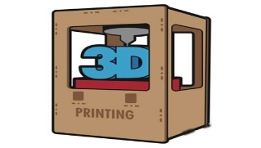
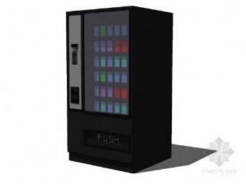
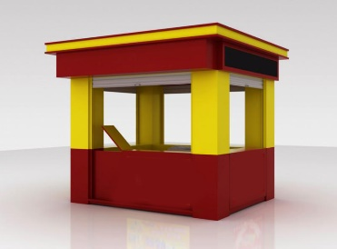

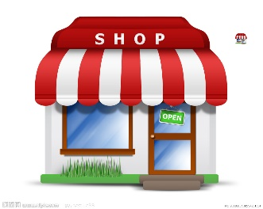
Industry
Company Overview
Analysis & Strategy
Long-term View
Long-term View:
Apply 3D printing technology to cookie making
Emerging 3D printing tech have a glorious prospect
The OREO Company has already applied 3D printing to their cookies and there lists some samples.
Individual requirements
Mass customization requirements
Apply 3D printing tech to cater for the demand of customers that they want to be special and attractive.
Thus Cookie Man can meet demand, reduce cost and expand sales.
vending machine
mother shop
The core-competitiveness of Cookie Man can be strengthened.
city kiosk
express
Source : Internet World States

Slide 20
Industry
Company Overview
Analysis & Strategy
Long-term View
Internet Plus: Create ‘Cloud’ Ecosystem of Cookie man
Pune
Delhi
APP
Nasik
Salem
Surat
Jaipur
Internet plus
Mysore
Parent company
Patna
Bhopal
Gangtok
Mysore
Cloud repository: record feedback
4
Cloud logistics: send deliveryman
3
Cloud map: position consumers
2
Cloud system: offer big data
Since popular drinks and cookies can interact with each other and increase mutual sales volume, it’s the right time for the R&D department in Cookie Man to develop some kinds of drinks.
1
Source : Official website

