Slide 1

SRI VENKATAESHWARA COLLEGE OF ENGINEERING AND TECHNOLOGY (AUTONOMOUS)
R.V.S Nagar, Chittoor – 517 127. (A.P)
Department of Information Technology
Project Title:
Sign Language Gesture Detection & Communication Support
TEAM MEMBERS :
1. ANNEM VASU GOWTHAM REDDY (22781A1202)
2. IVASAPURAM CHARAN KUMAR (22781A1236)
3. DUGGINENI KAVITHA (22781A1226)
4. KANDLAKUTI DINESH (22781A1249)
5. CHENNAMSETTI HEMANTH KUMAR (22781A1215)
Guide:
Mr.R.Gunasekaran
Assistant professor

Slide 2
AGENDA :
System Design
System Architecture
Database Design
UML Diagrams
Technology Stack
Data Preprocessing
Model Training
Model Evaluation
Testing
Results
Advantages & Limitations
Future Scope & Conclusion

Slide 3
SYSTEM DESIGN
Designed to recognize hand gestures and convert them into meaningful text and speech
Enables communication for deaf and speech-impaired users
Design Objectives:
Accurate real-time gesture recognition
Natural sentence generation from gestures
Lightweight and fast inference
User-friendly communication support

Slide 4
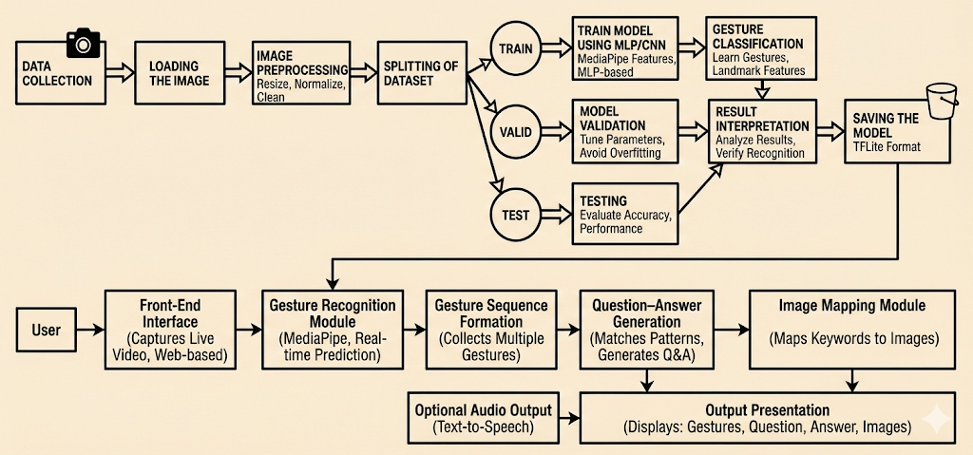
System Architecture

Slide 5
DATABASE DESIGN
Database / Data Storage Design
Raw gesture images stored in class-wise folders
Extracted landmark data stored as CSV files
Trained models stored for reuse and deployment
Stored Data Includes
Gesture images (single-hand & two-hand)
Landmark feature vectors
Gesture labels
Trained models (HDF5 / TFLite)

Slide 6
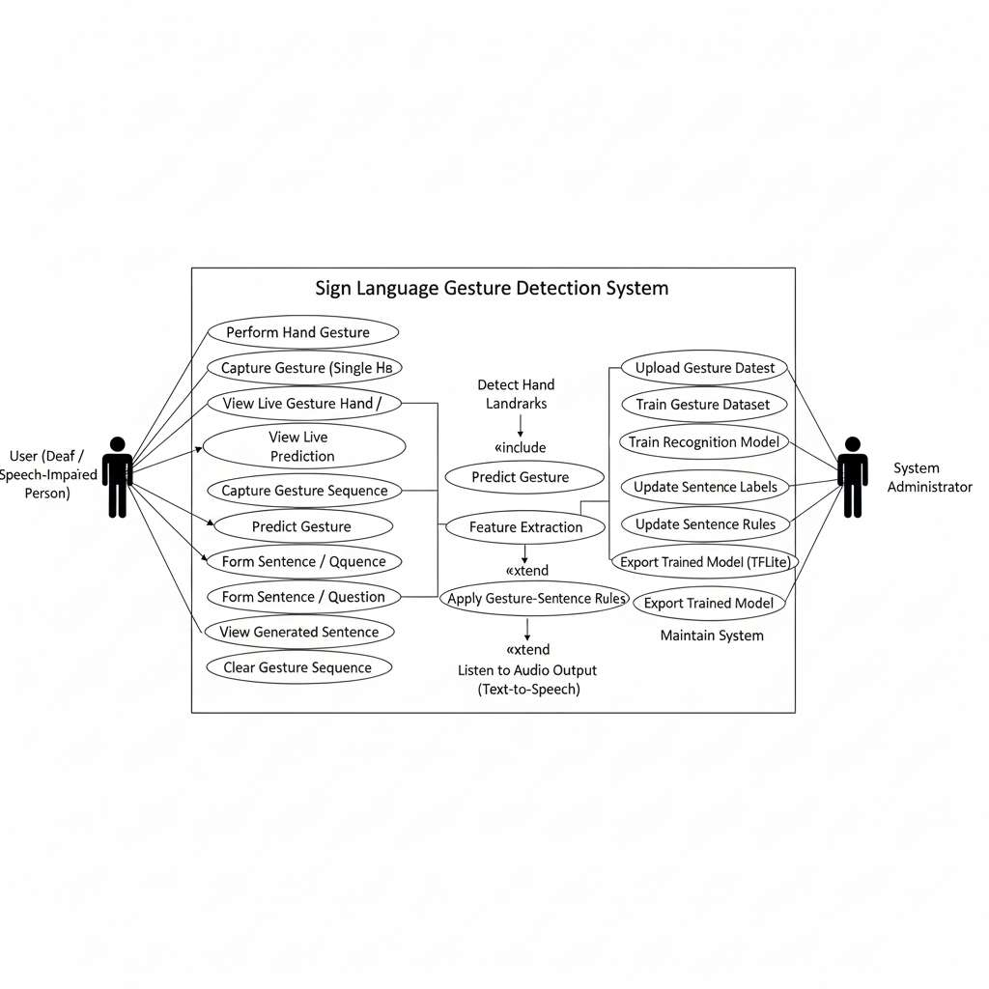
Use Case Diagram

Slide 7
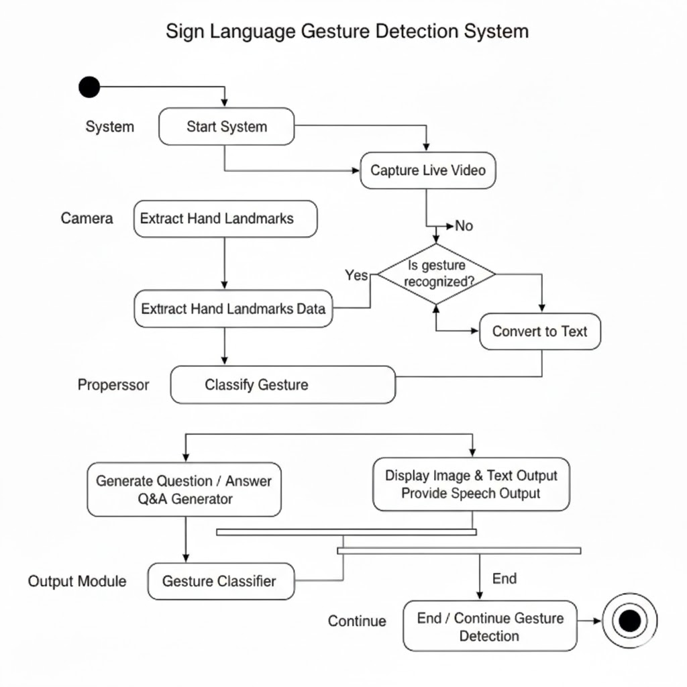
UML Activity Diagram

Slide 8
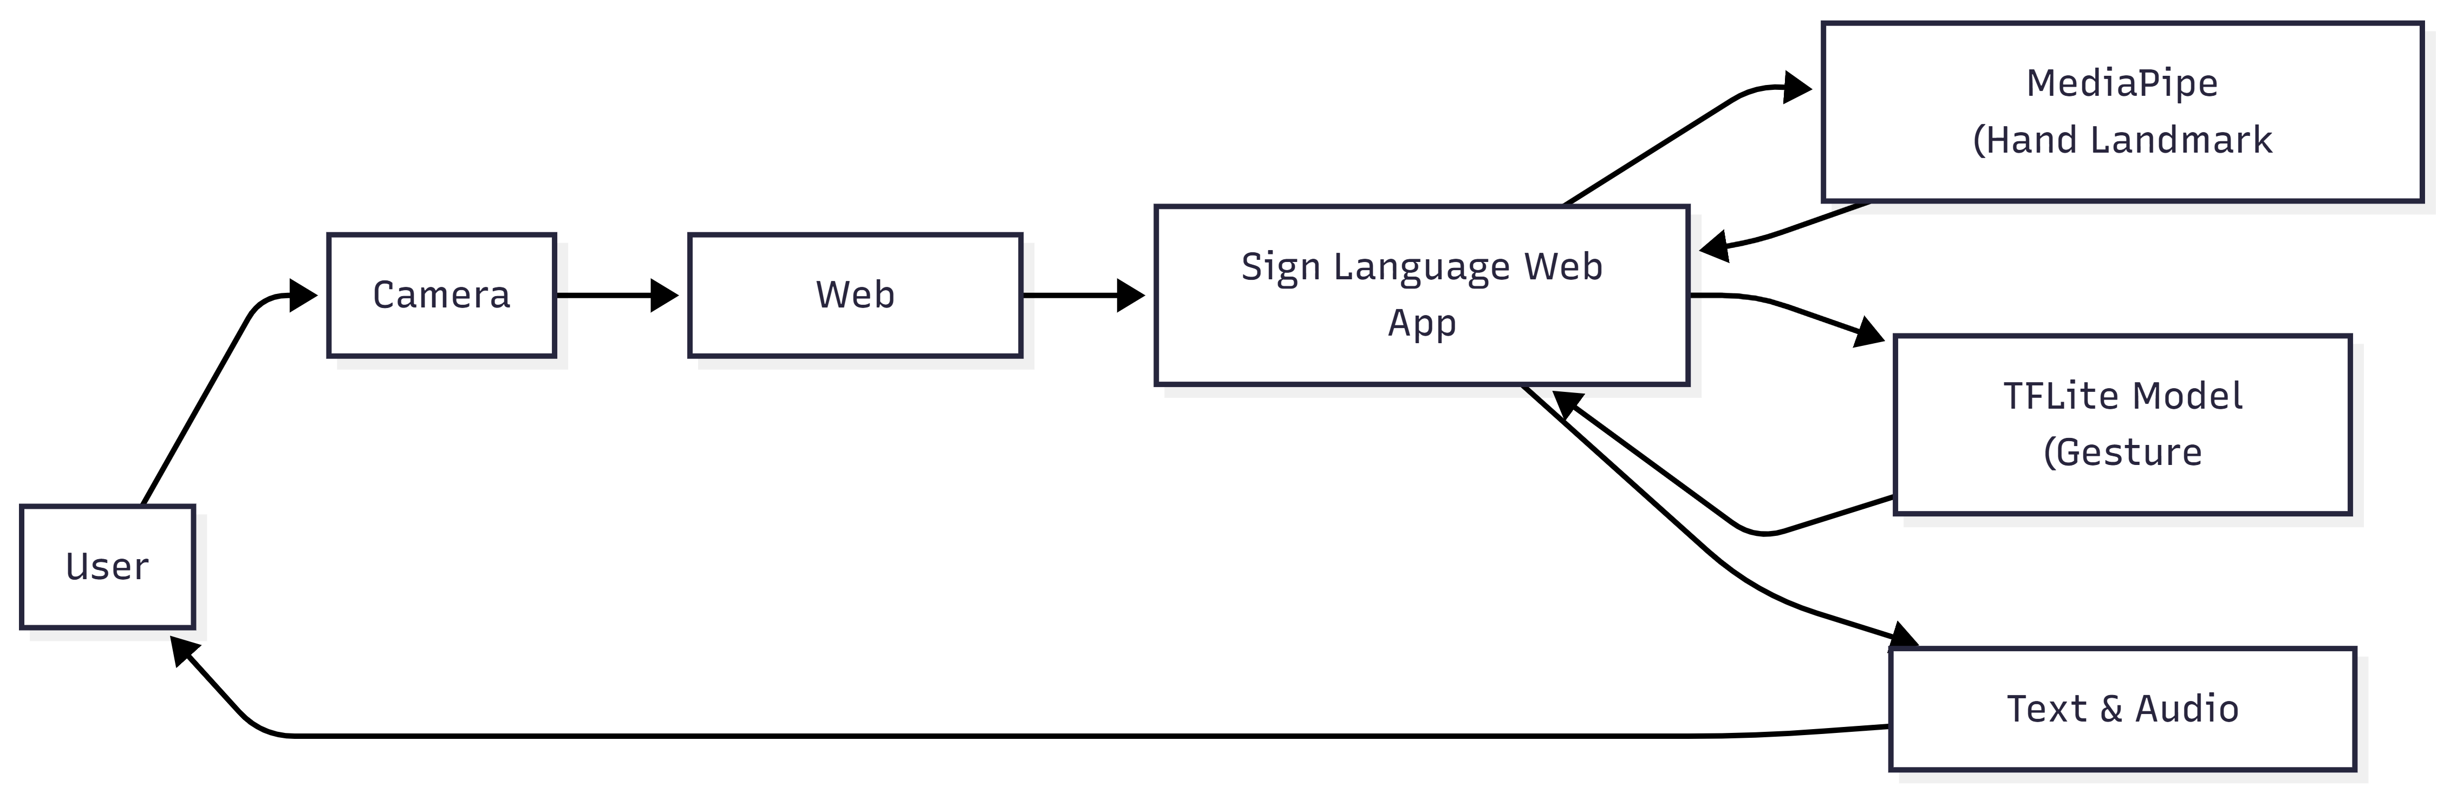
Deployment Diagram:

Slide 9
Tools and Technologies Used
1. Programming Languages:
Python – Used for data preprocessing, model training, and dataset preparation.
2. Machine Learning & AI:
MLP (Multi-Layer Perceptron) – Used for hand gesture classification.
TensorFlow – Used for training the gesture recognition model.
TensorFlow Lite (TFLite) – Used to deploy the trained model efficiently in the web application.
3. Computer Vision:
MediaPipe – Used for real-time hand landmark detection and tracking.
OpenCV (optional) – Used during data collection and image processing.
4. Web Technologies:
HTML5 – Used to structure the web interface.
CSS3 / Bootstrap – Used for responsive and user-friendly UI design.
JavaScript – Used for real-time gesture recognition and front-end logic.
Web APIs (Camera, Speech Synthesis) – Used for video capture and audio output.
5. Development & Deployment Tools:
Flask (optional) – Used for backend integration if required.
VS Code – Used as the development environment.
Browser (Chrome) – Used to run and test the web-based application.

Slide 10
DATA PREPROCESSING&FUTURE ENGINEERING
DATA PREPROCESSING:
Preprocessing Steps
Image validation and cleaning
Landmark normalization
Handling missing hands
Fixed-length feature vector creation
Purpose
Improve model accuracy
Ensure consistent gesture representation
Reduce noise and variability
FEATURE ENGINEERING:
Feature Engineering Technique
Hand landmark coordinates (x, y)
Relative positioning with respect to wrist
Normalized feature vectors
Advantages
Lightweight feature representation
Rotation and scale invariant
Suitable for real-time inference

Slide 11
MODEL TRAINING
Models Trained
Logistic Regression (Baseline Model)
Random Forest Classifier
Multi-Layer Perceptron (MLP)
Final Model Selected
✔ MLP Classifier (Deep Learning Model)
Reason for Selection:
Best balance between accuracy and inference speed
Effectively captures non-linear relationships in hand gesture landmark space
Performs well for both single-hand and two-hand gestures
Lightweight architecture, suitable for TFLite conversion and real-time deployment

Slide 12
UI + MediaPipe + ML model integration
MODEL EVALUATION & TESTING
Evaluation Metrics
Accuracy (Overall gesture classification accuracy)
Confusion Matrix (Class-wise gesture separation)
F1-Score (Per gesture class performance)
Inference Speed (Frames Per Second – FPS)
Validation Techniques
Train–test split evaluation
Class-wise performance analysis
Real-time testing using live camera input
Testing under different lighting conditions
Unit Testing
Camera input handling
Landmark extraction module
Model loading and inference
Integration Testing
UI + MediaPipe + ML model integration
System Testing:
End-to-end real-time gesture to sentence generation
Outcome:
table gesture detection in real-time
Smooth sentence construction workflow
Graceful handling of edge cases (no hand / partial hand detected)

Slide 13
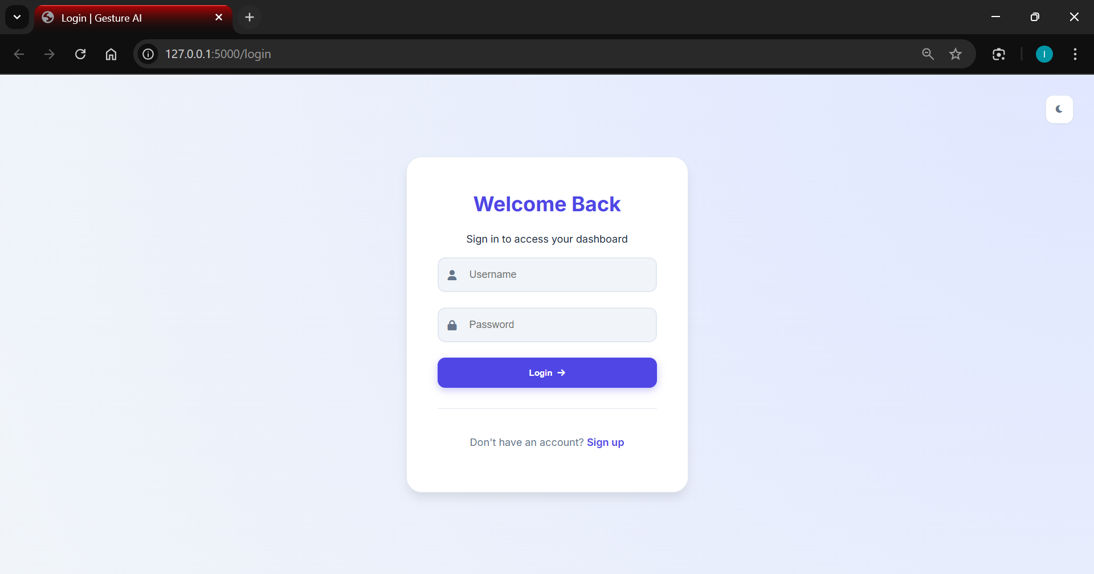
Results:

Slide 14
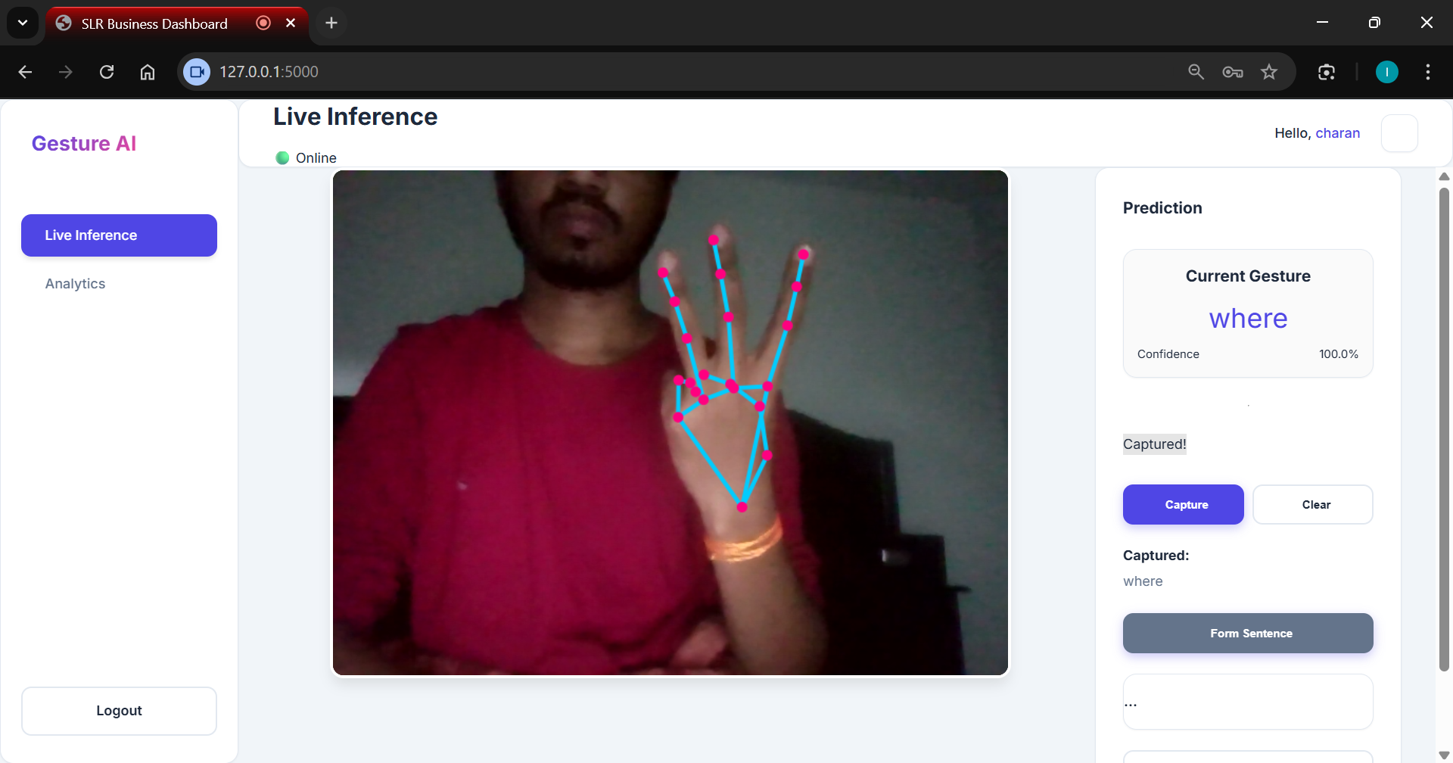
Results:

Slide 15
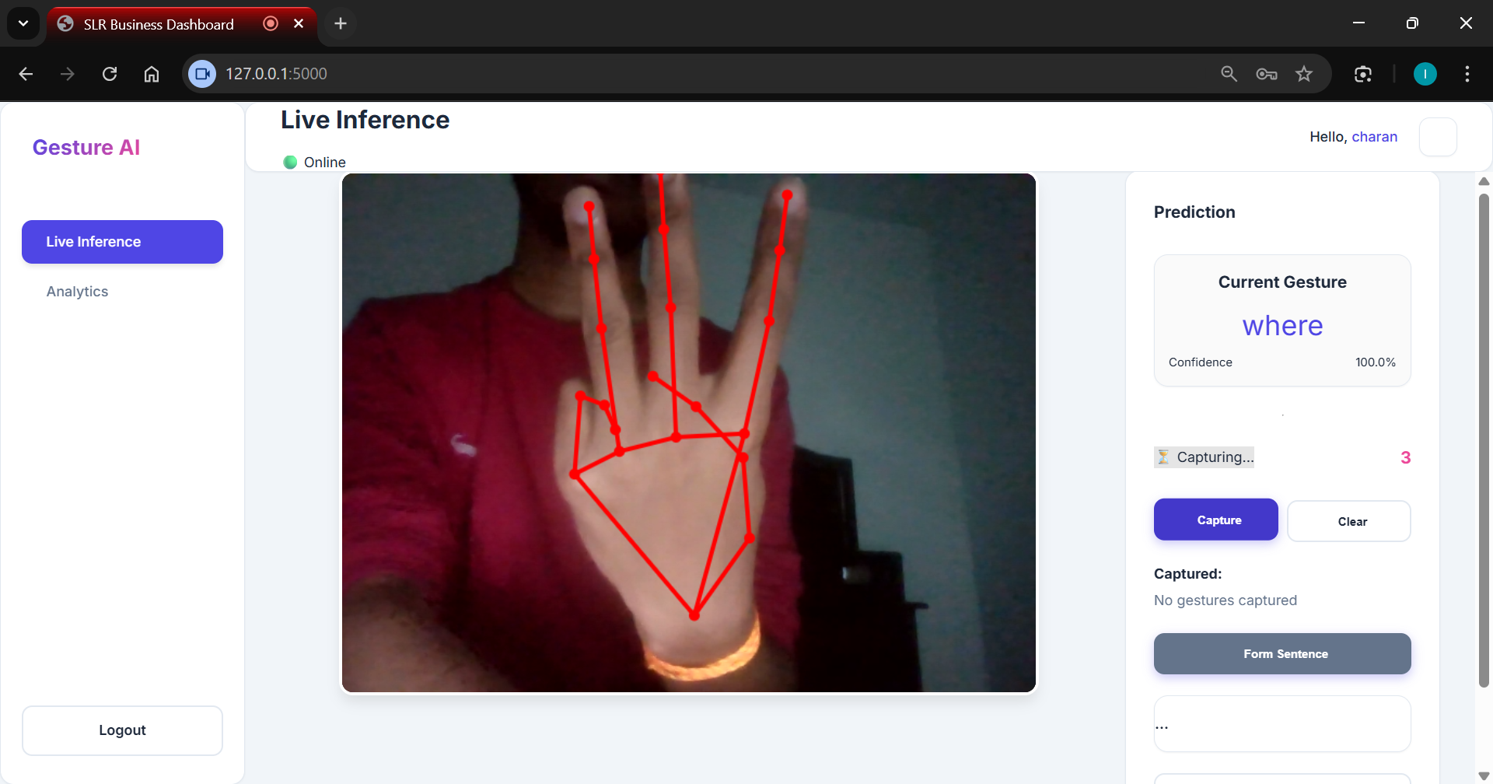
Results:

Slide 16
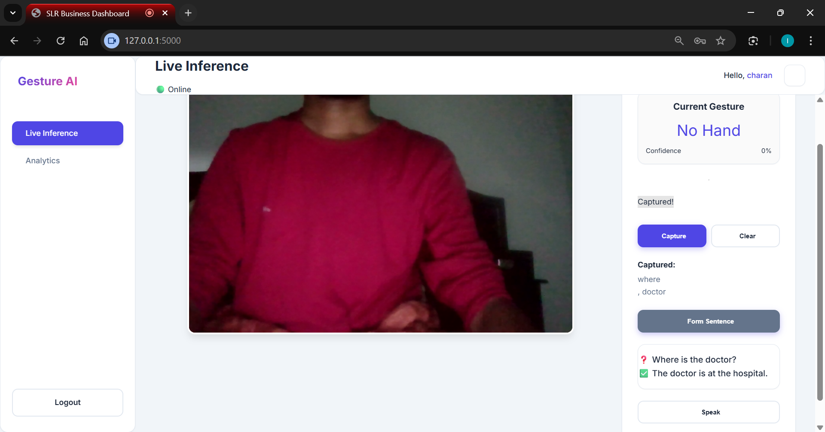
Results:

Slide 17
Advantages & Limitations
Advantages
Real-Time Performance – Provides instant gesture recognition with low latency
Cost-Effective Solution – Works on standard webcams without specialized hardware
Lightweight Model – MLP + landmark-based approach enables fast inference
Privacy Preserving – Uses hand keypoints instead of raw images
Web-Based Accessibility – Runs directly in the browser, no installation required
Scalable Design – Easy to add new gestures through retraining
Limitations
Lighting Dependency – Performance decreases under poor lighting conditions
Static Gesture Support – Currently limited to static hand gestures
Limited Vocabulary – Supports a predefined set of gestures
User Variation Sensitivity – Accuracy may vary across different users

Slide 18
FUTURE SCOPE :
dynamic gestures using temporal models (LSTM / RNN):
Enables recognition of time-based and continuous sign movements.
Expanded two-hand gesture vocabulary:
Allows more expressive and complex sign language communication.
Improved sentence generation logic:
Produces grammatically correct and context-aware sentences from gestures.
Enhanced text-to-speech support:
Converts generated sentences into clear and natural voice output.

Slide 19
Conclusion
The proposed system converts sign language gestures into meaningful questions using machine learning techniques.
Real-time hand landmark detection and gesture classification ensure accurate and reliable recognition.
Image-based visualization improves accessibility for deaf users who cannot rely only on text.
The web-based implementation is cost-effective, user-friendly, and easy to deploy.
Overall, the system helps bridge the communication gap between deaf and hearing individuals.

Slide 20
Thank you

